Slide 1
CHAMPVA & VA Caregiver Programs
Katherine Cassel
Assistant Director
Healthcare Policy

Slide 2
What is CHAMPVA
What is CHAMPVA and Caregiver Programs and the basics of each
Identify Eligibility and How to Apply/Enroll
Available Benefits and Services
Know the exclusions and considerations when utilizing Other Health Insurances (including Medicare)
Issue Resolution and the Appeals Process
Alternative support

Slide 3
CHAMPVA

Slide 4
What is CHAMPVA
Civilian Health and Medical Program of the Department of Veterans Affairs (CHAMPVA):
37 CFR 17.270 is the governing regulation
ChampVA is not an insurance plan, it is a cost share program in which VA shares the cost of covered health care services and supplies with eligible beneficiaries.
Affordable Care Act (ACA) designates CHAMPVA as fulfilling minimum essential coverage requirements
TRICARE
VA Health Care
Notes:
CHAMPVA & DOD TRICARE programs are very similar and are often mistaken for each other:
Tricare is a DOD regionally managed health care program for active duty and retirees and members of the uniformed services and their families
In some cases, a veteran may appear to be eligible for both programs, however if you are a military retiree, or the spouse of a veteran who was killed in action, you are and will always be a TRICARE beneficiary and cannot choose between the two programs.

Slide 5
Basics of ChampVA
The beneficiary must use an authorized provider to be covered
The beneficiaries will have a $50 annual deductible, and $100 for a family
ChampVA covers 75% of the allowable amount, which is the Medicare rate, and the beneficiary pays the remaining 25%, up to $3000.00 per year
Notes:
After using an authorized provider, the provider or the beneficiary files the claim to ChampVA using VA Form 10-7959a. In most cases the authorized provider will submit the necessary documentation
The following site has information regarding the procedures for beneficiaries to file reimbursement claims:
https://www.va.gov/COMMUNITYCARE/programs/dependents/champva/champva-claim.asp
Beneficiaries should send pharmacy and medical claims reimbursement

Slide 6
Eligibility for CHAMPVA
Covered services include:
Spouse or child of a Veteran who has been rated by VA as having a permanent and total service-connected disability, or
Spouse or child of a Veteran who has been rated by VA as having a permanent and total service-connected disability, or
Surviving spouse or child of a Veteran who was at the time of death rated permanently and totally disabled from a service-connected disability, or
Surviving spouse or child of a service member who dies in the line of duty, not due to misconduct*, or
An individual who is the Primary Family Caregiver in the Program of Comprehensive Assistance for Family Caregivers (PCAFC) who is not entitled to care and services under another health-plan
Notes:
A service-connected disability is a disability that we’ve concluded was caused , or made worse, by the Veteran’s active-duty service. Example: my elbow.
A permanent disability is one that’s not expected to improve. Can someone provide an example of a condition that may be classified as permanent?
If 2 spouses are both Veterans who qualify as CHAMPVA sponsors for their family, they both may now qualify for CHAMPVA benefits. Each time they need medical care, they may choose to get care through the VA health care program or using their CHAMPVA coverage.
*In most cases, these family members qualify for TRICARE, not CHAMPVA
PCAFC will be discussed in further detail later in this presentation
Eligible child pursing an approved course of instruction who incurs a disabling illness/injury while pursing the instruction, not of their own misconduct, and results in the inability to continue instruction

Slide 7
How to Apply for CHAMPVA
Required Documents:
VA Form 10-10d (Application for CHAMPVA Benefits)
VA Form 10-7959c (CHAMPVA—Other Health Insurance (OHI) Certification)
Copy of Medicare card for individuals who are eligible
For those 65+ years old and don’t qualify for Medicare, you will need to send documentation from the Social Security Administration the confirms you don’t qualify for Medicare
Notes:
For individuals who are eligible for Medicare for any reason, we need a copy of your Medicare card.
If you are age 65 or older and not entitled to Medicare, you must send documentation from the Social Security Administration that confirms you are not entitled to Medicare benefits under anyone's social security number.

Slide 8
How to Apply for CHAMPVA
Optional Documents: (copies only)
VBA decision showing permanent and total status, or death rating
Veteran’s DD 214 (Certificate of Release or Discharge from Active Duty)
Proof of Dependency
Marriage license
Remarried widow/widower once again single (legal documentation terminating the remarriage_
Birth Certificate/adoption papers for children
School certification of full-time enrollment for ages 18-23 years (original)
Notes:
Veteran's DD214, Certificate of Release or Discharge from Active Duty, or if the Veteran was a WWII or Korean War Veteran, the Report of Separation. If you do not have a copy of the necessary form, you may request it by submitting a Standard Form 180, Request Pertaining to Military Records, from the National Archives.
If you are a remarried widow/widower and are once again single, provide a copy of the legal documentation that terminated the remarriage. The legal documentation of termination of a remarriage may be a divorce decree, death certificate or annulment decree.
If you provide only the required documents, and not the optional documents, processing can take two to eight months since we have to confirm information with other federal agencies.
Once we get your application, we will review it to be sure it is complete and that all the required forms are included. If your application is not complete, we will return it to you with further instructions.

Slide 9
How to Apply for ChampVA
Mail your application, and associated documents, to:
VHA Office of Community Care
CHAMPVA Eligibility
PO Box 469028
Denver, CO 80246-9028
Or fax your forms: 303-331-7809
Notes:
IMPORTANT: Ensure the application is signed and dated. Also, if applying for a spouse, please include the date of marriage on the application
We are currently experiencing a backlog in processing applications. If you have questions regarding the status of your application, we encourage you to call the CHAMPVA call center at 800-733-8387.
If you send us all required and optional documents—and if your application is complete—it’ll take about 6 weeks after we get your package until you get your CHAMPVA ID card and related materials.
If you send us only the required documents, it may take 2 to 8 months since we’ll need to confirm your information with other federal agencies.

Slide 10
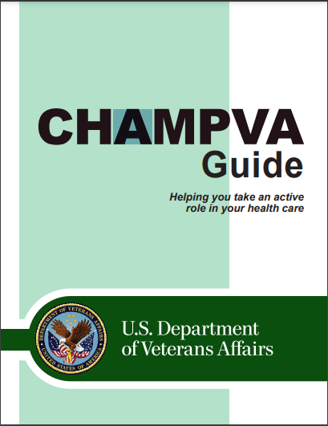
Benefits and Services
Ambulance service
Durable Medical Equipment
Family planning and maternity
Inpatient/Outpatient services
Pharmacy (prescription medicines)
Notes:
Additional services covered: Ambulatory surgery, hospice, skilled nursing care, and transplants
Some services that may be covered are substance abuse disorder/mental/behavioral health and dental care – refer to benefits guide or CHAMPVA program manager for further details and questions.
When you’re signed up for CHAMPVA, you’ll get a copy of the CHAMPVA Program Guide. This guide will tell you more about covered and non-covered services and supplies.
Services that require authorization: • Durable Medical Equipment (DME) with a purchase price or total rental of $2,000 or more (see Section 4) • Mental health care (Contact CHAMPVA for required approval) – Inpatient mental health care – Care at residential treatment facilities (RTF) – Alcohol/substance abuse – Care in Partial Hospital Programs (PHP) – Requests for extensions to our yearly limits on inpatient mental health care (see Section 4) – Outpatient mental health visits in excess of 23 per year • Dental care coverage (Dental coverage is very limited and under most circumstances is not covered.) • Organ transplant
Mental health services and durable medical equipment (DME) provided through the VA CITI program do not require authorization.

Slide 11
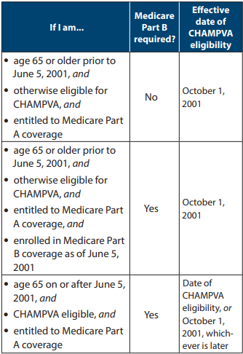
CHAMPVA and Medicare
CHAMPVA is always the second payer to Medicare
If you’re under 65 years old, you’re eligible for CHAMPVA if you meet both of these:
You have Medicare Parts A and B, and
You are otherwise eligible for CHAMPVA
If you’re 65 years old or older, you’re eligible for CHAMPVA if you’re eligible for Medicare.
See chart for specific requirements

Slide 12
CHAMPVA Contact
Customer Service – Eligibility, Other Health Insurance (OHI) Coverage, and Claims
Phone: 1-800-733-8387 (Monday - Friday, 8:05 a.m. to 7:30 p.m. ET)
Email Ask VA: ask.va.gov
Customer Engagement Portal – Payments
https://www.cep.fsc.va.gov/
Contact them by mail
CHAMPVA; PO Box 469063; Denver, CO; 80246-9063
Notes:
Every VAMC has a person who handles CHAMPVA problems. Contact your local VA to engage with your CHAMPVA representative.
Eligibility/Claims Status Inquiry (Payer ID: VAHAC) AND Medical Claims/Electronic Remittance Advice (ERA) (Payer ID: 84146)
Change Health Care (formerly Emdeon Inc.) Electronic Claim Submissions https://www.changehealthcare.com/
888-545-6127

Slide 13
Resources
CHAMPVA Guide
https://www.va.gov/COMMUNITYCARE/docs/pubfiles/programguides/CHAMPVA-Guide.pdf#
CHAMPVA Fact Sheets
https://www.va.gov/COMMUNITYCARE/pubs/factsheets.asp#CHAMPVA
Locating a Provider
https://www.va.gov/COMMUNITYCARE/programs/dependents/locate-provider.asp
How to File a CHAMPVA Claim
https://www.va.gov/COMMUNITYCARE/programs/dependents/champva/champva-claim.asp
Notes:
Additional services covered: Ambulatory surgery, hospice, skilled nursing care, and transplants
Some services that may be covered are substance abuse disorder/mental/behavioral health and dental care – refer to benefits guide or CHAMPVA program manager for further details and questions.
When you’re signed up for CHAMPVA, you’ll get a copy of the CHAMPVA Program Guide. This guide will tell you more about covered and non-covered services and supplies.
Services that require authorization: • Durable Medical Equipment (DME) with a purchase price or total rental of $2,000 or more (see Section 4) • Mental health care (Contact CHAMPVA for required approval) – Inpatient mental health care – Care at residential treatment facilities (RTF) – Alcohol/substance abuse – Care in Partial Hospital Programs (PHP) – Requests for extensions to our yearly limits on inpatient mental health care (see Section 4) – Outpatient mental health visits in excess of 23 per year • Dental care coverage (Dental coverage is very limited and under most circumstances is not covered.) • Organ transplant
Mental health services and durable medical equipment (DME) provided through the VA CITI program do not require authorization.

Slide 14
Caregiver Programs

Slide 15
VA Caregiver Programs
The VA has two Caregiver programs:
Program of General Caregiver Support Services (PGCSS) – There is no formal application required to enroll to this program
To be eligible, the Veteran must be enrolled in VA healthcare and receiving assistance from a caregiver
Program of Comprehensive Assistance for Family Caregivers (PCAFC) - There is a formal application process
The veteran and the caregiver need to meet certain eligibility criteria
https://www.va.gov/family-and-caregiver-benefits/health-and-disability/comprehensive-assistance-for-family-caregivers/

Slide 16
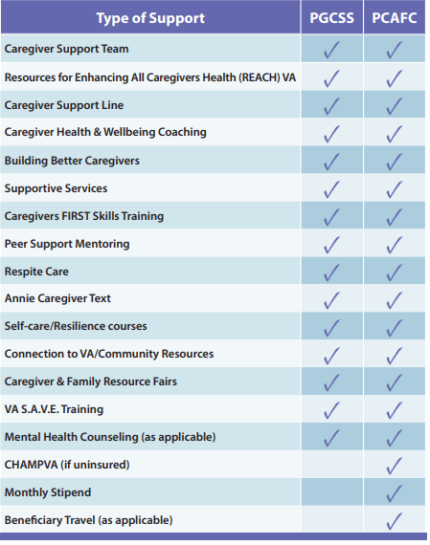
Caregiver Program Comparison

Slide 17
PCAFC Criteria for Eligibility
Caregiver eligibility – You must be at least 18 years old and at least one of the following must be true:
You’re a spouse, son, daughter, parent, stepfamily member, or extended family member of the veteran, OR
You live full time with the veteran, or you're willing to live full time with the veteran if designated as the family caregiver

Slide 18
PCAFC Criteria for Eligibility
Veteran Eligibility – All of the following must be true of the veteran:
Veteran must have a VA disability rating, individual or combined, of 70% or higher, and
Veteran was discharge from the U.S. military or has a date of medical discharge, and
Veteran must need at least 6 months of continuous, in-person personal care services

Slide 19
Qualifying Care for Veteran
Veteran must need continuous in-person care with activities of daily (ADLs) living for at least six-months
Basic/Primary – simple functioning tasks
Bathing
Dressing
Toileting
Executive/Instrumental – more complex tasks
Driving
Managing Finances
Medication

Slide 20
How to Apply
Utilizing an Accredited Veteran Service Officer
Apply on-line
You can apply by mailing your 10-10CG to:
Evidence Intake Center
PO Box 5154
Janesville, WI 53547-5154
Find your local Caregiver Support Team
You can apply in person, or
Call 1-855-260-3274
Notes:
You can take your completed 10-10CG to a local Caregiver Support Team member.
DO NOT send medical records with your application. VA will gathering any necessary documentation
The following website will walk you through the application process and provide the opportunity to begin applying on-line
https://www.va.gov/family-and-caregiver-benefits/health-and-disability/comprehensive-assistance-for-family-caregivers/apply-form-10-10cg/introduction

Slide 21
Benefits for the Veteran in PCAFC
This program supports the health and wellness of veterans by:
Providing the veteran with increased independence
Provides safety, protection and or instruction
Provides support for personal needs:
Feeding
Bathing
Dressing
Driving
Cooking & Cleaning
Medication

Slide 22
Benefits for the Caregiver in PCAFC
Comprehensive training
Peer support
A monthly stipend is payable to the Primary Caregiver
Eligibility to ChampVA for the Primary Caregiver
Mental Health Counseling
At least 30 days respite care per year for the Veteran

Slide 23
Misconceptions of PCAFC
ONLY spouses can be caregivers – The program is open to family members, parents, or anyone who is living with the veteran full-time.
ALL veterans are eligible – Not all veterans qualify for the program. They must have a 70% service-connection rating or higher and need continuous personal care services for at least six months and require assistance with activities of daily living.
Caregivers receive full time pay – Only the Primary Caregiver is eligible for a stipend and the stipend IS NOT equivalent to substantial full time employment income
Caregivers get health benefits – only the Primary Caregiver is eligible for ChampVA, and only if they do not have other health insurance

Slide 24
How to appeal a negative decision
VHA Clinical Review Process – this is also known as the clinical appeals process and is conducted locally.
Conducted at the Patient Advocates/Experience Office.
Higher-Level Review – request a new review of your case by higher-level reviewer will determine if an error or difference of opinion changed the decision.
Conducted at the VARO.
Board Appeal– Review by a Veterans Law Judge by submitting a completed VA Form 10-307 (PCAFC Notice of Disagreement (NOD))
Conducted at the Board of Veterans’ Appeals
Notes:
If you disagree with your Caregiver decision, you can begin a Clinical Appeal process at the Patient Advocates/Experience Office in your local VAMC
You can appeal a caregiver denial directly to the Board of Veterans Appeals. To appeal a decision issued on or after February 19, 2019, you must submit VA Form 10182 to the board by:
Online submission
Mail to: Board of Veterans’ Appeals; PO Box 27063 Washington DC 20038
Or fax to: 1-844-678-8979
There are multiple ways to appeal a denial of the VA's Program of Comprehensive Assistance for Family Caregivers (PCAFC):
Board Appeal: Request a review by a Veterans Law Judge at the Board of Veterans' Appeals by submitting a completed VA Form 10-307, the Program of Comprehensive Assistance for Family Caregivers (PCAFC) Notice of Disagreement (NOD).
Higher-Level Review: Request a new review of your case by a higher-level reviewer. This reviewer will determine if an error or difference of opinion changed the decision.
VHA Clinical Review Process: This process is also known as the VHA Clinical Appeals Process

Slide 25
Resources
VA Caregiver Support Program
https://www.caregiver.va.gov/
The Program of Comprehensive Assistance for Family Caregivers (PCAFC)
https://www.va.gov/family-and-caregiver-benefits/health-and-disability/comprehensive-assistance-for-family-caregivers/
Some additional Local Agencies that may be able to assist:
Department of Aging
Social Security Administration
Administration for Community Living
Department of Health & Human Services
Insurance Companies

Slide 26
Final Thoughts
The VFW Healthcare Team may be able to help with healthcare issues:
Katherine Cassell, Assistant Director of Veterans Health Policy
202-608-8371, Kcassell@vfw.org
Julie Holt, Special Assistant of Veterans Health Policy
202-608-8364, Jholt@vfw.org
Marion Fera, Health Consultant of Veterans Health Policy
202-608-8349, mfera@vfw.org

Slide 27
QUESTIONS?

