Slide 1
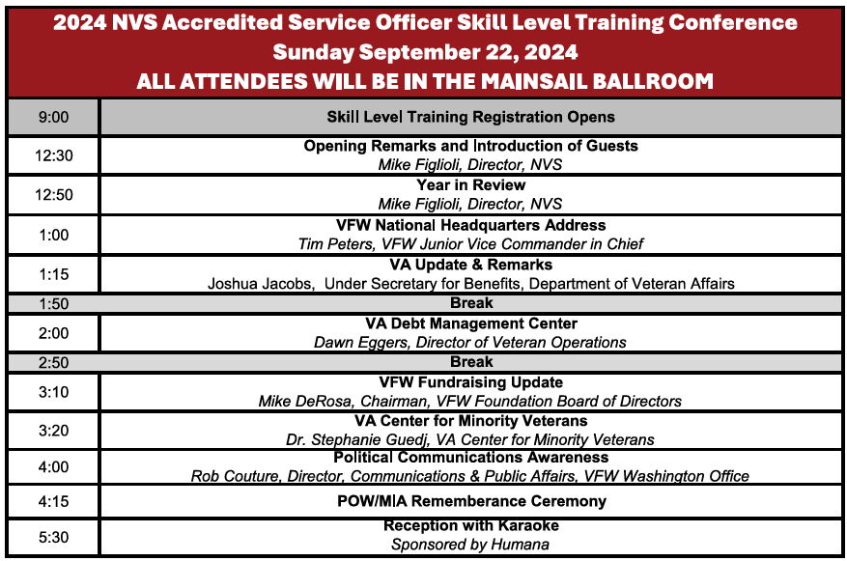

Slide 2
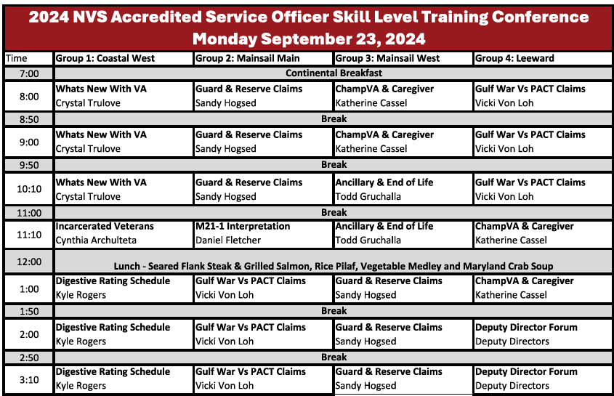

Slide 3
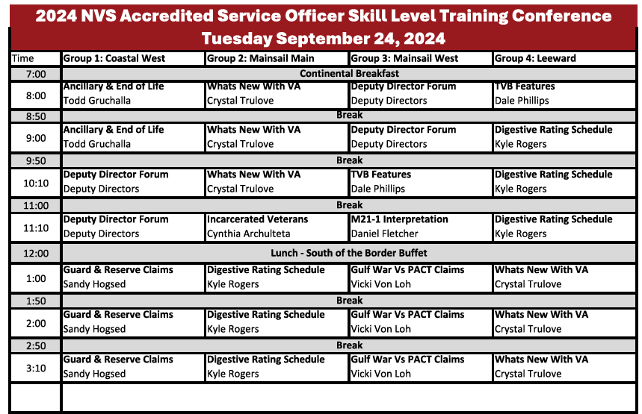

Slide 4
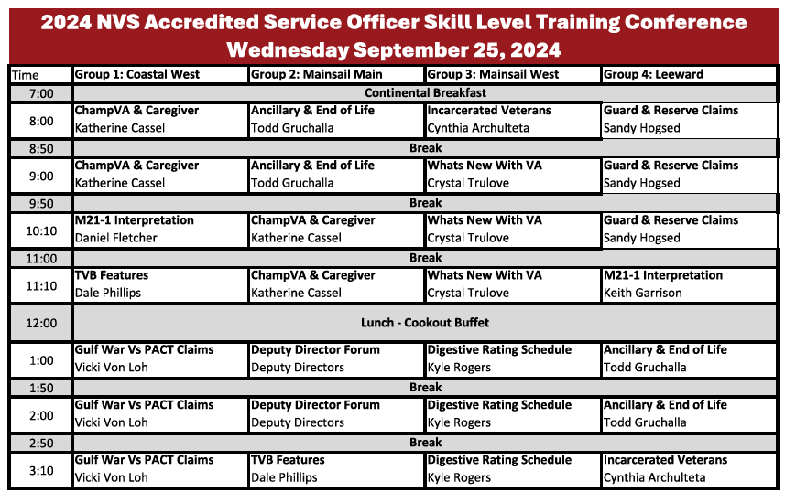

Slide 5


Slide 6

Center for Minority Veterans
Notes:
I’d like to start by thanking the organizers of this training for inviting me to speak today. My name is Dr. Stephanie Guedj, and I am currently serving as the LGBTQ+ Liaison detailee for the Center for Minority Veterans at the VA. In this role, my primary focus is advocating for and supporting LGBTQ+ Veterans, ensuring that their unique needs are addressed within the VA system. I’ve been with the VA since 2014, initially as a psychology trainee and now in various roles including as a psychologist in the PTSD Clinic and the LGBTQ+ Veteran Care Coordinator at the Washington DC VAMC. My focus has always been on supporting diverse Veteran populations, particularly LGBTQ+ Veterans, and ensuring their voices are heard in the broader VA system.
The purpose of my presentation today is to share with you more about the Center for Minority Veterans, who we are, and what we do. The CMV was established to ensure that minority Veterans, including those who identify as racial and ethnic minorities, LGBTQ+, women, and others, are provided with equitable access to VA benefits and services. Our work centers on advocacy, policy development, and creating a bridge between the VA and the communities we serve. We aim to ensure that the diverse voices of minority Veterans are heard, their experiences recognized, and their needs met.
I will be walking you through the organizational structure of the CMV, highlighting our key initiatives, and explaining how we collaborate with various stakeholders, including Veteran Service Organizations such as VFW, to support minority Veterans. By the end of this presentation, I hope you’ll have a better understanding of how the CMV operates and how we can work together to create a more inclusive and supportive environment for all Veterans.

Slide 7
Who Are We?
The Center for Minority Veterans (CMV) was established by Public Law (PL) 103-446 on November 2, 1994, in response to low utilization of VA benefits and services* by minority Veterans.
PL 103-446 defines “minority group member” as a Veteran who is:
Asian American;
Black;
Hispanic;
Native American (including American Indian, Alaskan Native, and Native Hawaiian); or
Pacific-Islander American.
CMV also supports Administration and SecVA Goals:
Executive Order On Advancing Racial Equity and Support for Underserved Communities Through the Federal Government (EO 13985)
VA Strategic Objective 2.1 - Reaching all Veterans
*Benefits do not accrue to Veterans based on their race or ethnicity except the Native American Direct Loan (NADL) Program.
Notes:
To start, CMV’s primary goal is to provide intentional engagement, outreach, support, and assistance to minority Veterans. This means addressing their unique challenges and ensuring they have equitable access to VA benefits, healthcare, services, and programs that they deserve.
Now, let’s take a moment to understand the origin story of the CMV and their vital role in serving Veterans. The CMV was established on November 2, 1994, through Public Law 103-446. This legislation was a response to the low utilization of VA benefits and services by minority Veterans. Under this law, a "minority group member" includes Veterans who are Asian American, Black, Hispanic, Native American, or Pacific Islander.
The creation of CMV was pivotal in addressing disparities and ensuring that these veterans, who faced historical inequities, receive the benefits and services they’ve earned.
In addition to its foundational mandate, the CMV supports broader administrative goals like Executive Order 13985, focused on Advancing Racial Equity and Support for Underserved Communities. This aims to tackle systemic inequities and improve access to resources for underserved communities. It also supports the VA Strategic Objective 2.1, titled "Reaching All Veterans," which focuses on ensuring that every Veteran, no matter their background, has full access to the VA’s services and resources.
It’s important to emphasize that VA benefits generally do not accrue based on race or ethnicity. However, there is one specific exception—the Native American Direct Loan (NADL) Program, which directly supports Native American Veterans with their homeownership goals.
Understanding this foundation helps us appreciate CMV’s ongoing role in advocating for and supporting minority Veterans. The work they do ensures that minority Veterans receive the equitable service and representation they deserve.
Now, let’s look at some of the key activities CMV undertakes:
We make strategic recommendations to the Secretary of Veterans Affairs and other department officials about programs for minority Veterans.
We promote the use of benefits by minority Veterans and actively participate in outreach efforts to engage with them.
CMV serves as a resource center, providing information on successful programs that improve services for minority Veterans. Additionally, CMV conducts social and demographic research on the needs of minority Veterans to ensure programs meet their needs.
We evaluate complaints made by or on behalf of minority Veterans to ensure the services provided by the VA are adequate and timely.
CMV works closely with Federal, State, local, and private programs to promote policies that benefit minority Veterans.
Another important area is their support of medical research focused on health issues affecting minority Veterans, advising on areas that require more attention. Lastly, CMV provides administrative support to the Advisory Committee on Minority Veterans and other relevant entities.

Slide 8
CMV Legislative Highlights
Legislative Proposal
Alignment with Administration and VA policies and Strategic Objective 2.1, Reaching All Veterans, which includes underserved, marginalized, and at-risk Veterans
Representative Sheila Cherfilus-McCormick (D-Fl) and 14 co-sponsors introduced the HR 4325 - Historically Underserved Veterans Inclusion Act of 2023
Expands to include “historically underserved” groups to include, but not limited to:
LGBTQ+
Language barriers
Without citizenship status
Religious minorities
Allows for SEVA to consider additional groups
Notes:
Since that time, new legislation has come about to expand PL 103-446. Specifically, HR 4325 - The Historically Underserved Veterans Inclusion Act of 2023.
Now, PL 103-446 was an important step toward improving benefits for all veterans, focusing on healthcare and disability services. However, it didn’t specifically address the unique needs of underserved populations like LGBTQ+ veterans, minority veterans, or veterans in rural areas.
That’s where HR 4325 comes in. This act explicitly names these historically underserved groups, ensuring they are now prioritized in the VA system.
It also mandates better data collection, so the VA can gain a deeper understanding of the experiences and challenges faced by these groups. This allows for more targeted outreach and tailored services, including healthcare, mental health support, and disability compensation.
By addressing these gaps, HR 4325 directly aligns with Strategic Objective 2.1: Reaching All Veterans, which emphasizes the VA’s commitment to ensuring that every veteran—regardless of background or location—has access to the care and benefits they’ve earned. HR 4325 furthers this mission by ensuring that historically underserved veterans receive the recognition and support they deserve.
In short, HR 4325 builds on PL 103-446 by closing the gap and making sure that all veterans, especially those who have been overlooked, are included in VA services and care.

Slide 9
Mission and Vision
Vision
Campion minority Veterans by ensuring awareness of, and equitable access to, the benefits and services they have earned by serving our Nation, with the goal of enhancing the well-being of Veterans, their families, and survivors.
Mission
Advise and make recommendations to the Secretary of VA on the adoption and implementation of policies and programs affecting minority Veterans
Promote the use of VA benefits by minority Veterans and the conduct of outreach activities to minority Veterans
Conduct and sponsor appropriate social and demographic research on the needs of minority Veterans
Advise the Secretary when laws or policies have the effect of discouraging the use of benefits by minority Veterans
Publicize the results of medical research which are of particular significance to minority Veterans
Provide support and administrative services to the Advisory Committee on Minority Veterans
Notes:
So now that you have a little background on how CMV came to be. I’d like to share more about our vision and mission for the care of our Veterans. Our vision is to empower minority veterans by ensuring they are aware of and have equitable access to the benefits and services they’ve earned. Our mission includes advising on policy implementation, promoting VA benefits usage, conducting research, and providing support to the Advisory Committee on Minority Veterans.
Looking ahead to 2024, we have several strategic goals: 1) We aim to enhance our visibility with both internal stakeholders and external community partners.
2) We plan to leverage technology to engage veterans, families, caregivers, and survivors through virtual workshops, mobile apps, webinars, and more. 3) We will analyze veteran participation across different demographics and geographic locations to identify gaps and create targeted strategies to improve engagement. 4) We’ll foster collaborative partnerships and streamline communication to ensure efficient program updates and feedback.”

Slide 10
Organizational Chart
James Albino
Director
Carl McPherson
Staff Assistant
Debra Walker
Deputy Director
Minority Veterans Program
Advocacy/Engagement/ Outreach
Research and Data
Carmen Drummond
Minority Veterans Program Manager / Hispanic Veterans Liaison
Dwayne Campbell
African American Veterans Liaison
VACANT
Research and Data Liaison
D’Andrea Jacobs
Hispanic Veterans Liaison
Gregorio Kishketon
American Indian Veterans Liaison
Ron Sagudan
Native Hawaiian, Asian American, Pacific Islander Veterans Liaison
10
Notes:
Here is the Center for Minority Veterans' organizational chart. At the top, we have our Executive Director, James Albino, and our Deputy Director, Debra Walker. Carmen Drummond serves as our MVP Program Manager and the Hispanic Veterans Liaison. Additionally, we have Liaisons dedicated to representing specific minority Veteran groups: Dwayne Campbell is our African American Veterans Liaison, Dee Jacobs serves as the Hispanic Veterans Liaison, Gregoria Kishketon is our American Indian Veterans Liaison, and Ron Sagudan represents Native Hawaiian, Asian American, and Pacific Islander Veterans.
Now, you may notice that the LGBTQ+ Liaison role is not reflected on this chart. That’s because this role was introduced in April 2023 and is still in the process of being formalized. We’re working toward creating a full-time position to ensure that the LGBTQ+ Veteran community has permanent representation within CMV.

Slide 11
Shift in Veteran Demographics
The Veteran population is becoming increasingly diverse in terms of gender and racial/ethnic backgrounds.
Take Away: We must adapt to meet the unique needs of a more diverse and evolving Veteran population.
Notes:
As we look at the evolving demographics of the Veteran population, it's important to highlight how this landscape is changing. If we compare the breakdown from 2021 with projections for 2041, we see a significant shift toward a more diverse Veteran population. In 2021, Veterans who identified as part of a racial minority made up about a quarter of the total population. By 2041, that figure is projected to grow to nearly half, reflecting the increasing diversity in our Veteran community.
Additionally, we’re seeing a rapid increase in the number of women Veterans. Today, more than 2 million women Veterans live in the U.S. In 2000, women Veterans made up just 4% of the total Veteran population. By 2040, they are projected to make up 18%, making women the fastest-growing group of Veterans.
These shifts are important to pay attention to because the VA must ultimately adapt to meet the unique needs of a more diverse and evolving Veteran population. Different racial, ethnic, and gender groups often have distinct healthcare challenges, cultural considerations, and barriers to access. By paying attention to these changes now, we can better tailor our services, from healthcare delivery to benefits outreach, ensuring we provide culturally competent care and equitable access for all Veterans.
This data allows us to anticipate and address gaps in care and services, ultimately improving how we support the Veterans who rely on us. By being proactive in understanding these demographic shifts, we can make informed decisions that lead to more personalized, effective care for every Veteran. I’ll give you some examples of this from my own experience as an LGBTQ+ Veteran Care Coordinator (which is separate from my work as the LGBTQ Liaison). Trans and gender diverse individuals are overrepresented in the Veteran population. Meaning, you’ll find a higher proportion of trans and gender diverse folks in the military and Veteran communities than you will amongst civilians. Gender diverse folks often have unique healthcare needs. One of the most common requests I get from my Veterans is for gender-affirming care. And in fact, the VA offers many types of services for gender-affirming care services because of course there is a need and a demand for it. We’re also getting better at demonstrating the data around these needs with improved data collection and tracking of sexual orientation and gender identity, and with that we hope to continue expanding care services and improving access to medically necessary services.

Slide 12

CMV Focus Areas
Advisory Committee on Minority Veterans (ACMV) is appointed by the Secretary and advises on VA’s administration of benefits and provision of health care and services to minority Veterans. Advisory Committee on Minority Veterans - Center for Minority Veterans (CMV) (va.gov)
Minority Veteran Program (MVP) increases awareness of minority Veteran-related issues at the local level and to develop strategies for increasing Veterans’ participation in VA healthcare, benefit programs, and other services. This is the Center’s boots on the ground program, and a very important footprint with Minority Veteran Program Coordinators (MVPCs) from VHA, VBA, and NCA as points of contact for local facilities..
CMV Liaisons provide case management for individual Veterans requesting assistance with accessing VA benefits, health care and services or who believe they have been subject to discrimination while interacting with VA. Liaisons work closely with the MVPCs for resolutions.
Research, Reports and Recommendations leverage data from across the Department, federal government and other sources to improve outcomes for minority Veterans.
Notes:
Here is an overview of our focus areas.
The Advisory Committee on Minority Veterans (ACMV) is crucial in advising the Secretary on VA’s service delivery. The committee members, appointed by the Secretary, represent various minority groups and offer invaluable insights through recommendations, reports, and direct engagement with stakeholders. Our Minority Veteran Program is driven by the Minority Veteran Program Manager and includes a network of Program Coordinators and Liaisons. This program aims to increase awareness of minority veteran issues and develop strategies to enhance participation in VA services. Coordinators provide direct support at VA centers and advocate for improved service delivery.” CMV Liaisons are dedicated to understanding the unique needs of specific minority communities. They engage with external stakeholders, provide case management for veterans seeking assistance, and advocate for equitable access to VA benefits and services. CMV conducts research to better understand social determinants of health and barriers faced by minority veterans. This research informs our strategies and helps improve outcomes for our veterans.

Slide 13
CMV Updates
September 17 – 19: Congressional Hispanic Caucus Institute Leadership Conference, Washington, DC (in-person)
September 18: Hispanic Heritage Month Program (hybrid)
September 20: Don’t Ask, Don’t Tell Program (virtual)
September 21 – 22: Pacific Islander Festival Association, San Diego, CA (in-person)
September 23: Million Veteran Program Celebration, Washington, DC (in-person)
October 2: Hispanic Heritage Month Program (hybrid)
October 8 – 10: Out & Equal Workplace Summit, Orlando, FL (in-person)
October 10 – 12: NAACP 82nd Georgia State Conference, Augusta, GA (in-person)
October 16: Hispanic Heritage Month Program (hybrid)
October 18: Filipino Heritage Month Program (hybrid)
October 24 – 27: NAACP California/Hawaii State Conference, Los Angeles, CA (in-person)
November 2: CMV and CWV 30th Birthday
November 6: Native American Heritage Month Program (hybrid)
November 12: Disabled Veterans National Foundation Veterans Resource Fairs, Silver Spring, MD (in-person)
November 13: Native American Heritage Month Program (in-person)
November 20: Transgender Day of Remembrance (hybrid)
November 20: Native American Heritage Month Program (hybrid)
February 5, 2025: Black History Month Program (hybrid)
February 26, 2025: Black History Month Program (hybrid)
Notes:
Here is an overview of recent and upcoming events for special observances.

Slide 14
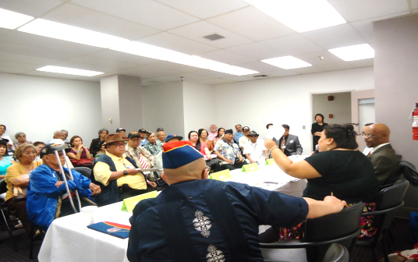
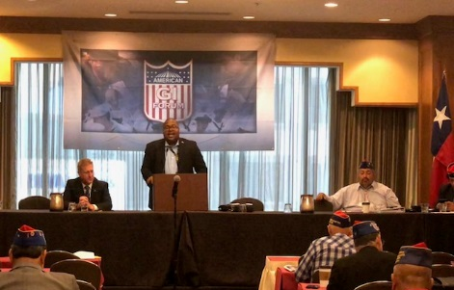
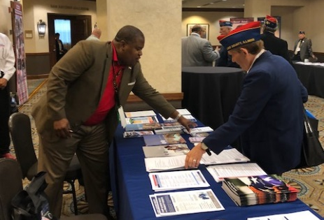
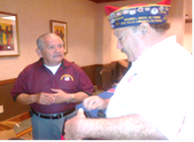


Outreach, Engagement and Collaboration
Support and initiate activities that educate and sensitize internal and external partners to the unique needs of minority Veterans.
Target and participate in outreach activities and educational forums utilizing Community Networks.
Assist CMV in disseminating information.
Notes:
At the Center for Minority Veterans, one of our core responsibilities is outreach and engagement with both internal and external stakeholders to ensure minority Veterans' unique needs are recognized and addressed.
We support and initiate activities that educate and sensitize staff, both within the VA and in the broader community. This means developing and participating in programs and training sessions designed to enhance cultural awareness, helping staff to better understand the challenges and experiences of minority Veterans. By doing so, we foster a more inclusive environment that ensures all Veterans receive equitable care and services.
To broaden our reach, we also participate in targeted outreach activities and educational forums, working with community networks that are vital to connecting us with minority Veterans. These networks allow us to engage directly with Veterans in their communities and build relationships that enable us to better understand and respond to their needs.
Finally, a key part of our mission is to assist in disseminating important information from CMV. Whether it’s sharing new policies, resources, or opportunities for Veterans, our goal is to ensure that minority Veterans are well-informed and able to access the benefits and services they have earned.
Through these efforts, we aim to strengthen our engagement with minority Veterans, improve awareness among service providers, and build lasting partnerships with community networks to ensure no Veteran is left behind
CMV engages with Veteran Service Organizations (VSOs) through several key avenues:
Advocacy and Legislative Support: CMV partners with VSOs like the VFW to advocate for legislation benefiting minority veterans. This includes drafting position papers, testifying at Congressional hearings, and organizing grassroots lobbying to ensure minority veterans' issues are prioritized in legislative discussions.
Outreach and Engagement: Together with VSOs, CMV participates in community events, town halls, and seminars to educate minority veterans about available benefits and services. This outreach helps overcome the information barriers that minority veterans often face.
Partnership in Research and Policy Development: CMV and VSOs collaborate on collecting and analyzing data on minority veteran populations. They work on research projects and reports to identify trends, barriers, and disparities in benefits and care, which inform policy recommendations and program enhancements.
Participation in National Events: CMV and VSOs come together for national observances and events such as MVPC trainings, Minority Veterans Summits, and Veterans Day celebrations. These events serve to raise awareness and provide direct services to veterans."

Slide 15





Connect with CMV
Scan our QR code to join our mailing list!
vacocmv@va.gov
(202) 461-6191 www.va.gov/centerforminorityveterans/
Notes:
For more information about our programs and updates, please visit our website. You can scan this QR code to join our mailing list as well.
Thank you for your time and attention today! I welcome any questions.

Slide 16
VA Debt Management Center (DMC)
Veterans Service Organization Presentation
VFW September 2024

Slide 17
Agenda
DMC overview
Debt establishment
Understand collection processes
Ask VA (AVA) Tips
Debt resolution options
Risks of non-payment
Questions

Slide 18
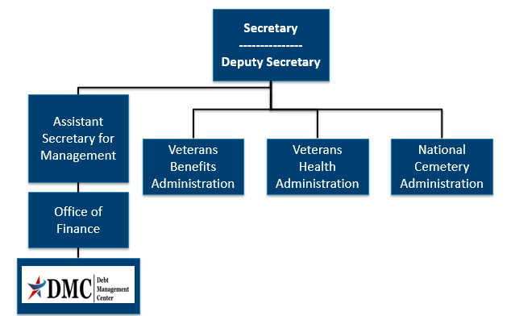
Organization Chart

Slide 19
DMC Mission
Provide distinctive, high quality accounts receivable services through a compassionate and value-added approach, empowering our stakeholders to focus on core missions.

Slide 20
Debt Establishment
Regional Office (RO)/Regional Processing Office (RPO) Receives information
RO/RPO Processes Claim/Award
DMC Collects Debts
Sends collection letters for debts
Sends a letter when payments are issued or debt created
Processes collection actions
Evaluates eligibility/ entitlement
Issues payments and establishes debts
Education Certification
Change in circumstances affecting benefit eligibility or entitlement

Slide 21
Debt Establishment
Compensation/ Pension
Changes in income or net worth
Active-duty time or drill pay days
Education
Withdrawal from class
Not attending class
Change in dependency
Payments issued after death of beneficiary
Class did not count toward graduation
Change in active-duty status
Fugitive felon status or incarceration

Slide 22
Collection Process
DMC sends Notice of Indebtedness letters, monitors accounts, and advises debtor of any delinquency, including the requirement to refer their account to Treasury
DMC Sends 1st Letter
30 or 90 days
DMC Sends 2nd Letter
30 days
DMC Sends 3rd Letter
If DMC receives payment, next collection letter is deferred
Debt is Referred to Cross Servicing
60 days
Debt is Referred to Treasury Offset Program
60 days

Slide 23
Relief, Resolution, and Referrals
DMC sends Debt Notice
Debtor contacts DMC
· Pay In Full
· Benefits Offset in Full or in Part
· Payment plan
· Compromise
· Waiver/Waiver Reconsideration
· Dispute
· Temporary Suspension
No Action/Payment
· Benefits offset in Full
· Referral to:
- TOP
- Cross-Servicing

Slide 24
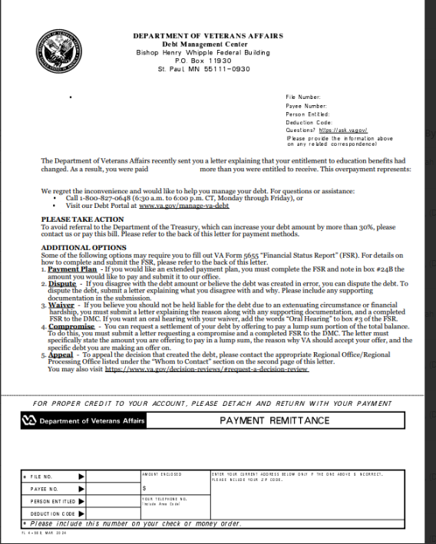
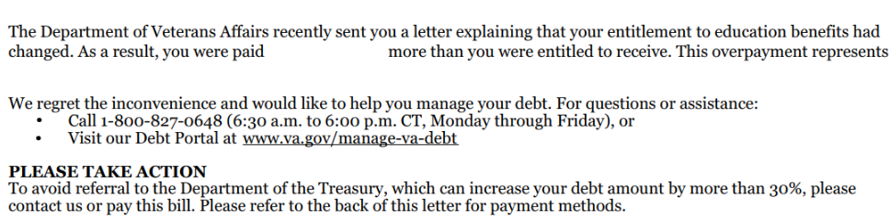
Letter Example: No Automated Plan

Slide 25
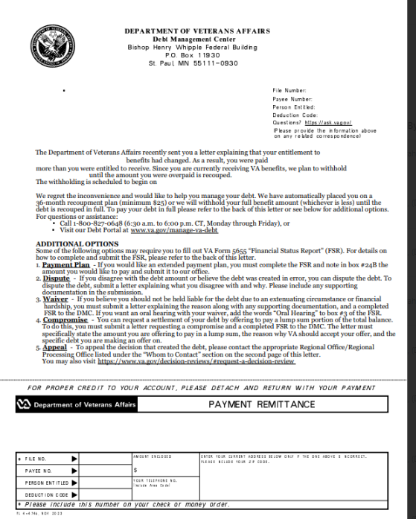
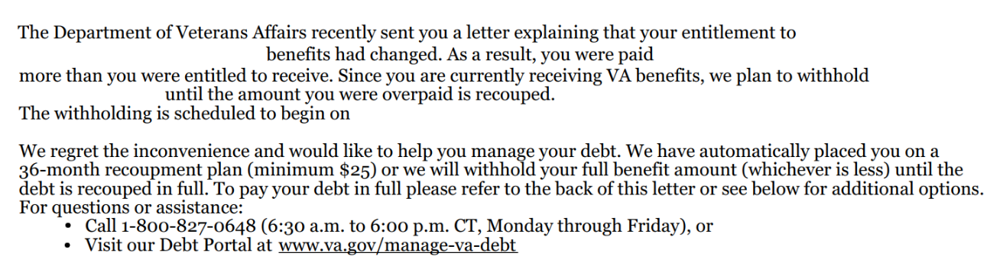
Letter Example: Automatic 36 month

Slide 26
FAQ: What makes a “good” waiver request?
Answer: There is no formula to guarantee the outcome of a waiver. Here are some things to bear in mind:
Indication of fraud, misrepresentation, or bad faith precludes granting of a waiver (See 38 U.S.C 5302(c) )
Request should explain facts and circumstances to enable the committee to consider the standards of equity and good conscience (see 38 C.F.R 1.965 for more details ):
- fault of debtor - balance of faults
- undue hardship - defeat the purpose
- unjust enrichment - changing position to one’s detriment
An accurate VA Form 5655 Financial Status Report facilitates evaluation of financial hardship

Slide 27
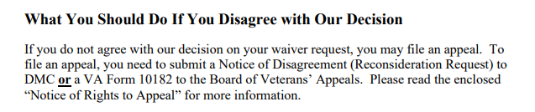
FAQ: How to Appeal a Waiver Decision ?
Language from Committee on Waivers and Compromises (COWC) letter:
*** Veterans should not use VA form 10182, 20-0996, or 20-0995 to appeal a waiver decision with DMC***

Slide 28
Appealing a Waiver Decision continued
Send to | Form to use | Info to include | Reviewed by | Stops collection?
DMC | None- request must be in writing | Indicate request is for reconsideration of waiver decision, include support for reconsideration | COWC | No
BVA | VA Form 10182 | Complete form including signature | Board of Veterans Appeals | No

Slide 29
VA Debt Portal for Veterans
Debt Portal: https://www.va.gov/manage-va-debt/
Veterans can log in to view balances
FAQ’s
Email notifications to Veterans
Online VA Form 5655 Financial Status Report (FSR) with “wizard”
More enhancements to come

Slide 30
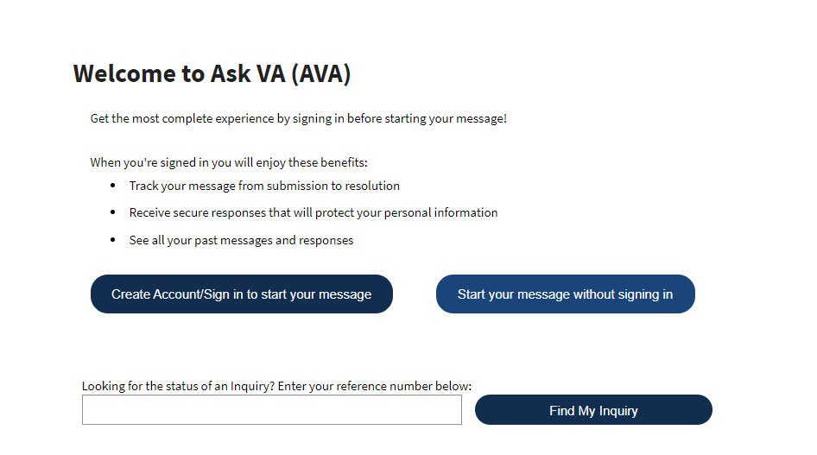
Ask VA (AVA)- DMC Tips
Located at https://ask.va.gov/
DMC has a PDF guide for VSOs on how to use AVA for DMC inquiries

Slide 31
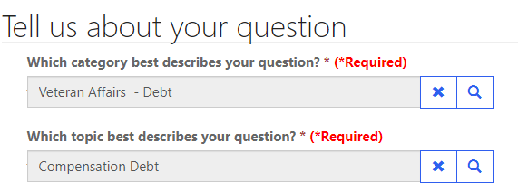
AVA- DMC Tips
Options to reach DMC are found under “Veteran Affairs- Debt” category and topics are used to select the type of debt for proper routing

Slide 32

AVA- DMC Tips
The option to Add Attachment is on the last page before submission

Slide 33
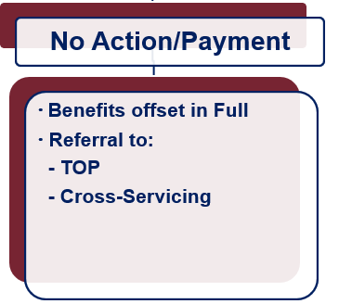
What if Payment is not Made?
Future VA benefits awarded will be withheld to satisfy debt
Department of Treasury
Offset of Federal payments
Referral to private collection agencies
Administrative Wage Garnishment Program

Slide 34
VHA Debts
For questions about medical care and pharmacy services copayment debt, contact the Health Resource Center:
1-866-400-1238
VA has options for Veterans who suffer from difficult financial circumstances and struggle to pay VA copayments:
Health Resource Center: 1-866-400-1238
https://www.va.gov/COMMUNITYCARE/revenue_ops/Financial_Hardship.asp

Slide 35
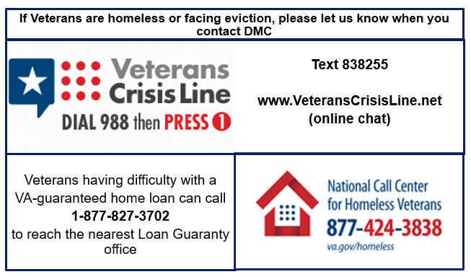
At Risk Veterans

Slide 36

Become a Debt Superstar (Contact DMC)
https://www.va.gov/manage-va-debt/ | Veteran Debt Portal
https://ask.va.gov | Online inquiry system
800-827-0648 | DMC Veteran Toll Free Line
612-970-5688 | Fax
612-970-5737 | DMC VSO Only Line

Slide 37
What would you do?
A Veteran comes into your office with a DMC debt letter and states their monthly compensation check amount is lower and it is causing them financial hardship:
What would you do to help the Veteran?
What options might this Veteran have with DMC?
Notes:
Things to mention if the group does not mention: VSO can call with Veteran to DMC VSO line, reduced monthly benefit offset with potential hardship refund, waiver request

Slide 38
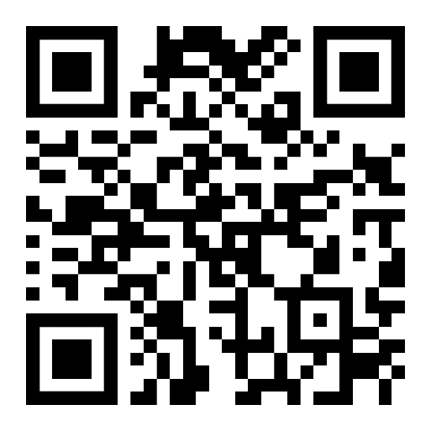
DMC Presentation Survey
DMC values your time and feedback on our presentation. We would appreciate it if you’re able to complete the survey below.
https://www.surveymonkey.com/r/DMCVSO

Slide 39
Additional Information
Notes:
.

Slide 40
Pay in Full
Pay by check: mail the check, payment coupon(s) and/or letter to:
VA Debt Management Center
Bishop Henry Whipple Federal Building
P.O. Box 11930
St. Paul, MN 55111-0930
Pay online: www.pay.va.gov
Pay by telephone: 800-827-0648

Slide 41
Withholding VA Benefits
Automatic 36-month repayment plan for compensation and pension debts
Full amount of benefit payment will be withheld until debt is paid in full for education debts
If debtors have financial hardship, please have them contact DMC
VA Form 5655, Financial Status Report, is required for any reduced withholding arrangement beyond 60 months

Slide 42
Compromise
Debtors should send letter to DMC indicating “compromise offer” and specifying amount
Offer should be a “lump sum”
Offer must include VA Form 5655
DMC refers offers to the Committee on Compromises
*** Payment should not be sent until the debtor receives a decision accepting the offer***

Slide 43
Waiver
Debtors have 180 days from date of first DMC debt letter to request waiver
Request must be:
Made in writing and submitted to DMC
Include VA Form 5655 Financial Status Report
Explain why debtor is unable to repay the debt
Received in the first 30 days for Education or 90 days for C&P debt to stop collection action

Slide 44
Dispute
Debtors can dispute the existence or amount of the debt created by VBA
Dispute must be in writing
DMC forwards disputes to the Regional Office/Regional Processing Office of jurisdiction

Slide 45
Temporary Suspension
Disaster Relief
Case by case financial hardship
Does not extend timeline to request waiver

Slide 46
FAQ: What happens when a debtor dies?
Answer: DMC reviews the account and may request funds from the debtor’s estate. Some things to bear in mind:
VA does not prorate monthly benefits when someone dies, so the payment for the month of death often creates a debt
Surviving spouses may be eligible for a month of death benefit, and if eligible that payment must be issued to the surviving spouse by VA, they cannot keep a payment VA issued to their deceased spouse. The Regional Office handles issuing month of death payments for eligible surviving spouses.
Unless there is fraud, VA does not pursue collection from a specific individual, but rather from the estate of the deceased debtor

Slide 47
Federal Debt Collection Laws
The Debt Collection Act of 1982
Authority for collection by administrative offset
The Debt Collection Improvement Act (DCIA) of 1996
Agencies required to refer delinquent non-tax debts to the Department of Treasury at 180 days
Digital Accountability and Transparency Act (DATA) of 2014
Changed referral requirement for delinquent non-tax debts from 180 days to 120 days

Slide 48
Navigating Politics as an Accredited Representative
Rob Couture
Dir., Comms & Public Affairs
VFW Washington Office
Brittany Dymond Murray
Associate Dir., Comms & Public Affairs
VFW Washington Office
September 2024

Slide 49
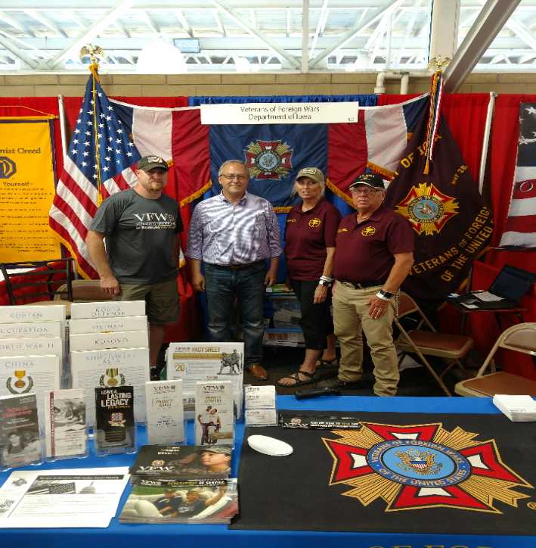
The VFW and Politics
The VFW is a congressionally-chartered, Veteran Service Organization that engages in non-partisan legislative advocacy.
All politics is local!
Members of Congress want to hear from their veteran constituents
Share your experience, but
know the VFW’s stance
Campaign Season
Get Out the Vote
Do your civic duty
Know your right and left limits
Notes:
Know the members of Congress and US Senators from your state. Use your status and access to garner support for the VFW’s legislative priorities.
Election:
DO’s
Do attend candidate Town Hall Meetings and other events and push our issues.
Do set up voter registration drives /Get Out the Vote Campaigns on the local level.
Do provide carpool service on Election Day to help the elderly and disabled get to the voting booth.
Do support and work for your favorite candidates as a voting constituent. As an individual and VFW member you can work or campaign on behalf of your favorite candidate - and are encouraged to do so. • Do wear your VFW cap.
DON’Ts
Don’t endorse candidates on behalf of the VFW as a Post, District, Department or National Leader.

Slide 50
Political Activities
DO’s
Attend candidate town hall meetings and other events to ask candidates where they stand on our issues
Set up voter registration drives / Get Out the Vote campaigns on the local level
Provide carpool service on Election Day to help the elderly and disabled get to the voting booths
Volunteer to be a poll worker
Support and work for your favorite candidates as an individual voting constituent
Wear your VFW cap at public events such as town halls, rallies, forums, or debates

Slide 51
Political Activities
DON’Ts
Don’t endorse (explicitly or implicitly) candidates on behalf of the VFW National Organization, Department, District or Post
Don’t wear your VFW cap when actively campaigning for a candidate, such as soliciting donations or knocking on doors asking people to pledge their vote for a candidate, or speaking in favor of a candidate at political rallies

Slide 52
QUESTIONS?
For legislative questions, visit vfw.org/advocacy or contact
VFW National Legislative Service
Email: pmurray@vfw.org
Call: (202) 608-8365

Slide 53
CHAMPVA & VA Caregiver Programs
Katherine Cassel
Assistant Director
Healthcare Policy

Slide 54
What is CHAMPVA
What is CHAMPVA and Caregiver Programs and the basics of each
Identify Eligibility and How to Apply/Enroll
Available Benefits and Services
Know the exclusions and considerations when utilizing Other Health Insurances (including Medicare)
Issue Resolution and the Appeals Process
Alternative support

Slide 55
CHAMPVA

Slide 56
What is CHAMPVA
Civilian Health and Medical Program of the Department of Veterans Affairs (CHAMPVA):
37 CFR 17.270 is the governing regulation
ChampVA is not an insurance plan, it is a cost share program in which VA shares the cost of covered health care services and supplies with eligible beneficiaries.
Affordable Care Act (ACA) designates CHAMPVA as fulfilling minimum essential coverage requirements
TRICARE
VA Health Care
Notes:
CHAMPVA & DOD TRICARE programs are very similar and are often mistaken for each other:
Tricare is a DOD regionally managed health care program for active duty and retirees and members of the uniformed services and their families
In some cases, a veteran may appear to be eligible for both programs, however if you are a military retiree, or the spouse of a veteran who was killed in action, you are and will always be a TRICARE beneficiary and cannot choose between the two programs.

Slide 57
Basics of ChampVA
The beneficiary must use an authorized provider to be covered
The beneficiaries will have a $50 annual deductible, and $100 for a family
ChampVA covers 75% of the allowable amount, which is the Medicare rate, and the beneficiary pays the remaining 25%, up to $3000.00 per year
Notes:
After using an authorized provider, the provider or the beneficiary files the claim to ChampVA using VA Form 10-7959a. In most cases the authorized provider will submit the necessary documentation
The following site has information regarding the procedures for beneficiaries to file reimbursement claims:
https://www.va.gov/COMMUNITYCARE/programs/dependents/champva/champva-claim.asp
Beneficiaries should send pharmacy and medical claims reimbursement

Slide 58
Eligibility for CHAMPVA
Covered services include:
Spouse or child of a Veteran who has been rated by VA as having a permanent and total service-connected disability, or
Spouse or child of a Veteran who has been rated by VA as having a permanent and total service-connected disability, or
Surviving spouse or child of a Veteran who was at the time of death rated permanently and totally disabled from a service-connected disability, or
Surviving spouse or child of a service member who dies in the line of duty, not due to misconduct*, or
An individual who is the Primary Family Caregiver in the Program of Comprehensive Assistance for Family Caregivers (PCAFC) who is not entitled to care and services under another health-plan
Notes:
A service-connected disability is a disability that we’ve concluded was caused , or made worse, by the Veteran’s active-duty service. Example: my elbow.
A permanent disability is one that’s not expected to improve. Can someone provide an example of a condition that may be classified as permanent?
If 2 spouses are both Veterans who qualify as CHAMPVA sponsors for their family, they both may now qualify for CHAMPVA benefits. Each time they need medical care, they may choose to get care through the VA health care program or using their CHAMPVA coverage.
*In most cases, these family members qualify for TRICARE, not CHAMPVA
PCAFC will be discussed in further detail later in this presentation
Eligible child pursing an approved course of instruction who incurs a disabling illness/injury while pursing the instruction, not of their own misconduct, and results in the inability to continue instruction

Slide 59
How to Apply for CHAMPVA
Required Documents:
VA Form 10-10d (Application for CHAMPVA Benefits)
VA Form 10-7959c (CHAMPVA—Other Health Insurance (OHI) Certification)
Copy of Medicare card for individuals who are eligible
For those 65+ years old and don’t qualify for Medicare, you will need to send documentation from the Social Security Administration the confirms you don’t qualify for Medicare
Notes:
For individuals who are eligible for Medicare for any reason, we need a copy of your Medicare card.
If you are age 65 or older and not entitled to Medicare, you must send documentation from the Social Security Administration that confirms you are not entitled to Medicare benefits under anyone's social security number.

Slide 60
How to Apply for CHAMPVA
Optional Documents: (copies only)
VBA decision showing permanent and total status, or death rating
Veteran’s DD 214 (Certificate of Release or Discharge from Active Duty)
Proof of Dependency
Marriage license
Remarried widow/widower once again single (legal documentation terminating the remarriage_
Birth Certificate/adoption papers for children
School certification of full-time enrollment for ages 18-23 years (original)
Notes:
Veteran's DD214, Certificate of Release or Discharge from Active Duty, or if the Veteran was a WWII or Korean War Veteran, the Report of Separation. If you do not have a copy of the necessary form, you may request it by submitting a Standard Form 180, Request Pertaining to Military Records, from the National Archives.
If you are a remarried widow/widower and are once again single, provide a copy of the legal documentation that terminated the remarriage. The legal documentation of termination of a remarriage may be a divorce decree, death certificate or annulment decree.
If you provide only the required documents, and not the optional documents, processing can take two to eight months since we have to confirm information with other federal agencies.
Once we get your application, we will review it to be sure it is complete and that all the required forms are included. If your application is not complete, we will return it to you with further instructions.

Slide 61
How to Apply for ChampVA
Mail your application, and associated documents, to:
VHA Office of Community Care
CHAMPVA Eligibility
PO Box 469028
Denver, CO 80246-9028
Or fax your forms: 303-331-7809
Notes:
IMPORTANT: Ensure the application is signed and dated. Also, if applying for a spouse, please include the date of marriage on the application
We are currently experiencing a backlog in processing applications. If you have questions regarding the status of your application, we encourage you to call the CHAMPVA call center at 800-733-8387.
If you send us all required and optional documents—and if your application is complete—it’ll take about 6 weeks after we get your package until you get your CHAMPVA ID card and related materials.
If you send us only the required documents, it may take 2 to 8 months since we’ll need to confirm your information with other federal agencies.

Slide 62
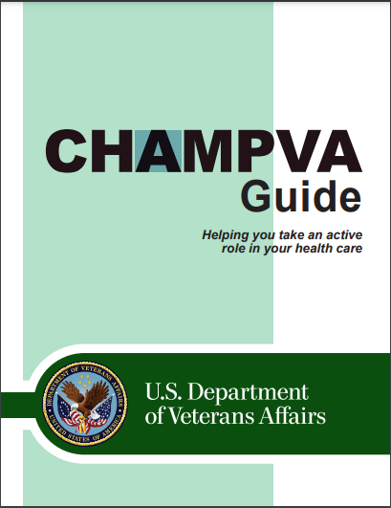
Benefits and Services
Ambulance service
Durable Medical Equipment
Family planning and maternity
Inpatient/Outpatient services
Pharmacy (prescription medicines)
Notes:
Additional services covered: Ambulatory surgery, hospice, skilled nursing care, and transplants
Some services that may be covered are substance abuse disorder/mental/behavioral health and dental care – refer to benefits guide or CHAMPVA program manager for further details and questions.
When you’re signed up for CHAMPVA, you’ll get a copy of the CHAMPVA Program Guide. This guide will tell you more about covered and non-covered services and supplies.
Services that require authorization: • Durable Medical Equipment (DME) with a purchase price or total rental of $2,000 or more (see Section 4) • Mental health care (Contact CHAMPVA for required approval) – Inpatient mental health care – Care at residential treatment facilities (RTF) – Alcohol/substance abuse – Care in Partial Hospital Programs (PHP) – Requests for extensions to our yearly limits on inpatient mental health care (see Section 4) – Outpatient mental health visits in excess of 23 per year • Dental care coverage (Dental coverage is very limited and under most circumstances is not covered.) • Organ transplant
Mental health services and durable medical equipment (DME) provided through the VA CITI program do not require authorization.

Slide 63
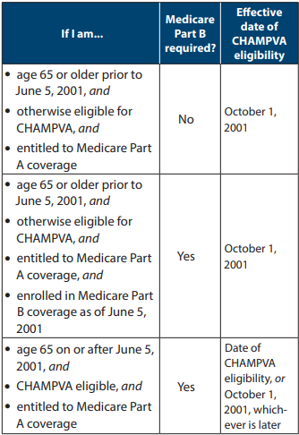
CHAMPVA and Medicare
CHAMPVA is always the second payer to Medicare
If you’re under 65 years old, you’re eligible for CHAMPVA if you meet both of these:
You have Medicare Parts A and B, and
You are otherwise eligible for CHAMPVA
If you’re 65 years old or older, you’re eligible for CHAMPVA if you’re eligible for Medicare.
See chart for specific requirements

Slide 64
CHAMPVA Contact
Customer Service – Eligibility, Other Health Insurance (OHI) Coverage, and Claims
Phone: 1-800-733-8387 (Monday - Friday, 8:05 a.m. to 7:30 p.m. ET)
Email Ask VA: ask.va.gov
Customer Engagement Portal – Payments
https://www.cep.fsc.va.gov/
Contact them by mail
CHAMPVA; PO Box 469063; Denver, CO; 80246-9063
Notes:
Every VAMC has a person who handles CHAMPVA problems. Contact your local VA to engage with your CHAMPVA representative.
Eligibility/Claims Status Inquiry (Payer ID: VAHAC) AND Medical Claims/Electronic Remittance Advice (ERA) (Payer ID: 84146)
Change Health Care (formerly Emdeon Inc.) Electronic Claim Submissions https://www.changehealthcare.com/
888-545-6127

Slide 65
Resources
CHAMPVA Guide
https://www.va.gov/COMMUNITYCARE/docs/pubfiles/programguides/CHAMPVA-Guide.pdf#
CHAMPVA Fact Sheets
https://www.va.gov/COMMUNITYCARE/pubs/factsheets.asp#CHAMPVA
Locating a Provider
https://www.va.gov/COMMUNITYCARE/programs/dependents/locate-provider.asp
How to File a CHAMPVA Claim
https://www.va.gov/COMMUNITYCARE/programs/dependents/champva/champva-claim.asp
Notes:
Additional services covered: Ambulatory surgery, hospice, skilled nursing care, and transplants
Some services that may be covered are substance abuse disorder/mental/behavioral health and dental care – refer to benefits guide or CHAMPVA program manager for further details and questions.
When you’re signed up for CHAMPVA, you’ll get a copy of the CHAMPVA Program Guide. This guide will tell you more about covered and non-covered services and supplies.
Services that require authorization: • Durable Medical Equipment (DME) with a purchase price or total rental of $2,000 or more (see Section 4) • Mental health care (Contact CHAMPVA for required approval) – Inpatient mental health care – Care at residential treatment facilities (RTF) – Alcohol/substance abuse – Care in Partial Hospital Programs (PHP) – Requests for extensions to our yearly limits on inpatient mental health care (see Section 4) – Outpatient mental health visits in excess of 23 per year • Dental care coverage (Dental coverage is very limited and under most circumstances is not covered.) • Organ transplant
Mental health services and durable medical equipment (DME) provided through the VA CITI program do not require authorization.

Slide 66
Caregiver Programs

Slide 67
VA Caregiver Programs
The VA has two Caregiver programs:
Program of General Caregiver Support Services (PGCSS) – There is no formal application required to enroll to this program
To be eligible, the Veteran must be enrolled in VA healthcare and receiving assistance from a caregiver
Program of Comprehensive Assistance for Family Caregivers (PCAFC) - There is a formal application process
The veteran and the caregiver need to meet certain eligibility criteria
https://www.va.gov/family-and-caregiver-benefits/health-and-disability/comprehensive-assistance-for-family-caregivers/

Slide 68
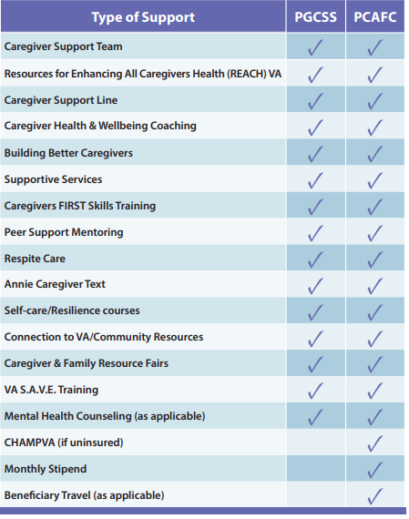
Caregiver Program Comparison

Slide 69
PCAFC Criteria for Eligibility
Caregiver eligibility – You must be at least 18 years old and at least one of the following must be true:
You’re a spouse, son, daughter, parent, stepfamily member, or extended family member of the veteran, OR
You live full time with the veteran, or you're willing to live full time with the veteran if designated as the family caregiver

Slide 70
PCAFC Criteria for Eligibility
Veteran Eligibility – All of the following must be true of the veteran:
Veteran must have a VA disability rating, individual or combined, of 70% or higher, and
Veteran was discharge from the U.S. military or has a date of medical discharge, and
Veteran must need at least 6 months of continuous, in-person personal care services

Slide 71
Qualifying Care for Veteran
Veteran must need continuous in-person care with activities of daily (ADLs) living for at least six-months
Basic/Primary – simple functioning tasks
Bathing
Dressing
Toileting
Executive/Instrumental – more complex tasks
Driving
Managing Finances
Medication

Slide 72
How to Apply
Utilizing an Accredited Veteran Service Officer
Apply on-line
You can apply by mailing your 10-10CG to:
Evidence Intake Center
PO Box 5154
Janesville, WI 53547-5154
Find your local Caregiver Support Team
You can apply in person, or
Call 1-855-260-3274
Notes:
You can take your completed 10-10CG to a local Caregiver Support Team member.
DO NOT send medical records with your application. VA will gathering any necessary documentation
The following website will walk you through the application process and provide the opportunity to begin applying on-line
https://www.va.gov/family-and-caregiver-benefits/health-and-disability/comprehensive-assistance-for-family-caregivers/apply-form-10-10cg/introduction

Slide 73
Benefits for the Veteran in PCAFC
This program supports the health and wellness of veterans by:
Providing the veteran with increased independence
Provides safety, protection and or instruction
Provides support for personal needs:
Feeding
Bathing
Dressing
Driving
Cooking & Cleaning
Medication

Slide 74
Benefits for the Caregiver in PCAFC
Comprehensive training
Peer support
A monthly stipend is payable to the Primary Caregiver
Eligibility to ChampVA for the Primary Caregiver
Mental Health Counseling
At least 30 days respite care per year for the Veteran

Slide 75
Misconceptions of PCAFC
ONLY spouses can be caregivers – The program is open to family members, parents, or anyone who is living with the veteran full-time.
ALL veterans are eligible – Not all veterans qualify for the program. They must have a 70% service-connection rating or higher and need continuous personal care services for at least six months and require assistance with activities of daily living.
Caregivers receive full time pay – Only the Primary Caregiver is eligible for a stipend and the stipend IS NOT equivalent to substantial full time employment income
Caregivers get health benefits – only the Primary Caregiver is eligible for ChampVA, and only if they do not have other health insurance

Slide 76
How to appeal a negative decision
VHA Clinical Review Process – this is also known as the clinical appeals process and is conducted locally.
Conducted at the Patient Advocates/Experience Office.
Higher-Level Review – request a new review of your case by higher-level reviewer will determine if an error or difference of opinion changed the decision.
Conducted at the VARO.
Board Appeal– Review by a Veterans Law Judge by submitting a completed VA Form 10-307 (PCAFC Notice of Disagreement (NOD))
Conducted at the Board of Veterans’ Appeals
Notes:
If you disagree with your Caregiver decision, you can begin a Clinical Appeal process at the Patient Advocates/Experience Office in your local VAMC
You can appeal a caregiver denial directly to the Board of Veterans Appeals. To appeal a decision issued on or after February 19, 2019, you must submit VA Form 10182 to the board by:
Online submission
Mail to: Board of Veterans’ Appeals; PO Box 27063 Washington DC 20038
Or fax to: 1-844-678-8979
There are multiple ways to appeal a denial of the VA's Program of Comprehensive Assistance for Family Caregivers (PCAFC):
Board Appeal: Request a review by a Veterans Law Judge at the Board of Veterans' Appeals by submitting a completed VA Form 10-307, the Program of Comprehensive Assistance for Family Caregivers (PCAFC) Notice of Disagreement (NOD).
Higher-Level Review: Request a new review of your case by a higher-level reviewer. This reviewer will determine if an error or difference of opinion changed the decision.
VHA Clinical Review Process: This process is also known as the VHA Clinical Appeals Process

Slide 77
Resources
VA Caregiver Support Program
https://www.caregiver.va.gov/
The Program of Comprehensive Assistance for Family Caregivers (PCAFC)
https://www.va.gov/family-and-caregiver-benefits/health-and-disability/comprehensive-assistance-for-family-caregivers/
Some additional Local Agencies that may be able to assist:
Department of Aging
Social Security Administration
Administration for Community Living
Department of Health & Human Services
Insurance Companies

Slide 78
Final Thoughts
The VFW Healthcare Team may be able to help with healthcare issues:
Katherine Cassell, Assistant Director of Veterans Health Policy
202-608-8371, Kcassell@vfw.org
Julie Holt, Special Assistant of Veterans Health Policy
202-608-8364, Jholt@vfw.org
Marion Fera, Health Consultant of Veterans Health Policy
202-608-8349, mfera@vfw.org

Slide 79
QUESTIONS?

Slide 80
ANCILLARY BENEFITS +
End of Life Care and Burial Benefits
Todd Gruchalla RQAS-WEST, NVS September 2024

Slide 81
ANCILLARY BENEFITS
Ancillary benefits are controlled by different areas of VA depending on their application.
Being aware of the forms number will aid you in correctly submitting a claim for ancillary benefits
Forms beginning with 21 are VBA related
Forms beginning with 10 are VHA related
Forms beginning with 26 are VBA related through the appropriate Regional Loan Center

Slide 82
ANCILLARY BENEFITS
Ancillary benefits are:
Secondary benefits that are contingent on a veteran’s eligibility for compensation or a dependent’s eligibility for Dependency and Indemnity Compensation (DIC)
Eligibility for ancillary benefits is based on the type of disability entitlement the veteran has or the circumstances of the veteran’s death.

Slide 83
Objectives
Definitions
Awareness of various benefits
Education Service Dogs
Health care Civil service preference
Clothing allowance State/local
Prosthetics DoD benefits
Automobile
Housing
Insurance

Slide 84
VETERAN READINESS AND EMPLOYMENT (VR&E)
Vocational rehabilitation and employment services, job training, employment accommodations, resume development, and job seeking skills coaching are available to veterans who didn’t receive a dishonorable discharge and have service-connected disability rating of at least 10%.
Other services may be provided to assist veterans in starting their own businesses or independent living services for those who are severely disabled and unable to work in traditional employment.
38 USC Chapter 31
Notes:
Healthcare/dental eligibility and housing adaptations may also be provided if the vet is enrolled in Voc Rehab

Slide 85
VETERAN READINESS AND EMPLOYMENT (VR&E)
Basic period of eligibility:
If you were discharged from active duty before January 1, 2013, ends 12 years from the date of notification of one of the following, whichever is later:
Date of separation from active military service
Date the veteran was first notified by VA of a service-connected disability rating
If you were discharged from active duty on or after January 1, 2013, there’s no time limit on your eligibility.
The basic period of eligibility may be extended if a Counselor determines that a veteran has a Serious Employment Handicap and needs extra time.

Slide 86
VETERAN READINESS AND EMPLOYMENT (VR&E)
How to apply:
The veteran will have to submit the VA Form 28-1900 “Disabled Veterans Application For Vocational Rehabilitation” to VA and then will meet with a counselor to determine the best course of action and eligibility.
If the veteran has not received a VA rating or has not yet been discharged (up to 6 months prior to discharge), they can still apply for VR&E; They will complete and submit the 28-1900 and the Notice to VA Veterans Service Center, located on the bottom of 28-0588. VA will review the available evidence and issue a memorandum rating determining eligibility.

Slide 87
Dependents Educational Allowance (DEA) (Chapter 35)
Provides education type benefits to spouse/children of:
Veteran who died or is permanently and totally disabled due to a service connected disability
Veteran who died after 10 years from any cause while permanently and totally disabled.
Servicemember who died on active duty, MIA or captured by hostile forces
Servicemember forcibly detained/interned in LOD by foreign govt
Servicemember hospitalized/receiving outpatient treatment for permanent and total service connected disability and likely to be discharged for that disability

Slide 88
DEA (continued)
Up to 45 months of benefits if benefits began before 8-1-18
Up to 36 months of benefits if benefits began on or after 8-1-18
Time limit
Children – No timeline if you became eligible on or after 8-1-2023
Turned 18 on or after 8-2-2023
Completed high school or received GED on or after 8-1-2023
Eligibility before 8-1-2023 up to 8 years before you turn 26 years old

Slide 89
DEA (continued)
Surviving spouse
up to 20 years if spouse died on active duty or effective date of permanent and total rating was withing 3 years of discharge from active duty
up to 10 years if veteran established eligibility after discharge from active duty

Slide 90
Veterans Health Care
No co-pays for healthcare and/or prescriptions if:
Former Prisoner of War
50% or more compensable VA service-connected disabilities (those with less than 50% may take co-pay test to determine prescription co-pay status)
Veteran deemed catastrophically disabled by VA provider

Slide 91
Veterans Health Care (continued)
Health care at VHA facilities based on “categories”
Priority groups
Group 1 – service-connected combined 50% or higher or Medal of Honor
Group 2 – service-connected combined 30-40%
Group 3 – former POW, Purple Heart, military discharge due to disability incurred/aggravated in LOD, service-connected combined 10-20%, entitlement under 38 USC 1151
Group 4 – receiving comp or pension based on need for A&A or housebound benefits

Slide 92
Veterans Health Care (continued)
Group 5 – Nonservice-connected veterans and non-compensable service-connected veterans rated by VA as 0% disabled who have an annual income below the VA’s geographically-adjusted income limit (based on resident ZIP code); veterans receiving VA pension benefits; and veterans eligible for Medicaid benefits.

Slide 93
Veterans Health Care (continued)
Group 6 - Compensable 0% service -connected veterans; veterans exposed to ionizing radiation during atmospheric testing or during the occupation of Hiroshima and Nagasaki, Project 112/SHAD participants; veterans who served in the Republic of Vietnam between 1-9-62 and 5-7-75; veterans who served in the Southwest Asia theater of operations from 8-2-90 thru 11-11-98; veterans who served in a theater of combat operations after 11-11-98, as follows:
Veterans discharged from active duty on or after 1-28-03, for five years post discharge; and veterans who served duty at Camp Lejeune for at least 30 days between 8-1-52, and 12-31-87

Slide 94
Veterans Health Care (continued)
Group 6 continued - Currently enrolled veterans and new enrollees who served in a theater of combat operations after 11-11-98 and those who were discharged from active duty on or after 1-28-03, are eligible for the enhanced benefits for five years post discharge Note: At the end of this enhanced enrollment priority group placement time period, veterans will be assigned to the highest priority group their eligibility for which their status at that time qualifies.

Slide 95
Veterans Health Care (continued)
Group 7 - veterans with gross household income below the geographically-adjusted VA income limit for their resident location and, who agree to pay copayments

Slide 96
Veterans Health Care (continued)
Group 8 - veterans with gross household incomes above VA national income limit and the geographically-adjusted income limit for their resident location and, who agree to pay copayments.
Veterans eligible for enrollment: Noncompensable 0% service-connected and are:
Subpriority a - Enrolled as of 1-16-03, and who have remained enrolled since that date and/or placed in this subpriority due to changed eligibility status.

Slide 97
Veterans Health Care (continued)
Subpriority b - Enrolled on or after 6-15-09, whose income exceeds the current VA national income limits or VA national geographic income limits by 10% or less veterans eligible for enrollment: nonservice-connected and:
Subpriority c - Enrolled as of 1-16-03, and who remained enrolled since that date and/or placed in this subpriority due to changed eligibility status
Subpriority d - enrolled on or after 6-15-09 whose income exceeds the current VA national income limits or VA national geographic income limits by 10 % or less

Slide 98
Veterans Health Care (continued)
Veterans NOT eligible for enrollment: Veterans not meeting the previous (a,b,c,d) criteria:
Subpriority e - noncompensable 0% service-connected (eligible for care of their service-connected condition only).
Subpriority f - nonservice-connected.

Slide 99
Veterans Health Care (continued)
Dental care
Eligibility based on “classes” not “categories – not same as for most other VHA medical benefits (see www.va.gov/healthbenefits for definitions of the various classes
Classes I, IIA, IIC, IV eligible for dental to maintain/restore oral health and masticatory function including repeat care
Some of the other classes have time and service limitations
Inpatient dental care services determined to be essential to management of patient’s medical condition under active treatment

Slide 100
Veterans Health Care (continued)
Long term services – 3 national programs
VA owned and operated Community Living Centers (CLC)
State Veterans’ Homes owned and operated by the states
Community Nursing Home (NH) program
Each program admission and eligibility criteria specific to the program
VA obligated to pay full cost of NH services for enrolled veterans who need NH care for service-connected disability or have 70% or higher service-connected disability or entitled to individual unemployability
VA provided NH care of other veterans based on available resources

Slide 101
CLOTHING ALLOWANCE
Eligibility:
The veteran must have been prescribed and use either of the following for a service connected disability:
Prosthetic or orthopedic appliance, such as a wheelchair, crutches, braces, artificial limb, etc. (Note: soft and flexible devices, such as an elastic stocking or soft brace, are not included)
Medication prescribed by a physician for a service-connected skin condition that causes permanent stains or otherwise damages outer garments
38 CFR 3.810

Slide 102
Clothing Allowance (continued)
Once a year payment
Applications collected throughout the year and held until closing date of August 1
Applications processed by VA prosthetics department
Payments issued between September 1 and October 31
Static disabilities eligible for recurring benefits automatically issued during August
Where eligible for more than 1 allowance, must reapply for extra each year

Slide 103
Clothing Allowance (continued)
Application: VA Form 10-8678, Application for Annual Clothing Allowance
Submit to VHA prosthetic department
Application must be received by August 1 to be eligible for payment for that year – applications received after August 1 will be held for following year benefit

Slide 104
CLOTHING ALLOWANCE
As of December 16, 2011, Veterans became eligible to receive multiple clothing allowance benefits, with a limit of two (2) per garment affected and total maximum of four (4) clothing allowances.
Annual clothing allowance benefit is currently $999.51
Approved Articles of Clothing:
Skirts
Pants
Blouses
Shirts
Disapproved Articles of Clothing:
Hats, Caps
Underwear
Socks, Stockings, Pantyhose
Shoes
Scarves, Ties, Gloves

Slide 105
Prosthetics
Audiology and diagnostic/preventive eye care services eligibility
Has compensable service-connected disability
Former POW
Purple Heart
Receiving benefits under 38 USC 1151
In receipt of NSC pension with SMP (housebound or A&A)
Has vision/hearing impairment related to disability for which receiving VHA medical care
Has significant impairment affecting ability to perform ADLs
Has vision and/or hearing impairment severe enough to interfere with ability to actively participate in personal medical treatment
Has SC hearing disability that contributes to loss of communication ability

Slide 106
Prosthetics (continued)
Non-service-connected veterans:
Eligible for hearing aids/glasses on basis of medical need
Must be enrolled at VA medical facility where receiving care
Have hearing/vision loss that interferes/restricts communication to extent it affects active participation in health care as determined by audiologist or eye care provider
Contact Prosthetics Department for further information or eligibility criteria: www.prosthetics.va.gov

Slide 107
Automobile Allowances
Financial assistance in the purchase of a new or used automobile or other conveyance may be made to a veteran with specific disabilities up to once every 10 years
Prior to January 5, 2023, veterans were only entitled to one auto allowance in their lifetime. If a veteran had already received an automobile allowance prior to 1/05/2023, they may apply immediately for a new auto allowance if more than 30 years have elapsed since they received their most recent auto allowance.
Beginning on January 5, 2023, veterans may apply for an additional auto allowance once 10 years have passed since their previous auto allowance was awarded.
38 CFR 3.808

Slide 108
AUTOMOBILE ALLOWANCE (continued)
Financial assistance, in the form of a grant, is available to purchase a new or used automobile (or other conveyance) to accommodate a veteran or servicemember with certain service-connected disabilities.
The grant may also be paid if disabilities are a result of medical treatment, examination, vocational rehabilitation, or compensated work therapy provided by the VA.
The grant is paid directly to the seller of the automobile for the total price (up to $25,603.02 of the automobile).
38 CFR 3.808

Slide 109
AUTOMOBILE ALLOWANCE (continued)
A veteran or servicemember must have one of the following disabilities to qualify for the automobile grant:
Loss, or permanent loss of use, of one or both feet
Loss, or permanent loss of use, of one or both hands
Impairment of vision 20/200 or less in better eye with correction or peripheral field less than 20 degrees
Severe burns causing contracture which limits motion of limbs
Amyotrophic lateral sclerosis (ALS)

Slide 110
AUTOMOBILE ALLOWANCE (continued)
The VA Form 21-4502 “Application for Automobile or Other Conveyance and Adaptive Equipment” is used to apply for an automobile allowance.
Only Sections I and II are to be completed when initially submitting the claim, Section III will be completed by VA and then the form is returned to the veteran.
Once the veteran receives the 21-4502 back from VA they can fill out Section IV and purchase their new or used vehicle.
Once purchased, the seller will need to submit the completed 21-4502 to VA in order to receive payment.

Slide 111
ADAPTIVE EQUIPMENT ALLOWANCE
That equipment which must be part of or added to a vehicle to make it safe for use by the claimant and to assist in meeting the applicable standards of licensure of the proper licensing authority.
Adaptive equipment may be certified for the initial vehicle purchased or for subsequent vehicles. This is not a one-time allowance.
38 CFR 3.808(e)
38 CFR 17.158

Slide 112
ADAPTIVE EQUIPMENT ALLOWANCE (continued)
Adaptive equipment includes, but not limited to, power steering, power windows, power seats, and special equipment necessary to assist the eligible person into and out of the vehicle.
Contact should be made with the local VA medical center’s Prosthetic Department prior to purchasing any equipment.
The adaptive equipment grant may be paid more than once and it may be paid to either the seller or the veteran.

Slide 113
ADAPTIVE EQUIPMENT ALLOWANCE (continued)
The VA Form 10-1394 “Application For Adaptive Equipment
Motor Vehicle” is used when applying for adaptive equipment only.
If filing for both an automobile grant and adaptive equipment, only the 21-4502 needs to be completed.

Slide 114
ADAPTIVE EQUIPMENT ELIGIBILITY
A veteran or servicemember must have one of the following disabilities to qualify for adaptive equipment:
Loss, or permanent loss of use, of one or both feet
Loss, or permanent loss of use, of one or both hands
Impairment of vision 20/200 or less in better eye with correction or peripheral field less than 20 degrees,
Severe burns causing contracture which limits motion of limbs,
Amyotrophic lateral sclerosis (ALS)
Ankyloses of one or both knees or one or both hips
Notes:
This is the same as the auto grant with the exception of ankyloses

Slide 115
ADAPTIVE EQUIPMENT ELIGIBILITY
A disability which is acquired as a result of treatment in a VA medical facility (38 USC 1151) or as a result of training under 38 USC Chapter 31 (compensated work therapy), even though compensation is payable, does not qualify a veteran for these benefits.
Even though compensation may be payable under 38 CFR 3.383, claimants do not qualify for adaptive equipment based on a loss of paired SC and NSC organs or extremities. (38 USC 1160)

Slide 116
Home Improvements and Structural Alterations (HISA)
The HISA benefit provides home improvements and structural alterations necessary only to ensure the continuation of treatment and/or to provide access to the home or to essential lavatory and sanitary facilities authorized under.
Lifetime benefit up to $6,800 may be provided for:
Veterans and Servicemembers who have a Service-connected condition that requires an adaptation
Veteran rated 50% or more and requires an adaptation even if the condition requiring the adaptation is not S/C
Lifetime benefit up to $2,000 may be provided for:
Non-service-connected Veterans

Slide 117
HISA (continued)
SAH and SHA eligible Veterans will also likely be eligible for Home Improvements and Structural Alterations (HISA)
HISA can provide additional funds for needed home modifications
The HISA grant may be used in conjunction with either the SAH or SHA grants

Slide 118

HISA (continued)
Commonly Approved
COMMONLY APPROVED
Permanent Ramps that allow entrance to or exit from the residence
Access to kitchen or bathroom sinks or counters
Entrance pathways or driveways
Plumbing;
Electrical systems/outlets
Hardwood flooring
Door latches
Roll-in showers/ Walk-in bathtubs
Widening doorways to essential lavatories or sanitary facilities
Interior and exterior lighting
Costs related to taxes, permits, inspections fees, which are required by local ordinances
COMMONLY DISAPPROVED
New home construction
Spa or Jacuzzi type tubs
Exterior decking
Any alterations or modifications that the property owner is required to furnish under the Americans with Disabilities Act due to commercial zoning
Home Security Systems
Elevators
Pathways that lead to workshops and barns
Regular home maintenance routine repairs (e.g. replacement of roofs, furnaces, or air conditioners)
Commonly Disapproved

Slide 119
HISA (continued)
What is needed for HISA:
A prescription from a VA physician that includes:
Beneficiary’s name, address and phone number
Description of the prescribed improvement or structural alteration
The diagnosis and medical justification for the prescribed improvement or structural alteration
VA Form 10-0103-HISA application with advance payment request
Homeowners notarized authorization (if applicant is a renter)
Written itemized estimate of costs for labor, materials, permits, and inspections
A color photograph of the unimproved area
Incomplete applications: if missing documentation is not received within 30 days, VA will notify beneficiary and close application
VA will conduct a pre-award inspection of site no later than 30 days after receiving a complete HISA package
Notes:
See HISA map handout

Slide 120
Specially Adapted Housing Grant (SAH)
Eligibility
The loss or loss of use of more than one limb
The loss or loss of use of a lower leg along with the residuals (lasting effects) of an organic (natural) disease or injury
Blindness in both eyes (with 20/200 visual acuity or less)
Certain severe burns
The loss, or loss of use, of one lower extremity (foot or leg) after September 11, 2001, which impairs balance or walk without the help of braces, crutches, canes, or wheelchair
Can be used to construct, build, remodel or acquire adapted home
Property must be owned by veteran/service member
38 CFR 3.809

Slide 121
SAH (continued)
FY 2024 maximum $117,014
May receive grant of not more than 50% of cost of specially adapted house
Grant can be awarded 3 times not to exceed max amount allowed
38 CFR 3.809

Slide 122
SAH (continued)
SAH grants can be used in one of the following ways:
Construct a specially adapted home on land to be acquired
Build a home on land already owned if it is suitable for specially adapted housing
Remodel an existing home if it can be made suitable for specially adapted housing
Use the grant to help pay the unpaid principal mortgage balance of an adapted home already acquired without the assistance of a VA grant

Slide 123
SAH (continued)
NOTE: Congress set a limit of 120 SAH grants per fiscal year. If the maximum is already reached, can reapply next fiscal year.

Slide 124
SPECIAL HOME ADAPTATION
The SHA grant is available to veterans and servicemembers who are entitled to disability compensation due to:
Blindness in both eyes with 20/200 visual acuity or less in the better eye with the use of a standard correcting lens
The anatomical loss or loss of use of both hands or extremities below the elbow,
A severe burn injury.
Certain severe respiratory conditions
Current SHA maximum is $23,444 for FY 24
The grant can be awarded six times not to exceed the maximum dollar amount allowable.
38 CFR 3.809a

Slide 125
TEMPORARY RESIDENCE ASSISTANCE (TRA) GRANT
Temporary grants may be made to those who are or will be temporarily residing in a home owned by a family member
SAH maximum is $47,130 FY 2024
SHA maximum is $8,415 FY 2024
Temporary grants do count as one of the three or 6 usages of SAH/SHA

Slide 126
SAH, SHA, & TRA PROCEDURES
VA Form 26-4555, “Veterans Application in Acquiring Specially Adapted Housing or Special Home Adaptation Grant” is used to apply for SAH, SHA, and TRA
The VA Regional Loan Center is responsible for determining entitlement to, and payment of, SAH, SHA, and TRA.
Conditional approval includes consideration of:
disability requirements
feasibility and suitability, and
usage or dollar amounts of assistance available vs. any amounts previously paid.
Final approval requires consideration of property requirements including
details of proposed adaptations
ownership
certifications
insurance
geographic limits

Slide 127
SAH, SHA, & TRA PROCEDURES
The veteran will be contacted by the Prosthetics department of VHA to determine:
Prescription for need of adaptation
Review of any required cost estimates

Slide 128
VA HOME LOAN GUARANTY FUNDING FEES
A veteran wanting to use the VA loan guaranty to purchase a house generally is subject to a funding fee based on the type of loan, their military category (NG, AD etc.) and if they have used their guaranty before.

Slide 129
VA HOME LOAN GUARANTY FUNDING FEES (continued)
The VA Loan Guaranty funding fee can be waived if:
Veteran is receiving VA compensation
Veteran would be entitled to receive compensation for a SC disability if he/she were not receiving retirement or active duty pay
Surviving spouse of a veteran who died of a SC disability
Veteran rated eligible to receive VA disability comp based on a pre-discharge rating and exam or a rating based on existing medical evidence.
The veteran received a compensable memorandum rating from VR&E
38 CFR 36.43113(e)(5)

Slide 130
VA HOME LOAN GUARANTY FUNDING FEES (continued)
If a veteran indicates that they desire to utilize the VA Home Loan Guaranty, ensure that a disability claim is filed before the home closes if possible. (At least an ITF)
If compensation is awarded after the loan closing but the effective date is prior to closing, the veteran can request reimbursement of the funding fee – the reimbursement is paid towards the principal loan balance
Certificates of Eligibility can be obtained from E-benefits
Married couples who both have eligibility cannot combine their benefit to raise the maximum amount of guaranty, though both are still eligible in their own right. However, if one veteran is not eligible to have the funding fee waived, VA requires that the borrowers pay half of the funding fee if both veterans are on the loan.

Slide 131
Insurance
Veterans’ Group Life Insurance (VGLI)
Allows veteran to continue life insurance coverage after service
Provides lifetime coverage as long as premiums paid
May enroll for maximum amount of coverage equal to amount of Servicemembers’ Group Life Insurance (SGLI) coverage had when separated from service
Once enrolled, veterans can increase coverage by $25,000 every 5 years up to legislated maximum of $500,000 until age 60
38 CFR Part 9

Slide 132
Insurance (continued)
Enrollment Period
Veterans have 1 year and 120 days from their date of separation to apply for VGLI. If they apply for coverage within 240 days from separation, no health questionnaire is needed.

Slide 133
Insurance (continued)
Veterans are eligible to apply for VGLI, if they had SGLI, and are within 1 year and 120 days of the following events:
release from active duty or active duty for training under a call or order to duty that does not specify a period of less than 31 days.
separation, retirement or release from assignment from the Ready Reserves/National Guard
assignment to the Individual Ready Reserves (IRR) of a branch of service or to the Inactive National Guard (ING).This includes members of the United States Public Health Service Inactive Reserve Corps (IRC)
placement on the Temporary Disability Retirement List (TDRL)

Slide 134
Insurance (continued)
Veterans are also eligible to apply for VGLI if they had part-time SGLI and while performing duty, suffered an injury or disability that rendered them uninsurable at standard premium rates. This includes travel directly to and from duty.
If the veteran is totally disabled at the time of separation, they can apply for an SGLI Disability Extension which provides free coverage for up to two years from the date of separation. An extension of SGLI due to total disability is not automatic.
At the end of the extension period, the veteran automatically becomes eligible for VGLI, subject to premium payments.

Slide 135
Insurance (continued)
S-DVI is an optional life insurance for service-connected veterans only that stopped taking applications after December 31, 2022.
If a veteran was already enrolled in S-DVI they can keep it
The basic S-DVI program insures eligible Veterans for up to $10,000 of coverage.
Veterans who have the basic S-DVI coverage and are 100% P&T service-connected can have their premiums waived.
If a premium waiver is granted, policyholders may apply for additional coverage of up to $30,000 under the Supplemental S-DVI program.
Premiums for Supplemental S-DVI coverage cannot be waived.

Slide 136
Insurance (continued)
S-DVI application
VA Form 29-4364, Application for Service Disabled Veterans Life Insurance
Download VA Pamphlet 29-9 for premium rates and plans available
VA Form 29-357 to apply for total disability waiver of premiums
VA Form 29-0188 Application for Supplemental Service-Disabled Veterans Life Insurance
Premiums to be paid monthly – can be withheld from VA benefits or military retired pay
Submit application on line or mail to VA Insurance Center in Philadelphia, PA

Slide 137
Insurance (continued)
To be eligible for S-DVI the veteran must meet all of the following requirements:
Released from service under other than dishonorable conditions on or after April 25, 1951
Must have a service-connected disability (even one rated 0%)
Healthy except for the service-related disability
Must apply within two years of being notified of a service-connected disability (can apply any time veteran receives a new disability award, even one rated 0%)

Slide 138
Insurance (continued)
In January 2023, VA launched Veterans Affairs Life Insurance (VALife), which provides guaranteed acceptance whole life insurance coverage to service-connected veterans aged 80 and under. Some Veterans aged 81 and older may also be eligible.
VALife offers guaranteed acceptance whole life insurance coverage that lasts for an individual’s entire life and provides the following benefits:
All veterans aged 80 and under with 0-100% VA disability ratings are eligible.
Fully automated online enrollment with instant approvals.
Coverage comes in increments of $10,000, up to a maximum of $40,000
No medical requirements for enrollment.
Cash value that builds over the life of the policy after the first two years of enrollment.

Slide 139
Insurance (continued)
Veterans who currently hold an S-DVI policy can either keep their current coverage or apply for VALife.
Veterans can keep their S-DVI policy until the full coverage of VALife begins two years after enrollment as long as the application is received between Jan. 1, 2023, and Dec. 31, 2025.

Slide 140
Insurance (continued)
VA Life
Elected coverage effective 2 years after enrollment as long as premiums paid during the 2-year period
If veteran dies within 2 years of application, beneficiary to receive all premiums paid plus interest
Premium rate paid monthly or annually
Fixed rates depends on age and amount of coverage elected
No waiver of premiums for any VA Life program
Estimated premium rates (could change prior to 1-1-23) can be found at: benefits.va.gov/insurance/valif_rates.asp

Slide 141
Insurance (continued)
What about S-DVI?
No new enrollments after 12-31-22
Can remain on S-DVI
Can apply for VA Life
If applying for VA Life between 1-1-23 and 12-31-25, can keep S-DVI during the 2 years from application while waiting for the full VA Life coverage to take effect
No premium waivers offered
IMPORTANT—except for the initial 2 year VA Life enrollment period when application received between 1-1-23 and 12-31-25, veteran CANNOT be insured under both S-DVI and VA Life

Slide 142
Service Dogs
The VA recognizes the potential benefits of service dogs for veterans with disabilities, including those with physical disabilities or mental health conditions. Service dogs can provide assistance, support, and companionship to veterans, enhancing their overall well-being. The process of obtaining and utilizing a service dog through the VA involves several steps:

Slide 143
Service Dog (continued)
Veterans with a service-connected disability may be eligible for a service dog provided by the VA. The disability can be physical, mental, or a combination of both.

Slide 144
Service Dogs (continued)
The VA supports the use of various types of service dogs, including guide dogs, mobility dogs, and psychiatric service dogs. Psychiatric service dogs can assist veterans with conditions such as post-traumatic stress disorder (PTSD)

Slide 145
Service Dogs (continued)
Service dogs must be trained to perform specific tasks related to the veteran's disability. While there is no specific certification process for service dogs, they should meet training standards to ensure they can assist the veteran effectively.

Slide 146
Application Process
Clinical Evaluation:
Veterans interested in obtaining a service dog typically start by discussing the option with their VA healthcare provider. A clinical evaluation is conducted to determine if a service dog would be beneficial for the veteran's specific needs.
Referral to VA Prosthetics and Sensory Aids Service (PSAS):
If the healthcare provider determines that a service dog would be beneficial, they may make a referral to the VA Prosthetics and Sensory Aids Service (PSAS). PSAS coordinates the provision of service dogs and related services.

Slide 147
Application Process
Application to Prosthetics and Sensory Aids Service:
Veterans may need to submit an application to the PSAS, which includes information about their disability, living situation, and the tasks they need assistance with. The application process may vary by VA medical center.
Assessment and Matching:
Once the application is received, the VA works to assess the veteran's needs and match them with a suitable service dog. The matching process considers the veteran's disability, lifestyle, and the tasks the service dog is trained to perform.

Slide 148
Application Process
Training and Placement:
If a suitable match is found, the service dog and the veteran undergo training together. The training may take place at a specialized facility or through a program recognized by the VA. Once trained, the service dog is placed with the veteran.
Follow-Up and Support:
The VA provides ongoing support and follow-up to ensure the success of the service dog placement. This may include periodic check-ins, additional training if needed, and assistance with any issues that arise.

Slide 149
Responsibilities of the Veteran
Veterans receiving a service dog should be prepared to take on the responsibilities of caring for and working with the dog. This includes daily care, ongoing training reinforcement, and ensuring the dog's well-being.
IMPORTANT NOTE: It's important for veterans to work closely with their VA healthcare providers and the Prosthetics and Sensory Aids Service to navigate the application process and ensure that the service dog meets their specific needs.

Slide 150
Civil Service Preference
Preference hiring for government positions
Basic eligibility
Honorable/under honorable conditions (general) discharge
Basically 3 types of preference eligibility
Sole survivorship (0 point preference eligible)
Non-disabled veteran (5 point preference eligible)
Service disabled veteran (10 point preference eligible)
Not all active duty service may qualify for veterans’ preference
5 USC 2108

Slide 151
Civil Service Preference (continued)
0 Point Preference – no points added to score but preference ahead of others
Released/discharged from period of active duty after 8-29-08 by reason of being only surviving child in family in which father or mother or one or more siblings:
Served in armed forces AND
Was killed, died as result of service, is POW or MIA status or permanently 100% disabled/hospitalized on continuing basis (not employed gainfully due to disability or hospitalization) WHERE
Death/status/disability not result from intentional misconduct or willful neglect of parent/sibling and not incurred during period of unauthorized absence

Slide 152
Civil Service Preference (continued)
5 Point Preference eligibility
Service for more than 180 consecutive days, other than for training, any part of which occurred 9-11-01 and ended 8-31-10 OR
From 8-2-90 to 1-2-92 OR
More than 180 consecutive days, other than for training, after1-31-55 and before 10-15-76 OR
Between 4-28-52 and 7-1-55 OR
In war, campaign or expedition for which a campaign medal/badge authorized

Slide 153
Civil Service Preference (continued)
10 Point Preference eligibility
Have a service-connected disability OR
Received a Purple Heart

Slide 154
Civil Service Preference (continued)
Preference groups are divided into 5 basic groups:
CPS – Disability rating 30% or more (10 points)
CP – Disability rating 10% to 30% (10 points)
XP – Disability rating less than 10% (10 points)
TP – Preference eligible with no disability rating (5 points)
SSP – Sole Survivorship Preference (0 points)
Letters for each category designate shorthand reference used by OPM in competitive exams. Disabled veterans receive 10 points regardless of rating

Slide 155
Civil Service Preference (continued)
When agency uses numerical rating and ranking to determine best qualified, additional 5 or 10 points are added to score
When agency uses category rating, preference eligible with 10% or more disability (CPS and CP) are placed at top of highest category on list
XP and TP are placed above non-preference eligible in assigned category

Slide 156
Civil Service Preference (continued)
Documentation
Copy of DD-214, Certificate of Release or Discharge from Active Duty which shows dates of service and character of discharge
Written “certification” from armed forces indicating service member expected to be discharged/released from active duty under honorable conditions no later than 120 days after the date certificate signed OR
SF-15, Application for 10-point Veterans’ Preference

Slide 157
Veteran Owned Business
Veterans Benefits, Health Care, and Information Technology Act of 2006 (PL 109-461) provided VA with unique authority for Service-Disabled Veteran-Owned Small Business (SDVOSB) and Veteran-Owned Small Business (VOSB) set-aside and sole source contracts
To qualify to participate, eligible VDSOSBs/VOSBs must be verified
38 CFR Part 74
13 CFR Part 125
38 USC 8127 and 8128

Slide 158
Veteran Owned Business (continued)
Department of Veterans Affairs and Federal Aviation Administration
All other federal agencies
Veteran-Owned and Service-Disabled Veteran-Owned Small Businesses
Service-disabled Veteran-Owned Small Businesses

Slide 159
Veteran Owned Business (continued) Eligibility:
Department of Veterans Affairs and Federal Aviation Administration
All other federal agencies
Formal verification required
Self-certification in SAM.gov

Slide 160
Veteran Owned Business (continued)
VOSB verification to transfer from VA to Small Business Administration (SBA) effective 1-1-23

Slide 161
Veteran Owned Business (continued)
SDVOSB
Federal govt targets at least 3% of all federal contracting dollars to SDVOSB annually
Meets small business criteria according to SBA
Be at least 51% owned and controlled by one or more service-connected veterans
Have one or more S/C veterans manage day-to-day operations who also make long-term decisions
Eligible veterans must have S/C disability

Slide 162
Veteran Owned Business (continued)
VOSBs may get federal surplus property from State Agency for Surplus Property (SASP)
Need to get from state where property to be primarily located and used
Be unconditionally owned/controlled by one or more eligible veterans, service-disabled veterans or surviving spouses
Is “verified” in Veterans First Verification Program database
Will use property in normal conduct of business activities (personal/non-business use prohibited)
Will not sell, transfer, loan, lease, encumber or otherwise dispose of property during period of restriction without express written authorization from SASP, GSA, and SBA

Slide 163
Veteran Owned Business (continued)
Will use property as intended within 1 year of receipt
Will maintain VOSB eligibility with VA and SASP for duration of federal period of restriction for donated property
Will give SBA, GSA and/or SASP access to inspect property and all pertinent records
Vets First Verification Program process takes applicants through four stages: Intake, Assessment, Federal Review and Decision (https://vetbiz.va.gov)

Slide 164
Veteran Owned Business (continued)
Resources:
Office of Veterans Business Development
409 Third Street SW, Suite 5700
Washington, DC 20416
202-205-6773

Slide 165
Commissary/Exchange Privileges
Eligible persons (beyond active military):
Military retired veterans and dependents
Unremarried surviving spouse of retired veteran and dependents
Effective 1-1-20, service-connected veterans (0% and above), dependents, and caregivers
Medal of Honor recipient
Former POW
Both in store and on-line access
DoD benefit
ID issued by military
DD Form 1172 (VA provides assistance in completing form)

Slide 166
Commissary/Exchange Privileges (continued)
Effective 1-1-20, for bases with restricted access, DoD to accept:
VA’s Veteran Health Identification Card (VHIC)
Letter from VA along with acceptable REAL ID-compliant identification (includes passports and some state driver’s licenses)
VHIC must show veteran’s eligibility status (Purple Heart, former POW, or service-connected) on front under photo
Veterans with non-compensable S/C condition (0%) will need a REAL-ID compliant identification and Health Eligibility Center Form H62A which shows Priority Group 8E

Slide 167
Commissary/Exchange Privileges (continued)
Veterans or caregivers with felony convictions, felony arrest warrants or derogatory information related to criminal history or terrorism will be prohibited from entering base
Caregivers must be registered in VA’s Program of Comprehensive Assistance for Family Caregivers to access commissaries, exchanges and MWR facilities – need letter issued by VA Office of Community Care saying they qualify
Commissary purchases pay a 5% surcharge; a 1.9% fee to use credit card and 0.5% fee for debit card
Exchanges do not charge a tax or surcharge

Slide 168
Commissary/Exchange Privileges (continued)
As of 11-11-17, honorably discharged veterans (no service-connected disability required) may shop the on-line exchange
Must register on-line to shop on-line even if eligible for in-person shopping
Apply on-line at VetVerify.org
Shop on-line at https://www.shopmyexchange.com

Slide 169
Space Available Travel
John S. McCain National Defense Authorization Act for Fiscal Year 2019 signed 8-13-18
Section 624 provides for amendment to 10 USC 2641b
Veteran with service-connected permanent disability rated as total
Authorizes space-available travel on military aircraft
Armed Forces Travel organization - committed to providing quality, value travel services to folks affiliated with Department of Defense – eligibility for their services extends to all S/C veterans and caregivers

Slide 170
Space A Flights
Eligibility for flights assigned categories
Category 1 – Emergency leave travel
Category 2 – Accompanied Environmental & Morale Leave (EML)
Category 3 – Ordinary Leave, House Hunting TDY
Category 4 – Unaccompanied dependents on EML
Category 5 – Permissive TDY, students, dependents, post-deployment/mobilization respite absence
Category 6 – Retirees, dependents, reservists and disabled veterans

Slide 171
Space A Flights (continued)
Space-A airfare is extremely low cost – often only a federal inspection fee and head tax
Check with military base where planning to leave from for potential flights
Must sign up at Base Operations
No guarantees of seat – need to be prepared to self-pay on commercial airlines if you get “bumped”
Costs vary by military base – some bases offer lunch boxes for purchase – need to check with base in advance

Slide 172
Space Available Lodgings
Lodging (on-base, Navy Lodge, etc.)
Overnight (single and multiple nights)
Recreational
Campgrounds/cabins
Beach cabana
Ski chalet
Air Force Inns (89 around the world)
AFRC Resorts (Hale Koa in Hawaii, Shades of Green at Disney World, Edelweiss Lodge & Resort in Germany, Dragon Hill Lodge in Seoul)
Check with Morale, Welfare and Recreation at local base for other offerings

Slide 173
Space Available Lodgings (continued)
Eligibility (not limited to) via Morale, Welfare & Recreation (MWR) generally include these and immediate families
Active duty service members
Members of reserve components
Service academy cadets
Retired service members and family
Honorably discharged veterans with 100% S/C
Medal of Honor
Unremarried surviving spouse/orphans of personnel who died on active duty or in retired status, or who were married to service member for 20 years while they were on active duty
Defense Dept and Coast Guard civilians stationed outside US

Slide 174
Space Available Lodgings (continued)
DoD Lodging website has links to the Air Force, Army, and Navy lodging policies
Each branch of service has own eligibility policy, but generally, Space-A lodging is more flexible than Space-A flying
Service member or retiree’s spouse may use the privilege without the sponsor present
Eligible patrons can usually sponsor guests, including family members or civilians who do not have a DoD identification card
Installation commanders establish limited-use eligibility requirements subject to local demand and capacity

Slide 175
Space Available Lodgings (continued)
Generally, clean, safe, relatively inexpensive, with access to fitness facility
Some rooms are spacious, often with a kitchen and living room, and many military lodges offer free laundry facilities for guests
Depending on the location, may be able to use other base services, such as the commissary, the BX, the golf course, or recreational equipment rentals

Slide 176
Space Available Travel & Lodging
Resources:
https://www.militaryonesource.mil/recreation-travel-shopping/recreation/fun-and-fitness/morale-welfare-and-recreation-programs-and-eligibility/
https://www.americanforcestravel.com
https://www.afvclub.com/
https://www.poppinsmoke.com/on-base/space-a-lodging/
www.dodlodging.net/info.aspx

Slide 177
Other Benefits
State benefits
State veteran’s homes
Waiver or fee reduction for fish and wildlife licenses
Reduction in real estate property taxes
Reduction in tuition/fees for education (veterans and/or dependents)
Check with local State benefits website for what is available
Other Federal benefits
Lifetime National Parks Pass (serviced by Dept of Interior)
Veteran with any VA disability rating
Limited to veteran and all passengers in veteran’s vehicle
Does not transfer to survivors or dependents without veteran in vehicle

Slide 178
Appeals process for denial of Ancillary benefits
Must be filed within 1 year of decision
Request a decision review: Supplemental Claim if you have new and relevant evidence
Higher Level Review: No new evidence can be submitted
Board Appeals: Appeal to the BVA and have a Veterans Law Judge review your case

Slide 179
Clinical Appeal Process
For medical determinations you disagree with prescription medicine, specific types of therapy.
Contact the VA health facility’s patient advocate.
If you want to appeal a VA decision about health care benefits, dental treatment eligibility, or travel reimbursement you will need to do a 20-0995, 20-0996 or BVA appeal.

Slide 180
Insurance Claims Appeals
Three Options
20-0995 Supplemental Claim
20-0996 Higher Level Review
BVA Appeal NOD VA Form 10182

Slide 181
Ancillary Recap
Be aware of the multiple ancillary benefits a veteran may be entitled to
Check current criteria for eligibility as it may change
REMEMBER: Veterans don’t always know what they are entitled to.
They need YOU!

Slide 182
End of Life and Burial Benefits

Slide 183
Why This Matters
The veteran has earned these benefits which includes benefits for their survivors. Ensure loved ones receive these benefits after a veteran pass away. End-of-life planning provides surviving family members with peace of mind following their veteran's death.

Slide 184
What to expect with End-of-Life Planning
Ensuring veterans and their loved ones are informed about their benefits is important when it comes to life insurance, care preferences, survivor benefits, memorial and burial benefits. There are resources available to help plan and ease the burden on loved ones during difficult times.

Slide 185
End-of-life planning
Life insurance and dependent support
Life insurance provides important financial support to family members when a Veteran dies. Veterans Affairs Life Insurance (VALife) recently opened for enrollment and provides guaranteed acceptance whole life insurance coverage for more service-connected Veterans than ever before. Veterans age 80 or under with any level of service-connected disability rating (0-100%) can apply for up to $40,000 and there is no time limit to apply. Veterans age 81 or older may also qualify for VALife if they meet additional eligibility criteria.

Slide 186
End-of-life planning
Life insurance and dependent support
With Veterans’ Group Life Insurance (VGLI), you may keep your term life insurance coverage up to $500,000 after you leave the military for as long as you continue to pay the premiums.
Loss of income can greatly affect a family’s financial stability when a Veteran passes. Dependency and Indemnity Compensation (DIC) provides monthly tax-free compensation to eligible survivors. Family members who may be eligible include the surviving spouse, child or parent of a Veteran or service member who died from a service-related injury or illness.

Slide 187
End-of-life planning
Advance Care Planning
Different people want different things when it comes to their health care. Advance care planning ensures that Veterans’ loved ones and health care teams know what’s important to Veterans and what their preferences are for health care in the future. There are different types of advance care planning, and health care teams can help determine which type is right for each individual Veteran. The VHA Advance Care Planning via Group Visits Program allows Veterans and their caregivers to join their peers and learn more about the process of planning for future health care needs.

Slide 188
Burial and Memorial Benefits
Burial and Memorial Benefits
VA provides several benefits and services to help ease the burden of a Veteran’s passing—all at no cost to the Veteran and their family. Burial and memorial benefits include opening and closing of the grave in a national cemetery, grave liner (vault), perpetual care and maintenance, a government headstone, marker, or medallion for any eligible Veteran buried anywhere in the world, a Presidential Memorial Certificate, a Veterans Legacy Memorial (VLM) page, burial flag and military honors.
VA provides burial benefits for all legal burial types, including cremation and burial at sea.

Slide 189
Burial and Memorial Benefits
Burial and Memorial Benefits
VA oversees 155 national cemeteries and assists Veterans and family members in burial planning ahead of time through pre-need eligibility. Veterans and dependents can submit an application before death to determine their eligibility for burial in a VA National Cemetery. Veterans, service members and eligible dependents do not need to be buried in a national cemetery to receive VA memorial benefits.
Additionally, VA partners with states, territories and tribes by providing grants to help fund 121 Veteran cemeteries, increasing the reach of VA’s burial benefit for Veterans and their eligible family members. Eligibility for burial in these cemeteries is like VA national cemeteries but may include residency requirements.

Slide 190
Planning Ahead
Planning for the future and having difficult discussions now can provide a small bit of respite for survivors when a loved one passes.
Counseling our veteran clients to create a folder that has a copy of their DD214, Advance Care Plan, life insurance policy and pre-need burial eligibility decision letter. Ensure loved ones know where to find it and what actions they need to take after your death.
Contact information for an accredited representative should also be included.

Slide 191
Burial Benefits
Service-related Death
VA will pay up to $2,000 toward burial expenses for deaths on or after September 11, 2001, or up to $1,500 for deaths prior to September 11, 2001. If the Veteran is buried in a VA national cemetery, some or all of the cost of transporting the deceased may be reimbursed.
Non-service-related Death
VA will pay up to $796 toward burial and funeral expenses for deaths on or after October 1, 2019 (if hospitalized by VA at time of death), or $300 toward burial and funeral expenses (if not hospitalized by VA at time of death), and a $796 plot-interment allowance (if not buried in a national cemetery). For deaths on or after December 1, 2001, but before October 1, 2011, VA will pay up to $300 toward burial and funeral expenses and a $300 plot-interment allowance. For deaths on or after April 1, 1988 but before October 1, 2011, VA will pay $300 toward burial and funeral expenses (for Veterans hospitalized by VA at the time of death).

Slide 192
Eligibility Requirements
You paid for a Veteran's burial or funeral, AND
You have not been reimbursed by another government agency or some other source, such as the deceased Veteran's employer, AND
The Veteran was discharged under conditions other than dishonorable, AND
The Veteran died because of a service-related disability, OR
The Veteran was receiving VA pension or compensation at the time of death, OR
The Veteran was entitled to receive VA pension or compensation, but decided not to reduce his/her military retirement or disability pay, OR
The Veteran died while hospitalized by VA, or while receiving care under VA contract at a non-VA facility, OR
The Veteran died while traveling under proper authorization and at VA expense to or from a specified place for the purpose of examination, treatment, or care, OR

Slide 193
Eligibility cont’d
The Veteran had an original or reopened claim pending at the time of death and has been found entitled to compensation or pension from a date prior to the date or death, OR
The Veteran died on or after October 9, 1996, while a patient at a VA-approved state nursing home.
NOTE: VA does not pay burial benefits if the deceased:
Died during active military service, OR
Was a member of Congress who died while holding office, OR
Was a Federal prisoner

Slide 194
Evidence Requirements
Acceptable proof of death AND
Receipted bills that show that you made payment in whole or part, OR
A statement of account, preferably on the printed billhead of the funeral director or cemetery owner. The statement of account must show:
The name of the deceased Veteran for whom the services and merchandise were furnished, AND
The nature and cost of the services and merchandise, AND
All credits, AND
The amount of the unpaid balance, if any

Slide 195
How to apply for Burial Benefits
Accredited representative completes VA Form 21P-530 application for burial allowance and submits to the Pension Management Center for processing.

Slide 196
EOL & Burial Recap
Be aware of the multiple ancillary benefits a veteran may be entitled to
Check current criteria for eligibility as it may change
REMEMBER: Veterans don’t always know what they are entitled to.
They need YOU!

Slide 197
QUESTIONS?
Todd Gruchalla RQAS-WEST, NVS September 2024

Slide 198
NATIONAL GUARD AND RESERVE BENEFITS
Sandy Hogsed Veterans of Foreign Wars September 2024
198

Slide 199



Purpose
Understanding Different Types of Military Duty and Their Impact on VA Benefits
National Guard and Reserve Members
199

Slide 200
Overview
OBJECTIVES:
Define and differentiate between Active Duty, ACDUTRA, INACDUTRA, and State Active Duty.
Explain how ROTC and Service Academies affect VA benefits
Explain travel status
200

Slide 201
Acronyms/Abbreviations
ACDUTRA - Active duty for training purposes
INACDUTRA or IDT – Inactive duty for training
IADT – Initial Active-Duty Training (think boot camp and AIT)
ADS – Active-Duty support
ADSW – Active Duty special work service
AGR – Active Guard Reserve
201

Slide 202
References: Verifying Veteran Status
38 CFR 3.6 -- Duty periods.
32 U.S.C. 316, 502, 503, 504, or 505
37 U.S.C. 206
38 CFR 3.12a -- Minimum active-duty service requirement.
Notes:
37 usc is pay allowances

Slide 203
References: Verifying Veteran Status
M21-1MR, Part III, Subpart i, Chapter 1, Section A - Establishing Veteran Status
M21-1MR, Part-III-Subpart I Chapter 1 Section A Establishing-Veteran-Status, #3 (Duty Status and Eligibility of Reservists)
M21-1, Part III, Subpart i, Chapter 1, Section A - Establishing Veteran Status (va.gov), #4 (Duty Status and Eligibility of National Guard Members
M21-1, Part III, Subpart i, Chapter 1, Section B - Service Requirements and Verification of Eligibility
203

Slide 204

Definition
A Veteran Is A Person Who…….
Served in the active-duty military, naval, air or space service, and
Was discharged or released under conditions other than dishonorable.

Slide 205
Qualifying Service
Qualifying service is any type of service that qualifies or potentially qualifies a claimant for Deptment of Veterans Affairs (VA) benefits.
Types of qualifying service are listed in 38 CFR 3.6 and 38 CFR 3.7

Slide 206
Active Service
Active military, naval, air, or space service. This includes:
active duty,
any period of active duty for training during which the individual concerned was disabled or died from a disease or injury incurred or aggravated in line of duty,
and any period of inactive duty training during which the individual concerned was disabled or died from an injury incurred or aggravated in line of duty or from:
an acute myocardial infarction
a cardiac arrest
or a cerebrovascular accident which occurred during such training

Slide 207
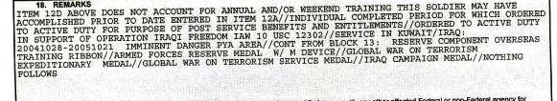
Minimum Active-Duty Service
Depends on the benefit sought
For Compensation:
38 CFR 3.12a(a)(1) defines the minimum period as
24 months of continuous active duty, or
the full period for which a person is called or ordered to active duty.

Slide 208
Active Duty
38 CFR 3.6(b) Active Duty This means: (most pertinent for the purposes of this class)
Full-time duty in the Armed Forces, other than active duty for training;
(4) Service at any time as a cadet at the United States Military, Air Force, or Coast Guard Academy, or as a midshipman at the United States Naval Academy;
(5) Attendance at the preparatory schools of the United States Air Force Academy, the United States Military Academy, or the United States Naval Academy for enlisted active-duty members who are reassigned to a preparatory school without a release from active duty, and for other individuals who have a commitment to active duty in the Armed Forces that would be binding upon disenrollment from the preparatory school;
(Public Health Service, NOAA & other recognized agency is understood for this class)

Slide 209
Active Duty (Cont’d)
(6) Authorized travel to or from such duty or service; and
(7) A person discharged or released from a period of active duty, shall be deemed to have continued on active duty during the period of time immediately following the date of such discharge or release from such duty determined by the Secretary concerned to have been required for him or her to proceed to his or her home by the most direct route, and, in all instances, until midnight of the date of such discharge or release.
NOTE: (Travel time can be up to 10 days. Sometimes DD 214 will show the number of days, if not we will need to develop to service department.)

Slide 210
Ways a National Guard Member or Reserve Member Can Perform “Active Duty”
Called to full time active duty under 10 United States Code (also referred to as Title 10 service)
Normally occurs as result of deployment
Establishes Veteran status
Results in issuance of DD Form 214, Certificate of Release or Discharge from Active Duty
Activation of a Coast Guard Reservist under 14 U.S.C. qualifies as active service for VA purposes.
Notes:
Caveat – some part qualify(look up the rule/part of the title. Title 10 & 14 for USCG.

Slide 211
Active Duty for Training (ACDUTRA)
38 CFR 3.6 (c) Active duty for training. This means:
(1) Full-time duty in the Armed Forces performed by Reserves for training purposes; (i.e. 2 week annual training)
(2) Full-time duty for training purposes performed as a commissioned officer of the Reserve Corps of the Public Health Service:
(i) On or after July 29, 1945, or
(ii) Before that date under circumstances affording entitlement to full military benefits, or
(iii) At any time, for the purposes of dependency and indemnity compensation:
(3) Full-time duty performed by members of the National Guard of any State, under 32 U.S.C. 316, 502, 503, 504, or 505, or the prior corresponding provisions of law or full-time duty by such members while participating in the reenactment of the Battle of First Manassas in July 1961

Slide 212
Active Duty for Training (ACDUTRA) (Cont’d)
4) Duty performed by a member of a Senior Reserve Officers' Training Corps program when ordered to such duty for the purpose of training or a practice cruise under chapter 103 of title 10 U.S.C.
(i) The requirements of this paragraph are effective—
(A) On or after October 1, 1982, with respect to deaths and disabilities resulting from diseases or injuries incurred or aggravated after September 30, 1982, and
(B) October 1, 1983, with respect to deaths and disabilities resulting from diseases or injuries incurred or aggravated before October 1, 1982.
(ii) Effective on or after October 1, 1988, such duty must be prerequisite to the member being commissioned and must be for a period of at least four continuous weeks.

Slide 213
Inactive Duty for Training(INACDUTRA)
38 CFR 3.6 (d) Inactive duty training. This means: -
Duty (other than full-time duty) (i.e. weekend drills)
prescribed for Reserves (including commissioned officers of the Reserve Corps of the Public Health Service) by the Secretary concerned under 37 U.S.C. 206 or any other provision of law;
Special additional duties authorized for Reserves (including commissioned officers of the Reserve Corps of the Public Health Service) by an authority designated by the Secretary concerned and performed by them on a voluntary basis in connection with the prescribed training or maintenance activities of the units to which they are assigned; and

Slide 214
Inactive Duty for Training(INACDUTRA) (Cont’d)
(3) Training (other than active duty for training) by a member of, or applicant for membership (as defined in 5 U.S.C. 8140(g)) in, the Senior Reserve Officers' Training Corps prescribed under chapter 103 of title 10
(4) Duty (other than full-time duty) performed by a member of the National Guard of any State, under 32 U.S.C. 316, 502, 503, 504, or 505, or the prior corresponding provisions of law. The term inactive duty training does not include: (i.e. weekend drills)
Work or study performed in connection with correspondence courses,
Attendance at an educational institution in an inactive status, or
Duty performed as a temporary member of the Coast Guard Reserve.
Notes:
Example - ROTC

Slide 215
Service Academies
38 CFR 3.6 (b)
(4) Service at any time as a cadet at the United States Military, Air Force, or Coast Guard Academy, or as a midshipman at the United States Naval Academy;
(5) Attendance at the preparatory schools of the United States Air Force Academy, the United States Military Academy, or the United States Naval Academy for enlisted active-duty members who are reassigned to a preparatory school without a release from active duty, and for other individuals who have a commitment to active duty in the Armed Forces that would be binding upon disenrollment from the preparatory school;
215
Notes:
Considered active duty

Slide 216
Service Academies (Cont’d)
38 CFR 3.6 (b)
(6) Authorized travel to or from such duty or service; and
(7) A person discharged or released from a period of active duty, shall be deemed to have continued on active duty during the period of time immediately following the date of such discharge or release from such duty determined by the Secretary concerned to have been required for him or her to proceed to his or her home by the most direct route, and, in all instances, until midnight of the date of such discharge or release.
NOTE: (Travel time can be up to 10 days. Sometimes DD 214 will show the number of days, if not we will need to develop to service department.)
216

Slide 217
Reserve Officer Training Corp (ROTC)
38 CFR 3.6(c)
(4) Duty performed by a member of a Senior Reserve Officers' Training Corps program when ordered to such duty for the purpose of training or a practice cruise under chapter 103 of title 10 U.S.C.
(i) The requirements of this paragraph are effective—
(A) On or after October 1, 1982, with respect to deaths and disabilities resulting from diseases or injuries incurred or aggravated after September 30, 1982, and
(B) October 1, 1983, with respect to deaths and disabilities resulting from diseases or injuries incurred or aggravated before October 1, 1982.
(ii) Effective on or after October 1, 1988, such duty must be prerequisite to the member being commissioned and must be for a period of at least four continuous weeks.
Notes:
Depends on Branches of service(or annual training.

Slide 218
Travel Status
38 CFR(e) Travel status—training duty (disability or death from injury or covered disease). Any individual:
(1) Who, when authorized or required by competent authority, assumes an obligation to perform active duty for training or inactive duty training; and
(2) Who is disabled or dies from an injury or covered disease incurred while proceeding directly to or returning directly from such active duty for training or inactive duty training shall be deemed to have been on active duty for training or inactive duty training, as the case may be. The Department of Veterans Affairs will determine whether such individual was so authorized or required to perform such duty, and whether the individual was disabled or died from an injury or covered disease so incurred. (cont’d next slide)

Slide 219
Travel Status (cont’d)
In making such determinations, there shall be taken into consideration the hour on which the individual began to proceed or return; the hour on which the individual was scheduled to arrive for, or on which the individual ceased to perform, such duty; the method of travel performed; the itinerary; the manner in which the travel was performed; and the immediate cause of disability or death. Whenever any claim is filed alleging that the claimant is entitled to benefits by reason of this paragraph, the burden of proof shall be on the claimant.
(3) For purposes of this section, the term covered disease means any of the following:
(i) An acute myocardial infarction.
(ii) A cardiac arrest.
(iii) A cerebrovascular accident.
NOTE: (Travel time can be up to 10 days. Sometimes DD 214 will show the number of days, if not we will need to develop to service department.)

Slide 220
Active Guard Reserve (AGR) and Active Duty Support (ADS)
Full time duty for operational support of Reserve or National Guard
AGR service in Reserves is performed under Title 10 and is considered active duty.
AGR service in National Guard is performed under Title 32 and is considered active duty for training
DD Form 214 will be issued for AGR service. This will be used to determine the kind of service it is. The VA will have to make determinations and develop as needed if clarification of the kind of duty is listed on the DD 214.

Slide 221
State Active Duty
State or territory’s governor activates National Guard members for State Active Duty such as in response to natural or man-made disaster
If ordered by the governor only for state duties (paid by the state) is NOT considered ACDUTRA or Active Service
State Active Duty based on state law does not qualify as “active service” for VA benefits
NG members on State Active Duty paid with state funds as opposed to Federal funds
Title 32 If ordered by executive order of the president, but initiated by the state, it is ACDUTRA as it is full time duty –– example: Hurricane Katrina, in support of Border Patrol, if requested by the Secretary of Defense.
Notes:
Check DFAS to check for pay records.

Slide 222
Dual Status Technician
Military technicians are civilian employees of Department of Army or Air Force who are required to maintain membership in NG or Reserves in order to retain employment
Technicians wear uniform or Reserve/National Guard
Technician status NOT reflected in military records and not type of qualifying service
Disease/injuries incurred during non-ACDUTRA or non-INACDUTRA Title 5 employments periods NOT entitled to VA benefits
Also perform monthly INACDUTRA drill weekends and 15-day ACDUTRA annual training and other service as directed
Notes:
Civilian job under NG has to do normal training. It actually falls under FECA. If died then SC?

Slide 223

What’s My Service?
I was attending my required weekend drill for the Army National Guard.
INACDUTRA, Inactive Duty for Training

Slide 224

What’s My Service?
Here is a picture of me on the obstacle course when I was attending my basic training for the Army Reserve.
ACDUTRA – Active Duty for Training

Slide 225

What’s My Service?
Here I am in Iraq with my Marine Corps reserve unit. We were deployed in June 2003.
Active Duty

Slide 226

What’s My Service?
This is a picture of me in my uniform at the Air Force Academy in Colorado Springs. My grandma says I am so handsome!!
Active Duty

Slide 227

What’s My Service?
The governor of my state called my unit up to fight forest fires in Washington state. I was paid by the state for my duty.
State Active Duty

Slide 228

What’s My Service?
My duty assignment in the Air Force Reserves is Active Guard Reserve.
Active Duty - AGR is considered Active Duty Under Title 10

Slide 229
Part 2 – Next Steps in Claims Processing
OBJECTIVES:
Describe the basic steps in processing a claim for benefits.
Describe the importance of Line of Duty (LOD) Determinations
List other sources of evidence that may be needed in support of a claim
229

Slide 230

VSO Interview
A day in the life of a VSO…..

Slide 231
Next Steps
Clients will come to see you for advice on variety of topics.
For you to assist them, you will first need to determine their duty status.
With that information, you can then take the next steps based on what they are requesting.
The most common inquiry is this: Are their injuries considered disabling by the VA and are they entitled to disability compensation.

Slide 232
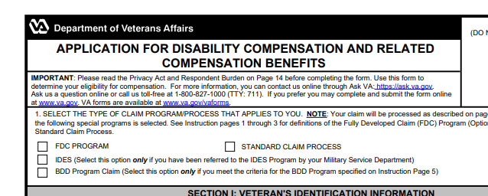
Next Steps
Fill out an application for compensation benefits – VA Form 21-526EZ.
VA Form 21-526EZ

Slide 233
Next Steps-What Else Do You Need?
VA has a duty to assist the claimant in requesting relevant records to help the support the claim. However, the claimant can submit any records in their possession that they believe may help their claim.
Does the vet have any original copies of service treatment records or personnel records in their possession? If so, these should be submitted to VA. (Make a copy for the vet’s records)
Even though the VA will request these, it may be helpful for the vet to submit any documents in his/her possession.
If they were treated privately, they will need to complete VA Form VA Form 21-4142, Authorization for Release of Information to the

Slide 234
Next Steps-What Else Do You Need? (cont’d)
If their injuries were caused by an accidental injury, they may want to complete VA Form 21-10210 - Lay/Witness Statement
VA is responsible for locating military records, but there are sometimes that records for National Guard and Reserve servicemembers may need to provide any pertinent information that the VA needs to be able to obtain such records, (complete units of assignment, locations of treatment, etc.)
VA will schedule examinations for claimed conditions if medical evidence is not sufficient to make a decision.

Slide 235
Line of Duty Determinations References (LOD)
38 CFR 3.301 Line of duty and misconduct (va.gov)
M21-1, Part X, Subpart iv, Chapter 1, Section C - Willful Misconduct and Line of Duty (LOD) (va.gov)
38 CFR 3.1(n) -- Definitions.

Slide 236
Line of Duty Determinations –Additional Information
A Line of Duty Determination is Required When: A Soldier’s service is interrupted by death, or injury, illness, or disease for a period of more than 24 hours with lasting significance, permanent disability, or requires follow on care. Commands must initiate an LOD investigation within 5 calendar days of the incident.
LOD investigations determine duty status at the time of incident and whether misconduct was involved and, if so, to what degree. Additionally, LOD investigations may be required to determine an entry prior to service (EPTS) condition, and, if so, determine service aggravation.
(Army Publication 600–8–4)

Slide 237
Line of Duty Determinations (Cont’d)
A service department finding that injury, disease, or death was not due to misconduct will be binding on the Department of Veterans Affairs (VA) unless it is patently inconsistent with the facts and the requirements of laws administered by VA.
In general, accept service department findings of no misconduct as conclusive unless there is a preponderance of evidence to the contrary
If a LOD determination is required, VA is to consider all evidence of record to determine whether injury/disease/death was incurred/aggravated in line of duty.

Slide 238
Line of Duty Determinations –Additional Information
Line of Duty determinations (DD Form 261) will in most cases be located when the VA requests service treatment records and personnel records.
If the veteran has a copy of the LOD for the claimed condition, it would be helpful for the vet to submit a copy to the VA.
In summary,
VA to prepare formal LOD determination IF service department
Did not make a LOD AND injury/death occurred under circumstances raising legitimate issue of willful misconduct
Holds disability/death to NOT be in LOD
Holds disability/death IN LOD but findings may be properly questioned

Slide 239

Scenario #1
Jane M served in the Marine Corps Reserve from March 3, 1992 through March 30, 2022. She was deployed to Afghanistan under Title 10 orders and served from January 27, 2003 through November 11, 2004. She now suffers from PTSD due to her combat service during that deployment.
Is she a veteran?
Do her injuries/disabilities qualify her for any VA benefits?

Slide 240

Scenario #2
Bob D served in the California Army National Guard from June 1, 2012 through May 31st, 2018. He performed all required drills including his 2-week annual training periods. He was called up by the governor of California to help with the wildfires. He was paid by the state. While he was fighting fires, he incurred 2nd and 3rd degree burns on his hands and arms and suffered smoke inhalation. All his other service training periods were unremarkable for any injuries or diseases.
Is he a veteran?
Do his injuries qualify him for any VA benefits?

Slide 241

Scenario #3
Pat Cake served in the Naval Reserve. On a weekend drill, he was loading a truck with supplies and fell from a ladder on the ship injuring his back, right shoulder, and left knee. He continues to experience pain and ended up having surgery to repair damage to his shoulder. The surgery helped but he still has residual loss of motion in his shoulder and complains of lingering pain.
Is he a veteran?
Do his injuries/disabilities qualify him for any benefits?

Slide 242

Scenario #4
Tommy Freeze attended college at United States Army Academy, West Point from July 5, 1983 through September 25, 1987. After graduation Tommy Freeze was commissioned and served from September 25, 1987 to September 30, 2007. He was diagnosed with lung cancer in June 2007.
Is he a veteran?
Do his injuries/disabilities qualify him for any benefits

Slide 243

Scenario #5
Delta Blue served in the Air Force National Guard. She attended her weekend drill from November 2nd through November 4th. As she was driving home on November 4th , she stopped by Olive Garden to have dinner with her girlfriends.
She then went to WalMart to buy groceries After leaving WalMart, she ran a red light and was involved in a motor vehicle accident and sustained multiple injuries.
Is she a veteran?
Do her injuries/disabilities qualify her for any benefits

Slide 244

Finally, VA Has Made A Decision!!
Now what?
VA will begin to pay out benefits for disability compensation in the same manner for regular active duty veterans and National Guard and Reserve veteran.
There are some rules that govern payments to veterans regarding concurrent payments of military pay and VA compensation. See 38 CFR 3.654 -- Active service pay. and 38 CFR 3.700 – General (a)(1).

Slide 245
Payment Considerations
OBJECTIVES:
Describe the effect that returning to Active Duty
Describe the steps that VA takes to process drill/training days
Describe Reserve and NG retirement benefits affects compensation and pension benefits
245

Slide 246
References for Types of Military Pay Adjustments
M21-1, Part VI, Subpart ii, Chapter 3, Section B - Withholding and Restoration of Benefits Associated With Receipt of Drill Pay (va.gov)
M21-1, Part VI, Subpart ii, Chapter 3, Section B - Withholding and Restoration of Benefits Associated With Receipt of Drill Pay (va.gov)
M21-1, Part VI, Subpart ii, Chapter 4, Section A - Elections and Waivers in Military Retired Pay (MRP) Cases (va.gov)
M21-1, Part X, Subpart v, Chapter 2, Section B - Award Adjustments Necessitated by a Veteran's Return to and Discharge From Active Duty (va.gov)

Slide 247
VA Disability Benefit Impact – Active Duty
Under 38 U.S.C. 5304(c), Veterans receiving Department of Veterans Affairs (VA) disability compensation or pension must relinquish these benefits when they return to active duty. This includes members of the National Guard who are activated under 10 U.S.C. or who serve full time in the Active Guard Reserve under 32 U.S.C.
When discharged from active duty, veteran must request resumption of VA compensation. Send in a copy of the DD 214.

Slide 248
VA Disability Benefit Impact – Drill Pay
The term drill pay refers to the monetary benefits a reservist or member of the National Guard receives for performing active or inactive duty training.
Starting with the VA Form 21-8951 that the Hines ITC issued to Veterans for fiscal year 2015, the ITC began
attaching a cover letter to each form that serves as a notice of proposed adverse action (should the recipient fail to return the form within 60 days), and uploading a copy of the cover letter into the corresponding eFolder.
If the Veteran declares the actual number of training days is less than the number the Hines ITC printed on VA Form 21-8951, the signature of the Veteran's unit commander is required on the form in most circumstances.

Slide 249
VA Disability Benefit Impact – Retired Pay
Veterans entitled to military retired pay must waive their military retired pay in order to receive VA disability compensation.
Exception: Per 10 U.S.C. 1414, 38 U.S.C. 5305, and 38 CFR 3.750(c), a waiver of military retired pay is not required when a Veteran is eligible for full Concurrent Retirement and Disability Pay (CRDP).

Slide 250
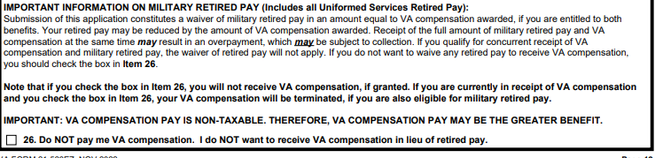
VA Disability Benefit Impact – Retired Pay
Signing a VA Form 21-526 is a waiver of retired pay unless specifically indicated they don’t waive VA Compensation.
Notes:
Block 26, 526ez now new form don’t check box 26 on new claims really explain retirement is taxable and VA isn’t taxable. For back dating. DoD- CRDP and CRSC military does that.
DFAS will control the release and Military will inform what needs to be done. No Double dipping. Can’t get CRDP & CRSC at same time.

Slide 251
VA Disability Benefit Impact – Retired Pay Other Considerations
Reservists/NG may not be in receipt of military retired pay at time of application for VA compensation (e.g. under age 60)
Responsibility of veteran to notify VA upon receipt of military retired pay – original VA award letter outlines veteran responsibilities
Retired pay counts as income for non-service-connected pension.
Notes:
No lower than age 50. Retirement: NG needs to tell VA and especially DFAS and DFAS will inform VA about retirement. DFAS responsible to collect over payment.

Slide 252
Resources for Additional Benefits
VA.gov Home-Veterans Affairs
Welcome to the KnowVA Knowledge Base
https://www.benefits.va.gov/BENEFITS/benefits-summary/SummaryofVANationalGuardandReserve.pdf
Notes:
new form by 2025 for reserve & national guard. Summary of benefits

Slide 253
Part 3 - Additional Benefits for National Guard & Reserve
Home Loan
Health Care
Education
Burial
Pension
Life Insurance
Vocational Readiness and Employment
253

Slide 254

Life Insurance
About VA Insurance Options And Eligibility Veterans Affairs

Slide 255

Home Loan
Eligibility For VA Home Loan Programs | Veterans Affairs
508_VBA_PC_Home_Loans_Brochure_091312 (va.gov)
VA-Backed Veterans Home Loans

Slide 256

Health Care
VA Health Benefits

Slide 257

Education
About GI Bill Benefits

Slide 258

Burial
VA Burial Benefits and Memorial Items

Slide 259

Vocational Rehabilitation
Veteran Readiness and Employment (Chapter 31)

Slide 260

Non-Service-Connected Pension
VA Pension Benefits

Slide 261

Questions

Slide 262
Thank you for the privilege of your time
and all that you do for veterans!
Please feel free to contact me if you have further questions.
Sandy Hogsed e-mail: rencehog@icloud.com
503-313-2652

Slide 263
Deputy Director Forum

Slide 264
Topics
Tap briefings for VSOs
VA Childcare Initiative
Toxic Exposure Screening Update
FMP/ChampVA Projections
MDMA-AT & PTSD
Policy & Procedure Updates
K2 Warning Order
Electronic Submission Concerns
Post Service Officer Changes
VA imaged Computer Obtainment
BVA Responsibilities
Notes:
VFW since 2019

Slide 265
Field Operations/Healthcare Policy
Tap briefings for VSOs
VA Childcare Initiative
Toxic Exposure Screening Update
FMP/ChampVA Projections
MDMA-AT & PTSD
Notes:
VFW since 2019

Slide 266
Compensation/Pension Policy
Policy & Procedure Updates
K2 Warning Order
Electronic Submission Concerns
Post Service Officer Changes
VA imaged Computer Obtainment
BVA Responsibilities
Notes:
VFW since 2019

Slide 267
TVB Claims Management System
September 2024

Slide 268
Lesson Objectives
What’s new with TVB
The New Veteran Home Screen
How to access “The old TVB”
How to upload documents
The New Claim Home Screen

Slide 269
What’s New with TVB?
TVB 4.0 was released in spring 2024 and with it came some quality-of-life improvements such as:
Updated tabbing on the 21-526EZ Form
A warning will be provided if a claim package has non-PDF Documents
Added the “Send to VA” Button to the document and form page for all forms. USE CAUTION with this button as it does not allow you to review your work before being sent to VA.

Slide 270
What’s New with TVB?
VA form 21-0781 now allows for 1,250 characters in field 14
Allowed multiple values to be selected in field 20A for VA form 21P-530EZ
Updated the Veteran Page
Updated the Claim page

Slide 271
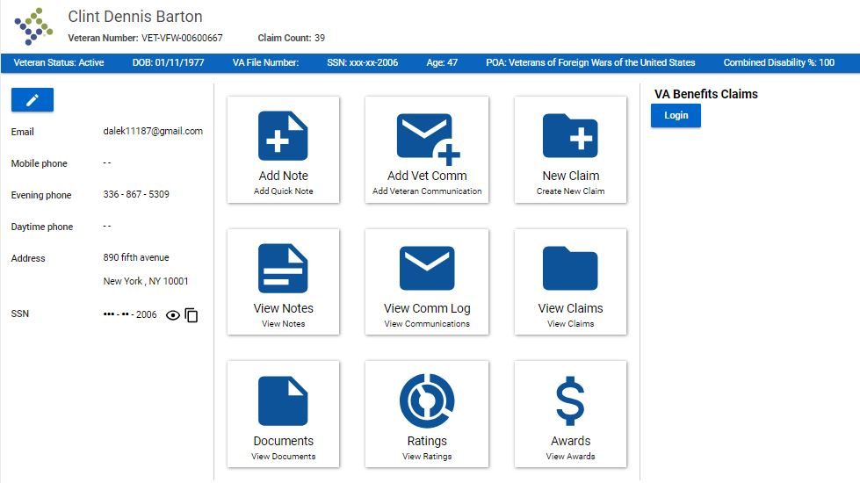
The New Veteran Home Screen

Slide 272
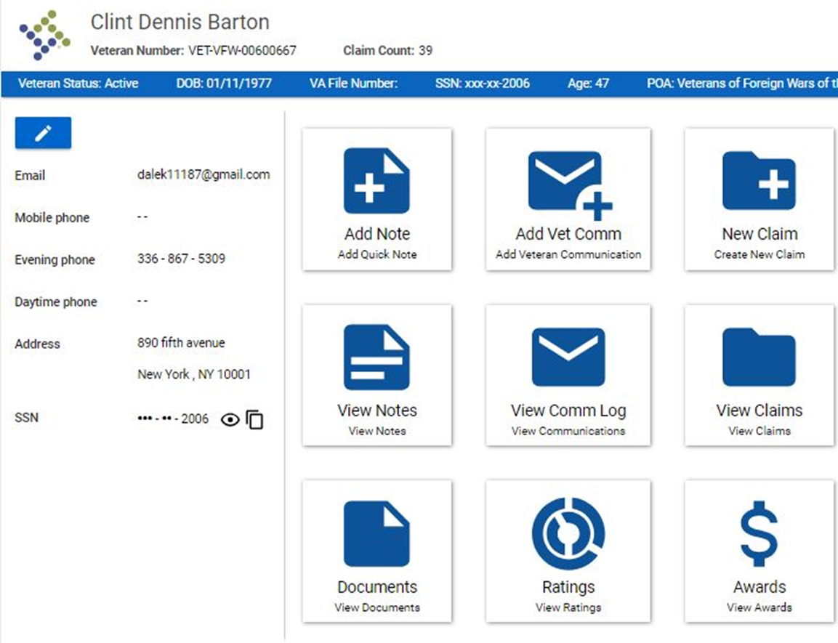
The New Veteran Home Screen
The Veteran Home Screen has been updated with Tiles to allow faster access to pages with the Veteran’s Folder

Slide 273
Accessing the “Old TVB”
Edit Veteran
To access the Veteran's folder also know as the “Old TVB” click on the Blue Edit Veteran Button

Slide 274
Uploading Documents
Despite one of the tiles on the Veteran’s Home Screen being called Documents; users are not able to upload documents from this Tab and instead must access the document page from the “Old TVB”

Slide 275
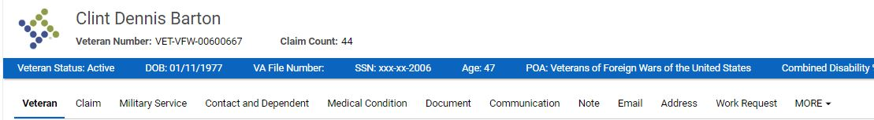
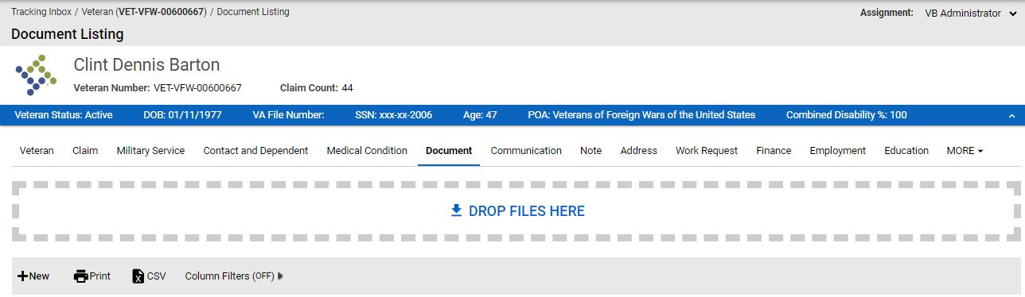
Uploading Document into TVB
Once in the Veteran Folder, clicking on the Document tab takes users to the Document page.
Once inside the Document page users can either drag the files into the box or press +New

Slide 276
Submitting a Claim to VA
To begin the process of subbing a claim through TVB click the New Claim Tile which will take users to the Claim Tab Page.

Slide 277
Submitting a claim to VA
**Please note the word “Claim” in TVB refers to any item being sent to VA through TVB including medical records or a 21-4138**

Slide 278
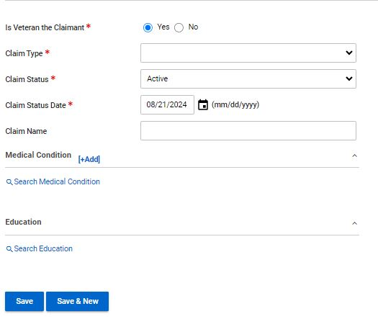
Submitting a claim to VA
In the Claim Tab Page users will need to select the correct choices from the required fields. TVB automatically populates to the most frequently options.
Claim Type: Compensation, DIC, Education, NSC Pension etc.
Claim Status: Active, HLR, ITF, Supplemental claim and Incomplete claim
Claim Status Date: Date the claim was generated
Save: Saves the pages and allows users to advance

Slide 279
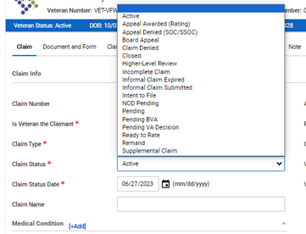
Claim Status
The default setting for Claim Status is Active but be sure to select the correct choice for the claim being sent to VA:
Active: 21-526EZ, 686C, 21P-530, 10-10EZ, 21P-527EZ, 21P-534EZ
Higher Level Review: 20-0996
Intent to File: 21-0966
Supplemental Claim: 20-0995
Incomplete claim: 21-22 and any other documents or supporting forms submitted to VA

Slide 280
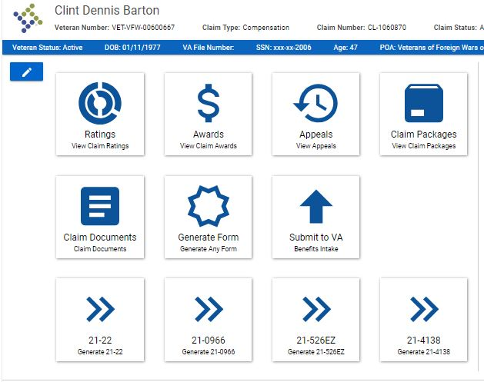
The Claim Home Screen
Once a Claim has been created the first page shown is the Claim Home Screen. This page contains tiles to various pages within the Claim folder.

Slide 281
Generating A Form
Depending on the type of claim selected, (Compensation, DIC, Education) The Claim Home Screen will populate with the four most frequently used forms associated with that claim type.

Slide 282
Generating A Form
To generate a form in TVB click on the Generate Form Tile form the Claim Home Page.
Alternatively, users can select from one of the four populated forms

Slide 283
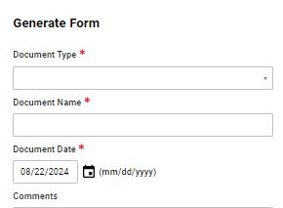

Generating a Form
When a user hits the Generate Form Tile, a new screen appears with two required fields: Document Type and Document Name.
Document Type: Allows users to select the form by either clicking the drop-down window or by typing in the form name.
Document Name: Names the document being generated.
Once finished click Generate Form

Slide 284
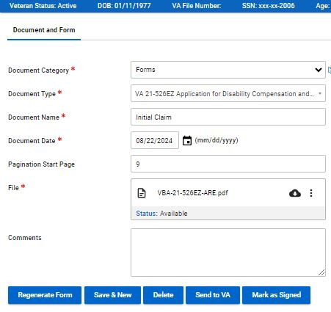
Editing The New Form
Once the form is generated, it can be edited by hovering over the 3 vertical dots and clicking Edit

Slide 285
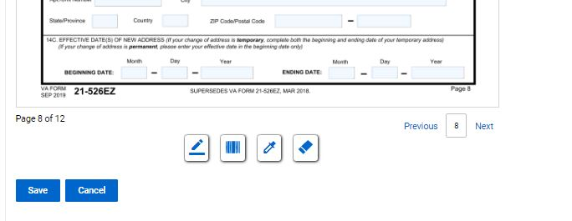
Editing The New Form
At the bottom of the page you will see 4 symbols:
Add Signature Add Barcode Highlight Redact

Slide 286
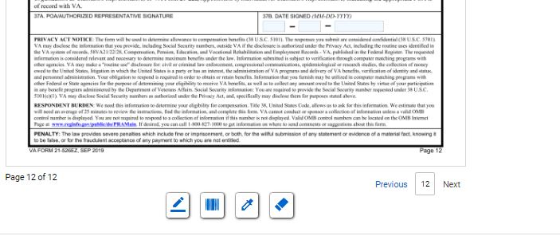
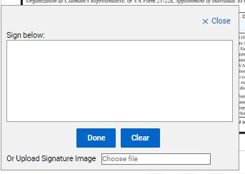
Signing The New Form
Once the form is complete, it will need to be signed. To do this click “Add Signature” which will pop up the signature box.
In the signature box you can either manually create a signature using your mouse or upload a signature image. Once finished click save.

Slide 287
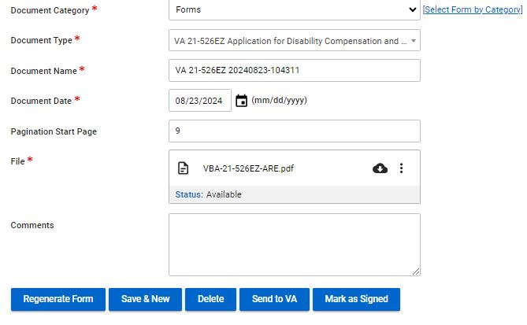
Signing the New Form
Once the signed document has been saved, Click
Mark as Signed
Once the document has been marked as signed, users can review the form but cannot make any changes to that form.
Users will need to hit Save and move on to the next step in the claim process

Slide 288
Send to VA WARNING
The Send to VA Button does just that, sends the document directly to VA without an opportunity to review or correct any mistakes.
Additionally, it does not allow users to add additional documents to send to VA
Use caution when using this feature.

Slide 289
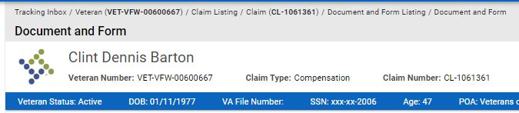
The Bread Crumb Trail
BreadCrumb
Users who wish to include additional documents or review their work before they send their claim to VA will need to return to the Claim Home Page by using the TVB Bread Crumb and select the claim that was just generated.

Slide 290
Submitting a Claim To VA
From the Claim Home Screen click the tile Submit to VA.

Slide 291
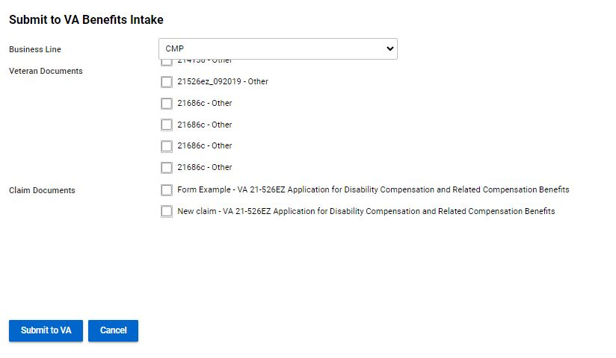
Submitting a Claim To VA
If documents were uploaded into the veteran’s folder, they will be displayed and can be attached to submit to VA.

Slide 292
Submitting a Claim To VA
The new screen defaults to the business line of CMP (Compensation) but depending on the claim type be sure to update this appropriately. The other options are:
PMC = Pension and Survivor
INS = Insurance
EDU= Education
VRE= VR&E
BVA= Board of Veterans Appeals
FID= Fiduciary
OTH= Other

Slide 293
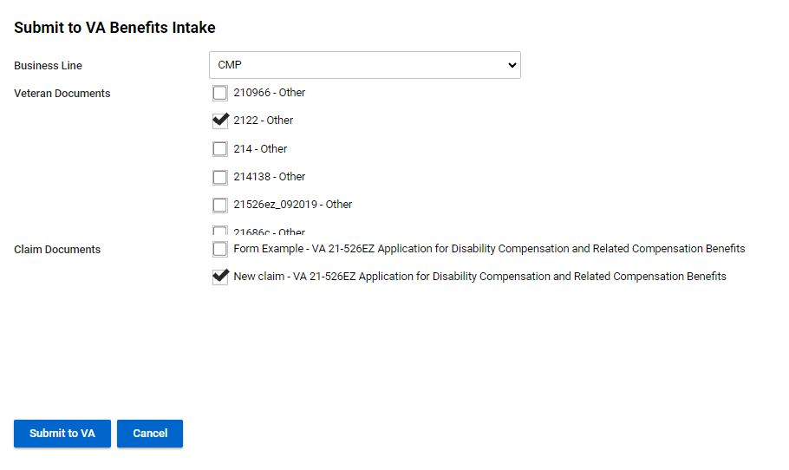
Submitting a Claim To VA
With your Claim Document Selected and any Veteran Documents selected, click Submit to VA

Slide 294
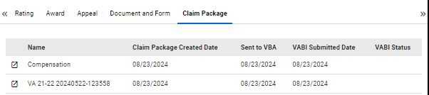
Submitting a Claim To VA
Once the claim is sent to VA, the page will refresh, and your claims will be displayed like the example.
Clicking on the left most box creates a New Window Tab and takes the user to the Claim Package Page
**Caution** When creating new windows in TVB as it can lead to errors with more than 1 TVB screen active at a time

Slide 295
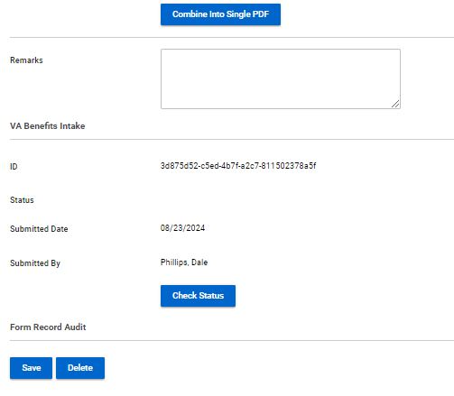
Claim Package Page
The Claim Package Page’s purpose is to check the status of the claim after it has been sent to VA.
**Please Note**
Just because a claim is sent to VA, does not mean that it was received correctly, please ensure that all claims show the status of Received as this is the claims Date Stamp

Slide 296
Viewing the Claim Folder
Edit Claim
To view the entire claim folder click the Edit Claim button

Slide 297
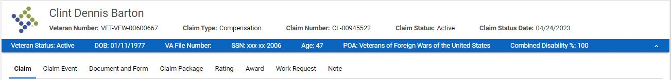
Tabs In The Claim Folder
Once in the Claim Folder, users will see a header with tabs that take them to other aspects of the Claim’s folder.
Claim
Claim Event
Document and Form
Claim Package
Rating
Award
Work Request
Note

Slide 298
The Claim Folder
Claim: Allows users to enter in historical data such as when VA received claim
Claim Event: Documents any events associated with the claim such as when it was generated
Document and Form: Shows forms associated with claim and allows users to create new forms with the selected claim
Claim Package: Provides status of claims sent to VA
Rating: Allows users to enter a VA rating if the claim grants service connection
Award: Allows users to enter in award data for the claim submitted
Work Request: Allows the assigning of tasks with this claim to other TVB users
Note: Allows users to add notes about the claim submitted

Slide 299
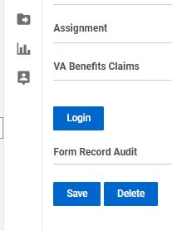
VA Benefits Claims
TVB has an API called VA Benefits Claims which allows TVB to connect to VA.gov.
This allows for some actions in TVB to be done in REAL TIME
The VA Benefits Claims API can be found when inside a veteran's folder.
Click Login to connect to continue with this API

Slide 300
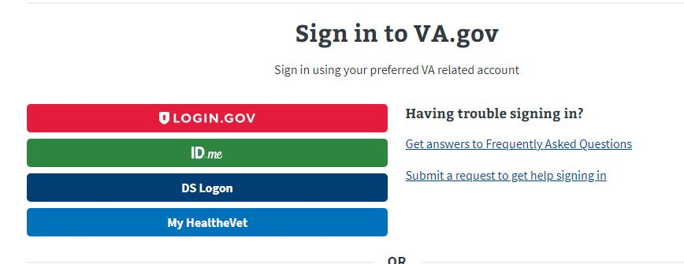
VA Benefits Claims
When utilizing this functionality, TVB requires the user to sign in to VA.gov using one of the following log in methods:

Slide 301
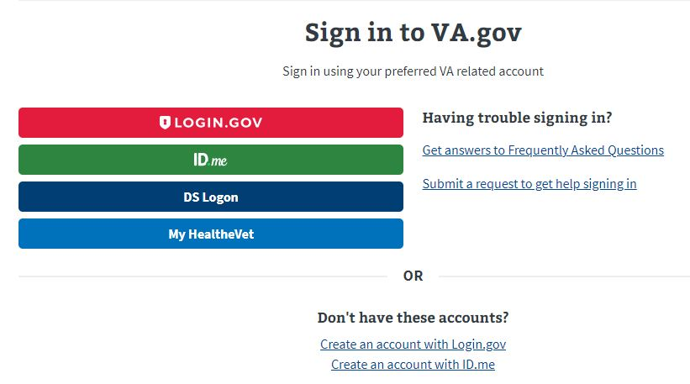
VA Benefits Log
If the user does not have any of these accounts, they can create either an Login.gov or ID.me account directly from the page by clicking the hyperlinks at the bottom.

Slide 302
Account Set up
An in-depth guide for creating either a Login.gov or ID.ME account can be found in the OLP next to this presentation.
Please note that in 2025 VA is removing Myhealthvet and DS Logon as log in options for VA.gov.

Slide 303
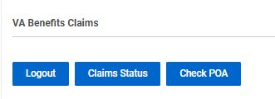
VA Benefits Claims
Once logged into the VA Benefits Claims section, clicking on VA Benefits Claims will populate new buttons.

Slide 304
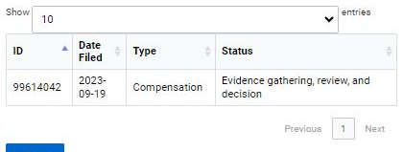
VA Benefits Claims: Claim Status
The Claim Status button will populate all the veteran’s claims (past and present) and show the Date Filed, Claim Type and Status of the claim

Slide 305

VA Benefits Claims: Check POA
The Check POA button will populate the veteran’s current POA as well as list any Previous POAs.

Slide 306
VA Benefits Claims: Submitting Forms Directly into VBMS
Another function of VA Benefits Claims is the ability to submit 21-22s, ITFs and 526EZs directly into VBMS.
To utilize this function, the following must be true.
Logged into VA.gov through VA Benefits Claims
The veteran’s folder is assigned to Your Field Office and Yourself.

Slide 307
VA Benefits Claims: Submitting Forms Directly into VBMS
To submit a form directly into VBMS a claim must first be created.
From the veteran folder Create a new claim and hit Save.
Create the form using the Document and Form Tab and once complete press Marked As Signed.

Slide 308

VA Benefits Claims: Submitting Forms Directly into VBMS
With the form Marked As Signed, follow the TVB Breadcrumb Trail back to the claim created.
Scroll back down to VA Benefits Claims and 3 new buttons have populated: POA(21-22) ITF(21-0966) Disability Compensation (21-526EZ)

Slide 309

Submitting Forms Directly into VBMS POA(21-22)
The POA(21-22) button takes the user to a page where they can attach a TVB Created, Marked As Signed 21-22 directly to VBMS.
*Please note for those who have multiple accreditations to select the correct POA *

Slide 310
Submitting Forms Directly into VBMS POA(21-22)
The page contains required fields such as POA, Signed Form Document and Authorizations and limits.
Signed Form Document has a dropdown box that will populate with the claim form that was generated and Marked As Signed in TVB

Slide 311
Submitting Forms Directly into VBMS POA(21-22)
With all required fields addressed, click submit to Submit the form to VBMS.
*Please note that the Authorization and limits on the signed 21-22 MUST MATCH the boxes displayed on the page. *

Slide 312

Submitting Forms Directly into VBMS ITF (21-0966)
To submit an ITF a TVB claim must be created.
With the Claim created select ITF (21-0966) which takes the user to the ITF screen.

Slide 313
Submitting Forms Directly into VBMS ITF (21-0966)
Press Validate to confirm POA with VA, TVB will provide a message that says valid if good or an error message that will need to be corrected.
After confirmation press submit
TVB will populate the previously empty boxes with:
Claim Type
Intent to File Date of Submission
Submission ID (confirmation number)

Slide 314
Submitting Forms Directly into VBMS 21-526EZ
TVB does have the ability to submit the 21-526EZ form directly to VA however this feature has more require more steps that other methods and has a higher rate of claim failure than the others.
Due to these issues NVS does not recommend using this feature.

Slide 315
Questions?

Slide 316
M21-1 Adjudication Procedures Manual

Slide 317
Objectives
What is the M21-1
Accessing the M21-1
Structure of the M21-1
Searching the M21-1
M21-1 Updates

Slide 318
What is the M21-1?
The M21-1 was digitized and officially launched on April 15, 2015 as the single source for reference materials and guidance. It also contains ongoing updates and summaries of court cases.
Reorganized in May 2021
The M21-1 is not law, it is VA’s interpretation of the law.
Essentially VA’s Policy and Procedure
CFR = What
M21 = How
Notes:
Before the M21, there were fast letters that were not organized and stored in a central location. You basically had to know the letter existed to apply it to a case. The manual has consolidated all that information in one, somewhat easy to use manual. When arguing law, cite the CFR, when arguing procedure, VA employees respond better to M21 references.

Slide 319
Precedence of VBA Laws, Regulations, and Procedures
Constitution/Law
↓
U.S. Code or Precedent setting court cases
↓
38 CFR
↓
Directives
(M-21)
Notes:
PACT Act example, takes years to catch up to legislation

Slide 320
Accessing the M21-1
Internet: KnowVA - https://www.knowva.ebenefits.va.gov/
Compensation and Pension
M21-1
VA Internet: KM Portals –https://vaww.vrm.km.va.gov
Know VA Portal
Compensation and Pension
M21-1
Also includes portals for VBA, VHA, and VEO
Notes:
Demonstrate

Slide 321
Structure of the M21
The M21 is divided into multiple manuals:
M21-1 Adjudication Procedures
M21-4 Manual
M21-5 Appeals and Reviews
Notes:
M21-4 covers internal VA policies such as National Quality Reviews or Workload management. M21-3 covers training for VBA employees

Slide 322

Structure of the M21-1
Notes:
14 searchable chapters, then broken down by sections and topics. Easiest to search for the topic you’re researching

Slide 323
Structure of the M21-1(cont.)
Understanding the layout:
M21-1V.ii.3.D.2.k
M21-1 is the manual
V is the Part
ii is the Subpart
3 is the Chapter
D is the Section
2 is the topic
k is the subtopic

Slide 324

Structure of the M21-1 (cont.)
Sections cover general topics
Each section begins with a table of contents with links to the associated topics
Topics begin with an introduction with links to subtopics
Subtopics can include important notes and references
Subtopics can include examples and tables to assist the reader with complex situations:
Notes:
Its as easy to navigate as possible, hyper links help to find the information you’re looking for quickly. The example shows the reference the VA employee would cite in a deferral for exam clarification

Slide 325
Searching the M21-1
Click M21-1 before searching; use the “Search within this topic” search bar
Use terms that are specific (related to your actual topic)
Avoid words that are likely to be included in every topic like “rating” or “decision”
Use unique words if possible
Avoid using long phrases that will result in topics unrelated to your search
Notes:
Demonstrate: Click M21-1 then “Search within this topic” searching the big search bar will search all topics on the page

Slide 326
Tips for searching the M21-1
When searching the M21-1, the system searches the content and title of each article.
The search engine looks for root words and variations of words. For example, a search for the word dependents will search the word dependents, dependent, dependency, depends, and depending.
If you use quotation marks it will only search for that word.
You can also enter an M21-1 reference if you have one and want to read more about the topic
Notes:
The words you searched for will be highlighted throughout the reference

Slide 327
Can’t find it?
Try alternate wording
Example: Use future exam vs. reexamination
Future exam brings up relevant references; reexamination brings up the keyword reexamination in a variety of different topics
TDIU, IU or Individual Unemployability: All of these pull up good specific references
Notes:
Using reputable law firm websites is sometimes helpful when looking for specific search terms

Slide 328
Let's Try It
Open the M21-1 by going to: https://www.knowva.ebenefits.va.gov
How would a VA employee verify POA submitted via SEP that did not generate a 21-22 in VBMS?
VA says the signature on the veteran’s claim form is not valid because it is not a wet signature
VA says the form you submitted is out of date
Notes:
SEP POA example: 1. Search POA SEP II.iii.4.B.1.c.
2. Search digital signature II.i.2.B.2.g. 3. search signature on behalf, ctrl f: VSO II.i.2.B.4.a.

Slide 329

M21-1 Updates
VA offers an email subscription for changes to the M21 as well as a wide variety of other topics.
Typically distributed weekly on Friday afternoon

Slide 330
M21-1 Updates (cont.)
To subscribe click the link and follow the on-screen instructions: https://public.govdelivery.com/accounts/USVA/subscriber/topics
Or - KnowVA - https://www.knowva.ebenefits.va.gov/
Compensation and Pension
Subscribe Here
Changes by date
Compensation and Pension
M21-1
VA Changes by Date
Historical Document and key changes documents attached to most topics
Notes:
Changes by date listed by year, then monthly by most recent

Slide 331
M21-1 Updates (cont.)
Historical Documents
The historical document is a copy of the content as it existed during a given time period. The date in the document name indicates the date that content was published and the watermark on the pages of the document indicate when the content became outdated due to the publication of a newer version.
Key Changes Documents
The Key Changes document provides general notes about the change, a table(s) providing a description and location of each significant change, and a copy of the edited version of the content, highlighting new text and using tracked changes to indicate deleted text. The date in the document name indicates the date the changes identified in the document were published.
Notes:
Most sections contain a change date as well

Slide 332
Most Important Step
Double chock your work!
Double check your work!
If you cite the M21-1 and your reference is incorrect you could add additional, unnecessary delay.

Slide 333
QUESTIONS?

Slide 334
The Old
The New
The Now
Undiagnosed Gulf War to PACT Act
By Vicki Von Loh
September 2024

Slide 335

Chart of Periods and Presumptives
publichealth.va.gov

Slide 336
VA Registries
EXPOSURE CATEGORIES
Chemicals (Agent Orange, contaminated water…)
Radiation (nuclear weapons, X-rays…)
Air Pollutants (burn pit smoke, dust…)
Occupational Hazards (asbestos, lead…)
Warfare Agents (chemical and biological weapons)

Slide 337
Beginning date is August 2, 1990, for Southwest Asia service or September 19, 2001 for service in Afghanistan, and the ending date has not been established. [38 USC 101(33) and 38 CFR3.317]
There is no minimum time period inside the listed areas required.
The law also covers the airspace above and the waters offshore.

Slide 338
Veterans of Afghanistan are included with service there after September 19, 2001.
These veterans are only considered under the provisions of the law referring to presumptive conditions, and are NOT included in the sections dealing with undiagnosed illnesses.

Slide 339
Southwest Asia is defined as the following countries/territories:
Iraq
Kuwait
Saudi Arabia
The neutral zone between Iraq and Saudi Arabia
United Arab Emirates
Bahrain
Qatar
Oman

Slide 340
Service in the waters offshore includes these bodies of water:
The Gulf of Aden
The Gulf of Oman
The Persian Gulf
The Arabian Sea
The Red Sea

Slide 341
Ideally, service in one of the required areas should be documented on the DD-214, including the award of campaign ribbons.
If not, service in the required areas will have to be established through other evidence, such as official personnel records.
Also consider using unit records that show the veteran was part of a deployed unit.

Slide 342
To qualify for Compensation, the veteran is not required to specify nor document that he/she was exposed to any of the hazards.
If the veteran was in the areas identified in 38 CFR 3.317, they meet the threshold for consideration.

Slide 343
If the veteran was not in Southwest Asia, but claims to have exposed to an environmental hazard not documented verification is required
Give complete details that can be verified through other records;
Place of exposure.
Dates.
Type of exposure specifying the hazard and health effects experienced by the veteran.

Slide 344
November 2, 1994
First law, passed on November 2, 1994, included compensation for chronic disability from undiagnosed illness(es).
Veterans reported symptoms including chronic headaches, cognitive disabilities, widespread bodily pain, unexplained fatigue, chronic diarrhea, skin rashes, respiratory problems and abnormalities that defied diagnosis.

Slide 345
If the claim is for:
Signs or symptoms of an undiagnosed illness or
During active duty in the Southwest Asia theater of operations during the Gulf War, or
to a degree of 10 percent or more within a presumptive period following service in the Southwest Asia theater of operations during the Gulf War.

Slide 346
1998
Next law, passed in 1998, added a presumption of service connection based on a positive association with exposure to toxic agents, environmental hazards or preventive medication.
The law does not specify particular hazards, only that the veteran has qualifying service.

Slide 347
December 27, 2001
Compensation for Veterans who served on active duty in the Southwest Asia theater of operations during the Persian Gulf War is for any diagnosed or undiagnosed illness that is determined by VA regulation to warrant a presumption of service connection (SC) based on a positive association with exposure to one of the following as a result of such service:
a biological, chemical, or other toxic agent
an environmental or wartime hazard, or
As preventative medication or vaccine.

Slide 348
March 1, 2002
The next law, passed on March 1, 2002, expanded “undiagnosed illness” to include “multi-symptom illness defined by a cluster of symptoms” gave the VA Secretary authority to add diagnosed conditions as the facts warranted.

Slide 349
VA has documented the symptoms and manifestations associated with an undiagnosed illness in 38 CFR 3.317(b).
Note that the list is inclusive, but not exclusive, which means that other symptoms will also be considered.
Symptoms must have persisted for at least six months.

Slide 350
These undiagnosed illnesses are presumptive if the veteran served in a recognized location, a health care provider diagnosed while on active duty or at any time after separation, and has been ill for at least 6 months:
Chronic fatigue syndrome
Fibromyalgia
Functional gastrointestinal disorders
Medically unexplained chronic multi symptom illness (MUCMI)
Other undiagnosed illnesses, such as cardiovascular signs and symptoms, muscle and joint pain, and headaches

Slide 351
March 2010
The law includes a list of presumptive diseases and anticipated complications from the diseases [38 CFR 3.317 (c)].
Most listed diseases have a one-year presumptive period from the date of separation, but there are exceptions for malaria, visceral leishmaniasis and tuberculosis.

Slide 352
Presumptive diseases listed in 38 CFR 3.317 (c)(2);
Brucellosis
Campylobacter Jejuni
Coxiella Burnetti (Q fever)
Malaria
Nontyphoid Salmonella
Shigella
West Nile Virus

Slide 353
Remember, unlike the undiagnosed conditions of “Gulf War Syndrome”, these presumptive conditions require a diagnosis, findings of residual permanent disability and must be at least 10% disabling if first diagnosed during the presumptive period.

Slide 354
July 15, 2011
Functional gastrointestinal disorders (FGIDs) were included as MUCMI on July 15, 2011. These include:
Abdominal pain
Substernal burning or pain
Nausea and or vomiting
Altered bowel habits
Indigestion and or bloating
Postprandal fullness and
Painful or difficulty swallowing

Slide 355
February 2012
The VA began granting service connection for chronic fatigue syndrome (CFS), fibromyalgia, irritable bowel syndrome, and medically unexplained chronic multi symptom illness on a presumptive basis in February 2012.

Slide 356
A presumptive disease not listed in 38 CFR 3.317 is amyotrophic lateral sclerosis.
Presumption for this condition is found in 38 CFR 3.318
Service in Southwest Asia is not required to qualify for service connection for this condition, but statistically, they are more likely to be found in veterans who served in the war zone.

Slide 357
Tuberculosis is shown as a presumptive condition in 38 CFR 3.317 with no time limit.
Tuberculosis is a bacterial infection of the lung [Mycobacterium tuberculosis (M. tuberculosis)].
You can get tuberculosis by breathing in air droplets from a cough or sneeze of an infected person.

Slide 358
Leishmaniasis is a parasitic disease caused by infection with Leishmania parasites, which are spread by the bite of phlebotomine sand flies.
There are several different forms of leishmaniasis in people; visceral leishmaniasis, affects several internal organs (usually spleen, liver, and bone marrow).

Slide 359
VA Airborne Hazards and Open Burn Pit August 5, 2021
“Airborne hazard” refers to any sort of contaminant or potentially toxic substance that we are exposed to through the air we breathe. While on active duty, military service members may have been exposed to a variety of airborne hazards including:
The smoke and fumes from open burn pits
Sand, dust, and particulate matter
General air pollution common in certain countries
Fuel, aircraft exhaust, and other mechanical fumes
Smoke from oil well fires

Slide 360
VA Airborne Hazards and Open Burn Pit
Depending on a variety of factors, veterans may experience health effects related to this exposure. Factors that may indicate veterans have a greater or lesser risk of short or long-term health effects include:
Types of waste burned
Proximity, amount of time, and frequency of exposure
Wind direction and other weather-related factors
Presence of other airborne or environmental hazards in the area

Slide 361

Locations of Burn Pits

Slide 362
Particulate Matter
Particulate matter is a complex mixture of extremely small particles and liquid droplets made up of a number of components including acids, organic chemicals, metals, and soil or dust particles.
Under 38 CFR 3.320, there is no length of deployment required in order to concede exposure. The service member shall be presumed to have been exposed, unless there is affirmative evidence that the veteran was not exposed to fine, particulate matter during that service.

Slide 363
Particulate Matter (continued)
The term qualifying period of service means any period of active military, naval, or air service in:
The Southwest Asia theater of operations, as defined in §3.317(e)(2), during the Persian Gulf War as defined in §3.2(i).
(ii) Afghanistan, Syria, Djibouti, or Uzbekistan on or after September 19, 2001 during the Persian Gulf War as defined in §3.2(i).

Slide 364
Particulate Matter (continued)
If the veteran’s exposure to particulate matter is conceded based on qualifying service, then the claim should be considered on a presumptive basis. VA should give a sympathetic reading of claims for respiratory symptoms.
However, a diagnosis of one of the presumptive respiratory conditions, within ten (10) years of separation from service, must be developed for and confirmed before service connection can be granted.
Claims will be developed by standard development procedures.

Slide 365
Particulate Matter (continued)
If it appears that entitlement can be established for the claimed respiratory disability on another basis, ie direct, then the claim should not be processed as GW particulate exposure claim.
If evidence show the condition existed prior to service, aggravation should be considered.
If entitlement exists under multiple theories, the grant should be based on the most advantageous effective date.

Slide 366
Particulate Matter (continued)
There is no requirement that the respiratory disabilities manifest to a compensable degree, ie. 10 percent or more, to establish presumptive service connection under 38 CFR 3.320.
Effective date considerations, under 38 CFR 3.114, are applicable. The regulation went into effect on
August 5, 2021; in no case will an award be effective prior to that date.

Slide 367
Presumptive Conditions Based on Particulate Matter Exposure
Chronic Asthma
Chronic Sinusitis
Chronic Rhinitis
Also includes Rhinosinusitis

Slide 368
Presumptive SC can be established under 38 CFR 3.320 effective August 5, 2021.
Apply the liberalizing law provisions of 38 CFR 3.114(a) when determining the effective date of SC under 38 CFR 3.320.
In order to establish presumptive SC for asthma, rhinitis, and/or sinusitis (to include rhinosinusitis) under 38 CFR 3.320, the evidence must show qualifying service, and manifestation of the qualifying chronic disability(ies) within the presumptive period. With those conditions met, VA can concede exposure to fine, particulate matter in the correlating duty location and the nexus between said exposure and the chronic disability(ies).

Slide 369
August 10, 2022
The PACT Act has added more than 25 new presumptive conditions that veterans can file for if they meet the requirements.
What is “Presumptive” Service Connection?
VA presumes that certain disabilities were caused by military service. This is because of the unique circumstances of a specific veteran’s military service.
If a presumed condition is diagnosed in a Veteran within a certain group, they can be awarded disability compensation.

Slide 370
The PACT Act Presumptive Areas
The PACT Act determined that veterans who served in any of the below locations on or after August 2, 1990 had exposure to burn pits or other toxins. We call this having a presumption of exposure.
Bahrain
Iraq
Kuwait
Oman
Qatar
Saudi Arabia
Somalia
The United Arab Emirates (UAE)
**Includes the airspace above any of these locations

Slide 371
The PACT Act Presumptive Areas
The PACT Act determined that veterans who served in any of the below locations on or after September 11, 2001 had exposure to burn pits or other toxins. We call this having a presumption of exposure.
Afghanistan Djibouti Egypt
Jordan Lebanon Syria
Uzbekistan Yemen
**Includes the airspace above any of these locations

Slide 372
Development for PACT Act Claims
Development for PACT Act Claims
Will include Individual Longitudinal Exposure Record and
Toxic Risk Exposure Activity

Slide 373
Individual longitudinal Exposure Record (ILER)
Individual Longitudinal Exposure Record (ILER)
Section 1119 (c) defines exposure tracking record system as any system, program, or pilot program used by the Secretary of Veterans Affairs or the Secretary of Defense to track how veterans or members of the Armed Forces have been exposed to various occupational or environmental hazards.

Slide 374
Individual longitudinal Exposure Record (ILER)
ILER will contain
Time of deployments
Locations and events during deployments
All-hazard occupational data
Environmental hazards that were known or found later
Any monitoring performed in the areas(s)
Medical encounter information (e.g., diagnosis, treatment, and laboratory data)
Medical concerns that should be addressed regarding possible exposures
ILER will be available to VA and DoD healthcare providers; epidemiologists and researchers; and VA disability evaluation and benefits determinations specialists. It will be used to improve internal processes and will not be available for individual access.

Slide 375
Individual longitudinal Exposure Record (ILER)
There is now a requirement which requires the use of the Individual Longitudinal Exposure (ILER), ILER-like tool or similar database during claims adjudication.
VA will establish a list of chemicals, substances and airborne hazards and presumes that a covered Veteran was exposed to the identified substances, chemicals and airborne hazards during qualified service.
A medical nexus examination will be required for toxic exposure risk activities, unless the evidence of record is sufficient.

Slide 376
Toxic Exposure Risk Activity
Toxic exposure risk activity (TERA) is defined in 38 USC 1710(e)(4)(C) as any activity that requires a corresponding entry into an exposure tracking records system (as defined in Section 1119(c); or that the Secretary determines qualifies for purposes of this subsection when taking into account what is reasonably prudent to protect the health of Veterans

Slide 377
Toxic Exposure
Toxic exposure is defined in 38 USC 101(37) to include, a toxic exposure risk activity (TERA), as defined in Section 1710(e)(4), and an exposure to a substance, chemical or airborne hazard identified in the list under section 1119(b)(2).
38 USC 1710(e)(4) defines the terms Vietnam-era herbicide exposed, radiation exposed Veteran and TERA
38 USC 1119(b)(2) states the Secretary of VA shall establish and maintain a list that identifies substances, chemicals and airborne hazards that are appropriate for presumptions of specific toxic exposure for members who served in certain locations

Slide 378
TERA Exception Job Aid
38 U.S.C. § 1168(b) provides that the examination requirements for TERA-related claims do not apply if the Secretary determines there is no indication of an association between the disability claimed by the Veteran and participation in the TERA.
At this time, claims processors should not order an examination based upon a TERA if one of the following exceptions applies.
Non-presumptive claims based on physical trauma. The Veteran claims service connection for a non-presumptive disability that is based on physical trauma (e.g., blunt force trauma, trauma due to repetitive use, penetrating trauma). Note: Hearing loss is not considered a physical trauma under this exception.

Slide 379
TERA Exception Job Aid (continued)
2. Mental disorders. This includes any condition contained in
38 C.F.R. § 4.130, the mental disorders section of the VA Schedule for Rating Disabilities.
Note: Toxic exposure can result in symptoms of neurobehavioral decline, like decreased memory and concentration. A diagnosis of a mental disorder should be considered on a direct or secondary basis.
3. Conditions determined to have no positive association with herbicide exposure. These are conditions determined by the Secretary based on cumulative scientific data reported by the National Academies of Science since 1993 and are as follows

Slide 380
4. Claims for disabilities that manifested during military service or with an etiology not associated with toxic exposure. This exception applies to conditions that manifested during service for which a medical nexus opinion would not be needed to decide service connection on a direct basis (evidence of chronicity or continuity is of record) and to claims where the evidence of record indicates that the claimed condition is clearly related to an etiology that is not associated with toxic exposure (to include post-service)

Slide 381
Important: Claims processors must liberally apply reasonable doubt when determining if this exception applies. When there is an approximate balance of evidence, they should err on the side of caution and request the TERA disability examination and medical nexus opinion.

Slide 382
TERA Exception Job Aid – Malignant conditions (Cancers)
Melanoma
Nonmelanoma skin cancer (basal cell and squamous cell)
Hepatobiliary cancers (liver, gallbladder, and bile ducts), and pancreatic cancer
Cancers of the pleura, mediastinum, and other unspecified sites within the respiratory system and intrathoracic organs
Bone and connective tissue cancer
Endocrine cancers (including thyroid and thymus)
Cancers of the reproductive organs (cervix, uterus, ovary, testes, and penis; excluding prostate)
Cancers of the digestive organs (esophageal cancer; stomach cancer; colorectal cancer (including small intestine and anus))

Slide 383
TERA Exception Job Aid – Malignant conditions (Cancers) continued
Renal cancer (kidney and renal pelvis)
Cancers of the brain and nervous system (including eye)•
Leukemia (other than all chronic B-cell leukemias including chronic lymphocytic leukemia and hairy cell leukemia)
Cancers of the oral cavity (including lips and tongue), pharynx (including tonsils), and nasal cavity (including ears and sinuses)

Slide 384
TERA Exception Non-Malignant Conditions
Osteoporosis
Farmer’s lung
Chronic obstructive pulmonary disease
Immune system disorders (immune suppression, allergy, and autoimmunity)
Neurodegenerative diseases (including amyotrophic lateral sclerosis (ALS) but excluding Parkinson's disease and Parkinsonism)
Asthma
Hearing loss
Neurobehavioral disorders (cognitive and neuropsychiatric)
Circulatory disorders (other than hypertension, ischemic heart disease, and stroke)

Slide 385
TERA Exception Non-Malignant Conditions (continued)
Endometriosis
Diseases of the eye
Gastrointestinal, metabolic, and digestive disorders
Chronic peripheral nervous system disorders (other than early-onset peripheral neuropathy)
Note: The malignant and non-malignant conditions under this exception (Exception 3) only apply to herbicide exposure. Claims processors must still consider all evidence as there may be a record of a different TERA (other than herbicides).

Slide 386
The PACT Act Presumptive conditions Gulf War and Post 9/11 Veterans
Brain Cancer | Chronic Rhinitis
Glioblastoma | Chronic Sinusitis
Respiratory (Breathing-related) cancer of any type | Constrictive bronchiolitis
Gastrointestinal cancer of any type | Obliterative Bronchiolitis
Head cancer of any type | Emphysema
Lymphoma of any type | Granulomatous disease
Lymphatic cancer of any type | Interstitial lung disease (ILD)
Neck cancer | Pleuritis
Pancreatic Cancer | Pulmonary Fibrosis
Reproductive cancer of any type | Sarcoidosis
Kidney Cancer | Chronic Bronchitis
Melanoma | Chronic Obstructive Pulmonary Disease (COPD)
Asthma (Diagnosed after service)

Slide 387
Additional PACT Act Guidance
Removed the manifestation period and compensability requirement for Persian Gulf Veterans, allowing for a qualifying chronic disability to manifest to any degree of disability at any time, and
Added additional locations associated with undiagnosed illness and MUCMI. In addition to the existing recognized service in the Southwest Asia theater of operations, the PACT Act added the following new service locations:
Afghanistan
Israel
Egypt
Turkey
Syria, and
Jordan.

Slide 388
June 2024
In June 2024, the VA announced that male breast cancer, urethral cancer, and cancer of the paraurethral glands are now presumptive diseases under the PACT Act. This designation allows veterans with these conditions to apply for expedited disability compensation and health care benefits.

Slide 389
Effective Dates
Effective Date of Law August 10, 2022
If Intent to File or VA Form 21-526EZ filed prior to August 14, 2023 effective date August 10, 2022
38 CFR 3.114 applies – if diagnosed prior August 10, 2022, effective date will be one year prior to date of claim, ie. Date of claim 9/2/23, diagnosed 7/25/2023, effective date 7/25/2023

Slide 390
Differences between Gulf War and Pact Act Claims
Conditions
Presumptive or Not Presumptive
Effective dates
Locations

Slide 391
References
Public Law 103-446 dated November 2, 1994
Public Law 105–277 Persian Gulf War Veterans Act of 1998
Public Law 107-103 under the veterans expansion and benefits act of 2001
Public Law 117-168 PACT Act of 2022
38 USC 1117
38 USC 1118
38 CFR 3.2
38 CFR 3.103
38 CFR 3.114
38 CFR 3.159
38 CFR 3.306
38 CFR 3.307
38 CFR 3.309
38 CFR 3.317
38 CFR 3.318
38 CFR 3.320

Slide 392
References (continued)
M 21-1.IV.2.D
M 21-1.V.ii.2
M 21-1.VIII.ii
https://www.publichealth.va.gov/exposures
https://www.va.gov/disability/eligibilty
https://www.va.gov
VA Memorandum dated June 8, 2021 concerning Persian Gulf War particulate Matter Exposure Interim Claims Processing
VBA Letter dated August 2, 2021 concerning Presumptive Service Connection for Respiratory Conditions due to Particulate Matter
National Defense Authorization Act for Fiscal Year 2021

Slide 393
VA Dashboard Shows PACT Act Performance:In recognition of the second anniversary of the passage of the PACT Act (Public Law 117-168), VA has published a special issue of the VA PACT Act Performance Dashboard that shows statistics compiled over the past two years. Highlights include one million related claims VA has approved totaling $6.8 billion, more than five million toxic exposure screenings, and an increase of nearly 186,000 new enrollees in VA health care.

Slide 394
QUESTIONS?
Vicki Von Loh
402-499-6836
vvonloh@gmail.com

Slide 395
Incarcerated Veterans
&
Dependent Considerations
Cynthia Archuleta
NVS RQAS- East

Slide 396

What will be covered
Incarcerated or Justice Involved Veterans Definition & Regulation
Exceptions
VA actions while incarcerated (Veteran or Dependent)
Regaining benefits
Apportionment for Spouse or Dependents
Appeal Considerations
This Photo by Unknown Author is licensed under CC BY-SA
Notes:
VFW since 2019

Slide 397
VA Definition
Incarceration for Department of Affairs (VA) purposes the Term incarceration:
Refers to the confinement of an individual in a penal institution, even though the individual may be allowed outside the institution temporarily on furlough or for medical treatment, and includes confinement at any of the following, as long as confinement is pursuant to a criminal sentence: medical facility or mental institution, or other locations, such as work camps, forestry camps, or boot camps.
Notes:
VFW since 2019

Slide 398
Regulation
38 CFR 3.665 requires the reduction of a beneficiary’s disability compensation or Dependency and Indemnity Compensation (DIC) when the beneficiary is incarcerated more than 60 days following conviction of a felony.
38 CFR 3.666 requires the discontinuance of a beneficiary’s pension when the beneficiary is incarcerated more than 60 days following conviction of a felony or misdemeanor.
38 CFR 3.666 requires the removal of an incarcerated dependent from a beneficiary’s award if the beneficiary receives pension. There is no such requirement, however, if the beneficiary is a Veteran receiving disability compensation, or surviving spouse receiving DIC
Notes:
VFW since 2019

Slide 399
Exceptions
Do not reduce or discontinue benefits for any period during which the Individual in question is:
Participating in a work release program
Under community control
Incarcerated in a foreign penal institution
Do not reduce or discontinue benefits for any period during which the individual in question is residing in a:
Halfway house
Residential re-entry center
Civil commitment center
Notes:
VFW since 2019

Slide 400
Benefits during Incarceration
WHAT HAPPENS TO THEIR COMPESATION
WHEN A VETERAN BECOMES INCARCERATED?
Notes:
VFW since 2019

Slide 401
Benefits during Incarceration
VA can pay certain benefits to veterans who are incarcerated in a Federal, State, or local institution but the amount depends on the type of benefit and the reason.
VA disability compensation payments are reduced if a veteran Is convicted of a felony and given a prison term for more than 60 days.
How much is a veteran entitled to while incarcerated?
Notes:
VFW since 2019

Slide 402

Benefits during Incarceration
A veteran rated at 20 percent or more will receive the 10 percent disability rate.
Notes:
VFW since 2019

Slide 403
Benefits during Incarceration
A veteran who is rated at 10 percent will receive how much?
Notes:
VFW since 2019

Slide 404

Benefits during Incarceration
A veteran who only receives 10 percent disability compensation the payment is reduced to one half.
Notes:
VFW since 2019

Slide 405
Benefits during Incarceration (SMC)
If the veteran’s disability evaluation for all service-connected (SC) disabilities is 0 percent, but the veteran is entitled to SMC under 38 U.S.C. 114(K) or a protected rate under 38 CFR 3.959 (statutory SMC Q) then 38 CFR 3.665(d)(2) requires VA to reduce the veteran’s monthly award to one half of the amount of the amount payable for a SC disability evaluated as 10 percent disabling.
Notes:
VFW since 2019

Slide 406
Incarceration Calculation
When calculating the 61st day of incarceration, start with the first full day of imprisonment following conviction.
Do not include in the calculation the number of days the incarcerated individual spent in confinement while awaiting trial, or for examination or treatment, even if the individual is credited for those days as “time served” following conviction.
Notes:
VFW since 2019

Slide 407
Regaining Benefits
VA does not require beneficiaries to submit a specific form to report that incarceration has ended.
May be reported in writing
By telephone or email
Or through a VA claims submission service website
For VA purposes incarceration ends when an individual:
Is released from prison
Is placed under community control (per VAOPGCPREC 59-1991)
Begins participation in a work release program
Moves to a halfway house, civil commitment center or residential re-entry center (as defined by M21-1, Part VI, Subpart iii, 1.A.1.d)
Notes:
VFW since 2019

Slide 408
Regaining Benefits
VA cannot resume the payment of benefits that VA reduced or discontinued due to incarceration without confirmation from an official source that incarceration has ended
What are official sources for VA purposes?

Slide 409
Regaining Benefits
Official sources for VA notification of release
Bureau of Prisons
County or State Department of Corrections
County Sherriff or other law enforcement
Prosecutor’s office
Parole Board
Prison Administration

Slide 410

Apportionment to Dependents
This Photo by Unknown Author is licensed under CC BY-NC-ND
Notes:
VFW since 2019

Slide 411
Apportionment to Dependents
All or part of the compensation not paid to an incarcerated veteran may be apportioned to the veteran’s spouse, child, or children and dependent parents based on individual need.
To determine individual need, consideration to such factors as:
Claimant’s income
Living expenses
Amount of compensation available to be apportioned
The needs and living expenses of other claimants
Notes:
VFW since 2019

Slide 412
Apportionment to Dependents
An apportionment of an incarcerated veteran’s VA benefits is not granted automatically to the veteran’s dependents.
The dependent(s) must file a claim for an apportionment.
VA form 21-0788 is what needs to be completed for the person seeking apportionment
Upon receipt of the claim, VA will develop evidence to decide the claim
Notes:
VFW since 2019

Slide 413
General Apportionment Rules
For a claimant to receive an apportionment of a competent primary beneficiary's benefits the claimant must:
File a claim and:
Demonstrate a need for benefits, per the requirements of 38 CFR 3.451 or
Live apart from the veteran and did not receive a reasonable level of support per 38 CFR 3.450
If the requirements are met and the primary beneficiary will not suffer undue hardship, VA may authorize an apportionment of the primary beneficiary’s benefits to be paid to the claimant.
Notes:
VFW since 2019

Slide 414
What may trigger an appeal
Incorrect date of incarceration (61st day)
Overpayment due to no notice to VA of incarceration
Apportionment denied
What other actions or circumstances may cause a need for appeal with an incarcerated beneficiary?
Notes:
VFW since 2019

Slide 415
Appeal Considerations
All appeal lanes are available to incarcerated or justice involved beneficiaries
Communication with the incarcerated individual will be limited or restricted
Establishment of 3rd party consent may be beneficial
Notes:
VFW since 2019

Slide 416

Notes:
VFW since 2019

Slide 417
What’s New at VA?
By Crystal M. Trulove
September 2024

Slide 418


Introduction
Crystal M. Trulove
crystal.trulove@gmail.com
Air Force
Weather Specialist
NOAA/National Weather Service
Weather Forecaster
Brandeis University
Department of Veterans Affairs
RVSR (Rating Veteran Service Representative)
DRO (Decision Review Officer)
Veterans of Foreign Wars
Notes:
VFW since 2019

Slide 419
Course Objectives
Introduction to, and basic understanding of:
Implications of six new court decisions
Final decision regarding partial knee replacement evaluations
Updates to Clothing Allowance payments
New guide for injectable non-insulin medications
Burn Pit Registry newest features
Guidance for using continuity of symptoms as a nexus
Veteran access to rating evaluations online
DAV ratings calculator

Slide 420
USC References & Court Cases
McCauley v McDonough
Frazier v McDonough
Frantzis v McDonough
Barry v McDonough
Banschbach v McDonough
NOVA v Secretary of Veterans Affairs
38 USC 5121 payment of accrued benefits
38 USC 5121A substitution
38 USC 1114(p) rates of wartime disability compensation
38 USC 7102 assignment of members of BVA
38 USC 7107(c) appeals; dockets; hearings

Slide 421
CFR and M21-1 References
38 CFR 3.303 principles relating to service connection
38 CFR 3.309 disease subject to presumptive service connection
38 CFR 3.350 special monthly compensation ratings
38 CFR 4.119 rating schedule – endocrine
38 CFR 4.123 neuritis
38 CFR 4.124 neuralgia
38 CFR 4.124a rating schedule - neurological
38 CFR 4.71a rating schedule - musculoskeletal
M21-1 V.ii.2.A.1. determining direct service connection
M21-1 V.iii.1.A.3.h. evaluating joints and functional loss
M21-1 V.iii.11.1.c. diabetes mellitus
M21-1 XIII.i.8.A.1.a. & A.2.a. clothing allowance

Slide 422
CAVC v CAFC
United States Court of Appeals for Veterans Claims (CAVC)
Exclusive jurisdiction to review decisions of the Board of Veterans' Appeals
United States Court of Appeals for the Federal Circuit (CAFC)
Appeals come from all U.S. federal district courts, including
United States Court of Appeals for Veterans Claims
…and more (trademarks, patents, Armed Services, Postal Service, international trade, etc.)

Slide 423
McCauley v McDonough (CAVC)
Decision: If service connection of a condition is found later to have been based on information that is clearly and unmistakably erroneous, all other means of service connection must be considered prior to severance, and payments must continue until final decision is made.
May 20, 2024
Question was: Prior to severance, must VA show only that there was an error, or must they also attempt all other means of SC?

Slide 424
McCauley v McDonough (CAVC)
Veteran claimed presumptive service connection for both diabetes and heart disease
Asked VA to grant due either to herbicide or contaminated water exposure
Navy veteran received award because USS Comstock was in inland waters of Vietnam
USS Comstock was not inland while veteran was aboard
Grant was clearly in error. VA proposed to sever, explained why, and then severed all service connection
Veteran appealed and BVA upheld RO decision

Slide 425
McCauley v McDonough (CAVC)
CAVC found that a discussion of all other means of SC is required
SOC mentioned contaminated water but BVA decision did not
Veteran specifically made contaminated water claim
Direct SC must also be addressed
VA severed without following standards required by law
Including only theories raised and/or suggested by record
Secretary requested no reinstatement of benefits till decision was revised
Unlike other claims, severance is anchored in present. Onus on government
Benefits must be reinstated until they are addressed properly

Slide 426

McCauley v McDonough (CAVC)
Macaulay was impacted by a mistake

Slide 427
Frazier v McDonough (CAVC)
Decision: Substitute claimants may be substituted in any claim for benefits and award is limited to expenses paid.
May 23, 2024
Question was: Can a qualified recipient be substituted when the claim is for non-accrued benefits?
Question was: Does the award limitation apply to those pursuing a substitution claim who qualify on a basis other than because they bore expense of last sickness and burial?

Slide 428
Frazier v McDonough (CAVC)
38 USC 5121 outlines accrued benefits and who qualifies to receive them in the event of a veteran’s death:
The veteran’s spouse.
The veteran’s children (in equal shares).
The veteran’s dependent parents (in equal shares).
Upon the death of one of the above, to the next person below them
In all other cases, only so much of the accrued benefits may be paid as may be necessary to reimburse the person who bore the expense of last sickness and burial.
38 USC 5121A outlines the rights of substitution to individuals listed in 5121

Slide 429
Frazier v McDonough (CAVC)
RO denied entitlement to SAH/SHA and auto adaptative benefits, and SMC based on A&A or HB. Veteran appealed.
Veteran died and claimant Frazier filed an application for accrued benefits – as well as – an application to substitute
BVA granted accrued benefits
granted A&A, so HB claim dismissed
dismissed remaining appeals for non-accrued benefits
Claimant Frazier argues that appeals should continue
Her father’s housebound claim was intended to be statutory
Benefits should not be limited

Slide 430
Frazier v McDonough (CAVC)
CAVC found that with an appropriate substitution, decision must still be made because the two actions are distinct
38 USC 5121 payment of certain accrued benefits
38 USC 5121A substitution for any benefit in case of death of claimant
CAVC also found that regardless of qualification of substitute, award is limited to costs of last sickness and burial
Accrued benefits has no limit
Substitution of claimant has a limit

Slide 431

Frazier v McDonough (CAVC)
Smokin’ Joe Frazier was a substitute
Notes:
Buster Mathis

Slide 432
Banschbach v McDonough (CAVC)
Decision: Nerve diagnostic codes separately identify paralysis, neuralgia, and neuritis and thus the Board cannot use prohibition of pyramiding to avoid addressing each.
July 26, 2024
Question was: Does the language of 4.123 and 4.124 prohibit the SC of neuritis and neuralgia when a veteran is evaluated under the diagnostic code for paralysis?

Slide 433
Banschbach v McDonough (CAVC)
38 CFR 4.14 Avoidance of pyramiding:
The evaluation of the same disability under various diagnoses is to be avoided. Disability from injuries to the muscles, nerves, and joints of an extremity may overlap to a great extent, so that special rules are included in the appropriate bodily system for their evaluation.
38 CFR 4.123 Neuritis
characterized by loss of reflexes, muscle atrophy, sensory disturbances, and constant pain, at times excruciating
38 CFR 4.124 Neuralgia
characterized usually by a dull and intermittent pain

Slide 434
Banschbach v McDonough (CAVC)
Veteran SC 10% for incomplete paralysis of ilio-inguinal nerve under DC 8530
Also SC 20% for incomplete paralysis of anterior crural nerve DC 8526
Veteran appealed decision not to address neuritis & neuralgia
BVA position
Symptoms of neuritis & neuralgia are included in paralysis, and to grant separate SC for more than one constitutes pyramiding
No harm is done to veteran
Ilio-inguinal nerve
 | 8530 Paralysis of:
 |  | Severe to complete | 10
 |  | Mild or moderate | 0
 | 8630 Neuritis.
 | 8730 Neuralgia.

Slide 435
Banschbach v McDonough (CAVC)
CAVC remanded
Since 4.123 and 4.124 discuss different symptoms of neuritis and neuralgia, logic implies they are different
No specific prohibition of using more than one DC for a nerve
The organization of the Rating Schedules implies that all three conditions are available for use
There may be symptom overlap, but that has no bearing on whether a veteran meets diagnostic criteria for a condition
VA’s interpretation renders the second and third DC for nerves superfluous
BVA must re-adjudicate and include discussion of neuritis & neuralgia

Slide 436

Banschbach v McDonough (CAVC)
A bunch of bucks in a pyramid

Slide 437
Frantzis v McDonough (CAFC)
Decision: The Board member who conducts a hearing is not statutorily required to make the final determination.
June 4, 2024
Question was: Though language was removed from 38 USC 7107(c) requiring judge who held hearing to make decision, does the language of 38 USC 7102 still hold VA to this requirement?

Slide 438
Frantzis v McDonough (CAFC)
Veteran was granted SC for headaches non-compensable.
Veteran appealed.
AMA was enacted, and veteran elected to have his appeal considered under AMA.
Changes under AMA included removal of wording in 7107(c) that required same judge who held hearing to make subsequent decision.
Veteran testified before one BVA judge and decision was made by a different judge.
Veteran contends that since 38 USC 7102 did not change with AMA, then the decision should have been made by the first judge.
CAVC upheld decision because of language removal.
Notes:
Appeals Modernization Act

Slide 439
Frantzis v McDonough (CAFC)
CAFC agreed with lower courts, relying on removal of language
They disagreed with veteran that 7102 still holds VA to previous rules
If so, then the new wording in 7107 is meaningless
They said veteran forfeited his “fair process doctrine” complaint
CAFC said veteran did not provide any argument or evidence

Slide 440

Frantzis v McDonough (CAFC)
Pope Francis can make a final decision, but his bishops often do the evidence gathering.

Slide 441
Barry v McDonough (CAFC)
Decision: 38 CFR 3.350(f)(3) does not limit how many SMC increases can be provided; instead, it is a mandatory entitlement that can apply multiple times, subject to a statutory cap.
May 16, 2024
Question was: Is VA bound legally to limit an SMC increase based on additional 50% or 100% evaluations to one or the other, or can subsequent additional evaluations be considered?
Notes:
100% roughly $4k, SMC roughly $4k, plus any k, plus A&A. With any spouse or dependent children or parents, this amount goes up.

Slide 442
Barry v McDonough (CAFC)
Special Monthly Compensation (SMC) Review
CFR mirrors USC
In this case, 38 CFR 3.350 reflects 38 USC 1114(p)
USC 1114, sections (a)-(j) discuss evaluations of 10%-100%
(k) is separate from 10-100%, so it’s called SMC
(l)-(o) are levels above (k), with (o) being the highest
USC 1114(p) is a discussion of how to qualify for those SMC levels
(q) was repealed, and (r) levels 1 and 2 describe benefits for when a veteran is at (o) level but requires Aid & Attendance (1), or Aid & Attendance with an additional level of care (2)

Slide 443
Barry v McDonough (CAFC)
38 CFR 3.350(f) discusses “next higher” rating above (k)
A greater benefit is allowed when severity of veteran’s condition warrants
Loss of extremities, loss of vision, etc.
Use Table II to determine the next higher rating
When veteran has additional serious medical conditions that are unrelated, use 38 CFR 3.350(f)(3) & (4)
If unrelated evaluation is 50% or higher, increase by half-step
Example: If Table II says level is L, then 50% takes it to L½
If unrelated evaluation is 100%, increase by a step
Example: If Table II says level is L, then 100% takes it to M
Notes:
3.350(f)(1) – anatomical loss or LOU & 3.350(f)(2) – eyes and blindness as ways to get next higher rating of l-o

Slide 444

Barry v McDonough (CAFC)
Veteran served 69-71 and earned Purple Heart. Injuries resulted in hospitalization for 13 months followed by disability retirement.
VA awarded veteran 100% with SMC level M using Table II; plus an additional bump for a separate 50% to M½

Slide 445
Barry v McDonough (CAFC)
In addition to his first 100% disability evaluation, veteran has THREE additional 50%+ evals, and no more 100%s
Veteran contends law should allow him to use all 3
VA granted only one bump for one 50%
Veteran appealed
BVA & CAVC upheld decision
Argued that language only allows for either or
Comparison to other SMCs supports this interpretation

Slide 446
Barry v McDonough (CAFC)
CAFC did not find that language of law prevents using 50% or 100% more than once
Subject to statutory cap at SMC (o) level
Broad context of law in 3.350 explains
How veterans qualify
Requirement that VA must pay when vet is eligible
Total cap on SMC benefits
No additional restrictions were found
VA has specified in other areas where a benefit can be used only once
Benefits such as (k) and clothing allowance can be used more than once
Notes:
K- creative organ, foot and hand, both buttocks, eye, deafness, aphonia

Slide 447




Barry v McDonough (CAFC)
No limit to how many disco musicians named Barry

Slide 448
NOVA v Secretary of VA (CAFC)
National Organization of Veteran’s Advocates (NOVA)
Decision: The Knee Replacement Guide is arbitrary and capricious, thus a pro-veteran finding regarding interpretation of DC 5055 can allow a 100% evaluation to apply to a partial knee replacement.
September 20, 2022
Question was: Does “prosthetic joint replacement” explicitly mean total joint replacement rather than partial replacement?

Slide 449
NOVA v Secretary of VA (CAFC)
Note (3): The term “prosthetic replacement” in diagnostic codes 5051-5053 and 5055-5056 means a total replacement of the named joint. However, in DC 5054, “prosthetic replacement” means a total replacement of the head of the femur or of the acetabulum.
5055 Knee, resurfacing or replacement (prosthesis):
For 4 months following implantation of prosthesis or resurfacing |  | 100
Prosthetic replacement of knee joint:
 | With chronic residuals consisting of severe painful motion or weakness in the affected extremity | 60
 | With intermediate degrees of residual weakness, pain or limitation of motion rate by analogy to diagnostic codes 5256, 5261, or 5262.
 | Minimum evaluation, total replacement only | 30

Slide 450
NOVA v Secretary of VA (CAFC)
Veteran appealed decision not to award temporary 100% following surgery for partial knee replacement.
VA published Knee Replacement Guide before appeal was decided
100% eval was only for total replacement
Added clarifying note to CFR 4.71a effective July 15, 2015
When CAFC decided on the appeal, they found that DC 5055 does not explicitly exclude partial knee replacement surgery
Because there has been inconsistent ruling historically
Knee Replacement Guide was published to support CAVC’s decision
Resolve in veteran’s favor

Slide 451
NOVA v Secretary of VA (CAFC)
VA then published Knee Replacement Manual Provision
Follow CAFC guidance for any historical decisions, but in the future do not use DC 5055 for partial knee replacements
NOVA v Secretary of VA
CAFC found that Manual Provision didn’t substantively change anything, so declined to address it
Knee Replacement Guide arbitrary and capricious
Upheld previous decision in veteran’s favor

Slide 452
Partial Knee Joint Replacement
History is covered in NOVA v Secretary of Veterans Affairs
May 10, 2024 – update to M21-1 V.iii.1.A.3.h.
When deciding any claim involving evaluation of a partial knee joint replacement that was pending and not finally adjudicated on September 20, 2022, rate as follows:
For any rating period at issue prior to February 7, 2021, apply the text of 38 CFR 4.71a, DC 5055 in effect at that time, but without the note added effective July 16, 2015.
For the rating period on or after February 7, 2021, apply the text of the current 38 CFR 4.71a, DC 5055 and the prefatory notes.
Notes:
M21-1 was amended to add a note explaining the history and the instructions, above.

Slide 453
Annual Clothing Allowance Payment
April 30, 2024
M21-1 XIII.i.8.A.1.a. & A.2.a.
Public Law 117-328 mandates that all clothing allowance payments (ACAPs) be made on a recurring basis
Until veteran opts out or is no longer eligible
Annual applications no longer necessary
Application still required for each additional ACAP based on multiple qualifying appliances and/or medications
ACAP eligibility determination by VHA still necessary for the initial establishment of each application
Additional changes to M21-1 due to deletion of old instructions

Slide 454
Chronic Symptoms as nexus
What has not changed: Service connection of chronic disabilities requires chronicity and continuity.
38 CFR 3.309(a) chronic diseases presumptive service connection
Chronicity = must be a diagnosed chronic disease
When symptoms reach a compensable degree during applicable time frame, any manifestation of the same disease at any later date, however remote, is service connected on a presumptive basis.
Time frame is often during service or within one year after separation
VAE/Medical opinion not needed

Slide 455
Chronic Symptoms as nexus
What has not changed: Service connection of chronic disabilities requires chronicity and continuity.
38 CFR 3.309(a) chronic diseases direct service connection
Continuity = symptoms are continuous
When a condition from 3.309(a) is noted during service but not to a compensable level, intervening symptoms must be shown.
Typically, a medical opinion is required
M21-1 V.ii.2.A.1.c. Continuous symptoms are demonstrated when the medical evidence shows symptoms continuing without stopping, or recurring regularly, with minimal interruptions, from military service.

Slide 456
Chronic Symptoms as nexus
June 5, 2024. This clarification is new:
M21-1 V.ii.2.A.1.
For any chronic disability:
Listed under 38 CFR 3.309(a) but not compensable within time frame
Shown to be chronic in a medical sense, but not listed in 38 CFR 3.309(a)
Continuous symptoms may be used to satisfy the nexus for direct SC
When the nexus element is met, a medical opinion is not needed.
Why can’t we use this shortcut for every claim for SC?
It only applies to chronic disabilities
Typically the evidence shows isolated instances of symptoms, not constant
Notes:
Veteran can point out that they do not need a medical opinion (i.e. do not need a VAE) when there is continuous symptoms

Slide 457
Chronic Symptoms as nexus
Example: Right knee degenerative joint disease (arthritis) diagnosed in service, but no medical treatment or complaints during service. The Veteran claims SC for right knee arthritis 10 years after separation. Medical records dated since separation from service show multiple complaints and treatment for right knee arthritis almost every year, and there is no evidence of post-service right knee injury.
Direct SC with no Medical Opinion needed, use continuity of symptoms as nexus
Example: Right knee degenerative joint disease (arthritis) caused painful movement and was diagnosed one month after active duty service with x-ray imaging. The Veteran claims SC for right knee arthritis 10 years after separation. Medical records dated since diagnosis are silent for right knee complaints or treatment, and there is no evidence of post-service right knee injury.
Presumptive SC with no Medical Opinion needed with current diagnosis

Slide 458
Endocrine conditions
June 6, 2024
M21-1 V.iii.11.1.c.
Non-insulin injectable medications such as Ozempic, Victoza, Trulicity
Can help veteran establish 20% disability evaluation
Evaluate a prescription for a non-insulin injectable medication in the same manner as a prescription for an oral hypoglycemic agent.
These medications do not support a 40% evaluation under DC 7913

Slide 459
Endocrine conditions
7913 Diabetes mellitus:
Requiring more than one daily injection of insulin, restricted diet, and regulation of activities (avoidance of strenuous occupational and recreational activities) with episodes of ketoacidosis or hypoglycemic reactions requiring at least three hospitalizations per year or weekly visits to a diabetic care provider, plus either progressive loss of weight and strength or complications that would be compensable if separately evaluated | 100
Requiring one or more daily injection of insulin, restricted diet, and regulation of activities with episodes of ketoacidosis or hypoglycemic reactions requiring one or two hospitalizations per year or twice a month visits to a diabetic care provider, plus complications that would not be compensable if separately evaluated | 60
Requiring one or more daily injection of insulin, restricted diet, and regulation of activities | 40
Requiring one or more daily injection of insulin and restricted diet, or; oral hypoglycemic agent and restricted diet | 20
Manageable by restricted diet only | 10

Slide 460
Burn Pit Registry redesign
Changes August 1, 2024
VA released a redesigned Airborne Hazards and Open Burn Pit Registry to better identify and investigate adverse health conditions
Broader participation criteria (eliminated registration forms and added countries)
Automatic registration based on DOD records
Clear opt-out procedures
Does not influence future health care for registrants, but does allow VA to develop more advanced treatments, predictive medicine, more targeted care, and decisions pertaining to presumptive conditions
https://vethome.va.gov/BurnPitRegistryOptOut/

Slide 461

https://veteran.mobilehealth.va.gov/AHBurnPitRegistry/index.html#page/home
Burn Pit Registry redesign
In lieu of the traditional Burn Pit Registry evaluation, Veterans enrolled in VA health care can ask about toxic exposure screening at their next VA appointment.

Slide 462

https://www.va.gov/disability/view-disability-rating/
Viewing Disability Ratings
View disability rating online
Website allows veterans to see exactly what disability evaluations have been assigned by VA

Slide 463
Examples for DAV Calculator
Tammy Cole
L hip 40% under DC5252
L hip 20% under DC5253
Sleep apnea 50%
Tinnitus 10%
Bilateral HL 0%
Divorced
23 year old child in college
17 year old child at home
Rodney White
R knee 10%
R ankle 10%
Diabetes mellitus II 20%
L foot amputation 40%
SMC(k) for LOU creative organ
Married
Caring for dependent parents
Children ages 32, 30, 27
Notes:
Tammy: $2373.01 Rodney: $2223.90

Slide 464




Mnemonic devices

Slide 465
Exercises
Ruma Nandini
Eugene Turner
Rose Nguyen
Calvin Freemont
Review the veteran’s circumstance and recommend action based on updated guidance.

Slide 466
Ruma Nandini – USMC veteran
Ms. Nandini served at Camp Lejeune from 1982-1985. Under the PACT Act, her claim for throat cancer was granted. However, a quality control review revealed that her claim had been granted service connection under the assumption that her throat cancer was on the list of presumptive diseases for contaminated water exposure, and it is not. VA sent Ms. Nandini a letter explaining their mistake, and proposing that her award would be terminated in less than 2 months. She plans to appeal this decision because her claim was for SC on a direct basis.
Does Ms. Nandini qualify to continue to receive payment despite the error?
What court case covers this scenario?

Slide 467
Eugene Turner – USA veteran
Mr. Turner was deployed near Baghdad when his vehicle took direct fire in 2004. He suffers with a constellation of musculoskeletal disabilities, and also TBI/PTSD 100%, neck and face scar 50%, five additional painful scars 30%, seborrheic dermatitis with constant systemic therapy 60%, light perception only in left eye and 20/70 vision in right eye 50%, bilateral hearing loss 10%, tinnitus 10%, and bronchial asthma 60%.
VA granted 100%. Using Table II, they found his SMC level to be M, based on amputations. VA noted the additional 100% not related to musculoskeletal conditions, and bumped his award up by a full step, to SMC N.
Due to a recent court decision, Mr. Turner can ask for an increase. What kind of increase could he now qualify for?
What was the name of the court decision?
Notes:
Mr. Turner is eligible for a full step for the 100%, and 4 additional ½ steps for all the 50%s. Altogether, these do not exceed the (o) level, so he can use them all.

Slide 468
Rose Nguyen – USA veteran
Ms. Nguyen’s father was a WWII veteran who recently passed away. She received accrued benefits that were due to him from his monthly awards. Before he died, Mr. Nguyen had a pending claim for Auto & Adaptive Equipment, and that claim was closed upon notification of death. Ms. Nguyen wishes to continue that claim.
Can the veteran’s daughter continue the claim for Auto & Adaptive Equipment even though it is for non-accrued benefits?
What court case can she cite in support of her request for substitution?

Slide 469
Calvin Freemont – USAF veteran
Mr. Freemont has suffered with bad knees for decades. He has finally decided to have surgery on his right knee. His primary care physician believes it would be possible to undergo a partial knee replacement rather than a total knee replacement. Mr. Freemont’s brother, an Army vet, told him that VA will award a temporary 100% to help with expenses of recovery for either operation.
Does Mr. Freemont’s brother have the most current information?
Prior to September 20, 2022, what is the rule about partial knee replacements?
What are two different ways VA might approach an award for partial knee replacement today?

Slide 470
QUESTIONS?
Crystal M. Trulove
crystal.trulove@gmail.com

Slide 471
Changes to the Digestive Rating Schedule
By Kyle J. Rogers
September 2024

Slide 472








Hi there! Nice to meet you!

Slide 473


Hi there! Nice to meet you!

Slide 474
Agenda
Welcome Back!
Federal Register (Vol. 89, No. 55 March 20, 2024)
Updates
Manual Changes
Pop Quiz!

Slide 475
Purpose of Federal Register Publications
Proposed changes are published (usually by the SECVA)
There is an allotted timeframe for response from stakeholders
What happens next?

Slide 476
VA Schedule for Rating Disabilities (VASRD)
VASRD for Digestive Disabilities
Change date: May 20, 2024
Major overhaul/ extensive changes to diagnostic criteria
Clarification of the regulatory framework for assigning evaluations for digestive disabilities
Diagnostic Codes – some added, some deleted, LOTS revised

Slide 477
VA Schedule for Rating Disabilities (VASRD)
VASRD for Digestive Disabilities – Part IV Sections
§ 4.110 (removed and reserved) – obsolete or redundant for ulcers
§ 4.111 (removed and reserved) – obsolete or redundant for post-gastrectomy
§ 4.112 revised
§ 4.113 coexisting abdominal conditions
§ 4.114 several additions, deletions, and revisions to diagnostic codes
Updates were to ensure more current medical terminology and provide more objective evaluation criteria. Not intended as liberalization

Slide 478
VA Schedule for Rating Disabilities (VASRD)
VASRD for Digestive Disabilities – Part IV Sections
§ 4.112 revised
(a) Weight loss.
Substantial weight loss =
Involuntary weight loss > 20% of baseline weight sustained 3 months with diminished quality of self-care or work tasks
Minor weight loss =
Involuntary 10% < X > 20% for 3 months with GI symptoms
Inability to gain weight = substantial weight loss with inability to regain despite appropriate therapy

Slide 479


VA Schedule for Rating Disabilities (VASRD)
VASRD for Digestive Disabilities – Part IV Sections
§ 4.112 revised

Slide 480
VA Schedule for Rating Disabilities (VASRD)
VASRD for Digestive Disabilities – Part IV Sections
§ 4.112 revised
(b) Baseline weight
Clinically documented
2-year period preceding onset of illness
(or weight at most recent discharge physical)
IF not available, then ideal body weight from Hamwi formula or BMI tables (whichever is most favorable to the Veteran)

Slide 481
VA Schedule for Rating Disabilities (VASRD)
VASRD for Digestive Disabilities – Part IV Sections
§ 4.112 revised
(c) Undernutrition
Deficiency resulted from insufficient intake or one or more essential nutrients
OR the inability of the body to absorb, utilize, or retain such nutrients
Characterized by failure of the body to maintain normal organ functions and healthy tissues
Loss of subcutaneous tissue, edema, peripheral neuropathy, muscle wasting, weakness, abdominal distension, ascites, and BMI < normal range

Slide 482


VA Schedule for Rating Disabilities (VASRD)
VASRD for Digestive Disabilities – Part IV Sections
§ 4.112 revised – let’s give BMI a try (you do not have to share with anyone)

Slide 483
VA Schedule for Rating Disabilities (VASRD)
VASRD for Digestive Disabilities – Part IV Sections
§ 4.112 revised
(d) Nutritional support
1 – TPN (total parenteral nutrition) or hyperalimentation
Bypasses normal digestion in stomach and bowel
2 – Assisted enteral nutrition
Delivered into the stomach or bowel through flexible feeding tube
Percutaneous endoscopic gastrostomy = goes into abdominal wall
OR nasogastric or nasoenteral = inserted through nose

Slide 484

VA Schedule for Rating Disabilities (VASRD)

Slide 485

VA Schedule for Rating Disabilities (VASRD)

Slide 486
VA Schedule for Rating Disabilities (VASRD)
VASRD for Digestive Disabilities - Deletions
7305 – Duodenal ulcers
7306 –Marginal gastrojejunal ulcers
7316 – Cholecystitis, chronic
7321 - Amebiasis
7322 –Dysentery, bacillary
7324 – Distomiasis, intestinal or hepatic
7339 – Hernia, ventral, postoperative
7340 – Hernia, femoral

Slide 487
VA Schedule for Rating Disabilities (VASRD)
VASRD for Digestive Disabilities - Additions
7206 – Gastroesophageal reflux disease (GERD)
7207 – Barrett’s esophagus
7303 – Chronic complications of upper gastrointestinal surgery
7350 – Liver abscess
7352 – Pancreas transplant
7355 – Celiac disease
7356 – Gastrointestinal dysmotility syndrome
7357 – Post pancreatectomy syndrome

Slide 488
VA Schedule for Rating Disabilities (VASRD)
VASRD for Digestive Disabilities - Revisions
7200 – Esophagus, stricture of
7205 – Esophagus, diverticulum of, acquired
7301 – Peritoneum, adhesions of, due to surgery, trauma, disease, or infection
7304 – Peptic Ulcer Disease
7307 – Gastritis, chronic
7308 – Post gastrectomy syndrome
7309 – Stomach, stenosis of

Slide 489
VA Schedule for Rating Disabilities (VASRD)
VASRD for Digestive Disabilities – Revisions (Cont’d)
7310 – Stomach, injury of, residuals
7312 – Cirrhosis of the liver
7314 – Chronic biliary tract disease
7315 – Cholelithiasis, chronic
7317 – Gallbladder, injury of
7318 – Cholecystectomy (gallbladder removal), complications of
7319 – Irritable Bowel Syndrome (IBS)

Slide 490
VA Schedule for Rating Disabilities (VASRD)
VASRD for Digestive Disabilities – Revisions (Cont’d)
7323 – Colitis, ulcerative
7325 – Enteritis, chronic
7326 – Crohn's disease or undifferentiated form inflammatory bowel disease
7327 – Diverticulitis and diverticulosis
7328 – Intestine, small, resection of
7329 – Intestine, large, resection of
7330 – Intestinal fistulous disease, external

Slide 491
VA Schedule for Rating Disabilities (VASRD)
VASRD for Digestive Disabilities – Revisions (Cont’d)
7332 – Rectum and anus, impairment of sphincter control
7333 – Rectum and anus, stricture of
7334 – Rectum, prolapse of
7335 – Ano, fistula in, including anorectal fistula and anorectal abscesses
7336 – Hemorrhoids, external or internal
7337 – Pruritus ani (anal itching)
7338 – Hernia, including femoral, inguinal, umbilical, ventral, incisional, or other (not including hiatal)

Slide 492
VA Schedule for Rating Disabilities (VASRD)
VASRD for Digestive Disabilities – Revisions (Cont’d)
7344 – Benign neoplasms, exclusive of skin growths
7345 – Chronic liver disease without cirrhosis
7346 – Hiatal hernia and paraesophageal hernia
7347 – Pancreatitis, chronic
7348 – Vagotomy with pyloroplasty or gastroenterostomy
7351 – Liver transplant
7354 – Hepatitis C (or non-A, non-B hepatitis)

Slide 493

Let’s take a break

Slide 494
VA Schedule for Rating Disabilities (VASRD)
VASRD for Digestive Disabilities – Let’s Dive In!
What do you see as the most relevant of the changes we discussed before the break?
Do you have any current clients that will be greatly benefited?
Do you have any current clients that you think will be harmed in any way? Why?

Slide 495

VA Schedule for Rating Disabilities (VASRD)
VASRD for Digestive Disabilities – Major Impact

Slide 496
VA Schedule for Rating Disabilities (VASRD)
VASRD for Digestive Disabilities – Major Impact
§ 4.113 – general warning that certain coexisting digestive conditions cannot be separately evaluated without pyramiding
While differing in the site of pathology, produce common disability picture characterized in the main by varying degrees of abdominal stress or pain, anemia and disturbances in nutrition.

Slide 497
VA Schedule for Rating Disabilities (VASRD)
VASRD for Digestive Disabilities – Major Impact
§ 4.114 has some additional clarifications
Prohibition of separate evaluation and combination of ratings
7301 - 7329,
7331,
7342,
7345 – 7350
7352
7355-7357

Slide 498
VA Schedule for Rating Disabilities (VASRD)
VASRD for Digestive Disabilities – Major Impact
§ 4.114 has some additional clarifications
Prohibition of combining ratings
Instead, when more than one rating is warranted, assign a single evaluation under the DC with the predominant disability picture
AND evaluate it to the next higher evaluation if warranted by severity of overall disability
Changes to diagnostic codes or evaluation criteria are not grounds to reduce current evaluation (38 CFR 3.951a)

Slide 499
VA Schedule for Rating Disabilities (VASRD)
VASRD for Digestive Disabilities –
M21-1, Part V, Subpart iii, Chapter 6, Section 1 (c) – addresses steps
Step 1 – determine which of the coexisting conditions is predominant
= the one that has the highest disability evaluation is predominant
= OR if the same, the most advantageous outcome to the Veteran
Step 2 – Determine if there are symptoms of the non-predominant disability that do not overlap (if yes Step 3, if no Step 4)
Step 3 – Reevaluate predominant disability but also consider non-overlapping symptoms of the predominant disability – determine if resultant evaluation is higher than the evaluation for symptoms of predominant disability alone (if yes Step 5)

Slide 500
VA Schedule for Rating Disabilities (VASRD)
VASRD for Digestive Disabilities –
M21-1, Part V, Subpart iii, Chapter 6, Section 1 (c) – addresses steps
Step 4 – Rate coexistent disabilities together under the rating criteria for the predominant disability without evaluation to the next higher evaluation
Step 5 – Rate the coexistent together under the rating criteria for the predominant disability and evaluate to the next higher evaluation
Next higher evaluation is lowest evaluation specified in the DC for the predominant disability – do not simply add 10%

Slide 501
VA Schedule for Rating Disabilities (VASRD)
VASRD for Digestive Disabilities –
Example: Veteran has 2 coexisting digestive disabilities – PUD for 20% due to 2 episodes of abdominal pain lasting for 3 consecutive days in the past 12 months, managed by daily prescribed medication
Also has ulcerative colitis – 30% due to mild disease managed with oral and topical agents other than immunosuppressants; abdominal pain 3 or fewer daily episodes of diarrhea.
Result = Separate evaluations are not permitted – instead a single 30% would be assigned because ulcerative colitis is the predominant disability, and there are no non-overlapping symptoms of PUD to establish criteria supporting a 60%

Slide 502
VA Schedule for Rating Disabilities (VASRD)
VASRD for Digestive Disabilities –
Example 2: Veteran has IBS (7319) at 10% (abdominal pain with defecation at least once during previous 3 months)
AND hiatal hernia (7346) at 10% due to documented esophageal strictures
Result = Separate evaluations ARE permitted
Why? It’s an exception under V.iii.6.1.b, and the criteria do not overlap. They do not compensate for the same disability or facet of disability that would be prohibited under 38 CFR 4.14.
Historically, these DCs could not be separately evaluated and combined without pyramiding.

Slide 503
VA Schedule for Rating Disabilities (VASRD)
VASRD for Digestive Disabilities –
Example 3: Veteran has IBS (7319) at 10% (abdominal pain with defecation at least once during previous 3 months)
AND hiatal hernia (7346) at 10% due to documented esophageal strictures
Result = Separate evaluations ARE permitted
Why? It’s an exception under V.iii.6.1.b, and the criteria do not overlap. They do not compensate for the same disability or facet of disability that would be prohibited under 38 CFR 4.14.
Historically, these DCs could not be separately evaluated and combined without pyramiding.

Slide 504
VA Schedule for Rating Disabilities (VASRD)
VASRD for Digestive Disabilities – Major Impact
Analogous diagnostic codes
GERD did not have its own DC – was generally rated under 7346 (hiatal hernia)
Might appear as 7399-7346 or just 7346 – is now DC 7206
If disability was previously rated under analogous code, the code should be updated but the evaluation should not be reduced solely based on changed criteria

Slide 505
VA Schedule for Rating Disabilities (VASRD)
VASRD for Digestive Disabilities – Major Impact
DC 7206 – GERD
Includes verbiage regarding esophageal stricture with other symptoms – up to 80%
Findings documented by barium swallow, CT, or EGD
Non-GI complications to receive separate evaluation
Includes GERD due to Mallory Weiss syndrome, esophagitis from various causes, including radiation therapy, etc.
DC 7203 – esophagus, stricture of
Accounts for dysphagia, undernutrition, weight loss, etc. – up to 80%
Evaluation basis for several other DCs

Slide 506
VA Schedule for Rating Disabilities (VASRD)
VASRD for Digestive Disabilities – Major Impact
DC 7304 – Peptic Ulcer Disease
Up to 100% evaluation for post-operative perforation or hemorrhage > 3 months
DC 7303 – Chronic complications of upper GI surgery
New criteria for TPN (nutritional support)
DC 7319 – IBS
Up to 30% evaluation for abdominal pain at least 1 day per week
Could go higher with symptoms of GI dysmotility syndrome

Slide 507
VA Schedule for Rating Disabilities (VASRD)
VASRD for Digestive Disabilities – Major Impact
DC 7326 – Crohn’s disease
Up to 100% for severe inflammatory bowel disease unresponsive to treatment
Requires confirmation by endoscopy or radiologic studies

Slide 508
Let’s take a break

Slide 509
VA Schedule for Rating Disabilities (VASRD)
Special Circumstances for Digestive Disabilities
Claims pending on May 19, 2024, apply guidance of M21-1, V.ii.4.A.6.p
What about appeals? Are you aware of any current court cases?
What about new claims? How would you approach a new claim? Would you change anything in how it is claimed?

Slide 510
VA Schedule for Rating Disabilities (VASRD)
Special Circumstances for Digestive Disabilities
Circumstances of service
For dysentery or other gastrointestinal disease, assign great weight to any service
Tropical service
Imprisonment or internment under unsanitary conditions
Food deprivation
38 CFR 3.309(b)

Slide 511
VA Schedule for Rating Disabilities (VASRD)
Special Circumstances for Digestive Disabilities
Recurrence of hemorrhoids
Unless the award for service-connection was clearly in error, do not assume that a superseding post service cause was the cause of a recurrence
After service-connection is established, consider hemorrhoids shown after a period of absence to be associated with the service-connected condition

Slide 512
VA Schedule for Rating Disabilities (VASRD)
Special Circumstances for Digestive Disabilities
Hepatitis
Three main categories – A (infectious hepatitis), B (serum hepatitis) and C (non-A non-B hepatitis)
Do not automatically grant service-connection for Hepatitis C – lab findings in service alone do not show HCV in service or allow a conclusion that HCV was incurred in service. Each type of hepatitis can be acquired at different times and through different means
Consider service-connection if there is a medical opinion linking condition to the confirmed in-service findings and/ or risk factors
If service-connection is granted, evaluation is based on DC 7345

Slide 513
Game Time! Trivia Set Up!
To play, go to XXXXXXurl tbd
OR scan this QR code with your smartphone
Create a name (doesn’t have to be your real name) AND choose your team.
The results of the game will be shared with all, so if you want to use an alias, feel free!

