Slide 1
Changes to the Digestive Rating Schedule
By Kyle J. Rogers
September 2024

Slide 2








Hi there! Nice to meet you!

Slide 3


Hi there! Nice to meet you!

Slide 4
Agenda
Welcome Back!
Federal Register (Vol. 89, No. 55 March 20, 2024)
Updates
Manual Changes
Pop Quiz!

Slide 5
Purpose of Federal Register Publications
Proposed changes are published (usually by the SECVA)
There is an allotted timeframe for response from stakeholders
What happens next?

Slide 6
VA Schedule for Rating Disabilities (VASRD)
VASRD for Digestive Disabilities
Change date: May 20, 2024
Major overhaul/ extensive changes to diagnostic criteria
Clarification of the regulatory framework for assigning evaluations for digestive disabilities
Diagnostic Codes – some added, some deleted, LOTS revised

Slide 7
VA Schedule for Rating Disabilities (VASRD)
VASRD for Digestive Disabilities – Part IV Sections
§ 4.110 (removed and reserved) – obsolete or redundant for ulcers
§ 4.111 (removed and reserved) – obsolete or redundant for post-gastrectomy
§ 4.112 revised
§ 4.113 coexisting abdominal conditions
§ 4.114 several additions, deletions, and revisions to diagnostic codes
Updates were to ensure more current medical terminology and provide more objective evaluation criteria. Not intended as liberalization

Slide 8
VA Schedule for Rating Disabilities (VASRD)
VASRD for Digestive Disabilities – Part IV Sections
§ 4.112 revised
(a) Weight loss.
  Substantial weight loss =
    Involuntary weight loss > 20% of baseline weight sustained 3 months with diminished quality of self-care or work tasks
  Minor weight loss =
    Involuntary 10% < X > 20% for 3 months with GI symptoms
  Inability to gain weight = substantial weight loss with inability to regain despite appropriate therapy

Slide 9


VA Schedule for Rating Disabilities (VASRD)
VASRD for Digestive Disabilities – Part IV Sections
§ 4.112 revised

Slide 10
VA Schedule for Rating Disabilities (VASRD)
VASRD for Digestive Disabilities – Part IV Sections
§ 4.112 revised
(b) Baseline weight
  Clinically documented
  2-year period preceding onset of illness
  (or weight at most recent discharge physical)
  IF not available, then ideal body weight from Hamwi formula or BMI tables (whichever is most favorable to the Veteran)

Slide 11
VA Schedule for Rating Disabilities (VASRD)
VASRD for Digestive Disabilities – Part IV Sections
§ 4.112 revised
(c) Undernutrition
  Deficiency resulted from insufficient intake or one or more essential nutrients
  OR the inability of the body to absorb, utilize, or retain such nutrients
  Characterized by failure of the body to maintain normal organ functions and healthy tissues
  Loss of subcutaneous tissue, edema, peripheral neuropathy, muscle wasting, weakness, abdominal distension, ascites, and BMI < normal range

Slide 12
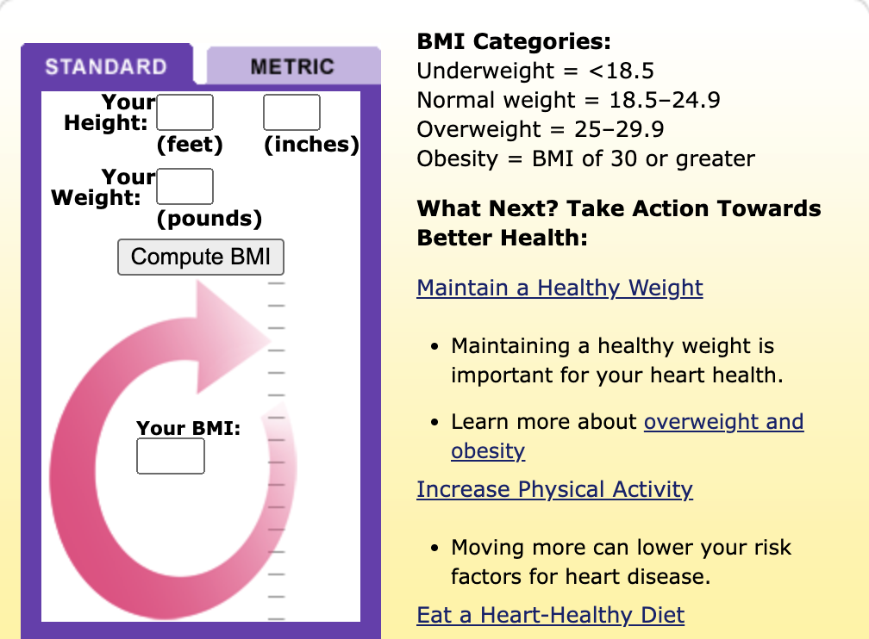

VA Schedule for Rating Disabilities (VASRD)
VASRD for Digestive Disabilities – Part IV Sections
§ 4.112 revised – let’s give BMI a try (you do not have to share with anyone)

Slide 13
VA Schedule for Rating Disabilities (VASRD)
VASRD for Digestive Disabilities – Part IV Sections
§ 4.112 revised
(d) Nutritional support
  1 – TPN (total parenteral nutrition) or hyperalimentation
    Bypasses normal digestion in stomach and bowel
  2 – Assisted enteral nutrition
    Delivered into the stomach or bowel through flexible feeding tube
      Percutaneous endoscopic gastrostomy = goes into abdominal wall
      OR nasogastric or nasoenteral = inserted through nose

Slide 14
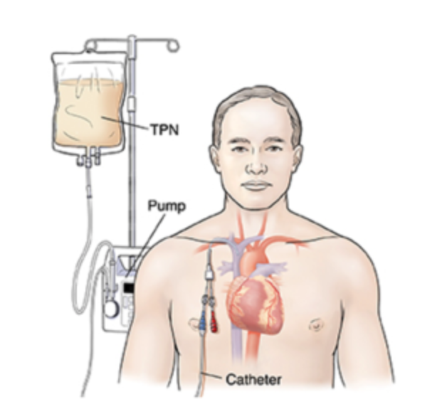
VA Schedule for Rating Disabilities (VASRD)

Slide 15

VA Schedule for Rating Disabilities (VASRD)

Slide 16
VA Schedule for Rating Disabilities (VASRD)
VASRD for Digestive Disabilities - Deletions
7305 – Duodenal ulcers
7306 –Marginal gastrojejunal ulcers
7316 – Cholecystitis, chronic
7321 - Amebiasis
7322 –Dysentery, bacillary
7324 – Distomiasis, intestinal or hepatic
7339 – Hernia, ventral, postoperative
7340 – Hernia, femoral

Slide 17
VA Schedule for Rating Disabilities (VASRD)
VASRD for Digestive Disabilities - Additions
7206 – Gastroesophageal reflux disease (GERD)
7207 – Barrett’s esophagus
7303 – Chronic complications of upper gastrointestinal surgery
7350 – Liver abscess
7352 – Pancreas transplant
7355 – Celiac disease
7356 – Gastrointestinal dysmotility syndrome
7357 – Post pancreatectomy syndrome

Slide 18
VA Schedule for Rating Disabilities (VASRD)
VASRD for Digestive Disabilities - Revisions
7200 – Esophagus, stricture of
7205 – Esophagus, diverticulum of, acquired
7301 – Peritoneum, adhesions of, due to surgery, trauma, disease, or infection
7304 – Peptic Ulcer Disease
7307 – Gastritis, chronic
7308 – Post gastrectomy syndrome
7309 – Stomach, stenosis of

Slide 19
VA Schedule for Rating Disabilities (VASRD)
VASRD for Digestive Disabilities – Revisions (Cont’d)
7310 – Stomach, injury of, residuals
7312 – Cirrhosis of the liver
7314 – Chronic biliary tract disease
7315 – Cholelithiasis, chronic
7317 – Gallbladder, injury of
7318 – Cholecystectomy (gallbladder removal), complications of
7319 – Irritable Bowel Syndrome (IBS)

Slide 20
VA Schedule for Rating Disabilities (VASRD)
VASRD for Digestive Disabilities – Revisions (Cont’d)
7323 – Colitis, ulcerative
7325 – Enteritis, chronic
7326 – Crohn's disease or undifferentiated form inflammatory bowel disease
7327 – Diverticulitis and diverticulosis
7328 – Intestine, small, resection of
7329 – Intestine, large, resection of
7330 – Intestinal fistulous disease, external

Slide 21
VA Schedule for Rating Disabilities (VASRD)
VASRD for Digestive Disabilities – Revisions (Cont’d)
7332 – Rectum and anus, impairment of sphincter control
7333 – Rectum and anus, stricture of
7334 – Rectum, prolapse of
7335 – Ano, fistula in, including anorectal fistula and anorectal abscesses
7336 – Hemorrhoids, external or internal
7337 – Pruritus ani (anal itching)
7338 – Hernia, including femoral, inguinal, umbilical, ventral, incisional, or other (not including hiatal)

Slide 22
VA Schedule for Rating Disabilities (VASRD)
VASRD for Digestive Disabilities – Revisions (Cont’d)
7344 – Benign neoplasms, exclusive of skin growths
7345 – Chronic liver disease without cirrhosis
7346 – Hiatal hernia and paraesophageal hernia
7347 – Pancreatitis, chronic
7348 – Vagotomy with pyloroplasty or gastroenterostomy
7351 – Liver transplant
7354 – Hepatitis C (or non-A, non-B hepatitis)

Slide 23

Let’s take a break

Slide 24
VA Schedule for Rating Disabilities (VASRD)
VASRD for Digestive Disabilities – Let’s Dive In!
What do you see as the most relevant of the changes we discussed before the break?
Do you have any current clients that will be greatly benefited?
Do you have any current clients that you think will be harmed in any way? Why?

Slide 25

VA Schedule for Rating Disabilities (VASRD)
VASRD for Digestive Disabilities – Major Impact

Slide 26
VA Schedule for Rating Disabilities (VASRD)
VASRD for Digestive Disabilities – Major Impact
§ 4.113 – general warning that certain coexisting digestive conditions cannot be separately evaluated without pyramiding
While differing in the site of pathology, produce common disability picture characterized in the main by varying degrees of abdominal stress or pain, anemia and disturbances in nutrition.

Slide 27
VA Schedule for Rating Disabilities (VASRD)
VASRD for Digestive Disabilities – Major Impact
§ 4.114 has some additional clarifications
Prohibition of separate evaluation and combination of ratings
  7301 - 7329,
  7331,
  7342,
  7345 – 7350
  7352
  7355-7357

Slide 28
VA Schedule for Rating Disabilities (VASRD)
VASRD for Digestive Disabilities – Major Impact
§ 4.114 has some additional clarifications
Prohibition of combining ratings
  Instead, when more than one rating is warranted, assign a single evaluation under the DC with the predominant disability picture
  AND evaluate it to the next higher evaluation if warranted by severity of overall disability
Changes to diagnostic codes or evaluation criteria are not grounds to reduce current evaluation (38 CFR 3.951a)

Slide 29
VA Schedule for Rating Disabilities (VASRD)
VASRD for Digestive Disabilities –
M21-1, Part V, Subpart iii, Chapter 6, Section 1 (c) – addresses steps
Step 1 – determine which of the coexisting conditions is predominant
= the one that has the highest disability evaluation is predominant
= OR if the same, the most advantageous outcome to the Veteran
Step 2 – Determine if there are symptoms of the non-predominant disability that do not overlap (if yes Step 3, if no Step 4)
Step 3 – Reevaluate predominant disability but also consider non-overlapping symptoms of the predominant disability – determine if resultant evaluation is higher than the evaluation for symptoms of predominant disability alone (if yes Step 5)

Slide 30
VA Schedule for Rating Disabilities (VASRD)
VASRD for Digestive Disabilities –
M21-1, Part V, Subpart iii, Chapter 6, Section 1 (c) – addresses steps
Step 4 – Rate coexistent disabilities together under the rating criteria for the predominant disability without evaluation to the next higher evaluation
Step 5 – Rate the coexistent together under the rating criteria for the predominant disability and evaluate to the next higher evaluation
Next higher evaluation is lowest evaluation specified in the DC for the predominant disability – do not simply add 10%

Slide 31
VA Schedule for Rating Disabilities (VASRD)
VASRD for Digestive Disabilities –
Example: Veteran has 2 coexisting digestive disabilities – PUD for 20% due to 2 episodes of abdominal pain lasting for 3 consecutive days in the past 12 months, managed by daily prescribed medication
Also has ulcerative colitis – 30% due to mild disease managed with oral and topical agents other than immunosuppressants; abdominal pain 3 or fewer daily episodes of diarrhea.
Result = Separate evaluations are not permitted – instead a single 30% would be assigned because ulcerative colitis is the predominant disability, and there are no non-overlapping symptoms of PUD to establish criteria supporting a 60%

Slide 32
VA Schedule for Rating Disabilities (VASRD)
VASRD for Digestive Disabilities –
Example 2: Veteran has IBS (7319) at 10% (abdominal pain with defecation at least once during previous 3 months)
AND hiatal hernia (7346) at 10% due to documented esophageal strictures
Result = Separate evaluations ARE permitted
Why? It’s an exception under V.iii.6.1.b, and the criteria do not overlap. They do not compensate for the same disability or facet of disability that would be prohibited under 38 CFR 4.14.
Historically, these DCs could not be separately evaluated and combined without pyramiding.

Slide 33
VA Schedule for Rating Disabilities (VASRD)
VASRD for Digestive Disabilities –
Example 3: Veteran has IBS (7319) at 10% (abdominal pain with defecation at least once during previous 3 months)
AND hiatal hernia (7346) at 10% due to documented esophageal strictures
Result = Separate evaluations ARE permitted
Why? It’s an exception under V.iii.6.1.b, and the criteria do not overlap. They do not compensate for the same disability or facet of disability that would be prohibited under 38 CFR 4.14.
Historically, these DCs could not be separately evaluated and combined without pyramiding.

Slide 34
VA Schedule for Rating Disabilities (VASRD)
VASRD for Digestive Disabilities – Major Impact
Analogous diagnostic codes
  GERD did not have its own DC – was generally rated under 7346 (hiatal hernia)
    Might appear as 7399-7346 or just 7346 – is now DC 7206
  If disability was previously rated under analogous code, the code should be updated but the evaluation should not be reduced solely based on changed criteria

Slide 35
VA Schedule for Rating Disabilities (VASRD)
VASRD for Digestive Disabilities – Major Impact
DC 7206 – GERD
  Includes verbiage regarding esophageal stricture with other symptoms – up to 80%
    Findings documented by barium swallow, CT, or EGD
    Non-GI complications to receive separate evaluation
    Includes GERD due to Mallory Weiss syndrome, esophagitis from various causes, including radiation therapy, etc.
DC 7203 – esophagus, stricture of
  Accounts for dysphagia, undernutrition, weight loss, etc. – up to 80%
  Evaluation basis for several other DCs

Slide 36
VA Schedule for Rating Disabilities (VASRD)
VASRD for Digestive Disabilities – Major Impact
DC 7304 – Peptic Ulcer Disease
  Up to 100% evaluation for post-operative perforation or hemorrhage > 3 months
DC 7303 – Chronic complications of upper GI surgery
  New criteria for TPN (nutritional support)
DC 7319 – IBS
  Up to 30% evaluation for abdominal pain at least 1 day per week
  Could go higher with symptoms of GI dysmotility syndrome

Slide 37
VA Schedule for Rating Disabilities (VASRD)
VASRD for Digestive Disabilities – Major Impact
DC 7326 – Crohn’s disease
  Up to 100% for severe inflammatory bowel disease unresponsive to treatment
  Requires confirmation by endoscopy or radiologic studies

Slide 38
Let’s take a break

Slide 39
VA Schedule for Rating Disabilities (VASRD)
Special Circumstances for Digestive Disabilities
Claims pending on May 19, 2024, apply guidance of M21-1, V.ii.4.A.6.p
What about appeals? Are you aware of any current court cases?
What about new claims? How would you approach a new claim? Would you change anything in how it is claimed?

Slide 40
VA Schedule for Rating Disabilities (VASRD)
Special Circumstances for Digestive Disabilities
Circumstances of service
  For dysentery or other gastrointestinal disease, assign great weight to any service
    Tropical service
    Imprisonment or internment under unsanitary conditions
    Food deprivation
    38 CFR 3.309(b)

Slide 41
VA Schedule for Rating Disabilities (VASRD)
Special Circumstances for Digestive Disabilities
Recurrence of hemorrhoids
  Unless the award for service-connection was clearly in error, do not assume that a superseding post service cause was the cause of a recurrence
  After service-connection is established, consider hemorrhoids shown after a period of absence to be associated with the service-connected condition

Slide 42
VA Schedule for Rating Disabilities (VASRD)
Special Circumstances for Digestive Disabilities
Hepatitis
  Three main categories – A (infectious hepatitis), B (serum hepatitis) and C (non-A non-B hepatitis)
  Do not automatically grant service-connection for Hepatitis C – lab findings in service alone do not show HCV in service or allow a conclusion that HCV was incurred in service. Each type of hepatitis can be acquired at different times and through different means
  Consider service-connection if there is a medical opinion linking condition to the confirmed in-service findings and/ or risk factors
  If service-connection is granted, evaluation is based on DC 7345

Slide 43
Game Time! Trivia Set Up!
To play, go to XXXXXXurl tbd
OR scan this QR code with your smartphone
Create a name (doesn’t have to be your real name) AND choose your team.
The results of the game will be shared with all, so if you want to use an alias, feel free!

