Slide 1
M21-1 Adjudication Procedures Manual

Slide 2
Objectives
What is the M21-1
Accessing the M21-1
Structure of the M21-1
Searching the M21-1
M21-1 Updates

Slide 3
What is the M21-1?
The M21-1 was digitized and officially launched on April 15, 2015 as the single source for reference materials and guidance. It also contains ongoing updates and summaries of court cases.
Reorganized in May 2021
The M21-1 is not law, it is VA’s interpretation of the law.
Essentially VA’s Policy and Procedure
CFR = What
M21 = How
Notes:
Before the M21, there were fast letters that were not organized and stored in a central location. You basically had to know the letter existed to apply it to a case. The manual has consolidated all that information in one, somewhat easy to use manual. When arguing law, cite the CFR, when arguing procedure, VA employees respond better to M21 references.

Slide 4
Precedence of VBA Laws, Regulations, and Procedures
Constitution/Law
↓
U.S. Code or Precedent setting court cases
↓
38 CFR
↓
Directives
(M-21)
Notes:
PACT Act example, takes years to catch up to legislation

Slide 5
Accessing the M21-1
Internet: KnowVA - https://www.knowva.ebenefits.va.gov/
  Compensation and Pension
  M21-1
VA Internet: KM Portals –https://vaww.vrm.km.va.gov
  Know VA Portal
    Compensation and Pension
    M21-1
  Also includes portals for VBA, VHA, and VEO
Notes:
Demonstrate

Slide 6
Structure of the M21
The M21 is divided into multiple manuals:
M21-1 Adjudication Procedures
M21-4 Manual
M21-5 Appeals and Reviews
Notes:
M21-4 covers internal VA policies such as National Quality Reviews or Workload management. M21-3 covers training for VBA employees

Slide 7
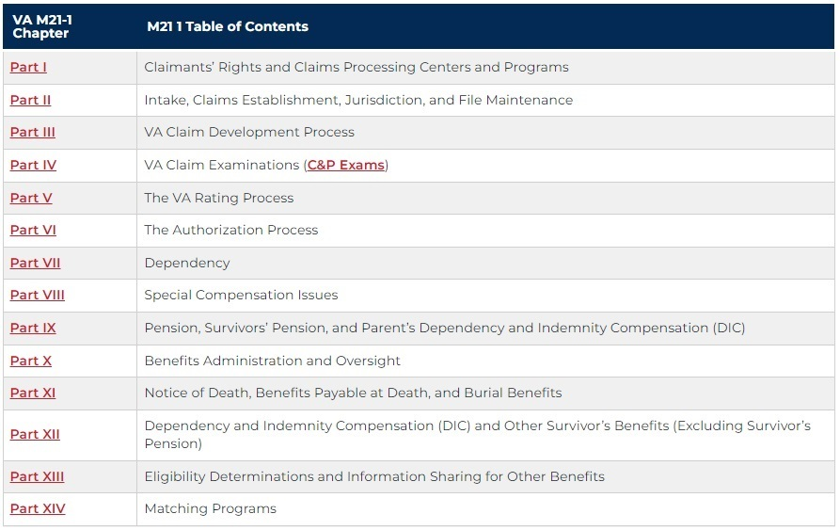
Structure of the M21-1
Notes:
14 searchable chapters, then broken down by sections and topics. Easiest to search for the topic you’re researching

Slide 8
Structure of the M21-1(cont.)
Understanding the layout:
M21-1V.ii.3.D.2.k
M21-1 is the manual
V is the Part
ii is the Subpart
3 is the Chapter
D is the Section
2 is the topic
k is the subtopic

Slide 9
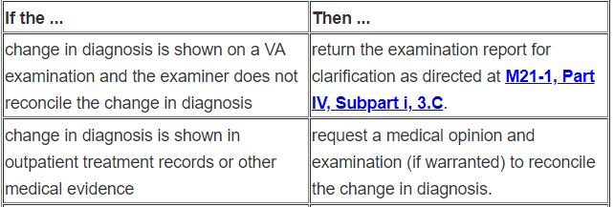
Structure of the M21-1 (cont.)
Sections cover general topics
  Each section begins with a table of contents with links to the associated topics
Topics begin with an introduction with links to subtopics
Subtopics can include important notes and references
Subtopics can include examples and tables to assist the reader with complex situations:
Notes:
Its as easy to navigate as possible, hyper links help to find the information you’re looking for quickly. The example shows the reference the VA employee would cite in a deferral for exam clarification

Slide 10
Searching the M21-1
Click M21-1 before searching; use the “Search within this topic” search bar
Use terms that are specific (related to your actual topic)
Avoid words that are likely to be included in every topic like “rating” or “decision”
Use unique words if possible
Avoid using long phrases that will result in topics unrelated to your search
Notes:
Demonstrate: Click M21-1 then “Search within this topic” searching the big search bar will search all topics on the page

Slide 11
Tips for searching the M21-1
When searching the M21-1, the system searches the content and title of each article.
The search engine looks for root words and variations of words. For example, a search for the word dependents will search the word dependents, dependent, dependency, depends, and depending.
If you use quotation marks it will only search for that word.
You can also enter an M21-1 reference if you have one and want to read more about the topic
Notes:
The words you searched for will be highlighted throughout the reference

Slide 12
Can’t find it?
Try alternate wording
Example: Use future exam vs. reexamination
Future exam brings up relevant references; reexamination brings up the keyword reexamination in a variety of different topics
TDIU, IU or Individual Unemployability: All of these pull up good specific references
Notes:
Using reputable law firm websites is sometimes helpful when looking for specific search terms

Slide 13
Let's Try It
Open the M21-1 by going to: https://www.knowva.ebenefits.va.gov
How would a VA employee verify POA submitted via SEP that did not generate a 21-22 in VBMS?
VA says the signature on the veteran’s claim form is not valid because it is not a wet signature
VA says the form you submitted is out of date
Notes:
SEP POA example: 1. Search POA SEP II.iii.4.B.1.c.
2. Search digital signature II.i.2.B.2.g. 3. search signature on behalf, ctrl f: VSO II.i.2.B.4.a.

Slide 14
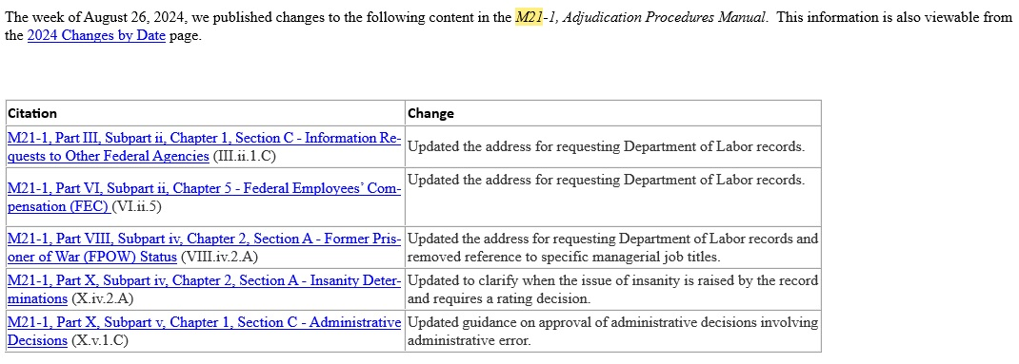
M21-1 Updates
VA offers an email subscription for changes to the M21 as well as a wide variety of other topics.
  Typically distributed weekly on Friday afternoon

Slide 15
M21-1 Updates (cont.)
To subscribe click the link and follow the on-screen instructions: https://public.govdelivery.com/accounts/USVA/subscriber/topics
Or - KnowVA - https://www.knowva.ebenefits.va.gov/
  Compensation and Pension
  Subscribe Here
Changes by date
  Compensation and Pension
  M21-1
  VA Changes by Date
Historical Document and key changes documents attached to most topics
Notes:
Changes by date listed by year, then monthly by most recent

Slide 16
M21-1 Updates (cont.)
Historical Documents
The historical document is a copy of the content as it existed during a given time period. The date in the document name indicates the date that content was published and the watermark on the pages of the document indicate when the content became outdated due to the publication of a newer version.
Key Changes Documents
The Key Changes document provides general notes about the change, a table(s) providing a description and location of each significant change, and a copy of the edited version of the content, highlighting new text and using tracked changes to indicate deleted text. The date in the document name indicates the date the changes identified in the document were published.
Notes:
Most sections contain a change date as well

Slide 17
Most Important Step
Double chock your work!
Double check your work!
If you cite the M21-1 and your reference is incorrect you could add additional, unnecessary delay.

Slide 18
QUESTIONS?

