Slide 1
The Old
The New
The Now
Undiagnosed Gulf War to PACT Act
By Vicki Von Loh
September 2024

Slide 2
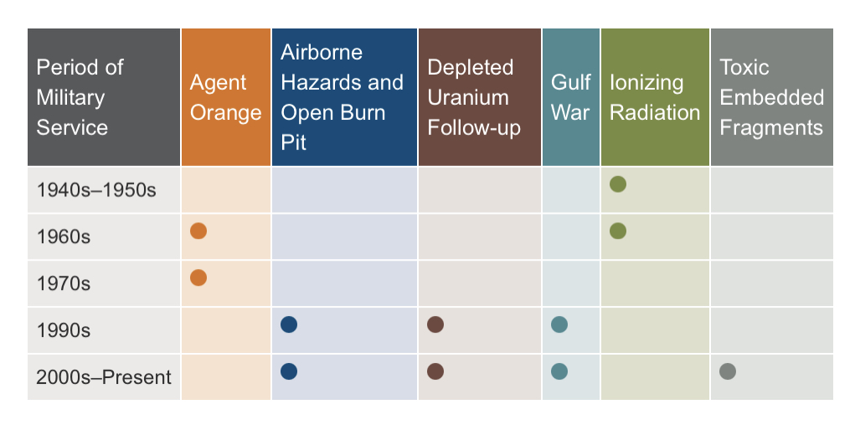
Chart of Periods and Presumptives
publichealth.va.gov

Slide 3
VA Registries
EXPOSURE CATEGORIES
Chemicals (Agent Orange, contaminated water…)
Radiation (nuclear weapons, X-rays…)
Air Pollutants (burn pit smoke, dust…)
Occupational Hazards (asbestos, lead…)
Warfare Agents (chemical and biological weapons)

Slide 4
Beginning date is August 2, 1990, for Southwest Asia service or September 19, 2001 for service in Afghanistan, and the ending date has not been established. [38 USC 101(33) and 38 CFR3.317]
There is no minimum time period inside the listed areas required.
The law also covers the airspace above and the waters offshore.

Slide 5
Veterans of Afghanistan are included with service there after September 19, 2001.
These veterans are only considered under the provisions of the law referring to presumptive conditions, and are NOT included in the sections dealing with undiagnosed illnesses.

Slide 6
Southwest Asia is defined as the following countries/territories:
Iraq
Kuwait
Saudi Arabia
The neutral zone between Iraq and Saudi Arabia
United Arab Emirates
Bahrain
Qatar
Oman

Slide 7
Service in the waters offshore includes these bodies of water:
The Gulf of Aden
The Gulf of Oman
The Persian Gulf
The Arabian Sea
The Red Sea

Slide 8
Ideally, service in one of the required areas should be documented on the DD-214, including the award of campaign ribbons.
If not, service in the required areas will have to be established through other evidence, such as official personnel records.
Also consider using unit records that show the veteran was part of a deployed unit.

Slide 9
To qualify for Compensation, the veteran is not required to specify nor document that he/she was exposed to any of the hazards.
If the veteran was in the areas identified in 38 CFR 3.317, they meet the threshold for consideration.

Slide 10
If the veteran was not in Southwest Asia, but claims to have exposed to an environmental hazard not documented verification is required
Give complete details that can be verified through other records;
Place of exposure.
Dates.
Type of exposure specifying the hazard and health effects experienced by the veteran.

Slide 11
November 2, 1994
First law, passed on November 2, 1994, included compensation for chronic disability from undiagnosed illness(es).
Veterans reported symptoms including chronic headaches, cognitive disabilities, widespread bodily pain, unexplained fatigue, chronic diarrhea, skin rashes, respiratory problems and abnormalities that defied diagnosis.

Slide 12
If the claim is for:
Signs or symptoms of an undiagnosed illness or
During active duty in the Southwest Asia theater of operations during the Gulf War, or
to a degree of 10 percent or more within a presumptive period following service in the Southwest Asia theater of operations during the Gulf War.

Slide 13
1998
Next law, passed in 1998, added a presumption of service connection based on a positive association with exposure to toxic agents, environmental hazards or preventive medication.
The law does not specify particular hazards, only that the veteran has qualifying service.

Slide 14
December 27, 2001
Compensation for Veterans who served on active duty in the Southwest Asia theater of operations during the Persian Gulf War is for any diagnosed or undiagnosed illness that is determined by VA regulation to warrant a presumption of service connection (SC) based on a positive association with exposure to one of the following as a result of such service:
a biological, chemical, or other toxic agent
an environmental or wartime hazard, or
As preventative medication or vaccine.

Slide 15
March 1, 2002
The next law, passed on March 1, 2002, expanded “undiagnosed illness” to include “multi-symptom illness defined by a cluster of symptoms” gave the VA Secretary authority to add diagnosed conditions as the facts warranted.

Slide 16
VA has documented the symptoms and manifestations associated with an undiagnosed illness in 38 CFR 3.317(b).
Note that the list is inclusive, but not exclusive, which means that other symptoms will also be considered.
Symptoms must have persisted for at least six months.

Slide 17
These undiagnosed illnesses are presumptive if the veteran served in a recognized location, a health care provider diagnosed while on active duty or at any time after separation, and has been ill for at least 6 months:
Chronic fatigue syndrome
Fibromyalgia
Functional gastrointestinal disorders
Medically unexplained chronic multi symptom illness (MUCMI)
Other undiagnosed illnesses, such as cardiovascular signs and symptoms, muscle and joint pain, and headaches

Slide 18
March 2010
The law includes a list of presumptive diseases and anticipated complications from the diseases [38 CFR 3.317 (c)].
Most listed diseases have a one-year presumptive period from the date of separation, but there are exceptions for malaria, visceral leishmaniasis and tuberculosis.

Slide 19
Presumptive diseases listed in 38 CFR 3.317 (c)(2);
Brucellosis
Campylobacter Jejuni
Coxiella Burnetti (Q fever)
Malaria
Nontyphoid Salmonella
Shigella
West Nile Virus

Slide 20
Remember, unlike the undiagnosed conditions of “Gulf War Syndrome”, these presumptive conditions require a diagnosis, findings of residual permanent disability and must be at least 10% disabling if first diagnosed during the presumptive period.

Slide 21
July 15, 2011
Functional gastrointestinal disorders (FGIDs) were included as MUCMI on July 15, 2011. These include:
Abdominal pain
Substernal burning or pain
Nausea and or vomiting
Altered bowel habits
Indigestion and or bloating
Postprandal fullness and
Painful or difficulty swallowing

Slide 22
February 2012
The VA began granting service connection for chronic fatigue syndrome (CFS), fibromyalgia, irritable bowel syndrome, and medically unexplained chronic multi symptom illness on a presumptive basis in February 2012.

Slide 23
A presumptive disease not listed in 38 CFR 3.317 is amyotrophic lateral sclerosis.
Presumption for this condition is found in 38 CFR 3.318
Service in Southwest Asia is not required to qualify for service connection for this condition, but statistically, they are more likely to be found in veterans who served in the war zone.

Slide 24
Tuberculosis is shown as a presumptive condition in 38 CFR 3.317 with no time limit.
Tuberculosis is a bacterial infection of the lung [Mycobacterium tuberculosis (M. tuberculosis)].
You can get tuberculosis by breathing in air droplets from a cough or sneeze of an infected person.

Slide 25
Leishmaniasis is a parasitic disease caused by infection with Leishmania parasites, which are spread by the bite of phlebotomine sand flies.
There are several different forms of leishmaniasis in people; visceral leishmaniasis, affects several internal organs (usually spleen, liver, and bone marrow).

Slide 26
VA Airborne Hazards and Open Burn Pit August 5, 2021
“Airborne hazard” refers to any sort of contaminant or potentially toxic substance that we are exposed to through the air we breathe. While on active duty, military service members may have been exposed to a variety of airborne hazards including:
The smoke and fumes from open burn pits
Sand, dust, and particulate matter
General air pollution common in certain countries
Fuel, aircraft exhaust, and other mechanical fumes
Smoke from oil well fires

Slide 27
VA Airborne Hazards and Open Burn Pit
Depending on a variety of factors, veterans may experience health effects related to this exposure. Factors that may indicate veterans have a greater or lesser risk of short or long-term health effects include:
Types of waste burned
Proximity, amount of time, and frequency of exposure
Wind direction and other weather-related factors
Presence of other airborne or environmental hazards in the area

Slide 28
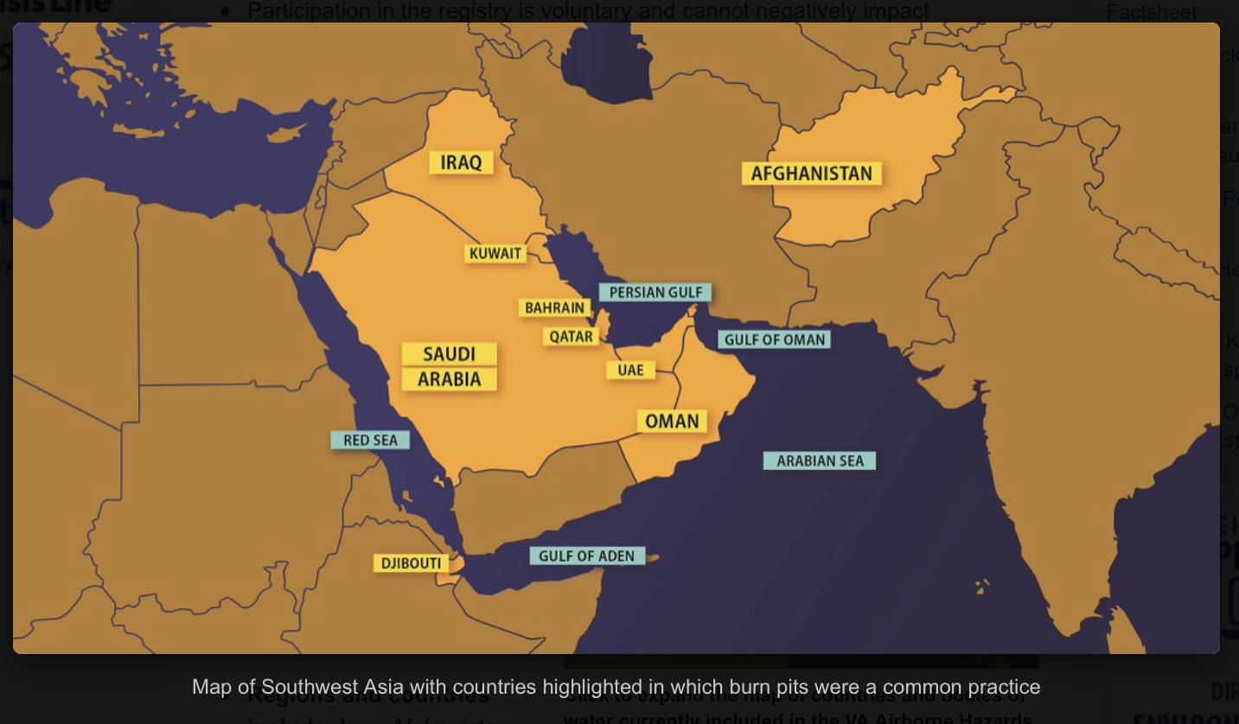
Locations of Burn Pits

Slide 29
Particulate Matter
Particulate matter is a complex mixture of extremely small particles and liquid droplets made up of a number of components including acids, organic chemicals, metals, and soil or dust particles.
Under 38 CFR 3.320, there is no length of deployment required in order to concede exposure. The service member shall be presumed to have been exposed, unless there is affirmative evidence that the veteran was not exposed to fine, particulate matter during that service.

Slide 30
Particulate Matter (continued)
The term qualifying period of service means any period of active military, naval, or air service in:
The Southwest Asia theater of operations, as defined in §3.317(e)(2), during the Persian Gulf War as defined in §3.2(i).
(ii) Afghanistan, Syria, Djibouti, or Uzbekistan on or after September 19, 2001 during the Persian Gulf War as defined in §3.2(i).

Slide 31
Particulate Matter (continued)
If the veteran’s exposure to particulate matter is conceded based on qualifying service, then the claim should be considered on a presumptive basis. VA should give a sympathetic reading of claims for respiratory symptoms.
However, a diagnosis of one of the presumptive respiratory conditions, within ten (10) years of separation from service, must be developed for and confirmed before service connection can be granted.
Claims will be developed by standard development procedures.

Slide 32
Particulate Matter (continued)
If it appears that entitlement can be established for the claimed respiratory disability on another basis, ie direct, then the claim should not be processed as GW particulate exposure claim.
If evidence show the condition existed prior to service, aggravation should be considered.
If entitlement exists under multiple theories, the grant should be based on the most advantageous effective date.

Slide 33
Particulate Matter (continued)
There is no requirement that the respiratory disabilities manifest to a compensable degree, ie. 10 percent or more, to establish presumptive service connection under 38 CFR 3.320.
Effective date considerations, under 38 CFR 3.114, are applicable. The regulation went into effect on
August 5, 2021; in no case will an award be effective prior to that date.

Slide 34
Presumptive Conditions Based on Particulate Matter Exposure
Chronic Asthma
Chronic Sinusitis
Chronic Rhinitis
Also includes Rhinosinusitis

Slide 35
Presumptive SC can be established under 38 CFR 3.320 effective August 5, 2021.
Apply the liberalizing law provisions of 38 CFR 3.114(a) when determining the effective date of SC under 38 CFR 3.320.
In order to establish presumptive SC for asthma, rhinitis, and/or sinusitis (to include rhinosinusitis) under 38 CFR 3.320, the evidence must show qualifying service, and manifestation of the qualifying chronic disability(ies) within the presumptive period. With those conditions met, VA can concede exposure to fine, particulate matter in the correlating duty location and the nexus between said exposure and the chronic disability(ies).

Slide 36
August 10, 2022
The PACT Act has added more than 25 new presumptive conditions that veterans can file for if they meet the requirements.
What is “Presumptive” Service Connection?
VA presumes that certain disabilities were caused by military service. This is because of the unique circumstances of a specific veteran’s military service.
If a presumed condition is diagnosed in a Veteran within a certain group, they can be awarded disability compensation.

Slide 37
The PACT Act Presumptive Areas
The PACT Act determined that veterans who served in any of the below locations on or after August 2, 1990 had exposure to burn pits or other toxins. We call this having a presumption of exposure.
Bahrain
Iraq
Kuwait
Oman
Qatar
Saudi Arabia
Somalia
The United Arab Emirates (UAE)
**Includes the airspace above any of these locations

Slide 38
The PACT Act Presumptive Areas
The PACT Act determined that veterans who served in any of the below locations on or after September 11, 2001 had exposure to burn pits or other toxins. We call this having a presumption of exposure.
Afghanistan Djibouti Egypt
Jordan Lebanon Syria
Uzbekistan Yemen
**Includes the airspace above any of these locations

Slide 39
Development for PACT Act Claims
Development for PACT Act Claims
Will include Individual Longitudinal Exposure Record and
Toxic Risk Exposure Activity

Slide 40
Individual longitudinal Exposure Record (ILER)
Individual Longitudinal Exposure Record (ILER)
Section 1119 (c) defines exposure tracking record system as any system, program, or pilot program used by the Secretary of Veterans Affairs or the Secretary of Defense to track how veterans or members of the Armed Forces have been exposed to various occupational or environmental hazards.

Slide 41
Individual longitudinal Exposure Record (ILER)
ILER will contain
Time of deployments
Locations and events during deployments
All-hazard occupational data
Environmental hazards that were known or found later
Any monitoring performed in the areas(s)
Medical encounter information (e.g., diagnosis, treatment, and laboratory data)
Medical concerns that should be addressed regarding possible exposures
ILER will be available to VA and DoD healthcare providers; epidemiologists and researchers; and VA disability evaluation and benefits determinations specialists. It will be used to improve internal processes and will not be available for individual access.

Slide 42
Individual longitudinal Exposure Record (ILER)
There is now a requirement which requires the use of the Individual Longitudinal Exposure (ILER), ILER-like tool or similar database during claims adjudication.
VA will establish a list of chemicals, substances and airborne hazards and presumes that a covered Veteran was exposed to the identified substances, chemicals and airborne hazards during qualified service.
A medical nexus examination will be required for toxic exposure risk activities, unless the evidence of record is sufficient.

Slide 43
Toxic Exposure Risk Activity
Toxic exposure risk activity (TERA) is defined in 38 USC 1710(e)(4)(C) as any activity that requires a corresponding entry into an exposure tracking records system (as defined in Section 1119(c); or that the Secretary determines qualifies for purposes of this subsection when taking into account what is reasonably prudent to protect the health of Veterans

Slide 44
Toxic Exposure
Toxic exposure is defined in 38 USC 101(37) to include, a toxic exposure risk activity (TERA), as defined in Section 1710(e)(4), and an exposure to a substance, chemical or airborne hazard identified in the list under section 1119(b)(2).
38 USC 1710(e)(4) defines the terms Vietnam-era herbicide exposed, radiation exposed Veteran and TERA
38 USC 1119(b)(2) states the Secretary of VA shall establish and maintain a list that identifies substances, chemicals and airborne hazards that are appropriate for presumptions of specific toxic exposure for members who served in certain locations

Slide 45
TERA Exception Job Aid
38 U.S.C. § 1168(b) provides that the examination requirements for TERA-related claims do not apply if the Secretary determines there is no indication of an association between the disability claimed by the Veteran and participation in the TERA.
At this time, claims processors should not order an examination based upon a TERA if one of the following exceptions applies.
Non-presumptive claims based on physical trauma. The Veteran claims service connection for a non-presumptive disability that is based on physical trauma (e.g., blunt force trauma, trauma due to repetitive use, penetrating trauma). Note: Hearing loss is not considered a physical trauma under this exception.

Slide 46
TERA Exception Job Aid (continued)
2. Mental disorders. This includes any condition contained in
38 C.F.R. § 4.130, the mental disorders section of the VA Schedule for Rating Disabilities.
Note: Toxic exposure can result in symptoms of neurobehavioral decline, like decreased memory and concentration. A diagnosis of a mental disorder should be considered on a direct or secondary basis.
3. Conditions determined to have no positive association with herbicide exposure. These are conditions determined by the Secretary based on cumulative scientific data reported by the National Academies of Science since 1993 and are as follows

Slide 47
4. Claims for disabilities that manifested during military service or with an etiology not associated with toxic exposure. This exception applies to conditions that manifested during service for which a medical nexus opinion would not be needed to decide service connection on a direct basis (evidence of chronicity or continuity is of record) and to claims where the evidence of record indicates that the claimed condition is clearly related to an etiology that is not associated with toxic exposure (to include post-service)

Slide 48
Important: Claims processors must liberally apply reasonable doubt when determining if this exception applies. When there is an approximate balance of evidence, they should err on the side of caution and request the TERA disability examination and medical nexus opinion.

Slide 49
TERA Exception Job Aid – Malignant conditions (Cancers)
Melanoma
Nonmelanoma skin cancer (basal cell and squamous cell)
Hepatobiliary cancers (liver, gallbladder, and bile ducts), and pancreatic cancer
Cancers of the pleura, mediastinum, and other unspecified sites within the respiratory system and intrathoracic organs
Bone and connective tissue cancer
Endocrine cancers (including thyroid and thymus)
Cancers of the reproductive organs (cervix, uterus, ovary, testes, and penis; excluding prostate)
Cancers of the digestive organs (esophageal cancer; stomach cancer; colorectal cancer (including small intestine and anus))

Slide 50
TERA Exception Job Aid – Malignant conditions (Cancers) continued
Renal cancer (kidney and renal pelvis)
Cancers of the brain and nervous system (including eye)•
Leukemia (other than all chronic B-cell leukemias including chronic lymphocytic leukemia and hairy cell leukemia)
Cancers of the oral cavity (including lips and tongue), pharynx (including tonsils), and nasal cavity (including ears and sinuses)

Slide 51
TERA Exception Non-Malignant Conditions
Osteoporosis
Farmer’s lung
Chronic obstructive pulmonary disease
Immune system disorders (immune suppression, allergy, and autoimmunity)
Neurodegenerative diseases (including amyotrophic lateral sclerosis (ALS) but excluding Parkinson's disease and Parkinsonism)
Asthma
Hearing loss
Neurobehavioral disorders (cognitive and neuropsychiatric)
Circulatory disorders (other than hypertension, ischemic heart disease, and stroke)

Slide 52
TERA Exception Non-Malignant Conditions (continued)
Endometriosis
Diseases of the eye
Gastrointestinal, metabolic, and digestive disorders
Chronic peripheral nervous system disorders (other than early-onset peripheral neuropathy)
Note: The malignant and non-malignant conditions under this exception (Exception 3) only apply to herbicide exposure. Claims processors must still consider all evidence as there may be a record of a different TERA (other than herbicides).

Slide 53
The PACT Act Presumptive conditions Gulf War and Post 9/11 Veterans
Brain Cancer | Chronic Rhinitis
Glioblastoma | Chronic Sinusitis
Respiratory (Breathing-related) cancer of any type | Constrictive bronchiolitis
Gastrointestinal cancer of any type | Obliterative Bronchiolitis
Head cancer of any type | Emphysema
Lymphoma of any type | Granulomatous disease
Lymphatic cancer of any type | Interstitial lung disease (ILD)
Neck cancer | Pleuritis
Pancreatic Cancer | Pulmonary Fibrosis
Reproductive cancer of any type | Sarcoidosis
Kidney Cancer | Chronic Bronchitis
Melanoma | Chronic Obstructive Pulmonary Disease (COPD)
Asthma (Diagnosed after service)

Slide 54
Additional PACT Act Guidance
Removed the manifestation period and compensability requirement for Persian Gulf Veterans, allowing for a qualifying chronic disability to manifest to any degree of disability at any time, and
Added additional locations associated with undiagnosed illness and MUCMI. In addition to the existing recognized service in the Southwest Asia theater of operations, the PACT Act added the following new service locations:
Afghanistan
Israel
Egypt
Turkey
Syria, and
Jordan.

Slide 55
June 2024
In June 2024, the VA announced that male breast cancer, urethral cancer, and cancer of the paraurethral glands are now presumptive diseases under the PACT Act. This designation allows veterans with these conditions to apply for expedited disability compensation and health care benefits.

Slide 56
Effective Dates
Effective Date of Law August 10, 2022
If Intent to File or VA Form 21-526EZ filed prior to August 14, 2023 effective date August 10, 2022
38 CFR 3.114 applies – if diagnosed prior August 10, 2022, effective date will be one year prior to date of claim, ie. Date of claim 9/2/23, diagnosed 7/25/2023, effective date 7/25/2023

Slide 57
Differences between Gulf War and Pact Act Claims
Conditions
Presumptive or Not Presumptive
Effective dates
Locations

Slide 58
References
Public Law 103-446 dated November 2, 1994
Public Law 105–277 Persian Gulf War Veterans Act of 1998
Public Law 107-103 under the veterans expansion and benefits act of 2001
Public Law 117-168 PACT Act of 2022
38 USC 1117
38 USC 1118
38 CFR 3.2
38 CFR 3.103
38 CFR 3.114
38 CFR 3.159
38 CFR 3.306
38 CFR 3.307
38 CFR 3.309
38 CFR 3.317
38 CFR 3.318
38 CFR 3.320

Slide 59
References (continued)
M 21-1.IV.2.D
M 21-1.V.ii.2
M 21-1.VIII.ii
https://www.publichealth.va.gov/exposures
https://www.va.gov/disability/eligibilty
https://www.va.gov
VA Memorandum dated June 8, 2021 concerning Persian Gulf War particulate Matter Exposure Interim Claims Processing
VBA Letter dated August 2, 2021 concerning Presumptive Service Connection for Respiratory Conditions due to Particulate Matter
National Defense Authorization Act for Fiscal Year 2021

Slide 60
VA Dashboard Shows PACT Act Performance:In recognition of the second anniversary of the passage of the PACT Act (Public Law 117-168), VA has published a special issue of the VA PACT Act Performance Dashboard that shows statistics compiled over the past two years. Highlights include one million related claims VA has approved totaling $6.8 billion, more than five million toxic exposure screenings, and an increase of nearly 186,000 new enrollees in VA health care.

Slide 61
QUESTIONS?
Vicki Von Loh
402-499-6836
vvonloh@gmail.com

