Slide 1
TVB Claims Management System
September 2024

Slide 2
Lesson Objectives
What’s new with TVB
The New Veteran Home Screen
How to access “The old TVB”
How to upload documents
The New Claim Home Screen

Slide 3
What’s New with TVB?
TVB 4.0 was released in spring 2024 and with it came some quality-of-life improvements such as:
Updated tabbing on the 21-526EZ Form
A warning will be provided if a claim package has non-PDF Documents
Added the “Send to VA” Button to the document and form page for all forms. USE CAUTION with this button as it does not allow you to review your work before being sent to VA.

Slide 4
What’s New with TVB?
VA form 21-0781 now allows for 1,250 characters in field 14
Allowed multiple values to be selected in field 20A for VA form 21P-530EZ
Updated the Veteran Page
Updated the Claim page

Slide 5
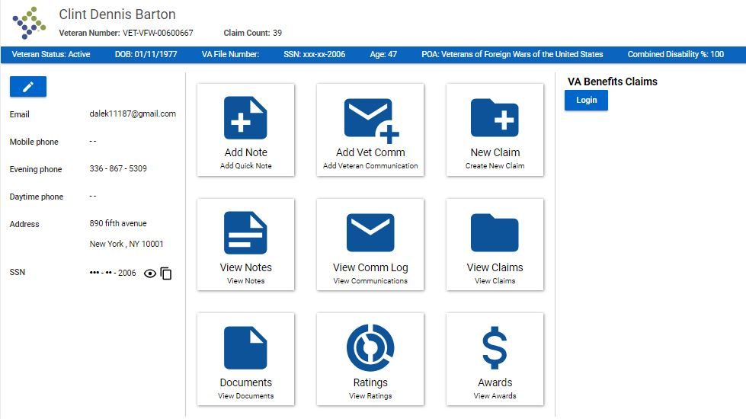
The New Veteran Home Screen

Slide 6
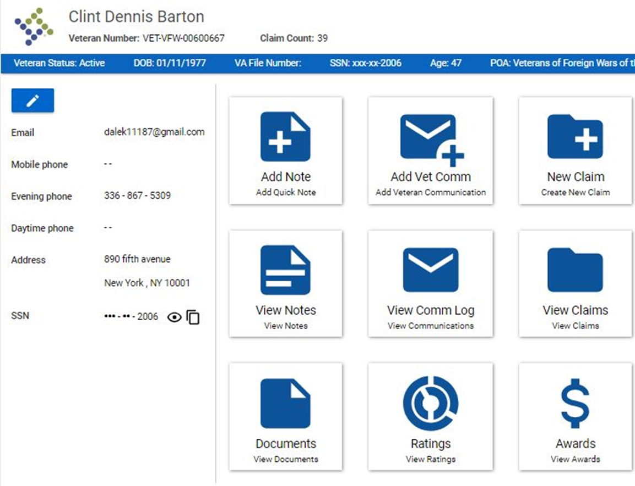
The New Veteran Home Screen
The Veteran Home Screen has been updated with Tiles to allow faster access to pages with the Veteran’s Folder

Slide 7
Accessing the “Old TVB”
Edit Veteran
To access the Veteran's folder also know as the “Old TVB” click on the Blue Edit Veteran Button

Slide 8
Uploading Documents
Despite one of the tiles on the Veteran’s Home Screen being called Documents; users are not able to upload documents from this Tab and instead must access the document page from the “Old TVB”

Slide 9
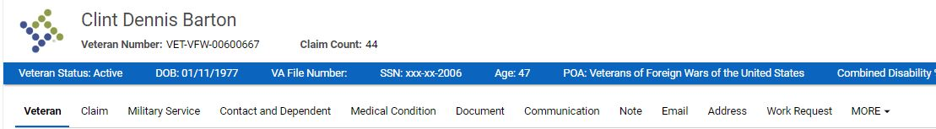
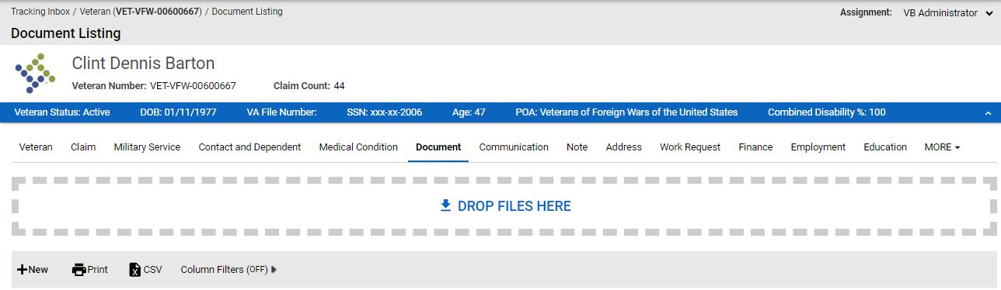
Uploading Document into TVB
Once in the Veteran Folder, clicking on the Document tab takes users to the Document page.
Once inside the Document page users can either drag the files into the box or press +New

Slide 10
Submitting a Claim to VA
To begin the process of subbing a claim through TVB click the New Claim Tile which will take users to the Claim Tab Page.

Slide 11
Submitting a claim to VA
**Please note the word “Claim” in TVB refers to any item being sent to VA through TVB including medical records or a 21-4138**

Slide 12
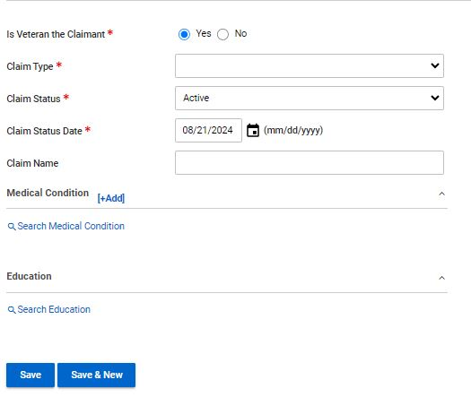
Submitting a claim to VA
In the Claim Tab Page users will need to select the correct choices from the required fields. TVB automatically populates to the most frequently options.
Claim Type: Compensation, DIC, Education, NSC Pension etc.
Claim Status: Active, HLR, ITF, Supplemental claim and Incomplete claim
Claim Status Date: Date the claim was generated
Save: Saves the pages and allows users to advance

Slide 13
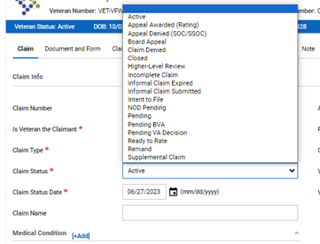
Claim Status
The default setting for Claim Status is Active but be sure to select the correct choice for the claim being sent to VA:
Active: 21-526EZ, 686C, 21P-530, 10-10EZ, 21P-527EZ, 21P-534EZ
Higher Level Review: 20-0996
Intent to File: 21-0966
Supplemental Claim: 20-0995
Incomplete claim: 21-22 and any other documents or supporting forms submitted to VA

Slide 14
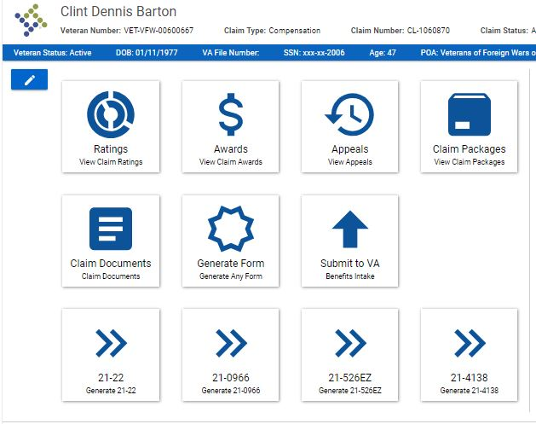
The Claim Home Screen
Once a Claim has been created the first page shown is the Claim Home Screen. This page contains tiles to various pages within the Claim folder.

Slide 15
Generating A Form
Depending on the type of claim selected, (Compensation, DIC, Education) The Claim Home Screen will populate with the four most frequently used forms associated with that claim type.

Slide 16
Generating A Form
To generate a form in TVB click on the Generate Form Tile form the Claim Home Page.
Alternatively, users can select from one of the four populated forms

Slide 17
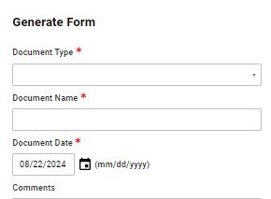
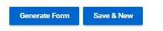
Generating a Form
When a user hits the Generate Form Tile, a new screen appears with two required fields: Document Type and Document Name.
Document Type: Allows users to select the form by either clicking the drop-down window or by typing in the form name.
Document Name: Names the document being generated.
Once finished click Generate Form

Slide 18
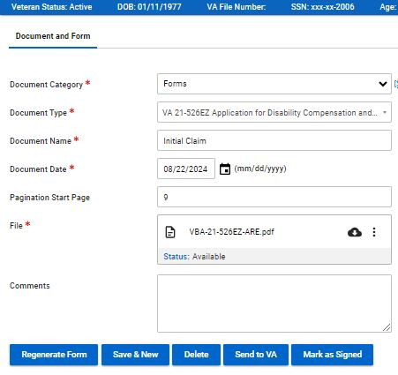
Editing The New Form
Once the form is generated, it can be edited by hovering over the 3 vertical dots and clicking Edit

Slide 19
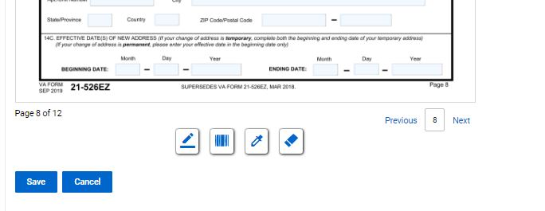
Editing The New Form
At the bottom of the page you will see 4 symbols:
Add Signature Add Barcode Highlight Redact

Slide 20
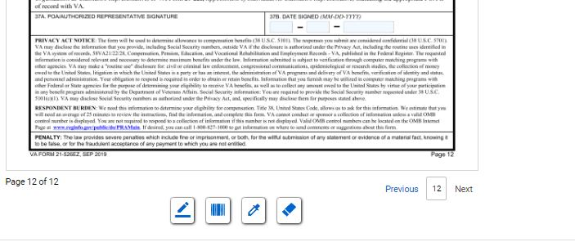
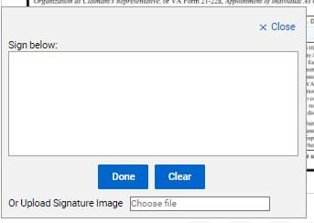

Signing The New Form
Once the form is complete, it will need to be signed. To do this click “Add Signature” which will pop up the signature box.
In the signature box you can either manually create a signature using your mouse or upload a signature image. Once finished click save.

Slide 21
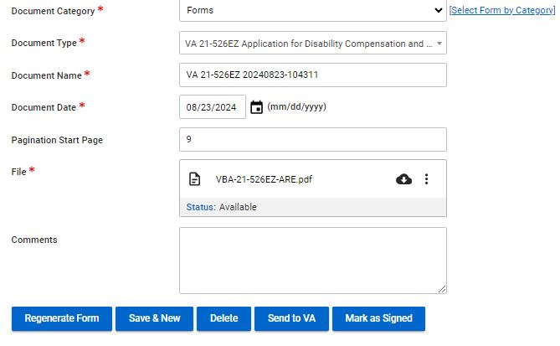
Signing the New Form
Once the signed document has been saved, Click
Mark as Signed
Once the document has been marked as signed, users can review the form but cannot make any changes to that form.
Users will need to hit Save and move on to the next step in the claim process

Slide 22
Send to VA WARNING
The Send to VA Button does just that, sends the document directly to VA without an opportunity to review or correct any mistakes.
Additionally, it does not allow users to add additional documents to send to VA
Use caution when using this feature.

Slide 23
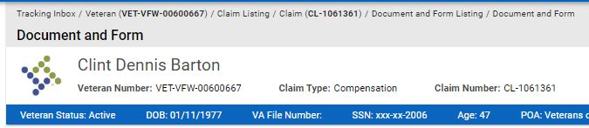
The Bread Crumb Trail
BreadCrumb
Users who wish to include additional documents or review their work before they send their claim to VA will need to return to the Claim Home Page by using the TVB Bread Crumb and select the claim that was just generated.

Slide 24
Submitting a Claim To VA
From the Claim Home Screen click the tile Submit to VA.

Slide 25
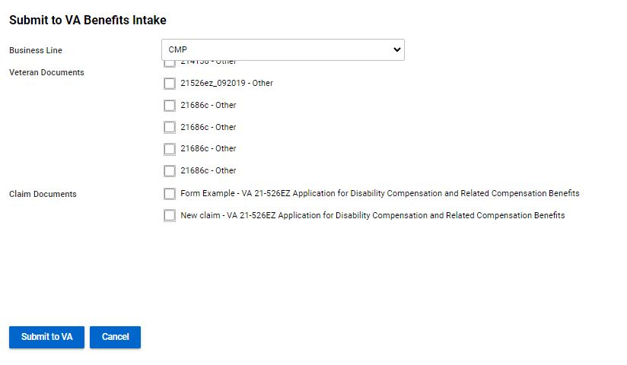
Submitting a Claim To VA
If documents were uploaded into the veteran’s folder, they will be displayed and can be attached to submit to VA.

Slide 26
Submitting a Claim To VA
The new screen defaults to the business line of CMP (Compensation) but depending on the claim type be sure to update this appropriately. The other options are:
PMC = Pension and Survivor
INS = Insurance
EDU= Education
VRE= VR&E
BVA= Board of Veterans Appeals
FID= Fiduciary
OTH= Other

Slide 27
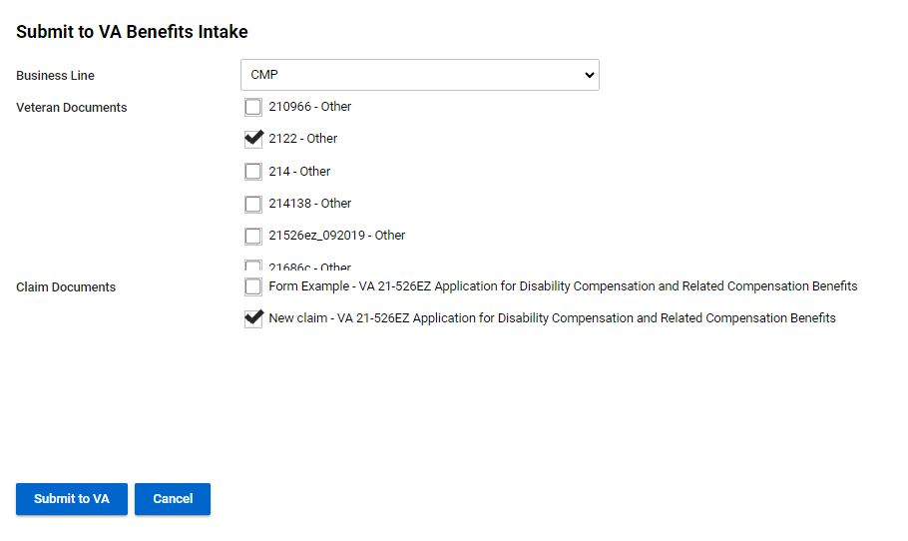
Submitting a Claim To VA
With your Claim Document Selected and any Veteran Documents selected, click Submit to VA

Slide 28
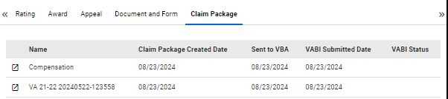
Submitting a Claim To VA
Once the claim is sent to VA, the page will refresh, and your claims will be displayed like the example.
Clicking on the left most box creates a New Window Tab and takes the user to the Claim Package Page
**Caution** When creating new windows in TVB as it can lead to errors with more than 1 TVB screen active at a time

Slide 29
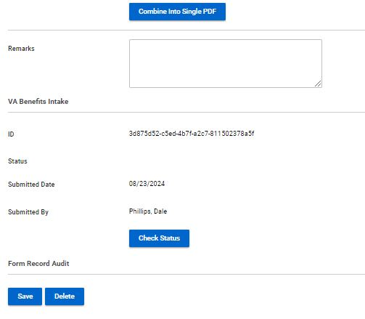
Claim Package Page
The Claim Package Page’s purpose is to check the status of the claim after it has been sent to VA.
**Please Note**
Just because a claim is sent to VA, does not mean that it was received correctly, please ensure that all claims show the status of Received as this is the claims Date Stamp

Slide 30
Viewing the Claim Folder
Edit Claim
To view the entire claim folder click the Edit Claim button

Slide 31
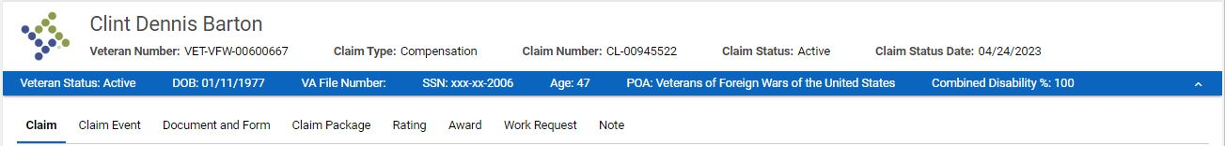
Tabs In The Claim Folder
Once in the Claim Folder, users will see a header with tabs that take them to other aspects of the Claim’s folder.
Claim
Claim Event
Document and Form
Claim Package
Rating
Award
Work Request
Note

Slide 32
The Claim Folder
Claim: Allows users to enter in historical data such as when VA received claim
Claim Event: Documents any events associated with the claim such as when it was generated
Document and Form: Shows forms associated with claim and allows users to create new forms with the selected claim
Claim Package: Provides status of claims sent to VA
Rating: Allows users to enter a VA rating if the claim grants service connection
Award: Allows users to enter in award data for the claim submitted
Work Request: Allows the assigning of tasks with this claim to other TVB users
Note: Allows users to add notes about the claim submitted

Slide 33
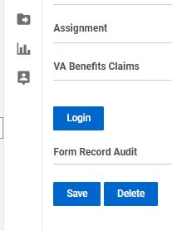
VA Benefits Claims
TVB has an API called VA Benefits Claims which allows TVB to connect to VA.gov.
This allows for some actions in TVB to be done in REAL TIME
The VA Benefits Claims API can be found when inside a veteran's folder.
Click Login to connect to continue with this API

Slide 34
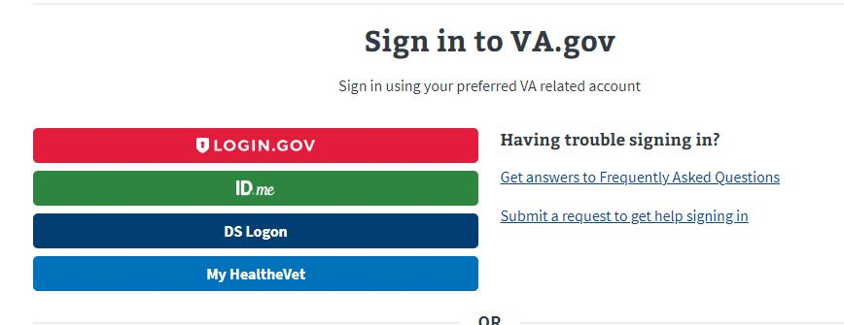
VA Benefits Claims
When utilizing this functionality, TVB requires the user to sign in to VA.gov using one of the following log in methods:

Slide 35
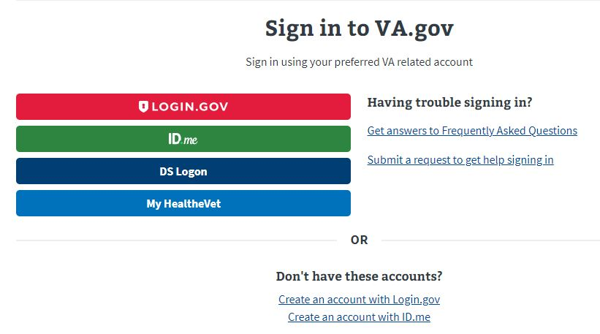
VA Benefits Log
If the user does not have any of these accounts, they can create either an Login.gov or ID.me account directly from the page by clicking the hyperlinks at the bottom.

Slide 36
Account Set up
An in-depth guide for creating either a Login.gov or ID.ME account can be found in the OLP next to this presentation.
Please note that in 2025 VA is removing Myhealthvet and DS Logon as log in options for VA.gov.

Slide 37
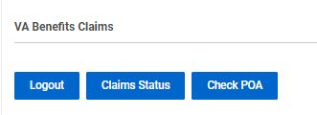
VA Benefits Claims
Once logged into the VA Benefits Claims section, clicking on VA Benefits Claims will populate new buttons.

Slide 38
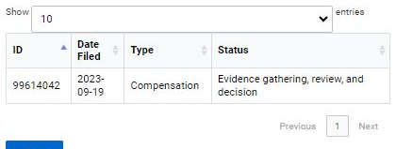
VA Benefits Claims: Claim Status
The Claim Status button will populate all the veteran’s claims (past and present) and show the Date Filed, Claim Type and Status of the claim

Slide 39
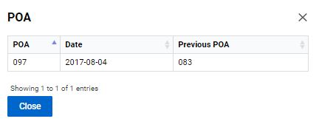
VA Benefits Claims: Check POA
The Check POA button will populate the veteran’s current POA as well as list any Previous POAs.

Slide 40
VA Benefits Claims: Submitting Forms Directly into VBMS
Another function of VA Benefits Claims is the ability to submit 21-22s, ITFs and 526EZs directly into VBMS.
To utilize this function, the following must be true.
Logged into VA.gov through VA Benefits Claims
The veteran’s folder is assigned to Your Field Office and Yourself.

Slide 41
VA Benefits Claims: Submitting Forms Directly into VBMS
To submit a form directly into VBMS a claim must first be created.
From the veteran folder Create a new claim and hit Save.
Create the form using the Document and Form Tab and once complete press Marked As Signed.

Slide 42
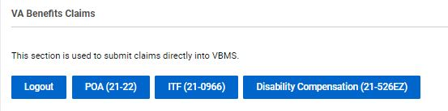
VA Benefits Claims: Submitting Forms Directly into VBMS
With the form Marked As Signed, follow the TVB Breadcrumb Trail back to the claim created.
Scroll back down to VA Benefits Claims and 3 new buttons have populated: POA(21-22) ITF(21-0966) Disability Compensation (21-526EZ)

Slide 43
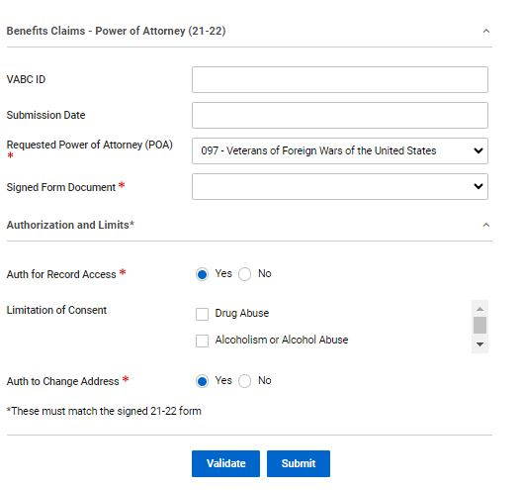
Submitting Forms Directly into VBMS POA(21-22)
The POA(21-22) button takes the user to a page where they can attach a TVB Created, Marked As Signed 21-22 directly to VBMS.
*Please note for those who have multiple accreditations to select the correct POA *

Slide 44
Submitting Forms Directly into VBMS POA(21-22)
The page contains required fields such as POA, Signed Form Document and Authorizations and limits.
Signed Form Document has a dropdown box that will populate with the claim form that was generated and Marked As Signed in TVB

Slide 45
Submitting Forms Directly into VBMS POA(21-22)
With all required fields addressed, click submit to Submit the form to VBMS.
*Please note that the Authorization and limits on the signed 21-22 MUST MATCH the boxes displayed on the page. *

Slide 46
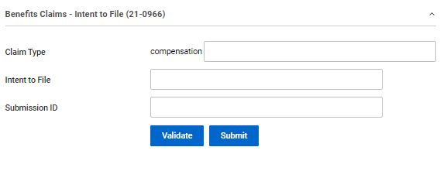
Submitting Forms Directly into VBMS ITF (21-0966)
To submit an ITF a TVB claim must be created.
With the Claim created select ITF (21-0966) which takes the user to the ITF screen.

Slide 47
Submitting Forms Directly into VBMS ITF (21-0966)
Press Validate to confirm POA with VA, TVB will provide a message that says valid if good or an error message that will need to be corrected.
After confirmation press submit
TVB will populate the previously empty boxes with:
Claim Type
Intent to File Date of Submission
Submission ID (confirmation number)

Slide 48
Submitting Forms Directly into VBMS 21-526EZ
TVB does have the ability to submit the 21-526EZ form directly to VA however this feature has more require more steps that other methods and has a higher rate of claim failure than the others.
Due to these issues NVS does not recommend using this feature.

Slide 49
Questions?

