Slide 1

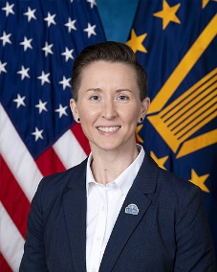
Department of Veterans Affairs Update
Kristina Messenger

Slide 2

U.S. Department of Veterans Affairs
Veterans Benefits Administration
Veterans of Foreign Wars
2024 NVS Accredited Service Officer Skill Level Training Conference
September 22, 2024

Slide 3
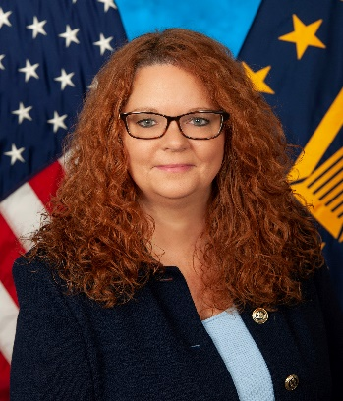
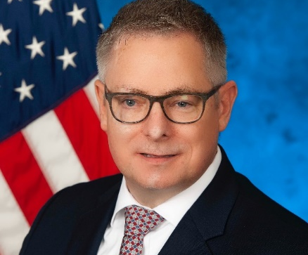
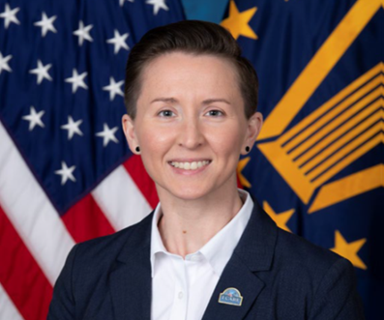
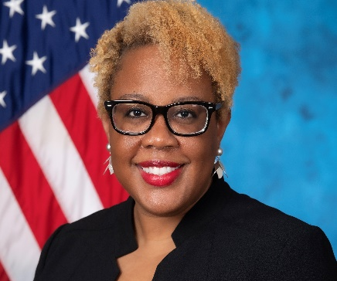
Compensation Service Leadership Team
Beth Murphy
Executive Director
James Smith
Deputy Executive Director, Policy and Procedures
Kristina Messenger
Deputy Executive Director, Operations
Jocelyn Moses
Senior Principal Advisor

Slide 4
Mission & Vision
Compensation Service Mission Statement
Guide and support the high-quality work of Veterans Benefits Administration’s (VBA’s) 56 Claims processing offices in administering disability compensation benefits and services.
Compensation Service Vision Statement
Optimize delivery of Veterans’ benefits through customer-focused program modernization, supporting field consistency with oversight resources and harnessing innovative solutions through guidance and evidence-based policymaking.
Operations Vision Statement
To ignite a culture of excellence through innovative and strategic solutions​.

Slide 5
Disability Compensation
VBA’s Compensation program provides monthly benefits to Veterans in recognition of the effects of disabilities, diseases, or injuries incurred or aggravated during active military service.
Disability Compensation Overview:
Tax-free benefit paid to eligible Veterans with service-related disabilities and with a discharge given under conditions other than dishonorable
Benefit amount determined by severity of condition(s)
Delivered over $130B in benefits to more than 5.6 million Veterans in 2023
FY24 Program Highlights:
Updated digestive rating criteria in VA Schedule for Rating Disabilities (VASRD) and published final rule to improve bilateral factor calculations
Published final rule to amend character of discharge determinations regulation, removing one of the bars to benefits and adding a compelling circumstances exception
Updated VBA policy letter for PACT Act implementation, along with associated guidance and training
Supported implementation of section 103 of the PACT Act for healthcare eligibility for toxic exposed Veterans
Published Active Service pay rule to ease burden on Veterans who return to active duty or earn drill pay
Launched initiatives to update Veteran notification letters and modernize national training program for new claims processors

Slide 6
CS Overview - Policy and Procedures
Responsible for creating and maintaining policy and procedures related to the disability claim process through legislation, regulations, prescribed forms and agency guidance.
Policy
Procedures and Interagency/Military Pay
Manages the M21-1 Adjudication Procedures Manual. Collaborates with stakeholders on numerous data sharing and computer matching agreements and acts as a conduit between DoD and VBA for all issues pertaining to military pay, retired pay and dual compensation.
Military Exposures Team
Compensation Services newest staff, established to assist with implementing and reporting requirements identified in the PACT Act regarding military environmental exposures and the Secretary’s presumptive process.
Responsible for researching, drafting, publishing, and processing regulatory amendments to title 38 of the Code of Federal Regulations (CFR), to include but not limited to, Part 4 and providing policy recommendations to senior leadership. Also leads VA’s efforts on the Earning Loss Studies and on GAO’s High Risk List (VASRD) remediation actions.
VASRD Program Management Office

Slide 7
CS Overview - Operations
Training
Provides new and seasoned employees with training tools and resources to be successful in fulfilling VA’s mission of serving Veterans and their dependents
Administers national quality assurance program for rating and non-rating. Conducts specialized reviews determined by leadership but could be initiated due to external interest from Congress, GAO or OIG.
Quality
Enables responsive, timely and compassionate delivery of disability benefits and services to Veterans and their families through development and maintenance of business line software, systems and data. Provides program oversight through regional office site visits.
Systems Support and Operation Review
Formulates and oversees execution of Compensation Service’s operating budget and prepares annual compensation budget narrative. Responsible for travel oversight and timekeeping and provides Federal contract management support.
Budget and Shared Services

Slide 8
CS Overview – Senior Advisor Staff
Serves as the link between the Department of Defense, partner agencies and VA to ensure transitioning servicemembers and Veterans have access to the benefits and services they have earned. Develops and administers programs designed to connect the Transitioning Service Member to VA through the VA-DoD Integrated Disability Evaluation System (IDES) Program and the Benefits Delivery at Discharge (BDD) Program. Administers and provide guidance training, oversight and support the field in execution of Pre-Discharge Programs
Pre-Discharge Programs
Facilitates engagement with external audits reviewing the disability compensation program. As of September 9, 2024
24 pending OIG Reports or reviews in progress
7 pending GAO Reports or reviews in progress
2 pending OAWP Reports or reviews in progress
24 Open OIG/GAO/OAWP recommendations
6 OIG/GAO/OAWP reports closed in FY24
OIG/GAO Stakeholder Engagement
Develop and manage service-wide enterprise risk management strategies and mitigations for the disability compensation program to include compliance with the Payment Integrity and Information Act of 2019.
Internal Controls & Risk Management

Slide 9
CS Initiatives
Regulations
Character of Discharge
Exposures
VSignals CX Surveys
Veteran Experience feedback from survey responses and sampling of follow up phone calls
Updated Notification Letter based on feedback
Trends: Exams, assistance to understand claims process
Disability Compensation survey launched April 2023. Began with initial, first-time filers then-
Supplemental Claim survey launched July 2021
Expanded to claims for increase and new conditions in January 2024
Will be using the customer experience data and insights to develop and implement action plans to improve the Veteran’s experience.
PACT Act implementation (radiation locations, Gulf War presumptives, Agent Orange presumptives)
VA Schedule for Rating Disabilities (VASRD)
14 body system reg packages
11 completed since 2017
Mental Disorders and Respiratory/Ear, Nose Throat pending at final rule stage
Neurological pending at proposed rule stage
Will be first wholesale update of VASRD since 1945 Schedule
Defining Toxic Exposure Risk Activity (TERA) to satisfy the needs/intentions of VBA and VHA
Individual Longitudinal Exposures Record (ILER) (Service Member/Veteran access, systems integration)
Delivering the annual and ad hoc requirements of the presumptive decision-making process with Veterans Health Administration Health Outcomes Military Exposures (HOME)
Military Exposures Team qualitative research projects
Disability claims data surveillance
Tracking the multi-layer governance and communications processes
Responding to stakeholder inquiries (ex radiation deep dive)
Engaging in formal evaluation process to consider adding urinary bladder and ureteral cancers as potential presumptive conditions due to burn pit/particulate matter exposures
Creating a process to intake and prioritize the multitude of incoming presumptives suggested by various sources

Slide 10
CS Initiatives (Con’t)
Training
Warrior Transition Advancement Course (WARTAC) - Skill bridge training program with DoD for transitioning SMs. In FY 24 WARTAC had 719 trainees.
Quality
Competency Based Training System (CBTS) Journey Level Training - went from blanket 40 hours of training to tailored training based on what employee needs after pre-test.
Virtual & In- Person Progression (VIP) Training - The VIP VSR and RVSR has incorporated PACT ACT and Automation training to the IWT and Classroom cohorts.
Pre-Discharge Programs
Electronic STR Transfer Process (eSTR) will allow VA to eliminate the requirement for active duty Service members to provide a copy of their STRs with their Benefits Delivery at Discharge (BDD) claim
Candidate Reviews of specific conditions processed using automation tools (in collaboration with Office of Automated Benefits Delivery.)
National Accuracy (August 2024)
Issue Based Rating Accuracy:
12-month rating benefit entitlement – 91.76%
3-month rating benefit entitlement – 92.15%
Goal 96%
Claim-based Non-Rating Accuracy
12-month non-rating benefit entitlement – 89.69% (goal 91.5%)
Military Service Coordinator (MSC) Symposium is a national training and collaboration event for MSCs and their coaches intended to improve customer service and the BDD and IDES Programs
Integrated Disability Evaluation System (IDES) Summit brings together IDES stakeholders from VA, DoD, and service branches to exchange ideas and best practices for strengthening the IDES Program

Slide 11
Disability Compensation Paid to Veterans
Compensation Service supported $136B in payments to Veterans in FY23
88% Growth
Billions
11

Slide 12
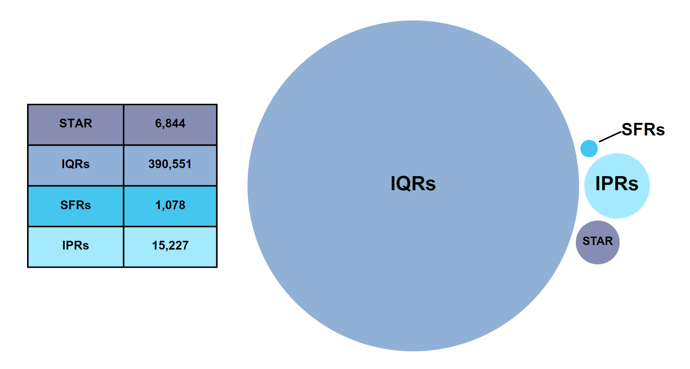
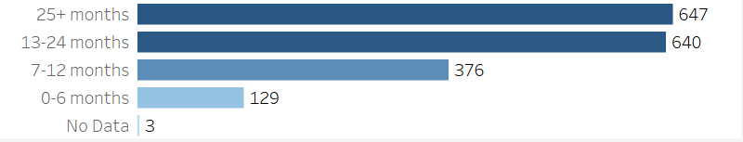
Quality Assurance Program Reviews
STAR: 6,844
IQRs: 390, 551
SFRs: 1,078
IPRs: 15,227
Top critical error descriptors in FY24
Insufficient VA exam/medical opinion
VA medical opinion was needed
Under-evaluation (general)
Liberalizing legislation misapplied
Level of Experience

Slide 13
Training Program Overview
Warrior Training Advancement Course (WARTAC)
Competency Based Training System (CBTS)
Virtual and In-Person Progression (VIP)
Training Modernization

Slide 14
Good To Know
Encourage Veterans and beneficiaries to be mindful of protecting themselves against identify theft and fraud. Remind them to safeguard their information and immediately report suspicion of personal information being compromised.
Manage the Veteran’s expectations.
Do not rush the process to preserve an effective date. Utilize the Intent to File (ITF).
Encourage claimants to read the correspondence in its entirety and respond to correspondence (i.e.., letters, examination notifications)
VA only recognizes compensation, pension, survivors, and related claims if they are submitted on the required standard forms. Additionally, the application must be signed by the claimant or other legally authorized individual on the application.
When a Veteran disagrees with a previous decision, they may file a supplemental claim. A supplemental claim must be filed on a VA Form 20-0995 and must identify or include potentially new evidence.
When submitting an original claim, be sure to include a voided personal check or deposit slip to avoid any delays in payment.
Assist in resolving issues that delay claim development:
Ensure the application is complete
Help claimant clarify claimed issues (if the VSO/NSO doesn't understand the condition, claims processors likely won't either)

Slide 15
Good To Know (Con’t)
A claim is not substantially complete if a Veteran alleges exposure to environmental or military occupational hazards during service but does not claim service connection for a specific disability. Exposure and MST in and of itself are not disabilities. When filing a claim, be sure to claim the disability associated with the exposure. For example: "PTSD - due to MST“. This will ensure proper routing to trained personnel.
When a Veteran claims a disability for a non-presumptive condition, the Claims Processor is required to review the file to determine if the Veteran participated in a Toxic Exposure Risk Activity (TERA). When determined that a Veteran participated in a TERA, an exam/medical opinion is ordered to determine if a nexus exists. These procedures apply even when the Veteran does not claim a condition as due to toxic exposure. All non-presumptive claims follow TERA procedures except conditions based on physical trauma, mental disorders, conditions determined to have no positive association with herbicide exposure (when herbicide is the only TERA) and claims for disabilities that manifested during military service or with an etiology not associated with toxic exposure.
Encourage Veterans to note any potential toxic exposure. Things change over the years and what is not considered a toxic exposure today may become one in the future as science evolves.
Character of Discharge (COD): Regulations have been liberalized and Veterans should be encouraged to reapply.
VA has added compelling circumstances to the regulatory bars of willful and persistent misconduct and moral turpitude and the statutory bar of absent without leave for more than 180 days.
VA has also removed the bar for aggravated homosexual acts.
Anyone who was previously denied eligibility for those are encouraged to reapply.

Slide 16
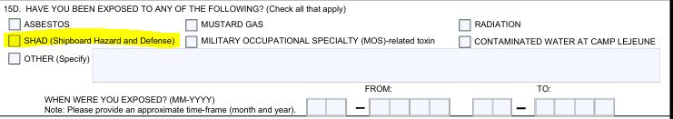
Good To Know (Con’t)
Section 15D of the 21-526 lists exposures the Veteran can claim. One check box is “SHAD (Shipboard Hazard and Defense). SHAD refers to a specific DoD chemical and biological weapons testing program conducted between 1962 and 1974. This box should not be checked to claim general hazards experienced while serving on a ship.

Slide 17
Compensation Service VBA Partners
Office of Field Operations – Deputy Under Secretary: Willie Clark
Responsibilities: Oversight of regional office field operations Tracking of disability claims inventory and workload projections Information Veteran specific disability claims
Medical Disability Examination Program Office - Executive Director: Jeffrey London
Responsibilities: Oversight of disability examination vendors and contracts |  | Email: VAVBAWAS/CO/21MDE
Office of Financial Management (OFM)- Executive Director: Lesheeco Graham
Responsibilities: | Budget preparation/execution Cost estimates (Bills, Legislative Proposals, etc.) Benefits paid- # of individuals and $ spent | Email: VAVBAWAS/CO24
Office of Performance and Integrity (PAI)- Executive Director: Elaine Saiz
Responsibilities: | Data related to beneficiaries receiving benefits, including for Congressional Inquiries Data Analytics Annual Benefits Report - https://www.benefits.va.gov/REPORTS/abr/ | Email: PAI.VBACO@va.gov
Outreach, Transition and Economic Development- Executive Director: Melissa Cohen (Acting)
Responsibilities: | VA’s Transition Assistance Program Transition Readiness Preparation Period (TRPP) Financial Literacy Economic Investment Initiatives Public Private Partnerships | Email: VAVBAWAS/COTED
Office of Business Integration (OBI)-Executive Director: Ray Tellez
Responsibilities: | IT Systems Veterans Benefits Management System (VBMS) Veterans Claims Intake Center (VCIP) Systems of Records Notification (SORNS) | Email: OBPI.VACO@va.gov
Pension and Fiduciary (P&F) – Executive Director: Nilijah Carter
Responsibilities: | Dependency and Indemnity Compensation (DIC) (surviving spouses) Aid and Attendance (A&A) increased monthly pension Death Pension and Accrued Benefits | Email: VAVBAWAS/CO/Pension&FiduciarySvc

Slide 18
Questions?

