Slide 1
VA Health Care
Katherine Cassell
Assistant Director, NVS

Slide 2
Objectives
Registration for VA health care for transitioning Service Members or new veterans
What to expect at the first visit to VA
How Service connection plays a role in health care
Priority Groups
Patient Advocate and their role
CHAMPVA for Service Member’s families
Foreign Medical Program

Slide 3
Registering for VA Health Care
Enrollment into VA health care is not automatic upon leaving service
Enroll by completing VA Form 10-10 (Application for Health Benefits)
Application methods
Phone: 877-222-8387
Mail: Health Eligibility Center, PO Box 5207, Janesville, WI 53547-5207
In-person at nearest VA facility
Online at va.gov
Trained professional (accredited service officer, claims agent, accredited attorney)
Process takes less than week for VA to make determination
Will receive a benefits package in mail
Clinic/PCM assignment

Slide 4
Expectations for First Visit to VA
What to bring
Verification of eligibility
Complete intake form with medical history
Medical assessment
Discuss concerns with VA provider
Establish a care plan based on eligibility and need
Share medical records
Benefits review & answer questions

Slide 5
How Service connection plays a role in health care
Eligibility for benefits
Service-connected condition that was caused or made worse due to active military service – VA required to provide care
Condition that has no connection to your time in service - VA not required to provide care
Establishes Priority of Care and Group assignment
Eight priority groups with category 1 is the highest
Used by VA to prioritize care for conditions incurred or aggravated while on active duty
Notes:
38 C.F.R. 17.36 is the governing authority for VA health care
VA disability compensation provides tax-free monthly payments.
Eligibility for benefits:
If a condition is deemed "service-connected," the veteran is eligible for VA disability compensation, which can include monthly payments depending on the severity of their disability.
Higher priority for care:
Veterans with service-connected disabilities are typically placed in a higher priority group for scheduling appointments and accessing VA healthcare services.
Proof of service connection:
To establish service connection, a veteran needs to provide medical evidence linking their current disability to an event or exposure that occurred during their military service.
Presumptive conditions:
In some cases, the VA may automatically presume that certain conditions, like exposure to Agent Orange, are service-connected based on a veteran's military service history.

Slide 6
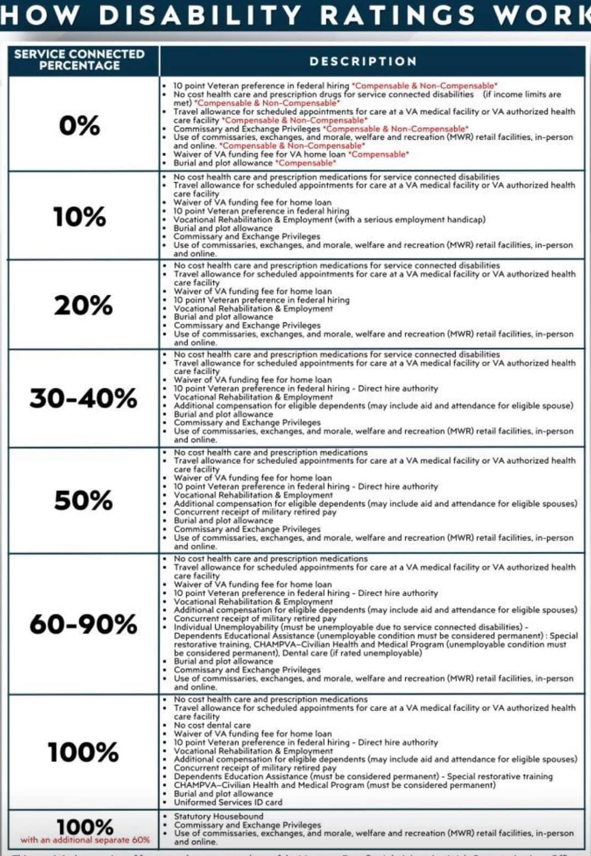
Service-Connected Benefits

Slide 7
Priority Groups
Notes:
What are VA priority groups and how do they affect me?
After we’ve processed your application and you’re enrolled in VA health care, we’ll assign you to 1 of 8 priority groups. Your priority group may affect how much (if anything) you’ll have to pay toward the cost of your care.

Slide 8
Priority Groups 1 & 2
Priority Group 1
Service-connected disability rated as 50% or more disabling, or
Service-connected disability that has been determined to make you unable to work (also called unemployable), or
Medal of Honor (MOH) recipient
Priority Group 2
Service-connected disability rated as 30% or 40% disabling

Slide 9
Priority Group 3
Priority Group 3
Former Prisoner of War (POW), or
Recipient of Purple Heart medal, or
Discharged for a disability that was caused by – or got worse because of – your active-duty service, or
Service-connected disability that we’ve rated at 10% or 20% disabling, or
You were awarded special eligibility classification under Title 38, U.S.C § 1151, “benefits for individuals disabled by treatment or vocational rehabilitation

Slide 10
Priority Group 4 & 5
Priority Group 4
Receiving VA aid and attendance or housebound benefits, or
Receiving a VA determination of being catastrophically disabled
Priority Group 5
Service-connected disability, or you have a non-compensable service-connected disability rated as 0% disabling, and you have an annual income level that’s below our adjusted income limits (based on your residential zip code), or
Receiving VA pension benefits, or
Eligible for Medicaid programs

Slide 11
Priority Group 6
We may assign you to priority group 6 if any of these descriptions are true:
You have a compensable service-connected disability that we’ve rated as 0% disabling, or
You participated in Project 112/SHAD, or
You served in World War II between December 7, 1941, and December 31, 1946, or
You served in the Persian Gulf War between August 2, 1990, and November 11, 1998, or
You served on active duty at Camp Lejeune for at least 30 days between August 1, 1953, and December 31, 1987

Slide 12
Priority Group 6 – cont.
We may assign you to priority group 6 if any of these descriptions are true:
You served in a theater of combat operations after November 11, 1998, and
You were discharged from active duty on or after October 1, 2013, and
You meet the minimum active-duty service requirement
*You’ll have 10 years of enhanced eligibility from the date of your discharge or release; after that you’ll be assigned to the highest priority group you qualify for.

Slide 13
Priority Group 6 Toxic Exposure Risk Activity (TERA)
We may assign you to priority group 6 if you were assigned to a duty station (including airspace above) in certain locations during specific periods:
On or after August 2, 1990, in Bahrain, Iraq, Kuwait, Oman, Qatar, Saudi Arabia, Somalia, or the United Arab Emirates, or
On or after September 11, 2001, in Afghanistan, Djibouti, Egypt, Jordan, Lebanon, Syria, Yemen, Uzbekistan, or any other country that we determine is relevant

Slide 14
Priority Group 6 – Toxic Exposure Risk Activity (TERA)
We may assign you to priority group 6 if you were deployed in support of any of these operations:
Operation Enduring Freedom, or
Operation Freedom’s Sentinel, or
Operation Iraqi Freedom, or
Operation New Dawn, or
Operation Inherent Resolve, or
Resolute Support Mission

Slide 15
Priority Group 6 – Toxic Exposure Risk Activity (TERA)
We may assign you to priority group 6 if you were exposed to ionizing radiation in any of these ways:
During atmospheric testing, or
During the occupation of Hiroshima and Nagasaki, or
While conducting cleanup of Enewetak Atoll between January 1, 1977, and December 31, 1980, or
While participating in onsite response efforts in Palomares, Spain, between January 17, 1966, and March 31, 1967, or
While participating in onsite response efforts on Thule Air Force Base, Greenland between January 21, 1968, and September 25, 1968

Slide 16
Priority Group 6 – Toxic Exposure Risk Activity (TERA)
We may assign you to priority group 6 if you were exposed to Agent Orange and served in any of these locations and time periods:
The Republic of Vietnam between January 9, 1962, and May 7, 1975, or
Thailand at any United States or Royal Thai base between January 9, 1962, and June 30, 1976, or
Laos between December 1, 1965, and September 30, 1969, or
Cambodia at Mimot or Krek, Kampong Cham Province between April 16, 1969, and April 30, 1969, or
Guam or American Samoa or in the territorial waters off of Guam or American Samoa between January 9, 1962, and July 31, 1980, or
Johnston Atoll or on a ship that called at Johnston Atoll between January 1, 1972, and September 30, 1977

Slide 17
Priority Group 7 & 8
Priority Group 7
Your gross household income is below the geographically adjusted income limits (GMT) for where you live, and
You agree to pay copays
Priority Group 8
Your gross household income is above VA income limits and geographically adjusted income limits for where you live, and
You agree to pay copays
Notes:
Review the criteria for the priority 8 subgroups:
You may be eligible for VA health care benefits if we place you in one of these subpriority groups:
Subpriority group a
All of these must be true:
You have a non-compensable service-connected condition that we’ve rated as 0% disabling, and
You enrolled in the VA health care program before January 16, 2003, and
You have remained enrolled since that date and/or were placed in this subpriority group because your eligibility status changed
Subpriority group b
All of these must be true:
You have a non-compensable service-connected condition that we’ve rated as 0% disabling, and
You enrolled in the VA health care program on or after June 15, 2009, and
You have income that exceeds current VA or geographical limits by 10% or less
Subpriority group c
All of these must be true:
You don’t have a service-connected condition, and
You enrolled in the VA health care program as of January 16, 2003, and
You have remained enrolled since that date and/or were placed in this subpriority group because your eligibility status changed
Subpriority group d
All of these must be true:
You don’t have a service-connected condition, and
You enrolled in the VA health care program on or after June 15, 2009, and
You have income that exceeds current VA or geographical limits by 10% or less
You’re not eligible for VA health care benefits if we place you in one of these subpriority groups:
Subpriority group e
All of these must be true:
You have a non-compensable service-connected condition that we’ve rated as 0% disabling, and
You don’t meet the criteria for subpriority group a or b above
Note: You’re eligible for care for your service-connected condition only.
Subpriority group g
All of these must be true:
You don’t have a service-connected condition, and
You don’t meet the criteria for subpriority group c or d

Slide 18
Patient Advocate

Slide 19
Patient Advocate and their Role
Available at every VA Medical Center
Highly trained professionals who can help resolve concerns about aspects of your health care experience
Listen to questions, problems, or special needs you may have
Refer concerns to appropriate staff for resolution, assist in filing an appeal for a review of your concern
Particularly those that cannot be resolved at the point of care
Oversight of VHA Benefits programs
Positive/Negative feedback to VA via their website at “Ask VA” (https://ask.va.gov/)
Notes:
We want to provide you with world-class Veteran customer service, and this is just one important way in which we do that!
If you have a compliment, suggestion or concern regarding your care, first speak with your treatment team. Your treatment team includes your doctor, nurse, social worker, dietitian, pharmacist, chaplain, therapist and other professionals associated with your medical care. If you feel your concerns are not being addressed by your treatment team, you may contact a VA Patient Advocate. A Patient Advocate is an employee who is specifically designated at each VHA facility to manage the feedback received from veterans, family members and friends. The Patient Advocate works directly with management and employees to facilitate resolutions.
If a veteran has a complaint:
Concerns should always be addressed with the Primary Care team first;
If unresolved, they should speak with the individual’s supervisor or Chief of Service;
If still unresolved, contact the Patient Advocate and request resolution to the concern.

Slide 20
CHAMPVA

Slide 21
What is CHAMPVA
Civilian Health and Medical Program of the Department of Veterans Affairs (CHAMPVA):
37 CFR 17.270 is the governing regulation
ChampVA is not an insurance plan, it is a cost share program in which VA shares the cost of covered health care services and supplies with eligible beneficiaries.
Affordable Care Act (ACA) designates CHAMPVA as fulfilling minimum essential coverage requirements
TRICARE
VA Health Care
Notes:
CHAMPVA & DOD TRICARE programs are very similar and are often mistaken for each other:
Tricare is a DOD regionally managed health care program for active duty and retirees and members of the uniformed services and their families
In some cases, a veteran may appear to be eligible for both programs, however if you are a military retiree, or the spouse of a veteran who was killed in action, you are and will always be a TRICARE beneficiary and cannot choose between the two programs.

Slide 22
CHAMPVA Eligibility
Spouse or child of a Veteran who has been rated by VA as having a permanent and total service-connected disability, or
Surviving spouse or child of a Veteran who died from a VA-rated service-connected disability, or
Surviving spouse or child of a Veteran who was at the time of death rated permanently and totally disabled from a service-connected disability, or
Surviving spouse or child of a service member who died in the line of duty, not due to misconduct*,
Notes:
A service-connected disability is a disability that we’ve concluded was caused, or made worse, by the Veteran’s active-duty service. Example: my elbow.
A permanent disability is one that’s not expected to improve. Can someone provide an example of a condition that may be classified as permanent?
If 2 spouses are both Veterans who qualify as CHAMPVA sponsors for their family, they both may now qualify for CHAMPVA benefits. Each time they need medical care, they may choose to get care through the VA health care program or using their CHAMPVA coverage.
Eligible child pursing an approved course of instruction who incurs a disabling illness/injury while pursing the instruction, not of their own misconduct, and results in the inability to continue instruction
*In most cases, these family members qualify for TRICARE, not CHAMPVA
A surviving family member would typically receive CHAMPVA instead of TRICARE if the deceased veteran was rated 100% disabled due to a service-connected disability at the time of death, meaning they died from a service-connected issue, and the surviving family member is not otherwise eligible for TRICARE; essentially, CHAMPVA is the option when a veteran's death is service-related and they do not qualify for TRICARE benefits

Slide 23
How to Apply for CHAMPVA
Required Documents:
VA Form 10-10d (Application for CHAMPVA Benefits
VA Form 10-7959c (CHAMPVA – Other Health Insurance (OHI) Certification
Copy of Medicare card for individuals who are eligible
Optional Documents: (copies only)
VBA decision showing permanent and total status, or death rating
Veteran’s DD-214(Certificate of Release of Discharge from Active Duty)
Proof of Dependents
Marriage license, birth certificates, 18-23 years school certification for full-time enrollment (original)
Notes:
For individuals who are eligible for Medicare for any reason, we need a copy of your Medicare card.
If you are age 65 or older and not entitled to Medicare, you must send documentation from the Social Security Administration that confirms you are not entitled to Medicare benefits under anyone's social security number.
Veteran's DD214, Certificate of Release or Discharge from Active Duty, or if the Veteran was a WWII or Korean War Veteran, the Report of Separation. If you do not have a copy of the necessary form, you may request it by submitting a Standard Form 180, Request Pertaining to Military Records, from the National Archives.
The new DD Form 214-1, or Certificate of Uniformed Service, Reserve Component Addendum, is expected to be fully implemented by February 2025. This form will be issued to all members of the National Guard and Reserve who separate or retire from service.
If you are a remarried widow/widower and are once again single, provide a copy of the legal documentation that terminated the remarriage. The legal documentation of termination of a remarriage may be a divorce decree, death certificate or annulment decree.
If you provide only the required documents, and not the optional documents, processing can take two to eight months since we have to confirm information with other federal agencies.
Once we get your application, we will review it to be sure it is complete and that all the required forms are included. If your application is not complete, we will return it to you with further instructions.
IMPORTANT: Ensure the application is signed and dated. Also, if applying for a spouse, please include the date of marriage on the application
We are currently experiencing a backlog in processing applications. If you have questions regarding the status of your application, we encourage you to call the CHAMPVA call center at 800-733-8387.
If you send us all required and optional documents—and if your application is complete—it’ll take about 6 weeks after we get your package until you get your CHAMPVA ID card and related materials.
If you send us only the required documents, it may take 2 to 8 months since we’ll need to confirm your information with other federal agencies.

Slide 24
How to Apply for CHAMPVA
Mail your application, and associated documents, to:
VHA Office of Community Care
CHAMPVA Eligibility
PO Box 469028
Denver, CO 80246-9028
Or fax your forms: 303-331-7809
Notes:
IMPORTANT: Ensure the application is signed and dated. Also, if applying for a spouse, please include the date of marriage on the application
We are currently experiencing a backlog in processing applications. If you have questions regarding the status of your application, we encourage you to call the CHAMPVA call center at 800-733-8387.
If you send us all required and optional documents—and if your application is complete—it’ll take about 6 weeks after we get your package until you get your CHAMPVA ID card and related materials.
If you send us only the required documents, it may take 2 to 8 months since we’ll need to confirm your information with other federal agencies.

Slide 25
Foreign Medical Program
Notes:
38 CFR 17.35

Slide 26
What is the Foreign Medical Program
Furnishes care to veterans for service-connected disabilities who are living outside USA
A condition that aggravates a service-connected disability
The veteran participates in the Veteran Readiness and Employment (VR&E) program, the VA may pay for care for other conditions.
Community Care Program strictly for the veteran
Telehealth is not an option for this program
Prescription medications approved by FDA are covered
You can use FMP only for care you get in a foreign country. It won’t cover care or supplies you get in or from the U.S. or U.S. territories.
Notes:
Travelers do not need to notify FMP prior to travel, contact FMP if an issue arises
Upon relocation and establishment of permanent mailing address (foreign) notify VHA IVC
FMP & TRICARE can not be used together
No, you cannot use both FMP and TRICARE at the same time. FMP and their dependents are not eligible to enroll in TRICARE Prime, TRICARE Prime Remote, TRICARE Young Adult, or to purchase dental coverage under the TRICARE Dental Plan.
However, you can have both TRICARE and Federal Employees Health Benefits (FEHB) coverage if you're a TRICARE For Life beneficiary or enrolled in a TRICARE Prime plan option.
Active duty service members can use other health insurance (OHI) under certain circumstances, but TRICARE won't be a second payer. This means there's no coordination of benefits between your OHI and TRICARE. You're responsible for all costs.
Not all countries recognize FDA guidelines or have further laws banning certain medications
For claims that result in a payment, we’ll send you a U.S. Treasury check.
You can choose any licensed health care provider in the foreign country where you live or travel. You don’t need a referral.
EFT Updates
Veterans: Domestic (US) accounts: Jan – Mar 2025; Foreign accounts: Jan – Mar 2026
Prescription medications approved by FDA are covered
Not all countries recognize FDA guidelines or have further laws banning certain medications
FMP Enterprise Eligibility Software Modernization Updates – FY25 Q2
Program Registration - Modernization
Claim Submission – Form updates and digitization
*VFW Resolution # 610 – FMP Reform; Possible other resolution if suitable action to systems are not improved
**VFW Accredited Service Officer imbedded in Europe

Slide 27
How to Apply for FMP
VA Form 10-7959f-1 (Foreign Medical Program (FMP) Registration form
Submit form
Online through ASK VA (https://ask.va.gov)
By mail: VHA Office of Integrated Veteran Care (OIVC)
Foreign Medical Program (FMP)
P.O. Box 469061
Denver, CO 80246-9061
By Fax: 303-331-7803
Notes:
Travelers do not need to notify FMP prior to travel, contact FMP if an issue arises
Upon relocation and establishment of permanent mailing address (foreign) notify VHA IVC
Not all countries recognize FDA guidelines or have further laws banning certain medications
What to expect after you register
We’ll send you a benefits authorization letter. This letter will list your service-connected conditions that we’ll cover. Then you can file FMP claims for care related to the covered conditions.
You can use FMP only for care you get in a foreign country. We won’t cover care or supplies you get in or from the U.S. or U.S. territories.
For claims that result in a payment, we’ll send you a U.S. Treasury check.
EFT Updates
Veterans: Domestic (US) accounts: Jan – Mar 2025; Foreign accounts: Jan – Mar 2026
Prescription medications approved by FDA are covered
Not all countries recognize FDA guidelines or have further laws banning certain medications
FMP Enterprise Eligibility Software Modernization Updates – FY25 Q2
Program Registration - Modernization
Claim Submission – Form updates and digitization
*VFW Resolution # 610 – FMP Reform; Possible other resolution if suitable action to systems are not improved
**VFW Accredited Service Officer imbedded in Europe

Slide 28
WHO TO CONTACT FOR HELP
If you are working with a veteran who needs assistance with their healthcare needs, first try to resolve the issue using local resources such as the patient advocate or Chief of Service.
If unsuccessful, the VFW Healthcare Team may be able to help.
Katherine Cassell
Assistant Director,
Veteran Health Policy
(202) 608-8371
Kcassell@vfw.org
Julie Holt
Special Assistant
Veteran Health Policy
(202) 608-8364
Jholt@vfw.org
Marion Fera
Health Consultant
Veteran Health Policy
(202) 608-8349
mfera@vfw.org

Slide 29
Are there any questions?
Notes:
VFW since 2019

