Slide 1

Center for Minority Veterans

Slide 2
Center for Minority Veterans (CMV)
Who We Are: The Center for Minority Veterans (CMV) is an office within the Department of Veterans Affairs dedicated to ensuring that minority Veterans receive equitable access to VA services and benefits.
Our Mission: CMV advocates on behalf of minority Veterans by promoting awareness of VA programs and addressing the unique needs of minority populations, including African American, Hispanic, Asian American, Pacific Islander, Native American, and LGBTQ+ Veterans.
The Center for Minority Veterans (CMV) was established by Public Law (PL) 103-446 on November 2, 1994, in response to low utilization of VA benefits and services* by minority Veterans.
PL 103-446 defines "minority group member" as a Veteran who is:
Asian American;
Black;
Hispanic;
Native American (including American Indian, Alaskan Native, and Native Hawaiian); or
Pacific-Islander American

Slide 3
CMV Organizational Structure & Team
James Albino
Executive Director
Carl McPherson
Staff Assistant
Debra Walker
Deputy Director
Minority Veterans Program
Advocacy/Engagement/ Outreach
Research and Data
Carmen Drummond
Minority Veterans Program Manager / Hispanic Veterans Liaison
Dwayne Campbell
African American Veterans Liaison
VACANT
Research and Data Liaison
D’Andrea Jacobs
Hispanic Veterans Liaison
Gregorio Kishketon
American Indian Veterans Liaison
Ron Sagudan
Native Hawaiian, Asian American, Pacific Islander Veterans Liaison
3

Slide 4
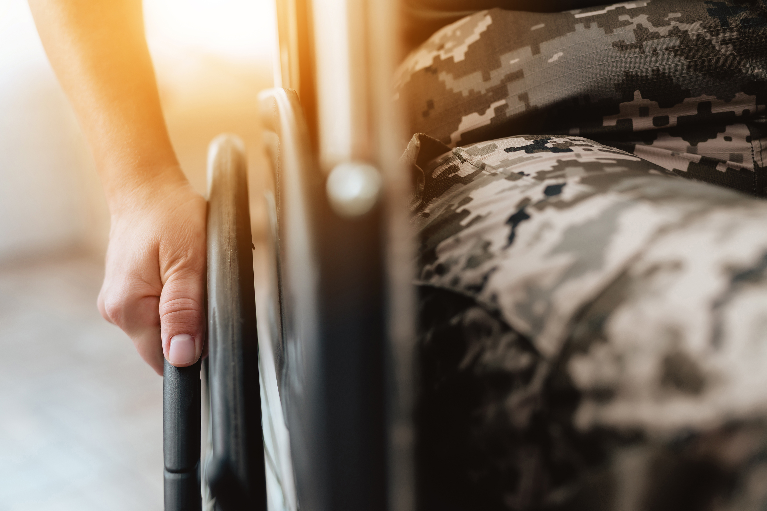
VA's Reach: Monthly Benefits
PACT Act Claims – 1.5 million
Monthly VA Benefits:
Disability Compensation: 5,993,022
GI Bill: 862,750
Line of Duty Survivors: 517,389
Pensioners: 235,977

Slide 5
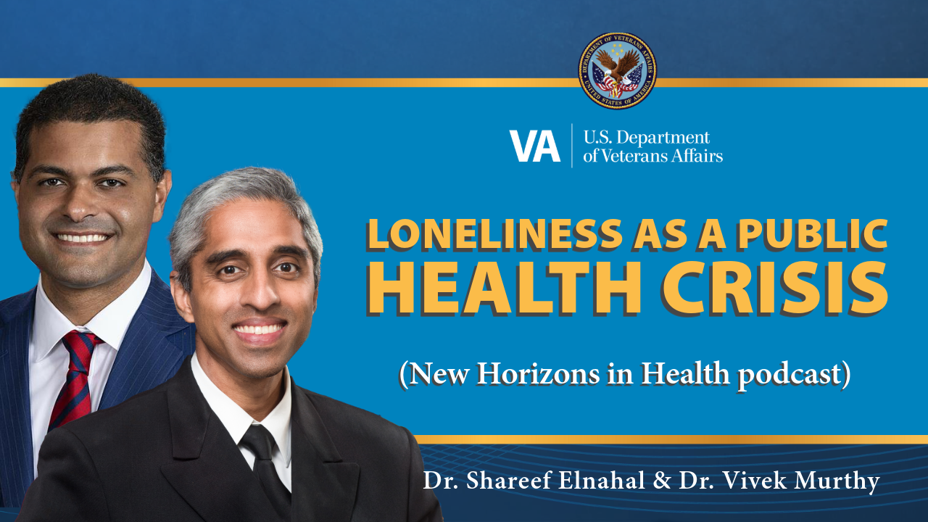
VA's Reach: Monthly Benefits
Introduction to Social Connection as a Determinant of Health

Slide 6
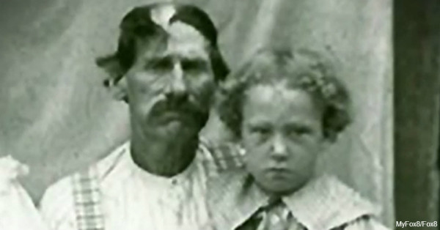
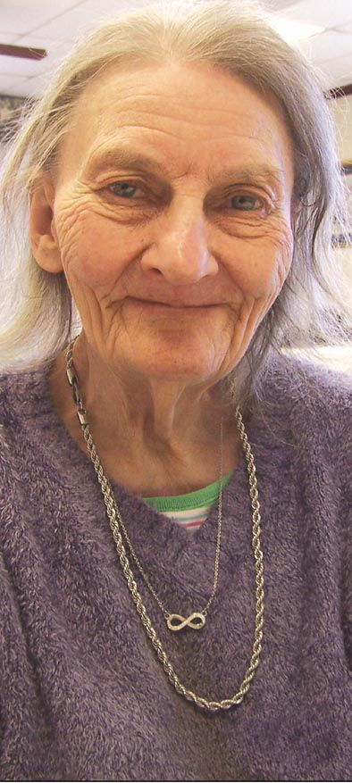
Did You Know?

Slide 7
Did You Know?
Irene Triplett

Slide 8
Rationale for Diversity Training
The Veteran population is evolving, becoming more diverse across racial, gender, and sexual identity lines (U.S. Department of Veterans Affairs, 2021).
Services must adapt to meet the unique needs of all Veterans, including those from marginalized communities (U.S. Department of Veterans Affairs, 2021).
Understanding how social determinants of health impact Veterans helps enhance the care and support you provide (Office of Health Equity, U.S. Department of Veterans Affairs, 2022).
Familiarity with the historical challenges faced by LGBTQ+ and minority Veterans improves your rapport and deepens your empathy (Kauth et al., 2019).
Building trust through inclusive communication practices, like using correct names and pronouns, can help Veterans feel safe accessing care and benefits (National LGBTQ Health Education Center, 2020).
By fostering inclusivity, you help prevent barriers to care, reduce disparities, and support suicide prevention efforts among at-risk Veteran populations (Blosnich et al., 2021; U.S. Department of Veterans Affairs, 2021).
Notes:
APA References:
Blosnich, J. R., Marsiglio, M. C., Gao, S., Gordon, A. J., Shipherd, J. C., Kauth, M. R., & Fine, M. J. (2021). Mental health of transgender Veterans in US states with and without nondiscrimination and anti-bullying policies. American Journal of Public Health, 111(2), 263–269. https://doi.org/10.2105/AJPH.2020.305978
Kauth, M. R., Meier, C., & Latini, D. M. (2019). LGBT Veteran health care: Understanding the intersection of multiple minority identities with the VA system. Journal of Gay & Lesbian Mental Health, 23(1), 1-13. https://doi.org/10.1080/19359705.2018.1524538
National LGBTQ Health Education Center. (2020). Affirmative health care for transgender and gender non-conforming people: Best practices for front-line health care staff. Fenway Institute. https://www.lgbtqiahealtheducation.org/
Office of Health Equity, U.S. Department of Veterans Affairs. (2022). Social determinants of health and minority Veterans. https://www.va.gov/HEALTHEQUITY/index.asp
U.S. Department of Veterans Affairs. (2021). National Veteran Suicide Prevention Annual Report. https://www.mentalhealth.va.gov/docs/data-sheets/2021/2021-National-Veteran-Suicide-Prevention-Annual-Report-FINAL-9-8-21.pdf

Slide 9
Exercise: Exploring Your Personal Identity
Cultural Characteristic | Power | Less Power
Age and Generational Influences | Adults | Children, adolescents, elders
Developmental Disability | Temporarily able-bodied | Individuals with disabilities
Disability Acquired Later in Life | Temporarily able-bodied | Individuals with disabilities (e.g., multiple sclerosis or dementia caused by stroke)
Religion and Spiritual Orientation | Christians | Non-Christians
Ethnicity/Race Identity | White or Caucasian | Persons of color
Socioeconomic Status | Owning and middle class (access to higher education) | People of lower status because of occupation, education, income, or rural habitat
Sexual Orientation | Heterosexuals | Gays, lesbians, and bisexual people
Indigenous Heritage | Non-native | Native
National Origin | U.S. born | Immigrants, refugees, and international students
Gender | Male | Women, transgender, and intersex people
Hays, P. A. (2001). Addressing Cultural Complexities in Practice: A Framework for Clinicians and Counselors. Washington, D. C.: American Psychological Association.
*Please note: The influences and examples of corresponding minority groups provided within the A.D.D.R.E.S.S.I.N.G. model are applicable within United States and Canada.
Notes:
15 minutes
Now, I’d like to take us through an experiential exercise. The goal of this exercise is to support self-reflection of how one’s own identities, life history, and individual differences may impact your work with Veterans. Additionally, the hope is that reflection of one’s own various identities can support awareness of intersectional identities of the Veterans you serve.
Instructions:
Review the ADDRESSING Model Framework you see on the screen. Examine how each cultural characteristic corresponds to your own identity. Take note of aspects of your identity that correspond with privilege or oppression.
Complete the following reflection statements:
The part of my identity that I am most/least aware of is:
The part of my identity that was most important to my birth family was:
The part of my identity that I would like to know more about is:
The part of my identity that I believe is the most misunderstood is:
The part of my identity that garners me the most privilege is:
The part of my identity that is difficult to discuss with others who identify differently is:
The part of my identity that makes me feel discriminated against is:
The part of my identity that I value most is:
If someone would like to really understand me, they should understand that:
In what ways do these aspects of your identity intersect and interact? How does social location impact your experience of your identity?

Slide 10
Exercise: Exploring Your Personal Identity
Instructions
Examine how each cultural characteristic corresponds to your own identity. Take note of aspects of your identity that correspond with more power or less power.
Complete the following reflection statements:
The part of my identity that I am most/least aware of is:
The part of my identity that was most important to my birth family was:
The part of my identity that I would like to know more about is:
The part of my identity that I believe is the most misunderstood is:
The part of my identity that garners me the most privilege is:
The part of my identity that is difficult to discuss with others who identify differently is:
The part of my identity that makes me feel discriminated against is:
The part of my identity that I value most is:
If someone would like to really understand me, they should understand that:
Cultural Characteristic | Power | Less Power
Age and Generational Influences | Adults | Children, adolescents, elders
Developmental Disability | Temporarily able-bodied | Individuals with disabilities
Disability Acquired Later in Life | Temporarily able-bodied | Individuals with disabilities (e.g., multiple sclerosis or dementia caused by stroke)
Religion and Spiritual Orientation | Christians | Non-Christians
Ethnicity/Race Identity | White or Caucasian | Persons of color
Socioeconomic Status | Owning and middle class (access to higher education) | People of lower status because of occupation, education, income, or rural habitat
Sexual Orientation | Heterosexuals | Gays, lesbians, and bisexual people
Indigenous Heritage | Non-native | Native
National Origin | U.S. born | Immigrants, refugees, and international students
Gender | Male | Women, transgender, and intersex people

Slide 11
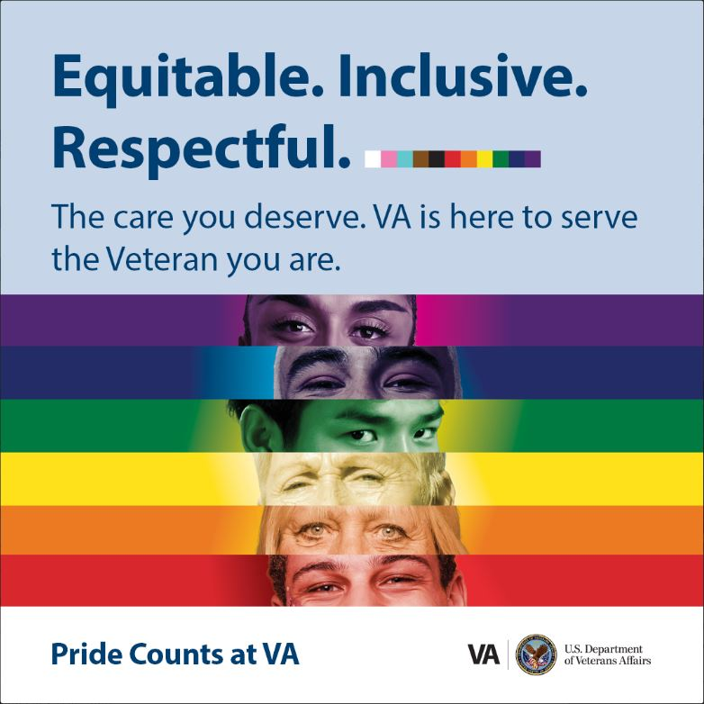
Practical Tips: How Do We Put LGBTQ+ Veterans at Ease?
Familiarize with Policies: Review VHA Directives 1340 and 1341 to understand protections for LGBTQ+ Veterans at VA.
Respectful Communication Do's:
Use the Veteran's preferred name and pronouns, even if different from legal records.
Use gender-neutral language (e.g., “Veteran” instead of “Mr./Ms.”).
Avoid assumptions about the gender of their partner(s).
Respectful Communication Don’ts:
Avoid making religious or moral comments about their identity.
Don’t use outdated or offensive terms like "homosexual" or "lifestyle" to refer to LGBTQ+ folks.
Demonstrate Allyship:
Display symbols of support, like a progress pride flag.
Share your pronouns openly.
Utilize Resources: Stay informed about VA services supporting LGBTQ+ Veterans.

Slide 12
LGBTQ+ Veteran Care and Services at VHA
Endocrinology
Speech and Language
Prosthetics
Fertility
Pre- and Post-Surgical Care
Enrollment/Registration (EMR changes for name and gender markers)
Laser Hair Removal
Support Groups
LGBTQ+ Veteran Care Coordinator (VCC)
PrEP/HIV Treatment and Prevention
VHA Directives 1340 and 1341
Resource for Providers: Gender-Affirming Care at VA
Notes:
APA References:
Bauer, G. R., Scheim, A. I., Pyne, J., Travers, R., & Hammond, R. (2015). Intervenable factors associated with suicide risk in transgender persons: A respondent-driven sampling study in Ontario, Canada. BMC Public Health, 15(525), 1-15. https://doi.org/10.1186/s12889-015-1867-2
Blosnich, J. R., Marsiglio, M. C., Gao, S., Gordon, A. J., Shipherd, J. C., Kauth, M. R., & Fine, M. J. (2021). Mental health of transgender Veterans in US states with and without nondiscrimination and anti-bullying policies. American Journal of Public Health, 111(2), 263–269. https://doi.org/10.2105/AJPH.2020.305978
Cantu, N. A., Robertson, M., Lane, E., & Shipherd, J. C. (2021). Mental health among transgender Veterans: The role of gender-affirming care. Psychological Services, 18(2), 208-216. https://doi.org/10.1037/ser0000433
Coleman, E., Radix, A. E., Bouman, W. P., Brown, G. R., de Vries, A. L. C., Deutsch, M. B., ... & Winter, S. (2022). Standards of care for the health of transgender and gender diverse people, version 8. International Journal of Transgender Health, 23(S1), S1-S259. https://doi.org/10.1080/26895269.2022.2100644
Downing, J. M., & Przedworski, J. M. (2018). Health of transgender adults in the U.S., 2014–2016. American Journal of Preventive Medicine, 55(3), 336–344. https://doi.org/10.1016/j.amepre.2018.04.045
James, S. E., Herman, J. L., Rankin, S., Keisling, M., Mottet, L., & Anafi, M. (2016). The report of the 2015 U.S. transgender survey. National Center for Transgender Equality. https://transequality.org/sites/default/files/docs/usts/USTS-Full-Report-Dec17.pdf
Shipherd, J. C., Mizock, L., Maguen, S., & Green, K. E. (2012). Male-to-female transgender Veterans and VA health care utilization. International Journal of Sexual Health, 24(1), 78-87. https://doi.org/10.1080/19317611.2011.639440
Turban, J. L., King, D., Carswell, J. M., & Keuroghlian, A. S. (2020). Pubertal suppression for transgender youth and risk of suicidal ideation. Pediatrics, 145(2), e20191725. https://doi.org/10.1542/peds.2019-1725
U.S. Department of Veterans Affairs. (2021). National Veteran suicide prevention annual report. https://www.mentalhealth.va.gov/docs/data-sheets/2021/2021-National-Veteran-Suicide-Prevention-Annual-Report-FINAL-9-8-21.pdf

Slide 13
Discharge Upgrades for LGBTQ+ Veterans
Historical Context of DADT: Enacted in 1993, DADT prohibited military service members from openly identifying as LGBTQ+, leading to over 14,000 discharges.
Reversal of DADT: The policy was repealed in 2011, allowing LGBTQ+ individuals to serve openly in the military.
Discharge Upgrade Eligibility: LGBTQ+ veterans discharged under DADT or earlier policies due to their sexual orientation may be eligible for discharge upgrades.
Correcting Military Records: Veterans can apply for a correction of their discharge status (e.g., from "other than honorable" to "honorable") to reflect their service accurately and equitably.
Benefits of Upgraded Discharges: An upgraded discharge can restore access to VA benefits, such as healthcare, GI Bill education benefits, and home loans.
Application Process: Go to How To Apply For A Discharge Upgrade | Veterans Affairs (va.gov)
Supporting Evidence: LGBTQ+ veterans should include evidence showing the discharge was based on DADT or related policies, such as service records, affidavits, or personal statements.

Slide 14
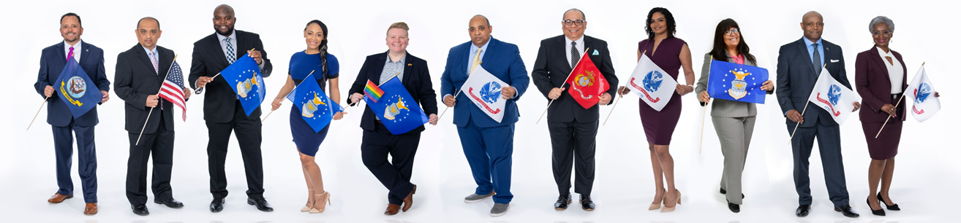
Diversity Beyond LGBTQ+
Minority Veteran Statistics
Description: This page provides data and resources about racial and ethnic disparities experienced by Veterans. It includes comparative health outcomes, tools, and information on health equity efforts.

Slide 15
Resources
Center for Minority Veterans (CMV)
https://www.va.gov/centerforminorityveterans/
Description: Provides information about CMV’s mission, programs, and initiatives for minority Veterans, including LGBTQ+ Veterans.
LGBTQ+ Health Care Program at VA
https://www.patientcare.va.gov/LGBT/index.asp
Description: Access to VA’s LGBTQ+ health care services, including policies, medical care options, and support for LGBTQ+ Veterans.
LGBTQ+ Veteran Health Care Handouts
https://www.patientcare.va.gov/LGBT/Resources.asp
Description: Printable resources and handouts related to LGBTQ+ Veteran healthcare services, such as gender-affirming care and mental health services.
Discharge Upgrades for DADT Veterans (VBA)
https://www.va.gov/discharge-upgrade-instructions/
Description: Guide from the VA Benefits Administration on how Veterans discharged under DADT or for their sexual orientation can apply for a discharge upgrade.
APA Guide on Inclusive and Affirming Communication
https://www.apa.org/about/apa/equity-diversity-inclusion/language-guidelines.pdf
Description: The American Psychological Association’s guide to inclusive and affirming language, helping professionals communicate respectfully with individuals from diverse backgrounds.
Informational YouTube Video: Aging as LGBT: Two Stories
https://www.youtube.com/watch?v=lkPJxQorieo
Description: A 2-minute video highlighting the unique challenges and potential psychosocial impacts faced by aging LGBTQ+ individuals, through two personal stories.
LGBTQ+ Veteran Care Coordinator (VCC) Program
https://www.patientcare.va.gov/LGBT/LGBT_Veteran_Care_Coordinator.asp
Description: Provides details on the role of VCCs, who assist LGBTQ+ Veterans with accessing tailored healthcare services and navigating VA resources, including mental health, gender-affirming care, and support services.

Slide 16
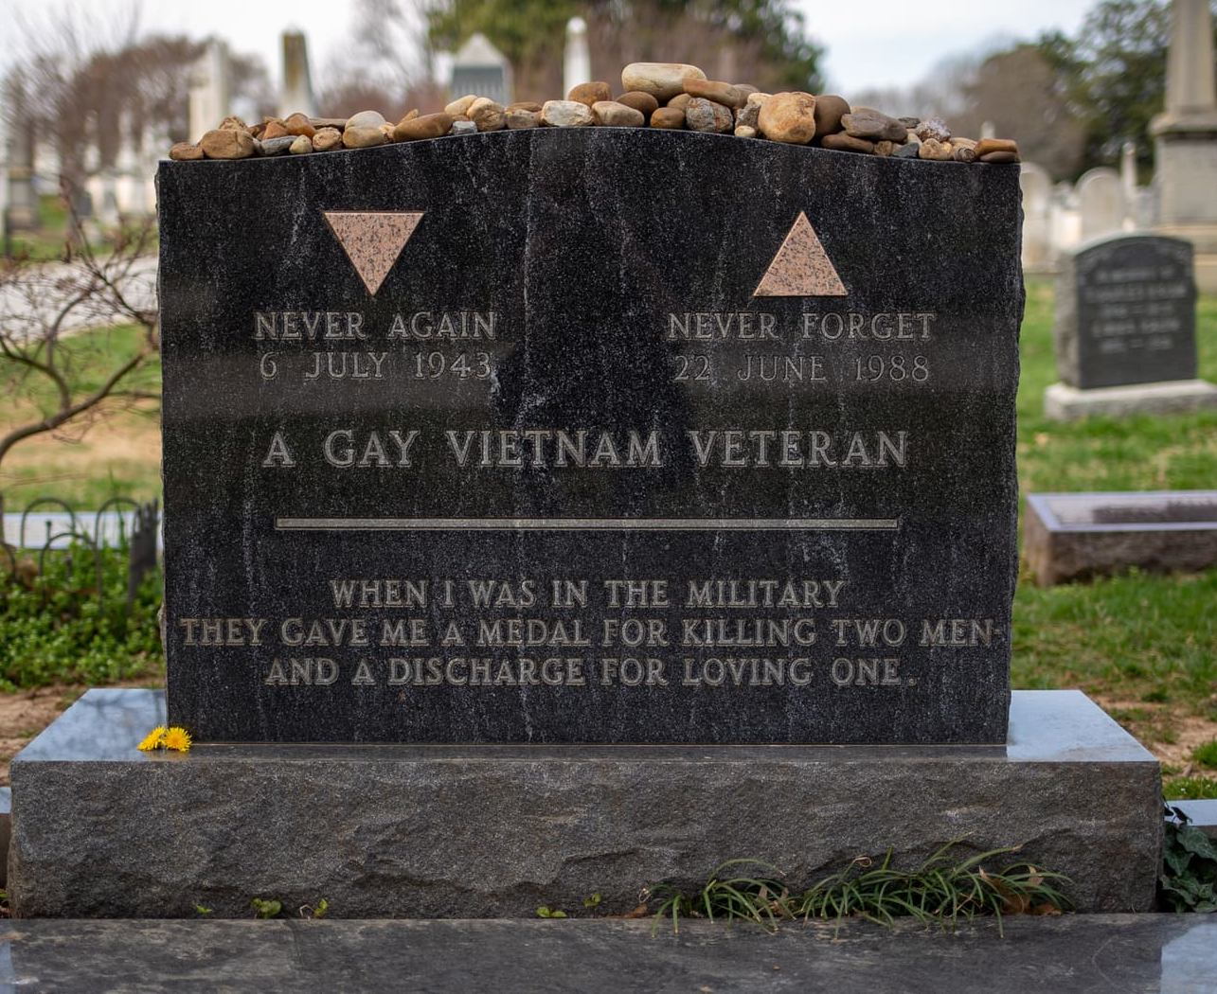
“When I was in the military they gave me a medal for killing two men and a discharge for loving one.”

Slide 17
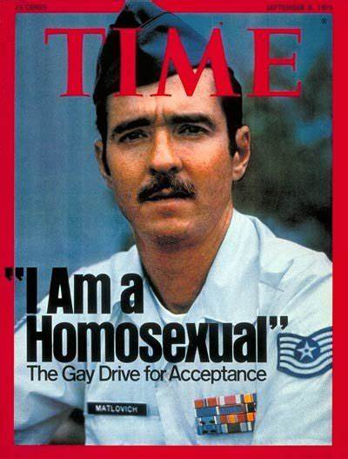
Sergeant Leonard Matlovich
Air Force Sergeant
Recipient of a Purple Heart and Bronze Star medals
The first U.S. service member to purposely out himself to challenge the military's ban on LGBT people
Appeared on the cover of Time in 1975

Slide 18
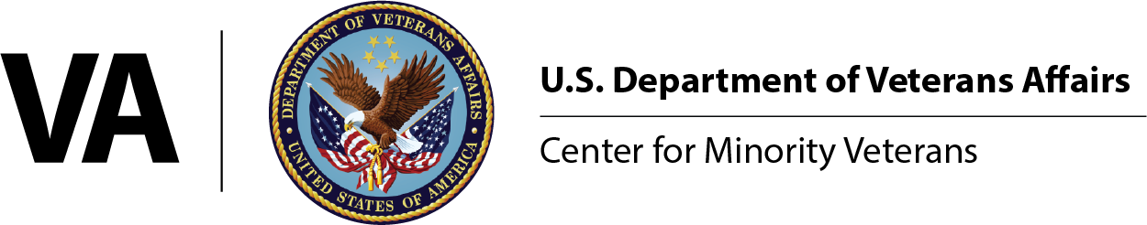
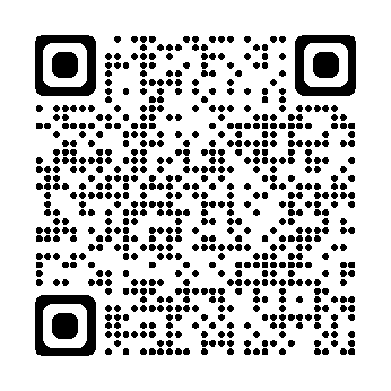



Connect with CMV
Scan our QR code to join our mailing list!
vacocmv@va.gov
(202) 461-6191 www.va.gov/centerforminorityveterans/

