Slide 1
Chapter 36 Benefits & Other VA Programs

Slide 2
Overview
What are Chapter 36 Benefits (Personalized Career Planning & Guidance)
How can Personalized Career Planning & Guidance (PCPG) assist a veteran
When should a veteran access PCPG?
VA Dental Insurance Program
Vet Centers for Counseling and Readjustment
Veteran-Owned Small Business – VetCert

Slide 3
What is PCPG or Chapter 36?
The Personalized Career and Planning Guidance program is a benefit that provides career counseling, assessment, education planning and guidance resources that are unique to each veteran.

Slide 4
How can PCPG Help a Veteran
Career Choice Assistance
Understand career options based on veteran interests and skills
Education/Career Counseling
Tailored training, education or employment plan.
Academic and Adjustment Counseling
Reintegrate to civilian/student life
Solutions and wats to overcome obstacles
Benefits Coaching
Help to use other benefits and resources effectively
Assistance with Resume Writing and Interviewing Skills

Slide 5
PGCP Eligibility
A veteran may be eligible for these services if one of these is true.
Will be discharged under conditions other than dishonorable from active duty within 6 months, or
Separated from active duty under conditions other than dishonorable not more than 1 year ago, or
Qualify as a Veteran or service member for educational assistance under a VA educational program, or
Currently a service member or Veteran currently eligible for VA education benefits

Slide 6
Dependent Eligibility
May be eligible for this benefit if they are using transferred education benefits
Transferred Post 9/11
Eligible under other VA education benefits like DEA

Slide 7
When Should a Veteran Access PCPG
Considering job or career options or going through employment changes
Facing obstacles in accessing education and employment opportunities
Ensuring your educational benefits are used in the best way possible
Interested in, or currently pursuing higher education
Transitioning from military to civilian life

Slide 8
Applying for PCPG
Apply online - https://www.va.gov/careers-employment/education-and-career-counseling/apply-career-guidance-form-25-8832/introduction
Apply by mail to the local VARO using a VA Form VBA-27-8832
Apply in person at the local VARO or VetSuccess On Campus (VSOC) office

Slide 9

VA Dental Insurance Program (VADIP)

Slide 10
What is VA Dental Insurance Program
The VA Dental Insurance Program (VADIP) offers discounted private dental insurance for Veterans and family members who meet certain requirements.

Slide 11
VADIP Eligibility
Veteran or family member may be eligible for VADIP if they meet one of these requirements.
You’re a Veteran who’s enrolled in VA health care, or
You’re the current or surviving spouse or dependent child of a Veteran or service member, and you’re enrolled in the Civilian Health and Medical Program of the VA (CHAMPVA)

Slide 12
VADIP What to Know
VADIP provides coverage throughout the United States and its territories, including Puerto Rico, Guam, the U.S. Virgin Islands, American Samoa, and the Commonwealth of the Northern Mariana Islands.
VADIP started as a temporary program. It’s now a permanent VA program with no end date.
Insurance carriers may offer separate coverage options for dependents who aren’t CHAMPVA beneficiaries

Slide 13
Types of dental care covered by VADIP, and how much will it cost?
VADIP plans cover many common dental procedures. These may include:
Diagnostic services
Preventive dental care
Root canals and other services to manage oral health problems and restore function (called endodontic or restorative services)
Dental surgery
Emergency dental care
Based on the plan selected by the veteran, they will pay:
The full insurance premium for each individual on your plan
Any required copays when they get care

Slide 14
Why should a Veteran consider VADIP
Some veterans enrolled in VA health care are eligible for free dental care from VA providers, many are not. Others may be eligible for free care for some, but not all, of their dental needs.
If a veteran is not eligible for free VA dental care, VADIP can help them buy private dental insurance at a reduced cost.
If they are eligible for free VA care for some of your dental needs, they can buy a VADIP plan if they want added dental insurance. Signing up for VADIP won’t affect Their ability to get free VA dental care.

Slide 15
VADIP Pilot Program
VADIP pilot program ran from 2013 to 2017
If a veteran was enrolled in the pilot program they will need to enroll again.
Veteran should be aware that plan options or fees may have changed in the current program.

Slide 16
VADIP Plan Providers
Delta Dental - https://feds.deltadentalins.com/vadip/
MetLife - https://www.metlife.com/vadip/

Slide 17

VA Vet Centers

Slide 18
VA Vet Centers
Vet Centers are community-based counseling centers that provide a wide range of social and psychological services, including professional readjustment counseling to eligible Veterans, active-duty service members, including National Guard and Reserve components, and their families.
Readjustment counseling is offered to make a successful transition from military to civilian life or after a traumatic event experienced in the military. Individual, group, marriage and family counseling is offered in addition to referral and connection to other VA or community benefits and services.
Vet Center counselors and outreach staff, many of whom are Veterans themselves, are experienced and prepared to discuss the tragedies of war, loss, grief and transition after trauma.

Slide 19
VA Vet Center Eligibility
Any Veterans and current service members, including members of the National Guard and Reserve components, are eligible if any of the following applies:
Have served on active military duty in any combat theater or area of hostility
Experienced a military sexual trauma (regardless of service era)
Provided mortuary services or direct emergent medical care to treat the casualties of war while serving on active military duty
Performed as a member of an unmanned aerial vehicle crew that provided direct support to operations in a combat theater or area of hostility
Accessed care at a Vet Center prior to Jan. 2, 2013, as a Vietnam-Era Veteran

Slide 20
Vet Center Eligibility (Continued)
Served on active military duty in response to a national emergency or major disaster declared by the president, or under orders of the governor or chief executive of a state in response to a disaster or civil disorder in that state
Are a current or former member of the Coast Guard who participated in a drug interdiction operation, regardless of the location
Are a current member of the Reserve Components assigned to a military command in a drilling status, including active Reserves, who has a behavioral health condition or psychological trauma related to military service that adversely effects quality of life or adjustment to civilian life.
Any veteran or service member pursuing a course of education using covered educational assistance benefits is eligible if they have a readjustment counseling need that is related to the individual's military service and hinders the individual's adjustment to either their civilian life, ongoing military service, or educational settings.

Slide 21
Vet Centers Services
Individual and group counseling for Veterans, service members, and their families
Family counseling for military related issues
Bereavement counseling for families who experience an active duty death
Military sexual trauma counseling and referral
Outreach and education including PDHRA, community events, etc.
Substance abuse assessment and referral
Employment assessment & referral
VBA benefits explanation and referral
Screening & referral for medical issues including TBI, depression, etc.

Slide 22
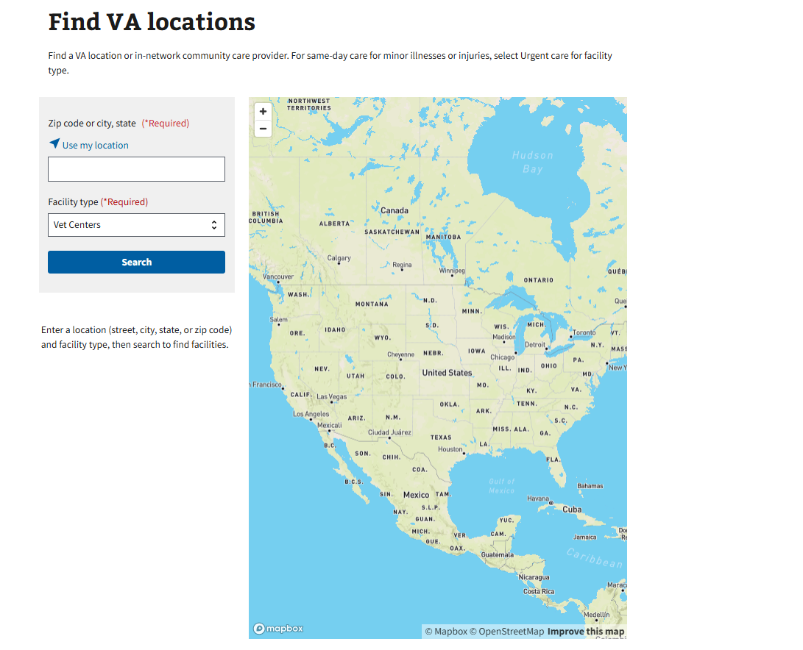
Vet Center Locations & Contact
Find a Vet Center using the online directory
https://www.va.gov/find-locations/?facilityType=vet_center
Vet Center Call Center 877-927-8387

Slide 23

Veteran-Owned Small Business

Slide 24
Veteran-Owned Small Business
A Veteran-Owned Small Business, may qualify for advantages when bidding on government contracts—along with access to other resources and support—through the Veteran Small Business Certification program (VetCert).
VetCert is run by the U.S. Small Business Administration (SBA).
Registering through SBA will allow veterans to work with SBA (all businesses who work with VA must be registered)
Register via https://veterans.certify.sba.gov/

Slide 25
Benefits for Veteran Owned Small Business
Getting certified by SBA as veteran-owned (VOSB) makes the business eligible to compete for sole-source and set-aside contracts at the Department of Veterans Affairs (VA).
The VA sets aside at least 7% of its contracts each year specifically for certified VOSBs and SDVOSBs.
You can also compete for contracts under other qualifying socio-economic programs.
Access to SBA tools to prepare for federal procurement, connect with commercial supply chains, meet your local business community, purchase surplus federal property, access capital, and mitigate disaster damage.
All federal government purchases between $10,000 and $250,000 are automatically set aside for small businesses, as long as there are at least two companies that can provide the product or service at a fair and reasonable price.

Slide 26
Benefits for Service-Disabled Veteran-Owned Small Businesses
Getting certified by SBA as service-disabled veteran-owned (SDVOSB) makes the business eligible to compete for sole-source and set-aside contracts.
At least 5% of all federal contracting dollars each year are set aside specifically for certified SDVOSBs.
They can also compete for contracts under other qualifying socio-economic programs.
Access to SBA tools to prepare for federal procurement, connect with commercial supply chains, meet your local business community, purchase surplus federal property, access capital, and mitigate disaster damage.
All federal government purchases between $10,000 and $250,000 are automatically set aside for small businesses, as long as there are at least two companies that can provide the product or service at a fair and reasonable price.

Slide 27


