Slide 1
VFW Combat Tested Gaming

Slide 2
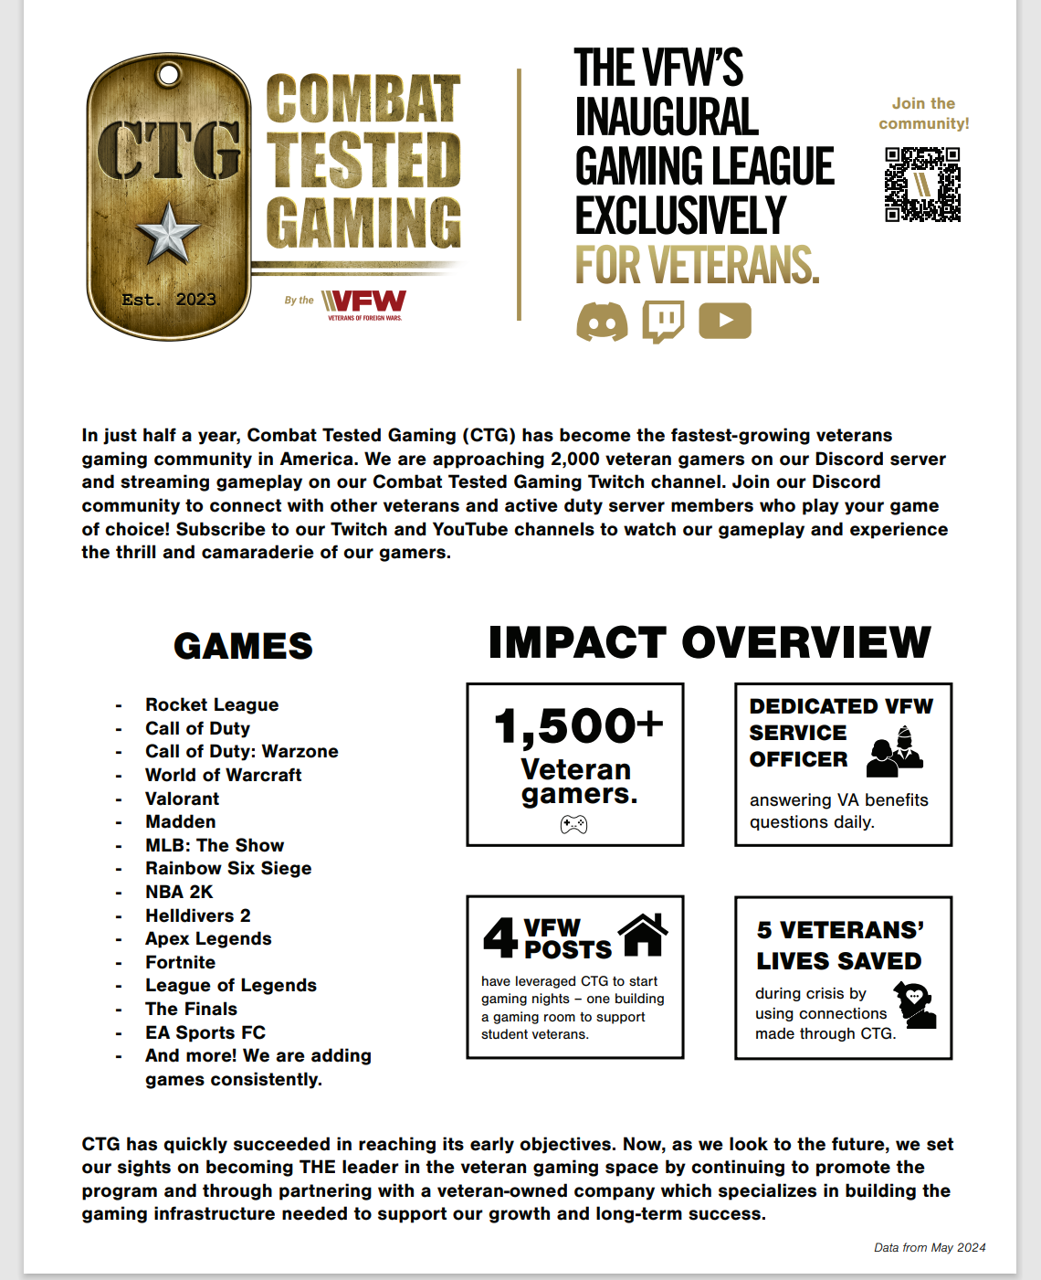
Combat Tested Gaming
The fastest-growing veterans-only gaming community
New market for us
Has already saved lives
Tournaments and league play
VA benefits questions
VFW resources
Emerging Technology

Slide 3
Purpose
The VFW has positioning itself to connect any active-duty service member, reserve component, national guardsman, and veterans to play video games to relieve stress, connect with friends, and have fun.
Video games have evolved significantly over the years, transforming from mere recreational activities to powerful tools that offer numerous benefits for individuals of all ages and backgrounds.
This VFW Program explores the positive impact video games can have on veterans, focusing on their mental health, social engagement, and skill development

Slide 4
Mission
The VFW E-Sports CTG promotes health, wellness, and comradeship through online gaming.
Esports and Gaming
The gaming industry is a $189.3B industry growing at a rate of 19.6%
2.3 billion people game worldwide
Esports revenue in 2019 was $1.1B with a 37% CAGR (Compound Annual Growth Rate)
Esports audience will be 500 M+ in 2021 with a CAGR of 11.3%

Slide 5
Video Games Enhancing Mental Health
Stress Reduction:
Immersive gameplay and escapism.
Mindfulness-based gaming and relaxation techniques.
Therapeutic Impact:
Addressing symptoms of post-traumatic stress disorder (PTSD).
Virtual reality (VR) exposure therapy

Slide 6
Promoting Social Engagement
Building Camaraderie:
Online multiplayer games.
Veterans-specific gaming communities.
Facilitating Communication:
Interacting with fellow veterans.
Bridging the gap between military and civilian populations.

Slide 7
Skill Development & Growth
Cognitive Abilities:
Increased problem-solving skills.
Enhanced attention and concentration.
Transferable Skills:
Teamwork and leadership.
Adaptability and strategic thinking.
Career Opportunities:
eSports and competitive gaming.
Game development and design

Slide 8
Considerations & limitations
Considerations and Limitations:
Addiction and Establishing Balance:
Ensuring responsible gaming habits.
Importance of establishing offline connections.
Accessibility and Inclusivity:
Addressing physical disabilities and limitations.
Expanding support for diverse populations.
Your Imagination- (Denton Post #2205)

Slide 9
VA Relationship
Absolutely Key
Relationships built- VR, Foreign Military groups, other gaming groups,

Slide 10
QUESTIONS?
Lynn W. Rolf III
816.968.1116
lrolf@vfw.org

