Slide 1
National Legislative Service
Kristina Keenan
Director

Slide 2
The Importance of
Legislative Advocacy
Impacts veterans and family members
  Veterans Preference
  GI Bill
  Toxic Exposures
Veteran benefits don’t just happen
  Stronger and better advocates together
Protect what we have secured
  Elimination of IU after reaching retirement age
  Round down of cost-of-living adjustment

Slide 3
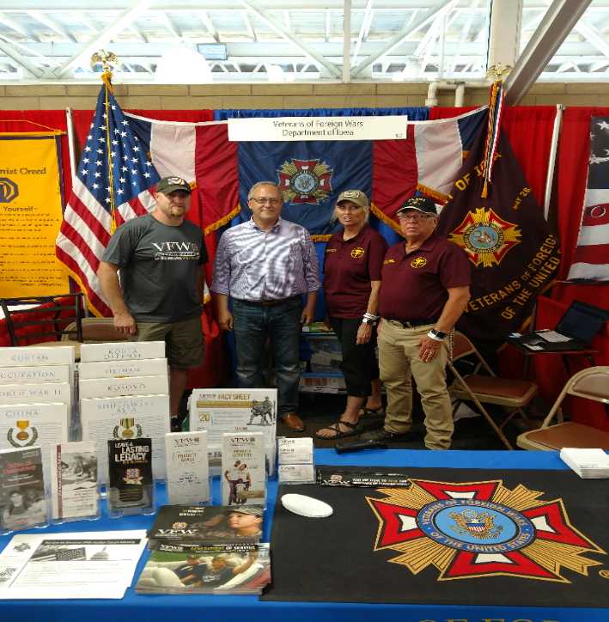
Make Legislative
Advocacy a Priority
All politics is local!
  Members of Congress
  care what their voters want
  Your perspective matters
  Know the VFW’s stance on issues
Work with National Legislative Committee Members
  Inform them about issues
  Every knowledgeable voice matters
Notes:
Know the members of Congress and US Senators from your state. Use your status and access to garner support for the VFW’s legislative priorities.
Election:
DO’s
Do attend candidate Town Hall Meetings and other events and push our issues.
Do set up voter registration drives /Get Out the Vote Campaigns on the local level.
Do provide carpool service on Election Day to help the elderly and disabled get to the voting booth.
Do support and work for your favorite candidates as a voting constituent. As an individual and VFW member you can work or campaign on behalf of your favorite candidate - and are encouraged to do so. • Do wear your VFW cap.
DON’Ts
Don’t endorse candidates on behalf of the VFW as a Post, District, Department or National Leader.

Slide 4
Recent Victories
Senator Elizabeth Dole 21st Century
Veterans Healthcare and Benefits Improvement Act
Ensuring VA funding shortfall was
prevented

Slide 5

Current Priority Goals
Access to high-quality health care
Expand education and employment opportunities for veterans
Improve the disability claims process
Crack down on Claim Sharks
Monitor PACT Act claims and new toxic exposures
Maintain military quality of life
Ensure VA is fully funded

Slide 6
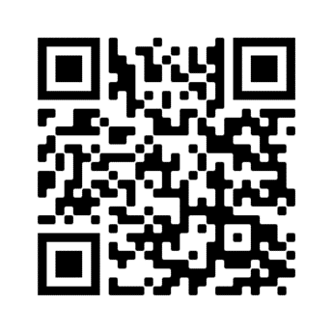
Join Action Corps
Weekly e-newsletter and Action Alerts
  Be informed and involved
  Respond to Action Alerts and make a difference
Informing your elected officials is crucial in helping get vital pieces of veteran legislation passed into law
Three ways to sign up:
  Visit www.vfw.org/JoinActionCorps
  Text “VFW” to 50457
  Scan the QR Code
Notes:
Identify and support the next generation of VFW leaders.
Involve younger members in legislative advocacy.
Provide a semester-long curriculum to receive academic credit at both the undergraduate and graduate level.
Foster collaboration between VFW and student veterans at the local and national levels.

Slide 7

Take Action
IMPACT OF ACTION CORPS
“Demand the PACT Act Passes”
  180,000 messages sent

Slide 8
How You Can Help
Inform your NVS Quality Assurance Representative about recurring issues you observe.
Examples:
  Claim Sharks activity
  Specific conditions difficult to get VA rating (MST, TBI, toxic exposures)
  Unexplainable denials when required evidence was provided
  Consistent mistakes made by VA raters
  Issues with appeals, ways to improve the process
Respond to our call-outs for information and stories for our testimony in DC. You may be asked to testify in your home states as well.
Draft VFW resolutions to enact change

Slide 9
We’re Here to Help
www.vfw.org/advocacy
  Talking points & priority goals
  Congressional testimony
  Action Corps
    Read the Action Corps Weekly
    Respond to Action Alerts
    Sign up advocates

Slide 10
QUESTIONS?
Contact the VFW National Legislative Service
  Email: kkeenan@vfw.org
  Call: (202)608-8365

