Slide 1
TVB Claims Management System Updates
April 2025

Slide 2
Lesson Objectives
TVB Home Screen updates
My Calendar
New Upload Document Location
International Phone Numbers and Addresses
VA Benefit Claims Log in
Instant POA and ITFs

Slide 3
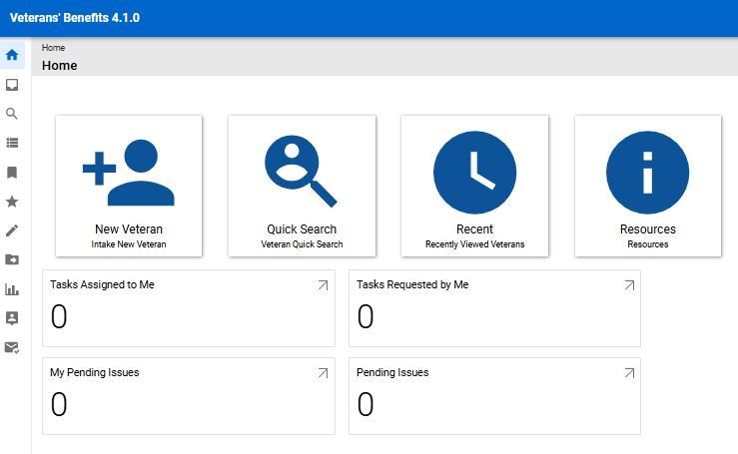

TVB Home Screen
TVB 4.1 added 2 new quick links to the TVB Boxes; these include:
My Tasks
My Issues

Slide 4
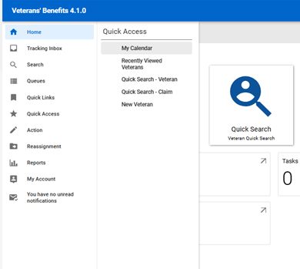
My Calendar
My Calendar is a new feature to TVB 4.1 which allows users to add calendar events or track due dates for assigned tasks.
To access My Calendar go to:
TVB Column -> Quick Access -> My Calendar

Slide 5
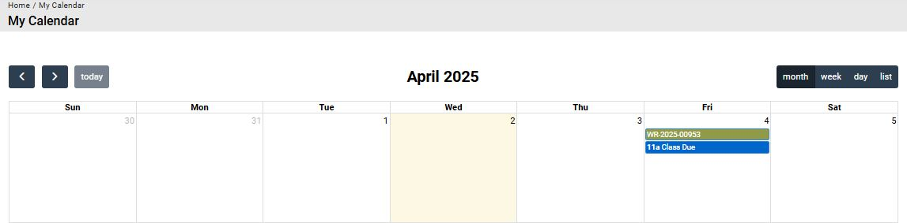
My Calendar
The Calendar default view is set up to view the entire month, but this can be changed by clicking either Week, Day or List.

Slide 6
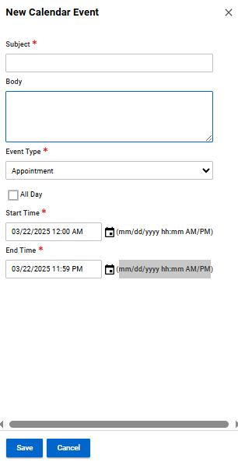
My Calendar – Calendar Events
Calendar events can be created by clicking on the date of the event and entering in the required data:
Subject
Event Type (Auto populates to only option of Appointment)
Start and End Time both requiring this specific entry method mm/dd/yyyy hh:mm AM/PM
Click Save

Slide 7
My Calendar
Events that you create in the Calander will populate as a Green Line while tasks assigned to you will populate as a Blue Line

Slide 8
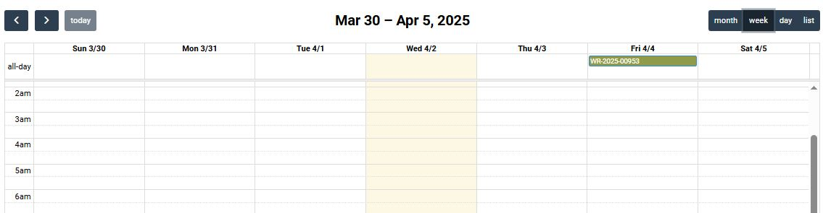
My Calendar – Week View
From the Weekly View, Users can create Events for the Date and select the time slot for the Event

Slide 9
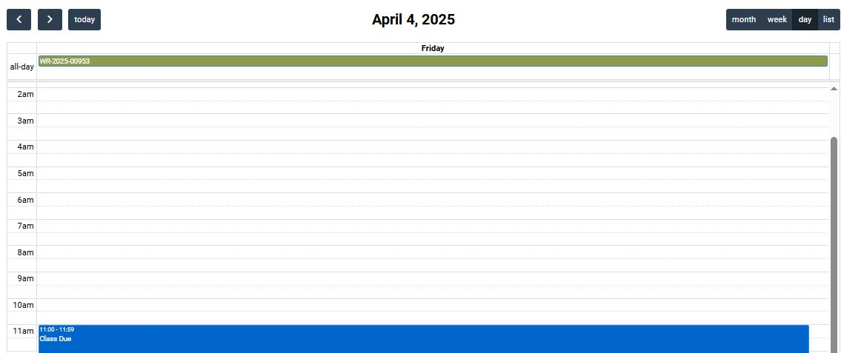
My Calendar- Day View
From the Day View, Users can create Events for that Day and select the time slot for the Event

Slide 10
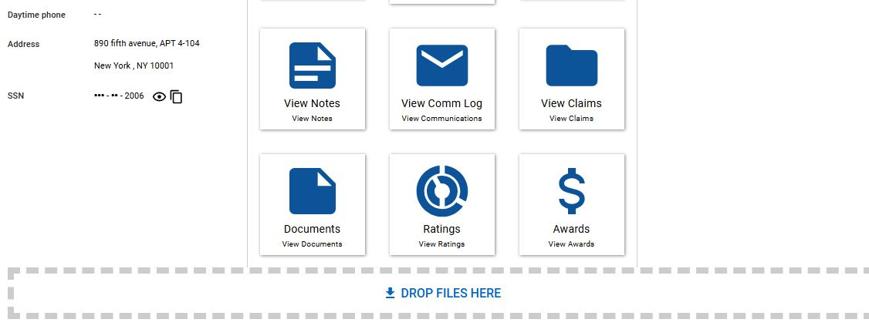
Upload Documents
TVB 4.1 has added a new location to upload documents to the veteran folder which is located at the bottom of the Veteran Home Page

Slide 11
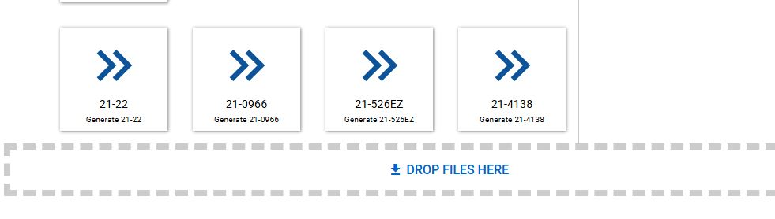
Uploading Documents
Another option to upload Documents is at the Bottom of the Claims Home Page.
Please Note Documents uploaded in a Claim Folder will be in the Claim Folder and Not Be in the Veteran Document Tab

Slide 12
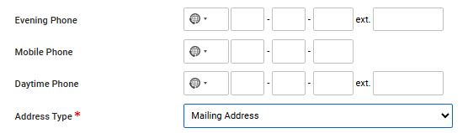

International Phone Numbers and Addresses
With TVB 4.1 the ability to capture International Phone Numbers and International Addresses when creating a New Veteran Profile.
For Phone Numbers enter the Country Code Number or select it from the Drop-Down box
For Addresses select the Country from the Drop-Down Box

Slide 13
International Phone Numbers and Addresses
VA forms are primarily designed for use within the United States and its territories, so they sometimes are not fully compatible with international phone numbers or addresses.
Because of this please ensure that the following are captured on VA forms correctly when working with an international veteran:
Phone Number including International Dialing Codes
Address fields including correct Postal or Zip Code
Direct Deposit Information including a correct Routing Number

Slide 14
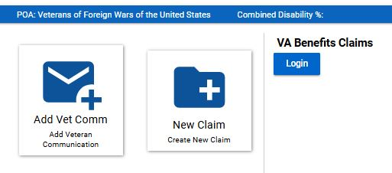
VA Benefits Claims
TVB has an API called VA Benefits Claims which allows TVB to connect to VA.gov.
This allows for some actions in TVB to be done in REAL TIME
The VA Benefits Claims API can be found on any Veterans Home Page
Click Login to connect to continue with this API

Slide 15
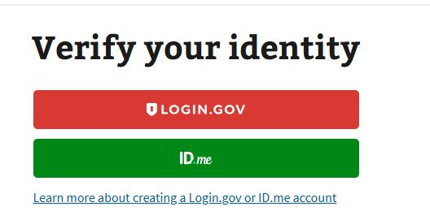
VA Benefits Claims
When utilizing this functionality, TVB requires the user to sign in to VA.gov using one of the following log in methods:

Slide 16
VA Benefits Log
If the user does not have any of these accounts, they can create either an Login.gov or ID.me account directly from the page by clicking the hyperlinks at the bottom.

Slide 17
Account Set up
An in-depth guide for creating either a Login.gov or ID.ME account can be found in the OLP TVB Resources and in the TVB 4.0 Resources Section.

Slide 18
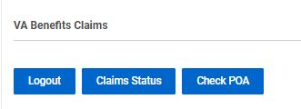
VA Benefits Claims
Once logged into the VA Benefits Claims section, clicking on VA Benefits Claims will populate new buttons.

Slide 19
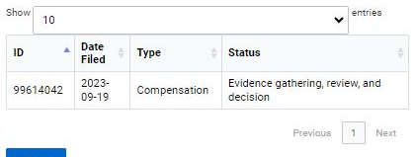
VA Benefits Claims: Claim Status
The Claim Status button will populate all the veteran’s claims (past and present) and show the Date Filed, Claim Type and Status of the claim

Slide 20
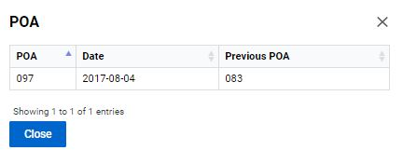
VA Benefits Claims: Check POA
The Check POA button will populate the veteran’s current POA as well as list any Previous POAs.

Slide 21
VA Benefits Claims: Submitting Forms Directly into VBMS
Another function of VA Benefits Claims is the ability to submit POAs and ITFs directly into VBMS.
To utilize this function, the following must be true.
Logged into VA.gov through VA Benefits Claims
The veteran’s folder is assigned to Your Field Office and Yourself.

Slide 22
VA Benefits Claims: Submitting Forms Directly into VBMS
To submit a POA or ITF directly into VBMS a claim must first be created.
From the veteran folder Create a new claim, Select Compensation and hit Save.
If Submitting a POA a completed and Marked as Signed 21-22 must be in the newly created Claim Folder; ITFs DO NOT NEED A form filled out.

Slide 23
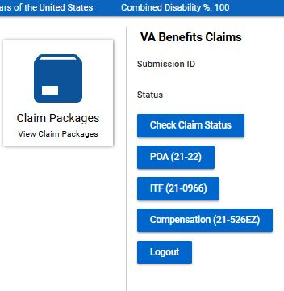
VA Benefits Claims: Submitting Forms Directly into VBMS
With the new claim created, follow the TVB Breadcrumb Trail back to Claim Page.
From the Claim Home Page you will see new buttons available und VA Benefits Claims

Slide 24
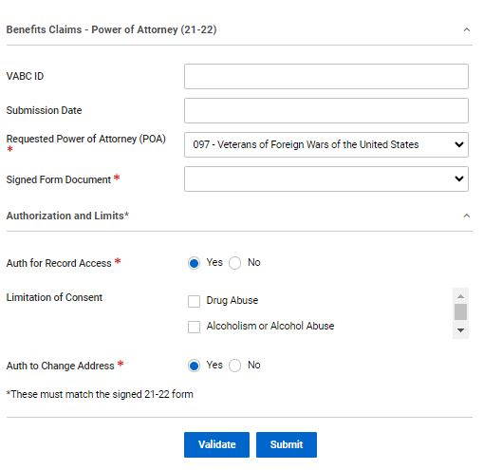
Submitting Forms Directly into VBMS POA(21-22)
The POA(21-22) button takes the user to a page where they can attach a TVB Created, Marked As Signed 21-22 directly to VBMS.
*Please note for those who have multiple accreditations to select the correct POA *

Slide 25
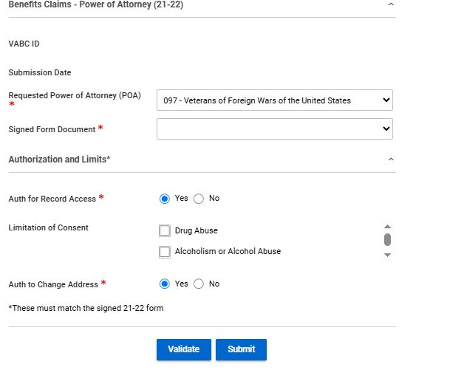
Submitting Forms Directly into VBMS POA(21-22)
The page contains required fields such as POA, Signed Form Document and Authorizations and limits.
Signed Form Document has a dropdown box that will populate with the claim form that was generated and Marked As Signed in TVB

Slide 26
Submitting Forms Directly into VBMS POA(21-22)
With all required fields addressed, click submit to Submit the form to VBMS.
*Please note that the Authorization and limits on the signed 21-22 MUST MATCH the boxes displayed on the page. *

Slide 27
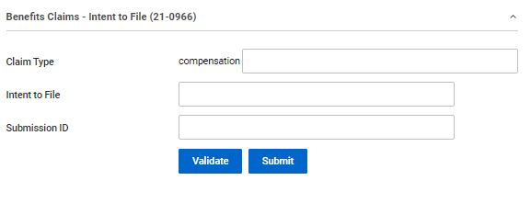
Submitting Forms Directly into VBMS ITF (21-0966)
The ITF(21-0966) button takes the user to a page where they can submit an ITF to VA Without the need of a VA form.

Slide 28
Submitting Forms Directly into VBMS ITF (21-0966)
Press Validate to confirm POA with VA, TVB will provide a message that says valid if good or an error message that will need to be corrected.
After confirmation press submit
TVB will populate the previously empty boxes with:
Claim Type
Intent to File Date of Submission
Submission ID (confirmation number)

Slide 29
Submitting Forms Directly into VBMS 21-526EZ
TVB does have the ability to submit the 21-526EZ form directly to VA however this feature has more require more steps that other methods and has a higher rate of claim failure than the others.
Due to these issues NVS Does Not recommend using this feature.

Slide 30
Questions?

