Slide 1


Social Security Disability Unit

Slide 2


Prepared Exclusively For:
By: Scott Layden, Jr.
Senior Disability Advocate

Slide 3

November 6, 2024 Memorandum of Understanding (MOU) between VFW and VHG
The purpose of the MOU is to allow Veteran's Help Group to assist the VFW's team of Veteran Service Officers (VSOs) to do 2 things:
To determine if the veteran meets the basic eligibility to file for Social Security disability benefits, and
To let veterans know that Veteran's Help Group is ready to help them prosecute their Social Security disability claims.

Slide 4

To assist VSOs, Veterans Help Group has developed an online screening tool for VFW
In under 5 minutes the tool educates veterans on Social Security disability, while also evaluating whether those benefits might be available to the veteran
If a veteran completes the online screening tool and wants assistance with Social Security disability from VHG, they will speak with Scott Layden or a member of his team for a more detailed consultation.

Slide 5
Social Security Disability Insurance (SSDI)
Title 2 of the Social Security Act
SSDI is a government administered insurance program
  Insurance "coverage" is earned through paying FICA payroll taxes to Social Security
Date Last Insured (DLI) is the date that the individual's coverage under the program expires
  The Claimant most prove that they are unable to work full time due to their medical conditions prior to the expiration of their DLI. The DLI normally expires 5 years after the last quarter an individual paid into Social Security.
  If found disabled, entitled to monthly monetary payments and Medicare insurance coverage.
SSDI benefits "stack" with Veterans Administration (VA) service-connected disability payments, meaning the veteran can collect both at the same time (if they qualify for each).
  Max payment for SSDI in 2025 is $4,018/month (for those without dependents)

Slide 6
SSDI Contingency Fee Agreement
Fees are the lesser of 25% of past due benefits or the max fee ($9,200 currently)
Representative fees are contingent on winning the claim.
  Fees are only awarded by Social Security if the veteran is found disabled and there are past due benefits
Fees are the lesser of 25% of the past due benefits or the max payment
  Max payment currently $9,200, adjusts yearly with inflation
Social Security approves all fee agreements and withholds the representative's payment.
  Social Security then distributes the past due benefits to the representative and the Claimant/veteran.

Slide 7
SSDI Contingency Fee Agreement, examples
Fees are the lesser of 25% of past due benefits or the max fee ($9,200 currently)
Example 1 = on March 14, 2025, veteran John Smith is found disabled by Social Security, effective January 1, 2024. Social Security calculates that it owes John Smith $20,000 in past due benefits.
  Social Security pays $5,000 to John Smith's representative, and $15,000 to John Smith.
Example 2 = on March 14, 2025, veteran Sally Smith is found disabled by Social Security effective January 1, 2023. Social Security calculates that it owes Sally Smith $100,000 in past due benefits.
  Social Security pays $9,200 to Sally Smith's representative, and $90,800 to Sally Smith
Example 3 = on March 14, 2025, veteran Bob Smith is found disabled by Social Security effective March 14, 2025. Social Security calculates that it owes Bob Smith $0 in past due benefits
  $0 is paid to Bob Smith's representative, and Bob Smith receives future ongoing monthly payments (but $0 in past due payments)

Slide 8

Trivia question 1 of 3
Question:
If a veteran was rated 100% service connected for VA disability compensation and was found disabled at the maximum rate for SSDI, how much would their annual compensation be?
  $50,000 - $75,000
  $75,001 - $90,000
  More than $90,000
Answer:
$94,188 annually
  2025 SSDI max is $4,018/mo
  2025 VA 100% rate is $3,831/mo

Slide 9

Issues affecting SSDI eligibility
The individual/veteran is working and making more than $1,620/month gross (pre-tax)
This is called "Substantial Gainful Activity" (SGA) and the veteran is not eligible to apply
Note: VA benefits, worker's compensation, short term/long term disability, etc. are not counted. Only if the individual is working and receiving $1,620/month are they ineligible.
The veteran last worked too long ago (i.e. their Date Last Insured is expired/remote)
If someone is already receiving full Social Security retirement benefits, they will be unable to file for SSDI
The veteran worked after leaving the service, but did not pay FICA/Social Security taxes.
Most police officers, firefighters, teachers do not pay Social Security taxes, they instead pay into a state retirement/disability fund (as an alternative to Social Security).
The January 5, 2025 Social Security Fairness Act applies mainly to retirement benefits (not disability)
Age / getting Social Security retirement
Practically speaking, the further in the past the Date Last Insured is, the harder the claim is to win

Slide 10
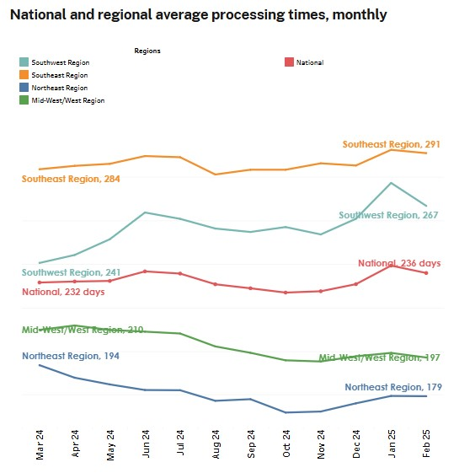
Certain veterans will have their Social Security Disability Insurance claim expedited
If the veteran has 100% Permanent & Total (P&T) service-connected disability through the Veteran's Administration.
  Even if 100% P&T (or TDIU), this is not a guarantee that Social Security will approve the veteran for Social Security Disability Insurance
If their disability began while on active duty on or after October 1, 2001 (SSA's Wounded Warrior Program).
This can mean the difference in months of SSDI claim processing time.
Graphic = https://www.ssa.gov/ssa-performance/disability-processing-time

Slide 11
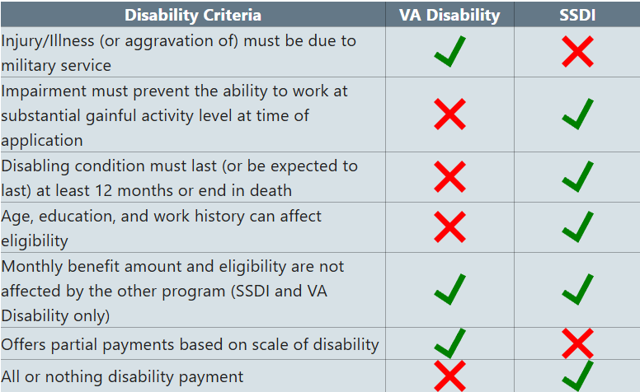
SSDI and VA service-connected disability, similarities and differences

Slide 12
5-Step Sequential Evaluation
Every Social Security disability claim goes through the same 5-step analysis
Is Claimant/veteran engaged in Substantial Gainful Activity (SGA)?
  SGA is working for more than $1,620/month gross)
  Generally, claim cannot proceed
Is there a "severe impairment"?
  Medical condition which lasts (or is expected to last) at least 12 months or result in death
Does the Claimant/veteran meet or equal a medical "Listing"?
  Designed to grant severe claims quickly, like terminal brain cancer, long term dialysis, etc.
  Most claims do not meet/equal a Listing. Step 3(b) would be assigning a "Residual Functional Capacity" (RFC), estimating what the Claimant can still do physically/mentally despite their severe impairments
Can the Claimant/veteran return to their Past Relevant Work (PRW)?
  Generally, PRW is any job the Claimant did at an SGA level in the last 5 years
Can the Claimant/veteran adjust to other work widely available in the national economy
  Medical Vocational Guidelines (GRID rules) come into play for those over age 50

Slide 13
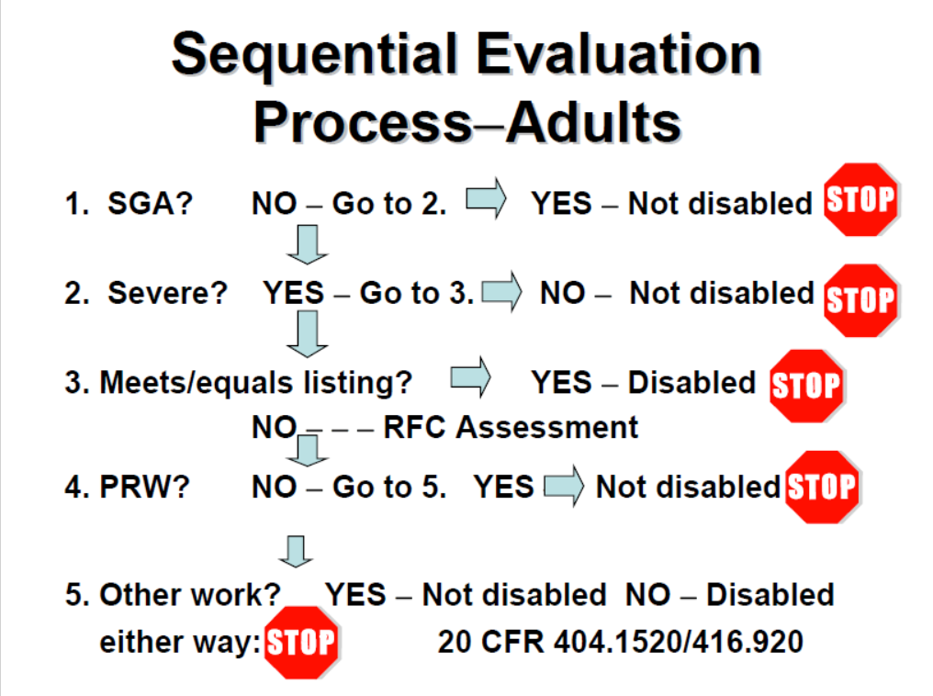

Slide 14
Social Security Grids Rules: The Older One Gets the easier Social Security Makes It to Get Approved!
At 50, 55, and again at 60, it becomes gradually easier to be found disabled
For individuals who have not attained age 50, Social Security requires them to prove they cannot work any job on a full-time basis because of their medical conditions
The older one gets, Social Security rules recognize the reality that making vocational adjustments can be difficult. The Grids rules apply when a Social Security claimant can no longer perform their past work.
  For individuals between the ages of 50 – 54, if they cannot perform their past work and the most they can do is a sit-down job, the individual is DISABLED.
  For individuals between age 55-59, if they cannot perform their past work and the most they can do is a light duty job, the individual is DISALBED.

Slide 15

Theory of disability
Veterans Help Group crafts strategies and legal arguments to fit each Veteran's individual situation
Unsuccessful Work Attempt (UWA)
  If a Claimant/veteran gets a job making more than SGA ($1,620/mo gross), but the job lasts for six (6) months or less, and the veteran if forced to quit, is fired, or put on leave due to their medical conditions
  The claim proceeds normally
Closed period of disability
  If a Claimant/veteran has medical improvement/returns to SGA after being out of work at least 12mos
  We can allege a "closed period" and attempt to obtain benefits for the time that they were out of work
Amending the Alleged Onset Date (AOD)
  Often makes a claim stronger (amend to an age change, or a strong piece of evidence like an MRI)
Request for an On The Record (OTR) decision
  Asking a Social Security Administrative Law Judge (ALJ) to grant a claim purely based on the medical records.
  No hearing would be held if granted; and if the ALJ denies the OTR, the claim simply proceeds to a hearing.
Help the Claimant/veteran "tell their story" to the Administrative Law Judge (ALJ)

Slide 16


Common problems that derail active SSDI claims
Returning to work within 12mos at SGA ($1,620/month gross)
Claimants who get frustrated and give up on the process
Claimants who do not return forms required by Social Security
Un-represented Claimants who do not know what they need to prove to win their claim
WAITING TOO LONG TO FILE

Slide 17
Trivia question 2 of 3
Question:
If a veteran stopped paying into the Social Security system in 2020, for how long would they be insured for disability protection?
Answer:
5 years, or 2025
  If a veteran cannot work and they have paid into Social Security there is no reason to wait. The clock is ticking!

Slide 18

Veterans Help Group is here to assist
We file review and file the SSDI claim
Every case is overseen by a Senior Disability Advocate who has handled thousands of disability hearings and is an expert who specializes in this field
We will work with veterans to avoid common mistakes when completing forms and interacting with SSA staff
We file the appeals (if necessary)
We will front the cost of medical records production
We will prepare the case for hearing, prepare the client for testimony, cross examine any experts, and all hearings will be attended by an attorney

Slide 19
Example "wins" of SSDI benefits by Veterans Help Group
Veteran Kevin M. (56yo, conditions include back/neck degeneration, COPD...)
  On August 18, 2022, Veterans Help Group filed an SSDI claim for Veteran Kevin M. His claim was denied at Initial and at Reconsideration. VHG handled his appeals and had an attorney with Kevin at his November 2024 hearing with a Social Security Administrative Law Judge (ALJ).
  Kevin was found disabled effective October of 2021 in a decision dated January 17, 2025. He was awarded over $40,000 in past due benefits, and he currently receives $1,194/month from Social Security
Veteran Gregory H. (39yo, conditions include PTSD, anxiety, depression...)
  In June 2024, VHG joined Gregory's active SSDI claim. VHG had an attorney with Gregory at his November 2024 hearing with a Social Security ALJ.
  Gregory was found disabled effective August of 2022 in a decision dated December 23, 2024. He was awarded over $50,000 in past due benefits, and he currently receives $2,245/month from Social Security.

Slide 20
Trivia question 3 of 3
Question:
Rank the Following Organizations from Oldest to Youngest:
  Social Security Administration
  Department of Veterans Affairs
  Veterans of Foreign Wars (VFW)
  Veterans Help Group

Slide 21
Trivia question 3 of 3
Answer:
1) The VFW! VFW was founded on September 29, 1899. The VFW was formed from the amalgamation of several societies formed immediately after the Spanish-American War
  Congratulations on your 125th Anniversary VFW!!!
2) Department of Veterans Affairs was established by President Herbert Hoover on July 21,1930
3) Social Security was created when President Franklin Delano Roosevelt signed the Social Security Act on August 14, 1935.
4) Veterans Help Group was founded in 2015
  Along with our sister company Disability Help Group, we have helped over 50,000 individuals get approved for Social Security disability
  We have helped our clients and their families receive over a billion dollars in financial benefits

Slide 22
Free, fast Online Screening Tool
If a veteran has questions about whether they qualify for Social Security Disability Insurance (SSDI), utilize the Online Screening Tool
Screening Tool =
  https://veteranshelpgroup.com/vfw/
  SLaydenJr@veteranshelpgroup.com

