Slide 1
What’s New at VA?
By Crystal M. Trulove
April 2025

Slide 2


Introduction
Crystal M. Trulove
  crystal.trulove@gmail.com
Air Force
  Weather Specialist
NOAA/National Weather Service
  Weather Forecaster
Brandeis University
Department of Veterans Affairs
  RVSR (Rating Veteran Service Representative)
  DRO (Decision Review Officer)
Veterans of Foreign Wars
Notes:
VFW since 2019

Slide 3
Course Objectives
You will leave with a better understanding of:
  Recent updates from the PACT Act
  Recent updates to M21-1
  Four new court cases
  Things we have in common
  (PACT Act and M21-1 not teaching the topics, only the updates)
Notes:
Explain my idea for avoiding politics in the classroom

Slide 4
Court Cases and URLs
Ingram v Collins
Laska v McDonough
Chisholm v Collins
Rudisill v McDonough
https://www.publichealth.va.gov/exposures/burnpits/
  Airborne Hazards and Burn Pit Exposures
https://www.govinfo.gov/content/pkg/PLAW-117publ168/pdf/PLAW-117publ168.pdf
  August 10, 2022 PACT Act

Slide 5
CFR and M21-1 References
38 CFR 3.302(a) – SC for mental unsoundness in suicide
38 CFR 3.304(f)(5) – SC for PTSD based on personal assault
38 CFR 3.354 – determinations of insanity
38 CFR 21.5022 – eligibility under more than one program
M21-1 V.iii.13. – mental unsoundness
M21-1 VIII.iv.1.B. – general information PTSD and personal trauma claims
M21-1 VIII.iv.1.C. – medical opinions for PTSD claims
M21-1 VIII.iv.1.E. – evidence evaluation for PTSD due to personal trauma
M21-1 X.ii.2. – revision based on new evidence
M21-1 X.ii.6.A. – incompetency for beneficiaries

Slide 6
PACT Act - Recap
The Sergeant First Class (SFC) Heath Robinson Honoring our Promise to Address Comprehensive Toxics (PACT) Act of 2022
  list of commitments but not enacted all at once
  changes continue to be made, in compliance with the Act
  https://www.govinfo.gov/content/pkg/PLAW-117publ168/pdf/PLAW-117publ168.pdf
Not path to service connection, rather a law that expands SC. e.g.:
  Qualifying areas
  Conditions included
  Toxic exposures
  Other benefits like screening, eligibility, education
Help veterans state their intent
  Not “make a PACT Act claim,” instead make a presumptive claim

Slide 7
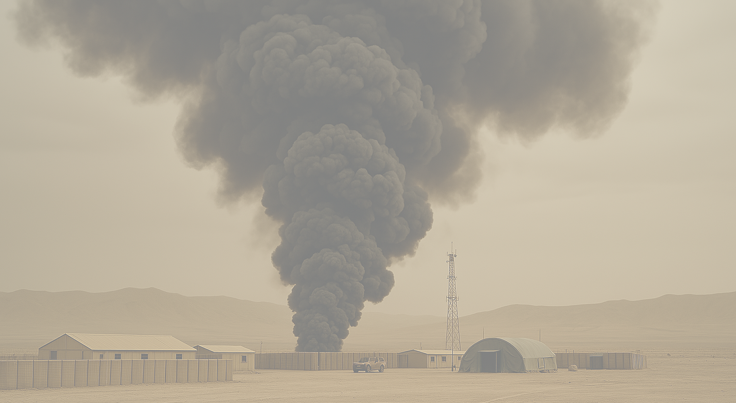
PACT Act – K-2 included in GW
January 8, 2025 - list of Gulf War locations finalized to include focus on Karshi-Khanabad Air Base in Uzbekistan, also known as K-2 or Camp Stronghold Freedom
VA can verify classified or restricted information using the Military Records Research Center (MRRC).
Potential Toxic Exposure Risk Activity (TERA) exposures at K-2 include:
Jet fuel
Volatile organic compounds
Particulate matter and dust
Depleted uranium
Asbestos
Lead based paint
Lead in water samples
Notes:
VA does not require a disability or a location to be on a list to grant SC

Slide 8
PACT Act – Gulf War Conditions
Update June 14, 2024. VA Presumptive Conditions added:
  Male breast cancer
  Urethral cancer
  Cancer of the paraurethral glands
Update January 8, 2025. VA Presumptive conditions added:
  Acute and chronic leukemias
  Multiple myelomas
  Myelodysplastic syndromes
  Myelofibrosis
  Urinary bladder, ureter, and related genitourinary cancers
Notes:
VA fact sheets and press releases

Slide 9
PACT Act – Gulf War Conditions
https://www.publichealth.va.gov/exposures/burnpits/
  Airborne Hazards and Burn Pit Exposures
https://www.va.gov/disability/eligibility/hazardous-materials-exposure/
  Start with exposure, move to conditions
https://www.va.gov/resources/presumptive-cancers-related-to-burn-pit-exposure/
  Lists cancers included
  Conditions named here that aren’t identified elsewhere

Slide 10
PTSD and/or Personal Trauma Claims
Basic requirements of personal trauma claims (VIII.iv.1.B.2.b.)
  Statement from veteran that identifies type of trauma
    MST or non-sexual personal trauma, like a mugging
  A brief description of the event
    BRIEF. Save the full story for the VAE
  Location of the event
  Veteran’s unit at the time
  Approximate date(s) of event(s)
    Exact dates not needed and there is no minimum time frame
VAF 21-0781 not needed if the pertinent evidence is of record (VIII.iv.1.B.1.b. & B.2.b.)
Notes:
Definitions

Slide 11
PTSD and/or Personal Trauma Claims
VA does not have a duty to assist until claim is substantially complete (VIII.iv.1.B.1.e.)
When veteran indicates existence of report or investigation during service, VA has a duty to assist (VIII.iv.1.B.2.d.)
Explanation of DoD’s reporting procedures and how to interpret records at VIII.iv.1.B.3.
  Veterans may find the information useful
If PTSD is diagnosed in service (VIII.iv.1.C.1.a.)
  Exam is warranted and VA should not develop for stressors or markers

Slide 12
PTSD and/or Personal Trauma Claims
Military Sexual Trauma (MST) (VIII.iv.1.E.1.a.)
  MST may result in a disability but is not itself a disability
  Experiences of MST are not related to a specific gender, background, or setting.
  Perpetrators of MST may or may not be affiliated with military
  PTSD can result from MST
    Not the only diagnosis that can result from MST (38 CFR 3.304(f)(5))
Alternative sources of evidence (VIII.iv.1.E.1.c.)
  When records contain insufficient documentary evidence that personal trauma occurred
  May or may not be sufficient on their own to establish occurrence
Notes:
These clarifications may seem obvious to us, but VA felt they needed to be clarified, so make sure your vets know these things

Slide 13
PTSD and/or Personal Trauma Claims
Alternative sources of evidence (VIII.iv.1.E.1.c.) may corroborate the Veteran's account of the personal traumatic event
a rape crisis center or center for domestic abuse
a counseling facility or health clinic
family members or roommates
a faculty member
civilian police reports
a chaplain or clergy
fellow service members, and
personal diaries or journals
medical reports from civilian physicians or caregivers who treated the Veteran immediately following the event or sometime later

Slide 14
PTSD and/or Personal Trauma Claims
Stressors (VIII.iv.1.B.2.)
Sufficient evidence to document personal trauma stressor
  If sufficient evidence is of record, VA should not continue to develop
  Examples of sufficient evidence
If the claim is for PTSD, then 38 CFR 3.304(f)(5) provides a lower evidentiary standard, which is why VA can accept “markers”
Examples of scenarios and alternative sources of evidence

Slide 15
PTSD and/or Personal Trauma Claims
Markers (VIII.iv.1.E.1.d.)
Definition of marker is an indicator of the effect or consequences of the personal trauma on the veteran
  Can include behavioral events, or a changed behavioral pattern (VIII.iv.1.E.1.e.)
  Behavioral evidence can occur during service or any time after
Think of a marker as a piece of paper a VA employee can find
  Hospital visit, divorce documents, orders
Examples and scenarios included
Notes:
Does not have to be behavioral pattern, but must be something that supports veterans description of the event. Example of getting ready to go out at home during break.

Slide 16
PTSD and/or Personal Trauma Claims
Markers (VIII.iv.1.E.1.d.)
When evidence of record is not sufficient to concede the claimed stressor, additional steps to corroborate the claim must be undertaken
Alternative sources of evidence may not be sufficient on their own (VIII.iv.1.E.1.e. & VIII.iv.1.C.1.e.)
  In this case, medical opinion corroboration is needed
  Neither VA nor an examiner can use the absence of documentation as evidence to refute personal trauma (VIII.iv.1.C.2.a.)

Slide 17
PTSD and/or Personal Trauma Claims
PTSD medical opinions (VIII.iv.1.C.1.)
VA cannot order a medical opinion if traumatic event isn’t supported
Conversely, exam is required with the following:
  Credible evidence stressor occurred, or markers, and
  Evidence (including lay statements) veteran has diagnosis or symptoms consistent with PTSD, and
  Indication that current symptoms may be associated with claimed event (statement of association)

Slide 18
PTSD and/or Personal Trauma Claims
PTSD medical opinions (VIII.iv.1.C.1.)
When the only evidence of personal trauma is behavioral markers, then a corroborating medical opinion is needed (VIII.iv.1.C.1.e.)
  This is a medical opinion that adds probative value to stressor event
In claims for PTSD based on personal trauma (including MST), a separate medical opinion DBQ should not be ordered when either
  Sufficient documentary evidence to establish the personal traumatic event(s) is of record, or
  In-service treatment of PTSD is shown

Slide 19

Death from Suicide in Service
A death in service by suicide will be considered service connected unless evidence shows willful misconduct (V.iii.13.1.c.)
Mental unsoundness is a means of determining willful misconduct. (38 CFR 3.302(a)). Mental unsoundness is not a disability itself.

Slide 20
Determination of Insanity
Insanity can overcome a bar to benefits
Definition (38 CFR 3.354(a))
  An insane person is not mentally defective but exhibits a deviation from normal behavior
Insanity can be placed at issue for a veteran (X.iv.2.A.1.b.) by:
  Specific allegation by veteran or representative
  By VA employee after records review
  Death by suicide occurs in service

Slide 21
Receipt of Supplemental Records
Definition: Supplemental service records are those which existed at the time of a decision but were not associated with the file, and are relevant to the decision
  Not internal memos
  Not duplicate records
VA Receipt of supplemental records after a decision (X.ii.2.B.1.d)
  If it is from DoD, all former decisions must be reviewed (i.e. it’s a claim) and treated as though the STRs were always of record
  If it is received from veteran or representative, it does not constitute a claim, unless accompanied by proper form

Slide 22

Incompetency of beneficiaries
VA recently removed refences to veteran vs. non-veteran competency when someone is a beneficiary of VA benefits. (X.ii.6.A.5.b)
New section revised to state that ‘beneficiary’ must be subject to competency determinations
Table discussing different actions for veterans and non-veterans has been eliminated.

Slide 23
Ingram v. Collins
Question: Do medical opinions discussing flare-ups eliminate need to discuss benefits of medication?
Answer: No. Each court decision (re: flare-ups and meds) was made as they relate to each other, and do not change the application or understanding of another.
Ingram SC at 10% for both back and ankle, resulting from Army and Army Reserve service
Takes prescribed medications
Submitted claim for increased evaluation

Slide 24
Ingram v. Collins
Decisions -BVA required to discount beneficial medication effects
  Jones v Shinseki
  Jackson v McDonough
Decisions -Examiners must provide range of motion estimates under the worst-case scenario of a flare-up
  Sharp v Shulkin
  Mitchell v Shinseki
  DeLuca v Brown
VA argued that since opinion already considers flare-ups, then additional consideration of medications for Ingram is moot
  CAVC found this argument in error, and all decisions remain relevant
Notes:
My thoughts are that this may result in future additional VAE requirements

Slide 25
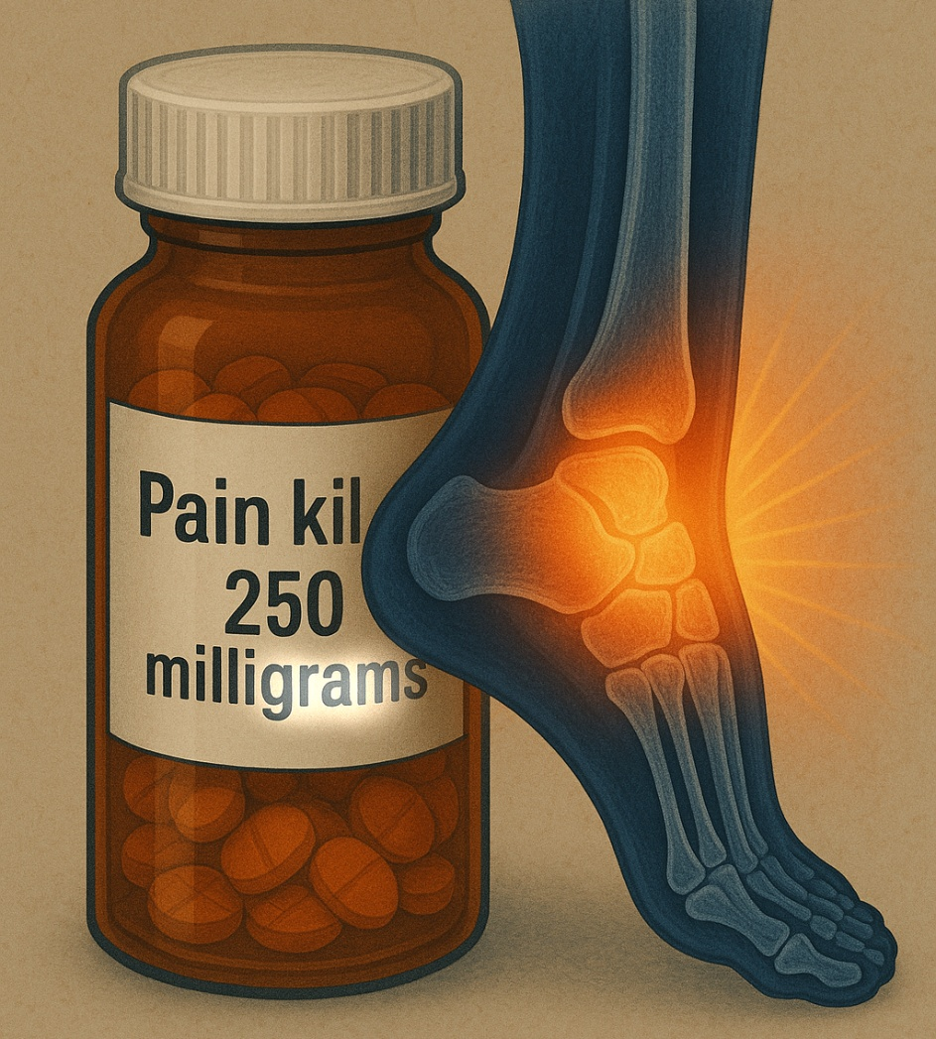
Ingram v Collins

Slide 26
Laska v McDonough
Question: Do the requirements to meet SMC(t) criteria mirror those to meet SMC(R)(2) criteria?
Answer: No. SMC(t) explicitly accommodates the unique disability of traumatic brain injury (TBI).
Veteran Haskell knocked unconscious by an RPG in Vietnam in 1967 and service connected for TBI ever since
His wife, Ms. Laska, a retired psychologist, provided in-home care
Veteran and Ms. Laska claimed he met criteria of SMC(t)
Veteran died before appeal was decided

Slide 27
Laska v McDonough
VA argued that SMC(t) was the same as SMC(R)(2) and therefore the veteran should be held to the same standards
  Higher level of Aid and Attendance
VA argued that not requiring veterans with TBI to meet the same criteria means some veterans would be compensated at the same level for a less serious condition
CAVC found this argument erroneous, and that the entire purpose of SMC(t) is to address the cognitive and psychological manifestations
  Veteran with SC TBI must be in need of regular Aid and Attendance, and without it would need residential care
  Otherwise, TBI would simply have been added to SMC(R)(2)

Slide 28

Laska v McDonough

Slide 29
Chisholm v Collins (cautionary tale)
Question: Is a Supplemental Claim (i.e. appeal) restricted in which forms can be used to initiate it?
Answer: No. The veteran only needs to make clear that a greater benefit is desired, and to provide additional evidence.
Claimant, Chisholm, is an attorney who once tried to help veteran
Later, veteran made a new claim for IU using an 8940, and did not have assistance with this claim from anyone
Chisholm argues that this is a supplemental claim and thus requires attorney fee payments

Slide 30
Chisholm v Collins
VA argues that a supplemental claim/appeal, has a specific form (VA Form 20-0995)
VA argues that the claim for IU, using VA Form 21-8940, is a new claim and not subject to attorney fees
CAVC found this argument in error
  Phillips v McDonough found that TDIU is considered by VA to be another way to claim increased evaluation for a disability
CAVC found that a supplemental claim is not restricted to initiation by form 0995.
  Intent to receive greater benefit + new evidence = supplemental claim
Notes:
A new favourite phrase from a court case: “Secretary admits that the decision is all sorts of wrong.” A new favourite flex: “Similar to how something can be both a wave and a particle in quantum physics, so TDIU defies categorization.”

Slide 31
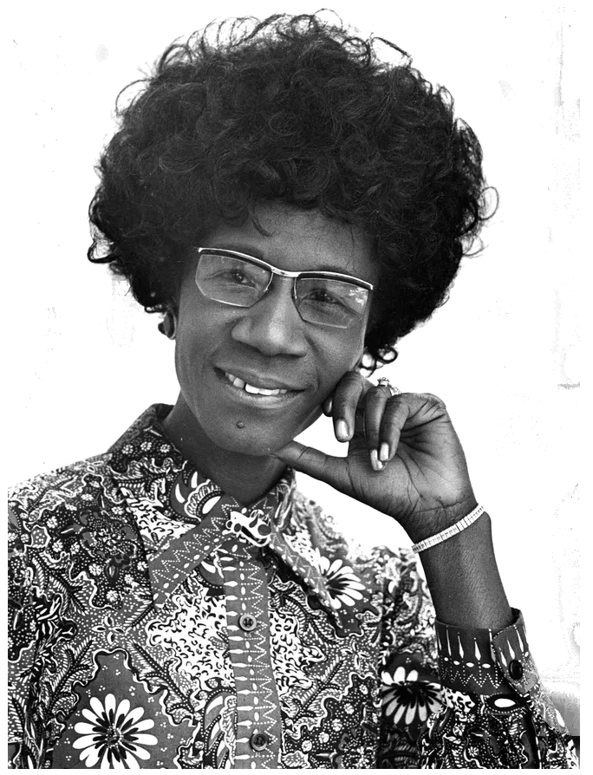

Chisholm v Collins
Notes:
Shirley Chisholm 1st Black woman elected to Congress in 1968. Sought candidacy in 1972, 84, and 88. In 72 Nixon defeated George McGovern. Advocated for, and created Supplemental food program.

Slide 32
Rudisill v McDonough
Question: If a veteran who qualifies for both the Montgomery GI Bill (CH 30) and also the Post-9/11 GI Bill (CH 33) wants to use the entire 48 months benefit, is that veteran first required to exhaust the Montgomery GI Bill?
Answer: No. Veterans who qualify to use both can do so in any combination, provided they do not exceed a total of 48 months of benefits.
Veteran Rudisill served 2000-2002, 2004-2005, and 2007-2011
Rudisill enrolled in college after all three periods of service
Notes:
Post-9/11 GI Bill wasn’t available for use until 2009. CAFC Court of Appeals for Federal Circuit

Slide 33
Rudisill v McDonough
Veteran completed undergraduate degree before his 3rd period of service in 2007, using up 25 ½ months of Montgomery GI Bill
Veteran began PhD program in 2011, and asked to use Post-9/11 GI Bill from then on
VA argued that since he started with Montgomery GI Bill, he must use it up before he can use a different benefit – or –
VA argued that if he switched to Post-9/11, he could only use the remainder of 36 months
SCOTUS found the argument in error, stating that neither 38 USC 3322(d) or 3327 restrict veterans’ use of both entitlements, as long as there is compliance with 38 USC 3695(a)
  38 USC 3695(a) discusses the 48 month cap on educational benefits

Slide 34

Rudisill v McDonough
Rude.

Slide 35
Hot Topics from VA Employees
Use VAF 21-10210 to certify witness statements.
  If VA can verify the two served together, it can be stressor corroboration
  Also useful for other conditions’ chronicity and continuity
Please for the love of all that is good, go to scheduled exam
  New VA guidance if vet cannot provide timeframe to contractor
  Call 800-827-1000 as soon as possible or upload a 4138
  Get it on record, then VA can request exam again
Statement of association. Veteran needs to say what caused what. Often missing, particularly in mental health claims.
Notes:
Things current VA employees are complaining about

Slide 36
Exercises
Jeremy Li
Tammy Cole
Sylvia Gallegos
Rodney White
Review the veteran’s circumstance and recommend action based on updated guidance.

Slide 37
Jeremy Li – USA veteran
Mr. Li emailed your office with the following message:
“I want to make a claim for the PACT Act because I can’t afford my medical bills. My insurance won’t cover it and my electricity just got raised. I was at K2 in 2005 and everybody there said the air was poisoning us. I’ve been dealing with GI issues for years and VA denies everything. Now I have to start treatment for cancer. If I didn’t get it there, where did I get it? Can you help me? I don’t need a lot, just about $175 a month would make a difference.”
Mr. Li needs help clarifying his claim. He has a greater chance of getting a claim approved if he words his claim in a way that VA expects. What can you suggest?

Slide 38
Tammy Cole – USAF Veteran
Ms. Cole has a diagnosis of PTSD with persistent nightmares about being lost on base at night when she was in Iraq in 2007. After drinking with a couple of men, one pinned her arms while the other groped her. She managed to get away, and took an unfamiliar route to escape and became disoriented, which caused increasing fear of being attacked again. She was found after an hour by military police and they took her to her barracks. Ms. Cole has been overwhelmed by the challenges of making a claim because 1) she doesn’t know how to get copies of the report, 2) she never told anyone in service what really happened, just that she got drunk and lost, and 3) her initial diagnosis of PTSD was after she got out of the Air Force.
What are some things you can tell her about her concerns? What are markers in her story that you can see already?
Notes:
Break up questions

Slide 39
Sylvia Gallegos – USA veteran
Ms. Gallegos has been encouraged by her therapist to make a claim with VA for mental health disorder due to military sexual trauma. She thought she did not qualify for VA assistance because 1) the perpetrator was her husband, who was never in the military, 2) it was at their home and not while she was on duty, and 3) she does not have a diagnosis of PTSD.
What can you tell her about each of her three reasons that she has not made a claim?

Slide 40
Rodney White – USMC veteran
Mr. Rodney White is service connected for his Right ankle at 10% for pain. He made a claim for increase that was denied. Without medications, his ankle is nearly immobilized, which he found on when he went to Hawaii over a year ago with his wife and forgot to bring his meds. Mr. White owns his own business that requires him to be on his feet when he’s at work. He does not need to work every day, but he does need to be on call. For that reason, he takes medication daily. He has not had a “flare-up” since Hawaii, and he told that to the examiner. In the denial decision, the RVSR referred to the VA exam, where the examiner stated the veteran’s ankle had not had a significant flare-up in over one year.
The veteran has asked you if there is anything he can say that might be relevant to his case, because he is planning to appeal.

Slide 41
QUESTIONS?
Crystal M. Trulove
crystal.trulove@gmail.com

