Slide 1
Caregiver Basic with
CHAMPVA
Katherine Cassell
Assistant Director, Veterans Health Policy

Slide 2
Objectives
What is Caregiver & CHAMPVA Programs and the basics of each
Identify Eligibility and How to Apply/Enroll
Available Benefits and Services
Know the exclusions and considerations when utilizing Other Health Insurances (including Medicare)
Issue Resolution and the Appeals Process
Resources

Slide 3
Caregiver Programs

Slide 4
A bit of history…
2007
The President’s Commission on Care for America’s Returning Wounded Warriors was established
2010
Establishment of the VA Caregiver Support Program via the Veterans Omnibus Health Service Act
2011
PCAFC Pilot
Begins for post-9/11 veterans
2017
VA addressed problems within the PCAFC program; new directive issued.
2020
First Phase of PCAFC Expansion
Eligible Veterans who served on or before May 7, 1975
Present
PCAFC available to Veterans of all Eras
2022
Second and Final Phase of PCAFC Expansion
Eligible Veterans who served after May 7, 1975, and before September 11, 2001
VA Mission Act of 2018
Elizabeth Dole 21st Century Veterans Healthcare and Benefits Improvement Act of 2025

Slide 5
VA Caregiver Program Today
Offers clinical services to caregivers of eligible and covered Veterans enrolled in VA health care system.
38 CFR 71 is the governing regulation
Mission of Caregiver Support Program (CSP)
  To Promote the health and well-being of caregivers who care for our Nation’s Veterans, through education, resources, support, and services.
Two Caregiver Programs
  Program of General Caregiver Support Services (PGCSS)
  Program of Comprehensive Assistance for Family Caregivers (PCAFC)

Slide 6
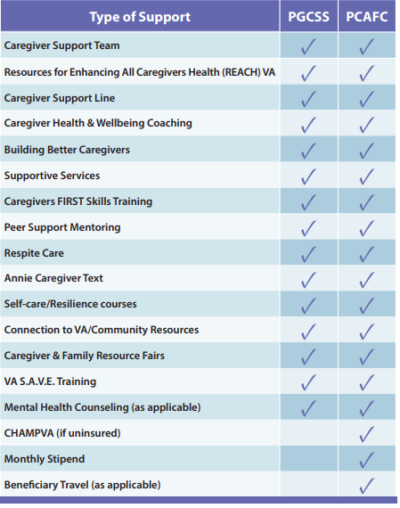
Caregiver Program Comparison

Slide 7
Program of General Caregiver Support Services (PGCSS)
No formal application required to enroll
  Reach out to VA facility CSP Team or request a referral from the Veteran’s provider
  Complete the intake with VA facility CSP Team
    Veteran will need to agree to receive care from the caregiver, will be noted in healthcare record
  Enroll and begin utilization of the support and services offered
PGCSS Caregivers are called General Caregivers
  No requirement to be related to or live with the veteran

Slide 8
Program of Comprehensive Assistance for Family Caregivers (PCAFC)
PCAFC offers enhanced clinical support and services for caregivers of eligible Veterans who have a serious injury/illness and require in-person personal care services.
Formal application required to enroll – Ten Step Process
  Eligibility Decision within 90 Days of Application Receipt
  VA Form 10-10CG
Qualifying Care and Eligibility for Veterans
Caregiver Eligibility – 1 primary & up to 2 secondary
  Primary: MUST reside with the Veteran
  Secondary:
    Serve as backup support for the primary caregiver when needed
    May receive mental health counseling and beneficiary travel benefits

Slide 9
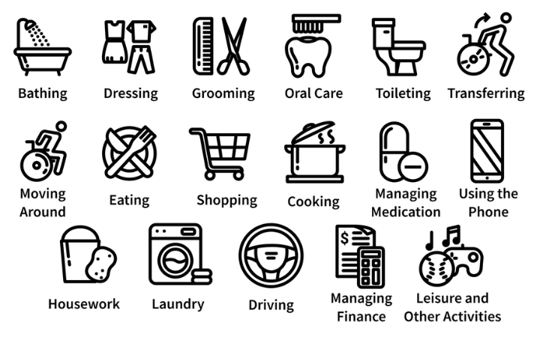
Qualifying Care for Veteran
Veteran must need continuous in-person care and require assistance with activities of daily (ADLs) living for at least six-months
Basic/Primary – simple functioning tasks
  Bathing
  Dressing
  Toileting
Executive/Instrumental – more complex tasks
  Driving
  Managing Finances
  Medication

Slide 10
PCAFC Eligibility Criteria
Veteran – all the following must be true:
  Veteran must have a VA disability rating, individual or combined, of 70% or higher, and
  Veteran was discharge from the U.S. military or has a date of medical discharge, and
  Veteran must need at least 6 months of continuous, in-person personal care services
Caregiver – must be at least 18 years old and at least one of the following must be true:
  You’re a spouse, son, daughter, parent, stepfamily member, or extended family member of the veterans, OR
  You live full time with the veteran, or you’re willing to live full time with the veteran if designated as the family caregiver

Slide 11
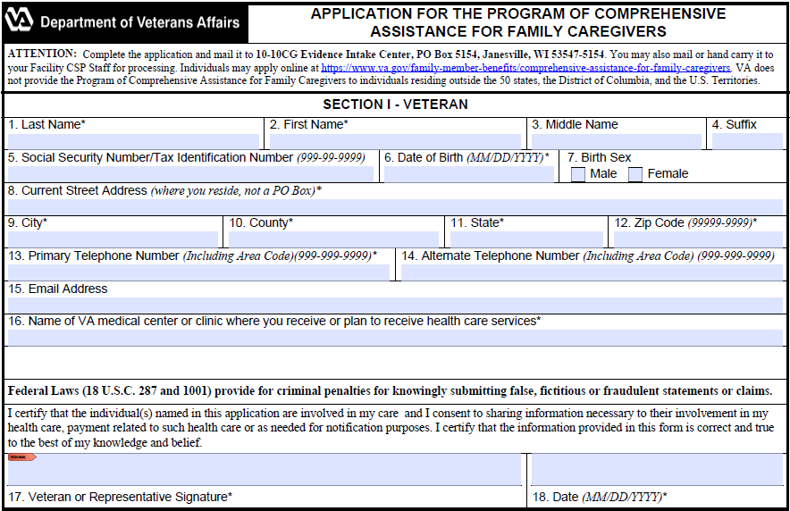
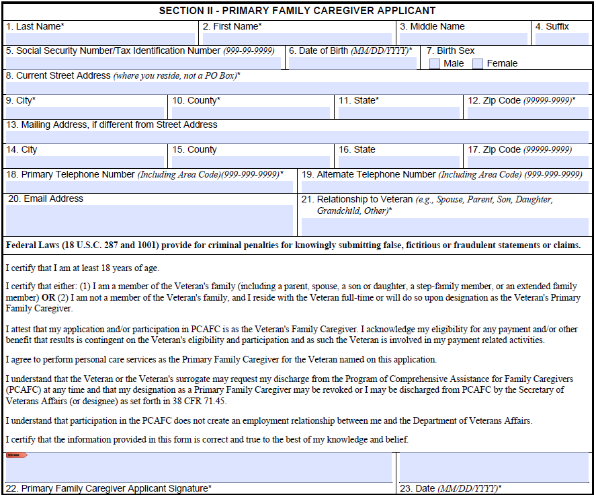
How to Apply
Utilizing an Accredited Veteran Service Officer
Apply on-line
You can apply by mailing your 10-10CG to:
  10-10CGEvidence Intake Center
PO Box 5154
Janesville, WI 53547-5154
Find your local Caregiver Support Team
  You can apply in person, or
  Call 1-855-260-3274

Slide 12
PCAFC Ten Step Process
Application Submission
Application Intake – CSP Team conducts review of forms with Veteran & Caregiver (phone, in-person, VA Video Connect)
Veteran Assessment – CSP Team conducts clinical assessment with Veteran with Caregiver input
Caregiver Assessment – CSP Team conducts clinical assessment with each Caregiver
Veterans Functional Assessment – Assess Veterans functional abilities conducted by CSP Clinical Assessor
Initial Application Review – Review of Veterans Medical Records (including all PCAFC assessments above)
Caregiver Training
Home-Care Assessment – CSP Clinical Assessor conducts assessment in home where Veteran will be residing
Final Application Review – Final Eligibility Review
Notification of Approval – For Veteran & Caregivers Individually

Slide 13
Benefits for the Veteran in PCAFC
This program supports the health and wellness of veterans by:
  Providing the veteran with increased independence
  Provides safety, protection and or instruction
  Provides support for personal needs:
    Feeding
    Bathing
    Dressing
    Driving
    Cooking & Cleaning
    Medication

Slide 14
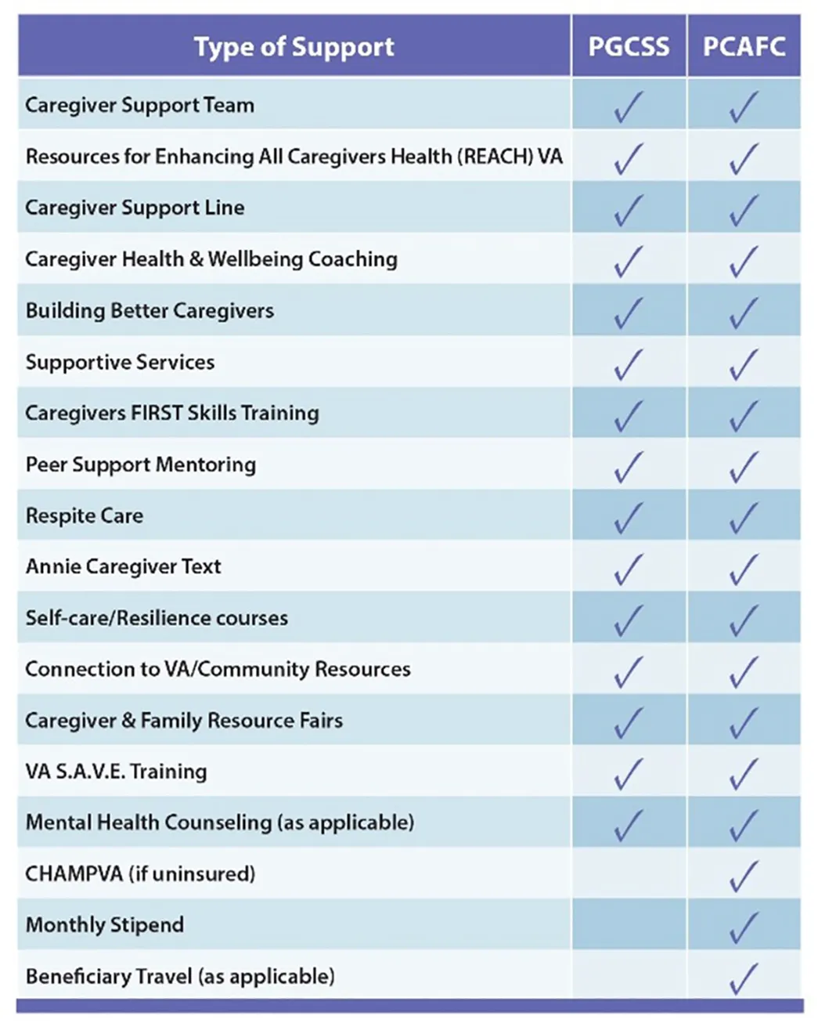
Benefits for a PCAFC Caregiver
Comprehensive training
Peer support
A monthly stipend is payable to the Primary Caregiver
Eligibility to CHAMPVA for the Primary Caregiver
Mental Health Counseling
At least 30 days respite care per year for the Veteran

Slide 15
PCAFC Knowledge Check
ONLY spouses can be caregivers
  The program is open to family members, parents, or anyone who is living with the veteran full-time.
ALL veterans are eligible
  Not all veterans qualify for the program. They must have a 70% service-connection rating or higher and need continuous personal care services for at least six months and require assistance with activities of daily living.
Caregivers receive full time pay
  Only the Primary Caregiver is eligible for a stipend and the stipend IS NOT equivalent to substantial full time employment income
All Caregivers get health benefits
  Only the Primary Caregiver is eligible for ChampVA, and only if they do not have other health insurance

Slide 16
How to appeal a negative decision
VHA Clinical Review Process – this is also known as the clinical appeals process and is conducted locally.
  Conducted at the Patient Advocates/Experience Office.
Higher-Level Review – request a new review of your case by higher-level reviewer will determine if an error or difference of opinion changed the decision.
  Conducted at the VARO.
Board Appeal– Review by a Veterans Law Judge by submitting a completed VA Form 10-307 (PCAFC Notice of Disagreement (NOD))
  Conducted at the Board of Veterans’ Appeals

Slide 17
Resources
VA Caregiver Support Program
  https://www.caregiver.va.gov/
The Program of Comprehensive Assistance for Family Caregivers (PCAFC)
  https://www.va.gov/family-and-caregiver-benefits/health-and-disability/comprehensive-assistance-for-family-caregivers/
Some additional Local Agencies that may be able to assist:
  Department of Aging
  Social Security Administration
  Administration for Community Living
  Department of Health & Human Services
  Insurance Companies

Slide 18
CHAMPVA

Slide 19
What is CHAMPVA
Civilian Health and Medical Program of the Department of Veterans Affairs (CHAMPVA):
  37 CFR 17.270 is the governing regulation
  ChampVA is not an insurance plan, it is a cost share program in which VA shares the cost of covered health care services and supplies with eligible beneficiaries.
  Affordable Care Act (ACA) designates CHAMPVA as fulfilling minimum essential coverage requirements
    TRICARE
    VA Health Care

Slide 20
Basics of CHAMPVA
The beneficiary must use an authorized provider to be covered
The beneficiaries will have a $50 annual deductible, and $100 for a family
ChampVA covers 75% of the allowable amount, which is the Medicare rate, and the beneficiary pays the remaining 25%, up to $3000.00 per year

Slide 21
Eligibility for CHAMPVA
Individual must meet one of the following:
  Spouse or child of a Veteran who has been rated by VA as having a permanent and total service-connected disability, or
  Spouse or child of a Veteran who has been rated by VA as having a permanent and total service-connected disability, or
  Surviving spouse or child of a Veteran who was at the time of death rated permanently and totally disabled from a service-connected disability, or
  Surviving spouse or child of a service member who dies in the line of duty, not due to misconduct*, or
  An individual who is the Primary Family Caregiver in the Program of Comprehensive Assistance for Family Caregivers (PCAFC) who is not entitled to care and services under another health-plan

Slide 22
How to apply for CHAMPVA
Required Documents:
  VA Form 10-10d (Application for CHAMPVA Benefits)
  VA Form 10-7959c (CHAMPVA—Other Health Insurance (OHI) Certification)
  Copy of Medicare card for individuals who are eligible
  For those 65+ years old and don’t qualify for Medicare, you will need to send documentation from the Social Security Administration the confirms you don’t qualify for Medicare

Slide 23
More on how to apply
Optional Documents: (copies only)
  VBA decision showing permanent and total status, or death rating
  Veteran’s DD 214 (Certificate of Release or Discharge from Active Duty)
  Proof of Dependency
    Marriage license
      Remarried widow/widower once again single (legal documentation terminating the remarriage_
    Birth Certificate/adoption papers for children
      School certification of full-time enrollment for ages 18-23 years (original)

Slide 24
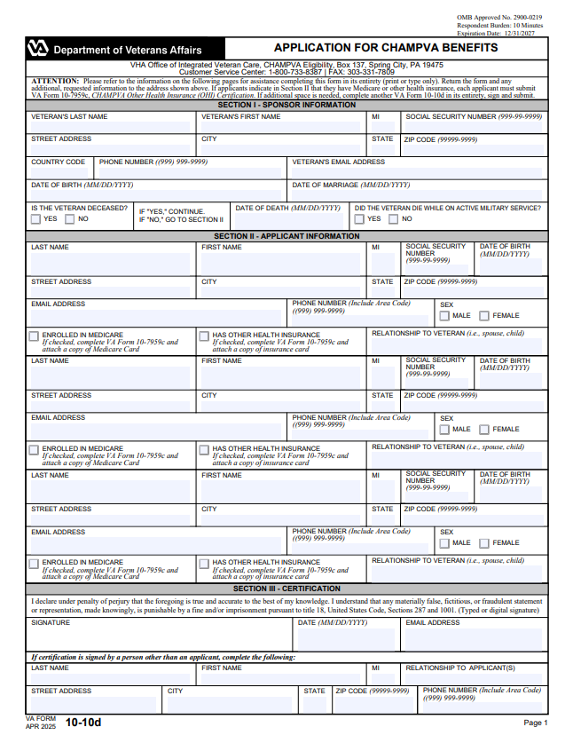
Where to apply
Apply online
Mail your application, and associated documents, to:
VHA Office of Community Care
CHAMPVA Eligibility
PO Box 137
Spring City, PA 19475
Or fax your forms: 303-331-7809

Slide 25
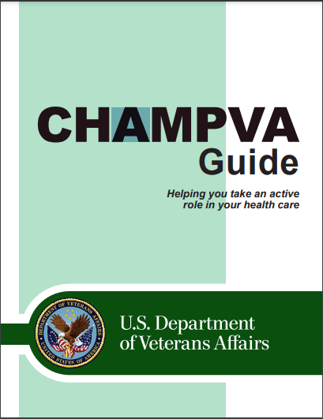
Benefits and Services
Ambulance service
Durable Medical Equipment
Family planning and maternity
Inpatient/Outpatient services
Pharmacy (prescription medicines)

Slide 26
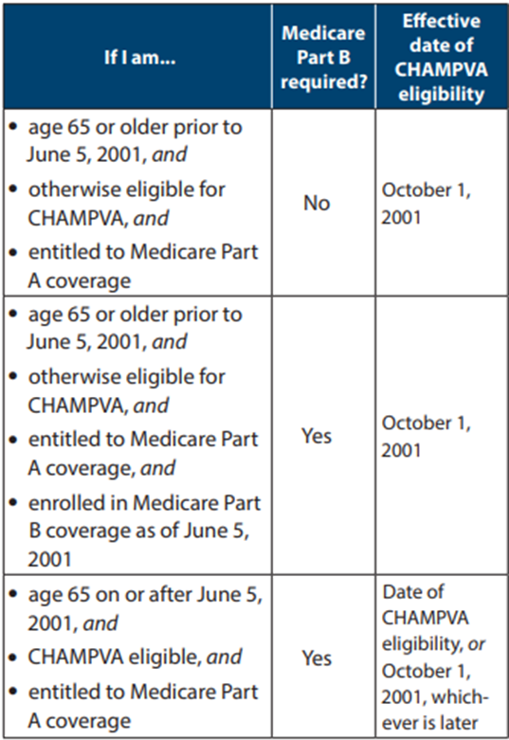
CHAMPVA and Medicare
CHAMPVA is always the second payer to Medicare
If you’re under 65 years old, you’re eligible for CHAMPVA if you meet both of these:
  You have Medicare Parts A and B, and
  You are otherwise eligible for CHAMPVA
If you’re 65 years old or older, you’re eligible for CHAMPVA if you’re eligible for Medicare.
  See chart for specific requirements

Slide 27
CHAMPVA Contact
Customer Service – Eligibility, Other Health Insurance (OHI) Coverage, and Claims
  Phone: 1-800-733-8387 (Monday - Friday, 8:05 a.m. to 7:30 p.m. ET)
  Email Ask VA: ask.va.gov
Customer Engagement Portal – Payments
  https://www.cep.fsc.va.gov/
Contact them by mail
  CHAMPVA; PO Box 469063; Denver, CO; 80246-9063

Slide 28
Resources
CHAMPVA Guide
  https://www.va.gov/COMMUNITYCARE/docs/pubfiles/programguides/CHAMPVA-Guide.pdf#
CHAMPVA Fact Sheets
  https://www.va.gov/COMMUNITYCARE/pubs/factsheets.asp#CHAMPVA
Locating a Provider
  https://www.va.gov/COMMUNITYCARE/programs/dependents/locate-provider.asp
How to File a CHAMPVA Claim
  https://www.va.gov/COMMUNITYCARE/programs/dependents/champva/champva-claim.asp

Slide 29
Final Thoughts and Questions
The VFW Healthcare Team may be able to help with healthcare issues:
  Katherine Cassell, Assistant Director of Veterans Health Policy
  202-608-8371, Kcassell@vfw.org
  Julie Holt, Special Assistant of Veterans Health Policy
  202-608-8364, Jholt@vfw.org
  Marion Fera, Health Consultant of Veterans Health Policy
  202-608-8349, mfera@vfw.org

