Slide 1
CONDUCTING AN INTERVIEW
Gregg Orto
Deputy Director, NVS
GOrto@vfw.org

Slide 2

OBJECTIVE
In this class, we are going to discuss how to prepare for and conduct an interview.

Slide 3
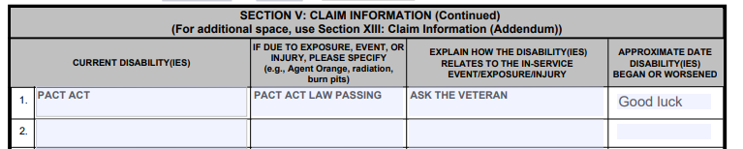
INTRO
“I need to file a claim for Pact Act!”
“There is no such condition as ‘Pact Act’”
“You are my rep and I need you to file me claim for Pact Act or I’m going to DAV”

Slide 4

PURPOSE
Interviews clarify
Interviews help manage expectation for the veteran
“Whassup?. What’cha need?”
Notes:
Veterans may not know what they need until they talk to a representative: Appeal, Initial Claim, DIC, Health Care enrollment etc

Slide 5
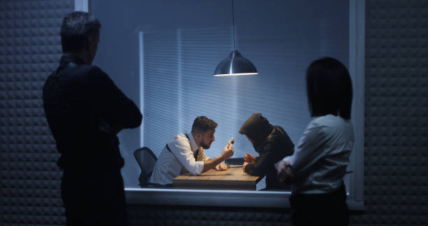
TYPES OF INTERVIEWS
What are some types of interviews?
Miscommunication Interview
What is the most common interview used by VFW service officers?
Hiring
Criminal
Intake Interview
Intake Interview
Notes:
Types of interviews:
Job Interview, Journalistic/Talk show, Police questioning, Medical appointments
Intake interview is the most common.

Slide 6

PREPARATION
What should the service officer do prior to veteran’s arrival?
Connectivity?
Forms
References
Notes:
Possible items – Forms, references, contact numbers for agencies to get additional evidence or financials, etc
Prior to arrival – Log into needed systems and ensure connectivity, Familiarize yourself with claim and veteran details, Protect PII
Update TVB with any 21-22 info or other updates

Slide 7
PREPARATION
How do you set up your veteran for success?
  Did you let them know what to bring?
  Do you have a checklist you send?
How were they referred to your office?
  What might this tell you if they were referred by the Vet Center?
What should you make sure the veteran understands before the initial interview?
  What is your security like in your building…what about parking?
Notes:
What items to bring – DD214, Wedding/Divorce certificates, Dependent SSNs etc
Referral – How they were referred will also indicate what the veteran needs, whether it be via friends, Vet Center, Shelter or other sources
Set expectations before meeting with the veteran, Security requirements

Slide 8


ENVIRONMENT – Your Attire
Dress properly
- What is your office dress code?
- Shirt Check…
- Wrinkles?
- Collared Shirt?
- Does it pass the smell fresh test?
Notes:
Turn display screen away from client if possible
Anticipate potential situations – bathroom, food, exits

Slide 9

ENVIRONMENT - PII
Check the office to not have claims or records sitting out
That last veteran you assisted…is that info still on the screen or desk?
Notes:
Turn display screen away from client if possible
Anticipate potential situations – bathroom, food, exits

Slide 10
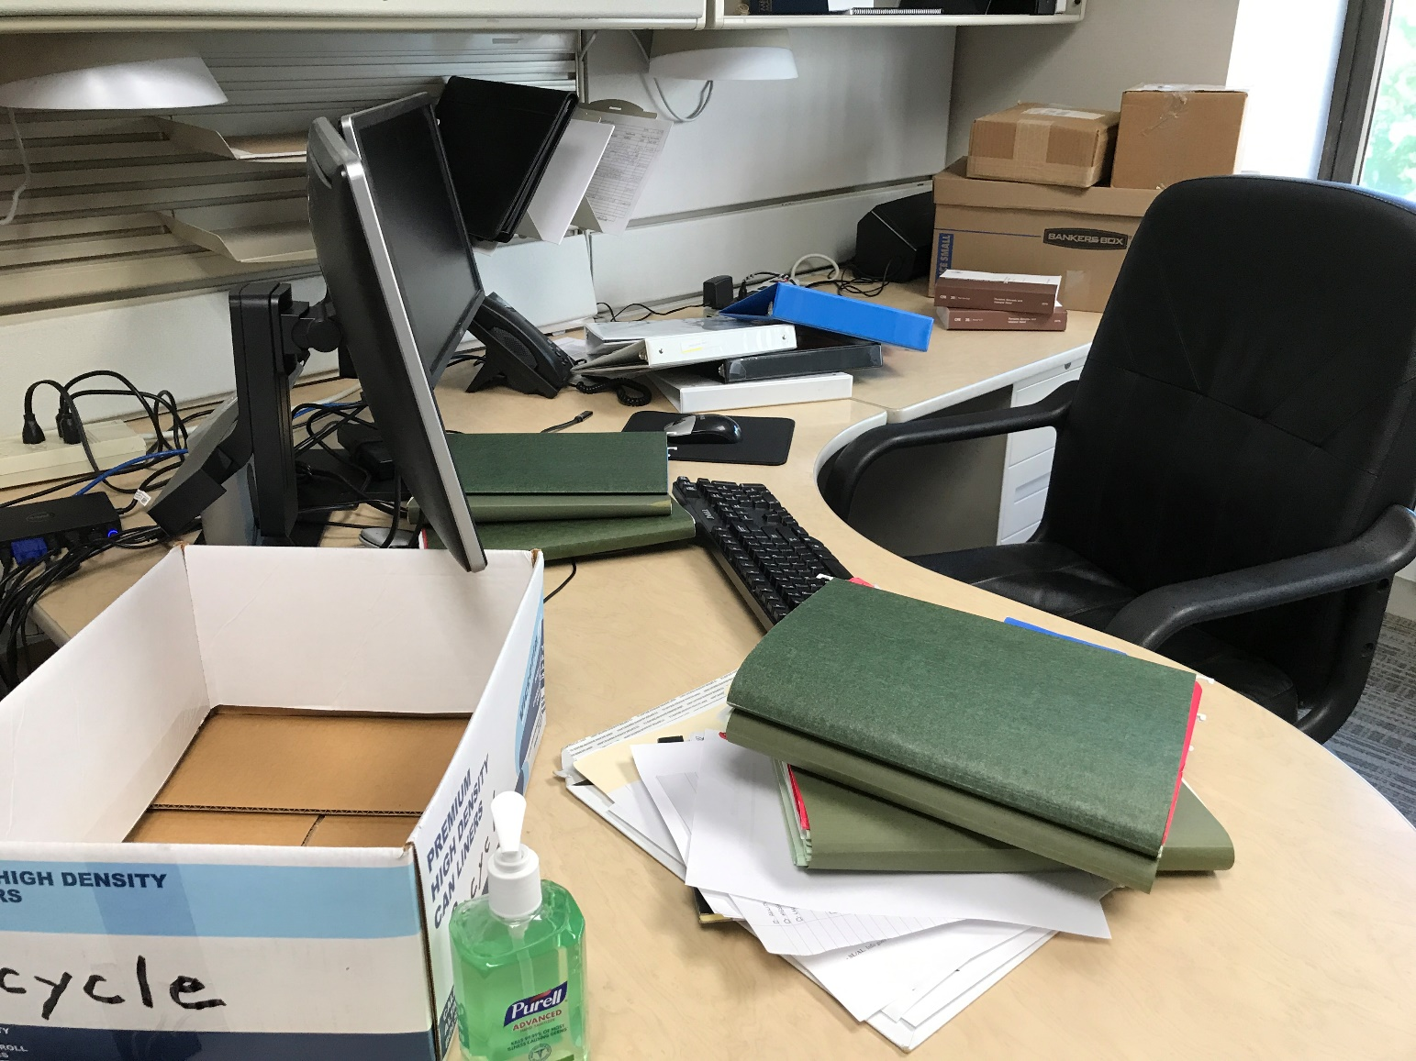
ENVIRONMENT – Office/Desk
Is this your desk?
Look at your space from the veteran’s point of view
Bring in a friend or family member to view your space
Is their chair lower than yours?
Notes:
Turn display screen away from client if possible
Anticipate potential situations – bathroom, food, exits

Slide 11
LIMIT DISRUPTIONS – Privacy
Do you use an “in meeting” sign?
  Not a “Go Away” Sign
Are disruptions frequent in your office when you have a client?
What do you do about incoming calls?
  What signal does it send to your veterans if you take a call during the interview?
Notes:
Note: hold all calls, veterans deserve all your attention
Do not have people walk in and out of your office while conducting interview. PRIVACY is critical when interviewing. You do not know what they have been through.

Slide 12
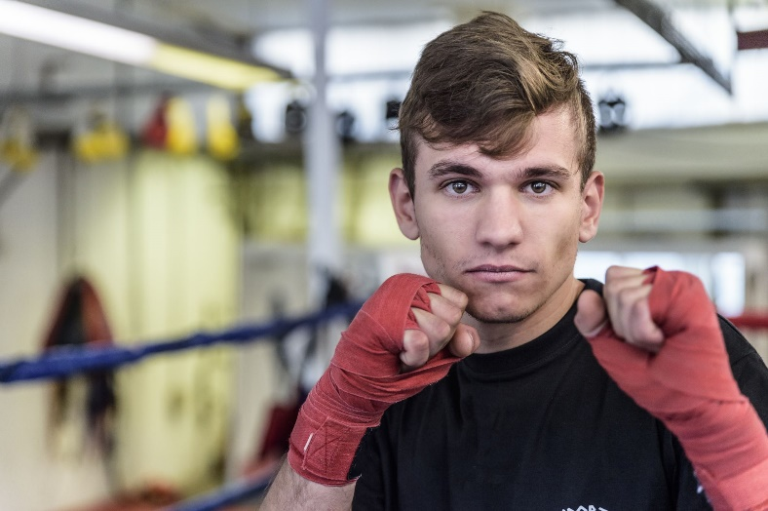
INTRODUCTIONS
Introduce yourself to the veteran or claimant
  Handshake or Fist bump?
  Please don’t shake someone’s fist bump
Let the veteran know your background
  “I’m a Navy veteran” or “My brother is Army”
  Common ground helps build rapport
Ask the purpose of the visit
Not this
Notes:
If the claimant has brought another person in, explain the process and try to read if you need time with just the veteran.
Determine the issue(s) to be raised
Discuss what benefits are available

Slide 13


SET THE TONE
When setting the tone, consider:
Context of meeting
  Reductions, appeals…how pleasant are those?
Introduction/greeting
  Do you greet the veteran when they arrive?
  Get up from the desk and meet at the door if possible
Notes:
Survivors, reductions: this is not going to be as cheery of a visit. Pay attention to your body language – psyche yourself up for the interview. Veteran’s privacy is paramount - lead to interview space before discussing sensitive topics

Slide 14
Representation
First form?
  VA 21-22
  Does it need to be updated?
  What has been your experience with older VA 21-22s?
  What about veterans who want to switch to VFW?
Notes:
Note:
Stress importance of communication added in system.
If the veteran is represented by another agency, direct them to that agency unless they have a legitimate reason to switch representation.

Slide 15
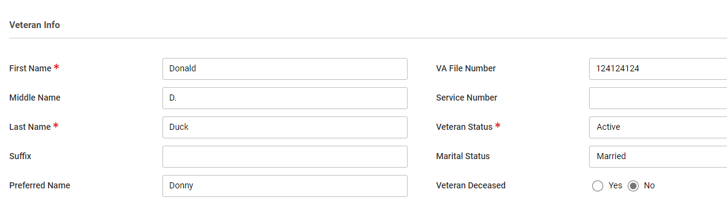
TVB/Claims Management System
Get the basic info into TVB/claims management system
  It will help populate forms
  Don’t forget the communications section.
    This assists other service officers
Notes:
Note:
Stress importance of communication added in system.
If the veteran is represented by another agency, direct them to that agency unless they have a legitimate reason to switch representation.

Slide 16
MAKE SURE YOU ARE UNDERSTOOD
“Do you understand the words that are coming out of my mouth?!”
Avoid jargon
  “Let me fire up old Jake the computer and see what’s in VBMS”
  “I see what you put in SEP, but it’s not cested yet”
  “Let me get this on a TPS report. The boss wants it on there”
Consider the client’s background, do not condescend
  “You filled out section II on the 674. Did you not read the instructions?”
  Think of VA forms like IRS forms. It’s just as foreign to the veteran
Notes:
Use proper language that will not be taken inappropriately. Avoid using slang words.
You are here to assist people. Respect every individual, do not talk down to people.

Slide 17
ACTIVE LISTENING – This is difficult
During an interview, use the following active listening steps:
Turn your focus to your customer/your client
Listen carefully to what he/she is saying
Restate what you heard
Allow the client to correct or clarify the information
Notes:
Note: if necessary ask veteran to clarify point. This will inform person that active listening is occurring.

Slide 18
The question type can influence the level of detail received
TYPES OF QUESTIONS
Close-ended Vs
Requires only short or single word answers
Provides factual information
Service Officer controls conversation
Open-ended
Allows for elaboration
Provides information containing opinions and feelings
Gives veteran control of the conversation
Notes:
Note: learn to select which type of questions are to be asked depending on the topic, situation and time restriction.
*emphasize that types of questions are important for hearings too… will be taught later in week.
The type of person also dictates the type of question along with topic situation and time

Slide 19
IDENTIFY POTENTIAL ELIGIBILITY TO BENEFITS
Listen to conversational cues
“I see you are retiring from the military in 4 months. Are you staying in the area?”
“Yes and we are looking at buying a new home - we’re looking to downsize since our kids are all off to college now”
Notes:
Repeated questions without context can seem like you are interrogating
Conversational cues clue you in to needs not previously mentioned – VA home loan guaranty, DEA/dependency

Slide 20
COMMUNICATING
WITH THIRD PARTIES
Remember the claim is the client’s
Family members in the interview?
Family member who may be a veteran; set a date/time for their claim
Ensure a VA form 21-0845 is signed by client if claim information is to be disclosed to a third party
What if veteran says – Do not disclose to my spouse.
  Note it in their claims management file, and never assume
Notes:
Don’t be late. Respect people’s time. If another appointment will run into someone else’s time schedule current appointment for a follow up or at least go inform your client waiting of your delay.
Keep conversations on topic.
Address people with proper respect. Treat people as you would like to be treated.
Don’t lie, only provide factual information. You are not expected to know every regulation, but you should know how to gather the correct information (network).

Slide 21
STRONG EMOTIONS:
ALWAYS REMAIN PROFESSIONAL
Sometimes veterans come in with “baggage”
Don’t argue with the veteran.
Tearful veterans
Veterans who get off topic, “And this scar was when I was in…”
Disrespectful veterans. We reserve the right to revoke our representation if necessary

Slide 22
ENDING THE INTERVIEW
AND FOLLOWING UP
Thank them for their visit/call, and walk them to the lobby
“Oh one other thing…” What do you do?
Add summary in TVB/claims management system
Notes:
Non-verbal body language to let them know interview is over – stand up, raise/lower pitch of voice, give office contact information

Slide 23
Transition Assistance Program Participation
VSOs may participate in the VA day for TAP:
VA accredited (OGC #)
Have a PIV card and access to the VA desktop
Sign up in the VA system (be logged into your VA desktop)
  https://dvagov.sharepoint.com/sites/vbaoted/apps/vsoReg/vsoEventRegistration.aspx
Don’t be a no show - We get a monthly by-name report on slackers
Notes:
Non-verbal body language to let them know interview is over – stand up, raise/lower pitch of voice, give office contact information

Slide 24
Transition Assistance Program Participation
Great opportunity to let Service Members know you are there to help them!
You are usually their first contact with a VFW rep
Not a membership drive – This is your opportunity to show your support for Service Members
Attire – business casual at the minimum
  It is a myth you get class credibility by walking in with a Harley Davidson t-shirt and jeans
Notes:
Non-verbal body language to let them know interview is over – stand up, raise/lower pitch of voice, give office contact information

Slide 25
TAP Details
15 minute time slot at the end of the VA TAP day
Cannot bring slide with you – there is a generic slide in the TAP circulum
Bring cards, bring your service hat
Please remember you are a guest on the military installation and further, a guest of the VA
Notes:
Non-verbal body language to let them know interview is over – stand up, raise/lower pitch of voice, give office contact information

Slide 26
?’s

