Slide 1
EDUCATION BENEFITS OVERVIEW

Slide 2
TOPICS
VA Education Programs
VR&E (Chapter 36)
Fry Scholarship
VA Training Programs
VFW Programs
Q & A

Slide 3
VA EDUCATION PROGRAMS
Post 9-11 GI Bill
Forever GI Bill
Montgomery GI Bill
Survivor & Dependent Benefits
Work Study
Tutorial Assistance
Non-College Degree Programs

Slide 4
POST 9-11 GI BILL
ELIGIBILITY
Served at least 90 aggregate days on active duty* after 9/11/2001
Honorable discharge from active duty for a service-connected disability after serving 30 continuous days following 9/11/2001
BENEFITS
Based on number of months served on AD
Tuition & Fees paid to School
Public School – All Tuition & Fees for In-State Student
Private School - $29,920.95 per year maximum
*$29,920.95 Effective 1 August 2025 to 31 July 2026
Flight training (a non-degree certificate or rating program): VA will pay the net tuition and mandatory fees up to $17,097.67

Slide 5
POST 9-11 GI BILL
Member Serves | Percentage of Maximum Benefit Payable
At least 36 months | 100%
At least 30 continuous days on active duty and must be discharged due to service-connected disability | 100%
At least 30 months, but less than 36 months | 90%
At least 24 months, but less than 30 months | 80%
At least 18 months, but less than 24 months | 70%
At least 12 months, but less than 18 months | 60%
At least 06 months, but less than 12 months | 50%
At least 90 days, but less than 06 months | 40%
Notes:
Basic Training and AIT do not count towards the AD day count .
All Title 10 active duty supporting named contingency operations
Title 32 service for the purpose of organizing, administering, recruiting, instructing, or training the National Guard
Title 32 service under section 502(f) for the purpose of responding to a national emergency
All voluntary active duty, with the exception of active duty for medical care and medical evaluation
Title 10 service under 502(f): Title 10 service under 12301(h) for the purpose of receiving service-related medical care
A reservist who receives a Purple Heart for service occurring on or after September 11, 2001.
Service under 12304, 12304a, and 12304b orders, mobilization to provide assistance in response to a major disaster or emergency or for preplanned missions in support of combatant commands
Individuals ordered to active duty under section 12301(h) of title 10, USC to receive authorized medical care, to be medically evaluated for disability or other purposes, or to complete a required Department of Defense healthcare study.
All forms of inactive duty training (drills and funeral honors), as well as annual training do not qualify for the Post-9/11 GI Bill education benefit.
The following chart outlines the breakdown of benefits based on amount of service:

Slide 6
POST 9-11 GI BILL
BENEFITS (Continued)
Book Stipend - $500 per semester/$1K year
Monthly Housing Allowance (MHA)
Based on E-5 w/Dependents Rate
Zip Code of campus – majority of classes
One-time Payment – Rural Benefit - $500
Transferability Option
Yellow Ribbon Program
https://www.benefits.va.gov/gibill/education_programs.asp

Slide 7
TRANSFERABILITY
Allows transfer of all or some unused benefits to spouse or dependent children
Any member of the Armed Forces (AD or RC, officer or enlisted) on or after 1 August 2009, who is eligible for the Post-9/11 GI Bill, AND
Has at least 6 years but not more than 16 years of service in the Armed Forces on the date of election and agrees to serve 4 additional years from the date of election, OR
Has at least 10 years of service in the Armed Forces (AD or RC) on the date of election, is precluded by either standard policy (service or DoD) or statute from committing to 4 additional years, AND agrees to serve for the maximum amount of time allowed by such policy or statute
Transfer requests must be submitted & approved while the member is on active duty
https://www.va.gov/education/transfer-post-9-11-gi-bill-benefits/

Slide 8
FOREVER GI BILL (FGIB)
Harry W. Colmery Veterans Educational Assistance Act
34 provisions improves and extends benefits
Eliminates the 15-year expiration date:
Veterans who departed AD on or after 1 January 2013
Restoration of benefits due to school closures
Transfer of Reserve Benefits to Post 9/11 GI Bill
Work Study Programs permanently authorized
Independent Study Programs authorized

Slide 9
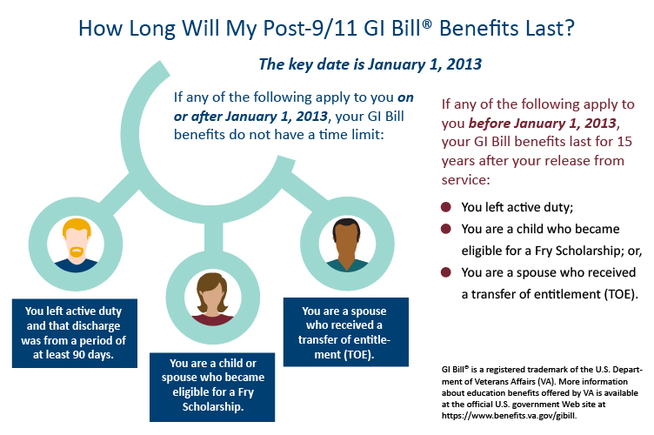
FOREVER GI BILL

Slide 10
FOREVER GI BILL - IMPACTS
VA started implementing provisions in August 2017. Some highlights include:
School Closure Eligibility Restoration. VA is authorized to restore benefits to Veterans affected by school closures or some program disapprovals.
Restore entitlement used during the term when the school closed
Can continue receiving housing payments until the original end of the term or for 120 days (whichever occurs sooner)
Priority Enrollment. Certain schools offer priority enrollment for Veterans with the GI Bill Comparison Tool. Visit the VA.GOV website
Reserve Educational Assistance Program (REAP) Eligibility Credited Toward Post-9/11 GI Bill Program. The individuals who lost their eligibility to REAP may apply for the Post-9/11 GI Bill. VA sent letters with instructions to the eligible individuals.

Slide 11
FOREVER GI BILL - IMPACTS
Active Duty and Housing Allowance
Those leaving active duty are eligible for the Post-9/11 GI Bill housing allowance day of discharge
Purple Heart Recipients
100% Post-9/11 GI Bill benefits if served on or after September 11, 2001. Regardless of length of service.
Yellow Ribbon for Purple Heart and Fry Recipients
May use beginning August 1, 2018
Informing Schools About Beneficiary Entitlement
VA will share entitlement information with schools, students can opt out
Less Entitlement Charged for License and Certification No longer taking an entire month of benefits

Slide 12
FOREVER GI BILL - IMPACTS
Changes to Survivors’ and Dependents’ Educational Assistance (DEA) Program.
The new law increases the amount of educational assistance payable under DEA but decreases the amount of entitlement that new eligible individuals will receive from 45 months to 36 months
Changes to Transfer of Benefits (TEB).
Veterans who transferred entitlement to a dependent can now designate a new dependent if the original dependent dies. If the Veteran dies, a dependent who received transferred entitlement can now designate a new eligible dependent of the Veteran to transfer any of the dependent’s remaining entitlement.
GI Bill Monthly Housing Allowance.
Housing will be paid based on the “campus” where the student attends the majority of classes.

Slide 13
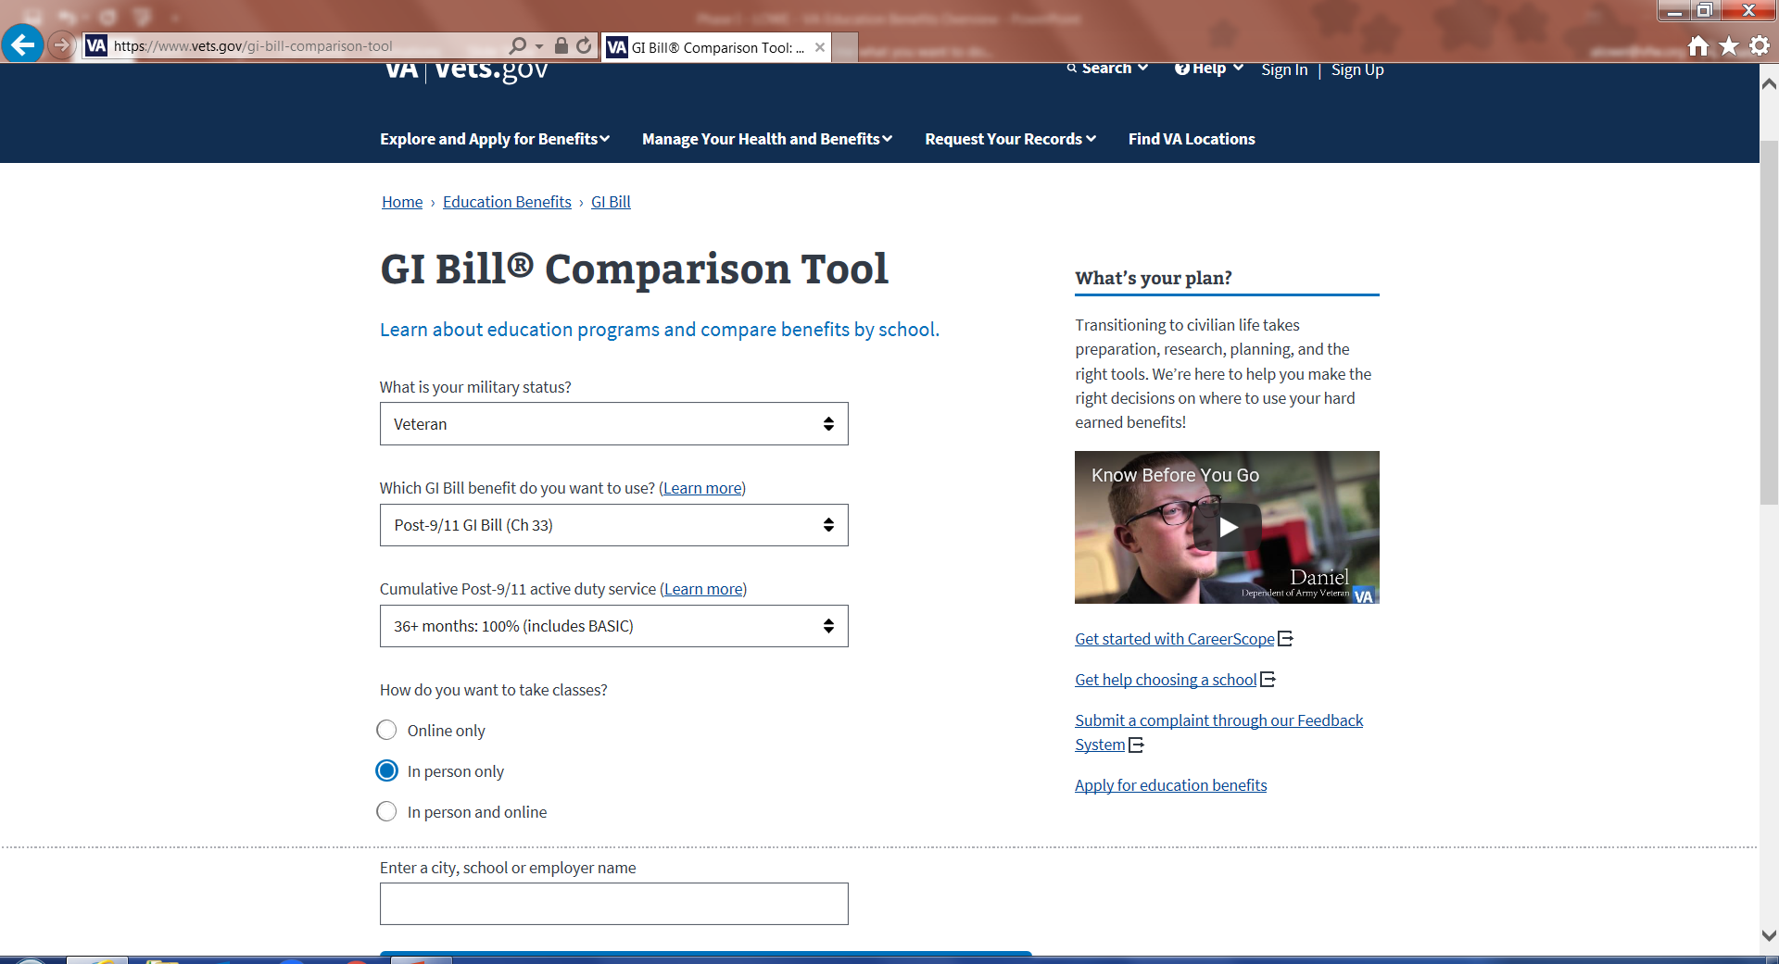
GI BILL COMPARISON TOOL

Slide 14
MONTGOMERY GI BILL
First entered active duty on or after 1 July 1985
Minimum 2 years of service
*Paid $1200 to participate in the program
Has an Honorable period of qualifying service
Obtained a high school diploma, or GED or equivalent, prior to applying for the benefits
$600 Buy-Up Option = $5400 additional benefits
* Refundable if eligible for Post 9/11 GI Bill
https://www.benefits.va.gov/gibill/mgib_ad.asp
Notes:
* Refundable $1200 if eligible for Post 9/11 Benefit also

Slide 15
MGIB AD - BENEFITS
Up to 36 months of benefits, up to 10 years following release from active duty
Benefits may be applied to;
degree and certificate programs
flight training
apprenticeship/on the job training
correspondence courses
Funds are paid to the student
https://www.benefits.va.gov/gibill/mgib_ad.asp

Slide 16
CURRENT RATE OF PAY
Institutional Training
Training Time | Monthly rate
Full time | $2,518.00
¾ time | $1,888.50
½ time | $1,259.00
less than ½ time more than ¼ time | $1,259.00**
¼ time or less | $629.50**
As of October 1, 2025
** Tuition & Fees only. Cannot exceed this amount
https://www.benefits.va.gov/GIBILL/resources/benefits_resources/rates/ch30/ch30rates100120.asp

Slide 17
MGIB – RESERVE COMPONENT
Montgomery GI Bill Selected Reserve Chapter 1606
6 year commitment (after 6/30/1985)
36 months of eligibility (max)
Paid to the student
Ends upon ETS from selected reserve
https://www.benefits.va.gov/gibill/mgib_sr.asp

Slide 18
ELIGIBILITY
First entered active duty after 30 June 1985 and did not decline MGIB
Veterans entitled to Chapter 34 under Vietnam era GI Bill
Certain veterans involuntarily separated under certain conditions and those separated under VSI (Voluntary Separation Incentive) or SSB (Special Separation Benefit)
Former Veterans Educational Assistance Program (VEAP) participants who converted to MGIB
https://www.benefits.va.gov/gibill/mgib_sr.asp

Slide 19
CURRENT RATE OF PAY
Institutional Training
Training Time | Monthly rate
Full time | $493.00
3/4 time | $369.00
1/2 time | $246.00
Less than 1/2 time | $123.25
https://www.benefits.va.gov/GIBILL/resources/benefits_resources/rates/ch1606/ch1606rates100120.asp

Slide 20
SURVIVOR AND DEPENDENT EDUCATION ASSISTANCE
Marine Gunnery Sergeant John David Fry Scholarship
Survivors and Dependents’ Educational Assistance Program (Chapter 35)
https://www.benefits.va.gov/gibill/survivor_dependent_assistance.asp

Slide 21
FRY SCHOLARSHIP
Eligibility
Children and surviving spouses of A/D who died in the line of duty on or after Sept 11, 2001
Children Ages 18 to 33
Spouses have a *delimiting period of 15 years from date of death. Eligibility is lost upon remarriage
Must make an irrevocable choice between Fry and DEA.
Surviving spouses are eligible to receive DIC while using the Fry Scholarship
Children in receipt of DIC must relinquish it upon use of Fry Scholarship
May now use the Yellow Ribbon Program also
*Delimiting date removed if eligibility began after 1/1/2013
https://www.benefits.va.gov/GIBILL/Fry_scholarship.asp

Slide 22
YELLOW RIBBON PROGRAM
Allows approved institutions of higher learning & the VA to partially or fully fund tuition & fee expenses that exceed the established thresholds under the Post-9/11 GI Bill
Matching Funds by the School & VA to cover the difference
Tuition & Fees only – Not Room & Board
School must participate, but is limited w/the number of quotas that it allocates

Slide 23
SURVIVOR AND DEPENDENT EDUCATION (CHAPTER 35)
Chapter 35 provides education benefits to the spouse and children of:
Service members who died on Active Duty
Veterans who died or are permanently & totally (P&T) disabled due to a service connected (S/C) disability
Veterans who have died from any cause while such P&T S/C disability existed
https://www.benefits.va.gov/GIBILL/DEA.asp

Slide 24
SURVIVOR AND DEPENDENT EDUCATION (CHAPTER 35)
Benefit expiration
Surviving spouses - Veteran
10 years from date of eligibility or death of Veteran
If VA rated Veteran 100% P/T within 3 years of discharge – 20 years
Surviving Spouses – Service Members
20 years from date of death
Children
Ages 18-26
https://www.benefits.va.gov/GIBILL/DEA.asp

Slide 25
SURVIVOR AND DEPENDENT EDUCATION
Service member MIA or captured by hostile force.
Service member forcibly detained or interned in the line of duty by a foreign government.
Service member who is hospitalized or receiving outpatient treatment for a S/C P&T disability and is likely to be discharged for that disability
If child qualifies for both Fry and DEA
May be eligible for both, but only use one at a time
81 months total of full-time training (not concurrent)
https://www.benefits.va.gov/GIBILL/DEA.asp

Slide 26
CHAPTER 35 RATES
Institutional Training
Training Time | Monthly rate
Full time | $1,574.00
¾ time | $1244.00
½ time | $912.00
less than ½ time and more than ¼ time | $912.00 **
¼ time or less | $393.50 **
As of October 1, 2025
https://www.benefits.va.gov/GIBILL/resources/benefits_resources/rates/ch35/ch35rates100120.asp

Slide 27
WORK STUDY
Training on a full time or ¾ time basis
Post-9/11 GI Bill--(Chapter 33) (Veterans and transfer-of-entitlement recipients)
Montgomery GI Bill--Active Duty (Chapter 30)
REAP Participants
Montgomery GI Bill--Selected Reserve (Chapter 1606)
VEAP (Chapter 32)
Dependents’ Educational Assistance Program (Chapter 35)
National Call to Service Participants
Vocational Rehabilitation & Employment Program -- (Chapter 31)
https://www.benefits.va.gov/gibill/workstudy.asp

Slide 28
WORK STUDY
VFW service offices can request to have a work study assist in the office
Though they would not be accredited, individuals using the work study program can help with administrative duties in the office
Contact your VARO Voc Rehab department to see if there is any availability for your office
Notes:
service offices can request VA work study students (as long as not on active duty) to help with VFW Department activities, especially admin help

Slide 29
NON-COLLEGE DEGREE PROGRAMS
Available for training at non-college-degree institutions
HVAC Repair
Truck Driving Schools
EMT Training
Barber/Beautician/Cosmetology School
Benefit based on number of clock hours attended each week of month
Payments are issued after the training is complete
https://www.benefits.va.gov/gibill/non_college_degree.asp

Slide 30
VA TRAINING PROGRAMS
Flight
Co-Op
National Testing
Licensing and Credentialing

Slide 31
FLIGHT TRAINING
Must have a private pilot license and medical certification certificates
Payments are issued after the training is completed and the school submits your enrollment information to VA.
Payment Amounts Under the Montgomery GI Bill
If using the Montgomery GI Bill, VA will reimburse 60% of the approved charges.
If using Post 9/11 GI Bill, payments will be based on the type of school (public, private, or vocational)
https://www.benefits.va.gov/gibill/flight_training.asp

Slide 32
CO-OP TRAINING
Attending school part-time and working full-time
Payment amount varies based on the GI Bill Program utilized
Post 9/11
Public - in-state tuition & fees
Private – Lesser of national maximum or in-state tuition & fees
Other GI Bills
Monthly rate varies based on program and how long qualifying service was
https://www.benefits.va.gov/gibill/coop_training.asp

Slide 33
NATIONAL TESTING
Reimbursement for mandatory national tests
Registration, Fees, Admin Fees for tests such as:
SAT
LSAT
GRE
GMAT
CLEP
ACT
MCAT
Reduces overall GI Bill Benefit
https://www.benefits.va.gov/gibill/national_testing.asp

Slide 34
LICENSING & CREDENTIALING
Additional licensing and credentialing required for employment
Up to $2000 per test - Reimbursed
Unlimited number of attempts, but it reduces your GI Bill Benefit
Apply for reimbursement within one-year of test date
https://www.benefits.va.gov/gibill/licensing_certification.asp

Slide 35
VETERAN READINESS & EMPLOYMENT (VR&E)
Program offers personalized counseling and support
Career path
Goal accomplishment
Most effective use of VA benefits
Veteran Employment Tracks
Reemployment
Rapid Access to Employment
Self-Employment
Employment through long-term services
Independent living
https://www.benefits.va.gov/VOCREHAB/index.asp

Slide 36
VETERAN READINESS & EMPLOYMENT (VR&E)
ELIGIBILITY
Active Duty
Expect to receive Honorable/Other than Dishonorable Discharge
Memo rating of 20% or more VA Disability
Veterans
Other than dishonorable discharge
Minimum 10% SC Disabled
Expires 12 years from separation from Active Duty* or
Date veteran was first notified of a VA SC disability rating if discharged before 1 January 2013
If discharged after 1 January 2013, there is no time limit on eligibility.
* May be extended due to serious employment handicap
https://www.benefits.va.gov/vocrehab/eligibility_and_entitlement.asp

Slide 37
VETERAN READINESS & EMPLOYMENT (VR&E)
ENTITLEMENT DETERMINATION
Veteran meets with Veteran Rehabilitation Counselor (VRC) to determine if employment handicap exists
Assessment of Veteran’s interest, aptitudes and abilities
Assessment of whether SC disabilities impair the Vet’s ability to find and/or hold a job using occupational skills already developed
Vocational exploration and goal development leading to employment and/or max independence
Employment Handicap
Determine transferable skills, aptitudes, and interests
Identify viable employment and/or independent living options
Explore labor market and wage information
Develop individualized rehab plan to achieve goals
https://www.benefits.va.gov/vocrehab/eligibility_and_entitlement.asp

Slide 38
VFW PROGRAMS
Voice of Democracy
Patriot’s Pen
VFW/SVA Fellowship
1 Student Veteran
Sports Clips – Scholarship

Slide 39
VFW PROGRAMS - VOICE OF DEMOCRACY
Available scholarships for High School students
3-5 min audio essay – Patriotic Theme (Changes Each Year)
Submitted to Department (State) NLT - 31 October
Must be in grades 9-12 by the deadline
Minimum $1K for each Department (State) Winner
All expense paid trip to Washington DC – March
First-place winner - $30K Paid to College/University
https://www.vfw.org/community/youth-and-education/youth-scholarships

Slide 40
VFW PROGRAMS – PATRIOT’S PEN
Available for Middle School students (Grades 6-8)
Written Essay no less than 300 but no more than 400 words
Patriotic Theme – changes every year
Submitted to VFW Post NLT – 31 October
Minimum $500 for each Department winner
All expense paid trip to Washington DC – March
First-place winner - $5K
https://www.vfw.org/community/youth-and-education/youth-scholarships

Slide 41
VFW PROGRAMS – VFW/SVA FELLOWSHIP
Partnership with Student Veterans of America
10 Fellows selected each year
Must be eligible for VFW membership
Active SVA chapter at college/university
Essay submission of advocacy proposal on four priority issues for the veteran community
https://www.vfw.org/studentfellowship

Slide 42
VFW PROGRAMS – 1 STUDENT VETERAN
Partnership with Student Veterans of America
Provides resources and guidance to student veterans
Difficulties with benefit payments
Explanation of benefits
1StudentVeteran@vfw.org
https://www.vfw.org/assistance/student-veterans-support

Slide 43
VFW PROGRAMS – HELP-A-HERO SCHOLARSHIP
Sponsored by Sport Clips
Scholarships up to $5000 to qualified applicants
Honorably discharged, retired, active duty, reserve component
Separated with or currently hold military rank of E-5 or below
Completed Basic Training and follow-on training (AIT, Tech School, etc.)
Demonstrate a need for financial assistance
Currently participating in, accepted, or enrolled in VA-approved program or school at an accredited post-secondary institution
Paid directly to schools for tuition and fees only
https://www.vfw.org/assistance/student-veterans-support

Slide 44
RESOURCES
VA Education Hotline – 888-442-4551
https://www.benefits.va.gov/WARMS/bookg.asp (VR&E)
1studentveteran@vfw.org (VFW Student Support)
www.benefits.va.gov (General Benefits Info)
https://www.benefits.va.gov/GIBILL/FGIBSummaries.asp (FGIB)
https://benefits.va.gov/benefits/factsheets.asp
https://iris.custhelp.va.gov/ (IRIS Support System)

Slide 45
QUESTIONS?

