Slide 1
Reductions & Debt Management

Slide 2
Overview
What is a Reduction
Common Reductions
Proposed Reduction what to do
Actions other than Appeals
What is the Debt Management Center
Debt Establishment
Debt Resolution Options
Risks of Non-Payment
DMC Contact information

Slide 3
What is a reduction?
A reduction in benefits occurs when VA finds reason or cause to reduce or sever a benefit previously granted to the claimant.

Slide 4
Common Reasons for a Reduction
VA Benefits can be reduced due to a variety of reasons:
Veteran’s disability showing material improvement
Failure to attend the required exam
Prison sentence
Review of medical history
VA finds a Clear & Unmistakable Error
TDIU removal due to the ability to maintain employment

Slide 5
What to do if a reduction is proposed
Act quickly
Respond immediately to any notification from the VA
60 day response window to request a hearing
Submit evidence to support the disability at the original rating
Attend any reexaminations
Request a decision review

Slide 6
Special circumstances & protections
Stabilized ratings (5-year rule)
Ratings that have been in place for five or more years are considered "stabilized" and have additional protections, though reduction is still possible if there is sustained improvement
Continuous ratings (20-year rule)
A continuous rating of 20 years or more can only be reduced if the VA proves the original rating was based on fraud.
100% ratings
A 100% rating can only be reduced if there is "material improvement" shown through an examination

Slide 7
Actions other than an Appeal
Apportionment
May be requested in the case of a reduction due to a prison sentence
File a VA Form 21-0788
Allows the family of the veteran to receive a portion or all compensation if there is undue hardship.
New Claim for residuals of a condition (IE Cancer)
File using a VA Form 21-526ez
Request 1-year waiver of TDIU to show the ability to maintain substantial gainful employment.

Slide 8
What is the Debt Management Center(DMC)
The VA department responsible for establishing a “debt” when a claimant has an overpayment that is not related to a VA error.

Slide 9
Debt Establishment
Regional Office (RO)/Regional Processing Office (RPO) Receives information
RO/RPO Processes Claim/Award
DMC Collects Debts
Sends collection letters for debts
Sends a letter when payments are issued or debt created
Processes collection actions
Evaluates eligibility/ entitlement
Issues payments and establishes debts
Education Certification
Change in circumstances affecting benefit eligibility or entitlement

Slide 10
Debt Establishment
Compensation/ Pension
Changes in income or net worth
Active-duty time or drill pay days
Education
Withdrawal from class
Not attending class
Change in dependency
Payments issued after death of beneficiary
Class did not count toward graduation
Change in active-duty status
Fugitive felon status or incarceration

Slide 11
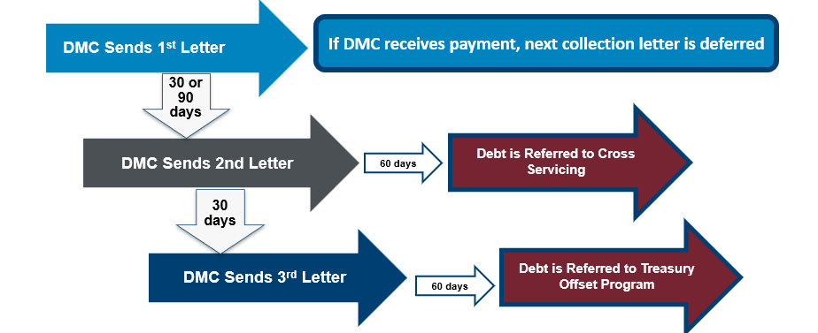
Debt Collection
DMC sends Notice of Indebtedness letters, monitors accounts, and advises debtor of any delinquency, including the requirement to refer their account to Treasury

Slide 12
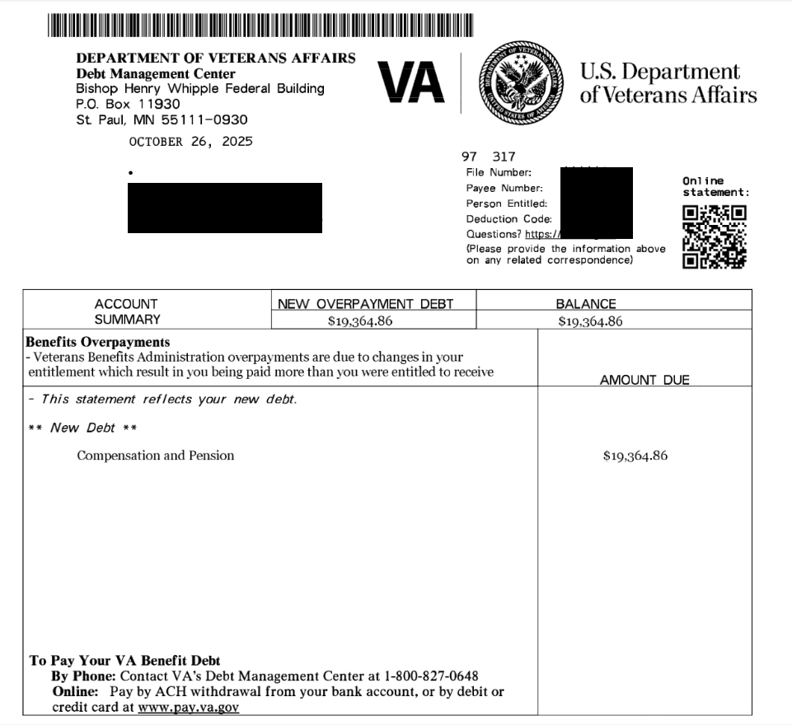
Example Debt Letter

Slide 13
Relief, Resolution, & Referrals
DMC sends Debt Notice
Debtor contacts DMC
· Pay In Full
· Benefits Offset in Full or Part
· Payment plan
· Compromise
· Waiver/Waiver Reconsideration
· Dispute
· Temporary Suspension
No Action/Payment
· Benefits offset in Full
· Referral to:
- TOP
- Cross-Servicing

Slide 14
Requesting a Waiver
Debtors have one year from date of first DMC debt letter to request waiver
Request must be:
Made in writing and submitted to DMC
Include VA Form 5655 Financial Status Report
Explain why debtor is unable to repay the debt
Received in the first 30 days for Education or 90 days for C&P debt to stop collection action

Slide 15
What makes a “good” waiver request
Answer: There is no formula to guarantee the outcome of a waiver. Here are some things to bear in mind:
Indication of fraud, misrepresentation, or bad faith precludes granting of a waiver (See 38 U.S.C 5302(c) )
Request should explain facts and circumstances to enable the committee to consider the standards of equity and good conscience (see 38 C.F.R 1.965 for more details ):
- fault of debtor - balance of faults
- undue hardship - defeat the purpose
- unjust enrichment - changing position to one’s detriment
An accurate VA Form 5655 Financial Status Report facilitates evaluation of financial hardship

Slide 16
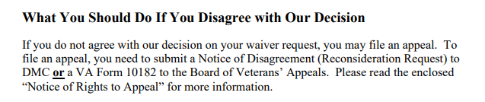
How to Appeal a Waiver Decision
Language from Committee on Waivers and Compromises (COWC) letter:
*** Veterans should not use VA form 10182, 20-0996, or 20-0995 to appeal a waiver decision with DMC***

Slide 17
Appealing a Waiver Decision (cont)
Send to | Form to use | Info to include | Reviewed by | Stops collection?
DMC | None- request must be in writing | Indicate request is for reconsideration of waiver decision, include support for reconsideration | COWC | No
BVA | VA Form 10182 | Complete form including signature | Board of Veterans Appeals | No

Slide 18
Disputing a Debt
Debtors can dispute the existence or amount of the debt created by VBA
Dispute must be in writing
DMC forwards disputes to the Regional Office/Regional Processing Office of jurisdiction
Veterans can now submit through the online debt portal

Slide 19
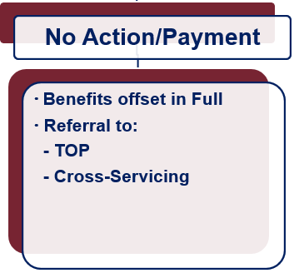
What if Payment is not Made?
Future VA benefits awarded will be withheld to satisfy debt
Department of Treasury
Offset of Federal payments
Referral to private collection agencies
Administrative Wage Garnishment Program

Slide 20
VA Debt Portal for Veterans or Claimants
Debt Portal: https://www.va.gov/manage-va-debt/
Veterans can log in to view balances
FAQ’s
Email notifications to Veterans
Online VA Form 5655 Financial Status Report (FSR) with “wizard”
Online Dispute
More enhancements to come

Slide 21
Contacting the DMC
https://www.va.gov/manage-va-debt/ | Veteran Debt Portal
https://ask.va.gov | Online inquiry system
800-827-0648 | DMC Veteran Toll Free Line
612-970-5688 | Fax
844-261-6570 | DMC VSO Only Line

