Slide 1
Introduction to TVB Claims Management System

Slide 2
Lesson Objectives
TVB Home Screen click and explain each tile and column button
Creating a new veteran folder
Assigning a Veteran
Tabs in the veteran’s folder
The traditional TVB Claim submission process
VA Benefits Claims Log in Process
How to check POA Status
Using VA Benefits claims to submit ITF, POA and 526EZ

Slide 3
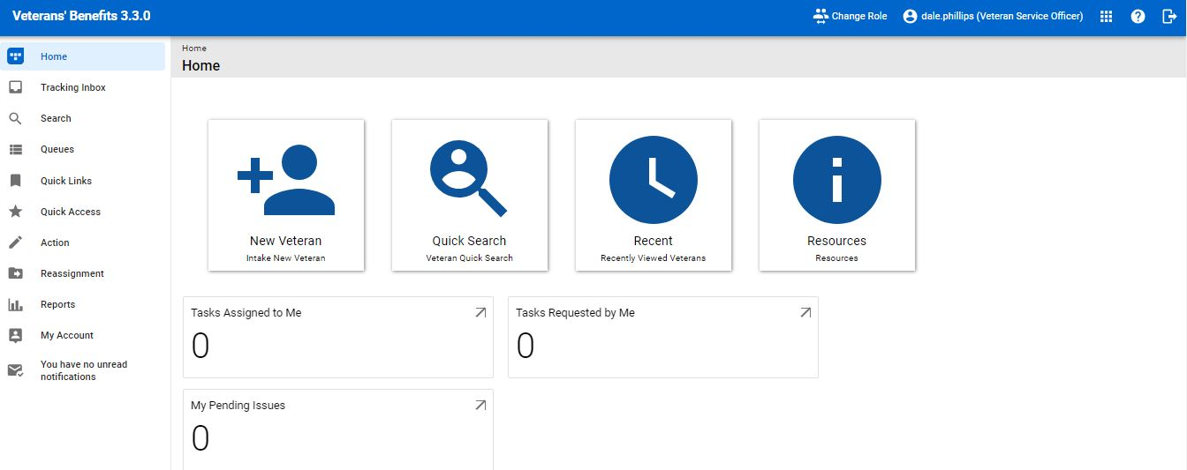
TVB Home Screen

Slide 4
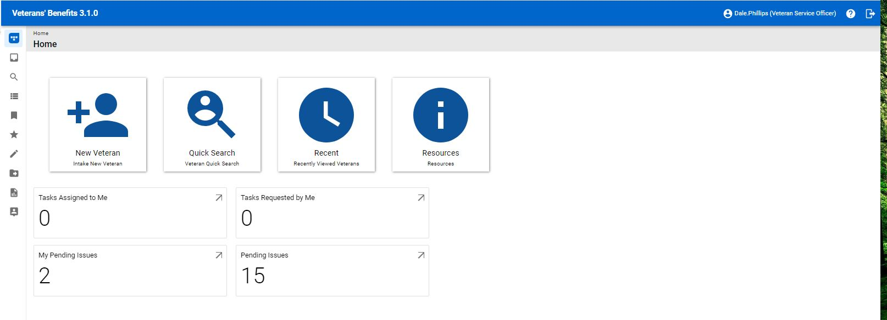
TVB Home Screen New Veteran
The New Veteran Button is used to create new veteran folders

Slide 5
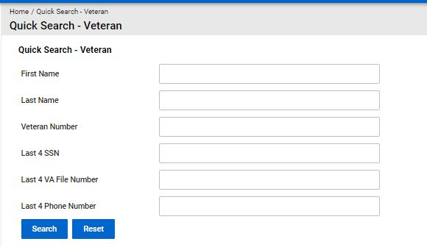
TVB Home Screen Quick Search
The Quick Search function allows users to search for veteran folders

Slide 6
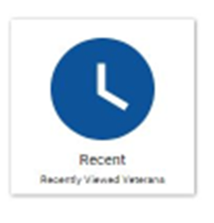
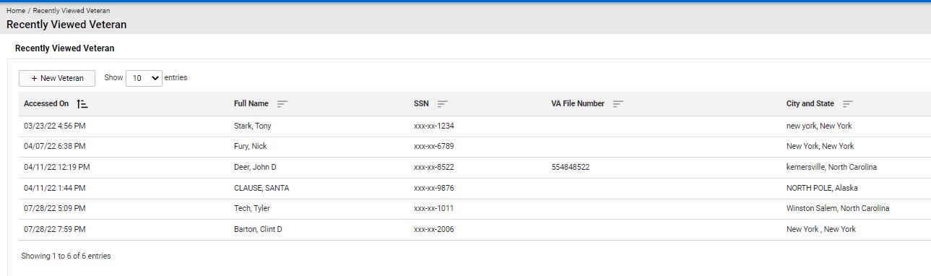
TVB Home Recent
The Recent function takes users to a listing of recent veteran folders they visited

Slide 7

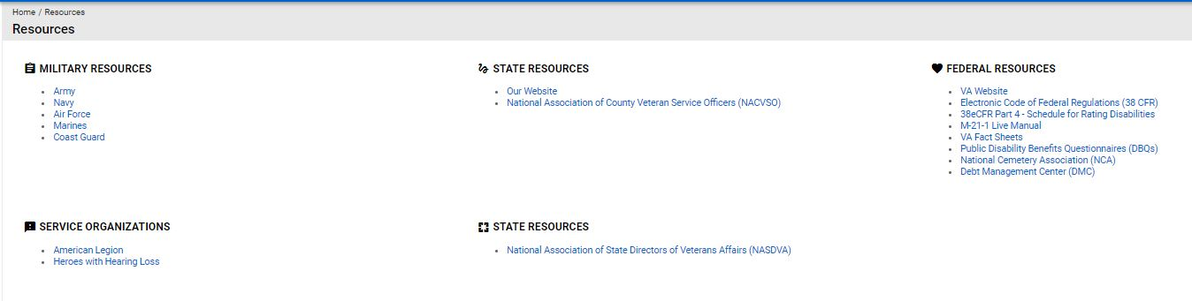
TVB Home Resources
The Resources function takes users to a listing of DOD and VA resources

Slide 8
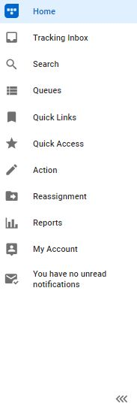
TVB Home Screen Columns
The home screen displays a column with icons. To expand this to show what each icon is named, click on the arrows marked below.

Slide 9
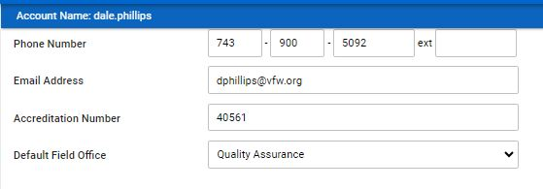
My Account Set Up
The first time a user logs into TVB they will need to access their account found on the TVB Column. From there they will need to update their information including Default Field Office.
** Your Field Office is the state your office is located in**

Slide 10
Adding a new Veteran
To add a new veteran from the home screen click on the icon titled:
“+ New Veteran”

Slide 11
Things to consider when adding a veteran
Not all the fields are required to create a record, but it is encouraged to fill out all applicable fields because:
Missing fields on veteran screen = missing fields on future claim forms submitted from TVB
If data such as contact information is omitted, users may not be able to contact the veteran.
The data will need to be captured at some point; capture it correctly in the beginning.
The more data captured, the easier it is to track trends and search for specific situations
The data is only as good as the data entered “Garbage in Garbage out”

Slide 12
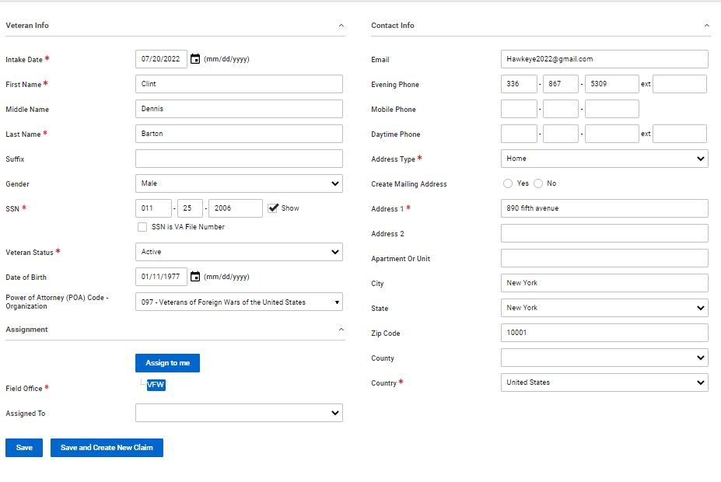
Creating a veteran folder
Once all veteran data has been captured, the last step is to Assign the veteran to the correct Field Office and VSO.
If the user Updated Their Account to reflect their Field Office they may click the “Assign to Me” and it will auto populate.

Slide 13
Assigning a Veteran
The foundation for TVB is in properly assigning claims to the correct Field Office and Service Officer. Failure to do this results in reports not being able to be run and extra work through repeated steps later.

Slide 14
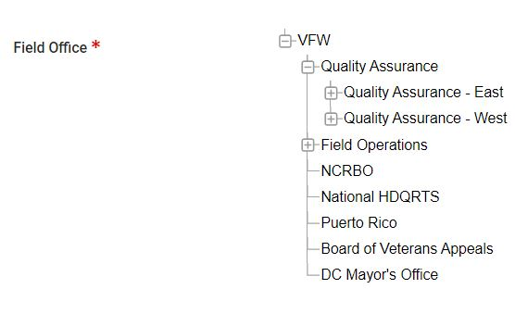
Assigning a Veteran to the Field Office
When creating a new veteran folder in TVB, follow these steps to assign the veteran to the correct Field Office:
In the required area of Field Office, Select the + next to VFW to expand the drop-down menu
Click Quality Assurance (QA).
Click on the region your office is located in QA East or QA West

Slide 15
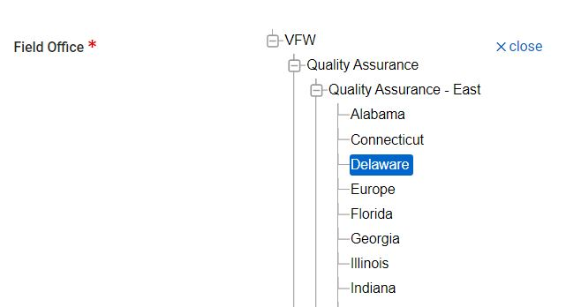
Assigning a Veteran to the Field Office
With the correct Quality Assurance Region Selected a new dropdown will populate with that region’s states.
Select the State your office is located in to correctly assign the Field Office

Slide 16
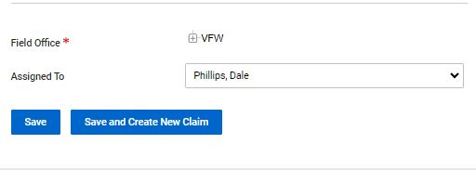
Assigning a Veteran to the VSO
With the field office correctly assigned the VSO can now assign the veteran to their TVB profile by:
Click the dropdown box next to Assigned To and select Your Name.
Click either Save or Save and Create New Claim to complete process.

Slide 17
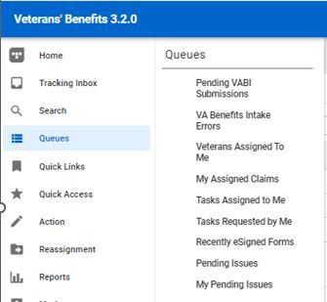
Veterans Assigned to Me
All veterans that are assigned to the user can be viewed in one location in TVB.
To view these veterans click:
Queues
Veterans Assigned to Me

Slide 18
The Veteran’s Folder
Once in a Veteran’s folder, users will see a header with tabs that take them to other aspects of the veteran’s folder.
Special Note** When clicking a tab, to enter data into the corresponding section, you must click +New
Claim
Military Service
Contact and Dependent
Medical Condition
Document
Communication
Note
Email
Address
Work Request
Finance
Employment
Education
Previous Marriage
Other Names Served
Audit Log

Slide 19
Tabs in the veteran’s folder
Claim: Used to submit a claim through TVB
Military Service: Documents military service and VFW membership
Contact and Dependent: Captures dependent information
Medical Condition: Will be used to enter and track conditions to assist with claim submission. Currently not active – will be active in a future update
Document: Houses the veteran’s documents
Communication: Used to enter a communication about veteran
Note: For general use
Email: TVB can compose and send an email from the program but cannot receive email.

Slide 20
Tabs in the veteran’s folder
Address: Used to capture veteran’s address
Work Request: Used to assign a claim or action from one VSO to another
Finance: Captures veteran’s financial records
Employment: Captures veteran’s employment records
Education: Captures veteran’s education records
Previous Marriage: Captures veteran’s previous marriage
Other Names Served: Captures veteran’s aliases
Audit Log: Provides a history of actions taken by account users in the veteran’s folder

Slide 21
Tabs in Veteran Folder: Medical Condition
The current version of TVB has entry-level steps for Application Programming Interface (API) using the Medical Condition Tab.
Currently, this API is not ready for use but once it is, we will release training material on how to utilize this advanced functionality.

Slide 22
Tabs in Veteran Folder: Communication
The Communication tab in TVB provides a history of VFW’s interaction with the veteran.
All Communications must be captured in TVB to when communicating with a veteran.
A General Communication can be created using the following: TVB Column—Action—New Communication

Slide 23
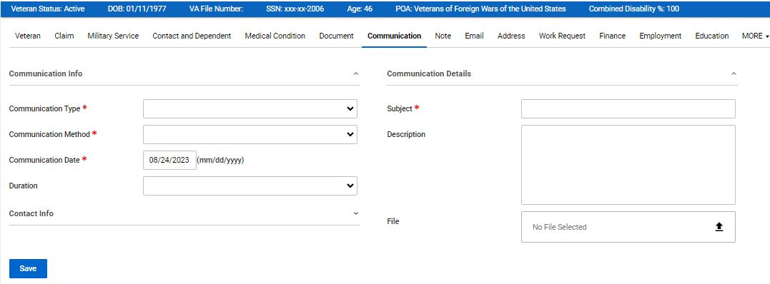
Tabs in Veteran Folder: Communication
Required fields consist of:
Communication Type
Communication Method
Communication Date (Auto populates to today’s date)
Subject
Files uploaded into a communication DO NOT populate into Veteran’s
Documents folder OR in the Claim Package Tab.

Slide 24
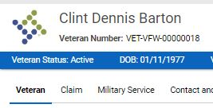

Submitting a claim to VA using TVB
From the veteran folder click on the Claim tab at the top.

Slide 25
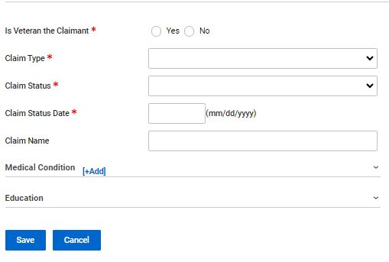
Submitting a claim to VA using TVB
The page will now display the claim page and the user may begin selecting a form to generate in TVB.
Claim Type: Compensation, DIC, Education, NSC Pension etc.
Claim Status: Active, HLR, ITF, Supplemental claim and Incomplete claim
Claim Status Date: Date the claim was generated
Save: Saves the pages and allows users to advance

Slide 26
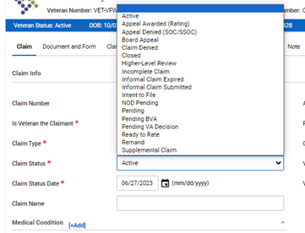
Claim Status
When submitting claims through TVB, it is Required to select from the appropriate claim status selection:
Active: 21-526EZ, 686C, 21P-530, 10-10EZ, 21P-527EZ, 21P-534EZ
Higher Level Review: 20-0996
Intent to File: 21-0966
Supplemental Claim: 20-0995
Incomplete claim: 21-22 and any other documents or supporting forms submitted to VA

Slide 27
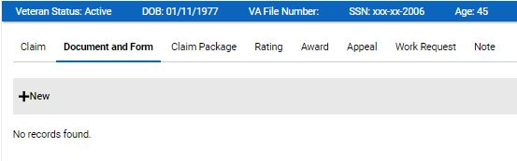
Submitting a claim to VA using TVB
Once the Claim Tab is saved users advance to the , “Document and Form” Tab and press +New

Slide 28
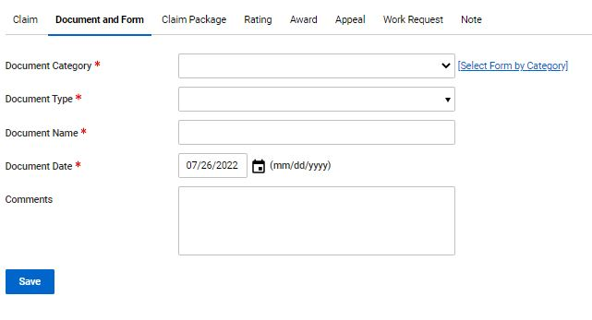
Submitting a claim to VA using TVB
Pressing +New takes you to this page where you will fill in the required fields
Document Category: Forms, General Correspondence, Other
Document Type: If Forms was previously selected VA Forms Populate this section
Document Name: does not auto populate
Document Date: This auto-populates to today’s date.

Slide 29
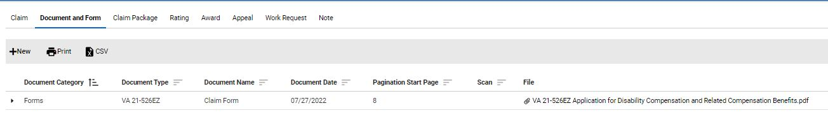
Submitting a claim to VA using TVB
Once the form has been generated, TVB will redirect you to the “Document and Form” Page and display your recently completed form.

Slide 30
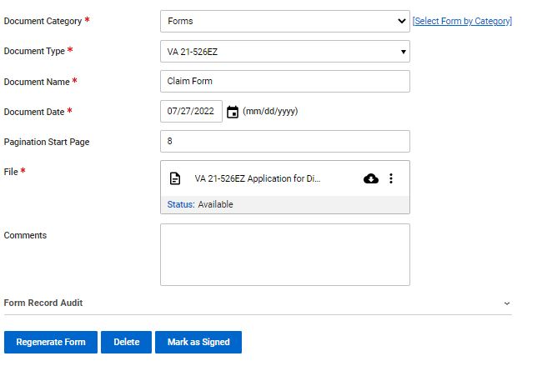
Submitting a claim to VA using TVB
With the required fields completed users can Edit the document by clicking the 3 circles

Slide 31
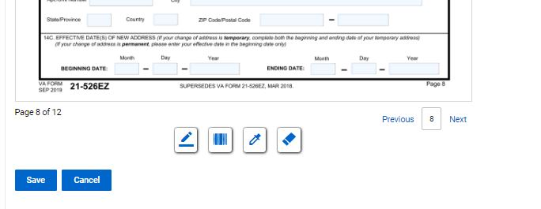
Submitting a claim to VA using TVB
At the bottom of the page you will see 4 symbols:
Add Signature Add Barcode Highlight Redact

Slide 32
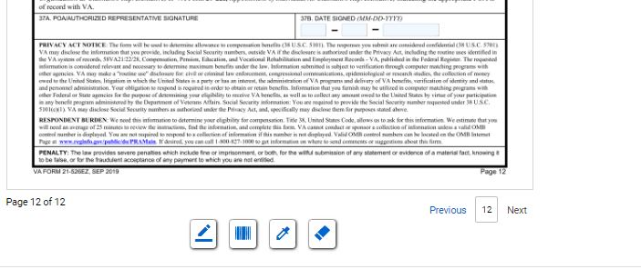
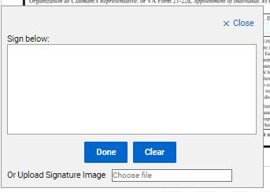

Submitting a claim to VA using TVB
Once the form is complete, it will need to be signed. To do this click “Add Signature” which will pop up the signature box.
In the signature box you can either manually create a signature using your mouse or upload a signature image. Once finished click save.

Slide 33

Submitting a claim to VA using TVB
Once the signed document has been saved, Click
Mark as Signed
Once the document has been marked as signed, no edits on the signed form can be made. Users will need to hit Save and move on to the next step in the claim process

Slide 34
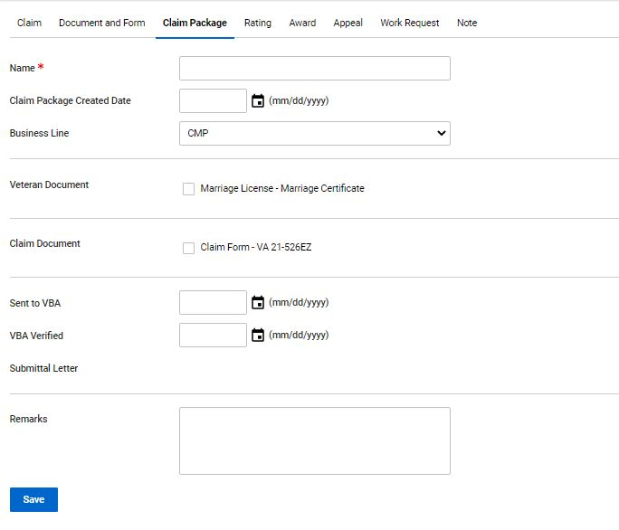
Submitting a claim to VA using TVB
On this screen users will need to enter in the following:
1) Name of the claim
2) Claim Package Created Date
3) Select the Business Line
4) Select all documents you want sent to VA
5) Select the date the claim was sent to VBA
Press Save

Slide 35
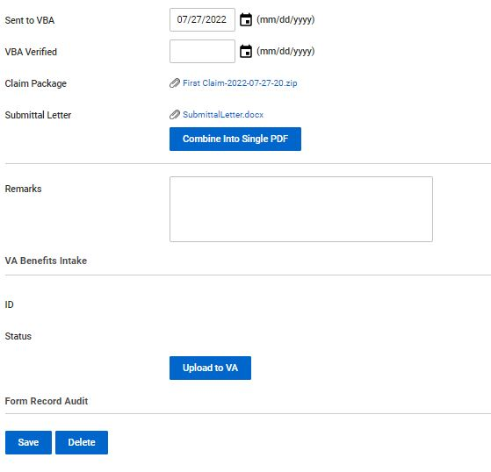

Submitting a claim to VA using TVB
Once saved users can view the changes prior to uploading the package to VA.
One thing to note is TVB will create a Submittal Letter which you can view. Once everything has been verified press “Upload to VA”

Slide 36
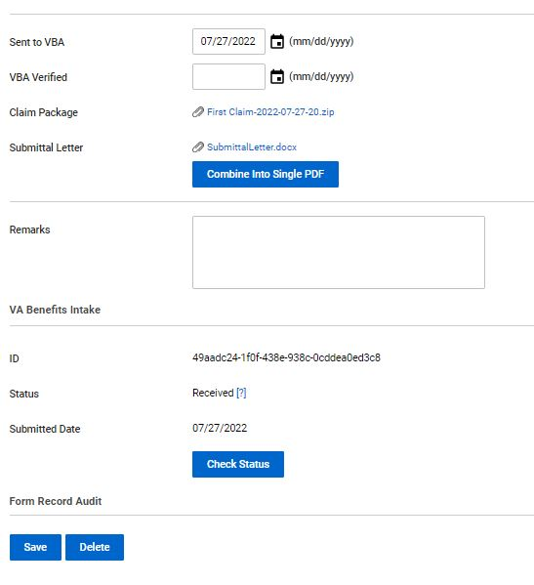

Submitting a claim to VA using TVB
After the claim is submitted users can check the status by clicking “Check Status”
Once the status shows received the effective date is preserved.

Slide 37
VA Benefits Claims
The following section requires the ability to log into VA.gov using one of the following log in methods:
Login.gov
ID.me

Slide 38
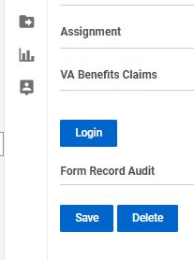
VA Benefits Claims
TVB has an API called VA Benefits Claims which allows TVB to connect to VA.gov.
This allows for some actions in TVB to be done in REAL TIME
The VA Benefits Claims API can be found when inside a veteran's folder toward the bottom of the page.
Click Login to connect to continue with this API

Slide 39
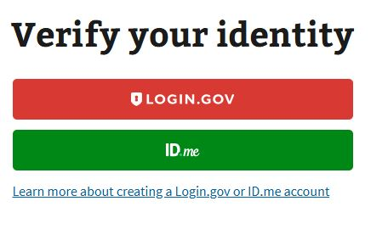
VA Benefits Claims
When utilizing this functionality, TVB requires users to sign in to VA.gov using one of the following log in methods:

Slide 40
VA Benefits Log
TVB users who do not have any of these accounts, can create either an Login.gov or ID.me account directly from the page by clicking the hyperlinks at the bottom.

Slide 41
Account Set up
An in-depth guide for creating either a Login.gov or ID.ME account can be found in the OLP next to this presentation.

Slide 42
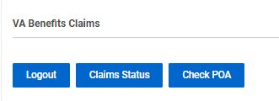
VA Benefits Claims
Once logged into the VA Benefits Claims section, clicking on VA Benefits Claims will populate new buttons.

Slide 43
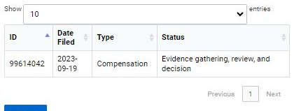
VA Benefits Claims: Claim Status
The Claim Status button will populate all the veteran’s claims (past and present) and show the Date Filed, Claim Type and Status of the claim

Slide 44
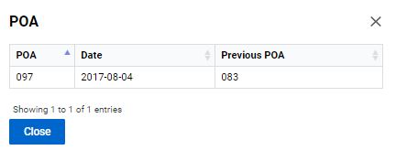
VA Benefits Claims: Check POA
The Check POA button will populate the veteran’s current POA as well as list any Previous POAs.

Slide 45
VA Benefits Claims: Submitting Forms Directly into VBMS
Another function of VA Benefits Claims is the ability to submit 21,22s, ITFs and 526EZs directly into VBMS.
To utilize this function, the following must be true.
Logged into VA.gov through VA Benefits Claims
The veteran’s folder is assigned to Your Field Office and Yourself.

Slide 46
VA Benefits Claims: Submitting Forms Directly into VBMS
To submit a form directly into VBMS a claim must first be created.
From the veteran folder Create a new claim and hit Save.
Create the form using the Document and Form Tab and once complete press Marked As Signed.
** If the claim folder does not have a form that has been Marked As Signed nothing will populate in the Signed Form Document Box**

Slide 47
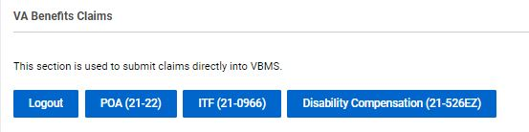
VA Benefits Claims: Submitting Forms Directly into VBMS
With the form Marked As Signed, follow the TVB Breadcrumb Trail back to the claim you just created.
Scroll back down to VA Benefits Claims and 3 new buttons have populated: POA(21-22) ITF(21-0966) Disability Compensation (21-526EZ)

Slide 48
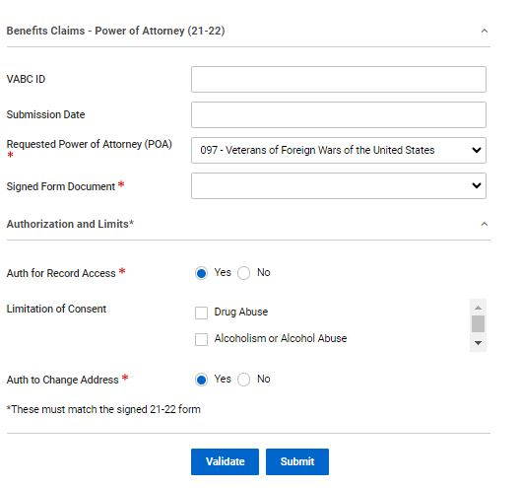
Submitting Forms Directly into VBMS POA(21-22)
The POA(21-22) button takes the user to a page where they can attach a TVB Created, Marked As Signed 21-22 directly to VBMS.
*Please note for those who have multiple accreditations to select the correct POA *

Slide 49
Submitting Forms Directly into VBMS POA(21-22)
The page contains required fields such as POA, Signed Form Document and Authorizations and limits.
Signed Form Document has a dropdown box that will populate with the claim form that was generated and Marked As Signed in TVB

Slide 50
Submitting Forms Directly into VBMS POA(21-22)
With all required fields addressed, click submit to Submit the form to VBMS.
*Please note that the Authorization and limits on the signed 21-22 MUST MATCH the boxes displayed on the page. *

Slide 51
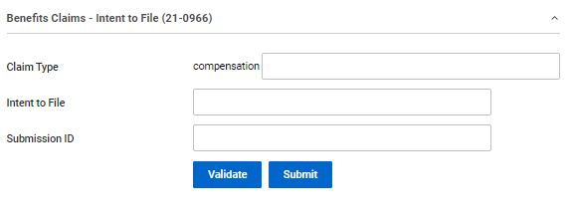
Submitting Forms Directly into VBMS ITF (21-0966)
To submit an ITF a TVB claim must be created.
With the Claim created select ITF (21-0966) which takes the user to the ITF screen.

Slide 52
Submitting Forms Directly into VBMS ITF (21-0966)
Press Validate to confirm POA with VA, TVB will provide a message that says valid if good or an error message that will need to be corrected.
After confirmation press submit
TVB will populate the previously empty boxes with:
Claim Type
Intent to File Date of Submission
Subission ID or confirmation number

Slide 53
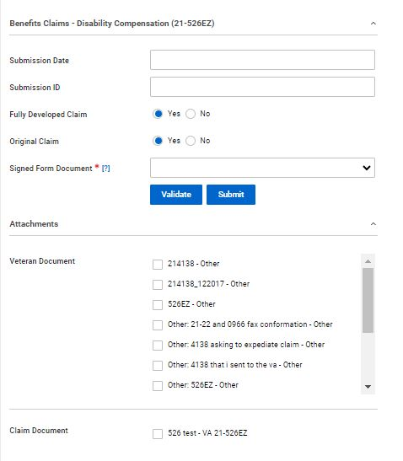
Submitting Forms Directly into VBMS Disability Compensation (21-526EZ)
The 21-526EZ button takes the user to a page where they can attach a TVB Created, Marked As Signed 21-526EZ directly to VBMS.
Signed Form Document has a dropdown box that will populate with the claim form that was generated and Marked As Signed in TVB

Slide 54
Submitting Forms Directly into VBMS Disability Compensation (21-526EZ)
The page only has the Signed Form Document as a required field but will default to Fully Developed Claim and Original Claim.
Veteran Documents can also be submitted with the 21-526EZ directly into VBMS.

Slide 55
Veteran Intake Queue
In 2025 the VFW partnered with MyVetBenefits (MVB) to allow their users to request VFW assistance with VA claims. These referrals come directly to TVB and are placed in the Veteran Intake Queue. To accept these referrals and have a TVB folder created, for the referral please follow the steps listed on the next slide:

Slide 56
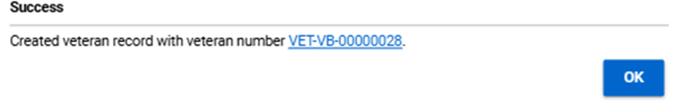
Veteran Intake Queue- How to Use
Step 1: From the TVB Column, go to Queues and Select Veteran Intake.
Step 2: The Veteran Intake Queue will appear and users will need to select referrals from their state
Step 3: Once a referral is clicked, contact will need to be made with the veteran to obtain the Required Social Security Number to complete creating the TVB Profile
Step 4: With the SSN captured users will scroll to the bottom of the referral and click Intake
Step 5: Clicking Intake shows that the referral was successful and provides the user with the TVB Number for the newly created veteran folder. Users can click on the Number to be taken to the veteran profile in TVB.

Slide 57
Veteran Intake Queue- Special Notes
Some referrals might come in from active-duty service members wanting to file a BDD claim. These referrals Are Still Handled By Your Office but are marked as BDD to provide insight into their claim needs.
Clicking on the header at the top that says “State” allows you to group referrals by state showing all the referrals each state has.
States that don’t use TVB will have their RQAS monitor the intake queue and share with the office the veteran’s contact information.

Slide 58
Creating a Signature Image
Here we will cover how to create a digital signature that is compatible with most programs

Slide 59
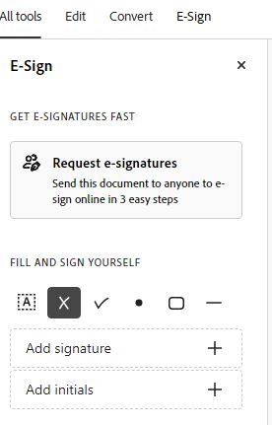
Creating a Signature Image
To add a Signature to an electronic Document, you will first need to create your signature. To do this in Adobe, you will first locate the E-Sign tab

Slide 60
Creating a Signature Image
Once selected locate the Add Signature box and press +

Slide 61

Creating a Signature Image
Once you have selected Add Signature, you will be given 3 options to capture the signature:
1) Type
2) Draw
3) (Upload) Image
Type is the easiest option to choose from but all 3 will be accepted by VA.

Slide 62
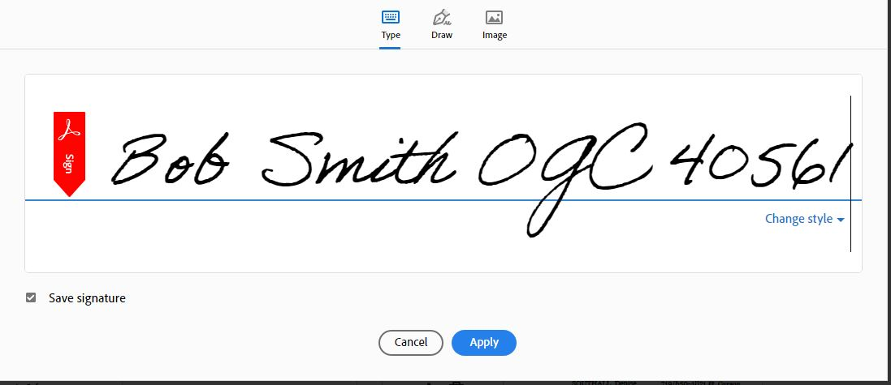
Creating a Signature Image
Once the signature is created, press “Apply”.
This will save your signature for future uses and allow you to apply the signature to the Electronic Document.

Slide 63
Saving a Signature Image
Now that you have your signature image, you will need to place it on a white background somewhere on the PDF.
With the signature in place you will need to open a new program called “Snipping Tool”
To find this tool open your computer’s start menu and search “Snipping Tool”. When you find it press the icon

Slide 64
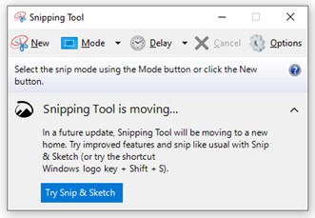
Saving a Signature Image
With the Snipping Tool Open click “New” which will change your curser to a +. From there you will cut out your signature.

Slide 65
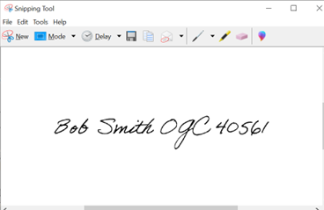
Saving a Signature Image
To save your captured signatured click
File
Save as
Choose where to save your signature

