Slide 1
Interpreting Medical Records
& VA Examinations
Notes:
Who here has a medical background?

Slide 2
MEDICAL TERMINOLOGY
Medical terminology - language used to accurately describe the human body and associated components, conditions, processes and procedures in a science-based manner.
Used in the medical and nursing fields.
Stems largely from Greek and Latin words
Notes:
Anatomy- description/location
Physiology- description/function
Diagnosis- tells what's wrong
Treatment- tells how to take care of issue
Prognosis- tells what the expected outcome is

Slide 3
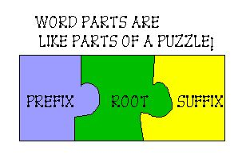
3 Basic Parts
Prefix
Beginning of the word, modify their meanings.
Specify the location, time, or number.
Root Words
Can stand alone as the main part of the medical term
Holds the fundamental meaning of the phrase
Suffix
Attached to the end of word, to change their meanings
Usually indicate the procedure, condition, disorder, or disease
Notes:
The words don’t always need to use all three parts
Prefix
Location-into, exo, peri
Time- pre, post
Number-mono, bi. Poly
The last part of the word puzzle…
Suffix
Procedure- ectomy (surgical removal)
Condition- it is(Inflammation), megaly(Enlargement),
Disorder or disease- oma(tumor),

Slide 4
WHAT ABOUT……
ACUTE
CHRONIC
BENIGN
MALIGNANT
METASTATIC
GET A GOOD DICTIONARY!! (or learn how to Google)
Notes:
Common words found in records and rating schedule…
Just need to learn
-Benign tumor grows slowly and is self-limiting
-Malignant Tending to have a destructive clinical course… Relating to cancer cells… opposite of Benign
-Metastasis is the medical term for cancer that spreads to a different part of the body from where it started.
Thoroughly read the rating schedule for the condition to understand the requirements for service connection and what rating should be applied

Slide 5
TYPES OF MEDICAL RECORDS
Service Treatment Records (STRs)
            Hard Copy STR
            Electronic STR
VA Medical Records (including C&P Exams)
Private Treatment Records
Specialty Records
Notes:
AHLTA (Armed Forces Health Longitudinal Technology Application)
CHCS (Composite Health Care System)
When it comes to Specialty Records (in-patient, behavioral health/mental health, Sleep study, Dental, and vet center records), a special request may be needed

Slide 6
SERVICE TREATMENT RECORDS
Entrance and Exit Physicals
Sick Call / Medical Appointments (Hand Written & Typed)
Periodic Health Assessments & Post Deployment Health Assessments (PHAs & PDHAs)
Audiograms, Labs, Etc…
Don’t list all of the AutoCites problems as claimable issues
Look at the actual medical notes
Notes:
Some different documentation you will see in the STRs include…
Not going to try to show you all of the possible forms or formats, just want to give you an idea of how to look at the files.
Evaluation/assessment/tests
Treatment- Preventative, Acute, Follow up
Prescriptions
Preventative
Notifications –Profiles
Diagnosis – Most important

Slide 7
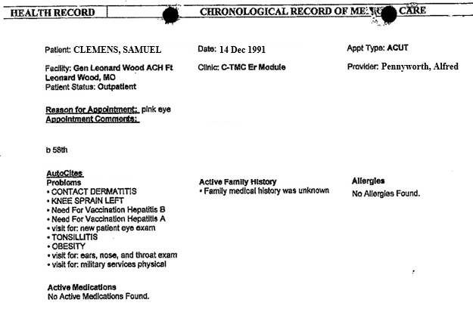
MEDICAL RECORDS
Notes:
Demographics
AUTO CITE
Past diagnosis/complaints- DON’T TOPSHEET!!! Use as a guide
Family medical history
Allergies
Medications

Slide 8
SOAP NOTES
Subjective: A brief summary of the veteran’s complaints
Objective: A summary of the medical professional’s findings
Assessment: The potential diagnosis
Plan: The recommended treatment
Notes:
Standardized method of medical documentation

Slide 9
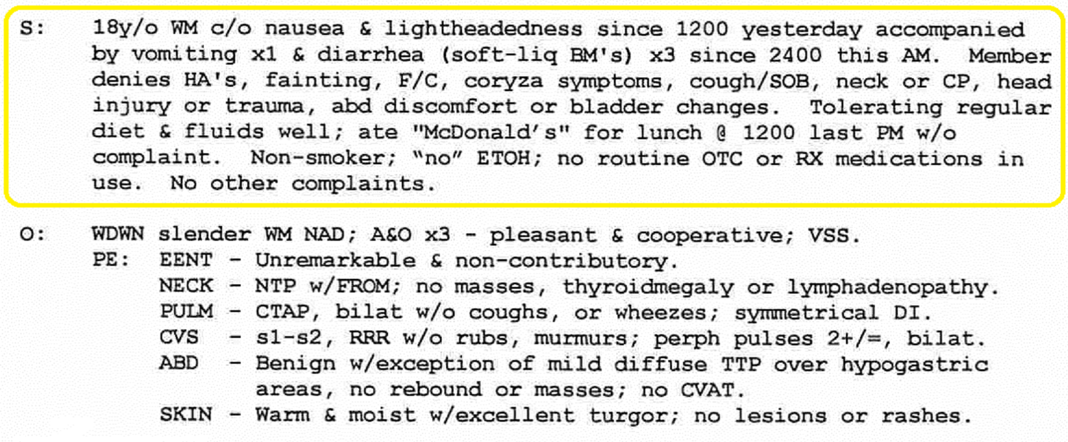
SUBJECTIVE/OBJECTIVE
Notes:
y/o year old
WM white male
c/o complains of
BM bowel movement
HA Headache
F/C fever/chills
Coryza (acute respiratory disease –rhinorrhea, conjunctivitis, mucous membrane inflammation)
SOB shortness of breath
CP chest pain
Abd abdominal
w/o with out
ETOH alcohol
OTC over the counter
RX prescription
WDWN well developed, well nourished
NAD no acute distress
A&O alert and oriented
VSS vital signs stable
PE physical exam
EENT eyes, ears, nose, throat
NTP ? Not tender/painful
PULM pulmonary (lungs)
CTAP clear to auscultation and percussion
DI ? Diaphragmatic inhalation
CVS cardiovascular system
S1 (lub) s2 (dub)
TTP tender to palpation
CVAT costovertebral angle tenderness (check kidneys)
S-Subjective…what the patient states
O-Objective…what is measured or observed

Slide 10
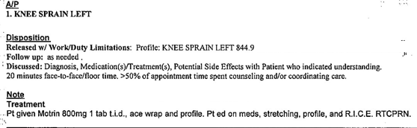
ASSESSMENT/PLAN
Notes:
This is the area that you will mainly focus on.
Pt patient
t.i.d three times a day
R.I.C.E rest, ice, compression, elevation
RTC return
PRN as needed

Slide 11
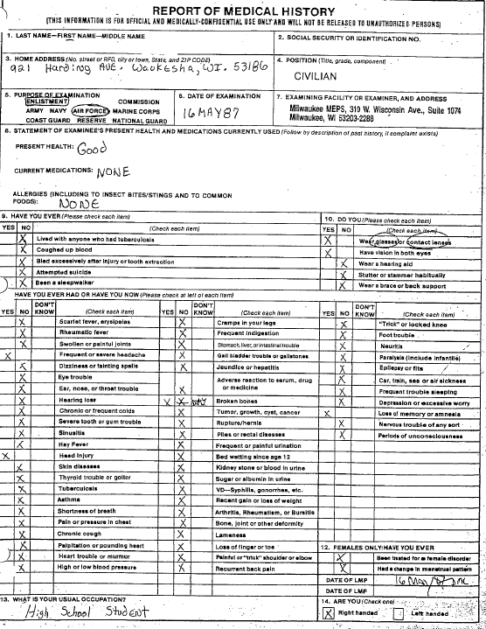
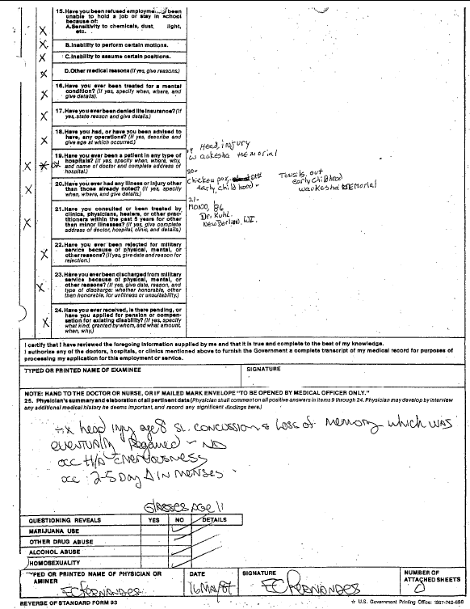
Physicals
Notes:
Entrance exam SF 93
is the Demographics and the S(ubjective)

Slide 12
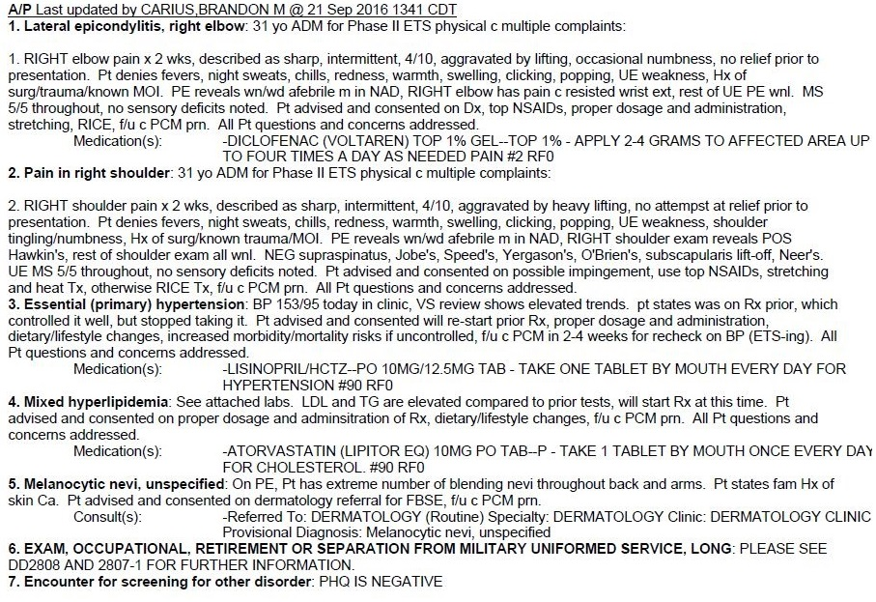
Physical Exam
Notes:
Slightly different format, need to take more time looking at it. This is the ALTHA version of a separation physical
Each issue (number) has a SOAP note

Slide 13
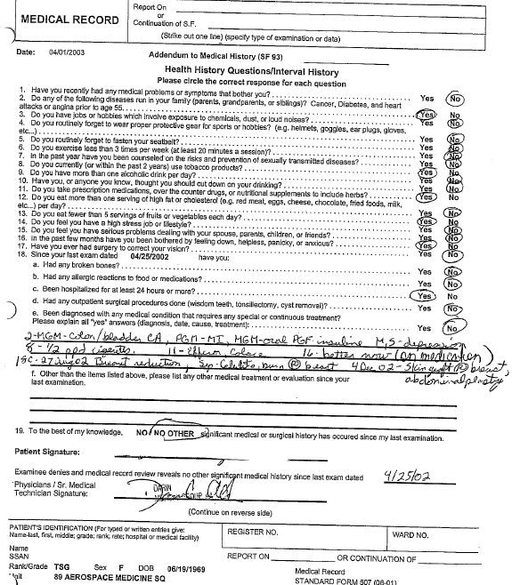
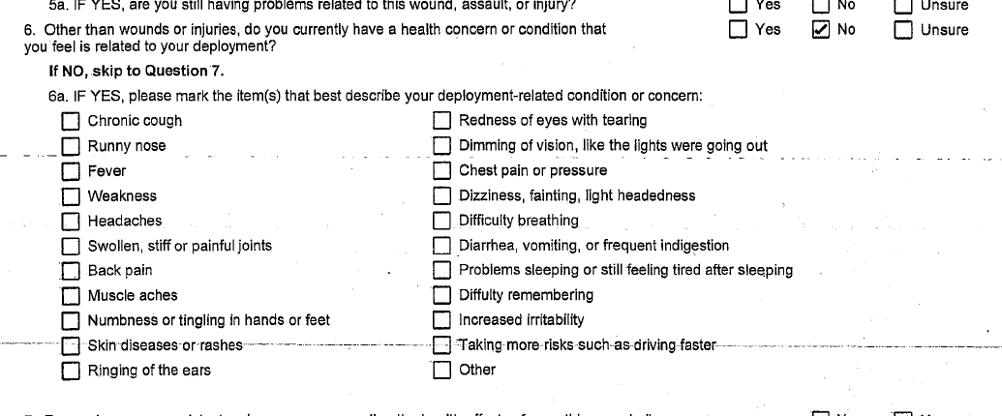
PERIODIC HEALTH ASSESSMENTS / POST DEPLOYMENT HEALTH ASSESSMENTS (PHAS & PDHAS)
Most veterans complete periodic health assessments throughout their career, especially if they were deployed
Make sure you pay attention to the possible exposures, and any changes the service member reports
Notes:
These are mainly records reviews and a chance for service member to bring something up to the doctor if they have concerns.

Slide 14
PRIVATE TREATMENT RECORDS AND SPECIALTY EXAMS
Different look/format
Same information
          Note the date of the record
          Look for any symptoms listed
          Check for diagnoses
          Ask the veteran for clarification
Notes:
In addition to STRs veterans may also bring in private medical records and specialty exams for you to review and submit.
Though every medical facility’s records will look different, the same principles apply to your review:

Slide 15
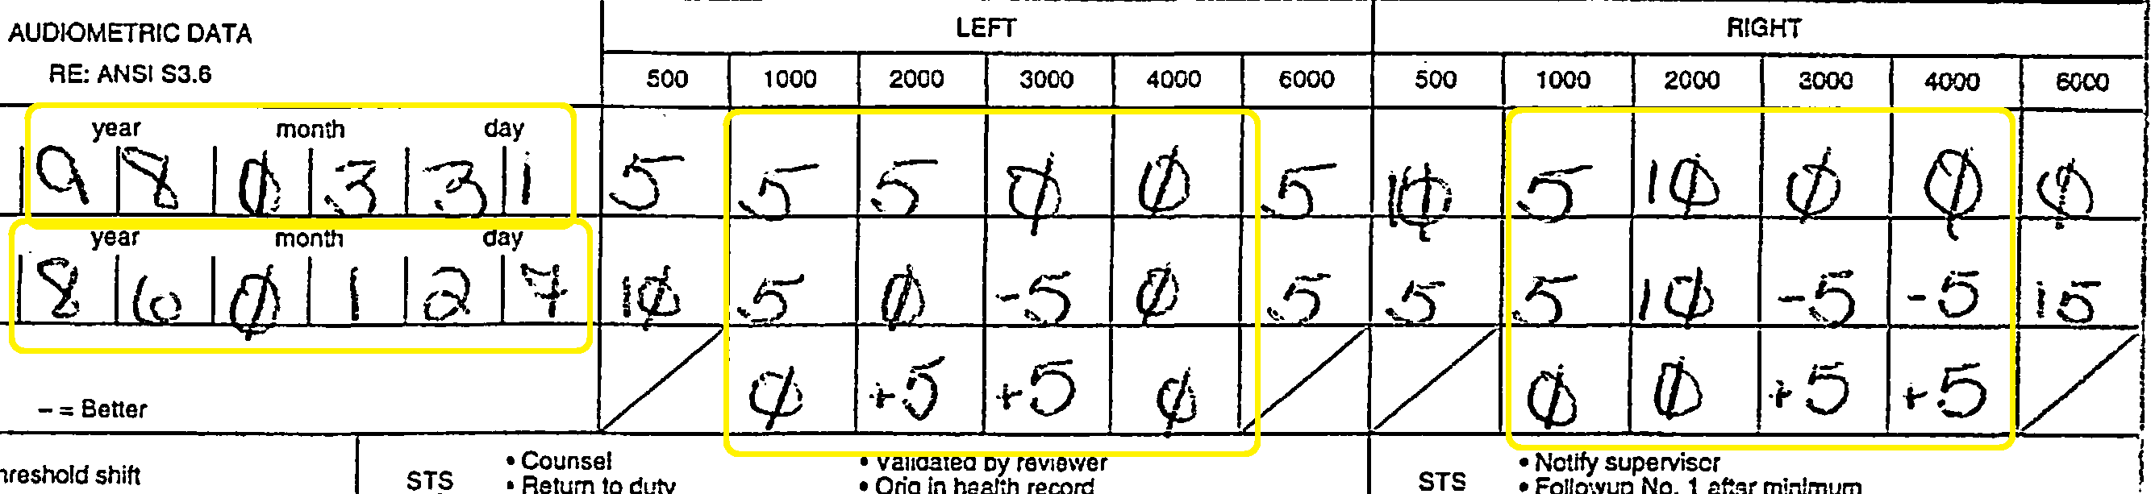
Audiograms
AUDIOGRAMS
For Audiograms, you need the average results of the 1000-4000 range
On DBQs, this is already done for you

Slide 16
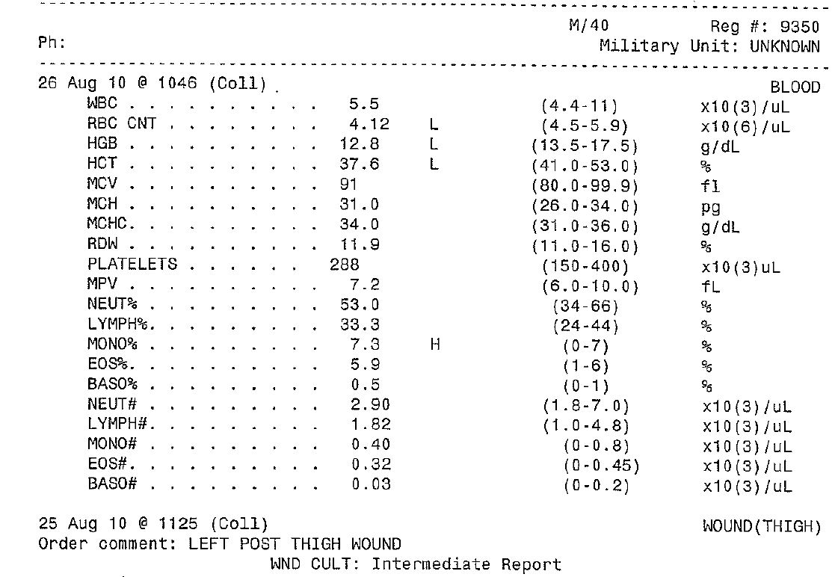
LAB REPORTS
Not expected to memorize labs
Most lab reports indicate normal/abnormal values
Look for any actual diagnoses on the lab report and attached documentation
Notes:
Lab results do not equal a diagnosis but can point to possible existence of disability.
Pay attention to the lab results that are noted “L” or “H” for low or high – see recommendations from doctor.

Slide 17
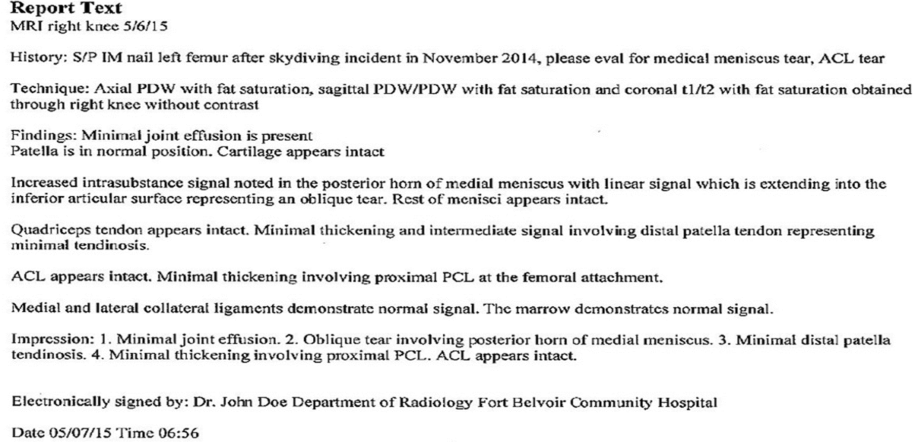
RADIOLOGY REPORTS/MRI’S
Radiology reports can reveal conditions that the veteran wasn’t even aware of
Notes:
IM- Intramuscular
ACL-anterior cruciate ligament (Knee)
What is important here? History: can establish timeline of injury: help determine path of service connection - during service? Secondary?
Impression: similar to “assessment”: Minimal joint effusion, tendinosis, tear of medial meniscus.
Type of exam: MRI shows soft tissue damage, x-ray often does not and might miss disabilities.

Slide 18
LOCATING STRs
    Ebenefits/VA.gov
    National Personnel Records Center (NPRC)
    1 Archives Drive
    St. Louis, MO 63138
    https://www.archives.gov/
    Private Treatment Facilities/Private Doctors
    State and Local Government offices
    National Guard/ Reserve Units
Notes:
If a veteran needs copies of their medical records, personnel records, or STR they may be able to obtain copies in the following ways:
#4 County Clerks offices “IF” the veteran has ever filed them with the office.
#5 If the veteran served in the NG/RES then their records may not be in the national archives they may still be with their unit.

Slide 19
NO MEDICAL RECORDS?
You can still file the claim!
VA will attempt to obtain medical records
  Federal records – no form necessary
  Private records – requires 21-4142 and 21-4142a for VA to obtain, no form is necessary if the veteran provides their records
An ITF may be helpful if the veteran does not have their records available
Notes:
Need to make VA aware that documents exist. What form? VA Form 21-4142
Explain what type of conditions you are looking for (Chronic)
3 Pillars of service connection
Do a head to toe assessment/interview
Consider MOS/Duty locations
Use what ever proof you have

Slide 20
HOW CAN YOU STILL FILE?
  Explain that records can be obtained at any time during the claims process
  Conduct a verbal interview/assessment with the veteran
    Be sensitive and PROFESSIONAL
    Ask about specific diagnoses and injuries
    Explain that exams will likely be necessary
  Consider military occupation and duty locations for presumptive conditions or exposures
Notes:
When interviewing your veteran, be sure to approach sensitive subjects such as reproductive issues, MST, or mental health issues tactfully and professionally.
Don’t make jokes about condition
Don’t ask if the veteran killed anybody
Don’t ask if the veteran was raped

Slide 21
A FEW KEY POINTS TO REMEMBER
Not everything in the STRs is a claimable condition
Rarely are all of the veteran’s disabilities listed in the STR or medical records
If a veteran insists on filing for something that you cannot find in the medical records, add it to the claim. (Unless it involves fraud)
COMMUNICATE WITH YOUR VETERAN!!
Notes:
Acute, Rule out conditions, “Pre” conditions
Flyers
It is their claim, explain what is needed to get issue service connected
Realistic expectations!

Slide 22
WHEN ARE EXAMINATIONS NEEDED?
38 CFR 3.159(c)(4): Providing medical examinations or obtaining opinions
In a claim for disability compensation, VA will provide a medical examination or obtain a medical opinion based on a review of the evidence of record if VA determines it is necessary to decide the claim.

Slide 23
WHEN ARE EXAMINATIONS NEEDED?
Examinations are required when the medical evidence is too ambiguous to rate the claim properly.
  If ordered, the veteran must attend, or the claim will be denied.
No exam is needed if adequate information is of record. This is called Acceptable Clinical Evidence (ACE).
POWs must have an exam before denial.
A private physician’s statement may be sufficient.
38 C.F.R. §3.326
Notes:
Discuss adequacy of exams and/or opinions. Such things as correct testing for disability, capturing whole disability picture, and details including “as likely/least likely as not,” “I have done a full and complete review of veteran’s health records…,” and supporting evidence for opinion

Slide 24
MEDICAL OPINIONS
In cases for service connection VA should ask for a medical opinion to go along with the exam
Medical opinions for service connection discuss the likelihood that a disability is related to military service or another service-connected disability
Medical opinions can also discuss other issues such as the need for aid and attendance, incompetence, or to justify an 1151 claim
Medical opinions can be provided by private medical providers

Slide 25
MEDICAL OPINIONS
All medical opinions regarding service connection should address the following question:
Is the claimed disability at least as likely as not related to active military service?
What does “at least as likely as not” mean?

Slide 26
MEDICAL OPINIONS
One of the most common reasons that VA will disregard a medical opinion is if it does not contain a rationale.
A rationale is the reason why the doctor believes that their opinion is valid
Without a rationale, the medical opinion is inadequate
If an examiner states that a medical opinion cannot be given without resorting to mere speculation, they still must provide a reason why they can’t offer an opinion.

Slide 27
EVALUATION OF MEDICAL EVIDENCE
Credible And Probative
Credible Value
  Inherently believable
  Has been received from a competent source
Probative Value
  Relevant to the issue
  Has sufficient weight to persuade the decision-maker
M21-1.III. iv. 5. A
Notes:
Competent source: when lay testimony can be competent (observed, pain, but not diagnosis)

Slide 28
Examples…
EVALUATION OF MEDICAL EVIDENCE
Credible
  A physician provides an opinion with a rationale to link a disability to an in-service event or injury.
Non-Credible
  The claimant’s spouse (non-medically trained) provides a statement linking the disability to an in-service event or injury.

Slide 29
EVALUATION OF MEDICAL EVIDENCE
VA Questions When Weighing Evidence
Did the evidence originate in service or in close proximity to service?
Is the medical opinion supported by clinical data and review of medical records?
How detailed, clear, or persuasive is the opinion?
Is the opinion based on personal knowledge? Or is it based on secondhand history provided by another person?
38 C.F.R. § 4.6 and M21-1 III.iv.5.A.9.b

Slide 30

EVALUATION OF MEDICAL EVIDENCE
Weighing Evidence
When evidence in favor of the claimant weighs the same as evidence against the claimant, the evidence is in equipoise.
Commonly referred to as…
Reasonable Doubt
38 C.F.R. § 3.102

Slide 31
EVALUATION OF MEDICAL EVIDENCE
Medical Assessments VA Considers:
Diagnoses: Identifies injuries or disease
Opinions: Deals with questions on cause or onset
Examination: Collection of relevant facts by a medical professional including diagnostic testing
History: A recounting of life events, habits, routines, symptoms and treatments
M21-1. III.iv.5.A.3.b

Slide 32
GENERAL EXAMINATIONS:
General Medical Examinations screen all body systems to:
Document normal findings, or
Identify disabilities that are found or suspected.
Required:
  Within 1 year of discharge
  For whole disability picture
        Unemployability or pension
  NOTE: It is not necessary to request a general medical examination if an original claim for compensation is being rated many years after separation from service.

Slide 33
SPECIALIST EXAMINATIONS:
Specialist Examinations
  A specialist examination is an examination that is required to be conducted by a clinician who specializes in a particular field.
  All vision, hearing, dental, and psychiatric examinations must be conducted by a specialist.
Specialist examinations may be required when:
  The claim is unusually complex
  Conflicting opinions or diagnoses
  Based on a Board of Veterans Appeals (BVA) remand, if remand order specifies a specialist examination is required

Slide 34
Disability Benefits Questionnaires (DBQ)
Disability Benefits Questionnaires are internal VA documents that help examiners relay information to the VA about the veteran’s examination in a standard format.
DBQs are specific to the disability claimed
VA removed public-facing DBQs in April 2020
DBQs can only be accessed from the VA intranet
VA is still authorized to accept private provider DBQs
VFW is currently urging VA to republish public-facing DBQs
Notes:
DBQs, properly completed by a private health care provider or VHA Primary Care Provider, and submitted by a veteran or his/her service organization, should be considered sufficient to rate in lieu of another VA C&P examination. No additional VA exam should be ordered, and doing so would potentially delay the claim.

Slide 35
SIGNATURES:
If the DBQ or examination report was prepared by a ... | Then the certification and signature block must contain his/her ...
VHA clinician | - signature, printed name and credentials.
VBA-contracted provider | - signature, credentials, and specialty
non-VA health care provider | - signature - printed name and credentials - phone and/or fax number, and license # Exception: Phone/fax not required if the DBQ is satisfactorily completed, and contact info can be verified via Internet
NOTE: Veterans Service Center employees are not expected to routinely scrutinize or question the medical professional’s credentials, unless there is contradictory evidence of record.
M21-1. III.iv.3.D.2

Slide 36
EXAMINATION NOTIFICATION LETTERS
Exam Informational letter: sent when it is determined that an exam is required.
Review Exam Informational letter: sent at the point a review of veteran benefits triggers the need for exam to update the stability or continued severity of a disability.
Exam Notice Letter: sent by the provider conducting the exam; usually includes the date and time of the exam or requests a call to schedule

Slide 37
WHAT IF THE VETERAN MISSES THEIR EXAM?
If a veteran misses their exam and it is not rescheduled, VA will most likely deny their claim
To reschedule a missed examination before the claim is decided, send a 21-4138 to request that the missed exam be rescheduled and explain that the veteran is ready and willing to report to the exam
To reschedule an exam after the claim is decided use a 20-0995 (Supplemental Claim Form)

Slide 38
INADEQUATE EXAMINATIONS
An inadequate examination is an exam that does not meet the criteria for a complete exam
This may include a lack of medical tests, missing information, improper measurement of joints, lack of a medical opinion, etc.
If you believe that an exam is inadequate, appeal and request a new examination
38 C.F.R. §4.70
Notes:
If VA refuses to get the exam fixed or fails to order another exam without good reason, consider an appeal. During the appeal, raise the adequacy of the exam on the appeal form and during a hearing, if one is scheduled.

Slide 39
RE-EXAMINATIONS
To request a re-examination, the VA must:
  Document the reason
  Identify any specific information needed in the examination report
  Give name and the facility of the medical examiner who conducted the prior examination

Slide 40
EDUCATE THE VETERAN
When talking to your veterans explain that exams are a good thing. It’s the veteran’s chance to tell VA what’s really going on and to have a medical professional confirm the disability
Do NOT instruct the veteran to lie or embellish the severity – VA needs the truth to create an accurate decision
Explain that when going to an exam, the VA is evaluating you from the moment you arrive to the moment you leave
Notes:
There have been cases where the veteran said and did everything right, but then the examiner saw them jogging to their car when they claimed they needed crutches to walk…

Slide 41
Interpreting Medical Records
& VA Examinations
Notes:
Who here has a medical background?

