Slide 1
How to Effectively and Efficiently Review Rating Decisions

Slide 2
Topics
What is a rating decision?
What does a rating decision look like?
Types of rating decisions
Why do we review rating decisions?
How to review a rating decision
What to do if you find an error
Common errors
Tips to improve efficiency

Slide 3
What is a Rating Decision?
A rating decision is a document prepared by VA that explains the outcome of a veteran or dependent’s claim for benefits.
All compensation and pension claims should receive a rating decision once a VA rater renders a decision.
Notes:
Admin decisions

Slide 4
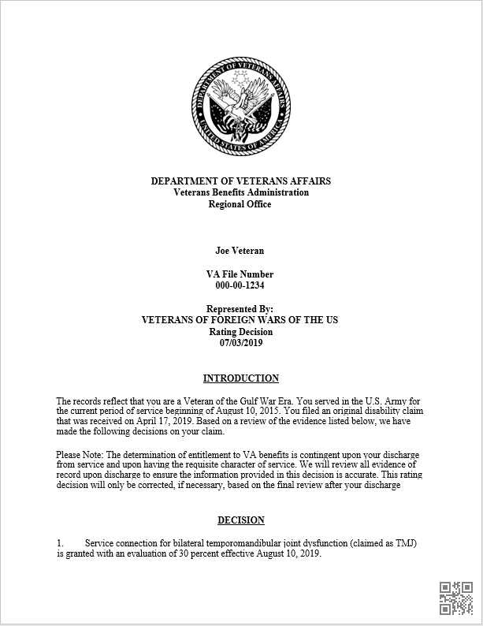
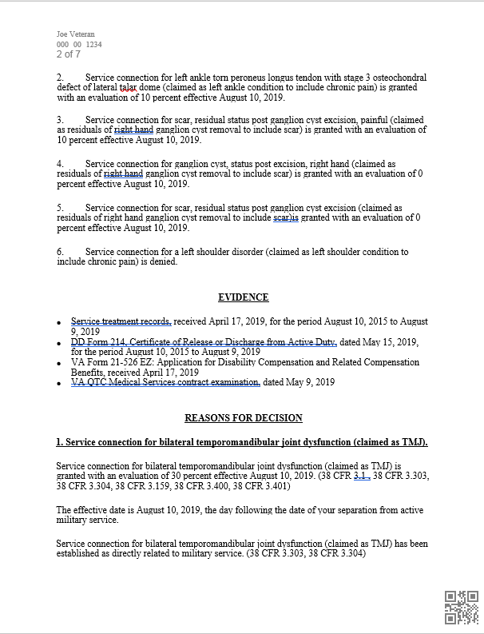
What Does a Rating Decision Look Like?
Notes:
Pictured are the first two pages of narrative. Includes the name of veteran, file number, representative, introduction, decision, evidence considered and reason for decision.

Slide 5
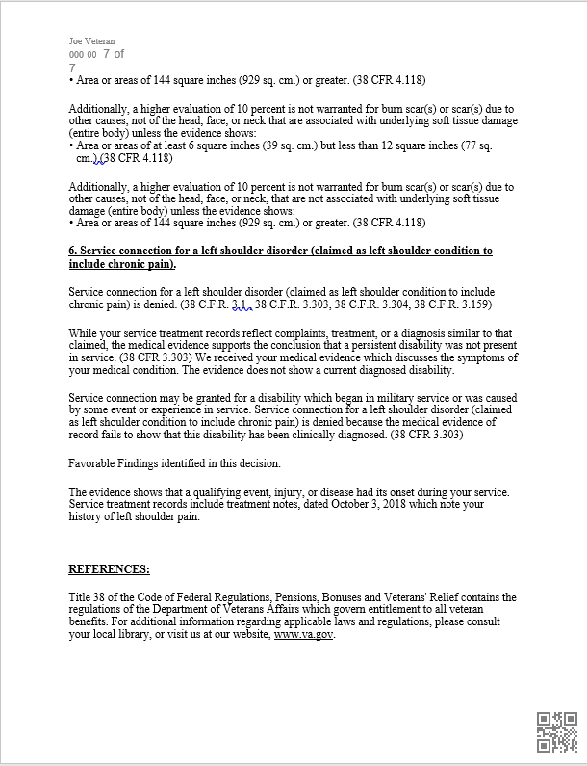
What Does a Rating Decision Look Like?
The first part of the rating decision is called the Narrative. It contains Demographic Info, Introduction, Decision, Evidence Considered, Reasons for Decision, Favorable Findings, and References

Slide 6
What Does a Rating Decision Look Like?
Narrative:
Demographic Info: States the veteran’s name, claim number, and the date of the decision
Introduction: States the era in which the veteran served, service dates, the type of claim, when the claim was received by VA, and the effective date of the claim
Decision: States VA’s decision on each issue
Evidence Considered: Lists all of the evidence that VA considered when making the decision
Notes:
Ask why each part of the introduction is important.
ERA – Could point the way to presumptives or pension
Service Dates – Can help make sure all STRs were obtained
Type of Claim – Was it an Original Claim? If so, you will likely have to Review STR. If its an increase you don’t
When the claim was received and Effective date – Did VA assign the correct effective date, was there an ITF, check dates on Claim form
Evidence Considered – Not all evidence in claims folder is relevant to claim

Slide 7
What Does a Rating Decision Look Like?
Narrative:
Reasons for Decision: Lists each issue separately with the reason why VA made their decision. If the issue was granted, VA will also include the requirements for the next higher rating
Favorable findings: If an issue is denied, VA will list any favorable findings
References: Lists which legal references were used to make the decision
Notes:
Reason for Decision – Will spell out reason for denial if applicable and any favorable findings.

Slide 8
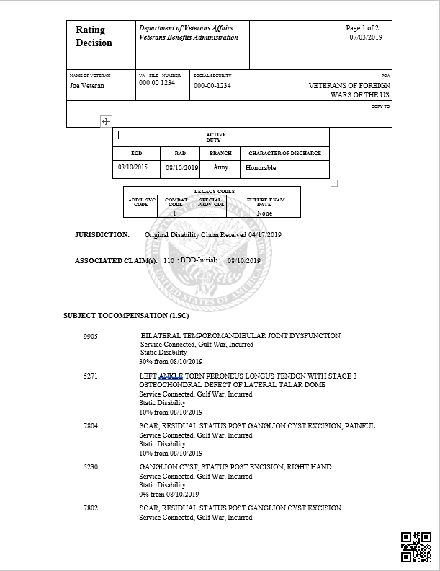
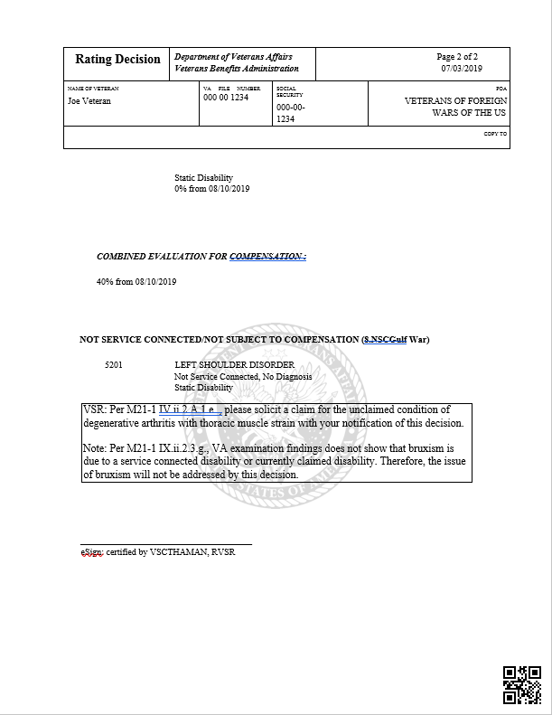
What Does a Rating Decision Look Like?

Slide 9
What Does a Rating Decision Look Like?
The Code Sheet contains Demographic Info, Active Military Service, Legacy Codes, Future Exam Dates, Jurisdiction, Associated Claims, A list of Service Connected and Non-Service Connected Issues, The Combined Evaluation, Special and Ancillary Benefits, and the Rater’s Signature

Slide 10
What Does a Rating Decision Look Like?
Code Sheet:
Demographic Info: States the veteran’s name, claim number and the date of the decision
Active Military Service: Lists the veteran’s active-duty dates, branch of service, and character of discharge
Legacy Codes: These are used to help determine eligibility to other Non-VA benefits
Future Exam Dates: Shows when and if the veteran will be scheduled for a routine future examination

Slide 11
What Does a Rating Decision Look Like?
Code Sheet:
Jurisdiction: Shows the type and date of the claim
Lists of Service Connected and Non-Service Connected Disabilities: Lists each disability in the order of severity. There may be two lists, one for service connected and one for non-service connected. This also shows the Diagnostic Codes, Era, Type of Service Connection, Future Examination, Percentage Granted, and Effective Date
Combined Evaluation: The total evaluation granted including Bilateral Factors and Effective Dates
Notes:
NSC can also list percentages – Ask Why?

Slide 12
What Does a Rating Decision Look Like?
Code Sheet:
Special and Ancillary Benefits: Lists any Special Monthly or Ancillary Benefits and their Effective Dates
Rater’s Signature: This space is reserved for the signature of the person who decided the claim
Notes:
Rater signature block may be left blank

Slide 13
Types of Rating Decisions
Original/New: Issues that the veteran has never claimed before
Supplemental Claims: Can be claims for increase or a reopening of an issue that was previously denied
Non-Service Connected Pension: Claims for pension based on non-service connected conditions
Proposal to Reduce: Preliminary decisions that notify the veteran of the VA’s intent to reduce a rating or sever service connection
Notes:
NODs cannot be submitted for Proposals

Slide 14
Types of Rating Decisions
Death/Burial Decisions: Determines if a veteran’s death is service connected and eligibility to burial benefits
Survivor Claims: Claims initiated by surviving dependents, can be for compensation or pension
Administrative Decisions: Used for non-rating issues such as character of discharge determinations
Notes:
Not all encompassing- can overlap

Slide 15
How to Access Rating Decisions
In order to review rating decisions, you must have access to VA’s Veterans Benefits Management System (VBMS)
Once logged in, define the search criteria to find the ratings needing review.
The current search criteria can be found in the VBMS filters Job aid in the Resources section of the Online Learning Portal

Slide 16
How to Review a Rating Decision
Ensure that you have the correct rating decision to review and determine the type of rating.
Look at the issues decided compared to what the veteran claimed on the claim form – Are they the same? Did VA address all the issues?
Check the evidence VA used to make their determination. Did they consider all of the pertinent evidence in the file?
Notes:
Correct veteran for decision / most recent rating decision
Scope of claim / difference between scope & secondary Inferred vs. Invited

Slide 17
How to Review a Rating Decision
Review the Reasons for Decision. Did VA correctly decide each issue? If the issue was granted, use your CFR to determine if the correct rating percentage was applied. If the issue was denied, look at the reason and determine if it is a valid reason for denial.
Check the effective dates for each granted issue.
Determine if bilateral factors, special benefits, or ancillary benefits have been correctly applied.
Notes:
4) VA is dependent on Evaluation Builder & DBQs

Slide 18
What To Do if You Find an Error
If you discover an error during your review notify the veteran and discuss possible appeal options
Annotate the error and any actions taken in VetraSpec.
Remember: There is a big difference between a factual error and a difference in opinion. Not every denial is an error.
Notes:
Cite references when addressing errors
What is Promulgation?
Ways of annotating errors and actions taken
PTSD Example Difference vs. Error Differences should likely be appealed

Slide 19
Common Errors
Missed Evidence: Did VA consider all of the evidence? Did they miss something in the STR, Medical Record, E-Folder?
Effective Dates: Did VA apply the correct effective date? Be sure to look for ITF or other ways that an effective date may be earlier that the date on the claim form.
Bilateral Factors: Did VA apply all of the eligible bilateral factors?
Special Monthly Benefits: Is the veteran eligible for SMC?
Chapter 35: Did VA grant CH 35 if eligible?
Missed contentions: Did VA address all issues claimed?
Notes:
DBQ Only Considered

Slide 20
Tips to Improve Efficiency
The type of decision will determine the type of review. (i.e. For initial claims you may need to review the STR, whereas for increases you do not)
You are looking for obvious errors (don’t dig too deep)
Have all of your reference material readily accessible
Use VBMS-R and Online tools if necessary
Notes:
If it doesn’t jump at you…its not obvious

Slide 21
Questions?

