Slide 1
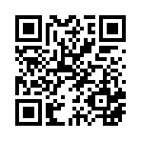
2025 Live SLT End of Conference Survey
Please scan the QR Code or click on the link below to take an anonymous survey about your experience during the 2025 Skill Level Training Conference.
https://www.research.net/r/7R2VKR3

Slide 2
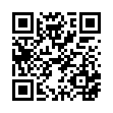
2025 NVS Basic Conference Survey
Please scan the QR Code or click on the link below to take an anonymous survey about your experience during the 2025 Basic Training Conference.
https://www.research.net/r/7SFKSLF

Slide 3
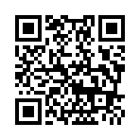
2025 Virtual SLT End of Conference Survey
Please scan the QR Code or click on the link below to take an anonymous survey about your experience during the 2025 Skill Level Training Conference.
https://www.research.net/r/RN23P7G

Slide 4
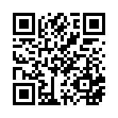
Workload Management
Please scan the QR Code or click on the link below to take an anonymous survey about your experience during the 2025 Skill Level Training Conference.
https://www.research.net/r/7WKFWPG

Slide 5
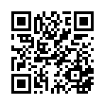
What’s New with VA Survey
Please scan the QR Code or click on the link below to take an anonymous survey about your experience during the 2025 Skill Level Training Conference.
https://www.research.net/r/5ZWY8FX

Slide 6
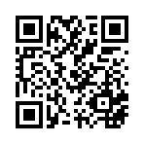
VBMS
Please scan the QR Code or click on the link below to take an anonymous survey about your experience during the 2025 Skill Level Training Conference.
https://www.research.net/r/7WDMZC2

Slide 7
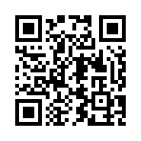
Veteran Communication
Please scan the QR Code or click on the link below to take an anonymous survey about your experience during the 2025 Skill Level Training Conference.
https://www.research.net/r/K9FY76H

Slide 8
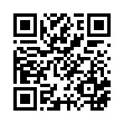
Pension Consideration
Please scan the QR Code or click on the link below to take an anonymous survey about your experience during the 2025 Skill Level Training Conference.
https://www.research.net/r/7QS55PX

Slide 9
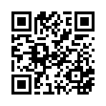
TAP Considerations
Please scan the QR Code or click on the link below to take an anonymous survey about your experience during the 2025 Skill Level Training Conference.
https://www.research.net/r/7Q65WKL

Slide 10
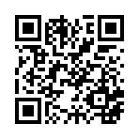
VA Education Benefits
Please scan the QR Code or click on the link below to take an anonymous survey about your experience during the 2025 Skill Level Training Conference.
https://www.research.net/r/K7P6KZH

Slide 11
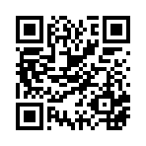
SMC Considerations
Please scan the QR Code or click on the link below to take an anonymous survey about your experience during the 2025 Skill Level Training Conference.
https://www.research.net/r/K7MMSLQ

Slide 12
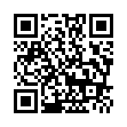
Secondary Conditions
Please scan the QR Code or click on the link below to take an anonymous survey about your experience during the 2025 Skill Level Training Conference.
https://www.research.net/r/55DGN6K

Slide 13
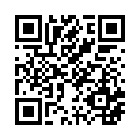
Ancillary Benefits
Please scan the QR Code or click on the link below to take an anonymous survey about your experience during the 2025 Skill Level Training Conference.
https://www.research.net/r/7QXRJ6Y

Slide 14
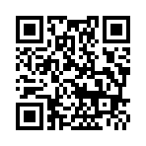
Beneficial Court Cases
Please scan the QR Code or click on the link below to take an anonymous survey about your experience during the 2025 Skill Level Training Conference.
https://www.research.net/r/K9DXHPB

Slide 15
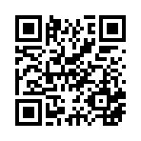
History of Claims
Please scan the QR Code or click on the link below to take an anonymous survey about your experience during the 2025 Skill Level Training Conference.
https://www.research.net/r/K752VJ3

Slide 16
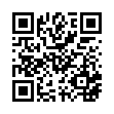
Hearings & Preparation
Please scan the QR Code or click on the link below to take an anonymous survey about your experience during the 2025 Skill Level Training Conference.
https://www.research.net/r/7W7JCVB

Slide 17
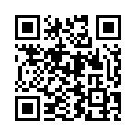
Esoteric Claims
Please scan the QR Code or click on the link below to take an anonymous survey about your experience during the 2025 Skill Level Training Conference.
https://www.research.net/r/77SFJYB

