Slide 1
ANCILLARY
BENEFITS

Slide 2
ANCILLARY BENEFITS
Ancillary benefits are:
Secondary benefits that are contingent on a veteran’s eligibility for compensation or a dependent’s eligibility for Dependency and Indemnity Compensation (DIC)
Eligibility for ancillary benefits is based on the type of disability entitlement the veteran has or the circumstances of the veteran’s death.

Slide 3
ANCILLARY BENEFITS
Ancillary benefits are controlled by different areas of VA depending on their application.
Being aware of the forms number will aid you in correctly submitting a claim for ancillary benefits
  Forms beginning with 21 are VBA related
  Forms beginning with 10 are VHA related
  Forms beginning with 26 are VBA related through the appropriate Regional Loan Center

Slide 4
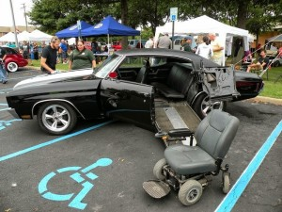
AUTOMOBILE ALLOWANCE
38 CFR 3.808
Financial assistance in the purchase of a new or used automobile or other conveyance may be made to a veteran with specific disabilities up to once every 10 years
Prior to January 5, 2023, veterans were only entitled to one auto allowance in their lifetime. If a veteran had already received an automobile allowance prior to 1/05/2023, they may apply immediately for a new auto allowance if more than 30 years have elapsed since they received their most recent auto allowance.
Beginning on January 5, 2023, veterans may apply for an additional auto allowance once 10 years have passed since their previous auto allowance was awarded.

Slide 5
AUTOMOBILE ALLOWANCE
38 CFR 3.808
Financial assistance, in the form of a grant, is available to purchase a new or used automobile (or other conveyance) to accommodate a veteran or servicemember with certain service-connected disabilities.
The grant may also be paid if disabilities are a result of medical treatment, examination, vocational rehabilitation, or compensated work therapy provided by the VA.
The grant is paid directly to the seller of the automobile for the total price (up to $26,417.20 as of 10/1/2024) of the automobile.
May also be paid for natural disaster or if insurance won’t compensate for loss of vehicle

Slide 6
AUTOMOBILE ALLOWANCE
A veteran or servicemember must have one of the following disabilities to qualify for the automobile grant:
  Loss, or permanent loss of use, of one or both feet
  Loss, or permanent loss of use, of one or both hands
  Impairment of vision 20/200 or less in better eye with correction or peripheral field less than 20 degrees
  Severe burns causing contracture which limits motion of limbs
  Amyotrophic lateral sclerosis (ALS)

Slide 7
AUTOMOBILE ALLOWANCE
The VA Form 21-4502 “Application for Automobile or Other Conveyance and Adaptive Equipment” is used to apply for an automobile allowance.
Only Sections I and II are to be completed when initially submitting the claim, Section III will be completed by VA and then the form is returned to the veteran.
Once the veteran receives the VAForm 21-4502 back from VA, they can fill out Section IV and purchase their new or used vehicle.
Once purchased, the seller will need to submit the completed VA Form 21-4502 to VA in order to receive payment.

Slide 8
ADAPTIVE EQUIPMENT ALLOWANCE
38 CFR 3.808(e)
That equipment which must be part of or added to a vehicle to make it safe for use by the claimant and to assist in meeting the applicable standards of licensure of the proper licensing authority.
38 CFR 17.158
Adaptive equipment may be certified for the initial vehicle purchased or for subsequent vehicles. This is not a one-time allowance.

Slide 9
ADAPTIVE EQUIPMENT ALLOWANCE
Adaptive equipment includes, but not limited to, power steering, power windows, power seats, and special equipment necessary to assist the eligible person into and out of the vehicle.
Contact should be made with the local VA medical center’s Prosthetic Department prior to purchasing any equipment.
The adaptive equipment grant may be paid more than once and it may be paid to either the seller or the veteran.

Slide 10
ADAPTIVE EQUIPMENT ALLOWANCE
The VA Form 10-1394 “Application For Adaptive Equipment
Motor Vehicle” is used when applying for adaptive equipment only.
If filing for both an automobile grant and adaptive equipment, only the VA Form 21-4502 needs to be completed.

Slide 11
ADAPTIVE EQUIPMENT ELIGIBILITY
A veteran or servicemember must have one of the following disabilities to qualify for adaptive equipment:
  Loss, or permanent loss of use, of one or both feet
  Loss, or permanent loss of use, of one or both hands
  Impairment of vision 20/200 or less in better eye with correction or peripheral field less than 20 degrees,
  Severe burns causing contracture which limits motion of limbs,
  Amyotrophic lateral sclerosis (ALS)
  Ankyloses of one or both knees or one or both hips
Notes:
This is the same as the auto grant with the exception of ankyloses

Slide 12
ADAPTIVE EQUIPMENT ELIGIBILITY
A disability which is acquired as a result of treatment in a VA medical facility (38 USC 1151) or as a result of training under 38 USC Chapter 31 (compensated work therapy), even though compensation is payable, does not qualify a veteran for these benefits.
Even though compensation may be payable under 38 CFR 3.383, claimants do not qualify for adaptive equipment based on a loss of paired SC and NSC organs or extremities. (38 USC 1160)

Slide 13

SPECIALLY ADAPTED HOUSING (SAH)
The Specially Adapted Housing (SAH) program offers grants to servicemembers and veterans with severe service-connected disabilities to assist them in building, remodeling, or purchasing an adapted home.

Slide 14
SPECIALLY ADAPTED HOUSING
38 CFR 3.809
An eligible person may receive a grant of not more than 50 percent of the cost of a specially adapted house.
SAH maximum is currently $117,014.
The grant can be awarded six times during the veteran’s lifetime not to exceed the maximum dollar amount allowable.

Slide 15
SPECIALLY ADAPTED HOUSING
SAH grants can be used in one of the following ways:
Construct a specially adapted home on land to be acquired
Build a home on land already owned if it is suitable for specially adapted housing
Remodel an existing home if it can be made suitable for specially adapted housing
Use the grant to help pay the unpaid principal mortgage balance of an adapted home already acquired without the assistance of a VA grant

Slide 16
SPECIALLY ADAPTED HOUSING ELIGIBILITY
The SAH grant is available to veterans and servicemembers who are entitled to VA disability compensation due to:
Loss or loss of use of both lower extremities, such as to preclude locomotion without the aid of braces, crutches, canes, or a wheelchair
Blindness in both eyes, plus loss or loss of use of one lower extremity
Loss or loss of use of one lower extremity together with either
    residuals of organic disease or injury or
    the loss or loss of use of one upper extremity, affecting balance or propulsion as to preclude locomotion without the aid of braces, crutches, canes, or a wheelchair
Loss or loss of use of both upper extremities at or above the elbows
A severe burn injury

Slide 17

SPECIAL HOME ADAPTATION
An eligible person may receive a grant for the actual cost to adapt a house or for the appraised market value of the necessary features already in a house when it was purchased.

Slide 18
SPECIAL HOME ADAPTATION
38 CFR 3.809a
The SHA grant is available to veterans and servicemembers who are entitled to disability compensation due to:
  Blindness in both eyes with 20/200 visual acuity or less in the better eye with the use of a standard correcting lens
  The anatomical loss or loss of use of both hands or extremities below the elbow,
  A severe burn injury
  Certain severe respiratory conditions
Current SHA maximum is $23,444
The grant can be awarded six times not to exceed the maximum dollar amount allowable

Slide 19
TEMPORARY RESIDENCE ASSISTANCE (TRA) GRANT
Temporary grants may be made to those who are or will be temporarily residing in a home owned by a family member
SAH maximum is $49,062
SHA maximum is $8,760
Temporary grants do count as one of the three usages of SAH/SHA

Slide 20
SAH, SHA, & TRA PROCEDURES
VA Form 26-4555, “Veterans Application in Acquiring Specially Adapted Housing or Special Home Adaptation Grant” is used to apply for SAH, SHA, and TRA
The VA Regional Loan Center is responsible for determining entitlement to, and payment of, SAH, SHA, and TRA.
Conditional approval includes consideration of:
      disability requirements
      feasibility and suitability, and
      usage or dollar amounts of assistance available vs. any amounts previously paid.
Final approval requires consideration of property requirements including
  details of proposed adaptations
  ownership
  certifications
  insurance
  geographic limits

Slide 21
SAH, SHA, & TRA PROCEDURES
The veteran will be contacted by the Prosthetics department of VHA to determine:
  Prescription for need of adaptation
  Review of any required cost estimates

Slide 22
HOME IMPROVEMENT AND STRUCTURAL ALTERATIONS (HISA)
The HISA benefit provides home improvements and structural alterations necessary only to ensure the continuation of treatment and/or to provide access to the home or to essential lavatory and sanitary facilities authorized under 38 USC § 1717.
Lifetime benefit up to $6,800 may be provided for:
  Veterans and Servicemembers who have a Service-connected condition that requires an adaptation
  Veteran rated 50% or more and requires an adaptation even if the condition requiring the adaptation is not S/C
Lifetime benefit up to $2,000 may be provided for:
  Non-service-connected Veterans

Slide 23
HOME IMPROVEMENT AND STRUCTURAL ALTERATIONS (HISA)
SAH and SHA eligible Veterans will also likely be eligible for Home Improvements and Structural Alterations (HISA)
HISA can provide additional funds for needed home modifications
The HISA grant may be used in conjunction with either the SAH or SHA grants

Slide 24

HOME IMPROVEMENT AND STRUCTURAL ALTERATIONS (HISA)
Commonly Approved
COMMONLY APPROVED
  Permanent Ramps that allow entrance to or exit from the residence
  Access to kitchen or bathroom sinks or counters
  Entrance pathways or driveways
  Plumbing;
  Electrical systems/outlets
  Hardwood flooring
  Door latches
  Roll-in showers/ Walk-in bathtubs
  Widening doorways to essential lavatories or sanitary facilities
  Interior and exterior lighting
  Costs related to taxes, permits, inspections fees, which are required by local ordinances
COMMONLY DISAPPROVED
  New home construction
  Spa or Jacuzzi type tubs
  Exterior decking
  Any alterations or modifications that the property owner is required to furnish under the Americans with Disabilities Act due to commercial zoning
  Home Security Systems
  Elevators
  Pathways that lead to workshops and barns
  Regular home maintenance routine repairs (e.g. replacement of roofs, furnaces, or air conditioners)
Commonly Disapproved

Slide 25
WHAT IS NEEDED FOR HISA
A prescription from a VA physician that includes:
      Beneficiary’s name, address, and phone number
      Description of the prescribed improvement or structural alteration
      The diagnosis and medical justification for the prescribed improvement or structural alteration
  VA Form 10-0103-HISA application with advance payment request
  Homeowners notarized authorization (if applicant is a renter)
  Written itemized estimate of costs for labor, materials, permits, and inspections
  A color photograph of the unimproved area
  Incomplete applications: if missing documentation is not received within 30 days, VA will notify the beneficiary and close the application
  VA will conduct a pre-award inspection of site no later than 30 days after receiving a complete HISA package
Notes:
See HISA map handout

Slide 26
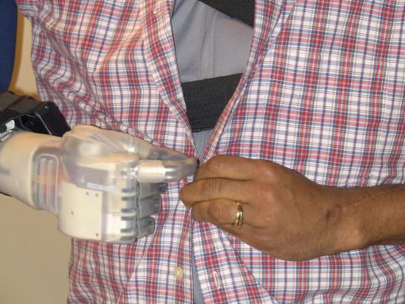
CLOTHING ALLOWANCE

Slide 27
CLOTHING ALLOWANCE
Veterans who utilize certain prosthetics are eligible for a yearly clothing allowance from the VA to help replace articles of clothing that are worn out faster because of their prosthesis or medications used for a skin condition.

Slide 28
CLOTHING ALLOWANCE
38 CFR 3.810
Eligibility:
  The veteran must have been prescribed and use either of the following for a service-connected disability:
  Prosthetic or orthopedic appliance, such as a wheelchair, crutches, braces, artificial limb, etc. (Note: soft and flexible devices, such as an elastic stocking or soft brace, are not included)
  Medication prescribed by a physician for a service-connected skin condition that causes permanent stains or otherwise damages outer garments
And this must be true:
  You need this device or skin medicine because of an injury or illness related to your military service (called a service-connected condition).

Slide 29
CLOTHING ALLOWANCE
Applications are collected throughout the year and held until the closing date of August 1st.
Applications are processed by the VA prosthetics department and veterans will receive payments between September 1st and October 31st.
This is an annual payment and will only be made during this time frame.

Slide 30
CLOTHING ALLOWANCE
As of December 16, 2011, Veterans became eligible to receive multiple clothing allowance benefits, with a limit of two (2) per garment affected and total maximum of four (4) clothing allowances.
Annual clothing allowance benefit is currently $1024.50
Approved Articles of Clothing:
  Skirts
  Pants
  Blouses
  Shirts
Disapproved Articles of Clothing:
  Hats, Caps
  Underwear
  Socks, Stockings, Pantyhose
  Shoes
  Scarves, Ties, Gloves

Slide 31
CLOTHING ALLOWANCE
How to Apply:
  Have the veteran submit VA Form 10-8678, “Application for Annual Clothing Allowance” to the prosthetic representative at their local VA medical center.
  Applications must be submitted by August 1 in order to be processed for that year
  If a veteran received a clothing allowance in 2022 or 2023, they no longer need to submit an application every year.
  If an additional clothing allowance is needed, new application is too.

Slide 32
PROSTHETICS
Home respiratory therapy
Artificial limbs
Orthopedic braces
Therapeutic shoes
Wheelchairs
Powered motility
Crutches
Service/Guide dog care
Canes
Walkers
Special aids
Appliances
Optical and electronic devices for visual impairment
Other durable medical equipment/supplies

Slide 33
AUDIOLOGY and EYE CARE SERVICES
Has compensable service-connected disability
Former POW/Purple Heart
Receiving benefits under 38 USC 1151
In receipt of NSC pension with Special Monthly Pension (Housebound or A&A)
Has vision/hearing impairment related to disability for which receiving VHA medical care
Has significant impairment affecting the ability to perform ADLs
Has vision and/or hearing impairment severe enough to interfere with the ability to actively participate in personal medical treatment

Slide 34
NON-SERVICE-CONNECTED VETERANS
Eligible for hearing aids/glasses on basis of medical need
Must be enrolled at VA medical facility where receiving care
Have hearing/vision loss that interferes/restricts communication to extent it affects active participation in health care as determined by audiologist or eye care provider
Contact Prosthetics Department for further information or eligibility criteria: www.prosthetics.va.gov

Slide 35
VA HOME LOAN GUARANTY FUNDING FEES
A veteran wanting to use the VA loan guaranty to purchase a house generally is subject to a funding fee based on the type of loan, their military category (NG, AD etc.) and if they have used their guaranty before.
The VA loan guarantee amount is typically capped at 25% of the loan amount for borrowers with full entitlement and no down payment.
The maximum guaranty amount is capped at the county loan limit, which varies by location.

Slide 36
VA HOME LOAN GUARANTY FUNDING FEES
  38 CFR 36.4313(e)(5)
  The VA Loan Guaranty funding fee can be waived if:
    Veteran is receiving VA compensation
    Veteran would be entitled to receive compensation for an SC disability if he/she were not receiving retirement or active duty pay
    Surviving spouse of a veteran who died of a SC disability
    Veteran rated eligible to receive VA disability comp based on a pre-discharge rating and exam or a rating based on existing medical evidence.
    The veteran received a compensable memorandum rating from VR&E

Slide 37
VA HOME LOAN GUARANTY FUNDING FEES
If a veteran indicates that they desire to utilize the VA Home Loan Guaranty, ensure that a disability claim is filed before the home closes if possible. (At least an ITF)
If compensation is awarded after the loan closing but the effective date is before closing, the veteran can request reimbursement of the funding fee – the reimbursement is paid towards the principal loan balance
Certificates of Eligibility can be obtained from VA.gov
Married couples who both have eligibility cannot combine their benefit to raise the maximum amount of guaranty, though both are still eligible in their own right. However, if one veteran is not eligible to have the funding fee waived, VA requires that the borrowers pay half of the funding fee if both veterans are on the loan.

Slide 38
VETERANS’ GROUP LIFE INSURANCE (VGLI)
  Veterans’ Group Life Insurance (VGLI) allows veterans to continue life insurance coverage after service.
  VGLI provides lifetime coverage as long as the premiums are paid. Veterans may enroll for a maximum amount of coverage that is equal to the amount of Servicemembers’ Group Life Insurance (SGLI) coverage they had when they separated from service.
  Once enrolled in VGLI, veterans can increase coverage by $25,000 every five years up to the legislated maximum of $500,000, until age 60.
  Veterans have 1 year and 120 days from their date of separation to apply for VGLI. If they apply for coverage within 240 days from separation, no health questionnaire is needed.

Slide 39
VETERANS’ GROUP LIFE INSURANCE (VGLI)
    Veterans are eligible to apply for VGLI, if they had SGLI, and are within 1 year and 120 days of the following events:
    release from active duty or active duty for training under a call or order to duty that does not specify a period of less than 31 days.
    separation, retirement or release from assignment from the Ready Reserves/National Guard
    assignment to the Individual Ready Reserves (IRR) of a branch of service or to the Inactive National Guard (ING).This includes members of the United States Public Health Service Inactive Reserve Corps (IRC)
    placement on the Temporary Disability Retirement List (TDRL)

Slide 40
VETERANS’ GROUP LIFE INSURANCE (VGLI)
Veterans are also eligible to apply for VGLI if they had part-time SGLI and while performing duty, suffered an injury or disability that rendered them uninsurable at standard premium rates. This includes travel directly to and from duty.
If the veteran is totally disabled at the time of separation, they can apply for an SGLI Disability Extension which provides free coverage for up to two years from the date of separation. An extension of SGLI due to total disability is not automatic.
At the end of the extension period, the veteran automatically becomes eligible for VGLI, subject to premium payments.

Slide 41
SERVICE-DISABLED VETERANS INSURANCE (S-DVI)
S-DVI is an optional life insurance for service-connected veterans only that stopped taking new applications after December 31, 2022.
If a veteran was already enrolled in S-DVI they can keep it. coverage.
Veterans who have the basic S-DVI coverage and are 100% P&T service-connected can have their premiums waived.
If a premium waiver is granted, policyholders may apply for additional coverage of up to $30,000 under the Supplemental S-DVI program.
Premiums for Supplemental S-DVI coverage cannot be waived.

Slide 42
SERVICE-DISABLED VETERANS INSURANCE (S-DVI)
    To be eligible for S-DVI the veteran must meet all of the following requirements:
    Released from service under other than dishonorable conditions on or after April 25, 1951
    Must have a service-connected disability (even one rated 0%)
    Healthy except for the service-related disability
    Must apply within two years of being notified of a service-connected disability (can apply any time veteran receives a new disability award, even one rated 0%)

Slide 43
SERVICE-DISABLED VETERANS INSURANCE (S-DVI)
The cost of the premium (the amount you will pay for coverage) is:
Your age, and
The amount of insurance you have and
The coverage plan requested and
Whether you pay once each month or once each year

Slide 44
VETERANS AFFAIRS LIFE INSURANCE (VALIFE)
    In January 2023, VA launched Veterans Affairs Life Insurance (VALife), which provides guaranteed acceptance whole life insurance coverage to service-connected veterans aged 80 and under. Some Veterans aged 81 and older may also be eligible.
    VALife offers guaranteed acceptance whole life insurance coverage that lasts for an individual’s entire life and provides the following benefits:
    All veterans aged 80 and under with 0-100% VA disability ratings are eligible.
    Fully automated online enrollment with instant approvals.
    Coverage comes in increments of $10,000, up to a maximum of $40,000
    No medical requirements for enrollment.
    Cash value that builds over the life of the policy after the first two years of enrollment.

Slide 45
If veteran is 81 years or older
All of these must be true:
Before turning 81, veteran applied for disability compensation for a service connected disability, and
After turning 81, veteran received a rating for that same disability, and
Veteran applied for VALife within 2 years of getting notification of the disability rating

Slide 46
VETERANS AFFAIRS LIFE INSURANCE (VALIFE)
    Veterans must apply for VALife within 2 years of getting notification of VA disability rating
    Veterans who currently hold an S-DVI policy can either keep their current coverage or apply for VALife.
    Veterans can keep their S-DVI policy until the full coverage of VALife begins two years after enrollment as long as the application is received between Jan. 1, 2023, and Dec. 31, 2025.

Slide 47

VETERAN READINESS AND EMPLOYMENT (VR&E)

Slide 48
VETERAN READINESS AND EMPLOYMENT (VR&E)
Vocational rehabilitation and employment services, job training, employment accommodations, resume development, and job-seeking skills coaching are available to veterans if: (Both must be true)
  You didn’t receive a dishonorable discharge, and
  You have a service-connected disability rating of at least 10% from VA
Other services may be provided to assist veterans in starting their own businesses or independent living services for those who are severely disabled and unable to work in traditional employment.
Notes:
Healthcare/dental eligibility and housing adaptations may also be provided if the vet is enrolled in Voc Rehab

Slide 49
VETERAN READINESS AND EMPLOYMENT (VR&E)
If you were discharged from active duty before January 1, 2013, your basic period of eligibility ends 12 years from one of these dates, whichever comes later:
  The date you received notice of your date of separation from active duty, or
  The date you received your first VA service-connected disability rating
  The basic period of eligibility may be extended if a VRC finds that you have a serious employment handicap (SEH). Having an SEH means your service-connected disability significantly limits your ability to prepare for, obtain, and maintain suitable employment (a job that doesn’t make your disability worse, is stable, and matches your abilities, aptitudes, and interests).
If you were discharged from active duty on or after January 1, 2013:
  The 12-year basic period of eligibility doesn’t apply to you. There’s no time limit on your eligibility

Slide 50
VETERAN READINESS AND EMPLOYMENT (VR&E)
How to apply:
The veteran will have to submit the VA Form 28-1900 “Disabled Veterans Application For Vocational Rehabilitation” to VA and then will meet with a counselor to determine the best course of action and eligibility.
If the veteran has not received a VA rating or has not yet been discharged (up to 6 months prior to discharge), they can still apply for VR&E; They will complete and submit the 28-1900 and the Notice to VA Veterans Service Center, located on the bottom of 28-0588. VA will review the available evidence and issue a memorandum rating determining eligibility

Slide 51

COMMISSARY AND EXCHANGE PRIVILEGES

Slide 52
COMMISSARY AND EXCHANGE PRIVILEGES
  As of January 1, 2020, all service-connected veterans, former POWs, and Purple Heart recipients have access to Commissary, Exchange, and MWR services on military installations.
  To gain access to the installation and use these services, veterans will need to enroll in the VA healthcare system and show their VA healthcare card at the military installation.
  Note: Even though DoD and VA authorize these benefits, the Base Commander has the ultimate say on who is allowed on the base.
Veterans who are not eligible to enroll in VA health care, or who are enrolled in VA health care but do not possess a VA healthcare card will not have access to military installations for in-person commissary, exchange, and MWR privileges, but will have full access to online exchanges and American Forces Travel.

Slide 53
COMMISSARY AND EXCHANGE PRIVILEGES
Though these benefits are provided by Department of Defense (DoD), VA does provide assistance in completing DD Form 1172, "Application for Uniformed Services Identification and Privilege Card." For detailed information, contact the nearest military installation.
This application is only used for 100% P&T service-connected veterans
As of November 11, 2017 all Honorably discharged veterans may shop the online exchange
https://www.shopmyexchange.com/account/register

Slide 54
Dependents Educational Allowance (DEA) (Chapter 35)
Provides education type benefits to spouse/children of:
Veteran who died or is permanently and totally disabled due to a service-connected disability
Veteran who died from any cause while permanently and totally disabled due to a service-connected disability
Service member who died on active duty, MIA or captured by hostile forces
Service member forcibly detained/interned in LOD by a foreign government
Service member hospitalized/receiving outpatient treatment for permanent and total service-connected disability and likely to be discharged for that disability

Slide 55
Dependents Educational Allowance (DEA) (Chapter 35) continued
Up to 45 months of benefits if benefits began before 8-1-18
Up to 36 months of benefits if benefits began on or after 8-1-18
Time limit
Children generally aged 18 to 26 (or up to age 31 in certain circumstances)
Surviving spouse
Up to 20 years if spouse died on active duty
Up to 10 years if veteran established eligibility after discharge from active duty

Slide 56
Other Programs-VA’s Benefits A-Z Page
Veterans Health Care
Caregiver Support Program
Civilian Health and Medical Program
of the Department of Veterans Affairs (CHAMPVA)
Veteran Owned Business Program
Civil Service Preference
Commissary/Exchange Privileges
Space Available Travel/Lodging
State Benefits

Slide 57
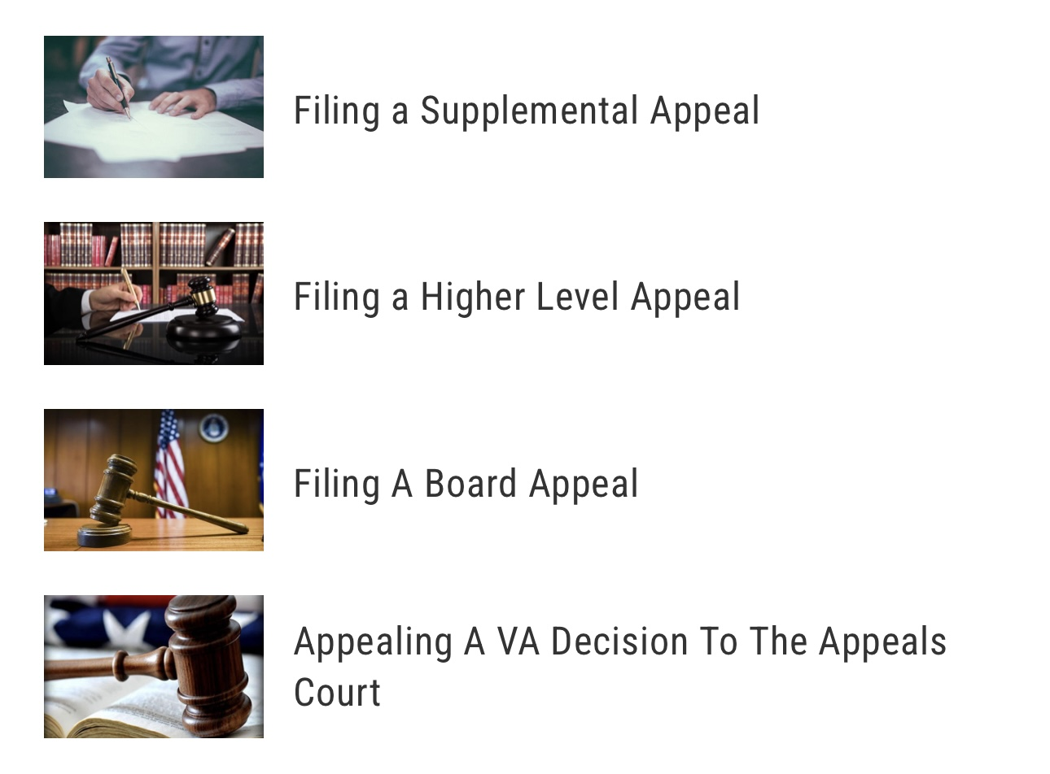
The Appeals Process For Ancillary Benefits

Slide 58
Appealing A Clinical Decision
If the veteran disagrees with a decision that their VA health care team makes about their treatment or care, they can request to have other medical professionals review that decision. This type of decision review follows the VHA Clinical Appeals process.
Veteran can request a review of a decision that their health care team makes about treatment or care. Here are some types of medical treatment decisions that can be appealed through the Clinical Appeals process:
If the provider should prescribe a specific medicine for veteran
Whether veteran should receive a specific type of therapy
These treatment decisions are also called “medical determinations.”

Slide 59
Appealing a Clinical Decision (cont.)
After the patient advocate reviews the appeal request, they’ll determine the next step for your appeal:
If new medical evidence was presented, the advocate may request that the health care team review their original decision again.
If the appeal enters the Clinical Appeals process, the facility’s chief medical officer, or someone they designate, will review the appeal and any relevant medical records. If needed, they’ll ask other experts to help review the appeal, too.
The veteran will then receive a final letter with the decision on your appeal. If they agree with the decision, the appeal will be considered closed. If they disagree with the decision, they can appeal the decision in writing to their Veterans Integrated Service Network (VISN) Office.

Slide 60
Be aware of the multiple ancillary benefits a veteran may be entitled to
Check current criteria for eligibility as it may change
REMEMBER: Veterans don’t always know what they are entitled to.
They need YOU!

Slide 61
Questions?

