Slide 1
Veteran Education Benefits

Slide 2
What we will discuss:
What are VA education benefits?
Who processes education benefits?
Application process
Eligibility Requirements
What programs are available?
Best Practices to Obtain
Appeals process for denial

Slide 3
What are VA Education benefits?
VA education benefits help Veterans, service members, and their qualified family members with needs like paying college tuition, finding the right school or training program, and getting career counseling.

Slide 4
What are VA Education benefits?
May include GI Bill (this is a registered trademark BTW)
Post-9/11 GI Bill
Yellow Ribbon program
Montgomery GI Bill
Reserve Educational Assistance Program
Survivor’s and Dependents’ Educational Assistance

Slide 5
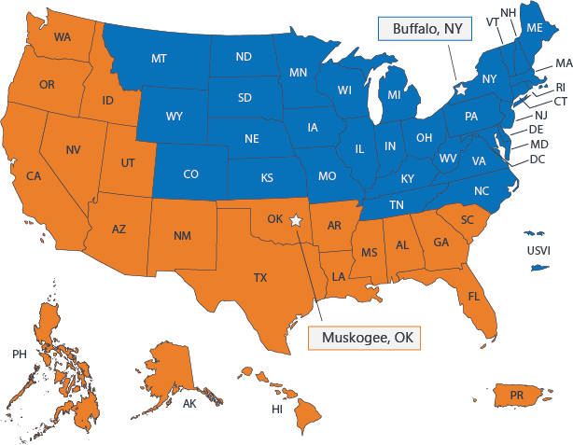
Education Administrators-Regional Processing Offices

Slide 6
Education Administrators
ELR=VBA Employee
SAA=State Employee
SCO= Designated School Employee
School Certifying Official (SCO)
Education Liaison Representative (ELR)
State Approving Agency (SAA)

Slide 7
Education Liaison Representative/State Approving Agency/School Certifying Official
What do they do?

Slide 8
Responsible to the VA for Education Administration
ELR
SAA
Updates Web Enabled Approval Management System (WEAMS)
Authorize SCO access through VA form 22-8794
Handles Direct Deposit information for schools (Public Law 104-134, also known as "The Debt Collection Improvement Act of 1996" requires all federal payments be made by Electronic Funds Transfer (EFT) and there are no exceptions for Vendor payments.)
Gathers and maintains education documentation related to programming.
Helps coordinate Risk Based Surveys
Approves/Disapproves education programs based on VA requirements.
Acts as Liaison between VA and SCO

Slide 9
School Certifying Official-HEAVY LIFTER
Submits VA 22-1999 (VA Enrollment Certification)
Maintains student education file:class schedule, transcripts, bursar record, etc. 3 year record keeping.
May advise student academically. May be a Jack of All Trades!
Constant point of contact with Veteran and dependents.
Handles Risk Based Survey (RBS).
Use the SCO Handbook as a guide for certifications. 8 hours of training annually.
SCO’s are located found in various areas around campus.
Some may be found within the Registrar Office, Financial Aid Office, Student Account Office, or Admissions.
Every organization is structured differently. However, the role of SCO doesn’t change!

Slide 10
Approval Process for GI Bill
Organization Creates Program
Regional/National Accreditation Approve/Disapprove
Organization Submits to SAA for Approval
Organization submits all relevant documentation to include marketing, finances, and catalog to SAA.
SAA/ELR Approve
SAA notifies organization of approval/disapproval. ELR updates WEAMS. SCO is cleared to report student and program.

Slide 11
Who is Eligible?
Veterans
Active-duty service members
National Guard or Reserves
Qualified survivors
Qualified dependents

Slide 12
Recent Change!
This will be discussed in more detail in your “What’s New at VA” Class with Crystal
There may be additional entitlement in the recent Rudisill decision (for those with 2 or more qualifying periods of active duty = potentially up to 48 months of entitlement
Some specific examples in Perkins v Collins
Also look at Loomis v Collins

Slide 13
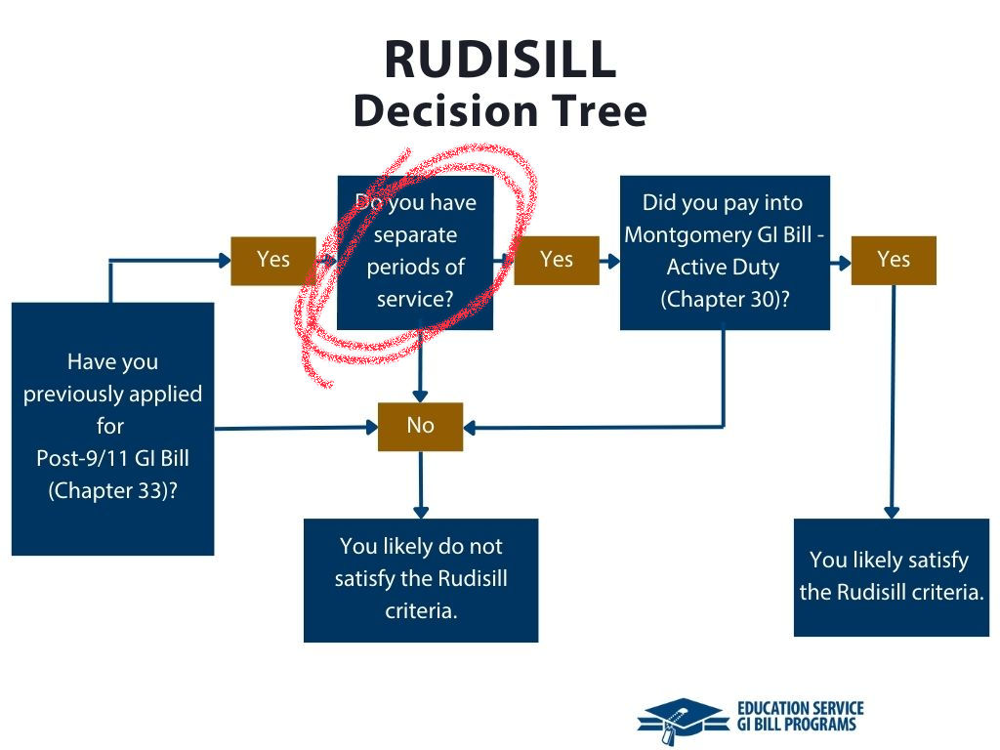
Recent Change!

Slide 14
(Fairly) Recent Changes
VRRAP – Veteran Rapid Retraining Assistance Program does not have any enrollments after December 10, 2022 – was in place due to COVID-19

Slide 15
Post-911 GI Bill Eligibility
Also known as Chapter 33
Active duty for at least 90 days after 9/10/2001 (continuous or interrupted)
Served for at least 30 continuous days after 9/10/01 and were discharged because of SC disability
Received Purple Heart after 9/10/2001
If you have one period of service after 8/1/2011 and you qualify for others, you must choose only 1 education benefit

Slide 16
Montgomery GI Bill Active Duty Eligibility
Also referred to as MGIB-AD
Generally, at least 2 years active duty plus:
  Honorably discharged, and
  You have HS diploma or GED, or 12 hours college credit, and
  You didn’t decline enrollment in MGIB-AD when you started AD, and
  You meet other requirements
  You must choose only 1 education benefit if you have only 1 period of service after 8/1/2011 (same as Post-911 requirement)

Slide 17
Montgomery GI Bill Selected Reserve Eligibility
Also referred to as MGIB-SR
Army, Navy, Air Force, Marine Corps, or Coast Guard Reserves
One MUST be true:
  6-year service obligation, or
  Officer in the Selected Reserve who agreed to serve 6 years in addition to the initial service obligation

Slide 18
Montgomery GI Bill Selected Reserve Eligibility
ALL of these must be true:
  IADT is complete
  HS Diploma or GED is completed prior to finishing IADT
  Good standing while serving in an active SR unit

Slide 19
Let’s evaluate
Does anyone know?
Which is better – Montgomery GI Bill? Or Post-9/11 GI Bill?
Why?

Slide 20
Education Benefits Highlights
If there is eligibility for more than one education benefit, there is a maximum 48 months/ 4 years of benefits available
Keep in mind that Veteran Readiness and Employment (VR&E) benefits (Chapter 31) are separate

Slide 21
Edith Nourse Rogers STEM Scholarship
Veterans or Fry Scholars may be eligible if:
  Enrolled in an undergraduate STEM degree program
  Earned a post-secondary degree or graduate degree in approved STEM degree field and enrolled in a covered clinical training program for HC professionals
  Earned a post-secondary degree in an approved STEM degree field and working toward a teaching certification
Priority is given to Veterans and Fry Scholars who are eligible at the 100% level for Post-9/11 GI Bill and require the most credit hours compared to other applicants
Benefit: 9 additional months (or $30,000 whichever comes first)

Slide 22
Yellow Ribbon Program
Can help pay for higher out-of-state, private school, foreign school, or graduate school tuition and fees that the Post-9/11 GI Bill doesn’t cover.
Recipient must qualify for the Post-911 GI Bill at the 100% level
School must offer the Yellow Ribbon Program, have available slots, and will make the decision.
Benefit = school will contribute a certain amount toward the extra tuition and fees through a grant, scholarship, or similar program. VA will match the contribution.

Slide 23
Post-911 GI Bill at the 100% level
36 months on active duty and honorably discharged
Purple Heart recipient on or after 9/11/2001 and honorably discharged
30 continuous days on or after 9/11/2011 and discharged for SC disability
Active-duty member with at least 36 months on active duty
Spouse using the transferred benefits of active-duty service member with at least 36 months active-duty service
Dependent child using benefits transferred by a Veteran
Fry Scholar

Slide 24
Fry Scholarship
Available to the child or surviving spouse of a service member or member of Selected Reserve who died on or after September 11, 2001.
Named for Marine Gunnery Sergeant John David Fry
Service member died in LOD, or died from SC disability within 120 days of discharge
Selected Reserve member died in LOD not on AD, or from SC disability
School must be an approved program for the Fry Scholarship

Slide 25
Chapter 36
Free educational and career counseling through Personalized Career Planning and Guidance (Chapter 36)
Leaving active service soon
Discharged within the past year
Veteran or dependent who is eligible for VA education benefits

Slide 26
Spouse or Child education benefits
If Post 9/11 benefits have not been used, up to 36 months may be transferred to spouse or dependent children. While the service member is on Active Duty or in the Selected Reserve.
All of these must be true:
  You’ve completed at least 6 years of service on the date your request is approved, and
  You agree to add 4 more years of service, and
  The person getting benefits is enrolled in the Defense Enrollment Eligibility Reporting System (DEERS)
Note: If you received a Purple Heart, you don’t need to meet a service requirement. But you’ll need to request to transfer your benefits while you’re still on active duty.

Slide 27
Spouse or Child education benefits
For SC disabilities, dependent family members may be eligible through Chapter 36
Surviving spouse and children can obtain educational assistance
  P&T Veteran due to SC disabilities
  Died as a result of SC disability, or in line of duty, MIA, POW
  Service member is in the hospital for SC permanent disability

Slide 28
Spouse or Child education benefits
January 1, 2013 is an important date for eligibility for spouses.
If service member separated before 1/1/2013, the spouse has up to 15 years from separation to use the benefits (assuming no revocation)
If service member separated ON OR AFTER 1/1/2013, there is no time limit unless the SM or Veteran revokes the transfer

Slide 29
Spouse or Child education benefits
A dependent child can start to use these benefits only after you’ve finished at least 10 years of service. They can use these benefits while The service member is on active duty or after they have separated from service.
The child must meet these requirements to use the benefits:
They have a high school diploma (or a certificate that’s equivalent) or they’re at least 18 years old
They’re younger than 26 years old

Slide 30
Special Circumstances
For individuals without an honorable discharge, it may be possible to:
Apply for a discharge upgrade
As for VA Character of Discharge review

Slide 31
How to Apply
Apply Online –
  There is a GI Bill Comparison Tool that is super helpful
Apply In Person – at a benefits office
Apply at School – with an SCO
Apply by Mail (yes this still exists)

Slide 32
HOT TIP
Make sure that the student you are helping forms a relationship with their School Certifying Official
They will be a wealth of information and guide

Slide 33


GI Bill Benefit Process-Application
VA 22-1990
Ch 1606 Selected Reserves MGIB
Ch 30 Montgomery GI Bill
Ch 33 Post 9/11 GI Bill
VA 22-1990e
Ch 33 Post 9/11 Transfer of Entitle Benefits (TEB)
VA 22-5490
Ch 35 Dependents Education Assistance (DEA)
GySgt Fry Scholarship (Post 9/11)
VA 28-1900
Ch 31 Veteran Readiness & Employment
22-10203
Edith Nourse STEM Scholarship

Slide 34
What are the Benefits? (Post-9/11)
Post-9/11 GI Bill (Chapter 33) rates for tuition and fees:
  Public institutions = up to the net tuition and mandatory fees
  Private, foreign, non-college degree = up to $29,920.95
  Flight training = up to $17,097.67
  Correspondence school = up to $14,533

Slide 35
What are the Benefits?
Post-9/11 GI Bill (Chapter 33) rates for monthly housing:
  Must not be on active duty
  Must be more than half-time
  Based on zip code for in-person courses
  For online learning, it is 50% of the national average
    After 1/1/2018, $1,169 is the max

Slide 36
What are the Benefits?
Post-9/11 GI Bill (Chapter 33) rates for monthly housing:
  The Defense Travel Management Office Basic Allowance for Housing (BAH) is used based on zip code, at the E-5 level
  For example, Louisville KY is $1,950 with dependents, $1,500 without dependents
  Annapolis, MD is $2,859 with, and $2,448 without
  Atlanta, GA is $2,367 with, and $1,989 without
  New York, NY is $3,240 with, and $2,835 without

Slide 37
What are the Benefits?
Post-9/11 GI Bill (Chapter 33) rates for books & supplies:
  $1,000 each academic year
    Up to $41.67 per credit hour (limit 24 hours) for college or university
    $83/ month for non-college
  If student is moving from a rural area, there is an additional benefit of $500 to help with moving expenses (county with no more than 6 ppl per sq mile and relocating at least 500 miles away)
  Tutorial assistance up to $1,200 total ($100/ month) is available

Slide 38
What are the Benefits?
Additional benefits:
Work study program
On-the-job training and apprenticeship living expenses (rates determined by zip code)
Test fees = up to $2,000
Prep courses
National tests

Slide 39
What are the Benefits?
Chapter 35 rates for survivors and dependents (per full month at higher learning institution:
  $1,536 for full-time enrollment
  $1,214 for ¾ time enrollment
  $890 for ½ time enrollment
These are same rates for non-college degree programs

Slide 40
Montgomery GI Bill Benefits
For institutions of higher learning rates based on full months with at least 3 continuous years of service:
$2,438 for full-time enrollment
$1,828.50 for ¾ time enrollment
$1,219 for ½ time enrollment
Same for non-college degree programs
60% of flight training charges

Slide 41
Montgomery GI Bill Benefits
For institutions of higher learning rates based on full months with at 2-3 continuous years of service:
  $1,978 for full-time enrollment
  $1,483.50 for ¾ time enrollment
  $989 for ½ time enrollment
  Same for non-college degree programs
60% of flight training charges

Slide 42
Montgomery GI Bill Benefits
There was a Buy-up program for MGIB-AD
  If member contributed $600, there is up to $5,400 more available
  $150 more per month for full-time enrollment
  $112.50 more for ¾ time
  $75 more for ½ time

Slide 43
Montgomery GI Bill Benefits – Selected Reserve
For Selected Reserve (MGIB-SR):
  $481 for full-time enrollment
  $360 for ¾ time enrollment
  $240 for ½ time enrollment
  Same for non-college degree programs
  60% of flight training charges

Slide 44
… and there’s more!
Senator Elizabeth Dole 21st Century Veterans Healthcare and Benefits Improvement Act of 2025
15 provisions to enhance benefit programs
Effective January 2, 2025

Slide 45
… and there’s more!
Accelerated payments for high-technology programs
Enrolled in qualifying high-tech degree or non-college program
Tuition and fees cost more than 200% of the monthly amount of assistance you would normally qualify to receive
Benefit = accelerated payments of 60% of tuition and fees
Qualifying programs may include engineering, mathematics, computer specialties, and so on
Must certify the intention to look for employment in a related field

Slide 46
Best Practices to obtain benefits
Know your eligibility
Know which program will pay you the most! (GI Bill Comparison Tool is a great start)
Get to know the School Certifying Official
If the student is having a hard time deciding on a major, it might be smart to pick one in STEM! And apply for the Nourse! And find a Yellow Ribbon school!
Don’t forget about programs that can supplement (like VR&E)

Slide 47
Education – How to Appeal
Supplemental claim (new and relevant evidence)
Higher-Level Review
Board Appeals
Must follow timelines as stated within the decision notification (generally one year from notification)

Slide 48

Questions?

