Slide 1
Caring for Those Who Have Borne the Battle The History of Veterans Benefits Prior to the Department of Veterans Affairs

Slide 2
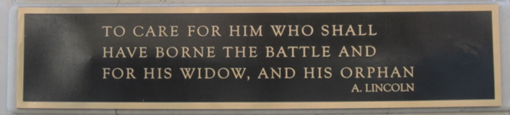
Lincoln’s Second Inaugural Address

Slide 3
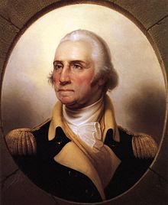
“The willingness with which our young people are likely to serve in any war, no matter how justified, shall be directly proportional as to how they perceive veterans of earlier wars were treated and appreciated by this country.” George Washington

Slide 4
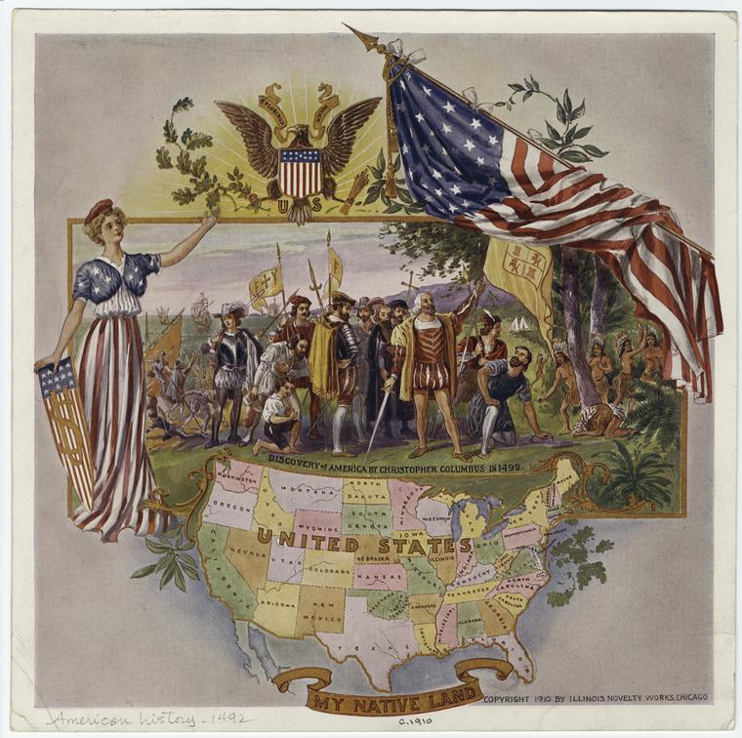
Before America

Slide 5
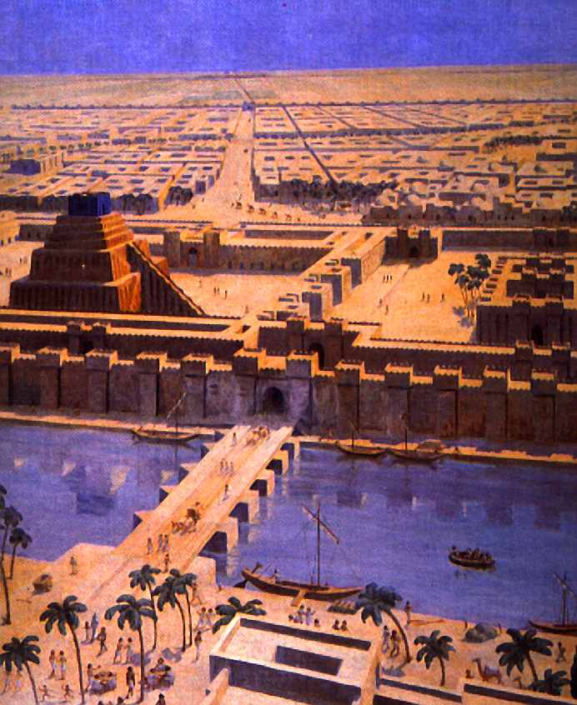

Before America

Slide 6

Before America

Slide 7

Before America
Aerarium Militare
Capitoline Hill

Slide 8
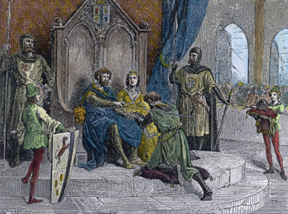
Before America

Slide 9
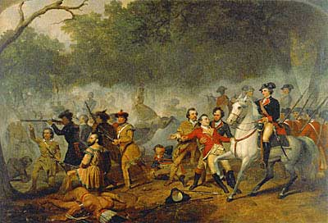
Colonial America
1592-93: English Parliament passes national system of disability compensation for veterans
Disability Benefits
Officer Pensions

Slide 10
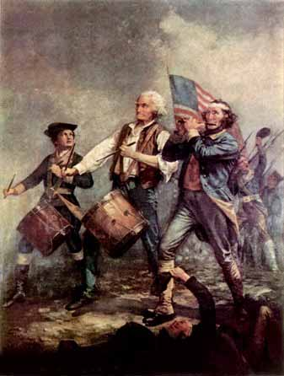
The Revolutionary War

Slide 11
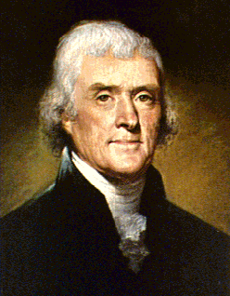
The Revolutionary War
Duty
Taxes
Hereditary Aristocracy

Slide 12
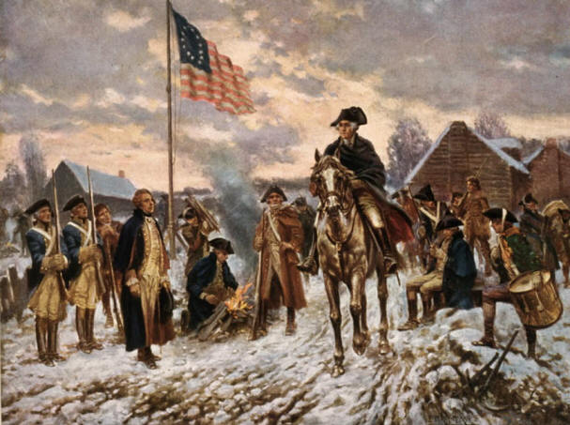
The Revolutionary War

Slide 13
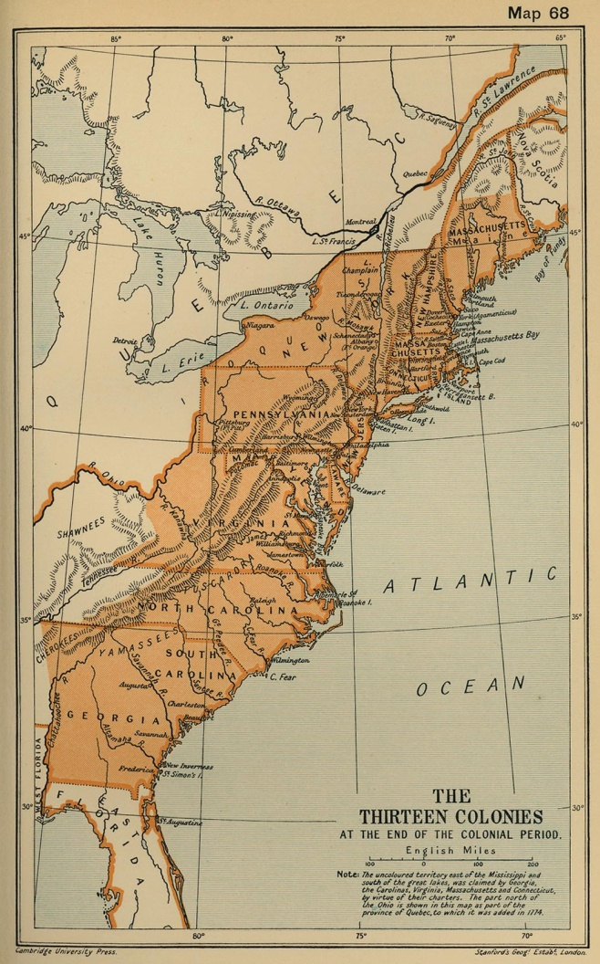
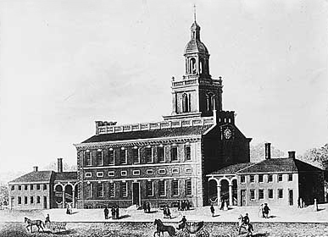
The Articles of Confederation
States largely failed to honor the promises of the Continental Congress.
1783 : The Philadelphia Mutiny

Slide 14
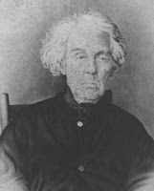
Benefits after the Constitution
Local governments contract care of destitute veterans to the lowest bidder
Petersborough, NH
Benjamin Alld, 96¢/week
Service Pension Law of 1818
1820 Rescission
1832 Pension Law

Slide 15
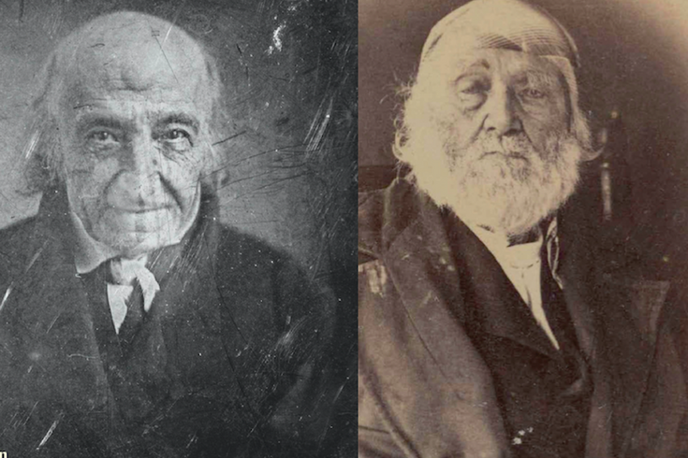
The Revolutionary War
250,000
850

Slide 16

Judicial Review after the Constitution
Act of Sept. 29, 1789, Ch. 24
Invalid Pension Act of 1792

Slide 17
Marbury v. Madison
“It must be well recollected that in 1792 an act passed, directing the secretary at war to place on the pension list such disabled officers and soldiers as should be reported to him by the circuit courts, which act, so far as the duty was imposed on the courts, was deemed unconstitutional . . . .”
5 U.S. 137, 171 (1803) (discussing Hayburn’s Case, 2 U.S. 409 (1792)).
Notes:
+A decade before Marbury v. Madison, the Supreme Court declared a statute impacting veterans benefits to be an unconstitutional violation of separation of powers. In fact, that case—Hayburn’s Case—was relied upon to decide Marbury.
Hayburn’s case is cited in Marbury v. Madison

Slide 18
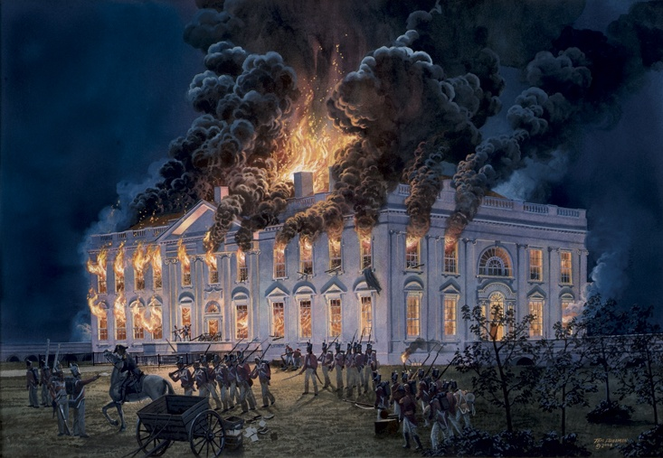
The War of 1812
War ended in 1815
The War of 1812 Veterans Act
of 1871

Slide 19
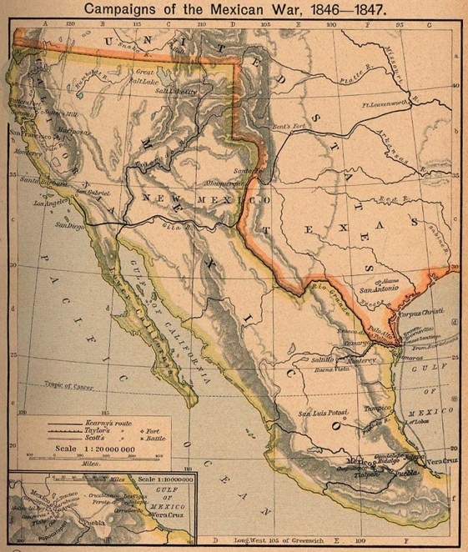
The Mexican-American War
116,000 veterans
Twice as deadly as the Civil War
Disability benefits first awarded for disease contracted in service
Between 1847 and 1855, veterans were issued warrants for 60 million acres of land.

Slide 20
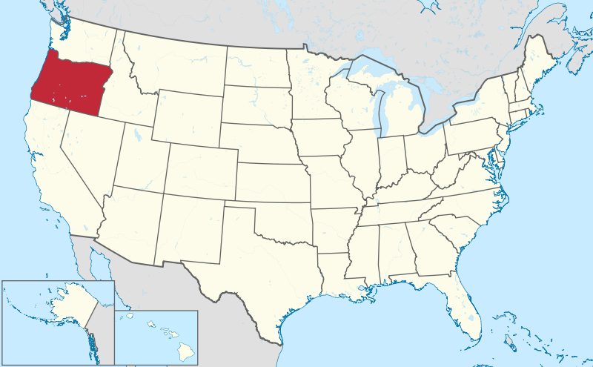
The Mexican-American War

Slide 21
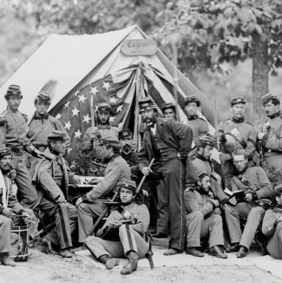
The Civil War

Slide 22
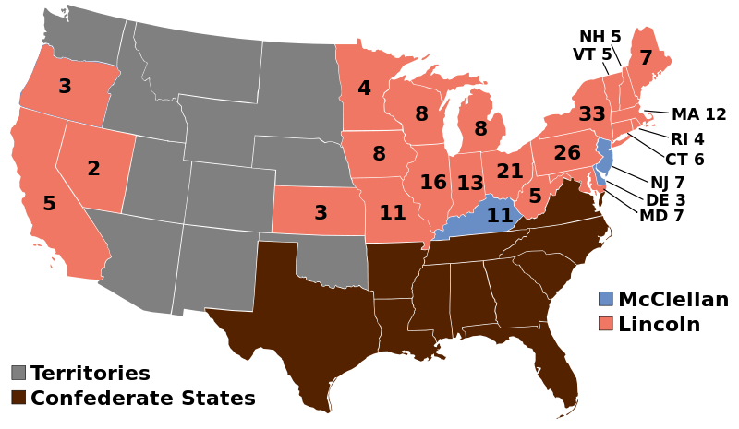
The 1864 Election

Slide 23

The 1864 Election
Lincoln McClellen
296,292 277,443

Slide 24
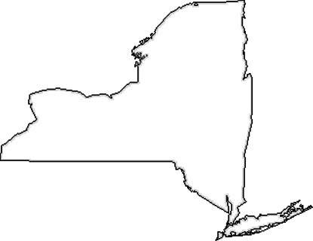
The 1864 Election
Lincoln McClellen
368,735 361,986

Slide 25
The 1864 Election
Lincoln McClellen
2,218,388 1,812,807
4,031,887
2,000,000

Slide 26
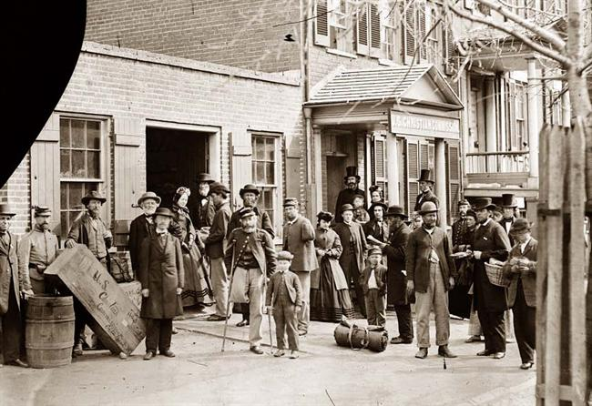
1866 Bounty Equalization Act
Unemployment
Homelessness
“Soldier’s Heart”
“Soldier’s Disease”
$70,000,000

Slide 27
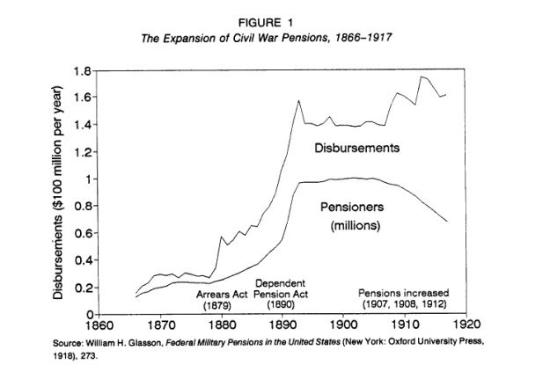
Civil War Benefits Legislation
1866: Bounty Equalization Act
1880: Arrears Act
1890: Disability Pension Act
1906: Age substitutes for disability

Slide 28
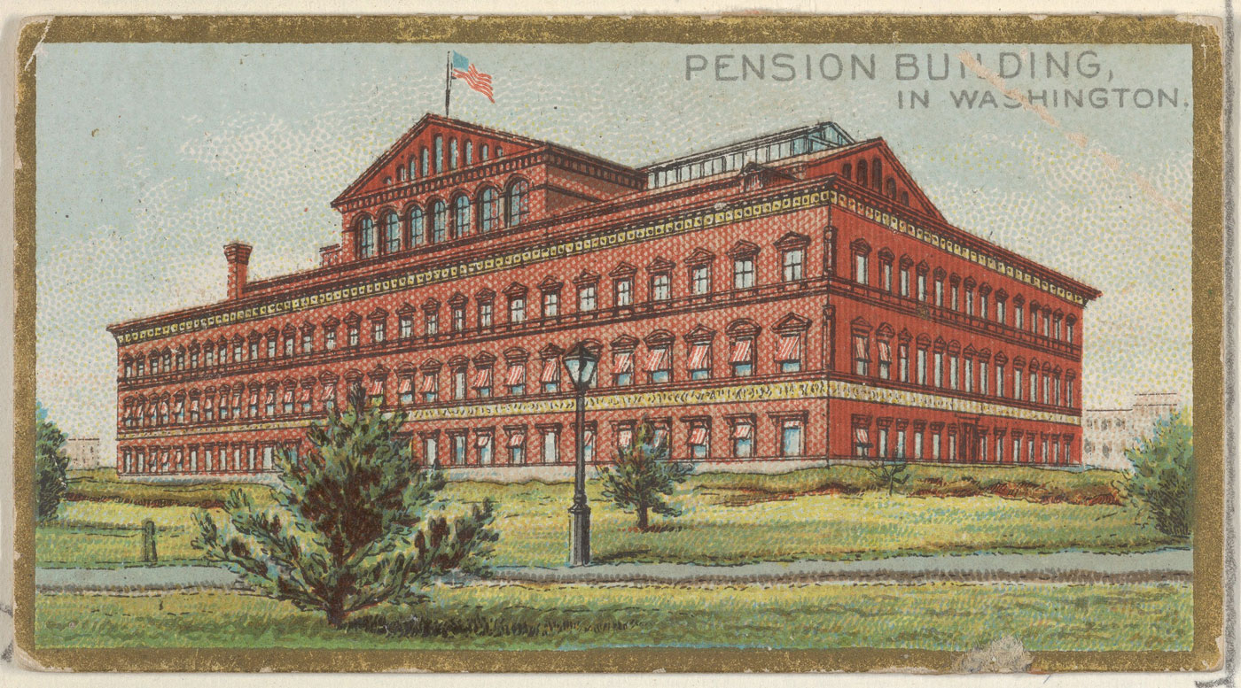
Pension Bureau building

Slide 29
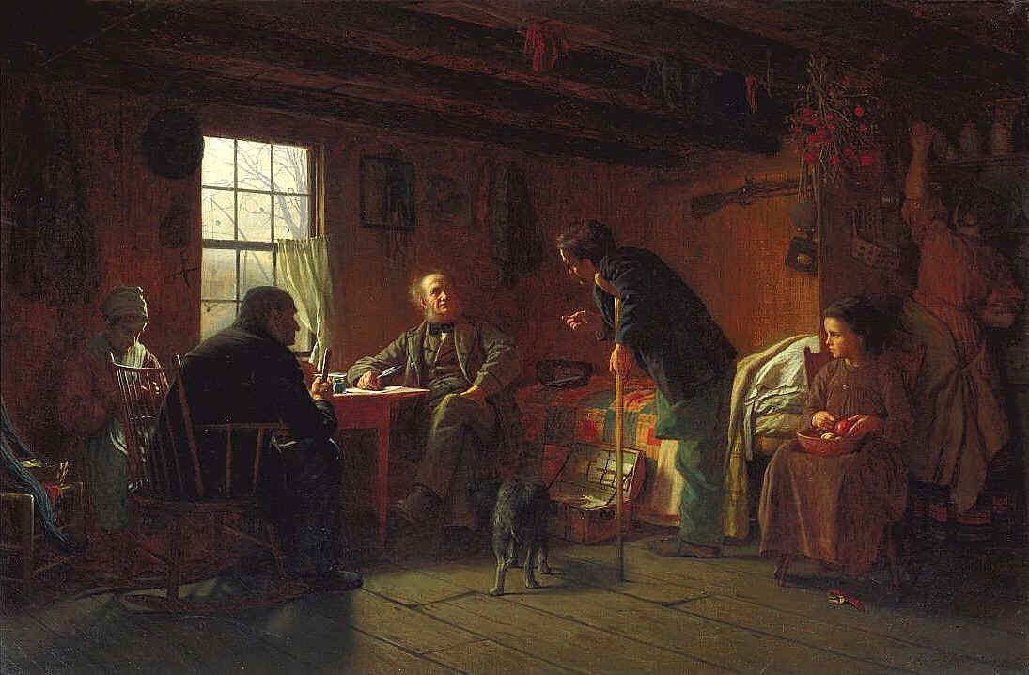
Claims Agents

Slide 30
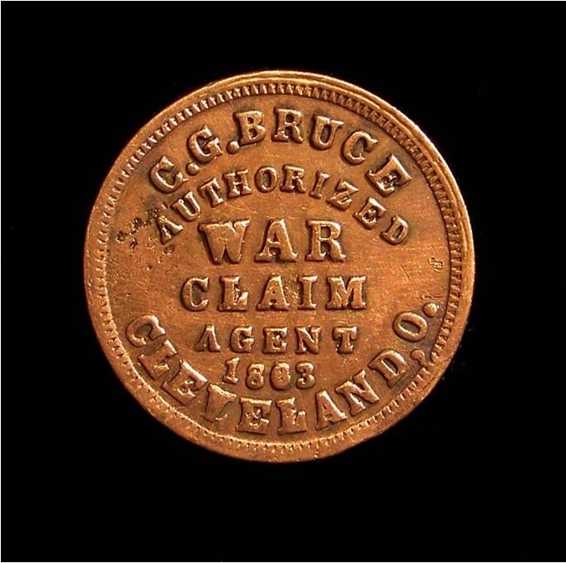
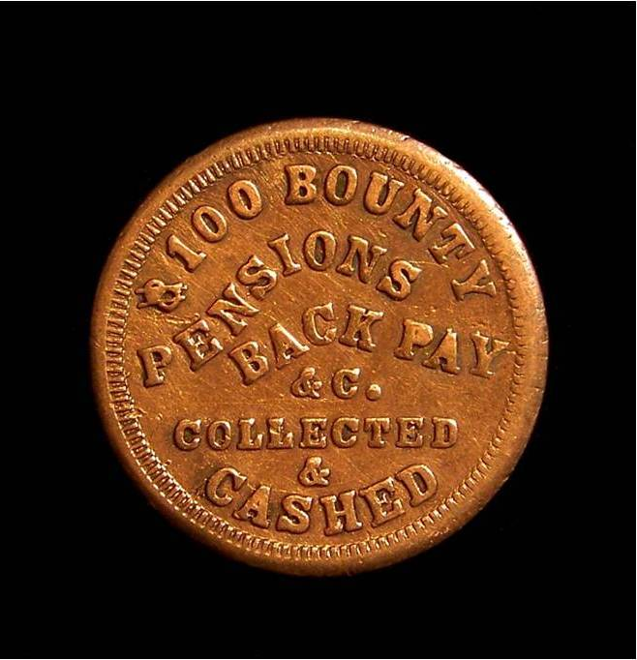
Claims Agents
1872: Secretary of Interior estimates that ¼ of all pension payments were based upon fraud.

Slide 31
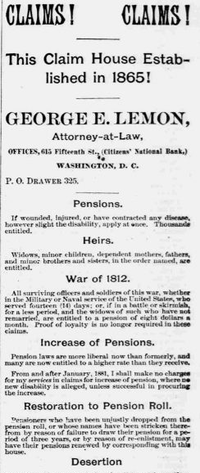
Claims Agents
1872: Secretary of Interior estimates that ¼ of all pension payments were based upon fraud.
1877: The National Review established.
$10 Fee limit

Slide 32
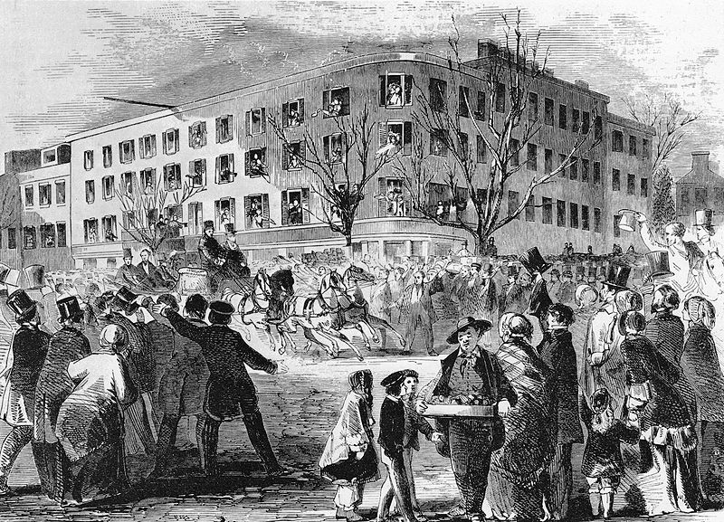
U.S. Court of Claims

Slide 33
U.S. ex rel. Burnett v. Teller
“No pensioner has a vested legal right to his pension. Pensions are the bounties of the government, which Congress has the right to give, withhold, distribute, or recall, at its discretion.”
107 U.S. 64, 67-68 (1882).
Notes:
The Supreme Court changed the rationale for not reviewing veterans benefits claims.

Slide 34
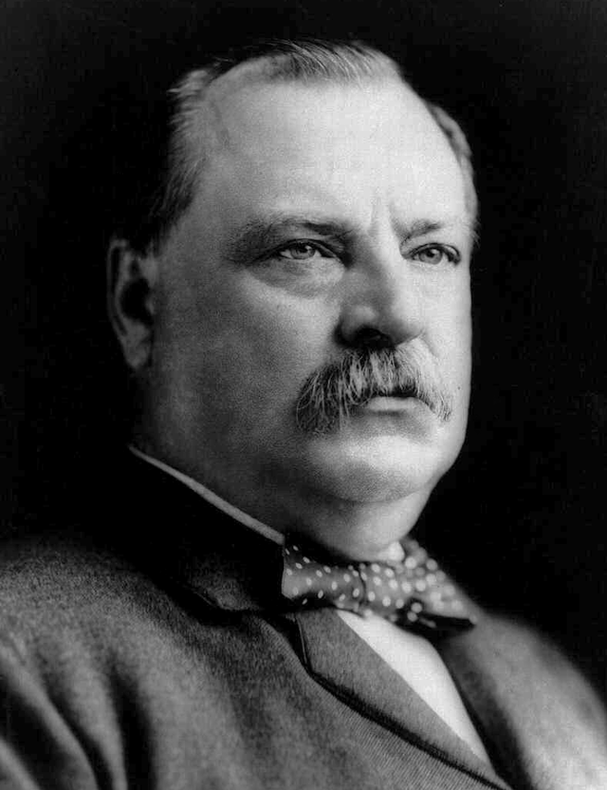
Pension Politics in the 19th Century
First session of the 49th Congress (1885): 4,500 special pension acts introduced
Grover Cleveland (1885-89): Signed 1,453 bills
1884: Pension Bureau Commissioner W.W. Dudley uses claims staff to campaign against William Warner

Slide 35
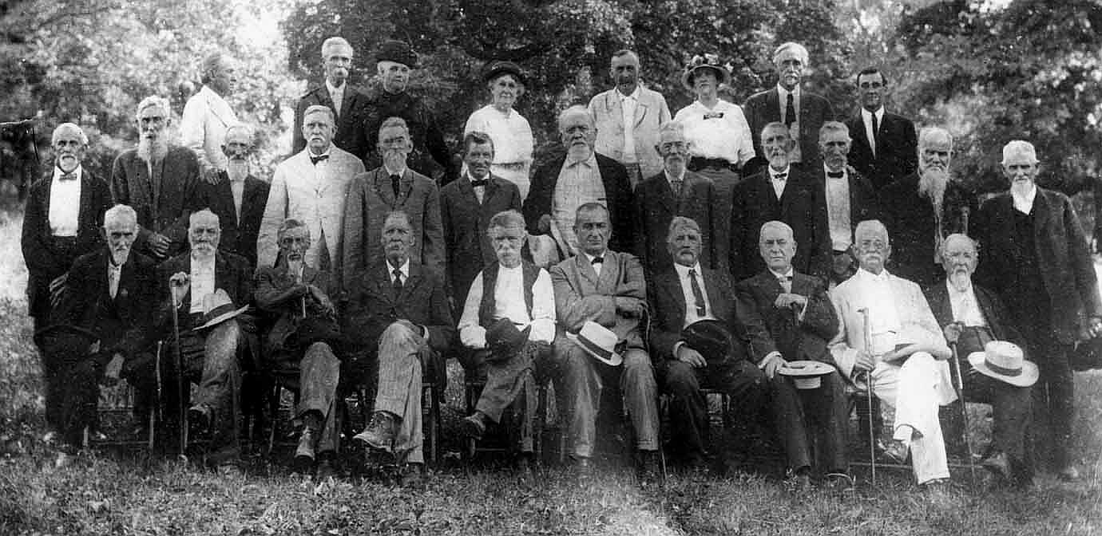
Peak Benefits
1913 -- 48 years after the end of the war
33-40% of the federal budget

Slide 36
The moral degeneration caused by the changing view of the true character of pensions led to the evil of extending them to men whose service was brief and resulted in no injury to them. Moreover, pensions were taken without compunction by some men who, while technically entitled to them, had other means of adequate support; to say nothing of young widows of old soldiers. For such people to take pensions is to throw a shadow of graft on the whole system.
As a result of these and other evil influences, the whole pension system became gradually discredited. Nobody begrudged the deserving pensioner his pittance from the public treasury, but the developing rottenness of the system led the public at last to look with more or less suspicion on applications for pensions, even when they were meritorious.
William Henry Glasson, Federal Military Pensions in the United States (1918)

Slide 37
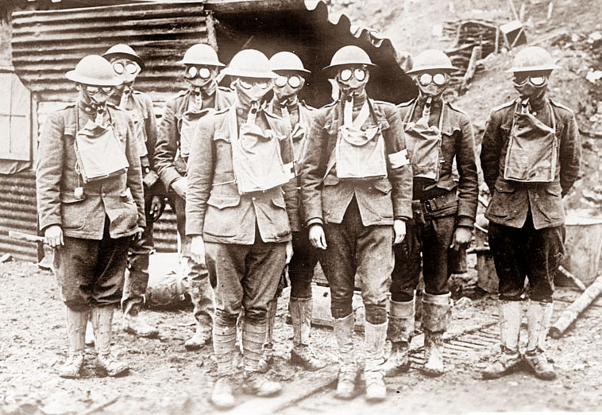
World War I

Slide 38
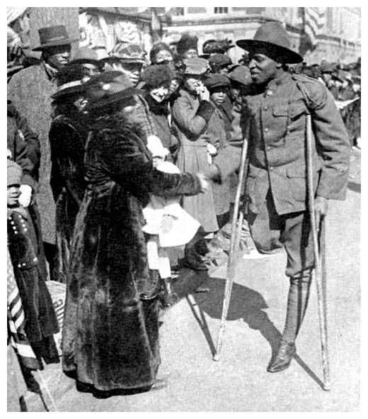
World War I
4,700,000 veterans
“Compensation”

Slide 39
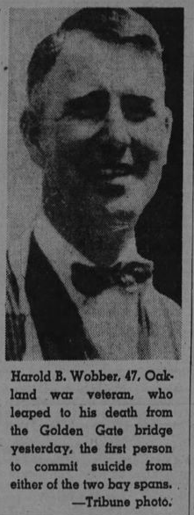
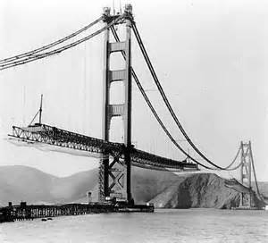
World War I
Harold Wobber

Slide 40
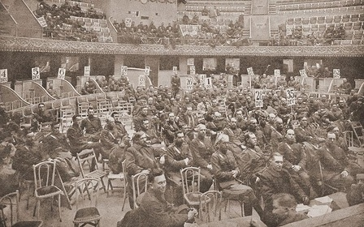
World War I
Veterans Service Organizations

Slide 41
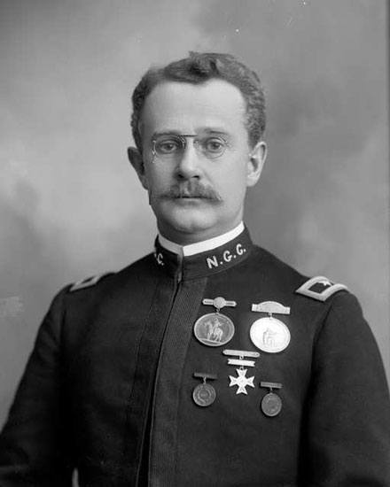
Veterans Service Organizations
1913: Veterans of Foreign Wars
1919: American Legion
1920: Disabled American Veterans

Slide 42
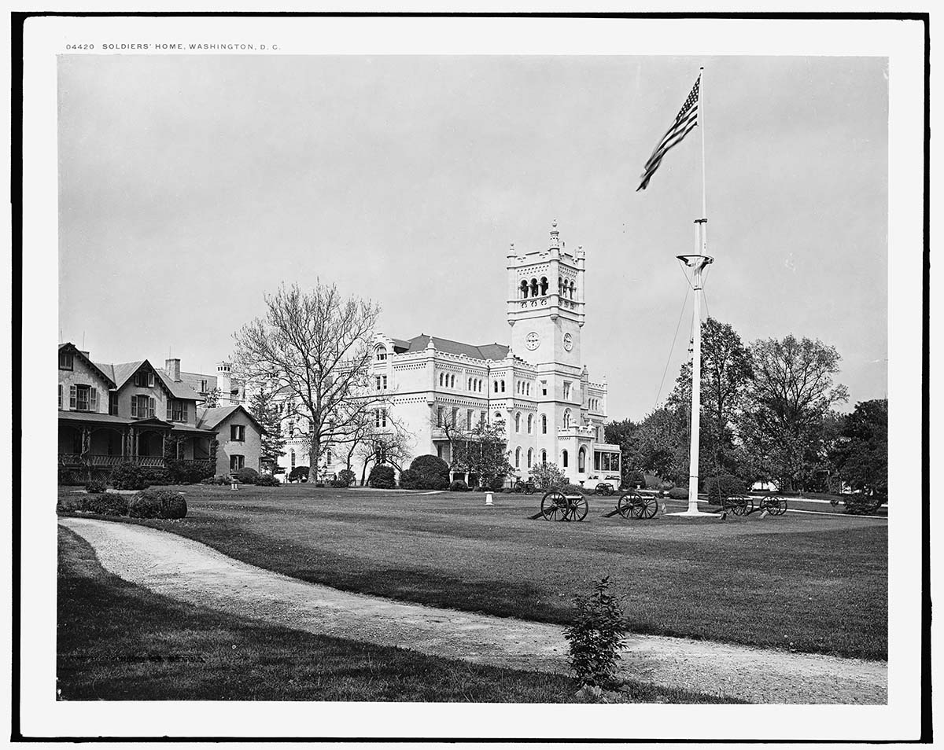
The VA Hospital System
1851: First national home for disabled veterans

Slide 43
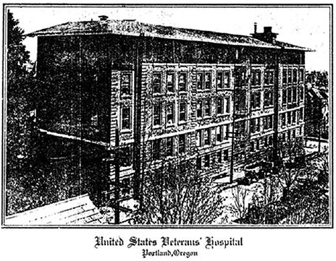
The VA Hospital System
1921: “shell-shocked veterans sent to hospitals for feeble-minded children, where they were forced to sit on infants’ chairs, and of tuberculous patients sent to marshy districts detrimental to their health.”
1924: Non-service connected conditions eligible for hospital care
1933: Peacetime veterans eligible for VA hospital care

Slide 44
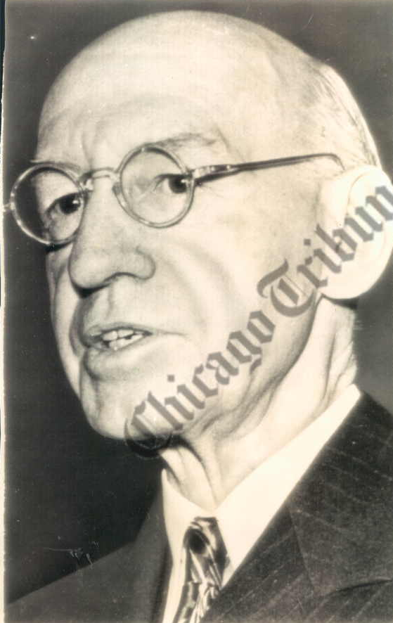
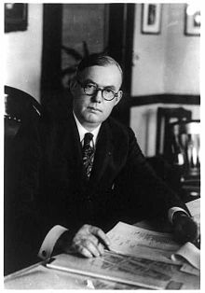
World War I
1921 – “Veterans’ Bureau” created
1921-23 – Charles Forbes
1924-46 – Frank Hines
1930 – “Veterans Administration” (VA) created

Slide 45
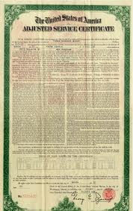
World War I
VA hospital system
The Veterans Administration (“VA”)
The Bonus

Slide 46
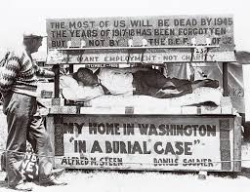
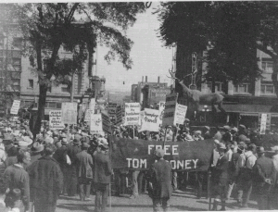
The Bonus Army
“The Tombstone Bonus”

Slide 47
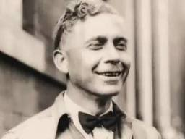
The Bonus Army
Walter W. Waters

Slide 48
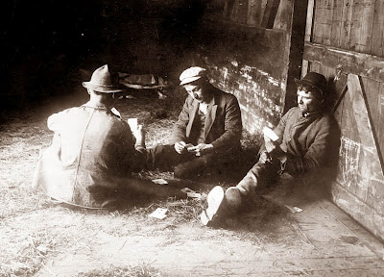
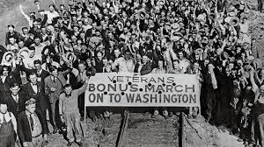
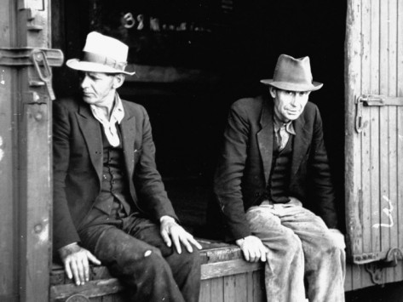
The Bonus Army

Slide 49
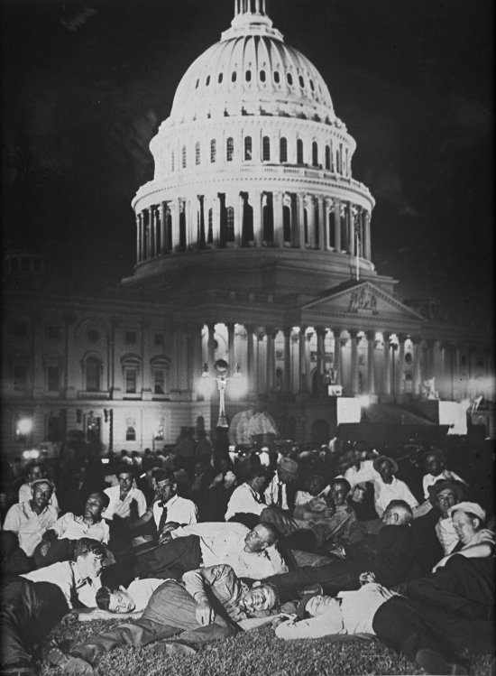
The Bonus Army

Slide 50
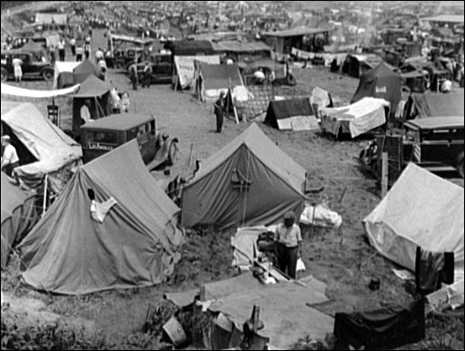
The Bonus Army

Slide 51
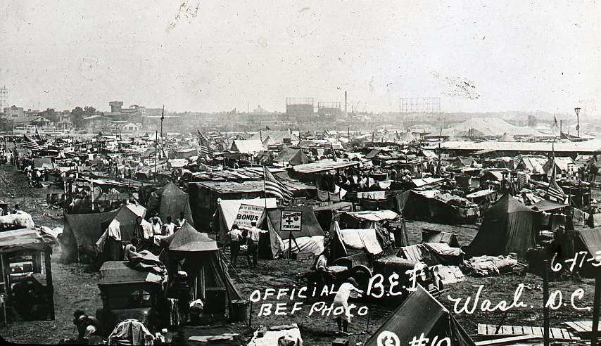
The Bonus Army

Slide 52
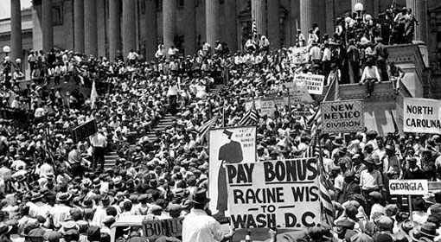
The Bonus Army

Slide 53


The Bonus Army
Smedley Butler

Slide 54

July 28, 1932

Slide 55

July 28, 1932

Slide 56

July 28, 1932

Slide 57

July 28, 1932

Slide 58

July 28, 1932

Slide 59


Slide 60

Franklin Roosevelt
Economy Act 0f 1933

Slide 61

The Board of Veterans’ Appeals

Slide 62
The Economy Act of 1933
Section 5: “All decisions rendered by the Administrator of Veterans’ Affairs under the provisions of this title . . . [s]hall be final and conclusive on all questions of law and fact and no other official or court of the United States shall have jurisdiction to review by mandamus or otherwise any such decision.”
Notes:
Between the Wars: New Deal – Economy Act of 1933. This prevented judicial review of veterans benefits decisions. This was to contain costs to pay for other New Deal programs.

Slide 63



Economy Act 0f 1933
Cuts $400,000,000 from VA budget

Slide 64

1935 Labor Day Hurricane
Works Progress Administration
Windley and Lower Matecumbe Keys

Slide 65

1935 Labor Day Hurricane
Over 250 veterans killed

Slide 66



1935 Labor Day Hurricane

Slide 67

1935 Labor Day Hurricane

Slide 68
“Who Murdered the Vet?” in The New Masses
“...wealthy people, yachtsmen, fishermen such as President Hoover and Presidents Roosevelt, do not come to the Florida Keys in hurricane months.... There is a known danger to property. But veterans, especially the bonus-marching variety of veterans, are not property. They are only human beings; unsuccessful human beings, and all they have to lose is their lives. They are doing coolie labor for a top wage of $45 a month and they have been put down on the Florida Keys where they can’t make trouble. It is hurricane months, sure, but if anything comes up, you can always evacuate them, can't you?.....It is not necessary to go into the deaths of the civilians and their families since they were on the Keys of their own free will; They made their living there, had property and knew the hazards involved. But the veterans had been sent there; they had no opportunity to leave, nor any protection against hurricanes; and they never had a chance for their lives. Who sent nearly a thousand war veterans, many of them husky, hard-working and simply out of luck, but many of them close to the border of pathological cases, to live in frame shacks on the Florida Keys in hurricane months?”

Slide 69

World War II

Slide 70

World War II
16,112,566 served
Notes:
Between the Wars: New Deal – Economy Act of 1933. This prevented judicial review of veterans benefits decisions. This was to contain costs to pay for other New Deal programs.

Slide 71

World War II
“When demobilization day comes we are going to suffer another Pearl Harbor, a Pearl Harbor perfectly foreseeable now—a Pearl Harbor of peace, not war.”
The New Republic, Aug. 2, 1943
Notes:
Between the Wars: New Deal – Economy Act of 1933. This prevented judicial review of veterans benefits decisions. This was to contain costs to pay for other New Deal programs.

Slide 72


The G.I. Bill
January 9, 1944: American Legion proposes the Bill of Rights for G.I. Joe and G.I. Jane in a New York Times editorial

Slide 73

The G.I. Bill
January 9, 1944
John E. Rankin

Slide 74

The G.I. Bill
January 9, 1944
John E. Rankin
John S. Gibson

Slide 75

The G.I. Bill

Slide 76


The G.I. Bill
Eddie Rickenbacker
June 7, 1944

Slide 77

The G.I. Bill
June 22, 1944

Slide 78

The VA Hospital System
1945: VA hospital scandal
1946: $448,000,000
183 hospitals in 39 states

Slide 79

The Korean War

Slide 80

The Korean War
5,700,000 served

Slide 81

The Korean War
5,700,000 served
1956: Bradley Commission

Slide 82

The Vietnam War

Slide 83

The Vietnam War
9,000,000
1967: Vietnam Veterans Against the War
1979: Vietnam Veterans of America

Slide 84



Post-traumatic Stress Disorder
Dr. Robert Jay Lifton Shad Meshad Sarah Haley

Slide 85

Post-traumatic Stress Disorder
American Psychiatric Association (APA)
Vietnam Veterans Working Group
Diagnostic and Statistical Manual of Mental Disorders, 3rd ed. (DSM-III)

Slide 86

Community Based Outreach Centers
Max Cleland
1979: First CBOC opened

Slide 87

Agent Orange
1965-71: 11,000,000 gallons sprayed through Operation Ranch Hand
Dioxin

Slide 88

Agent Orange
1977: First claim
1978: Maude DeVictor
1978: Agent Orange: The Deadly Fog

Slide 89

Agent Orange
1979: Veterans Health Programs Extension and Improvement Act
1987: CDC scraps its study with no results

Slide 90

Agent Orange
1979: Class action lawsuit filed
1984: Settled for $180 million
Notes:
The settlement was just the end of the first act in the litigation drama. Due to legal wrangling,
it would be another five years before any funds were disbursed. niCosia, supra note
349, at 573-77. In the end, only veterans totally disabled by conditions related to Agent
Orange would get any money, and those veterans received at most $12,800, while the
families of deceased veterans were awarded $3,400.

Slide 91

Agent Orange
1979: Class action lawsuit filed
1983: Times Beach
Notes:
In addition,
Admiral Elmo R. Zumwalt emerged as a powerful symbolic figure in support of the movement.
As Commander of U.S. Naval Forces, in 1968 he ordered the spraying in areas where his son,
Lieutenant Elmo Zumwalt III, was serving. Id. at 601. After the war, Lieutenant Zumwalt had
a son born with severe learning disabilities. Id. Lieutenant Zumwalt was then diagnosed in
1983 with a rare combination of cancers that was “like winning the biggest cancer lottery in
the world.” Id. As a result of these events, Admiral Zumwalt became an activist advocating
for money to study the effects of Agent Orange and to compensate veterans affected by related
conditions. Id. at 601-05. Nonetheless, Admiral Zumwalt maintained until his death that
he still would have ordered the use of Agent Orange even knowing its effects, because of its
crucial role in saving thousands of soldiers during the war. Id. at 602.

Slide 92

Agent Orange
“Perhaps dioxin is poisonous only when in proximity to civilians but harmless to men and women in uniform.”
Washington Post
Notes:
Between the Wars: New Deal – Economy Act of 1933. This prevented judicial review of veterans benefits decisions. This was to contain costs to pay for other New Deal programs.

Slide 93

Agent Orange
1989: American Legion-Columbia University Study of Vietnam-era Veterans submitted to Congress.

Slide 94

Agent Orange
Veterans Dioxin and Radiation Exposure Compensation Standards Act of 1984
1990: Secretary Derwinski grants presumption for non-Hodgkin’s lymphoma and soft-tissue sarcomas
Agent Orange Act of 1991

Slide 95

Judicial Review
Johnson v. Robinson, 415 U.S. 361 (1974)
Walters v. National Association of Radiation Survivors, 473 U.S. 305 (1985)

Slide 96

Veterans Judicial Review Act

Slide 97

Department of Veterans Affairs Act of 1988

Slide 98
“The willingness with which our young people are likely to serve in any war, no matter how justified, shall be directly proportional as to how they perceive veterans of earlier wars were treated and appreciated by this country.”

Slide 99
Bedtime Reading
Available at http://ssrn.com/author=1378084.
Short Version --- Caring for Those Who Have Borne the Battle: Exploring the Myths and Realities of Veterans' Benefits Since the Revolution , 6 J. Fed. Cir. Hist. Soc. 73 (2013)
The Long Version --- The Splendid Isolation Revisited: Lessons from the History of Veterans Benefits Before Judicial Review, 3 Veterans L. Rev. 135 (2011)
The History Since Judicial Review --- The Veterans’ Judicial Review Act Twenty Years Later: Confronting the New Complexities of Veterans Benefits System, 66 NYU Ann. Surv. Am. L. 251 (2010)
The Technical History of the Statutes, Regulations, and Procedures --- Recovering an Institutional Memory: The Origins of the Modern Veterans Benefits System, 1914 to 1958, 5 Veterans L. Rev. 1 (2013)

Slide 100
Selected Bibliography
Pre-Civil War
William Henry Glasson, Federal Military Pensions in the United States (1918)
A.F. Sisson, History of Veterans’ Pensions and Related Benefits (1946)
James W. Oberly, Sixty Million Acres: American Veterans and the Public Lands Before the Civil War (1990)
Civil War
Mary R. Dearing, Veterans in Politics: The Story of the G.A.R. (1952)
Theda Skocpol, Protecting Soldiers and Mothers: The Political Origins of Social Policy in the United States (1992)
Patrick J. Kelly, Creating a National Home: Building the Veterans’ Welfare State 1860-1900 (1997)

Slide 101
Selected Bibliography
World War I
William Pyrle Dillingham, Federal Aid to Veterans 1917-1941 (1952)
Paul Dickson & Thomas B. Allen, The Bonus Army: An American Epic (2004)
Gustavus A. Weber & Laurence F. Schmeckebier, The Veterans’ Administration: Its History, Activities and Organization (1934)
Wolrd War II
Edward Humes, Over Here: How the G.I. Bill Transformed the American Dream (2006)
Glenn C. Altschuler & Stuart M. Blumin, The GI Bill: A New Deal for Veterans (2009)
Davis R.B. Ross, Preparing for Ulysses: Politics and Veterans During World War II (1969)

Slide 102
Selected Bibliography
Korean War
The President’s Commission on Veterans’ Pensions, Veterans’ Benefits in the United States: A Report to the President (1956)
Vietnam War
Wilbur J. Scott, Vietnam Veterans Since the War: The Politics of PTSD, Agent Orange, and the National Memorial (1993)
Gerald Nicosia, Home to War: A History of the Vietnam Veterans’ Movement (2001)
Paul C. Light, Forging Legislation (1992)

