Slide 1

Honoring &
Serving Veterans

Slide 2
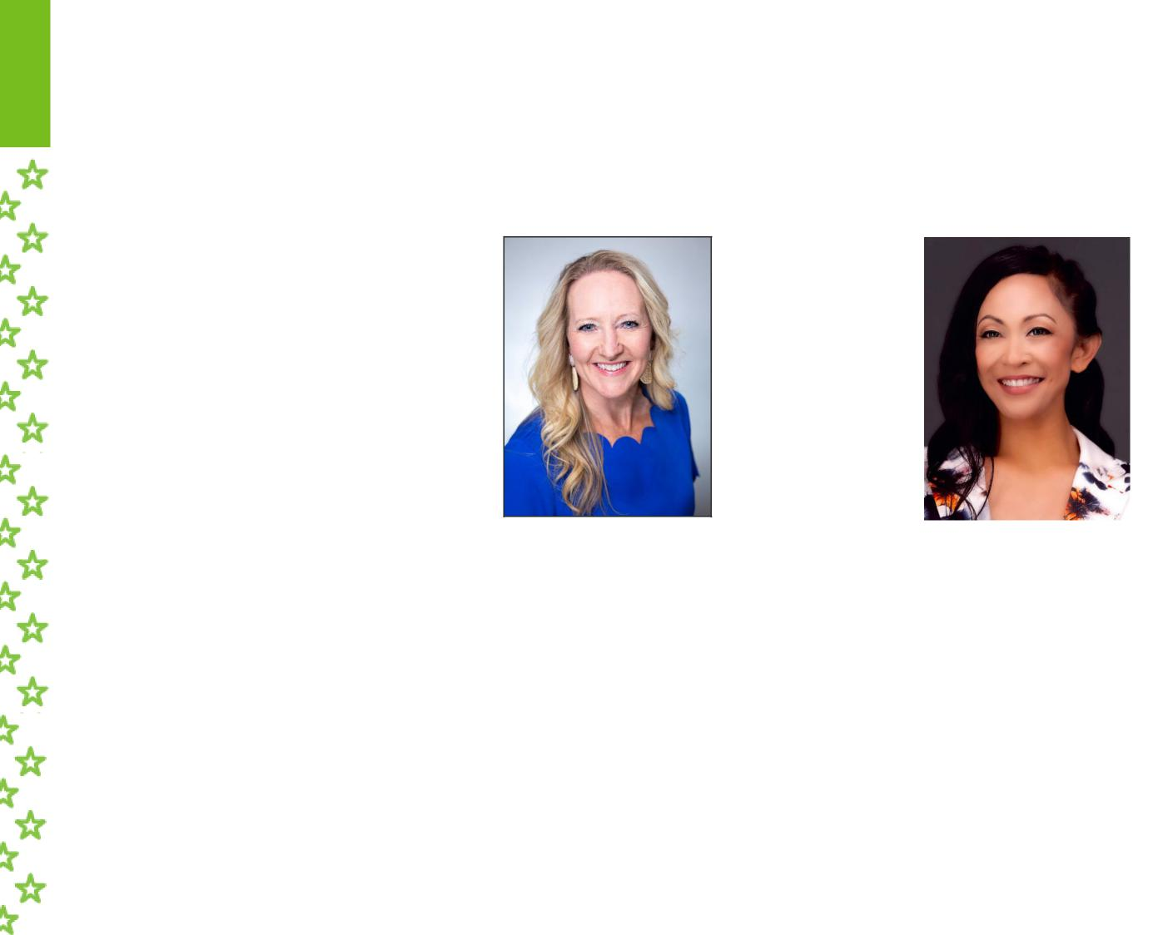
Today’s Speakers
Tonya Schram
Leah Vicente
Humana National Sales Executive
Humana Career Agent DC | Maryland | Virginia | DE | Nevada

Slide 3


 | Humana's Commitment to Veterans
Veteran Advocates:
200+ associates volunteer grassroots engagement with veteran community, monthly training
National VSO Partnerships:
Exclusive relationship with organizations that support veterans
USAA:
Partnership and co-branded products with a veteran trusted
company/brand
Veteran Health Equity & Social Impact:
Preventing veteran suicide & addressing social determinants of
health for veterans & their families

Slide 4

 | Humana's Commitment to Veterans
Veteran Service Experience:
Veteran Service Team that addresses veteran-specific healthcare
needs and help members get the most out of their plans
Humana Military:
Partner with DoD to administer the TRICARE health program in
the East Region for active, retired, Guard & Reserve beneficiaries
Military Connected Associates:
6,000+ veterans and military spouses hired since 2011, goal to
hire at least 2,000 military connected associates by 2032
888-HUM-VETS
(888-486-8387)

Slide 5
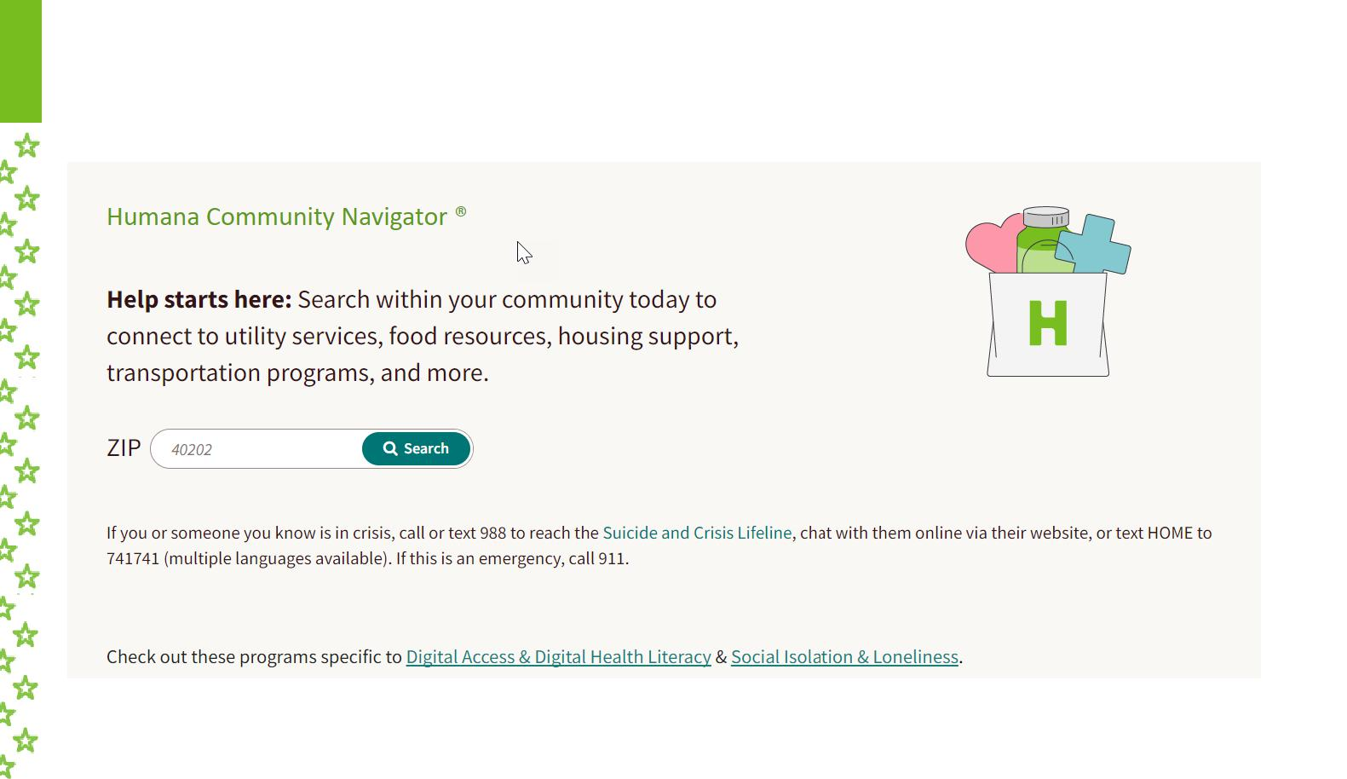
Connect veterans to resources in their local community
Humana Community Navigator®
Humana.FindHelp.com

Slide 6

Veterans Service Officer Advocacy
Identify Barriers: Veterans Service Officers are
underutilized, not well known across generations of
Veterans, and their role is often misunderstood
Co-Create Solution:
15 Things Veterans
Service Officers
Want You to Know
curriculum
Achieve Best Health: Improve Veteran health
literacy through education and increase the # of
Veterans who connect with a FREE ACCREDITED
Veterans Service Officer
| 6

Slide 7
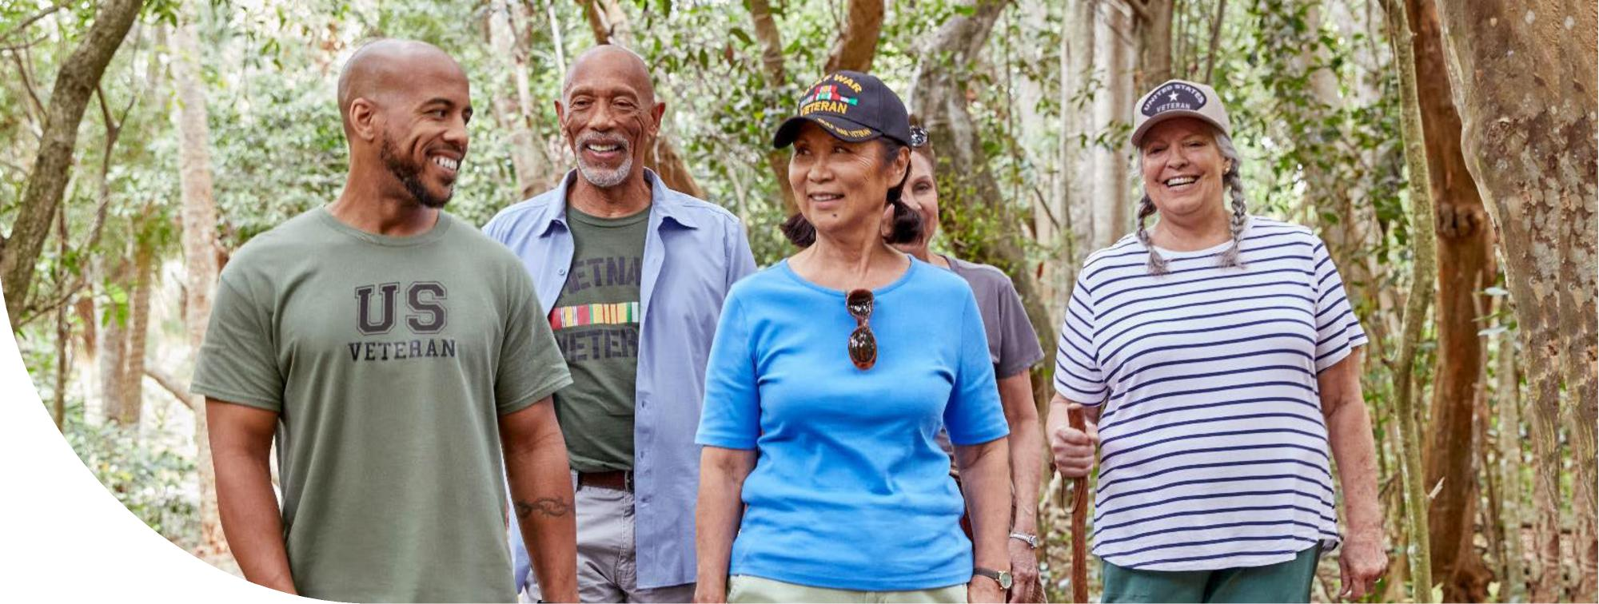
UNITING FOR VETERANS | Humnnn ^{WPW V Volunteers} of America. VETERANS OF FOREIGN WARS

Slide 8



Uniting for Veterans
Humana’s Got Your Six To combat risk factors to Veteran suicide
Veterans with disabilities,
female veterans, and rural
veterans face higher rates of
food insecurity
Only ~15% of food-insecure
45% of homeless veterans
suffer from mental illness,
including PTSD
70% of homeless veterans
struggle with substance abuse
Hunger
Food insecurity /
Homelessness
Stable, safe, adequate housing
nutrition / healthy food choices
veterans participate in SNAP
One Veteran at a time
Committed to ensuring Veterans and their families no matter their age, race or gender, have access to the care they need and deserve, especially those who stem from underserved and diverse communities.
Humana Health Equity | Veteran Community
| 8

Slide 9

UTCH OG campaign logo | UTCH2 Expanded scope to include food insecurity and homelessness | UFV New look to reflect our commitment to addressing the diverse and evolving needs of military and veteran communities

Slide 10

A collective impact campaign:
Inaugural campaign launches at VFW National
Convention in Kansas City
2018
1,000,000
1,047,369
1,018,832
1,023,224
1,023,190
2019 Expansion to Florida
806,089
Expands nationally & 1 million meals are raised
during a global pandemic
2020
2021 Surpass 1 million meals for the 2nd year in a row
2022 Raise 1 million meals in just 7 months
321,538
Over 1 million meals raised by 155 VFW posts and
auxiliaries across 40 states
2023
175,000
2024 Over 1 million meals raised for the 5th year in a row
Program expands to include homelessness, over
6.4 million meals raised to date!
2025
2018 2019 2020 2021 2022 2023 2024 2025
| 10
*For internal use only

Slide 11


 |  | VFW Foundation Uniting For Veterans Grant
Grant will reopen September 1, 2025
Matching donation grant of up to $1,500 available to VFW Posts & Auxiliaries
For monetary, food or item donations to local food banks, pantries or homeless relief organizations in their communities
Grant funds are not provided directly to VFW Posts or Auxiliaries, they are sent to the donation location listed on the application
$1 match for every pound of food or dollar donated to food insecurity or homeless relief organizations
Minimum of 500 pounds or $500 must be met for each submission
Multiple requests may be made, up to a max of $1,500
A Post OR Auxiliary may receive this grant but not both
Applications from a VFW Post must be submitted on the dashboard
VFW Auxiliaries can apply atwww.vfwfoundation.org/grants
Applications for 2025-2026 award year will remain open until June 1, 2026 or until grant funding is exhausted
Questions? Contact Mary Spencer:mspencer@vfw.org or 866-789-6333
More info:www.vfwfoundation.org/grants | 11

Slide 12

Our Partnership

Slide 13

USAA AGENCY PARTNERSHIP
Broker for Humana Medicare Advantage since 2006
USAA trained our Veteran Service Team, DUOS, CenterWell associates
USAA EVENTS PARTNERSHIP
Salute the Troops Event at the Opry
VFW National Convention
Co-Sponsors of the cornhole tournament (2024)
DAV National Convention
Health and Financial Wellness Seminar
Vietnam Veteran Pinning Ceremonies
VFW Day of Service
USAA MARKETING PARTNERSHIP
Began in 2019 earning the "recommended by USAA" badge and co-branded marketing campaign
Strategy: leverage USAA brand to increase Vet consideration/response
USAA co-branding on all Vet plans: “Humana USAA Honor Plan”

Slide 14


Face The Fight: Initiative to Reduce and Prevent Veteran Suicide
❑ 988 added to all Humana MA/MAPD/PDP plan ID cards  Face the Fight Night at the Grand Ole Opry
❑ DUOS for Veterans Pilot: Louisiana Veteran members
❑ PsychArmor Veteran Ready Healthcare Organization Certification Pilot:
Conviva/CenterWell clinics
❑ VA S.A.V.E. Training: Veteran Service team (call center)
❑ GO365 mental health programming: Humana members
❑ Identifying and adding suicide prevention resources (ex. 988) to Humana websites

Slide 15
Thank you!

