Slide 1
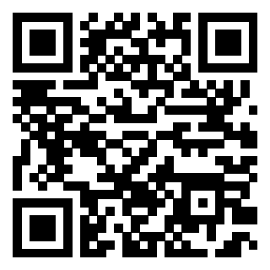
Recent Court Opinions and Regulatory Changes
https://bergmannandmoore4.participoll.com

Slide 2
Polling Test Question
In FY2024, what percentage of Board decisions that were reviewed by the Court of Appeals for Veterans Claims were reversed or remanded (in favor of the Veteran)?
Less than 25% were reversed or remanded
Between 25% and 50%
Between 50% and 70%
Between 70% and 80%
Between 80% and 90%
More than 90%
A
B
C
D
E
F
0

Slide 3
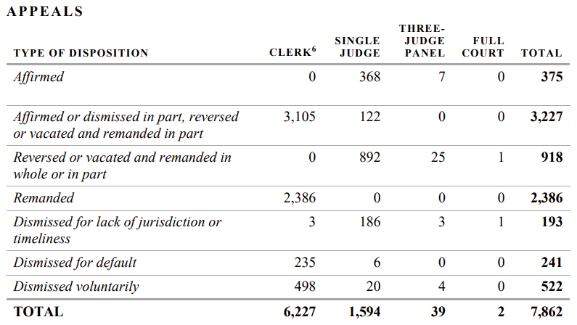
Polling Test Answer
More than 90%
Of the 6,531 appeals the court decided on the merits, the court affirmed only 375.
In 5,491 appeals, VA conceded error without even contesting the case before a judge.
Notes:
The answer is 10%
DC 6260 is one of only a few DCs that have a single rating for a disability. If a Veteran is service connected for tinnitus, then the only possible rating is 10%.
[click to appear]
It is important to be aware that some DCs include “Notes” that should be read to see if they apply to the Veteran’s situation.
These notes are binding.

Slide 4
Learning Objectives
Learn about important recent court decisions.
  Review the different courts above VA.
  Learn about some recent court decisions.
  Learn arguments to make based off these recent decisions.
Notes:
In this lesson, we will learn about the federal courts over VA.
[click] To this this, we will identify the different courts over VA;
[click] Learn about some recent decisions from the courts;
[click] And learn about the implications of these recent decisions.

Slide 5


Brief Overview of VA’s Judicial Review
The Board of Veterans’ Appeals (Board) is the highest appellate body within VA.
Denials from Board can be appealed to the U.S. Court of Appeals for Veterans Claims (CAVC).
  CAVC handles only Board appeals from VA.
  Claimants cannot take VA appeals to any other court.
Denials from CAVC can be appealed to the U.S. Court of Appeals for the Federal Circuit (Fed. Cir.).
  Only decides questions of law.
  The next and highest court is the U.S. Supreme Court.
Notes:
Here is a brief overview of the federal courts that review decisions by VA.
[click] The Board of Veterans’ Appeals (Board) is the highest appellate body within VA.
Although its members are called judges, it is not a court. The employees work for VA.
[click] Denials from Board can be appealed to the Court of Appeals for Veterans Claims (CAVC).
[click] The CAVC handles only appeals from VA. Every type of VA benefit is handled by the CAVC, including education, healthcare, and other VA benefits.
[click] Claimants cannot appeal VA decisions to any other court.
[click] If the CAVC denies a claim, then that decision can be appealed to the U.S. Court of Appeals for the Federal Circuit
[click] However, that court only decides questions of law! So if the Veteran merely disagrees with the facts that were found or how the law was applied to those facts, then no further appeal is possible.
[click] If the Federal Circuit issues a ruling of law in a VA case, then it is possible to appeal to the U.S. Supreme Court, the highest court in our country.
However, the Supreme Court agrees to accept less than 1% of cases appealed to it. The Supreme Court decides a veteran law case only once every few years.

Slide 6

Issue Break!
The Pro-Veteran Canon of Interpretation
Notes:
First, lets go over the threshold eligibility requirements for TDIU

Slide 7
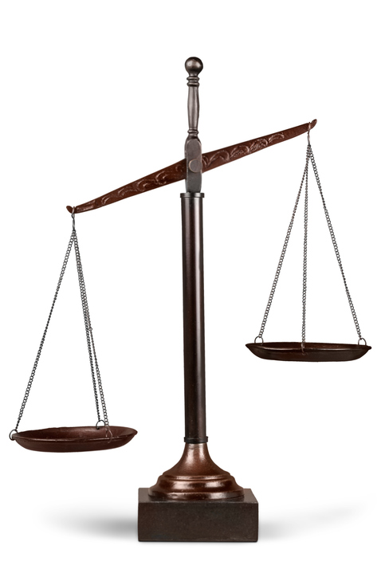
Brown v. Gardner
In 1994, in the first Supreme Court case after the Veterans’ Judicial Review Act (VJRA), the Court unanimously said that “interpretive doubt [in statutes] is to be resolved in the veteran’s favor.”
This was rooted in decades of caselaw on Veteran preferences in other laws.
Since then, Gardner has been routinely cited by courts to side with Veterans when interpreting laws.
Notes:
It’s also important to recognize that the process doesn’t end when you complete the request.
Hopefully, the doctor will send the evidence back to you.
At this point, you need to read what the doctor provided and decide what to do next.
Review the documents before submitting them. Don’t submit records without looking at them.
[click] The first thing you want to do is to make sure that it is complete and accurate.
If there is a minor problem, contact the doctor to see if you can obtain a clarification.
[click] If there is a significant problem, you will likely need to contact the Veteran to sort out what happened.
Hopefully, the issue can be fixed.
But sometimes a Veteran misinterprets what their doctor is saying or the medical evidence turns out to problematic for some reason. Ultimately, [click] you are not required to submit evidence to VA that you think is bad for the Veteran.
Assuming that you get useful evidence, [click] now you have to decide how to use it.

Slide 8
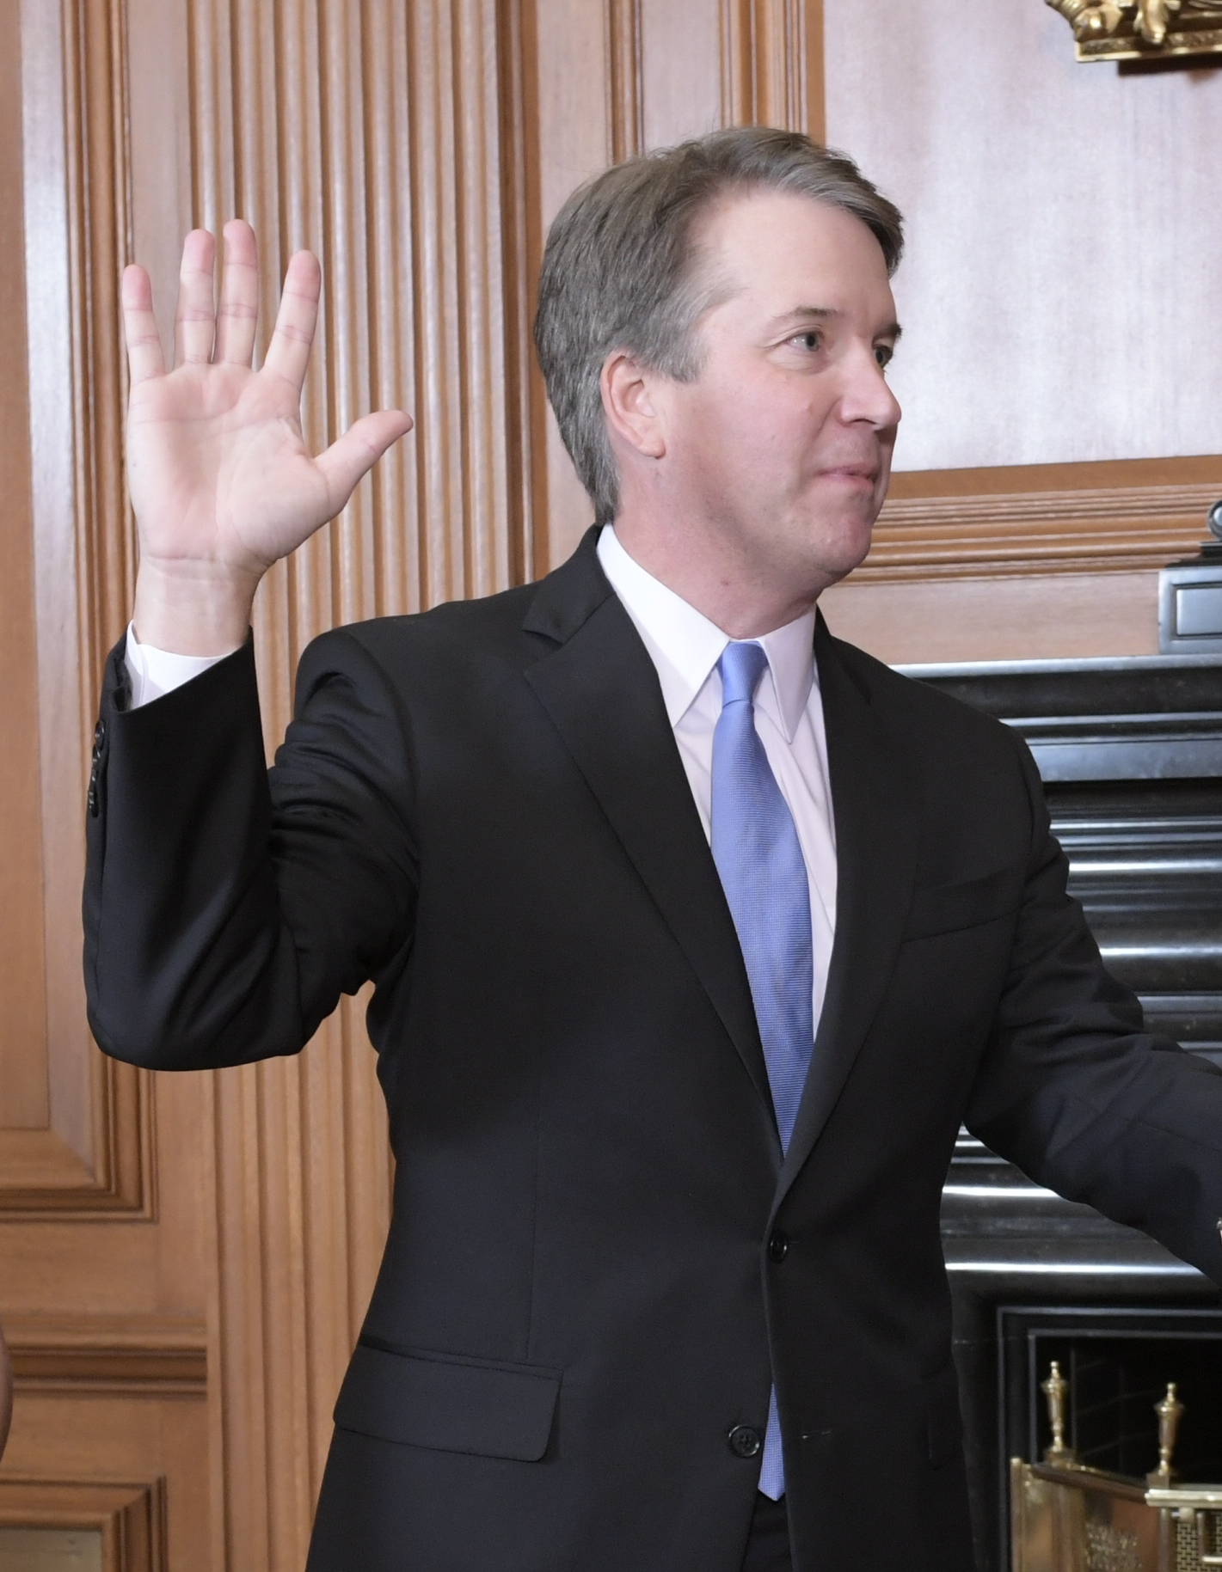
Kavanaugh’s Rudisill concurrence
Associate Justice Brett Kavanaugh wrote, “The Judiciary’s role is to neutrally interpret those statutes, not to put a thumb on the scale in favor of or against any particular group. For that reason, it may be important in a future case for this Court to address the justification for any benefits-related canon that favors one group over others.”
  Joined by Associate Justice Amy Coney Barrett.
Associate Justice Clarence Thomas (joined by Associate Justice Samuel Alito) agreed saying: “I question whether this purported canon should ever have a role in our interpretation.”
Associate Justice Brett Kavanaugh, United States Supreme Court
Notes:
It’s also important to recognize that the process doesn’t end when you complete the request.
Hopefully, the doctor will send the evidence back to you.
At this point, you need to read what the doctor provided and decide what to do next.
Review the documents before submitting them. Don’t submit records without looking at them.
[click] The first thing you want to do is to make sure that it is complete and accurate.
If there is a minor problem, contact the doctor to see if you can obtain a clarification.
[click] If there is a significant problem, you will likely need to contact the Veteran to sort out what happened.
Hopefully, the issue can be fixed.
But sometimes a Veteran misinterprets what their doctor is saying or the medical evidence turns out to problematic for some reason. Ultimately, [click] you are not required to submit evidence to VA that you think is bad for the Veteran.
Assuming that you get useful evidence, [click] now you have to decide how to use it.

Slide 9

End of Issue Break
Notes:
First, lets go over the threshold eligibility requirements for TDIU

Slide 10

Soto v. United States
145 S. Ct. 1677 (Jun. 12, 2025)
Notes:
Finally, here are two pending Supreme Court cases that we are keeping an eye on because they could be quite important.

Slide 11
Veteran Simon Soto retired in 2006. In 2016, he was awarded “combat-related special compensation” based on his service in Iraq. (This is not a VA benefit.) A general statute passed by Congress limits retroactive awards paid by DoD to six years. That law does not apply to “settlements.” The law creating CRSC does refer to the benefit as a “settlement.”
Is Mr. Soto entitled to six or ten years of benefits?
Six years. The language of the statute is clear.
Ten years. Congress is presumed to be generous to Veterans.
A
B
0

Slide 12
Soto v. United States
Ten years. Congress is presumed to be generous to Veterans.
In Soto, the Court did not address the presumption in favor of Veterans explicitly.
However, in a unanimous opinion by Justice Thomas, the Court ruled in favor of the Veteran because “where, as here, the statutory scheme involves a small group of particularly deserving claimants, it is not extraordinary to think that Congress wished to forgo a limitations period.” 145 S. Ct. 1677 at 1687.
Soto creates an opportunity to save the pro-Veteran canon of interpretation. However, this requires a knowledgeable advocate to raise this case at the right time!
Notes:
[click] The answer here is that The Veteran can appeal the original decision because he was still within a year of that decision.
[click] The CAVC held that that the relevant AMA statute, 38 U.S.C. § 5104C(a), unambiguously permits the claimant to file more than one administrative review request in response to, and within 1 year of, a VA decision.
[click] This is important because creates the opportunity to preserve a Veteran’s effective date by continuously pursuing a merits decision even if the Veteran filed a Supplemental Claim that was not supported by new and relevant evidence.
Look for this issue when a Veteran comes to you after an unsuccessful Supplemental Claim. If possible, do not get caught up fighting over whether evidence was new and relevant. If you lose that fight, the Veteran can lose continuous pursuit and the best effective date
To be clear: Advocates should choose whichever type of review is appropriate in their best judgment. However, frame it as a dispute with the most recent decision on the merits rather than a denial of reopening if you are filing within a year of the merits decision. Of course, if it has been more than a year, then you’ll have to attack the Supplemental Claim decision.
.

Slide 13

Amezquita v. Collins
135 F.4th 1369
(Fed. Cir. 2025)
Notes:
The fourth recent case we will talk about is Amezquita v. Collins from the Federal Circuit.

Slide 14
Prior to enlisting, Veteran Edward Amezquita had surgery to repair his shoulder after a car accident. His entrance physical noted the surgery but listed his shoulder asymptomatic. After service, Mr. Amezquita applied for service connection for a shoulder disability. Doe the presumption of sound condition apply to his claim?
No. If the service member is not experiencing any symptoms then—by definition—they do not have a condition at the time they entered service.
Yes. Even though he had not symptoms, the condition was still noted on his entrance physical.
A
B
0

Slide 15
Amezquita v. Collins
Yes. Even though he had not symptoms, the condition was still noted on his entrance physical.
The Federal Circuit rejected the argument that only conditions that have some kind of active symptom count as preexisting conditions.
Therefore, the burden is on the Veteran to prove that his condition was made worse by his service.
Notes:
[click] The answer here is Yes. Even though he had no symptoms, the condition was still noted on his entrance physical.
[click] The Federal Circuit rejected the argument that only conditions that have some kind of active symptom count as preexisting conditions. This holding is particularly important for situations like these where there was an injury prior to service, such as a high-school sports injury, that is documented but not actually affecting the service member at the time.
It’s important to remember that the Veteran can still get service connection, but
[click] The burden is on the Veteran to prove that his condition was made worse by his service.
Technically, the benefit will be only the difference between the pre-service severity and the current severity, but if the condition was asymptomatic then there should be nothing to discount.
Finally, don’t forget that the presumption still applies if the pre-service injury is not noted on the entrance physical even if there is no dispute at all that it happened.
In that case, the burden shifts to VA to show than any worsening was not caused by service, which makes it much easier to win benefits.

Slide 16

Loyd v. Collins
__ Vet.App. ___
2025 U.S. App. Vet. Claims LEXIS 614
(May 8, 2025)
Notes:
The fifth recent case we will talk about is Loyd v. Collins from the CAVC.

Slide 17
Veteran Marvin Loyd sought service connection for an eye condition as secondary to a service-connected stroke. After his claim was denied, he filed a Supplemental Claim. The regional office, however, determined that there was no new and relevant evidence to reopen the claim. Mr. Loyd then appealed that decision to the Board.
What issue is before the Board?
Only the issue of whether the Supplemental Claim was supported by new and relevant evidence.
The merits of whether his eye condition should be granted service connection.
A
B
0

Slide 18
Loyd v. Collins
Only the issue of whether the Supplemental Claim was supported by new and relevant evidence.
The CAVC held that an appeal of a denial of reopening is focused only on the issue of whether the claim should have been readjudicated.
The Court also noted that it may be true—as it was in the legacy system—that if the Board grants readjudication then it must remand for a decision on the merits.
The opinion indicates that the Secretary conceded that continuous pursuit would still apply after a denial of readjudication!
Notes:
[click] The answer here is that the Board should address Only the issue of whether the Supplemental Claim was supported by new and relevant evidence.
[click] The CAVC held that an appeal of a denial of readjudication is focused only on the issue of whether the claim should have been reopened. Therefore, if you appeal a denial of reopening to the Board, then it is imperative that you focus on the specific issue of whether the evidence was new and relevant.
[click] In fact, the Court also noted that it may be true—as it was in the legacy system—that if the Board grants reopening then it must remand for a decision on the merits. This mean that the Board may not even be able to consider granting the claim on the merits even if it decides the evidence is new and relevant.
That wasn’t an official holding, so the Court may not reach that conclusion when the issue is squarely before it, but you should not be surprised when the Board remands after you successfully appeal a denial of readjudication.
[click] The opinion indicates that the Secretary conceded that continuous pursuit would still apply after a denial of reopening! It is not clear that the Court will hold VA to this position in the future, but if it does that could make a huge difference for some Veterans who filed Supplemental Claims without new and relevant evidence.
For now, you are much better off helping the Veteran to file another Supplemental Claim—one that *is* supported with new and relevant evidence—if you are still within a year of the prior denial of benefits on the merits. This is the surest way to protect their effective date and also makes it more likely that the claim will be granted quickly.
Of course, sometimes fighting a denial of reopening is the right move because there really is nothing else that could be submitted but this is not what you want to be doing if you can avoid it.

Slide 19

Rudisill v. McDonough
144 S. Ct. 945 (2024)
Notes:
The next recent case we will talk about is Rudisill v. McDonough from the Supreme Court.

Slide 20
Veteran James Rudisill served a total of eight years over three separate periods of service beginning in 2000. He used 25 months of benefits under the Montgomery G.I. Bill. However, he also qualified for educational benefits under the Post-9/11 G.I. Bill.
How many months of benefits does he have available under that program?
11 months because that is what he had left under the Montgomery G.I. Bill.
36 months because the Post-9/11 program is completely separate.
23 months because there is a separate, 48-month cap on combined benefits.
A
B
C
0

Slide 21
Rudisill v. McDonough
23 months because there is a separate, 48-month cap on combined benefits.
Veterans who qualify for both the Montgomery G.I. Bill and the Post-9/11 G.I. Bill education benefits through separate periods of service may use either one, in any order, up to a total 48-month aggregate cap.
This was a hard case because there are many educational benefits statutes passed at different times that have conflicting language about how to combine eligibility.
Notes:
The answer here 23 months because there is a separate, 48-month cap on combined benefits.
[click] Veterans who qualify for both the Montgomery G.I. Bill and the Post-9/11 G.I. Bill education benefits through separate periods of service may use either one, in any order, up to a total 48-month aggregate cap.
[click] This was a hard case because there are many educational benefits statutes passed at different times that have conflicting language about how to combine eligibility.
You may have heard about this case already because it came out in the first part of last year.
However, we are revisiting it because there has been an important development.

Slide 22
Rudisill Implementation Plan
Veterans have the amount of time that was remaining at the time of their original election plus 90 days to use the benefits.
Veterans should avoid applying until they are ready to use the benefits because the time period for using them will be calculated based upon the date of the new application.
Veterans should use VA Form 22-1995 to apply when ready.
Veterans must apply by October 1, 2030. Claims may still be submitted after that date, but the delimiting date will be based on the normal rules.
For more, go to https://benefits.va.gov/GIBILL/rudisill.asp.
Notes:
VA has announced critical details about the effect of this decision and how Veterans can obtain the benefits that they have earned.
Approximately 660,000 Veterans will have their eligibility redetermined and will receive notice that they have been granted an additional 12 months of benefits.
Another 380,000 Veterans will receive notice that they may be eligible for an additional 12 months of benefits and encouraged to apply.
[click] For all benefits restored, Veterans will have the amount of time that was remaining at the time of their original election plus 90 days to use the benefits. For example, if a Veteran chose to use the Post-9/11 GI Bill at a time when they had 5 years left to use the Montgomery GI Bill, they would be given 5 years plus 90 days to use any additional benefits.
[click] Whether the extension is granted automatically or through an application, Veterans should avoid applying until they are ready to use the benefits because the time period for using them will be calculated based upon the date of the new application.
[click] Veterans should use VA Form 22-1995 to apply when ready.
[click] To receive an extended delimiting date, Veterans must apply by October 1, 2030. Claims may still be submitted after that date, but the delimiting date will be based on the normal rules.
[click] Complete information at: https://benefits.va.gov/GIBILL/rudisill.asp
.

Slide 23

Perkins v. Collins
__ Vet.App. ___
2025 U.S. App. Vet. Claims LEXIS 558
(May 16, 2025)
Notes:
You may be wondering why we just looked at Rudisill even though it came out last year. Part of it was to cover the implementation plan, but part of it was because of the next case will talk about, Perkins v. Collins from the CAVC.

Slide 24
The Montgomery G.I. Bill requires two years of service. The Post-9/11 G.I. Bill requires three years of service. Veteran Kassidy Perkins served in the Air Force for six years from 2014 to 2020. She applies for a total of 48 months of educational benefits under the Rudisill decision.
Can she receive 48 months of benefits?
Yes because she served long enough to qualify for both benefits without double counting any of her years of service.
No. Rudisill applies only to Veterans like Mr. Rudisill who had multiple periods of service each with a separate DD-214.
A
B
0

Slide 25
Perkins v. Collins
Yes because she served long enough to qualify for both benefits without double counting any of her years of service.
The CAVC held that the Supreme Court’s decision applies to any Veteran with enough service to qualify for both benefits.
VA’s implementation plan is based upon its narrow reading of Rudisill.
It is quite possible VA will appeal this decision!
Notes:
[click] The answer here is Yes because she served long enough to qualify for both benefits without double counting any of her years of service.
[click] The CAVC held that the Supreme Court’s decision applies to any Veteran with enough service to qualify for both benefits. The Court rejected VA’s argument that the statute would somehow treat Veterans differently depending on whether they had one long period of service or multiple shorter periods of service that added up to the same amount of time.
[click] Note that VA’s implementation plan is based upon its narrow reading of Rudisill. You will likely run into many Veterans that have been improperly denied benefits and need to file a dispute.
[click] This decision just came out and it is quite possible VA will appeal this decision! That means that we don’t know if these errors can be quickly corrected through Higher-Level Review because VA will cooperate or if you will need to appeal to the Board to get VA to follow the Court’s decision. You can try HLR, but it may quickly be apparent that VA will not follow this decision until it loses at a higher level.

Slide 26

Johnson v. Collins
Johnson v. Collins
38 Vet. App. 151 (2025)
Notes:
The first recent case we will talk about is Terry v. McDonough from the CAVC.

Slide 27
Veteran Robert Johnson filed a claim for service connection for diabetes asserting exposure to Agent Orange while serving as a security guard at Nam Phong Royal Thai Air Force Base, patrolling the perimeter every night. The RO found there was no evidence of herbicide exposure during service. Mr. Johnson appealed to the Board. While his appeal was pending, he filed Supplemental Claims for the same disabilities pursuant to the PACT Act. In March 2023, the RO granted service connection effective from the date of the PACT Act. Mr. Johnson appealed again seeking earlier effective dates considering his pending Board appeal. The Board dismissed the 2016 appeal as “moot” because service connection has been established. Does a PACT Act grant moot a pending claim for direct service connection?
Yes. The effective date requires a separate 10182 to appeal.
No. Direct service connection could provide a better effective date.
A
B
0

Slide 28
Johnson v. Collins
No. Direct service connection could provide a better effective date.
The Court held that grants based on the PACT Act do not resolve earlier claims or appeals.
Therefore, the Board must address the original appeal, which could entitle the Veteran to an earlier effective date.
If VA Grants service connection under the PACT Act (or any new law) and the Veteran had a claim/appeal pending before the date of the liberalizing law, do not withdraw or accept a dismissal of the original claim/appeal.
Notes:
[click] The answer here is that The Veteran can appeal the original decision because he was still within a year of that decision.
[click] The CAVC held that that the relevant AMA statute, 38 U.S.C. § 5104C(a), unambiguously permits the claimant to file more than one administrative review request in response to, and within 1 year of, a VA decision.
[click] This is important because creates the opportunity to preserve a Veteran’s effective date by continuously pursuing a merits decision even if the Veteran filed a Supplemental Claim that was not supported by new and relevant evidence.
Look for this issue when a Veteran comes to you after an unsuccessful Supplemental Claim. If possible, do not get caught up fighting over whether evidence was new and relevant. If you lose that fight, the Veteran can lose continuous pursuit and the best effective date
To be clear: Advocates should choose whichever type of review is appropriate in their best judgment. However, frame it as a dispute with the most recent decision on the merits rather than a denial of reopening if you are filing within a year of the merits decision. Of course, if it has been more than a year, then you’ll have to attack the Supplemental Claim decision.
.

Slide 29
Johnson argument
Although VA granted [Veteran’s name]’s claim of [state specific claim] based on a liberalizing change in law, effective from the date of the liberalizing law, the Veteran’s claim [or appeal] based on the law as it existed prior to the liberalizing law remains pending before VA. Johnson v. Collins, 38 Vet. App. 151 (2025) (holding that “[t]he RO’s grants of service connection under the PACT Act did not resolve the pending Board appeal”).
Notes:
Here is an argument that you can use under Terry if you are still within the year to attack the last merits decision.

Slide 30

Westervelt v. Collins
Westervelt v. Collins
38 Vet.App. 206
(2025)
Notes:
The first recent case we will talk about is Terry v. McDonough from the CAVC.

Slide 31
In the Legacy system, the Veteran Edward Westervelt was originally rated 70% for a Traumatic Brain Injury. Later, VA also granted 30% for PTSD. After the Veteran filed an appeal, a DRO decided the 30% PTSD rating was CUE because the symptoms overlapped with the TBI and should not have been rated separately.
What exactly was the Board allowed to review? Just the rating issue, or also the validity of the CUE finding?
Just the rating issue because that was the subject of the rating decision.
Everything because the CUE determination is not separate from the original appeal.
A
B
0

Slide 32
Westervelt v. Collins
Everything because the CUE determination is not separate from the original appeal.
The CAVC rejected arguments that the CUE decision somehow split the appeal into separate tracks or limited the Board’s scope of review.
The Court held that the general rule that VA must address all issues raised by the Veteran and the record that could result in greater compensation still applies.
Therefore, everything reasonably related to the PTSD rating was still before the Board including whether the PTSD rating should be restored, increased, or rated separately from the TBI.
This includes questioning whether the CUE determination was correct.
Notes:
[click] The answer here is that The Veteran can appeal the original decision because he was still within a year of that decision.
[click] The CAVC held that that the relevant AMA statute, 38 U.S.C. § 5104C(a), unambiguously permits the claimant to file more than one administrative review request in response to, and within 1 year of, a VA decision.
[click] This is important because creates the opportunity to preserve a Veteran’s effective date by continuously pursuing a merits decision even if the Veteran filed a Supplemental Claim that was not supported by new and relevant evidence.
Look for this issue when a Veteran comes to you after an unsuccessful Supplemental Claim. If possible, do not get caught up fighting over whether evidence was new and relevant. If you lose that fight, the Veteran can lose continuous pursuit and the best effective date
To be clear: Advocates should choose whichever type of review is appropriate in their best judgment. However, frame it as a dispute with the most recent decision on the merits rather than a denial of reopening if you are filing within a year of the merits decision. Of course, if it has been more than a year, then you’ll have to attack the Supplemental Claim decision.
.

Slide 33
Westervelt Takeaways
Even when VA claims it corrected a “CUE,” the Board must still review everything tied to the original appeal.
Don’t let a CUE finding discourage broader argument for a higher or restored rating.
In legacy cases or AMA reviews, VSOs should still raise all relevant issues including the accuracy of any unfavorable VA findings made during the appeal.
Notes:
Here is an argument that you can use under Terry if you are still within the year to attack the last merits decision.

Slide 34

Hatfield v. Collins
Hatfield v. Collins
135 F.4th 1362
(Fed. Cir. 2025)
Notes:
The first recent case we will talk about is Terry v. McDonough from the CAVC.

Slide 35
In 1978, the Veteran Archie Hatfield died after receiving radiation therapy at a VA hospital. In 1980, the Board denied 38 U.S.C. § 1151 benefits to his wife for the causes of his death. Decades later, she argued that the Board decision amounted to clear and unmistakable error for failing to properly apply 38 U.S.C. § 1151 and § 4131—which she believed should have been read together to award compensation because there was no record of informed consent for the procedure. The interaction of these two laws had never been considered before.
Can the widow win her CUE motion?
No because this legal theory had never been considered before.
Yes because both laws were in effect when the 1980 decision was made.
A
B
0

Slide 36
Hatfield v. Collins
No because this legal theory had never been considered before.
The Federal Circuit held that, while the legal theory was interesting, it didn’t rise to the level of undebatable legal error that’s required for CUE.
The Court reaffirmed that CUE cannot be based on new or novel interpretations of older laws.
Even if two laws could logically be read together today, that doesn’t mean VA’s failure to do so decades ago is automatically a legal error.
If you’re dealing with a CUE case, you must show that VA clearly violated a legal requirement that was established and understood at the time of the original decision!
Notes:
[click] The answer here is that The Veteran can appeal the original decision because he was still within a year of that decision.
[click] The CAVC held that that the relevant AMA statute, 38 U.S.C. § 5104C(a), unambiguously permits the claimant to file more than one administrative review request in response to, and within 1 year of, a VA decision.
[click] This is important because creates the opportunity to preserve a Veteran’s effective date by continuously pursuing a merits decision even if the Veteran filed a Supplemental Claim that was not supported by new and relevant evidence.
Look for this issue when a Veteran comes to you after an unsuccessful Supplemental Claim. If possible, do not get caught up fighting over whether evidence was new and relevant. If you lose that fight, the Veteran can lose continuous pursuit and the best effective date
To be clear: Advocates should choose whichever type of review is appropriate in their best judgment. However, frame it as a dispute with the most recent decision on the merits rather than a denial of reopening if you are filing within a year of the merits decision. Of course, if it has been more than a year, then you’ll have to attack the Supplemental Claim decision.
.

Slide 37

Willen v. Collins
Willen v. Collins
38 Vet. App. 259
(2025)
Notes:
The first recent case we will talk about is Terry v. McDonough from the CAVC.

Slide 38
In November 2023, the Board remanded Veteran James Willen’s claims for a higher rating for major depression disorder and TDIU. Within that remand, in a section labeled “Preliminary Matters,” the Board stated that the appeal period could not begin earlier than April 11, 2016. Mr. Willen appealed this conclusion, arguing it was effectively a final denial of an earlier effective date for increased evaluations. VA argued that there was no final Board decision to review.
Is a comment in a preliminary part of a decision an appealable final action?
No. Only the formal actions in a decision are appealable.
Yes. It functionally limits the Veteran’s potential award.
A
B
0

Slide 39
Willen v. Collins
Yes. It functionally limits the Veteran’s potential award.
The CAVC held that the comment was a reviewable decision because “[t]here is no sign that VA contemplated any further adjudication on the issue of Mr. Willen's compensation before April 2016.”
This means that a Board “remand” can include final decisions, which are subject to an appeal.
More generally, the Court decision means that sometimes a decision from VA may include a final determination on a matter even if it isn’t formatted like a decision on that issue.
Carefully read all decisions from VA, including any remands from the Board or deferred rating decisions from the RO.
Notes:
[click] The answer here is that The Veteran can appeal the original decision because he was still within a year of that decision.
[click] The CAVC held that that the relevant AMA statute, 38 U.S.C. § 5104C(a), unambiguously permits the claimant to file more than one administrative review request in response to, and within 1 year of, a VA decision.
[click] This is important because creates the opportunity to preserve a Veteran’s effective date by continuously pursuing a merits decision even if the Veteran filed a Supplemental Claim that was not supported by new and relevant evidence.
Look for this issue when a Veteran comes to you after an unsuccessful Supplemental Claim. If possible, do not get caught up fighting over whether evidence was new and relevant. If you lose that fight, the Veteran can lose continuous pursuit and the best effective date
To be clear: Advocates should choose whichever type of review is appropriate in their best judgment. However, frame it as a dispute with the most recent decision on the merits rather than a denial of reopening if you are filing within a year of the merits decision. Of course, if it has been more than a year, then you’ll have to attack the Supplemental Claim decision.
.

Slide 40
Willen Takeaways
Follow the government’s own guidance: if you see something, say something.
Carefully read all decisions from VA, including any remands from the Board or deferred rating decisions from the RO.
If you think any part of those decisions includes a denial of part of the Veteran’s claim, be sure to seek additional review or appeal of that issue.
Notes:
Here is an argument that you can use under Terry if you are still within the year to attack the last merits decision.

Slide 41

Adams v. Collins
Adams v. Collins
2025 U.S. App. Vet. Claims LEXIS 922
(Jul. 15, 2025)
Notes:
The first recent case we will talk about is Terry v. McDonough from the CAVC.

Slide 42
Veteran Millard Adams filed a claim filed a claim for service connection for obesity as secondary to PTSD supported by an article that links weight gain to cortisol, a hormone that increases with stress. The Board denied this claim holding that that “obesity is not a disease or disability for VA purposes and is not subject to service connection.”
Can VA award service connection for obesity?
No. Obesity is not a disability.
Yes. Obesity causes functional impairment.
It depends upon whether the claim is asserting primary or secondary service connection.
A
B
C
0

Slide 43
Adams v. Collins
It depends upon whether the claim is asserting primary or secondary service connection.
This is a confusing decision!
The focus was on a legal opinion from VA’s Office of General Counsel.
It upheld VA OGC’s opinion that obesity is not a “disease,” but struck down the opinion that it is not a “disability.”
This led the Court to the conclusion that obesity cannot be granted primary service connection, but it can be granted secondary service connection.
This doesn’t seem like it will be the last word.
Notes:
[click] The answer here is that The Veteran can appeal the original decision because he was still within a year of that decision.
[click] The CAVC held that that the relevant AMA statute, 38 U.S.C. § 5104C(a), unambiguously permits the claimant to file more than one administrative review request in response to, and within 1 year of, a VA decision.
[click] This is important because creates the opportunity to preserve a Veteran’s effective date by continuously pursuing a merits decision even if the Veteran filed a Supplemental Claim that was not supported by new and relevant evidence.
Look for this issue when a Veteran comes to you after an unsuccessful Supplemental Claim. If possible, do not get caught up fighting over whether evidence was new and relevant. If you lose that fight, the Veteran can lose continuous pursuit and the best effective date
To be clear: Advocates should choose whichever type of review is appropriate in their best judgment. However, frame it as a dispute with the most recent decision on the merits rather than a denial of reopening if you are filing within a year of the merits decision. Of course, if it has been more than a year, then you’ll have to attack the Supplemental Claim decision.
.

Slide 44

Loomis v. Collins
2025 U.S. App. Vet. Claims LEXIS 953 (Jul. 15, 2025)
Loomis v. Collins
2025 U.S. App. Vet. Claims LEXIS 953
(Jul. 15, 2025)
Notes:
The first recent case we will talk about is Terry v. McDonough from the CAVC.

Slide 45
Mr. Loomis was an Air Force Veteran. After his separation from service, he worked for a private energy defense contractor. To qualify for a promotion at that job, he needed to get a private pilot certification. He applied to use his VA education benefits at a private flight school, MidCoast Aviation Services. VA denied his claim because MidCoast Aviation Services was not approved by the state of Georgia or VA; and it was not an educational institution of higher learning (i.e. a college or university).
Was this denial correct?
Yes.
No.
A
B
0

Slide 46
Loomis v. Collins
Yes.
The CAVC recognized that a private flight school must meet one of two criteria:
  Actually approved by the state or by VA; or
  “Constructively approved” by the Federal Aviation Administration (FAA).
As to the second prong, the CAVC held that a flight school may only be “constructively approved” if offered by a college or university “as part of credit toward a standard college degree.”
In other words, the flight school is part of a college’s curriculum.
Notes:
[click] The answer here is that The Veteran can appeal the original decision because he was still within a year of that decision.
[click] The CAVC held that that the relevant AMA statute, 38 U.S.C. § 5104C(a), unambiguously permits the claimant to file more than one administrative review request in response to, and within 1 year of, a VA decision.
[click] This is important because creates the opportunity to preserve a Veteran’s effective date by continuously pursuing a merits decision even if the Veteran filed a Supplemental Claim that was not supported by new and relevant evidence.
Look for this issue when a Veteran comes to you after an unsuccessful Supplemental Claim. If possible, do not get caught up fighting over whether evidence was new and relevant. If you lose that fight, the Veteran can lose continuous pursuit and the best effective date
To be clear: Advocates should choose whichever type of review is appropriate in their best judgment. However, frame it as a dispute with the most recent decision on the merits rather than a denial of reopening if you are filing within a year of the merits decision. Of course, if it has been more than a year, then you’ll have to attack the Supplemental Claim decision.
.

Slide 47

Bilharz v. Collins
2025 U.S. App. Vet. Claims LEXIS ____ (Aug. 14, 2025)
Notes:
The first recent case we will talk about is Terry v. McDonough from the CAVC.

Slide 48

Bilharz v. Collins
Veteran Eric Bilharz appealed the denial of service connection for several musculoskeletal conditions. At a Board hearing, he testified before a Veterans Law Judge regarding how his disabilities began in the Marine Corps because of the extreme training that lead to his unit setting records in the Super Squad competition. His wife also testified corroborating his statements about symptoms since service. After the hearing, his case was reassigned to another judge who denied the claims while saying nothing about the testimony other than it was not “competent” on medical issues.
Does a Veteran have the right to have their appeal decided by the judge who heard their testimony?
No. Congress repealed the law that created this right.
Yes. This is a traditional common law right that cannot be taken away.
A
B
0

Slide 49
Bilharz v. Collins
No. Congress repealed the law that created this right.
The CAVC held that there is no constitutional right to a decision by the judge who witnessed the Veteran’s testimony.
Unfortunately, the opinion did not respond to several arguments that were made as well as cases from the Supreme Court and other federal courts preventing district judges from ignoring findings made by magistrate judges based upon live testimony.
This decision is not appealable because the Court remanded all the claims on other grounds.
Notes:
[click] The answer here is that The Veteran can appeal the original decision because he was still within a year of that decision.
[click] The CAVC held that that the relevant AMA statute, 38 U.S.C. § 5104C(a), unambiguously permits the claimant to file more than one administrative review request in response to, and within 1 year of, a VA decision.
[click] This is important because creates the opportunity to preserve a Veteran’s effective date by continuously pursuing a merits decision even if the Veteran filed a Supplemental Claim that was not supported by new and relevant evidence.
Look for this issue when a Veteran comes to you after an unsuccessful Supplemental Claim. If possible, do not get caught up fighting over whether evidence was new and relevant. If you lose that fight, the Veteran can lose continuous pursuit and the best effective date
To be clear: Advocates should choose whichever type of review is appropriate in their best judgment. However, frame it as a dispute with the most recent decision on the merits rather than a denial of reopening if you are filing within a year of the merits decision. Of course, if it has been more than a year, then you’ll have to attack the Supplemental Claim decision.
.

Slide 50
Issue Break!
Judges
Notes:
First, lets go over the threshold eligibility requirements for TDIU

Slide 51
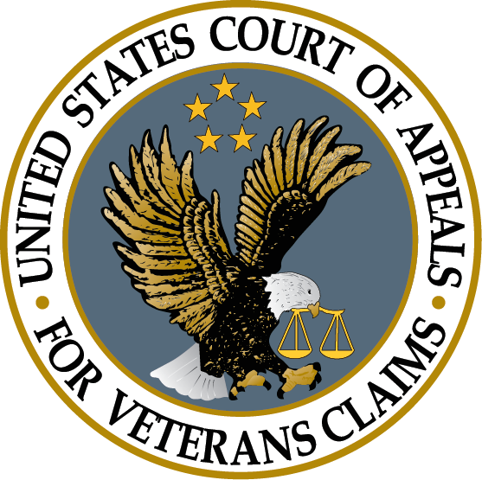

Background of Judges
Judicial review of Veterans’ benefits claims was established in 1988.
No CAVC judge in history has had experience at the Board of Veterans’ Appeals or adjudicating claims for VA.
No veterans law practitioner has ever been appointed as a Federal Circuit judge.
Notes:
It’s also important to recognize that the process doesn’t end when you complete the request.
Hopefully, the doctor will send the evidence back to you.
At this point, you need to read what the doctor provided and decide what to do next.
Review the documents before submitting them. Don’t submit records without looking at them.
[click] The first thing you want to do is to make sure that it is complete and accurate.
If there is a minor problem, contact the doctor to see if you can obtain a clarification.
[click] If there is a significant problem, you will likely need to contact the Veteran to sort out what happened.
Hopefully, the issue can be fixed.
But sometimes a Veteran misinterprets what their doctor is saying or the medical evidence turns out to problematic for some reason. Ultimately, [click] you are not required to submit evidence to VA that you think is bad for the Veteran.
Assuming that you get useful evidence, [click] now you have to decide how to use it.

Slide 52
End of Issue Break
Notes:
First, lets go over the threshold eligibility requirements for TDIU

Slide 53
Final Rule – New Burn Pit Presumptive Diseases
Notes:
Now let’s turn to Final Rules that VA did publish in the past year. The first added new burn pit presumptive diseases.

Slide 54

New Burn Pit Presumptives
The PACT Act of 2022 gave VA authority to add new disabilities to the Burn Pit presumptives.
In January 2025, VA used this authority to add the following disabilities:
  Urinary bladder, ureter, and related genitourinary cancers effective January 2, 2025.
  Acute leukemias, chronic leukemias, multiple myelomas, myelodyslastic syndromes, and myelofibrosis effective January 10, 2025.
Notes:
-The PACT Act gave VA explicitly authority to add new disabilities to the Burn Pit presumptives as medical science determines that more conditions may be related to the exposures of toxins from Burn Pit.
-In January 2025 VA used this authority to add the following disabilities to the list of conditions that are presumptively service connected due to exposure to Burn Pits:
*The first category was for urinary bladder and related genitourinary cancers effective January 2, 2025
*The second included acute leukemias and chronic leukemias effective January 10, 2025

Slide 55
Final Rule - Exception to the Bilateral Factor
Notes:
Next we will discuss a Final Rule that revised how the Bilateral Factor applies

Slide 56
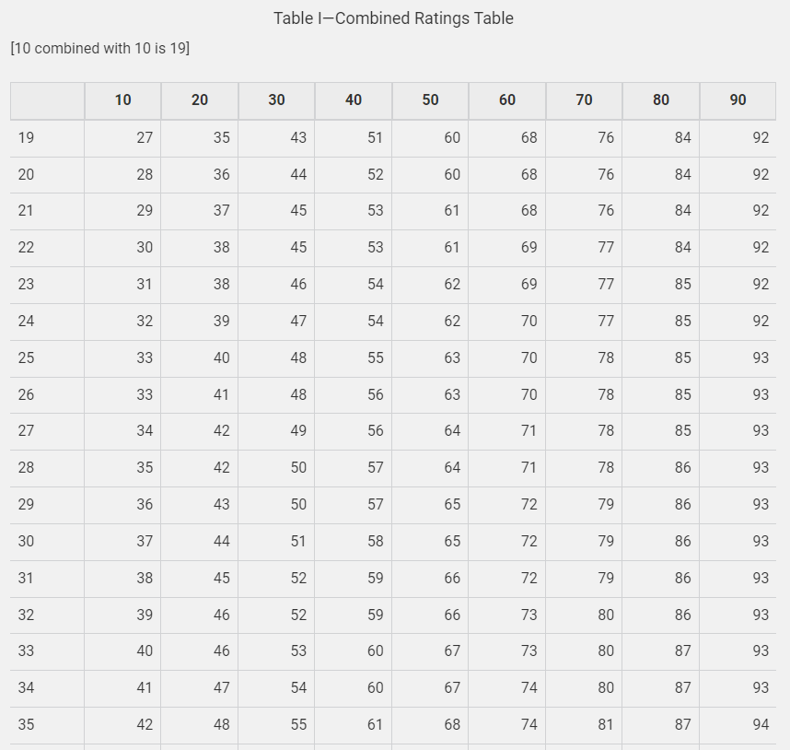
Bilateral Factor § 4.26
This regulation functions to provide Veteran with a higher combined rating if the Veteran receives compensable ratings for both arms or legs.
Applies if Veteran receives a compensable rating for both arms, both legs, or “paired skeletal muscles.”
  Here “arms” and “legs” refers to whole extremity.
  For example, if the Veteran is rated for her right hip and left foot, she receives a rating for “both legs” and therefore the bilateral factor applies.
Notes:
-Before we can explain what VA changed lets briefly review what the bilateral factor is and how it’s applied.
-VA’s regulations at 4.26 serves to provide Veterans with a higher combined rating if they receive a compensable rating for both arms or both legs. This is often called the “bilateral factor”
-In this reg the terms ‘arms’ and ‘elgs’ apply to the whole extremity. So for example, if a Veteran is rated for her right hip and left foot, she receives a rating for “both legs” and the bilateral factor applies even though her paired ratings are on different parts of each leg.

Slide 57
Bilateral Factor § 4.26 – How Applies
If this applies, then combine the ratings for the right and left sides as normal. Then add 10 percent of the resulting combined value.
Bilateral factor applies before other combined ratings and only applies once.
Combine all qualifying bilateral factor ratings together first, then add 10% of the resulting value.
Bilateral ratings are then treated as one disability for purposes of combining with other ratings.
Notes:
-
-If the bilateral factor applies, then VA will combine the ratings for the right and left leg as normal. After combining the ratings for the extremity, the legs in our example, VA then adds 10 percent of the resulting combined value. That’s adding through normal math addition, not combining under VA math.
-*The bilateral factor applies before combining other ratings but only applies once. So if the Veteran has two ratings on one leg and one rating on the other, combine all those ratings together first before adding the 10 percent.
-After adding the 10%, the bilateral ratings are they treated as one disability for purposes of combining with any other VA ratings.

Slide 58
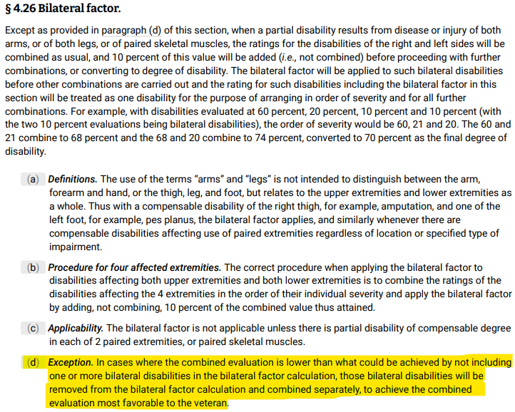
Bilateral Factor
On December 27, 2023, VA published a final rule fixing a situation when applying the bilateral factor would actually result in a lower overall rating.
  Arises most often if the Veteran’s overall combined rating is in the low 90s percent.
Fixed by adding a new paragraph (d) to § 4.26 saying if the bilateral factor results in a lower overall rating, then it doesn’t apply.
Effective on April 16, 2023.
Notes:
-In December of 2023 VA published a final rule that fixed a situation when applying the bilateral factor would actually result in a lower overall rating for the Veteran.
-Because of the rounding involved, this situation occurred most often if the Veteran’s overall combined rating was in the low 90s percent, especially if the Veteran had several disabilities that were combining to reach that rating.
-VA said it was never the intention of the bilateral factor to lower an overall rating, it’s supposed to function to always raise the rating.
-*So VA published a final rule fixing this situation by simply adding a new paragraph (d) to 4.26 saying that if the bilateral factor results in a lower overall rating, then it doesn’t apply.
-This change was effective April 16, 2023.
-VA’s computer systems should automatically fix this for any Veteran it applies to, so it’s not something you need to worry about in most cases. But, if you’re helping a Veteran whose combined rating is in the low 90s it may be worth checking the math yourself to see if they could reach the 100 percent rating without applying the bilateral factor.

Slide 59
Example of Bilateral Factor Fix
Example: Veteran has a combined 93 rating plus two 10% ratings that would qualify for the bilateral factor.
Applying the bilateral factor:
  10 combined with 10 is 19, add 1.9 under the bilateral factor for rating of 21, rounded to 20.
  93 combined with 20 is 94 – which results in a combined total rating of 90%
No bilateral factor:
  93 and 10 combine to 94
  94 and 10 combine to 95 - which results in a combined total rating of 100% more favorable to the Veteran.
Notes:
-Let’s look at an example of how the bilateral factor and this fix would apply.
-*Say this veteran hsaa a combined 93 percent rating plus two 10% ratings that would qualify for the bialtera factor.
-If VA applied the bilateral factor, then *10 combined with 10 is 19 using VA’s combined ratings table. Then add 10% of that 19, or 1.9, to get a combined rating of 21. This rounds down to a 20% rating.
-*93 combined with 20 using VA’s combined ratings table is 94. 94 rounds down to a total combined rating of 90%
-If the bilateral factor does not apply, then
-*93 and 10 combined to 94 under the combined ratings table
-That resulting 94 combined with the last 10% to 95. This 95 would round up to a 100% rating. So in this case, it would be better for the Veteran to not use the combined ratings table.

Slide 60
Final Rule – Character of Discharge
Notes:
Next we will look at VA’s final rule revising the character of discharge

Slide 61
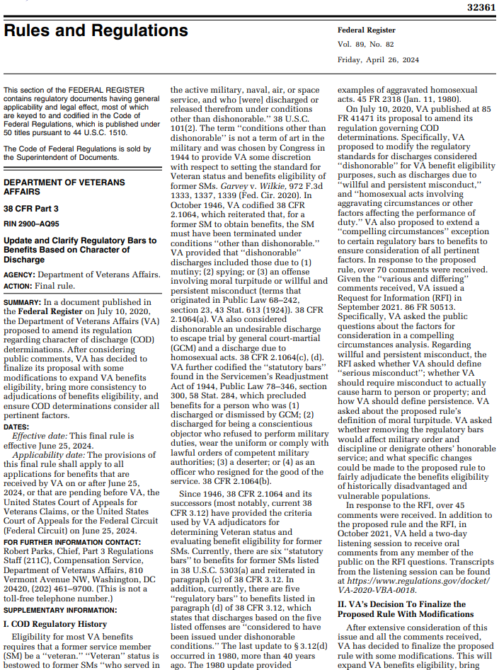
Character of Discharge
Effective June 25, 2024, VA updated 38 C.F.R. § 3.12 regarding character of discharge determinations.
VA expanded exceptions to excuse a bar to benefits based upon an unfavorable character of discharge to three significant ways:
  Extended the compelling circumstances exception.
  Removed the regulatory bar to benefits based on discharges due to homosexual acts involving aggravating circumstances. (VA had not enforced this for years already)
  Redefined the definition of “willful and persistent misconduct.”
Notes:
-*Effective June of 2024, VA updated their regulation at 38 CFR .12 regarding character of discharge determinations.
-This revision is helpful to Veterans as VA expanded the exceptions to excuse a bar to benefits based upon an unfavorable character of discharge in 3 main ways:
*1) VA extended the compelling circumstances exception
*2) VA removed the regulatory bar to benefits based on discharges due to homosexual acts involving aggravating circumstances. VA had already not enforced this provision for several years, but now they officially took it off the books.
*and 3) they redefined the definition of willful and persistent misconduct

Slide 62
Compelling Circumstances Exception
VA will not pay benefits for Veterans who were involved in an offense involving moral turpitude or willful and persistent misconduct.
The new rule applies a compelling circumstances exception to both of these categories.
The factors to consider for compelling circumstances are:
38 C.F.R. § 3.12(e)
Length and character of service exclusive of the period of misconduct.
Reasons for misconduct, including:
(i) mental or cognitive impairment; (ii) physical health, (iii) combat-related or overseas-related hardship; (iv) sexual abuse/assault; (v) duress, coercion, or desperation; (vi) family obligations or comparable obligations; and (vii) age, education, cultural background, and judgmental authority
Whether a valid legal defense would have precluded a conviction for misconduct under the UCMJ.
Help Veterans submit detailed statements addressing compelling circumstances!
Notes:
-Let’s discuss the compelling circumstances exception first.
-VA will not pay benefits for Veterans who were involved in an offense involving moral turpitude or willful and persistent misconduct.
-*The new rule adds a compelling circumstances exception to both of those categories.
-The reg further defines some factors to consider if compelling circumstances exist. Those include * length and character of service without misconduct, the reason for misconduct which are up on your screen, or whether there was a valid legal defense that would have precluded a conviction for misconduct under the UCMJ.

Slide 63

Willful and Persist Misconduct
VA has also refined the definition of “willful and persistent misconduct” as follows:
  Instances of minor misconduct occurring within two years of each other are persistent;
  An instance of minor misconduct within two years of more serious misconduct is persistent; and
  Instances of more serious misconduct occurring within five years of each other are persistent.
“Minor misconduct” is defined as misconduct for which the maximum sentence imposable pursuant to the Manual for Courts-Martial would not include a dishonorable discharge or confinement for more than one year if tried by general court-martial.
Notes:
-Lets also look at the revised definition of willful and persistent misconduct. VA defined some of these key words
-*Instances of minor misconduct occurring within two years counts as persisten
-*An instance of minor misconduct within two years of more serious misconduct is persistent
-* Instances of more serious misconduct occurring within 5 years are persistent
-*Minor misconduct is also defined as misconduct for which the maximum sentence under Court Martial would not include dishonorable discharge or confinement of more than one year

