Slide 1
Special Monthly Compensation

Slide 2
Course Topics
SMC (K)
SMC criteria for Housebound and A&A
SMC for extremity losses at all levels (L thru O)
(P) elevations
The multiple ways to get to (O)
SMC (R) and (T)

Slide 3
What is Special Monthly
Compensation?
Special Monthly Compensation (SMC) is an additional level of compensation to Veterans (above the basic levels of compensation payable based on disability ratings of 0 to 100 percent) for various types of anatomical losses or levels of impairment due solely to service-connected (SC) disabilities.
Notes:
this is why it may be helpful to look at higher ratings for Veterans already rated at 100%

Slide 4
SMC – How to Apply
File a new claim
File an increase
SMC is available for spouses surviving spouses (A&A only)
Don’t forget about ancillary benefits! (adapted housing, SAH, adaptive equipment, auto allowance, clothing allowance)

Slide 5
References
38 CFR 3.350
38 CFR 3.352
38 CFR 3.552
38 USC 1114
M21-1 MR VIII, Subpart iv, Chapter 4, Section A

Slide 6
SMC – Major Changes
There are very few changes to SMC:
The rating activity must include “SMC Calculator Worksheet” as the subject of the document uploaded into VBMS
A single disability evaluated as 100-percent disabling under a schedular evaluation is generally a prerequisite for entitlement to A&A. There is not a statutory or regulatory requirement for a 100-percent disability to qualify for A&A. However, any lesser disability would typically be incompatible with the requirements of 38 CFR 3.352(a).
The VA Office of General Counsel concluded in VAOPGCPREC 66-1991 that, based on the specific statutory and regulatory language used in 38 U.S.C. 1114(s) and 38 CFR 3.350(i), there must be one single disability rated at 100-percent disabling to establish entitlement at the SMC (s) rate. Multiple disabilities that combine to 100 percent, even if from a common etiology, do not satisfy the requirement for “a single SC disability rated as 100 percent” for the purpose of SMC housebound benefits.

Slide 7
Selected SMC Rates
(Single Veteran no Children)
$136.06 per month, added on
(S) $4,288.45 per month
$4,767.34 per month
$6,689.81 per month
(R1) $9,559.22 per month
(R2/T) $10,964.66 per month
Effective December 1, 2024

Slide 8
SMC (K)
Generally, SMC at the (K) rate is payable for loss or loss of use of a single body part or loss of a single body function.
The current rate (effective 12/1/2024) is $ 136.06; this is added to the basic compensation rate.
38 CFR 3.350(a) and 38 USC 1114(k)

Slide 9
SMC (K)
SMC (K) is payable for:
Loss or loss of use of one hand
Loss or loss of use of one foot
Blindness of one eye, having only light perception
Loss of use of both buttocks
Bilateral Deafness
Complete organic aphonia
Loss or loss of use of a creative organ
Loss of breast tissue > 25% (limited to female Veterans)
38 CFR 3.350(a)
Notes:
including female sexual arousal disorder

Slide 10
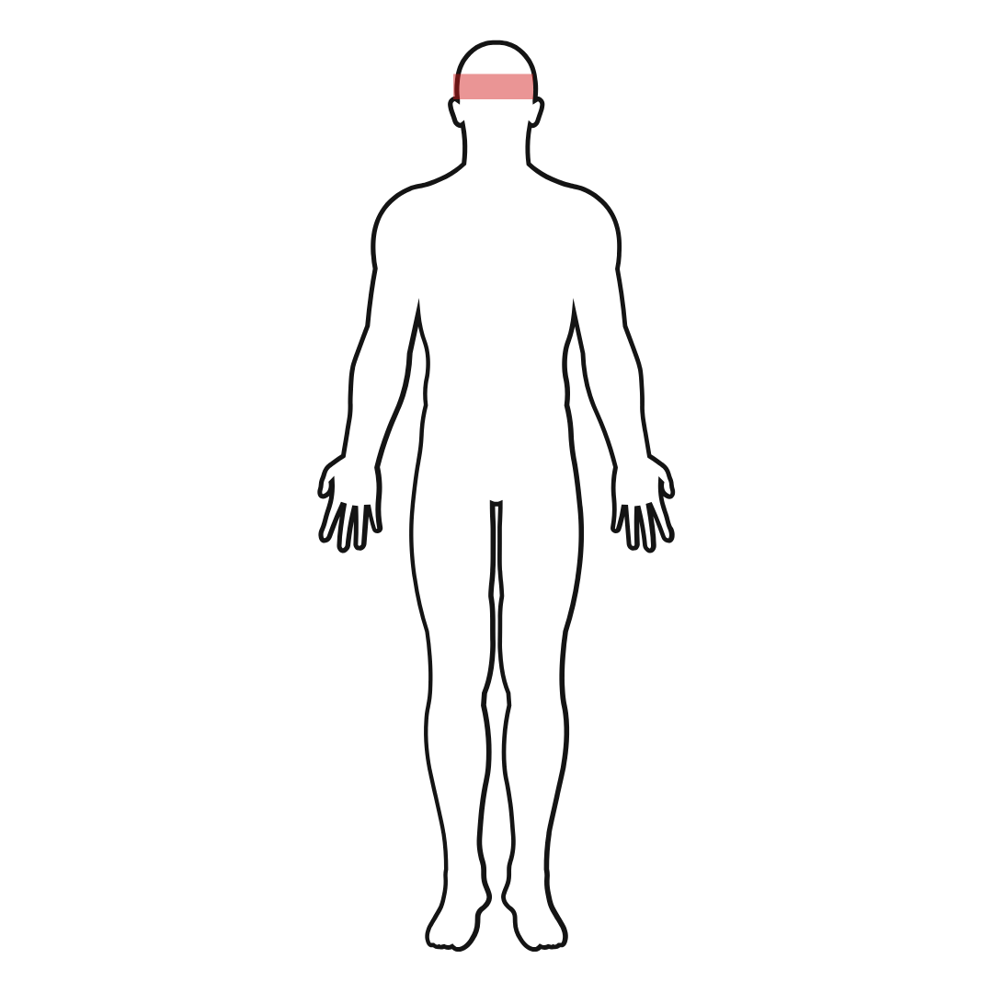
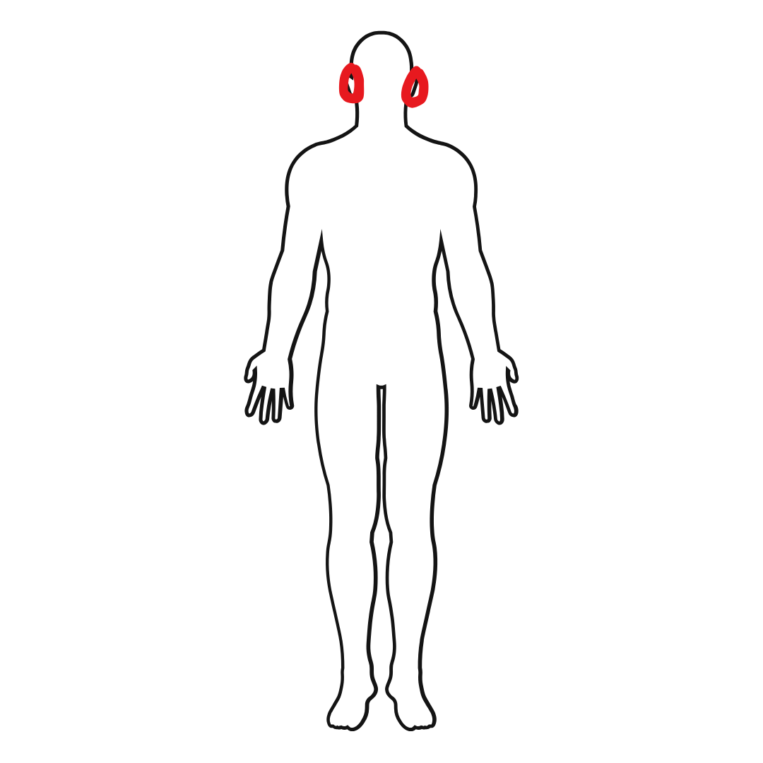
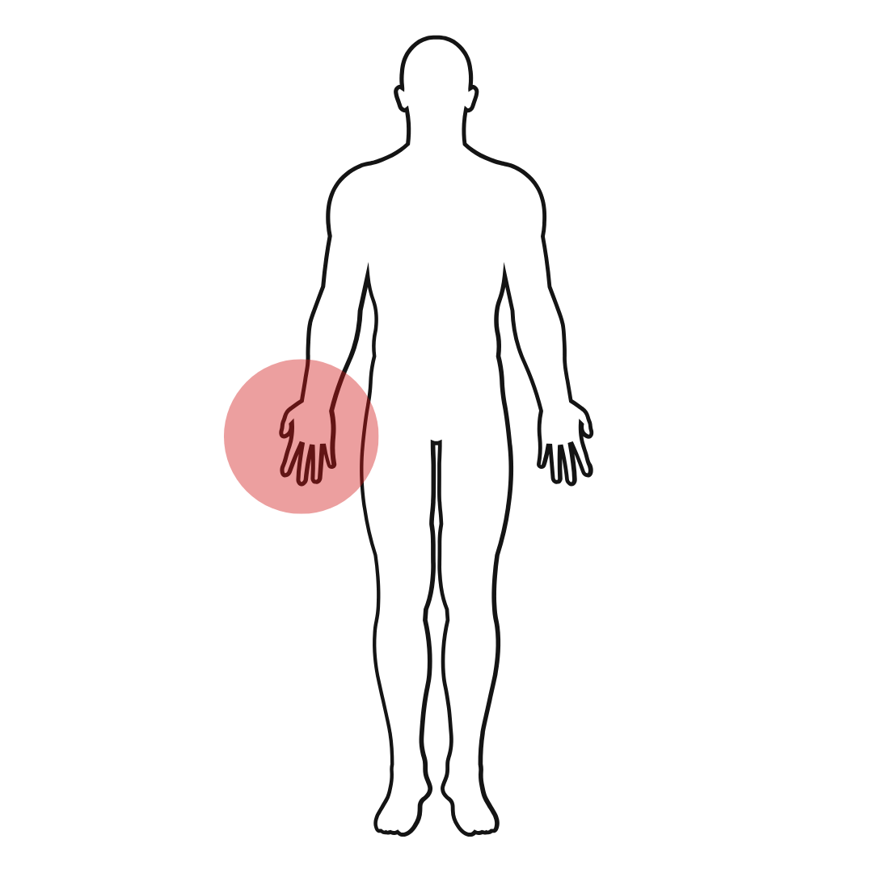
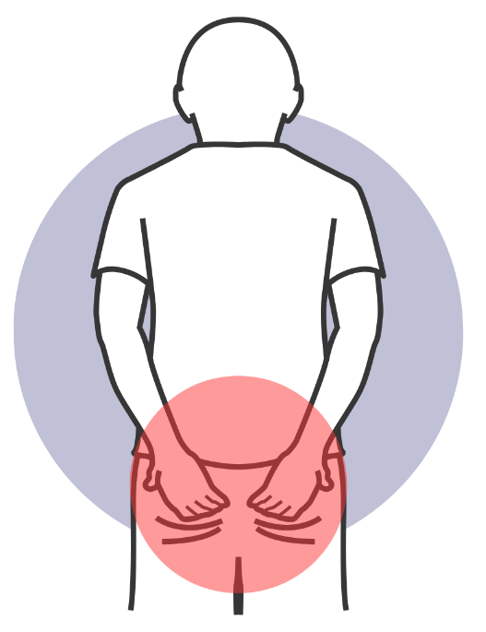
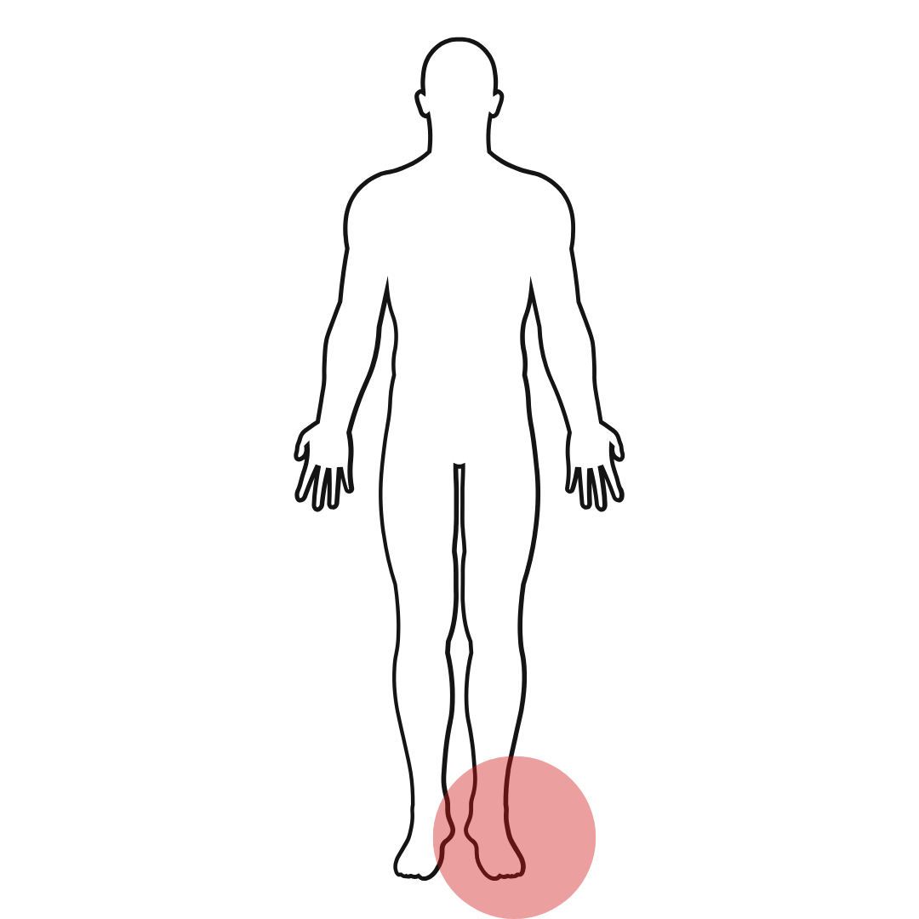
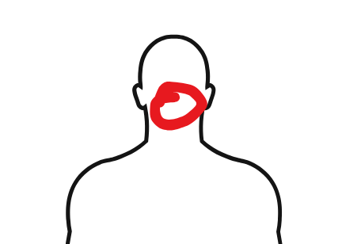
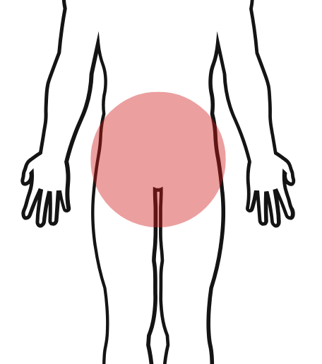
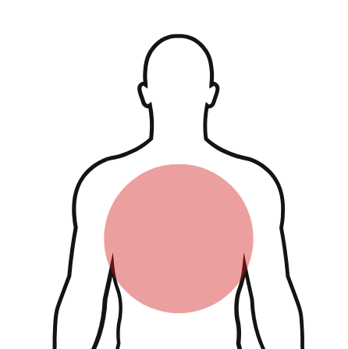
SMC (K)
Notes:
including female sexual arousal disorder

Slide 11
Loss of Use (LOU)
Special Note about Loss of Use (LOU)
Responsibility for determining LOU rests solely with the rating activity
Cannot be delegated to the examiner
LOU can be organic loss or functional loss
Mandatory use of the SMC Calculator by the rating activity (results must be uploaded into VBMS)
Notes:
including female sexual arousal disorder

Slide 12
Loss of Use (LOU) of a Hand
Loss of use of a hand or a foot will be held to exist when no effective function remains other than that which would be equally well served by an amputation stump at the site of election below elbow or knee with use of a suitable prosthetic appliance. The determination will be made on the basis of the actual remaining function, whether the acts of grasping, manipulation, etc., in the case of the hand, or of balance, propulsion, etc., in the case of the foot, could be accomplished equally well by an amputation stump with prosthesis
38 CFR 3.350(a)(2)(i)

Slide 13

Loss of Use (LOU) of a Hand
Effective remaining function is assessed on the basis of grasping and manipulation.
Can the Veteran pick up small objects such as paper clips or coins? Can the Veteran oppose the index finger to the thumb? Can the Veteran button clothing, open an envelope, or use a screwdriver?

Slide 14
Loss of Use (LOU) of a Hand
Loss of use of a hand could also be established by a clinical finding of complete ankylosis of two major joints of an upper extremity.
What is ankylosis?
Can a Veteran receive SMC K for LOU of the arm and LOU of the hand?
3.350(a)(2)(i)(a)
Notes:
Ankylosis = frozen joint

Slide 15
Loss of Use (LOU) of a Foot
Similar criteria as for hand. No effective function remains other than that which would be equally well served by an amputation stump at the site of election below the knee, with the use of a suitable prosthesis.
3.350(a)(2)

Slide 16

Loss of Use (LOU) of a Foot
Effective remaining function is assessed with respect to the elements of balance and propulsion.
Can the Veteran raise the heel off the floor? Can they push off with the ball of the foot?
3.350(a)(2)(i)

Slide 17
Loss of Use (LOU) of a Foot
Loss of use of a foot could also be established by a clinical finding of:
  Complete ankylosis of two major joints of a lower extremity
  Shortening of a lower extremity by 3 ½ inches
  Extremely unfavorable ankylosis of the knee
  Complete paralysis of the external popliteal nerve (common peroneal) and consequent foot drop with characteristic organic changes.
3.350(a)(2)(i)(a)and (b)

Slide 18
SMC (K)
The SMC (K) rate is added to any other SMC entitlement until the SMC level reaches SMC (O).
Question: Can a Veteran have more than one SMC (K) rating at the same time?

Slide 19
SMC (K)
SMC (K) is payable for loss or loss of use of a single extremity.
If another extremity also has loss or loss of use, the SMC for the pair of extremities is SMC (L) or higher.
The (K) no longer applies.

Slide 20
SMC (K)
Example:
Veteran is rated for loss of one foot and receives SMC (K). If she later loses the other foot due to a service-connected disability, she is entitled to SMC (L) instead of two SMC (K)’s.

Slide 21
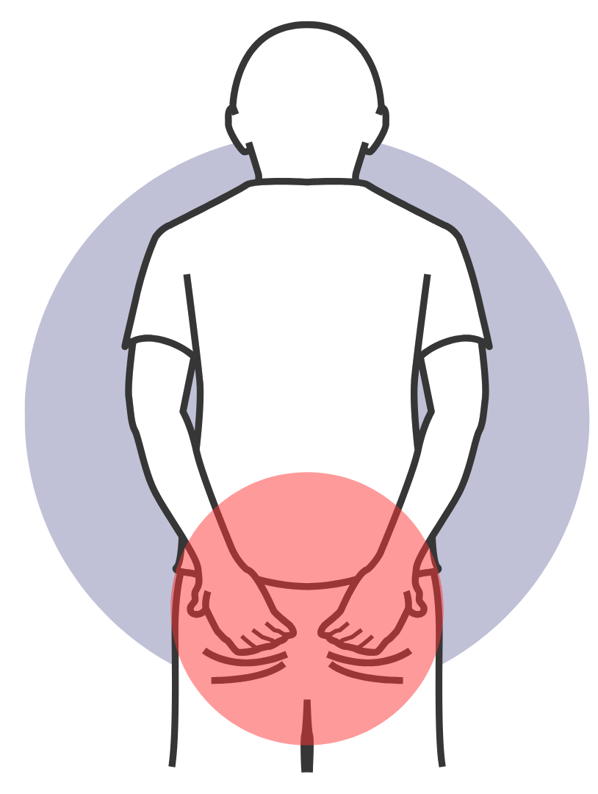
SMC (K) – less common considerations
Both Buttocks – without assistance, can the Veteran rise from a seated or stooped position?
  K can be added to L in certain circumstances

Slide 22
SMC (K) – less common considerations
Blindness (one eye) – cannot view test letters at 1 foot, or objects/ hand movements at 3 feet

Slide 23
SMC (K) – less common considerations
Deafness – both ears for air and bone conduction greater than the maximum hearing rating schedule

Slide 24
SMC (K) – let’s review
Practical Exercise #1

Slide 25
SMC (K) – let’s review
What level of SMC would a Veteran receive who has:
Deafness in one ear
Loss of one buttocks
Anatomical loss of the left hand

Slide 26
SMC (K) – let’s review
What level of SMC would a Veteran receive who has:
Deafness in both ears
Loss of both buttocks
Anatomical loss of the left hand

Slide 27
SMC (K) – let’s review
What level of SMC would a Veteran receive who has:
Deafness in both ears
Loss of both buttocks
Anatomical loss of the left hand
Loss of use of the right foot

Slide 28
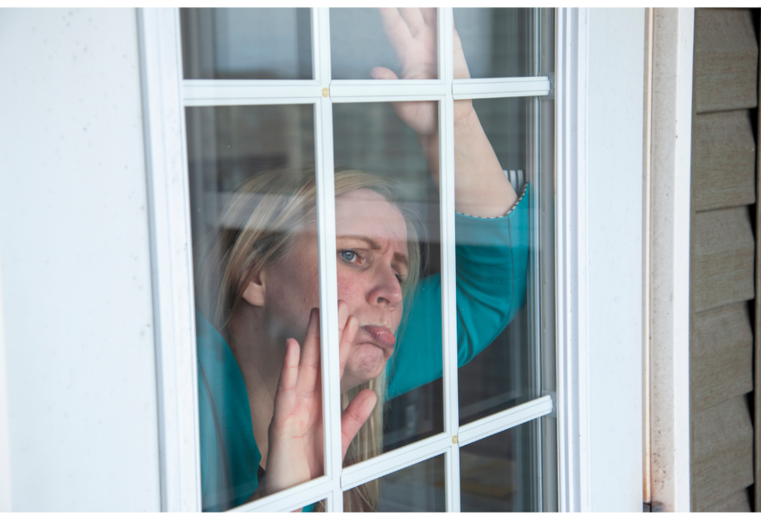
SMC (S): Housebound
Requires a single SC disability rated at 100%
and either:
An additional SC disability or combined disabilities independently ratable at 60 percent or more
or
The Veteran is permanently housebound as a result of SC disabilities.
38 CFR 3.350 (i)

Slide 29
SMC (S): Housebound
The “single disability” must be one condition rated 100 percent. (TDIU also based on ONE disability can apply).
When a Veteran has multiple conditions that combine to 100 percent, but none is rated 100 percent by itself, housebound is not payable.

Slide 30

SMC (S): Housebound
Example (100 percent plus 60 percent):
PTSD rated at 100 percent and Hearing Loss rated at 60 percent would qualify for SMC (S).
Example (Housebound “in fact”) – must be permanent
The Veteran is rated 100 percent for lung disease. He is on home oxygen and cannot leave home except to go to the doctor. He is medically confined to his home and therefore entitled to SMC (S).

Slide 31
SMC (S): Housebound
Example
70% PTSD
60% Type 2 Diabetes Mellitus
20% Peripheral Neuropathy – Left Upper
20% Peripheral Neuropathy – Right Upper
20% Peripheral Neuropathy – Left Lower
20% Peripheral Neuropathy – Right Lower
10% Diabetic Retinopathy
10% Tinnitus
The Veteran is not confined to their home.
Should SMC(S) be applied?
Notes:
Answer is NO

Slide 32
SMC (S): Housebound
How about now?
70% PTSD –TDIU granted solely on this condition
60% Type 2 Diabetes Mellitus
20% Peripheral Neuropathy – Left Upper
20% Peripheral Neuropathy – Right Upper
20% Peripheral Neuropathy – Left Lower
20% Peripheral Neuropathy – Right Lower
10% Diabetic Retinopathy
10% Tinnitus
The Veteran is not confined to their home.
Should SMC(S) be applied?
Notes:
Answer is NO

Slide 33
SMC (S): Housebound
The 100% for SMC (S) can be based on individual unemployability, provided the TDIU rating is based on a single disability.

Slide 34
SMC (S): Housebound
SMC (S) can also be assigned based on a temporary total evaluation under paragraph 28, 29 or 30.
Example:
A Veteran requires 1 year of post-surgical convalescence for a service-connected disability. If the other disabilities combine to 60% or higher, SMC (S) is payable during the Paragraph 30 time period.
Notes:
If the vet qualifies for L or higher, the S no longer applies

Slide 35
SMC (L) and Higher
SMC (L) and/or higher are awarded for:
Double extremity loss or loss of use (LOU)
Need for aid and attendance (A&A)
Blindness and Deafness
38 CFR 3.350

Slide 36

SMC (L) for Aid and Attendance
SMC (L) is payable when the Veteran requires regular aid and attendance:
  To perform activities of daily living (ADL)
  To protect from the hazards of daily living
  Includes being “bedridden”
38 CFR 3.350(b) and 3.352

Slide 37
SMC (L) for Aid and Attendance
What are some ADL’s?
  Dressing and/or Undressing
  Cleaning/Bathing
  Frequent adjustment of prosthetics needing the aid of another person that normally could be adjusted without aid
  Feeding/preparing meals
  Calls of Nature
  Protection from the hazards of daily living
38 CFR 3.352(a)

Slide 38
SMC (L) for Aid and Attendance
For SMC (L) based on need for A&A, a 100 percent rating is generally required.
This includes multiple ratings for a “single disease entity” such as Parkinson’s or Multiple Sclerosis.
  Example:
  MS-related conditions:
  80% Eye condition
  70% Depression
  40% Right upper extremity
  30% Left upper extremity
Combined is 100%.
If the vet needs A&A, SMC (L) applies
Notes:
If the vet does not have a 100% condition, you can request SMC L for A&A but explain to vet that it’s a long shot.

Slide 39
SMC (L) for Aid and Attendance
Example:
100% for Diabetes Mellitus
40% for left below the knee amputation (BKA)
Vet needs A&A due to service-connected disabilities.
SMC level is L plus K
L for A&A
K for BKA
**Note that K entitlement can be used with L for A&A.

Slide 40

Break Time!
Let’s take a break

Slide 41
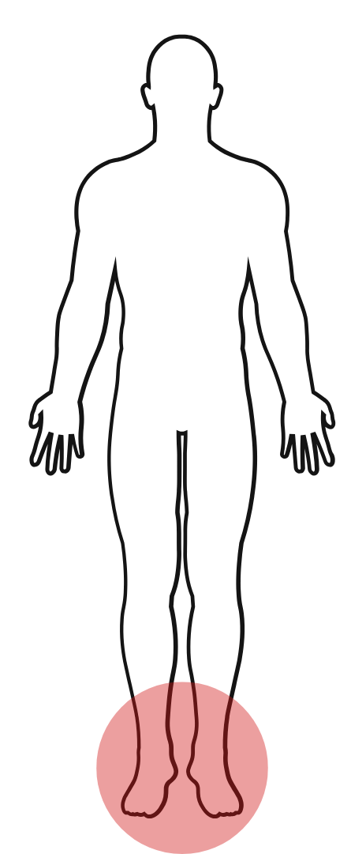
SMC (L) for Double Extremity Loss
The starting levels for SMC due to multiple extremity loss are as follows:
SMC (L) is payable for both feet
38 CFR 3.350 (b) and (c)

Slide 42
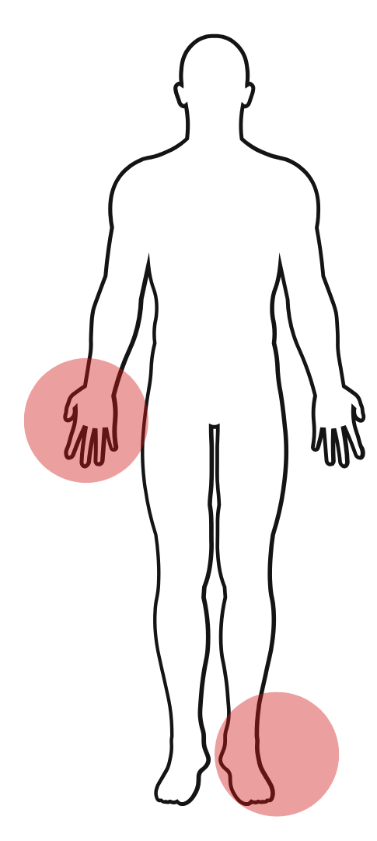
SMC (L) for Double Extremity Loss
The starting levels for SMC due to multiple extremity loss are as follows:
SMC (L) is payable for one foot and one hand
38 CFR 3.350 (b) and (c)

Slide 43
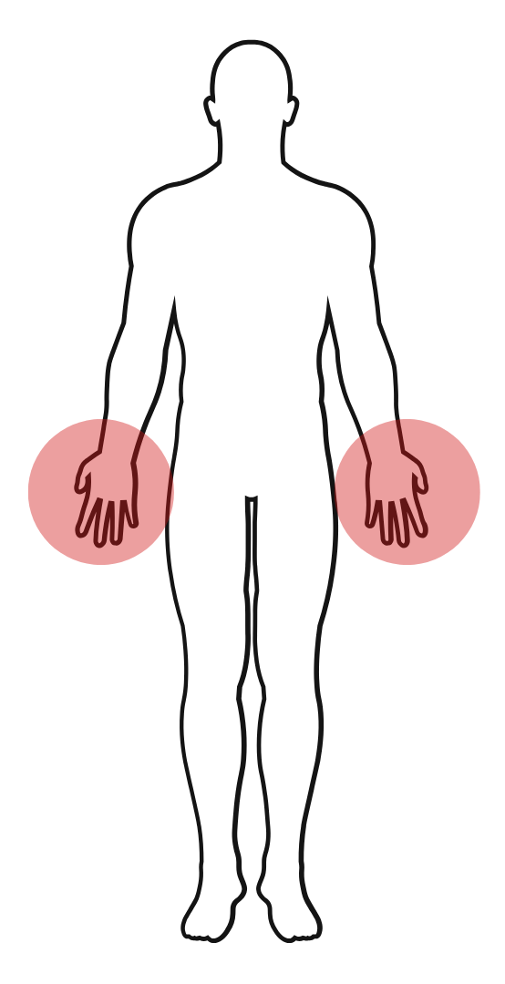
SMC (M) for Double Extremity Loss
The starting levels for SMC due to multiple extremity loss are as follows:
SMC (M) is payable for both hands
38 CFR 3.350 (b) and (c)

Slide 44
SMC (L) for bilateral eyes
For blindness,
5/200 or less visual acuity
Concentric contraction of field of vision beyond 5 degrees
38 CFR 3.350 (b)(2)

Slide 45
SMC for Double Extremity Loss
To understand the concept of building up SMC entitlement for greater losses, we need two ideas:
Elevating an SMC level by 1/2 steps
Joint Levels
38 CFR 3.350 (b),(c), and (d)

Slide 46
SMC for Double Extremity Loss
A half step elevation means to increase the SMC level to the next higher rate or intermediate rate: e.g. from (L) to (L ½) or from (M ½) to (N).
A full step elevation would be from (L) to (M) or from (M ½) to (N ½).
The principle is that SMC is elevated ½ step per joint level per extremity affected.
38 CFR 3.350 (b)-(f)

Slide 47
SMC for Double Extremity Loss
Lower Extremity Joint
Levels:
Foot: Below knee
amputation (BKA)
or loss of use
Knee: Above knee
amputation (AKA)
or loss of natural
knee action with
prosthesis in place.
Hip: Amputation (only)
so high as to prevent prosthesis
Upper Extremity Joint
Levels:
Hand: Below elbow
amputation (BEA)
or loss of use
Elbow: Above elbow
amputation (AEA)
or loss of natural
elbow action with
prosthesis in place.
Shoulder: Amputation (only)
so high as to
prevent prosthesis
Notes:
Note that the first two joint levels can be either loss or loss of use. However, the highest joint level requires loss only (amputation so high that a prosthesis cannot be worn).

Slide 48
SMC for Double Extremity Loss
Loss of Natural elbow or knee action
This means that the Veteran does not have natural use of the joint, to the point that muscles affecting joint motion, if not already atrophied, will become so. Ankylosis or paralysis of the joint is entitling.
38 CFR 3.350(c)(2)

Slide 49
SMC for Double Extremity Loss
Examples of elevations based on multiple extremity loss:
For a BKA on one side and an AKA on the other, the SMC (L) for both feet would be elevated ½ step for the knee level to SMC (L ½).
For loss of a hand on one side and above elbow amputation on the other side, the starting level of SMC (M) would be elevated to (M ½) for the elbow level.

Slide 50
SMC – let’s review
Practical Exercise #2

Slide 51
SMC – let’s review
What level of SMC would apply for the following:
Anatomical loss at the mid-calf of the left leg
Loss of use of the right leg at mid-thigh

Slide 52
SMC – let’s review
What level of SMC would apply for the following:
Anatomical loss at the mid-thigh of the left leg
Loss of use of the right leg at mid-thigh

Slide 53
SMC – let’s review
What level of SMC would apply for the following:
Anatomical loss at the hip area of the left leg
Loss of use of the right leg at mid-thigh

Slide 54
SMC (P) Elevations
Elevation of SMC level under (P)
For a Veteran already rated at SMC (L) or higher, the following factors permit elevation of the SMC level.
Additional independent 50% disabilities= Half step
Additional independent 100% single disability = Full step
Triple extremity loss = Half step
38 CFR 3.350(f)(3), (f)(4) and (f)(5)

Slide 55
SMC (P) Elevations
Additional independent 50% disabilities
A half step elevation is provided for an additional single disability or combination of disabilities independently ratable as 50 percent or more.
38 CFR 3.350 (f)(3)

Slide 56
SMC (P) Elevations
Additional independent 100 percent disability
A full step elevation is provided if the Veteran has an additional single disability independently ratable as 100 percent.
Whole Step Example:
100 percent both hands SMC (M)
100 percent heart disease Full step to SMC (N)
0 percent creative organ Add SMC (K)
SMC Entitlement is now SMC (N) + (K)
38 CFR 3.350(f)(4)

Slide 57
SMC (P) Elevations
The 50% (P) elevation permits a combination of disabilities but the 100% (P) elevation requires a single disability.

Slide 58
SMC (P) Elevations
A Veteran may only receive either the 50% or 100% (P) elevation NOT BOTH
Example:
100% for both hands (LOU) SMC (M)
100 % heart disease Full step to SMC (N)
50% PTSD (No Change)
0% creative organ Add SMC (K)
SMC entitlement is now SMC (N) plus (K)

Slide 59
SMC (P) Elevations
(P) elevation for triple extremity
Anatomical loss or loss of use, or a combination of loss and loss of use, of three extremities is entitled to a ½ step elevation.
This elevation is in addition to SMC (K) entitlement and can be used with the 50 or 100 percent elevations.
38 CFR 3.350(f)(5)

Slide 60
SMC (P) Elevations
Triple Extremity Example:
Both feet SMC (L)
One hand (60%) ½ for triple plus ½ for 50% (P) plus (K)
SMC entitlement is now SMC (M)+(K)
NOTE: Loss or loss of use of a hand is ALWAYS rated at least 60 percent.

Slide 61
SMC (P) Elevations
Triple Extremity Example:
1. Both hands (M)
One foot (40%) ½ for triple plus (K)
SMC entitlement is now SMC (M ½) + (K)
2. Both hands (M)
One foot (40%) ½ for triple plus (K)
100% Heart Disease Full step (P) elevation
SMC entitlement is now SMC (N ½) + (K)

Slide 62
SMC (P) Elevations
(P) Elevations with Aid and Attendance
For SMC (L) based on A&A, the (P) elevations under 3.350 (f)(3) and (f)(4) are permitted.
The (L) can be elevated a half step for an additional 50 percent evaluation.
The (L) can be elevated a full step for an additional, single 100% disability.

Slide 63
SMC (P) Elevations
A&A Example with P Elevation:
100% for Diabetes Mellitus
50% for Migraines
40% for left BKA
Vet needs A&A due to diabetes.
100% with A&A (L)
½ for additional 50% condition (L½)
BKA (K)
SMC entitlement is SMC (L ½)+(K)

Slide 64
SMC (O)
There are multiple ways to get to SMC (O):
Both arms, shoulder level amputation
Paraplegia with loss of bowel and bladder sphincter
Conditions entitling to two SMC codes rated (L) to (N)
Elevations under (P)
Blindness and deafness

Slide 65
SMC (O)
SMC (O): Paraplegia with loss of bowel and bladder sphincter control
Paraplegia (paralysis of both lower extremities) together with loss of anal and sphincter control entitles the Veteran to SMC (O), even though incontinence has been overcome under a strict regimen of rehabilitation of bowel and bladder training and other auxiliary measures such as a bowel management program.
Bowel management program: Overcoming the inability to void the bowel using medical or artificial means such as laxatives & digital stimulation.
38 CFR 3.350(e)(2)

Slide 66
SMC (O)
SMC (O): Conditions entitling to two SMC codes rated (L) to (N).
Must be separate and distinct disabilities but can be losses resulting from a common etiological agent, for example, one injury or rheumatoid arthritis.
38CFR 3.350(e)(1)(ii)

Slide 67
SMC (O)
SMC (O): Conditions entitling to two SMC codes rated (L) to (N).
Examples:
1. 100% LOU Hands SMC (M)
100% LOU Feet SMC (L)
SMC entitlement is SMC (O)
2. 100% Hands SMC (M)
100% Psychosis requiring A&A SMC (L)
SMC entitlement is SMC (O)

Slide 68
SMC (O)
SMC (O): Elevations under (P) to the (O) level.
Example:
100% Both legs, hip level amputations SMC (N)
100% PTSD Full step (P)
SMC entitlement is now SMC (O)

Slide 69
SMC (O)
SMC (O): Blindness and Deafness
Bilateral service connected hearing loss rated at 60% or more disabling in combination with service-connected blindness with bilateral visual acuity 20/200 or less.
Or
Service-connected total deafness in one ear or bilateral deafness rated at 40% or more disabling in combination with service-connected blindness of both eyes having only light perception or less.
38 CFR 3.350(e)(iii) and (iv)

Slide 70
SMC (O)
Once a Veteran is entitled to SMC (O), SMC (K) no longer applies
There is no SMC (O ½) or SMC (O)+(K)
38 CFR 3.350(a)

Slide 71
SMC (R)
Eligibility for SMC (R)
1. Requires A&A
And
2. Meets one of two threshold levels:
SMC (O)
SMC (N ½) plus (K)
38 CFR 3.350(h)(1) and (2)

Slide 72
SMC (R)
Eligibility for SMC (R)
Examples:
1. 100% Both legs, hip level amputations SMC (N)
50% PTSD SMC (N½)
0% Loss of creative organ SMC (K)
If the vet needs A&A SMC level will be elevated to SMC (R)
2. 100% Both hands above elbow amputation SMC (N)
100% Heart Disease SMC (O)
If the vet needs A&A SMC level will be elevated to SMC (R)

Slide 73
SMC (R)
SMC (R) is based on a factual need for A&A under 38 CFR 3.352, the same criteria for SMC (L) based on A&A.
SMC (R) can be payable even if A&A was a partial basis of the rate under SMC (O) or SMC (P).
In other words, even if the A&A was used to determine SMC (O) entitlement, it can also be used to determine SMC (R) entitlement.
NOTE: SMC (R) is only paid when the Veteran is not hospitalized at the government’s expense.
38 CFR 3.350(h)(1) and (2)

Slide 74
SMC (R)
The SMC (R1) rate is paid unless the Veteran meets the specific requirements for SMC (R2)
(R2) is only provided when a higher level of care is required to prevent institutionalization.
If a Veteran who is receiving SMC (R2) is hospitalized, the rate is reduced to SMC (R1).
If a Veteran is receiving SMC (R1) or (R2) and is hospitalized at the government’s expense, the rate will be reduced to SMC (O)
38 CFR 3.352(b)(1) and (2)

Slide 75
SMC (R)
SMC (R2): Higher Level of Care to Prevent Institutionalization
  Entitled to (R1)
  Without higher care, the Veteran would be institutionalized.
  Need must be certified by a physician.
38 CFR 3.352(b)

Slide 76
SMC (R)
SMC (R2) Higher Level of Care Criteria:
Skilled services (e.g. PT, injections, indwelling catheter, sterile dressing, etc.)
Performed in the person’s home
Daily
Performed by a licensed health care provider or by a person under regular supervision of a LHC professional (Can be a relative)
38 CFR 3.352 (b)(2),(3),and (4)
Notes:
Regular means at least once a month, at least a phone call

Slide 77
SMC (T)
SMC (T) is equal to the (R2) rate and is payable for Veterans who:
Need regular A&A for residuals of traumatic brain injury (TBI),
AND
Would require hospitalization, nursing home, or other residential institutional care in the absence of regular in-home A&A
38 CFR 3.350(j)

Slide 78
SMC (T)
SMC (T) is not payable if the Veteran is otherwise eligible for SMC (R2)
If a Veteran receiving SMC (T) is hospitalized the rate is reduced to SMC (S) plus any applicable (K’s)

Slide 79
SMC – How to Appeal
Supplemental claim (new and relevant evidence)
Higher-Level Review
Board Appeals
Must follow timelines as stated within the decision notification (generally one year from notification)

Slide 80
Final Thoughts
Special Monthly Compensation is paid to Veterans whose injuries are more severe than the rating schedule reflects
Remember to look for SMC entitlement when reviewing ratings (especially SMC-K)
There can be eligibility to multiple SMC-Ks but once the vet reaches SMC-O they no longer apply
A SMC-P elevation can only be used once per Veteran
SMC can be applied during temporary rating periods (4.28, 4.29, 4.30)

Slide 81

Break Time!
Questions?

