Slide 1
Tap Considerations

Slide 2
Objectives
TAP and Accredited VSOs
VSO Responsibilities
VSO Scheduling Tool/Proxy
Registration
15-min Briefings
Tips
Questions

Slide 3
TAP and Accredited VSOs
VSO’s opportunity to inform active-duty service members early about claim process
Share how to prepare for filing a VA claim
Three VSOs allotted 15 minutes each to brief at end of course
First Come, First Serve

Slide 4
VSO Responsibilities
Respect and support the prescribed TAP course schedule
Register for courses via scheduling tool in advance
Coordinate installation access
Notify TAP personnel of cancellations in advance
Provide feedback on briefing experience
Sign in to classroom using accreditation number

Slide 5
VSO Scheduling Tool/Proxy
Verifies VSO accreditation against OGC accreditation
Located on the VA SharePoint landing page
A VA Personal Identity Verification (PIV) card is required to request access, and a valid VA.gov email account

Slide 6
VSO Scheduling Tool/Proxy
Proxy Registration for newly accredited VSOs awaiting PIV badges
  Registration completed by supervisor
  Notification sent to new VSO
  Forward email notification
  Make formal introduction (location, time)

Slide 7
Registration
Log in to VA system- Desktop (VA LAN, Citrix, Cisco)
https://dvagov.sharepoint.com/sites/vbaoted/apps/vsoReg/vsoEventRegistration.aspx

Slide 8
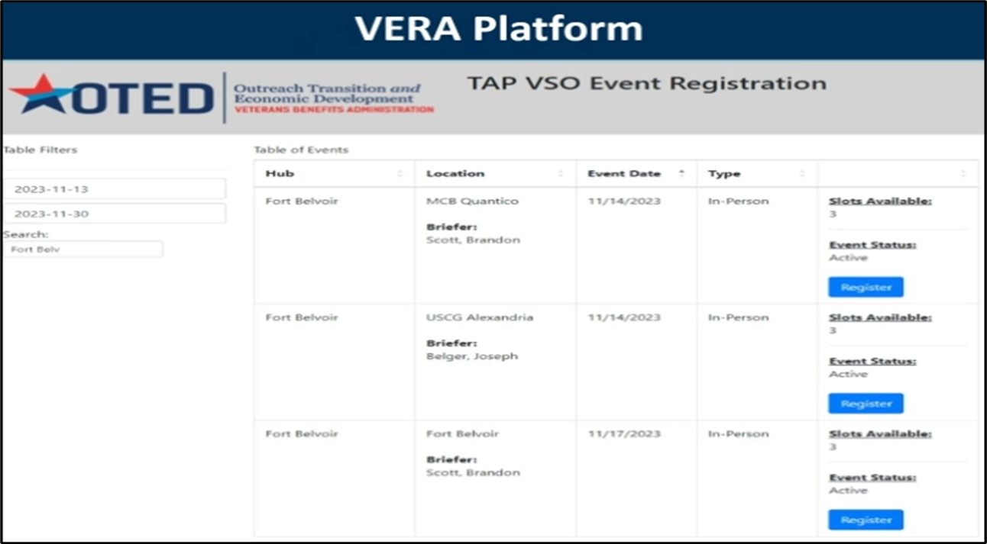
VSO Scheduling Tool

Slide 9
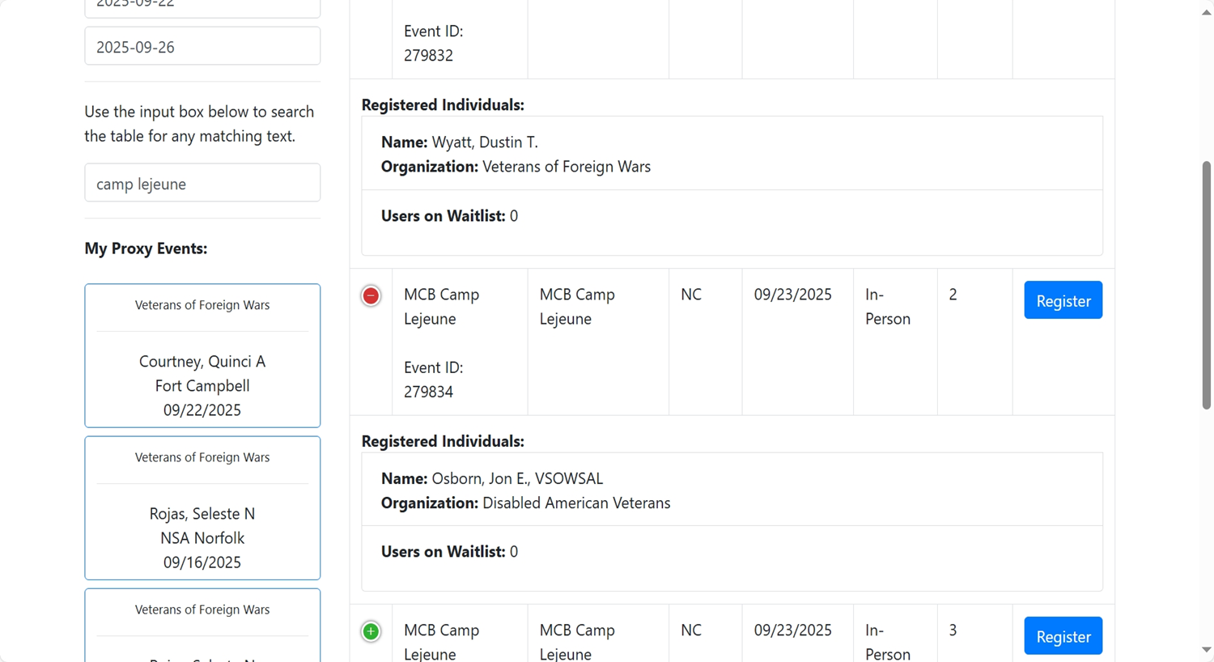
VSO Scheduling Tool

Slide 10
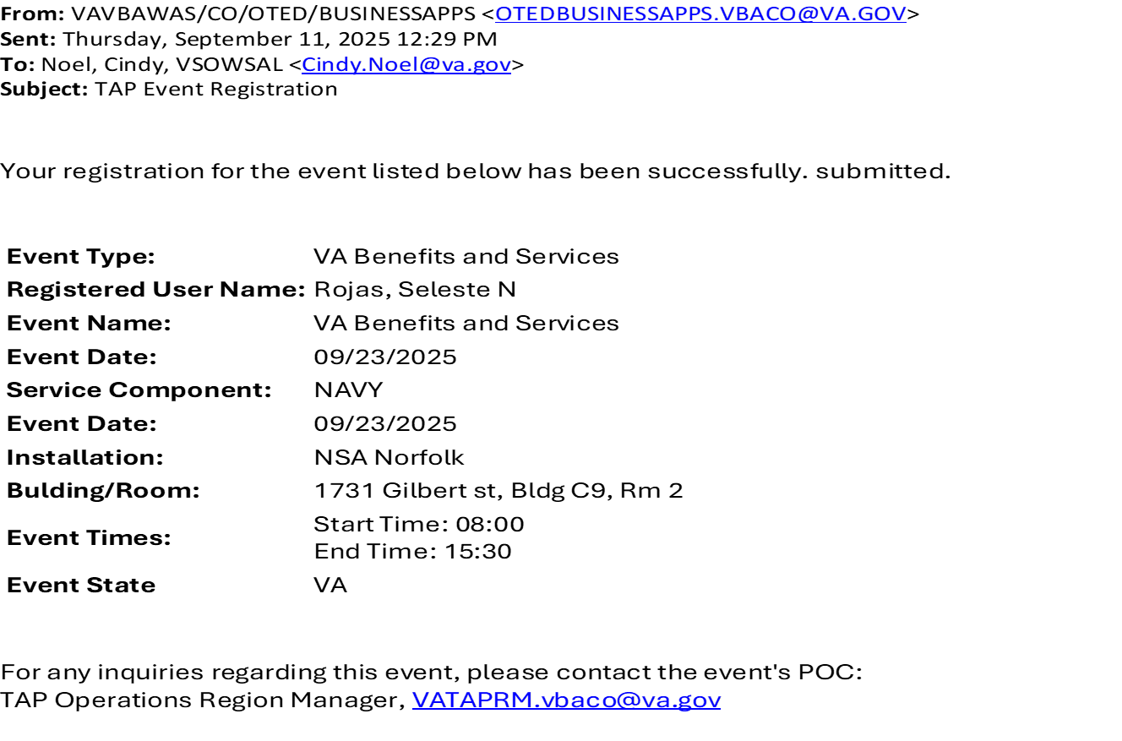
VSO Scheduling Tool

Slide 11
15-Minute Briefings
Who are you?
Where are you located?
Best way to reach you? Phone/email?
What do you do? How long?
Why file a BDD claim?
What is VA looking for in your medical records?
What to expect once claim is submitted?
What happens after rating decision?

Slide 12
Tips
Dress and Appearance
Business Casual- No jeans, shorts, t-shirts, wrinkles
You are representing the VFW organization
No Slides
Recommended:
9 mins of how to prepare for VA claim submission
6 mins of questions
This is not a membership drive

Slide 13


