Slide 1
Veterans Benefits Management System (VBMS)

Slide 2
Lesson Objectives
What is VBMS
How to gain access to VBMS
How filters work in VBMS
Navigating VBMS
The life of a claim in VBMS
VA Employees and duties in VBMS
Checking the status of a claim
Navigating VBMS and helpful tips (Live Demo)

Slide 3
What is VBMS?
The Veterans Benefits Management System (VBMS) is an electronic database that contains claims that are submitted to VA.
VBMS allows representatives to see a claim folder in real time; access includes rating decisions, exams, medical evidence, appeals correspondence with VA, and more.
Notes:
SPEND SOME TIME EXPLAINING WHAT SEP IS GOOD FOR, SUCH AS UPLOADING RECORDS, THAT YOU WOULD LIKE UPLOADED INTO VBMS FASTER.
POA REQUEST ACCEPTANCE, USEFUL FOR ASSISTING VETERANS REMOTELY – PROVIDE EXAMPLE:
EXAMPLE: ASSISTING VETERAN OVER THE PHONE, EMAIL. VETERAN CAN REQUEST POA ON EBENEFITS AND YOU ACCEPT ON SEP AND WORK CLAIM FROM THERE.

Slide 4
How to gain access to VBMS
In order for a representative to be granted access to VBMS, they must complete VA sponsored TRIP training and be issued a PIV Card.
To obtain a PIV card contact your VA Regional Office (VARO) Change Management Agent (CMA)
It is against the law for representatives to share their PIV cards with others.
If you share your PIV card it will lead to your accreditation being removed and/or legal action.

Slide 5
Logging into VBMS
To log onto VBMS you must be behind the VA Firewall. For those who are located in a VARO, this is automatic.
Remote representatives will need to use either Citrix or Cisco to connect to VA’s intranet and access VBMS. If VA imaged your laptop, you will be using Cisco, if not you will be using Citrix
Remote access must be requested from your CMA and should be done when obtaining your initial PIV Card

Slide 6
Logging into VBMS
To log into VBMS visit VBMS.VBA.VA.gov while behind the VA firewall or ask your VA IT department for assistance by having them place the VBMS Icon on your desktop.
After entering your PIV card information, you will need to enter your Station ID, which is the three-digit number of your assigned Regional office.
A complete list of all VARO station IDs can be found in the VFW-provided job aid section of the OLP Resources.

Slide 7
First time in VBMS
The first time you log into VBMS, it will take a few minutes to load as the software is loading over 1,500 claims into your All Claims Queue.
To expedite how quickly VBMS loads, you can use VBMS Filters to only show claims for veterans in your state.

Slide 8
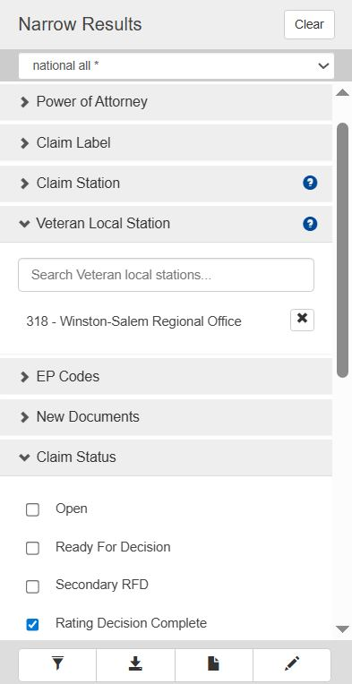
Setting up the All Claims Queue Filters
To filter the results of the All Claims Queue to only show claims in your state make sure these boxes are checked in the VBMS Column:
POA: VFW
Veteran Local Station: Your State RO
Claim Status: Rating Decision Complete

Slide 9
How filters work in VBMS
Without filters, VBMS will display all claims associated with your POA.
    Each Filter helps sort your listing into a smaller category
    More filters = Fewer results in the listing
    Only filters with an entry are in use, blank entries do nothing

Slide 10
Claim Station vs Local Station
Claim Station: The VARO that the claim has been assigned to.
Local Station: The VARO located in the area the veteran resides in.
National Work Queue: If a claim has not been assigned to a claim station, it defaults to the National Work Queue (NWQ - Claim Station 499)

Slide 11
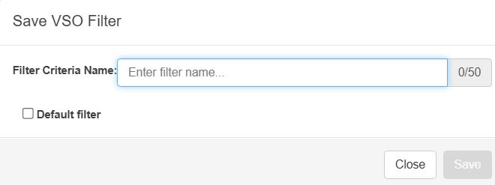
Setting up the All Claims Queue Filters
Once your filters have been added Click the “Save New Filter Button” at the bottom.
This will allow you to name the new filter and make it your Default Filter. With that option set VBMS will now display in the All Claims Queue with only the filtered results each time it is opened.

Slide 12
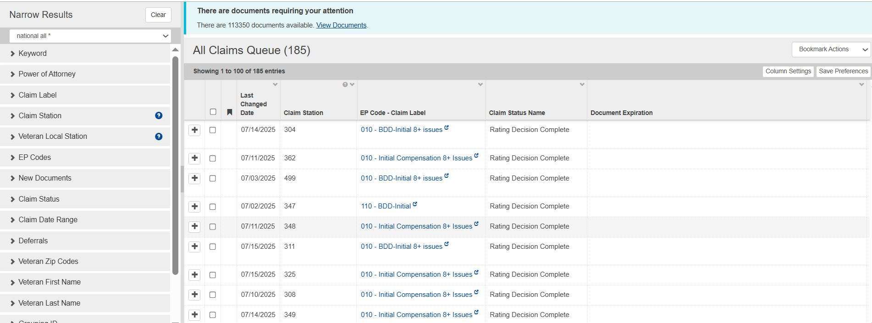
The VBMS Home Page

Slide 13
VBMS Home Page Personalization
The VBMS Home Screen can be personalized to show only columns that you want to be displayed. To edit the displayed columns click on “Column Settings to be taken to the Column Manager Screen

Slide 14
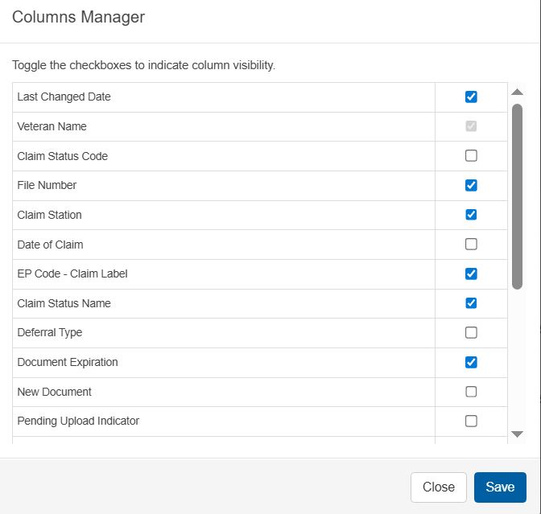
VBMS Home Page Personalization
Users now have the ability to select what columns are displayed from the Column Manager list by selecting the item and clicking save.

Slide 15

The VBMS Home Page
The Columns that users have added can be placed in whatever order the users would like by clicking and holding on the column and dragging it into position.

Slide 16
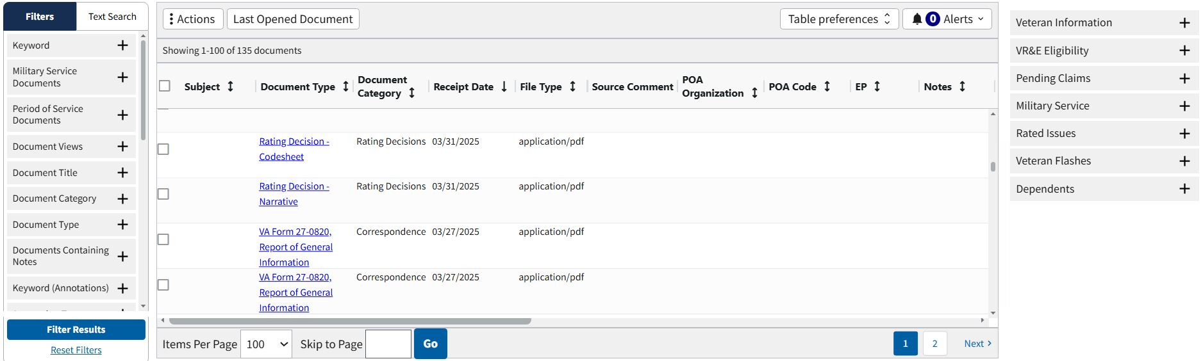
The Veteran Home Page

Slide 17
The Veteran Home Page- Searching
Users have the ability to filter the results in the Veteran’s folder by searching for Keyword of documents such as Narrative or C&P Exam.
Users can also search the contents of all documents through a Text Search by typing in a word and if it is contained in a document in the veteran’s folder it will be displayed.

Slide 18
The Veteran Home Page- Personalizing
Columns in the Veteran Folder can also be personalized by clicking on Table Preferences and dragged into position like in the VBMS Home Screen.
Clicking on the headers of a column such as the “Receipt Date” will filter all results to show the most recent or the earliest documents received into the veteran folder.

Slide 19
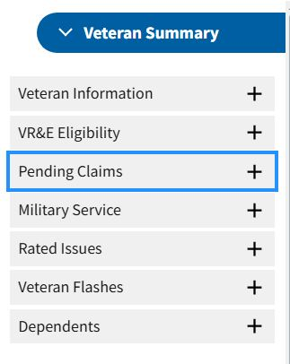
The Veteran Home Page- Extra Info
The Veteran Summary section contains an overview of useful information about the veteran’s military service, rated issues and lists any dependents claimed already.

Slide 20
The life of a claim in VBMS
The life of a claim in VBMS
Claim is submitted to VA
VA scan site in Janesville, WI receives the claim and uploads it into VBMS, this creates an End Product code (EP). This may take a few hours but can take several days or weeks
Claim and submitted evidence is uploaded into VBMS; the claim is placed in the National Work Queue (Station 499) until it is assigned to be worked at a VARO
Claim is assigned to a team who will develop the claim by soliciting evidence, requesting records, and scheduling exams. The VSR handles the development of the claim

Slide 21
The life of a claim in VBMS
The life of a claim in VBMS continued
Veteran attends C&P Exams if needed. C&P exams may be conducted by VA or a 3rd party contractor typically QTC, VES, or LHI.
Exams are reviewed by the contract examiner quality team then released to VA.
RVSR reviews the totality of the evidence and generates a rating
The rating is reviewed by a VA awards/promulgation team who activates the benefit and sends a notification letter to the veteran.

Slide 22
VA Employees and duties in VBMS
VA Employees and their responsibilities
  VSR: Developments the claim, solicits evidence, and schedules exams.
  RVSR: Reviews all evidence and determines the claim’s outcome. If your VARO allows, the RVSR is your go-to person if you have questions about a claim.
  Assistant Coach: Assistant supervisor of a team of RVSRs and VSRs. Can perform all roles of VSR and RVSR in addition to pulling ratings from other stations

Slide 23
VA Employees and duties in VBMS
VA Employees and their responsibilities
  Coach: Supervisor of a team of RVSRs and VSRs. Can perform all roles of VSR and RVSR in addition to pulling ratings from other stations
  DRO: An appeals specialist. When a Higher-Level Review is submitted, it is reviewed by a DRO. DROs are great sources of information
  CMA: Your default POC within the VA

Slide 24
Checking the Status of a Claim in VBMS
VBMS provides insight into what is happening with a veteran’s claim in multiple different ways including:
Veteran Documents to see the latest documents regarding the claim
Claim EP and its Chevrons like Contentions, Development, and Exams which show what VA is tracking and the actions they need to work on
Claim Notes showing behind the scenes actions with the claim and who the claim is currently assigned to

Slide 25
Using VBMS Documents to check Claim Status
Using VBMS Documents to check a claim status is the first step in understanding what is happening; to do this follow these steps:
Open the veteran folder in VBMS by typing in their SSN in the search bar and clicking Open eFolder
Update your Table Preferences to show Subject, Document Type, and Receipt Date
View most recent document and work backwards to understand the latest actions with the veteran’s claim and what VA is working on.
For example, if a recent document is a notification letter to the veteran asking them to send in a document regarding their claim; the claim is paused until this document is received.

Slide 26
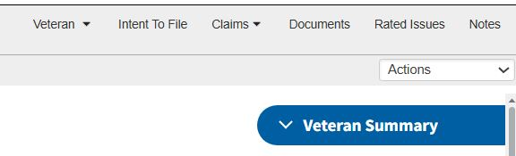
Claim EP’s and their Chevrons
At the top of the Veteran’s folder you will see tabs to different pages within the veteran folder including:
Veteran: Shows additional information such as dependents and military service
Intent to File: Shows if there is an active ITF
Claims: Shows Active EP and legacy Ep codes for the veteran’s claim

Slide 27
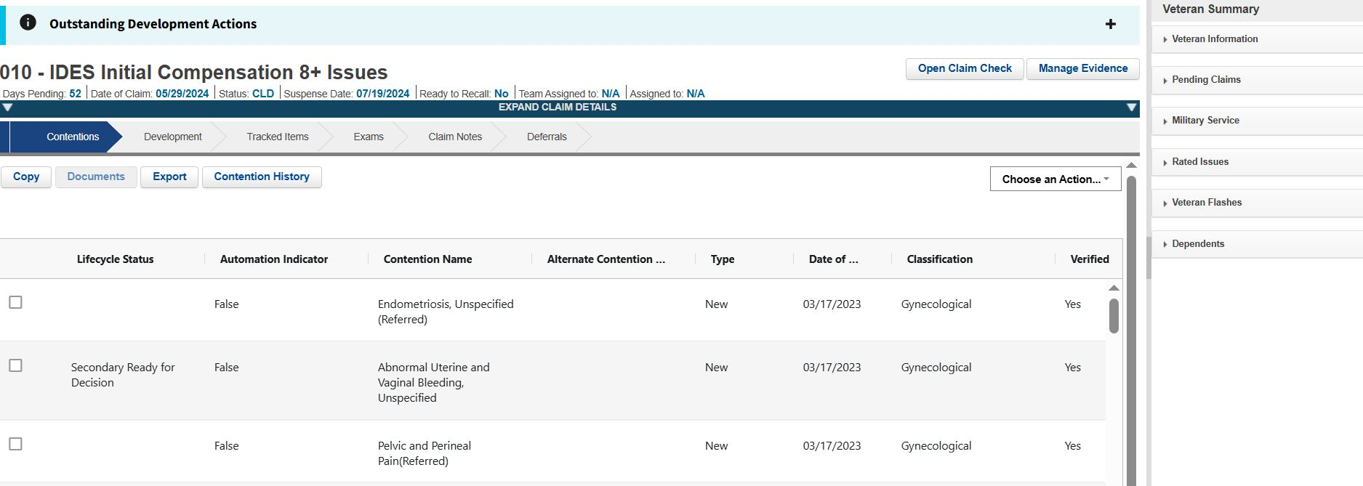
Claim EP’s and their Chevrons
Clicking on the Claims section and selecting the active EP takes the user to the claim details page as seen below:

Slide 28
Claim EP’s and their Chevrons
Each Chevron inside the Claim Detail page takes the user to that Chevron’s page within the veteran’s folder.

Slide 29
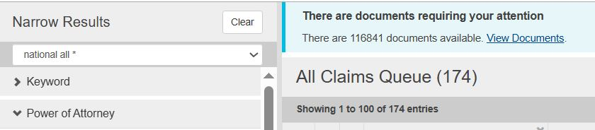
We’ve Notified your POA…
When a veteran receives a notification letter at the bottom the letter states that VA has “notified” the veteran’s VSO of their decision; this “notification” is then sent into our VSO Notification queue which can be found on the VBMS Home Screen.
Clicking on “View Documents” takes you to the VBMS Notification page.

Slide 30
The VBMS Notification Page
The Notification page displays all VFW notifications and must be filtered to show notifications only for your office.
The filtering process works the same here as it does on the main page of VBMS.

Slide 31
VBMS Notification filter Categories
VBMS Notifications filter into 6 Categories:
          Appeal
          Development
          Due Process
          General
          Notification
          Medical Records

Slide 32
VBMS Notification Filter Descriptions
Each of the six categories governs another filter called “Descriptions”
Descriptions are more refined filter results of the chosen category.
For example, the Appeal Category governs the following Descriptions/Documents:
      BVA Decision
      CAVC Decision
      Appeal Notification Letter
      BVA General
      Appeal Satisfaction Notice
A complete list of Category and Description/Documents can be found at the end of this presentation.

Slide 33
Common VBMS Filters
3 MOST COMMON FILTER SETTINGS
      Notifications
      BVA/CAVC Decisions
      Correspondences

Slide 34
VBMS Filters For Notifications
Document Status – Default is new documents
Power of Attorney – VFW
Date of Document – Date or dates you want to search
Categories – Choose Notification and Correspondence
Descriptions – Leave Blank
Local Station – This is your RO
Zip Code – Leave Blank
File number – Leave Blank
Award Station – Leave Blank
System Source – Choose VBMS and VBMS-UI
With these filters in place, the vast majority of the results will be decision letters that you can review for errors and use for reports

Slide 35
VBMS Filters For BVA/CAVC Decisions
Document Status – Default is New Documents
Power of Attorney – VFW
Date of Document – Date or dates you want to search
Categories – Leave Blank
Descriptions – Choose BVA Decision and CAVC Decision
Local Station – This is your RO
Zip Code – Leave Blank
File number – Leave Blank
Award Station – Leave Blank
System Source – Leave blank
With these filters in place, only BVA/CAVC letters will populate for review.

Slide 36
VBMS Filters For Correspondences
Document Status – Default is New Documents, Acknowledged should be reviewed as well
Power of Attorney – VFW
Date of Document upload – Date or dates you want to search
Categories – Leave blank
Descriptions – Choose correspondence
Local Station – This is your RO
Zip Code – Leave Blank
File number – Leave blank
Award Station – Leave blank
System Source – VBMS-UI
With these filters in place, you can look at letters to see if something needs to be corrected, i.e.: claim on the wrong form, missing signature

Slide 37
TVB Veteran Intake Queue
In 2025 the VFW partnered with MyVetBenefits (MVB) to allow their users to request VFW assistance with VA claims. These referrals come directly to TVB and are placed in the Veteran Intake Queue. To accept these referrals and have a TVB folder created, for the referral please follow these steps:
Step 1 From the TVB Column, go to Queues and Select Veteran Intake.
Step 2 The Veteran Intake Queue will appear and users will need to select referrals from their state

Slide 38
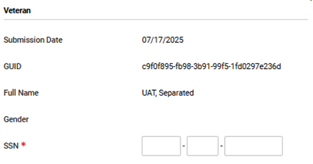
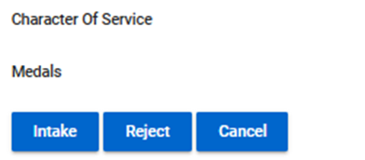
TVB Veteran Intake Queue
Step 3 Once a referral is clicked, contact will need to be made with the veteran to obtain the Required Social Security Number to complete creating the TVB
Step 4 With the SSN captured users will scroll to the bottom of the referral and click Intake

Slide 39
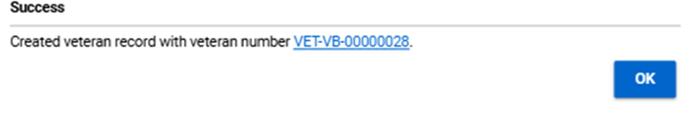
TVB Veteran Intake Queue
Step 5 Clicking Intake shows that the referral was successful and provides the user with the TVB Number for the newly created veteran folder.
Some referrals might come in from active-duty service members wanting to file a BDD claim. These referrals Are Still Handled By Your Office but are marked as BDD to provide insight into their claim needs.

Slide 40
Accredited Representative Portal
The Accredited Representative Portal (ARP) is a secure, user-friendly system that streamlines the power of attorney and claims process for representatives and the Veterans they support

Slide 41
How to set up your account
Before using the Accredited Representative Portal, you will need to set up a Login.gov account and associate it with your email on file with the VA’s Office of General Counsel (OGC). Here are instructions to walk you through this process.
Identify the email you have on file with the Office of General Counsel (OGC) If you’re unsure which email you have on file with OGC, look yourself up using the Find a Representative tool on VA.gov to see which email is on file.
Create a Login.gov account
Login.gov is a secure way to sign into many government websites using just one account. Follow the instructions on Login.gov for creating an account. Login.gov recommends that you use a personal email that you will always be able to access. However, it is also appropriate to use your work email address.

Slide 42
How to set up your account
Associate your OGC email with your Login.gov account
If you did not use your email on file with OGC as your primary email for Login.gov, you will need to add the OGC email to your account. While signed in to Login.gov, go to the account page and select “Add email address” from the menu of options under “Your Account.” Enter your OGC email address and follow the prompts to confirm the address.
Once the Accredited Representative Portal officially launches, you can sign in
Sign into the portal at va.gov/representative. If you have trouble signing in, refer to the troubleshooting section for next steps.

Slide 43
Frequently Asked Questions
Can I use ID.me instead of login.gov?
The portal does not currently support sign in using ID.me during this pilot phase. We will be adding this functionality in the future.
In the past, I used ID.me to log into SEP (Stakeholder Enterprise Portal). Will the same sign in method work for ARP?
Once we support ID.me as a sign in method, you will be able to use the same ID.me account for signing into the portal. Make sure to add your email on file with OGC to your ID.me account, either as a primary or secondary email.

Slide 44
Frequently Asked Questions
Can I use my PIV card to log into the portal?
Yes, you can set this up using Login.gov. After creating your Login.gov account and associating it with the email on file with OGC, add your PIV card as an authentication method under “Add your government employee ID”. Next time you sign in, select the “Sign in with your government ID” option on the sign in screen. In the future, we may consider adding functionality to allow direct PIV login.

Slide 45
ARP TIMELINE
September 2025 ARP Launch
Accept or decline requests for representation (VA Form 21-22) RQAS completes this for you
Submit VA Forms 21-686C/21-674 currently does not give 24-hour approval
Submit VA Form 21-526EZ

Slide 46
ARP TIMELINE
October 2025 Transition to ARP
New applications must be initiated through ARP
Requests of representation pending in SEP can be accepted or declined until early December 2025 (RQAS will handle).

Slide 47
ARP Timeline
November 2025 Decommission eBenefits
Veterans will need to use VA.gov fully by early November 2025
December 2025 Decommission SEP
Accredited representatives will need to use ARP fully by early December 2025

Slide 48
VBMS Live Demonstration
For this live Demo we will be using VBMS’s testing website which doesn’t contain PII.
In this demo we will show you:
How to set up VBMS Filters
How to set up and clear VBMS Notifications
Ways to navigate the veteran folder including VBMS Notes and Chevrons
How to check the status of the claim and who to contact if there is an issue with a claim
Tips and Tricks to VBMS
Notes:
UAT Demonstration breakdown – Instructor notes
Be logged in prior to streaming
Set default filter to all, show my filters already set up and how to create a new filter
Depending on UAT we also show VBMS Notification filter process.
We look at documents and show how to filter with them using the keyword filter.
We cover the banner tabs Veteran, Intent To File, Claims Documents Related Issues Notes
Under Claims we also show “Include Inactive” to view legacy claims. Click claim EP to take you into the claims folder.
Go over Contentions, Development Tracked Items, Exams, and Claim Note Chevrons
Claim Notes & Claim Status & Who you gonna call! RSVR!
Questions and freestyle demo

Slide 49
All Description/ Document types and Categories
Description/ Document Type | Category
BVA Decision | Appeal
CAVC Decision | Appeal
Appeal Notification Letter | Appeal
BVA- General Correspondence | Appeal
Appeal Satisfaction Notice | Appeal
MAP-D Development Letter | Development
Standard 5103 Notice | Development
Custom 5103 Notice | Development
Subsequent Development Letter | Development
Federal Third-Party Reserve or Guard Unit Records | Development
Federal Letter PTSD Request of Vet Center Records | Development
Federal Letter PTSD Obtain Investigative Reports | Development
Federal Letter PTSD diagnosed, Confirm Stressor, to MC | Development
Initial Private 3rd Party Letter | Development

Slide 50
All Description/ Document types and Categories
Description/ Document Type | Category
Informal Claim Letter | Development
Initial Private 3rd Party Letter, 21-4192 | Development
Final Attempt Letter | Development
Request final hospitalization and autopsy findings | Development
Request report of accident investigation- CPD | Development
Public Record- request for certified copy | Development
Prison Development- 21-4193 Needed | Development
1151 Development to VAMC | Development
IDES Return to Duty Letter | Due Process
Proposed Incompetency Letter | Due Process
Proposal to Reduce Service-Connected Compensation | Due Process
Proposal to Reduce Failure to Report for an Exam Letter | Due Process
Proposal to Reduce School Child Verification Letter | Due Process
Character of Discharge Letter | Due Process

Slide 51
All Description/ Document types and Categories
Description/ Document Type | Category
Drill Pay Letter | Development
Proposal to Reduce Failure to Submit Dependency Questionnaire | Development
DIC Dep Questionnaire not submitted | Development
Proposal to Reduce Pension Claimant in Medicaid Approved Nursing Home | Development
Apportionment Notice to Claimant | Development
Apportionment Notice to Veteran | Development
Proposal to Remove A&A, Discharge from Nursing Home | Development
Proposal to Reduce improved Pension, Claimant in Domiciliary/Nursing Home | Development
Proposal to Reduce Claimant No Longer P&T | Due Process
Proposal to Stop A/A for VAMC Admission and Restore | Due Process
Proposal to Stop A/A for VAMC Admission and Reduce for Domiciliary/Nursing Home | Due Process

Slide 52
All Description/ Document types and Categories
Description/ Document Type | Category
Correspondence | General
Returned Mail | General
Apportionment Decision | Notification
Notification Letter e.g. VA 20-8993, VA 21-0290, PCGL | Notification
Burial Letter | Notification
C&P Exam | Medical Records
Exam Request | Medical Records
VA 21-2507a Request for Physical Examination | Medical Records

Slide 53
2025 Skill Level Training Conference: VBMS
Please scan the QR Code or click on the link below to take an anonymous survey about your experience during the 2025 Skill Level Training Conference.
https://www.research.net/r/DNVCZ5Poutdated

