Slide 1
VA Debt Management Center (DMC)
Veterans Service Organization Presentation
VFW 2025

Slide 2
Agenda
DMC overview
Debt establishment
Collection process
Debt resolution options
Risks of non-payment
Contact Information
Questions

Slide 3
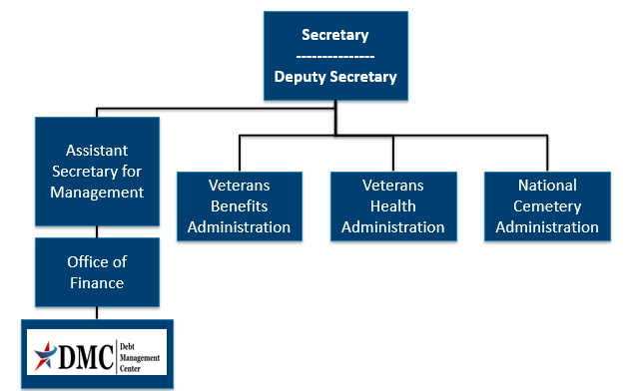
Organization Chart

Slide 4
DMC Mission
Provide distinctive, high quality accounts receivable services through a compassionate and value-added approach, empowering our stakeholders to focus on core missions.

Slide 5
Debt Establishment
Regional Office (RO)/Regional Processing Office (RPO) Receives information
RO/RPO Processes Claim/Award
DMC Collects Debts
Sends collection letters for debts
Sends a letter when payments are issued or debt created
Processes collection actions
Evaluates eligibility/ entitlement
Issues payments and establishes debts
Education Certification
Change in circumstances affecting benefit eligibility or entitlement

Slide 6
Debt Establishment
Compensation/ Pension
Changes in income or net worth
Active-duty time or drill pay days
Education
Withdrawal from class
Not attending class
Change in dependency
Payments issued after death of beneficiary
Class did not count toward graduation
Change in active-duty status
Fugitive felon status or incarceration

Slide 7
Collection Process
DMC sends Notice of Indebtedness letters, monitors accounts, and advises debtor of any delinquency, including the requirement to refer their account to Treasury
DMC Sends 1st Letter
30 or 90 days
DMC Sends 2nd Letter
30 days
DMC Sends 3rd Letter
If DMC receives payment, next collection letter is deferred
Debt is Referred to Cross Servicing
60 days
Debt is Referred to Treasury Offset Program
60 days

Slide 8
Update to Education Debt Identification
DMC transitioned from using VA File Number or SSN to a debt specific Receivable ID to improve security effective August 4th, 2025
For all education debts, Receivable ID will be required instead of File number on pay.va.gov
If a student needs assistance identifying their Receivable ID:
Visit the Debt Portal at www.va.gov/manage-va-debt and go to “more details” to find the Receivable ID
Send a message to https://ask.va.gov/
Call 1-800-827-0648 (6:30 a.m. to 6 p.m. CT Monday through Friday) to ask a debt counselor

Slide 9
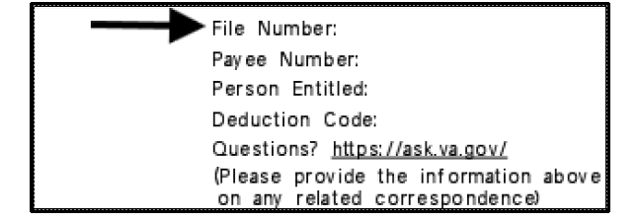
Update to Education Debt Identification
The Receivable ID will be viewable on education letters in the current file number field on the top right of the page Although the number will now be the Receivable ID, the letter will still say “File Number”. You will know it is a Receivable ID if the entire number is visible. Previously listed file numbers only show the last 4-digits.

Slide 10
Relief, Resolution, and Referrals
DMC sends Debt Notice
Debtor contacts DMC
· Pay In Full
· Benefits Offset in Full or Part
· Payment plan
· Compromise
· Waiver/Waiver Reconsideration
· Dispute
· Temporary Suspension
No Action/Payment
· Benefits offset in Full
· Referral to:
- TOP
- Cross-Servicing

Slide 11
FAQ: What makes a “good” waiver request?
Answer: There is no formula to guarantee the outcome of a waiver. Here are some things to bear in mind:
Indication of fraud, misrepresentation, or bad faith precludes granting of a waiver (See 38 U.S.C 5302(c) )
Request should explain facts and circumstances to enable the committee to consider the standards of equity and good conscience (see 38 C.F.R 1.965 for more details ):
- fault of debtor - balance of faults
- undue hardship - defeat the purpose
- unjust enrichment - changing position to one’s detriment
An accurate VA Form 5655 Financial Status Report facilitates evaluation of financial hardship

Slide 12
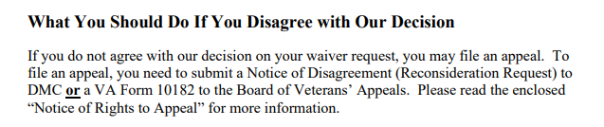
FAQ: How to Appeal a Waiver Decision ?
Language from Committee on Waivers and Compromises (COWC) letter:
*** Veterans should not use VA form 10182, 20-0996, or 20-0995 to appeal a waiver decision with DMC***

Slide 13
Appealing a Waiver Decision continued
Send to | Form to use | Info to include | Reviewed by | Stops collection?
DMC | None- request must be in writing | Indicate request is for reconsideration of waiver decision, include support for reconsideration | COWC | No
BVA | VA Form 10182 | Complete form including signature | Board of Veterans Appeals | No

Slide 14
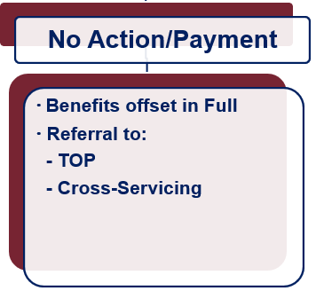
What if Payment is not Made?
Future VA benefits awarded will be withheld to satisfy debt
Department of Treasury
Offset of Federal payments
Referral to private collection agencies
Administrative Wage Garnishment Program

Slide 15
VA Debt Portal for Veterans
Debt Portal: https://www.va.gov/manage-va-debt/
Veterans can log in to view balances
FAQ’s
Email notifications to Veterans
Online VA Form 5655 Financial Status Report (FSR) with “wizard”
Online Dispute
More enhancements to come

Slide 16
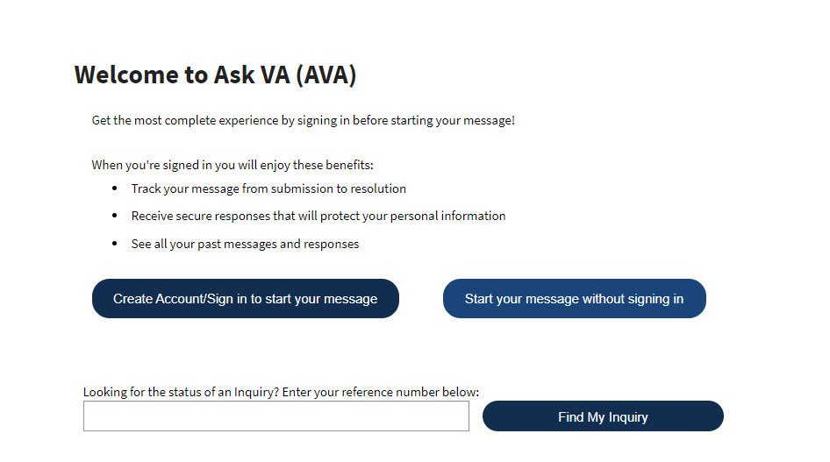
Ask VA (AVA)- DMC Tips
Located at https://www.va.gov/contact-us/ask-va/

Slide 17
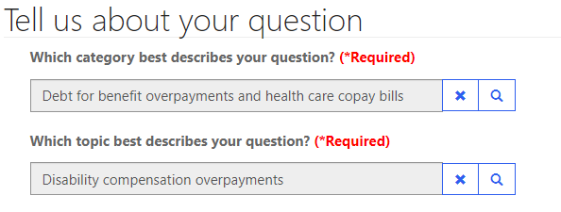
AVA- DMC Tips
Options to reach DMC are found under “Debt for benefit overpayments and health care copay bills” category and topics are used to select the type of debt for proper routing

Slide 18
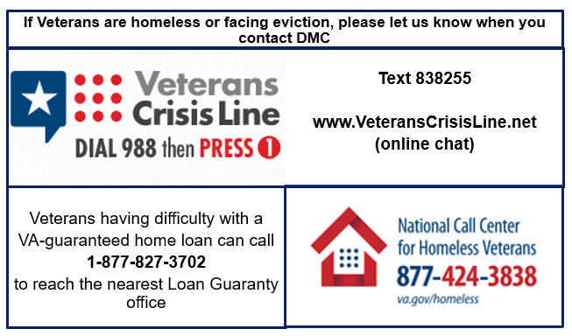
At Risk Veterans

Slide 19

Become a Debt Superstar (Contact DMC)
https://www.va.gov/manage-va-debt/ | Veteran Debt Portal
https://ask.va.gov | Online inquiry system
800-827-0648 | DMC Veteran Toll Free Line
612-970-5688 | Fax
844-261-6570 | DMC VSO Only Line

Slide 20
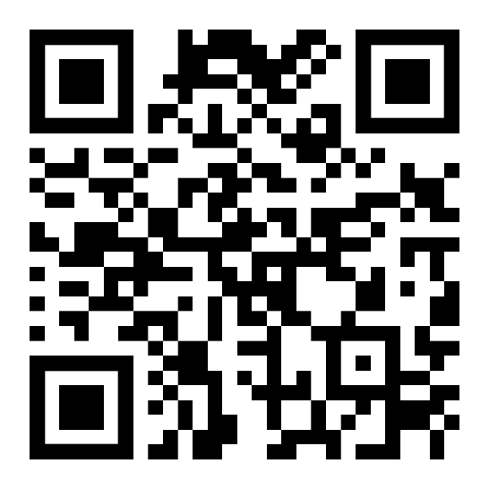
DMC Presentation Survey
DMC values your time and feedback on our presentation. We would appreciate it if you’re able to complete the survey below.
https://www.surveymonkey.com/r/DMCVSO

Slide 21
Additional Information

Slide 22
Pay in Full
Pay by check: mail the check, payment coupon(s) and/or letter to:
VA Debt Management Center
Bishop Henry Whipple Federal Building
P.O. Box 11930
St. Paul, MN 55111-0930
Pay online: www.pay.va.gov
Pay by telephone: 800-827-0648

Slide 23
Withholding VA Benefits
Automatic 36-month repayment plan for compensation and pension debts
Automated benefit offset for education debts
If debtors have financial hardship, please have them contact DMC
VA Form 5655, Financial Status Report, is required for any reduced withholding arrangement beyond 60 months

Slide 24
Compromise
Debtors should send letter to DMC indicating “compromise offer” and specifying amount
Offer should be a “lump sum”
Offer must include VA Form 5655
DMC refers offers to the Committee on Compromises
*** Payment should not be sent until the debtor receives a decision accepting the offer***

Slide 25
Waiver
Debtors have one year from date of first DMC debt letter to request waiver
Request must be:
Made in writing and submitted to DMC
Include VA Form 5655 Financial Status Report
Explain why debtor is unable to repay the debt
Received in the first 30 days for Education or 90 days for C&P debt to stop collection action

Slide 26
Dispute
Debtors can dispute the existence or amount of the debt created by VBA
Dispute must be in writing
DMC forwards disputes to the Regional Office/Regional Processing Office of jurisdiction
Veterans can now submit through online debt portal

Slide 27
Temporary Suspension
Disaster Relief
Case by case financial hardship
Does not extend timeline to request waiver

Slide 28
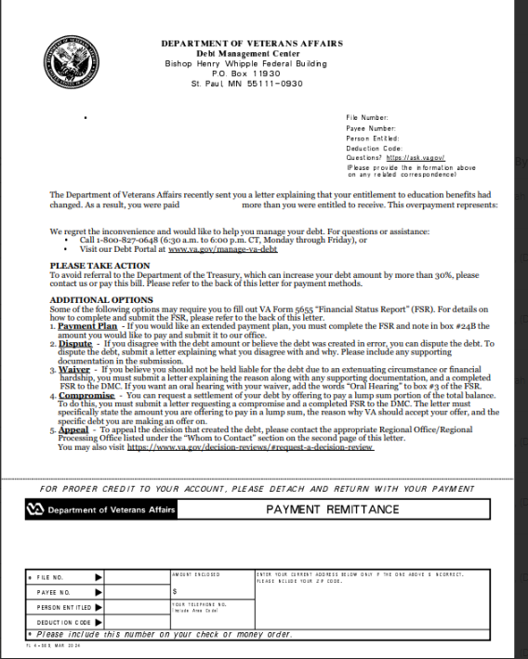
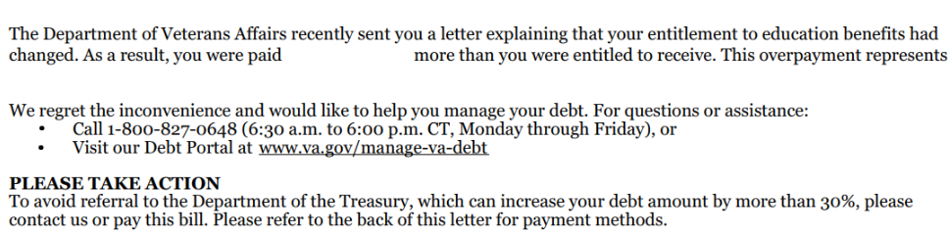
Letter Example: No Automated Plan

Slide 29
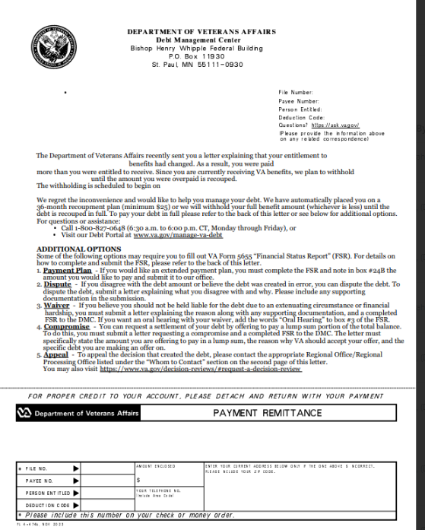
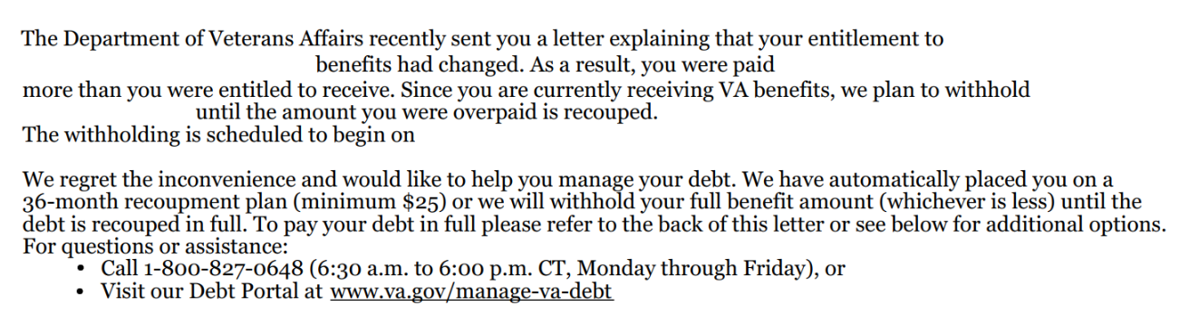
Letter Example: Automatic 36 month

Slide 30
FAQ: What happens when a debtor dies?
Answer: DMC reviews the account and may request funds from the debtor’s estate. Some things to bear in mind:
VA does not prorate monthly benefits when someone dies, so the payment for the month of death often creates a debt
Surviving spouses may be eligible for a month of death benefit, and if eligible that payment must be issued to the surviving spouse by VA, they cannot keep a payment VA issued to their deceased spouse. The Regional Office handles issuing month of death payments for eligible surviving spouses
Unless there is fraud, VA does not pursue collection from a specific individual, but rather from the estate of the deceased debtor

Slide 31
VHA Debts
For questions about medical care and pharmacy services copayment debt, contact the Health Resource Center:
1-866-400-1238
VA has options for Veterans who suffer from difficult financial circumstances and struggle to pay VA copayments:
Health Resource Center: 1-866-400-1238
https://www.va.gov/COMMUNITYCARE/revenue_ops/Financial_Hardship.asp

Slide 32
Federal Debt Collection Laws
The Debt Collection Act of 1982
Authority for collection by administrative offset
The Debt Collection Improvement Act (DCIA) of 1996
Agencies required to refer delinquent non-tax debts to the Department of Treasury at 180 days
Digital Accountability and Transparency Act (DATA) of 2014
Changed referral requirement for delinquent non-tax debts from 180 days to 120 days

