Slide 1
Veteran Communication

Slide 2
What’s to come
3 Basic parts to all communication
Tips to ensure clear communication
The storytelling veteran…
The emotional veteran
Setting boundaries
Following up with the veteran

Slide 3
You can always tell a veteran…. You just can’t tell them much…..

Slide 4
3 Basic parts to all communication
The sender of the information
Generally, the accredited representative for our purposes
The message to be sent
Processes (Claims, Appeals, Reviews, etc)
Background
Evidence needs
The receiver of the information
The veteran or spouse or both….

Slide 5
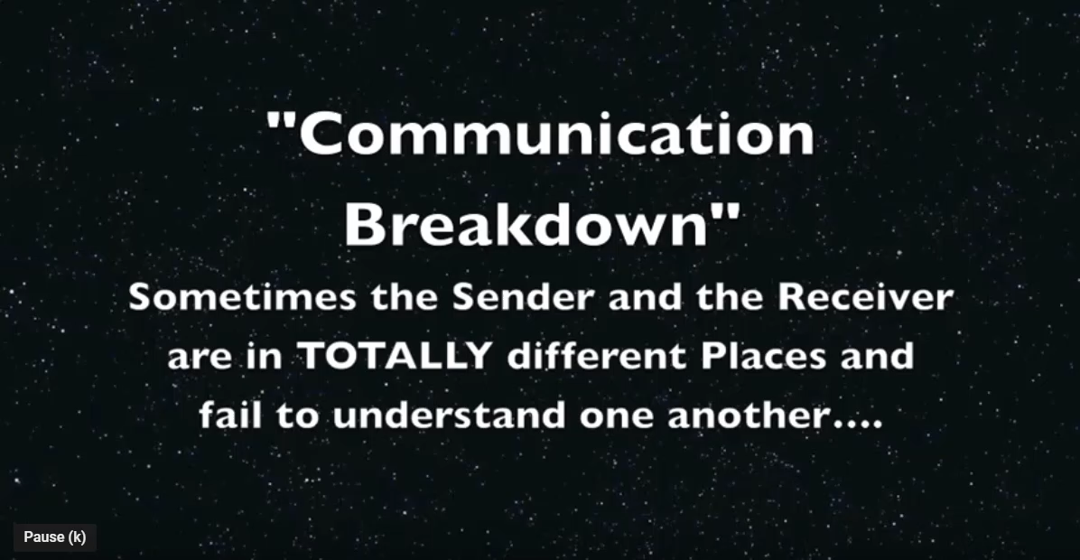
Communicating with Veterans
https://www.youtube.com/watch?v=7di5zAMMxaI&t=46s

Slide 6
Tips to clear communication
Assume nothing about the person sitting across from you, other than he/she served in the United States military.
Spouse may or may not have any grasp of the military or the VA.
Unknown factors can include:
Innate intellectual level (were they Army…..)
Level of education
Cultural/regional/religious differences
Background and life experiences

Slide 7
Tips for clear communication
Be precise
Give examples
Be careful about using acronyms (e.g., DIC, VSO, etc.)
Be careful about using pronouns that have no reference (e.g., “he” said, “they” don’t want you to do this or that, etc.).
Does the client exhibit non-verbal behavior that suggests he/she is puzzled or confused?

Slide 8
Tips for clear communication
What is the method of communication? (Phone, Zoom, In-Person)
Different methods have different challenges
Know your goal for the meeting/session
At the beginning of the session, provide a brief outline of the agenda. (e.g., Today I thought we could go over your written trauma account and then check to make sure you covered all the criteria and information asked for.)
Review relevant policies
Be organized; have handouts and other written material available, or know where to access the material on the internet for easy distribution.
Bookmarking common websites (PACT Act, Agent Orange, Pension, ECFR)

Slide 9
Tips for clear communication
*** Ensure meetings/sessions are not too lengthy. The average person’s attention span is seconds to minutes, not hours.
***Discussing emotionally-laden material can add to a person’s level of fatigue and distractibility.

Slide 10
Tips to ensure receiver understands
This is harder to do because the sender (that’s you!) has much less control over how the receiver (that’s the other guy or gal) interprets what you say

Slide 11
Tips to ensure receiver understands
Be a good listener!!!!!!!
We have to allow the veteran/spouse/family member to talk
Notice his/her body language and facial expressions
Have him/her summarize what he/she just heard you say
Encourage him/her to ask questions

Slide 12
Chatty veterans
Try to steer conversation back to topic at hand
Look for natural breaks in the story to bring it back on track
Ask more closed-ended questions (yes or no)
Remind the veteran of time constraints
Re-direct veteran/spouse or family member to topic and re-direct again and again
Comment on the process in the room
e.g., you seem to have a lot to talk about today, but unless we stay on track, we won’t accomplish our goal

Slide 13
Emotional veteran or others
Identify what the emotion is from
PTSD
Death of the veteran
Frustration with VA or the situation
Others
Descalate
Calm yourself
Lower your voice/use non-threatening tone
Encourage veteran to take a slow, deep breath
Remind yourself to take a slow, deep breath
Offer a break to the veteran
Offer to re-schedule
Offer yourself a break!!

Slide 14
Setting boundaries
VSOs, DSOs, Claims Consultants, and Accredited Representatives are not there for anyone to mistreat or walk all over.
NVS Policy and procedure provides guidance on what is and what is not acceptable conduct.
Revocation of POA is possible; DSO can revoke if warranted
Contact your RQAS for clarification on procedures to revoke
Tough love may be required with any of our clients and should be utilized with tact and empathy.

Slide 15
Setting boundaries
Manage expectations
Provide realistic timelines for contact
Explain when the veteran may hear from a VFW representative again.
Set the veteran/client up for success by explaining what to expect next
Letters from VA (Claim has been filed, ITF acknowledgement, Development letters)
Contracted exams (Possible names of vendors, methods of contact, what happens if they don’t report)
Other examples?

Slide 16
Following up with the veteran
When should an accredited representative reach out?
How often?
Depends in many cases on the client load and availability
How much is too much…?
If a veteran calls, can you email them instead of calling back?
Is the client computer savvy?
Can the question be answered effectively via email?
Will this satisfy the veteran?

Slide 17
Final thoughts
Communication is key to the success of our veterans and their families
Remember to listen as well as talk
Boundaries are important!
Taking a few minutes early in the process to explain what to expect can save you hours down the road

Slide 18
QUESTIONS?

