Slide 1
What’s New at VA?

Slide 2


Introduction
Crystal M. Trulove
crystal.trulove@gmail.com
Air Force
Weather Specialist
NOAA/National Weather Service
Weather Forecaster
Brandeis University
Department of Veterans Affairs
RVSR (Rating Veteran Service Representative)
DRO (Decision Review Officer)
Veterans of Foreign Wars
Notes:
VFW since 2019

Slide 3
Course Objectives
You will leave with a better understanding of:
Recent updates to M21-1
Six new court cases
Where to find more Rudisill GI Bill information
Definitions of legal terms (fun!)

Slide 4
Court Cases
Rudisill v McDonough update
Perkins v Collins
Loomis v Collins
Adams v Collins
Bilharz & Pinto, Jr. v Collins
Bufkin (& Thornton) v Collins
Frantzis v McDonough
Saunders v Wilkie
Allen v Brown

Slide 5
URL links and M21-1 References
https://benefits.va.gov/GIBILL/rudisill.asp
https://benefits.va.gov/GIBILL/rudisill-decision-tree.asp
https://www.va.gov/education/about-gi-bill-benefits/post-9-11/
M21-1 XI.ii.3.B.1.c. – Substitution for DIC with PACT Act
M21-1 XI.ii.3.A.1.b. – Accrued benefits for DIC with PACT Act
M21-1 X.i.2.A.2.a., g. – 21P-530EZ added to FDC and notice

Slide 6
Update to DIC substitution claim
M21-1 (XI.ii.3.B.1.c) A claimant seeking substitution may only continue a claim for Dependency and Indemnity Compensation (DIC) reevaluation under Section 204 of Public Law (PL) 117-168, Sergeant First Class Heath Robinson Honoring our Promise to Address Comprehensive Toxics (PACT) Act of 2022 if an election for reevaluation of a previously denied DIC claim was pending at the time of the original claimant’s death.

Slide 7
Update to DIC accrued claims
M21-1 (XI.ii.3.A.1.b) A claimant seeking accrued benefits or substitution may only continue a claim for Dependency and Indemnity Compensation (DIC) reevaluation under Section 204 of Public Law (PL) 117-168, Sergeant First Class Heath Robinson Honoring our Promise to Address Comprehensive Toxics (PACT) Act of 2022 if an election for reevaluation of a previously denied DIC claim was pending at the time of the original claimant’s death.

Slide 8
Updates to VA Form 21P-530EZ
M21-1 X.i.2.A.2.a. Adds the form 21P-530EZ, Application for Burial Benefits (Under 38 U.S.C. Chapter 23) to list of forms used to participate in the Fully Developed Program.
M21-1 X.i.2.A.2.g. The form includes 38 U.S.C. 5103 notice for claims for the following burial benefits:
Non-service connected burial allowance
Service connected burial allowance
Plot or internment allowance
Transportation benefit, and
Burial benefits for the unclaimed remains of a veteran

Slide 9
Rudisill v McDonough
Updates – BUT only until they hear about Perkins
April 16, 2024 Rudisill v McDonough SCOTUS
Veterans who qualify for both Montgomery GI Bill and Post 9/11 GI Bill can use both
Must have sufficient length of service and not use time twice
Additional 12 months granted for total of 48 months
Vet chooses how and when to use benefits (36 month limit)
January 3, 2025 VA updated process
VA will automatically adjudicate claims for 660,000
Remaining Veterans will receive a letter to file a claim
Notes:
Kyle’s class is going to cover education in more detail, for another opportunity to ask questions!

Slide 10

Rudisill v McDonough
That is a rude seal

Slide 11
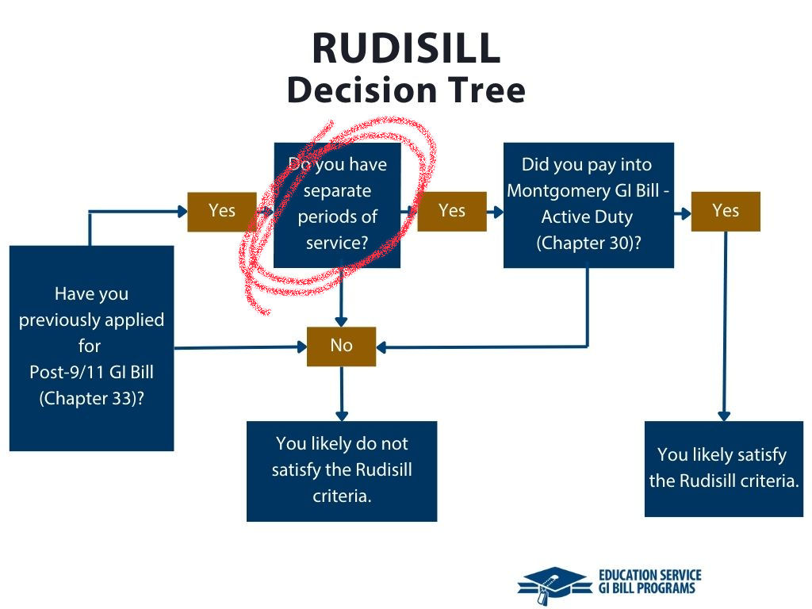

Rudisill v McDonough
Rudisill Webpage
https://benefits.va.gov/GIBILL/rudisill.asp
Rudisill Decision Tree
https://benefits.va.gov/GIBILL/rudisill-decision-tree.asp

Slide 12
Perkins v Collins CAVC May 16, 2025
All that Rudisill gave us, but more
Question: Does the opportunity to use 48 months of education benefits (see slide 9) apply to veterans who had only one period of service?
Answer: Yes. A veteran whose single period of service is long enough to qualify for both is entitled to both.

Slide 13
Perkins v Collins CAVC May 16, 2025
AIR FORCE
Perkins served in the Air Force from 2014 to 2020
Veteran argues that these six years entitle her to both the Montgomery GI Bill and to the Post 9/11 GI Bill
VA said yes, but only 36 months of educational benefits, and she must choose one
CAVC used Rudisill as a guide and found that Perkins’ period of service was long enough
A person must serve 2 years honorably to qualify for Montgomery GI Bill, and a person must serve 3 years honorably to qualify for the Post 9/11 GI Bill
The same years cannot be used to support both benefits

Slide 14
Perkins v Collins CAVC May 16, 2025
VA argued that entitlement to Montgomery GI Bill benefits was no longer allowed for any veteran whose service began after August 1, 2011
CAVC found that 38 USC 3322(h)(1) does not state that veterans no longer can earn the Montgomery GI Bill
August 1, 2011 is the date that 38 USC 3322(h)(1) became effective
This regulation states that an individual cannot receive double credit for a single period of service

Slide 15
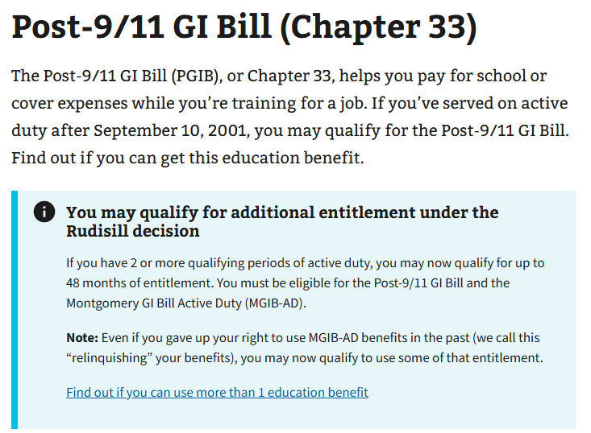
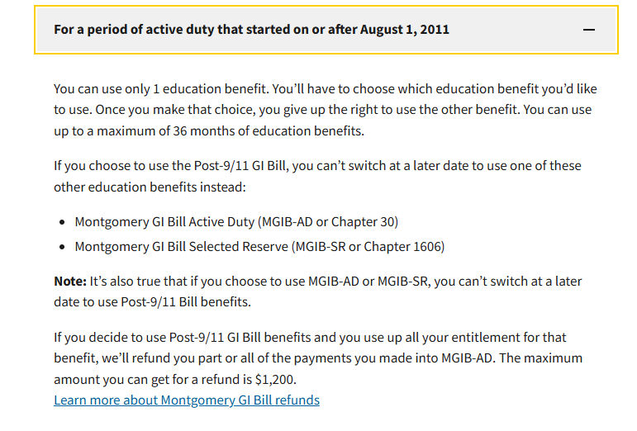
Perkins v Collins CAVC May 16, 2025
VA must update website information.

Slide 16

Perkins v Collins CAVC May 16, 2025
That is a perky, educated seal

Slide 17
Loomis v Collins CAVC July 15, 2025
Some educational benefits are treated differently
Question: Does a private flight training school need to meet criteria to be considered an Institute of Higher Learning before a student can receive GI Bill benefits for attending?
Answer: Yes. The veteran must prove flight training is part of a degree program or it cannot be covered by GI Bill benefits.

Slide 18
Loomis v Collins CAVC July 15, 2025
Loomis served 20 years in AF as JTAC on ground
Now employed by a civilian company with a very similar position offered – but requires pilot's license
VA laws governing GI Bill assistance for flight training
Must be approved by a State or by VA
Otherwise, if FAA accredited, can be constructively approved
Loomis chose the latter
Veteran not interested in degree program
College courses offered during daytime work hours
Notes:
JTAC – Joint Terminal Attack Controller

Slide 19
Loomis v Collins CAVC July 15, 2025
VA argued that law governing this exception applies only to students who already have a pilot’s license
For additional certification, like commercial license
VA states that without a pilot’s license already, then the training must be given by IHL for degree credit
Loomis argued that makes the guidance redundant
CAVC agrees with VA – the law is clear
Notes:
IHL – Institute of Higher Learning

Slide 20
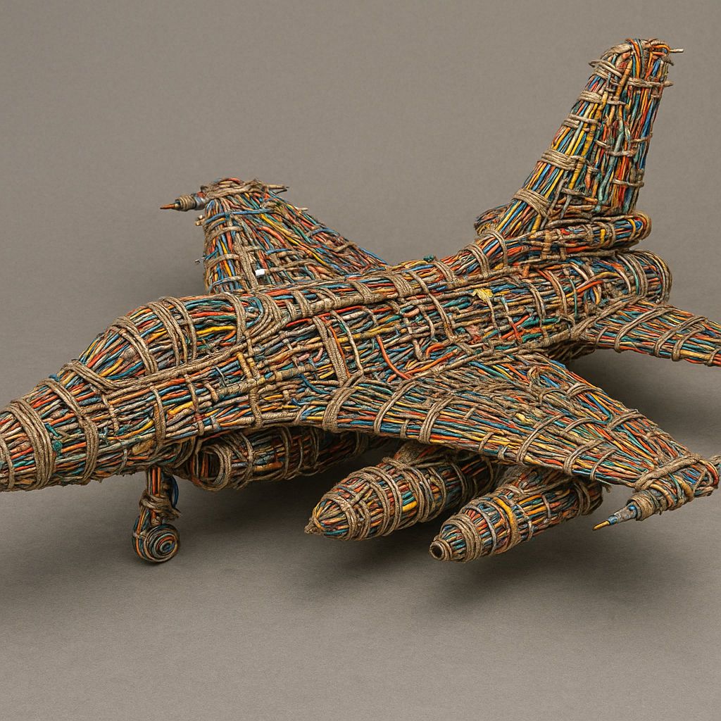
Loomis v Collins CAVC July 15, 2025
A wire loom, more commonly known today as a wiring harness, is a bundle of electrical cables and wires that transmits power, signals, and data throughout an aircraft to connect and control systems like engines, landing gear, and communications.

Slide 21
Adams v Collins CAVC July 8, 2025
A case with potentially wide impact
Question: Does obesity need to be a disability or disease in order to be subject to secondary service connection?
Answer: No. Entitlement to secondary service connection requires only functional impairment of earning capacity resulting from the service connected disease or injury.

Slide 22
Adams v Collins CAVC July 8, 2025
Adams served in the Air Force in the Vietnam Era
SC for PTSD and claims obesity secondary
Veteran had weight gain from 125 to 230 on active duty
Current BMI of 38 results in functional impairment due to fatigability, core weakness and postural changes
Veteran argues that, similar to the case of Saunders v Wilkie wherein pain can be a disability if it causes functional impairment, so too should be obesity
Notes:
BMI – body mass index

Slide 23
Adams v Collins CAVC July 8, 2025
VA relies on historical treatment of obesity
Not a disease or disability, therefore doesn’t qualify
Does not cause functional impairment for everyone
CAVC find this is a “but-for” case, i.e. aggravation
Natural progression of a non-SC condition, but would have been less severe were it not for the SC disability
Allen v Brown (1995) decided that any additional impairment resulting from an already SC disability shall be compensated, whether or not the additional impairment is itself a separate disease or injury
Notes:
SC – service connected

Slide 24

Adams v Collins CAVC July 8, 2025
Morticia and Gomez have a chance for service connection on a secondary basis.

Slide 25
Bilharz & Pinto v Collins CAVC August 14, 2025
The Pope is still with us
Question: Under AMA, is it a failure of fair process or due process if the Board judge who held the hearing is not the judge who makes the next decision?
Answer: No. Neither the Due Process Clause nor the fair process doctrine (if different) categorically prohibits the practice of having different Board members conduct a hearing and render a decision on a claim for benefits.
Notes:
AMA – Appeals Modernization Act

Slide 26
Bilharz & Pinto v Collins CAVC August 14, 2025
Bilharz served in Marine Corps and Pinto, Jr. served in the Army
Both claims argue BVA judges who preside over hearings must also be the judges who make the next decision
Both appeals are in the AMA system, not legacy
With AMA, judges can be different
change was upheld in Frantzis v McDonough
Claimants ask that both “fair process doctrine” and “Due Process Clause” be considered separately
These are basically the same

Slide 27
Bilharz & Pinto v Collins CAVC August 14, 2025
Claimants feel that Board member’s role in a hearing is greater than simply collecting evidence, and that these interactions inform the final decision:
evaluate credibility
clarify factual ambiguities
focus on testimony
A decision made by a different person, they argue, fails to afford adjudicatory consistency and transparency
At the least, VA should alert veterans and allow the veteran to submit additional evidence

Slide 28
Bilharz & Pinto v Collins CAVC August 14, 2025
In response, the VA Secretary recalls Frantzis
Fulfilling all lawful obligations
Avoid unnecessary burden to adjudication process and lead to inconsistencies in procedure and timing
CAVC found in VA’s favor on this point, stating that appellants’ challenge is without merit.
CAVC remanded for unrelated reasons
Bilharz denial had incomplete rationale
Pinto, Jr. denial relied on inadequate hearing
Notes:
You can still use this case to support these very common VA failures: inadequate rationale in explanation of denial, and a hearing that does not follow guidance to protect veteran

Slide 29

Bilharz & Pinto v Collins CAVC August 14, 2025
Bill the Horse Pony with a Pinto Pony
Two ponies but they only want one judge
Notes:
Happy Birthday Bilbo and Frodo!

Slide 30
Bufkin v Collins SCOTUS March 5, 2025
Let’s practice some legal terminology
Question: Does the benefit-of-the-doubt rule require a de novo review to determine “approximate balance?” In other words, is it a legal or factual obligation?
Answer: “Approximate balance” of evidence is a factual determination reviewed only for clear error, and thus does not require de novo review.
(Claimant Norman Thornton, also included)

Slide 31
Bufkin v Collins SCOTUS March 5, 2025
Benefit-of-the-doubt rule
Tips the scales in a veteran’s favor when evidence material to a disability claim is in equipoise, or approximate balance
Approximate balance (also know as equipoise)
whenever there is an approximate balance of positive and negative evidence
Legal v Factual determination
Legal is an issue about the correct application of law, typically decided by a judge
Factual is an issue based on evidence, typically decided by a jury. In VA benefits claims, anyone trained to review the file

Slide 32
Bufkin v Collins SCOTUS March 5, 2025
Veteran Bufkin, Air Force, claimed SC for PTSD
Veteran’s private physician diagnosed PTSD due to military service
VA examiner did not diagnose PTSD, VA denied
Veteran appealed, asking for benefit-of-the-doubt
VA asked for another examination, and that examiner said no diagnosis, VA denied
Vet submitted a fourth exam from physician who diagnosed PTSD again, “anxiety disorder at a minimum”, VA denied

Slide 33
Bufkin v Collins SCOTUS March 5, 2025
De novo review (Latin for “over again” or “anew”)
A review from page one, made as though no previous examination of the file has been done
SCOTUS held that
lower court must review legal issues de novo and factual issues for clear error
VA’s determination that the evidence is in approximate balance is not a legal issue, but a predominantly factual determination reviewed only for clear error

Slide 34
Bufkin v Collins SCOTUS March 5, 2025
Clear error review
fact findings by a judge in a nonjury trial stand unless clearly erroneous
Clearly erroneous
when although there may be evidence to support a decision, the reviewing court is left with the definite and firm conviction that a mistake has been committed
SCOTUS affirmed CAFC decision

Slide 35

Bufkin v Collins SCOTUS March 5, 2025
If you have buff kin, it’s not a judgement, it’s a fact

Slide 36
Practice Exercises
Calvin Freemont
Sylvia Gallegos

Slide 37
Calvin Freemont
Calvin Freemont served honorably in the Army from July 2008 to September 2010. He paid $100 a month and served more than two consecutive years and therefore has earned entitlement to the Montgomery GI Bill. He served 26 months of consecutive active duty service which entitles him to 80% benefits of the Post 9/11 GI Bill. What educational benefits has he earned and what are the restrictions?
If he chooses Montgomery GI Bill only?
He has earned full 36 months of benefits, no restrictions
If he chooses Post 9/11 GI Bill only?
He has earned 80% of the benefits for 36 months because there is a minimum of three years required to receive full benefits.
If he wants to use a portion of both?
He cannot
Notes:
If he uses all 26 months for Post 9/11, then he doesn’t have anything left for Montgomery GI Bill, because you can’t use the same years twice. If he uses 24 months for Montgomery GI Bill, he has only two months remaining, and that is not enough for Post 9/11 at the lowest level.

Slide 38
Sylvia Gallegos
Sylvia Gallegos served honorably in the Army over two periods of service 1999-2002, in which she contributed to the MGIB, and then again from 2005 to 2011, in which she earned full P9/11GIB. What educational benefits has she earned and what are the restrictions?
If she chooses to use the Montgomery GI Bill?
She can use full 36 months of benefits, no restrictions
If she chooses to use the Post 9/11 GI Bill?
She can use full 36 months of benefits, no restrictions
Sylvia knows she can use both. Which benefit does she have to start with?
Either one.

Slide 39
Sylvia Gallegos
Sylvia Gallegos served honorably in the Army over two periods of service 1999-2002, in which she contributed to the MGIB, and then again from 2005 to 2011, in which she earned full P9/11GIB. What educational benefits has she earned and what are the restrictions?
What is the maximum number of months she can use for either GI Bill?
36 months.
What is the maximum number of months she can use total?
48 months.
If Sylvia’s first period of service didn’t exist, and all she had was the 2005-2011 period, what are the rules for her in that case?
All exactly the same, as long as she contributed $1200 to MGIB

Slide 40
QUESTIONS?
Crystal M. Trulove
crystal.trulove@gmail.com

