Slide 1
VA Health Care
Katherine Cassell
Assistant Director, NVS

Slide 2
Objectives
Enrolling/Registering for VA health care for transitioning Service Members or veterans
What to expect at the first visit to VA
How Service connection plays a role in health care
Priority Groups
Patient Advocate and their role
CHAMPVA for Service Member’s families
Foreign Medical Program
Navigating VA Health Care

Slide 3
VA Health Care
Enrolling & Registering

Slide 4
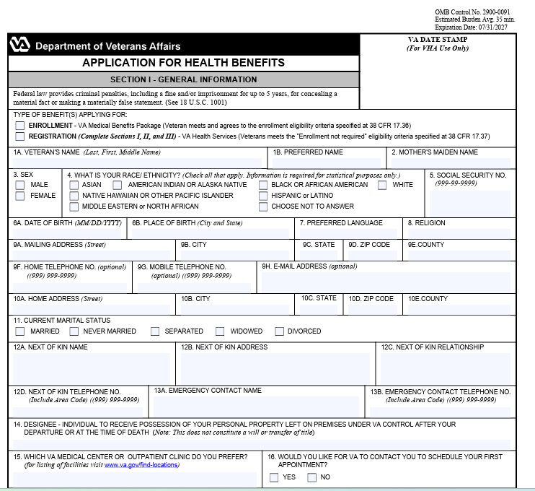

Enrolling vs Registering in VA Health Care
What does “Enrolling in VA health care” mean?
  Applying for and being approved to receive health benefits.
    Allows veteran to access VA services
What does “Registering for VA health care” mean?
  This is the act of requesting medical care (medical appointments/Primary Care) at a specific VA facility.
  A veteran may need to register multiple times throughout their lifetime
    Initial registration/enrollment
    Move locations – which requires care at new VA location/facility
    Leave/terminate VA care – reinitiate to return to care

Slide 5
How to Register/Enroll for VA Health Care
Enrollment into VA health care is not automatic upon leaving service
Enroll by completing VA Form 10-10 (Application for Health Benefits)
Application methods
  Phone: 877-222-8387
  Mail: Health Eligibility Center, PO Box 5207, Janesville, WI 53547-5207
  In-person at nearest VA facility
  Online at va.gov
  Trained professional (accredited service officer, claims agent, accredited attorney)
Process takes less than 1 week for VA to make determination
  Will receive a benefits package in mail
  Clinic/PCM assignment

Slide 6
Expectations for First Visit to VA
What to bring
Verification of eligibility
Complete intake form with medical history
Medical assessment
Discuss concerns with VA provider
  Establish a care plan based on eligibility and need
Share medical records
Benefits review & answer questions

Slide 7
How Service connection plays a role in health care
Eligibility for benefits
  Service-connected condition that was caused or made worse due to active military service – VA required to provide care
  Condition that has no connection to your time in service - VA not required to provide care
Establishes Priority of Care and Group assignment
  Eight priority groups; category 1 is the highest
Used by VA to prioritize care for conditions incurred or aggravated while on active duty

Slide 8
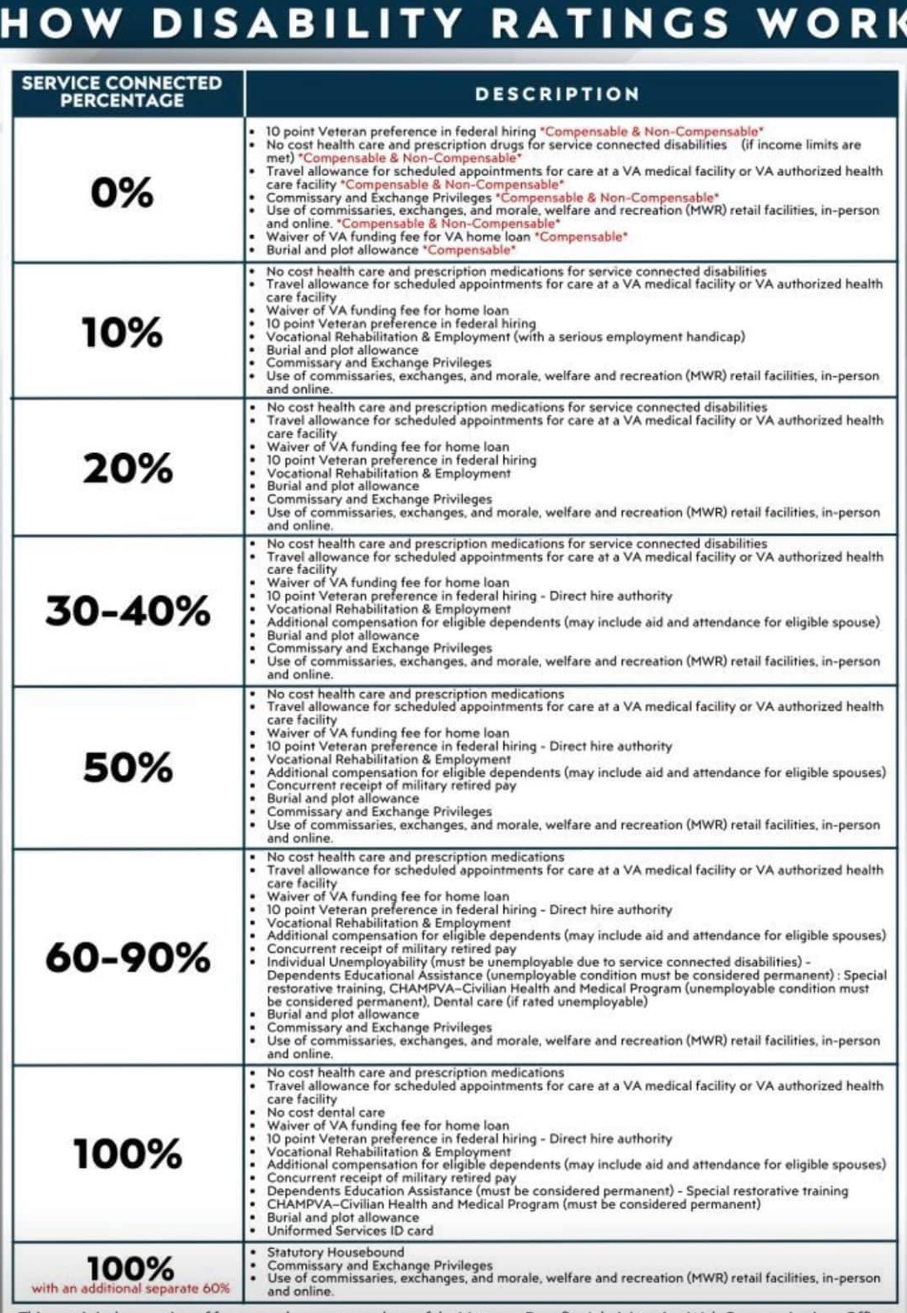
Service-Connected Benefits

Slide 9
Priority Groups
Notes:
What are VA priority groups and how do they affect me?
After we’ve processed your application and you’re enrolled in VA health care, we’ll assign you to 1 of 8 priority groups. Your priority group may affect how much (if anything) you’ll have to pay toward the cost of your care.

Slide 10
Priority Groups 1 & 2
Priority Group 1
Service-connected disability rated as 50% or more disabling, or
Service-connected disability that has been determined to make you unable to work (also called unemployable), or
Medal of Honor (MOH) recipient
Priority Group 2
Service-connected disability rated as 30% or 40% disabling

Slide 11
Priority Group 3
Priority Group 3
Former Prisoner of War (POW), or
Recipient of Purple Heart medal, or
Discharged for a disability that was caused by – or got worse because of – your active-duty service, or
Service-connected disability that we’ve rated at 10% or 20% disabling, or
You were awarded special eligibility classification under Title 38, U.S.C § 1151, “benefits for individuals disabled by treatment or vocational rehabilitation

Slide 12
Priority Group 4 & 5
Priority Group 4
Receiving VA aid and attendance or housebound benefits, or
Receiving a VA determination of being catastrophically disabled
Priority Group 5
Service-connected disability, or you have a non-compensable service-connected disability rated as 0% disabling, and you have an annual income level that’s below our adjusted income limits (based on your residential zip code), or
Receiving VA pension benefits, or
Eligible for Medicaid programs

Slide 13
Priority Group 6
We may assign you to priority group 6 if any of these descriptions are true:
You have a compensable service-connected disability that we’ve rated as 0% disabling, or
You participated in Project 112/SHAD, or
You served in World War II between December 7, 1941, and December 31, 1946, or
You served in the Persian Gulf War between August 2, 1990, and November 11, 1998, or
You served on active duty at Camp Lejeune for at least 30 days between August 1, 1953, and December 31, 1987

Slide 14
Priority Group 6 – cont.
We may assign you to priority group 6 if any of these descriptions are true:
You served in a theater of combat operations after November 11, 1998, and
You were discharged from active duty on or after October 1, 2013, and
You meet the minimum active-duty service requirement
*You’ll have 10 years of enhanced eligibility from the date of your discharge or release; after that you’ll be assigned to the highest priority group you qualify for.

Slide 15
Priority Group 6
Toxic Exposure Risk Activity (TERA)
We may assign you to priority group 6 if you were assigned to a duty station (including airspace above) in certain locations during specific periods:
On or after August 2, 1990, in Bahrain, Iraq, Kuwait, Oman, Qatar, Saudi Arabia, Somalia, or the United Arab Emirates, or
On or after September 11, 2001, in Afghanistan, Djibouti, Egypt, Jordan, Lebanon, Syria, Yemen, Uzbekistan, or any other country that we determine is relevant

Slide 16
Priority Group 6 –
Toxic Exposure Risk Activity (TERA)
We may assign you to priority group 6 if you were deployed in support of any of these operations:
Operation Enduring Freedom, or
Operation Freedom’s Sentinel, or
Operation Iraqi Freedom, or
Operation New Dawn, or
Operation Inherent Resolve, or
Resolute Support Mission

Slide 17
Priority Group 6 –
Toxic Exposure Risk Activity (TERA)
We may assign you to priority group 6 if you were exposed to ionizing radiation in any of these ways:
During atmospheric testing, or
During the occupation of Hiroshima and Nagasaki, or
While conducting cleanup of Enewetak Atoll between January 1, 1977, and December 31, 1980, or
While participating in onsite response efforts in Palomares, Spain, between January 17, 1966, and March 31, 1967, or
While participating in onsite response efforts on Thule Air Force Base, Greenland between January 21, 1968, and September 25, 1968

Slide 18
Priority Group 6 –
Toxic Exposure Risk Activity (TERA)
We may assign you to priority group 6 if you were exposed to Agent Orange and served in any of these locations and time periods:
The Republic of Vietnam between January 9, 1962, and May 7, 1975, or
Thailand at any United States or Royal Thai base between January 9, 1962, and June 30, 1976, or
Laos between December 1, 1965, and September 30, 1969, or
Cambodia at Mimot or Krek, Kampong Cham Province between April 16, 1969, and April 30, 1969, or
Guam or American Samoa or in the territorial waters off of Guam or American Samoa between January 9, 1962, and July 31, 1980, or
Johnston Atoll or on a ship that called at Johnston Atoll between January 1, 1972, and September 30, 1977

Slide 19
Priority Group 7 & 8
Priority Group 7
Your gross household income is below the geographically adjusted income limits (GMT) for where you live, and
You agree to pay copays
Priority Group 8
Your gross household income is above VA income limits and geographically adjusted income limits for where you live, and
You agree to pay copays

Slide 20
Patient Advocate

Slide 21
Patient Advocate and their Role
Available at every VA Medical Center
Highly trained professionals who can help resolve concerns about aspects of your health care experience
  Listen to questions, problems, or special needs you may have
  Refer concerns to appropriate staff for resolution, assist in filing an appeal for a review of your concern
    Particularly those that cannot be resolved at the point of care
Oversight of VHA Benefits programs
Positive/Negative feedback to VA
  In person
  Telephone
  Mail
  Online at “Ask VA” (https://ask.va.gov/)

Slide 22
CHAMPVA

Slide 23
What is CHAMPVA
Civilian Health and Medical Program of the Department of Veterans Affairs (CHAMPVA):
  37 CFR 17.270 is the governing regulation
  ChampVA is not an insurance plan, it is a cost share program in which VA shares the cost of covered health care services and supplies with eligible beneficiaries.
  Affordable Care Act (ACA) designates CHAMPVA as fulfilling minimum essential coverage requirements
    TRICARE
    VA Health Care

Slide 24
CHAMPVA Eligibility
Spouse or child of a Veteran who has been rated by VA as having a permanent and total service-connected disability, or
Surviving spouse or child of a Veteran who died from a VA-rated service-connected disability, or
Surviving spouse or child of a Veteran who was at the time of death rated permanently and totally disabled from a service-connected disability, or
Surviving spouse or child of a service member who died in the line of duty, not due to misconduct*,

Slide 25
How to Apply for CHAMPVA
Required Documents:
  VA Form 10-10d (Application for CHAMPVA Benefits
  VA Form 10-7959c (CHAMPVA – Other Health Insurance (OHI) Certification
  Copy of Medicare card for individuals who are eligible
Optional Documents: (copies only)
  VBA decision showing permanent and total status, or death rating
  Veteran’s DD-214(Certificate of Release of Discharge from Active Duty)
  Proof of Dependents
    Marriage license, birth certificates, 18-23 years school certification for full-time enrollment (original)

Slide 26
How to Apply for CHAMPVA
Apply online at VA.GOV digital portal
Mail your application, and associated documents, to:
VHA Office of Community Care
CHAMPVA Eligibility
PO Box 137
Spring City, PA 19475
If you have questions or need assistance: (800)733-8387

Slide 27
Foreign Medical Program

Slide 28
What is the Foreign Medical Program
37 CFR 17.35 is the governing regulation
Furnishes care to veterans for service-connected disabilities who are living or traveling outside USA
  A condition that aggravates a service-connected disability
  The veteran participates in the Veteran Readiness and Employment (VR&E) program, the VA may pay for care for other conditions.
Community Care Program strictly for the veteran
  Telehealth is not an option for this program
  Prescription medications approved by FDA are covered
You can use FMP only for care you get in a foreign country. It won’t cover care or supplies you get in or from the U.S. or U.S. territories.

Slide 29
How to Apply for FMP
VA Form 10-7959f-1 (Foreign Medical Program (FMP) Registration form
Submit form
  VA.GOV digital portal
  By mail: VHA Office of Integrated Veteran Care (OIVC)
  Foreign Medical Program (FMP)
  P.O. Box 200
  Spring City, PA 19475
  By Fax: 303-331-7803

Slide 30
Navigating
VA Health Care

Slide 31
Navigating VA Health Care
If you are working with a veteran who needs assistance with their healthcare needs:
Try to resolve the issue using primary care team
Local resources such as Patient Advocate or Chief of Service.
  ASK VA
  MyVA411: (800) 698-2411
Use the VA Health Connect service
File a Health Care Appeal
Veterans Service Organization – limited capabilities due to HIPAA

Slide 32
Common Health Care Issues
Medical or Mental Health Crisis: Go to local emergency room (VA or non-VA) in the United States; if overseas seek medical guidance from FMP program manager (hotline). Call 988 press 1 for mental health crisis!
Urgent/Emergency Medication Refill: Call VA Health Connect line at (866) 481-0011 or go to local emergency room in the United States; if overseas seek medical guidance from FMP program manager (hotline).
Caregiver Application Process for PCAFC: Caregiver support line (855) 260-3274, or visit your local Caregiver support team
Disruptive Behavior Flags: Call your assigned facility and work with Patient Advocate/Patient Care team for specific guidance and support to access care.

Slide 33
Are there any questions?
Katherine Cassell
Assistant Director,
Veteran Health Policy
(202) 608-8371
Kcassell@vfw.org
Julie Holt
Special Assistant
Veteran Health Policy
(202) 608-8364
Jholt@vfw.org
Marion Fera
Health Consultant
Veteran Health Policy
(202) 608-8349
mfera@vfw.org

