Slide 1
NVS Health Team Update

Slide 2
Electronic Health Record Deployment
Currently there are six VA sites with EHRM:
Spokane, WA (Mann-Grandstaff VAMC – first site)
Seattle, WA
Walla Walla, WA
Boise, ID
Roseburg, OR
White City, OR
All six sites continue to get the upgrades to the system. They are not legacy sites.

Slide 3
Electronic Health Record Deployment
Site | Location | Go-Live Date
VA Detroit Healthcare System | Detroit, Michigan | April 2026
VA Saginaw Healthcare System | Saginaw, Michigan | April 2026
VA Ann Arbor Healthcare System | Ann Arbor, Michigan | April 2026
VA Battle Creek Medical Center | Battle Creek, Michigan | April 2026
Dayton VA Medical Center | Dayton, Ohio | June 2026
Chillicothe VA Medical Center | Chillicothe, Ohio | June 2026
Cincinnati VA Medical Center | Cincinnati, Ohio | June 2026
Cincinnati VA Medical Center-Fort Thomas | Fort Thomas, Kentucky | June 2026
Richard L. Roudebush Veterans’ Administration Medical Center | Indianapolis, Indiana | August 2026
Marion VA Medical Center | Marion, Indiana | August 2026
Fort Wayne VA Medical Center | Fort Wayne, Indiana | August 2026
Louis Stokes Cleveland Department of Veterans Affairs Medical Center | Cleveland, Ohio | October 2026
VA Alaska Healthcare System | Anchorage, Alaska | October 2026

Slide 4
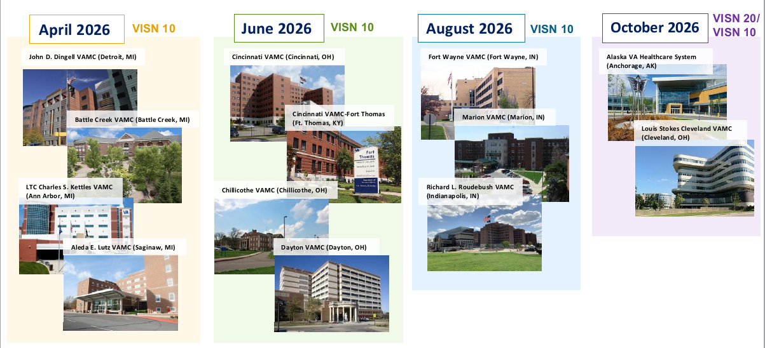
Electronic Health Record Deployment
Extract from VA briefing slide April 7, 2026

Slide 5
Timeline for Go-Live Sites
Deployment Year | Deployment Sites Numbers | VISNs Affected
2026 | 13 | 10, 20
2027 | 26 | 12, 15, 20, 23
2028 | 28 | 15, 16, 21, 22
2029 | 32 | 4, 16, 17, 19
2030 | 32 | 1, 6, 8, 9
2031 | 33 | 2, 5, 7
To Find the VISN: https://www.va.gov/HEALTH/visns.asp

Slide 6
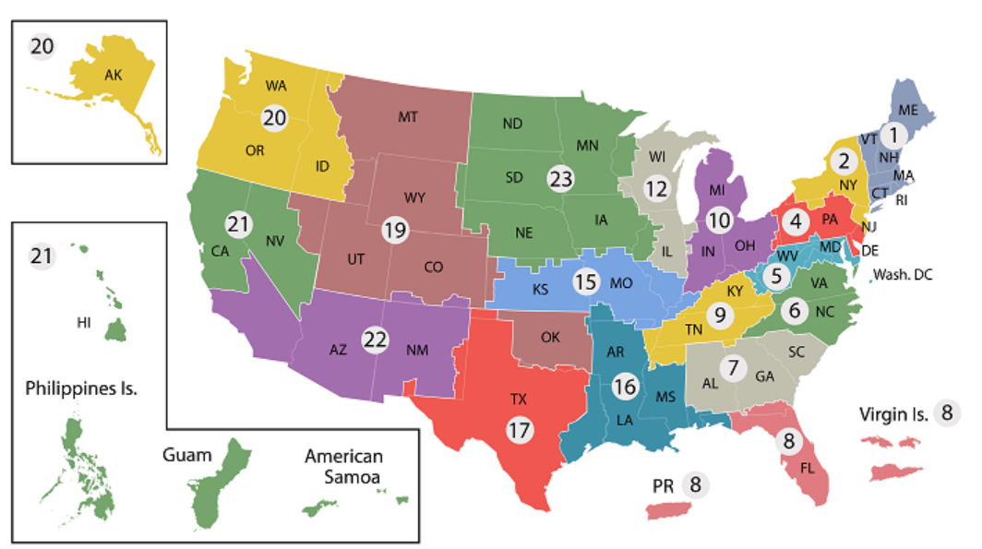
Timeline for Go-Live Sites
https://www.va.gov/HEALTH/visns.asp

Slide 7
Hospital Staff - Initial Expectations
Based on previous deployments:
Productivity slower first few weeks
Staff needs to use new workflows
More checking of orders, pharmacy flow
Probably backlog of patients
Staff can become tired (have patience with them)
Learning a new system is frustrating
More folks looking over shoulders; IT, superusers, leadership
We will likely hear how the old way was better, easier

Slide 8
Patients- Initial Expectations
Based on previous deployments:
Fewer appointments first few weeks
Wait times will likely be longer for appointments and pharmacy
Visits may be longer
Providers may need more time inputting information initially
Providers may need to reconfirm basics
Meds
History
Spending time on the phone for appointments may take longer

Slide 9
Service Officers - Initial Expectations
There will likely be local town hall listening sessions
Attend if you can – It will keep you updated on the local progress
Last time, VA and Oracle had asked for:
locations to conduct town halls
Departments to encourage veterans to attend town halls

Slide 10
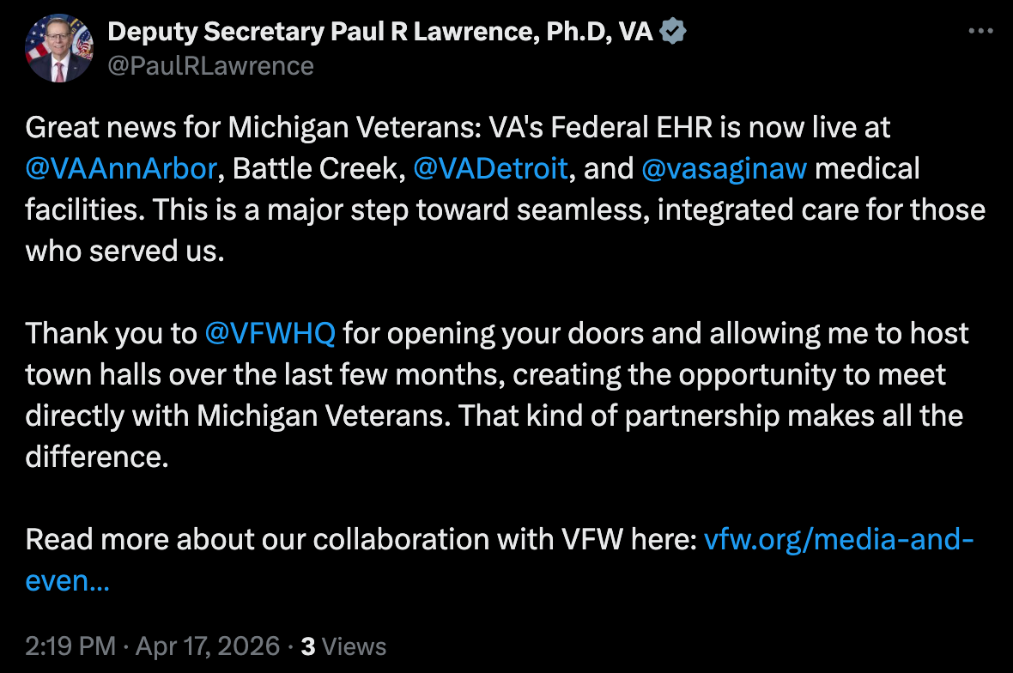
Thanks to the Departments!
From: https://x.com/PaulRLawrence/status/2045205563173212179?s=20

Slide 11
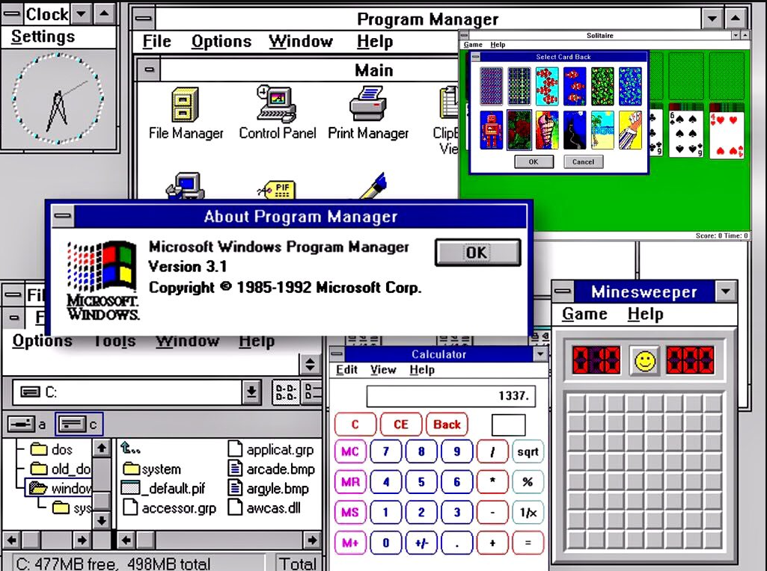
Why ? VistA is Good – Like Windows 3.1
VistA – VA’s current system
Developed in 1970s
Deployed in 1980s
Pre-dates internet
Has more than 130 patches and just as many variations in VA facilities
Incompatible with modern health systems
Courtesy: https://ia800404.us.archive.org/10/items/windows-3.1_202103/win%203.1.jpg

Slide 12
VistA Cont.
Records and data managed by each health care facility
Not integrated
Sending information to another facility involves a transfer; fax, electronic, or physical
Somone has to reconcile it on the other end
Good luck getting records from private health care facilities

Slide 13
VA Oracle EHR
Interoperability between military and VA – transition/use of facilities
Improved care
Real-time data viewing; Spokane can see same patient data as Roseburg OR VA
Less repeated tests, exams, x-rays
Will not need to repeat your health history; more time for treatment
Standardized care across all VA facilities
Will be able to know capacity, bed-space in each facility
Ex: Baltimore will know bed-space in Richmond
New system connects private providers and records
No need for physical records carried by patient or faxed/mailed

Slide 14
Clinical AI Agent (VA Pilot Program)
It is being piloted in the current six VAMC facilities that have EHRM
Records conversations and generates clinical notes
Reduction in documentation time in primary care by 24%
1-2% AI generated notes need updates; most capture everything correctly
Can distinguish between multiple people in a room and different languages

Slide 15
Clinical AI Agent (DoW Implementation)
In recent Oracle brief:
DoW is implementing the Clinical AI Agent
89% improvement in patient quality
96% reduction in document burden
Especially helpfully in mental health appointments
Example – a 45 minute appointment
AI agent being tested and modified for other clinics; in-patient and ER
Notes:
45 minute appointment took 45 additional minutes to document; but now only takes 5 minutes

Slide 16
AI and Civilian Health Care
Recent AMA survey:
More than 80% surveyed use AI – double the rate from 2023
Majority believes it improves their care for patients
39% use for research and standards of care
30% use for progress notes, care plans or discharge instructions
19% use for draft responses in the patient portal
17% assistive diagnosis
70% say they are concerned about loss of physician skills among students
https://www.ama-assn.org/practice-management/digital-health/more-80-physicians-use-ai-professionally-ama-survey
Notes:
45 minute appointment took 45 additional minutes to document; but now only takes 5 minutes

Slide 17
Armed Forces Retirement Homes
Gulfport, MS and Washington DC
Independent governance – separate from VA and DoW
Currently uses completely different health records system
AFRH actively evaluating whether to implement MHS-Genesis
Their strategic plan for 2026-2030 indicates potential transition plan
Notes:
45 minute appointment took 45 additional minutes to document; but now only takes 5 minutes

Slide 18
WellHive Pilot - Scheduling
External Provider Scheduling (EPS)
VA schedulers book appointments directly into CCN provider schedule
VA scheduler sees referrals and what is available in the network
Next is integrated scheduling showing VA and community appointment availabilities
Notes:
45 minute appointment took 45 additional minutes to document; but now only takes 5 minutes

Slide 19
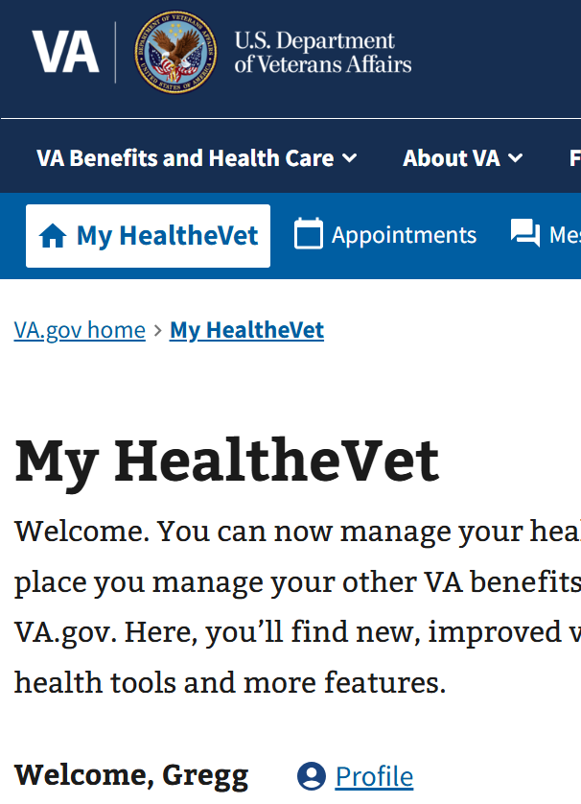
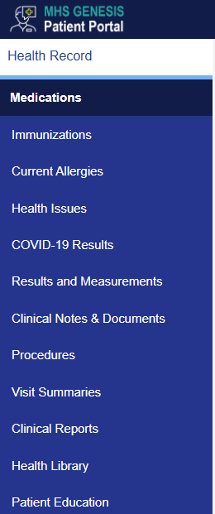
Patient Portals VA vs MHS Genesis
Oracle Product
Non- Oracle
Notes:
45 minute appointment took 45 additional minutes to document; but now only takes 5 minutes

Slide 20
72 Hour Notice with VA
Community emergency care
Notify VA within 72 hours
Reasons:
Payment 2) VA confirms eligibility 3) VA coordinates follow-on care
Who may report it?
Where to report
844-72HRVHA (844-724-7842)
https://emergencycarereporting.communitycare.va.gov/compliance
VA Clinic
Notes:
45 minute appointment took 45 additional minutes to document; but now only takes 5 minutes

Slide 21
Bonus Material
Foreign Medical Program
This summer - auto-enrollment for all veterans with a service-connected rating of zero (0) or greater.
Letters should be autogenerated within the veterans VA.GOV account and should be located under letters.
Alternative filing options if online services are not accessible:
Mail to: VHA Office of Integrated Veteran Care
Foreign Medical Program
PO Box 200
Spring City, PA 19475
If you are traveling…invest in medical insurance
Notes:
45 minute appointment took 45 additional minutes to document; but now only takes 5 minutes

