Slide 1
National Legislative Service
Nancy Springer
Deputy Director

Slide 2
The Importance of Legislative Advocacy
Impacts veterans and family members
Veterans Preference
GI Bill
Toxic Exposures
Veteran benefits don’t just happen
Stronger and better advocates together
Protect what we have secured
Elimination of IU after reaching retirement age
Round down of cost-of-living adjustment

Slide 3
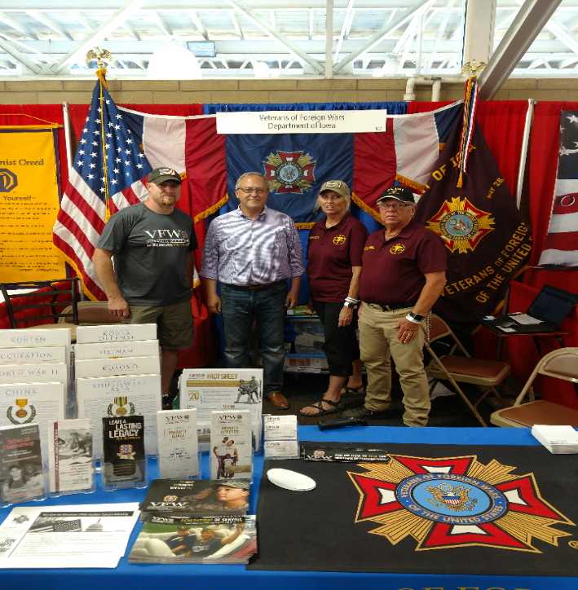
Make Legislative Advocacy a Priority
All politics is local!
Members of Congress
care what their voters want
Your perspective matters
Know the VFW’s stance on issues
Work with National Legislative Committee Members
Inform them about issues
Every knowledgeable voice matters
Notes:
Know the members of Congress and US Senators from your state. Use your status and access to garner support for the VFW’s legislative priorities.
Election:
DO’s
Do attend candidate Town Hall Meetings and other events and push our issues.
Do set up voter registration drives /Get Out the Vote Campaigns on the local level.
Do provide carpool service on Election Day to help the elderly and disabled get to the voting booth.
Do support and work for your favorite candidates as a voting constituent. As an individual and VFW member you can work or campaign on behalf of your favorite candidate - and are encouraged to do so. • Do wear your VFW cap.
DON’Ts
Don’t endorse candidates on behalf of the VFW as a Post, District, Department or National Leader.

Slide 4
Recent Victories
H.R. 1815, VA Home Loan Program Reform Act, became law on Jul 30, 2025.
S.201, ACES Act of 2025, became law on Aug 14, 2025.
H.R. 983, Montgomery GI Bill Selected Reserves Tuition Fairness Act of 2025, became law on Dec 12, 2025.

Slide 5
Current Priority Goals
Fully fund relevant programs for service members, veterans, and their families
Ensure timely service member and veteran access to high-quality health care without increasing cost shares
Secure access to education/employment opportunities and assistance for success after leaving military service
Improve the claims process to protect the earned benefits of our veterans and survivors
Maintain military quality of life and comprehensive benefits/retirement packages
Support the all-volunteer force that protects our citizens and defends American interests around the world

Slide 6
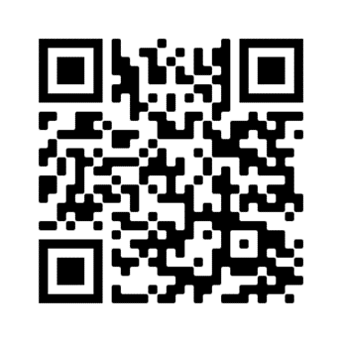
Join Action Corps
Weekly e-newsletter and Action Alerts
Be informed and involved
Respond to Action Alerts and make a difference
Informing your elected officials is crucial in helping get vital pieces of veteran legislation passed into law
Three ways to sign up:
Visit www.vfw.org/JoinActionCorps
Text “VFW” to 50457
Scan the QR Code
Notes:
Identify and support the next generation of VFW leaders.
Involve younger members in legislative advocacy.
Provide a semester-long curriculum to receive academic credit at both the undergraduate and graduate level.
Foster collaboration between VFW and student veterans at the local and national levels.

Slide 7

Take Action
IMPACT OF ACTION CORPS
“Demand the PACT Act Passes”
180,000 messages sent

Slide 8
How You Can Help
Inform your NVS Quality Assurance Representative about recurring issues you observe.
Examples:
Claim Sharks activity
Specific conditions difficult to get VA rating (MST, TBI, toxic exposures)
Unexplainable denials when required evidence was provided
Consistent mistakes made by VA raters
Issues with appeals, ways to improve the process
Respond to our call-outs for information and stories for our testimony in DC. You may be asked to testify in your home states as well.
Draft VFW resolutions to enact change

Slide 9
We’re Here to Help
www.vfw.org/advocacy
Talking points & priority goals
Congressional testimony
Action Corps
Read the Action Corps Weekly
Respond to Action Alerts
Sign up advocates

Slide 10
QUESTIONS?
Contact the VFW National Legislative Service
Email: nspringer@vfw.org
Call: (202) 997-2853

