Slide 1
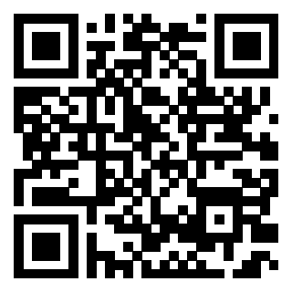
Recent Court Opinions and Regulatory Changes
Sept. 2025 - April 2026
https://bergmannmoore.participoll.com/

Slide 2
Polling Test Question
https://bergmannmoore.participoll.com/
How many decisions did the CAVC issue in FY2025 (Oct. 2024-Sept. 2025)?
Under 6,000
6,000-6,999
7,000-7,999
8,000-8,999
9,000-9,999
Over 10,000
A
B
C
D
E
F
0
Notes:
The answer is 10%
DC 6260 is one of only a few DCs that have a single rating for a disability. If a Veteran is service connected for tinnitus, then the only possible rating is 10%.
[click to appear]
It is important to be aware that some DCs include “Notes” that should be read to see if they apply to the Veteran’s situation.
These notes are binding.

Slide 3

Polling Test Answer
Over 10,000
This is a record number!
Official report has not been released.
However, the Chief Judge has been stating this publicly.
He has also stated that FY26 numbers are already running higher than FY25.
Notes:
The answer is 10%
DC 6260 is one of only a few DCs that have a single rating for a disability. If a Veteran is service connected for tinnitus, then the only possible rating is 10%.
[click to appear]
It is important to be aware that some DCs include “Notes” that should be read to see if they apply to the Veteran’s situation.
These notes are binding.

Slide 4
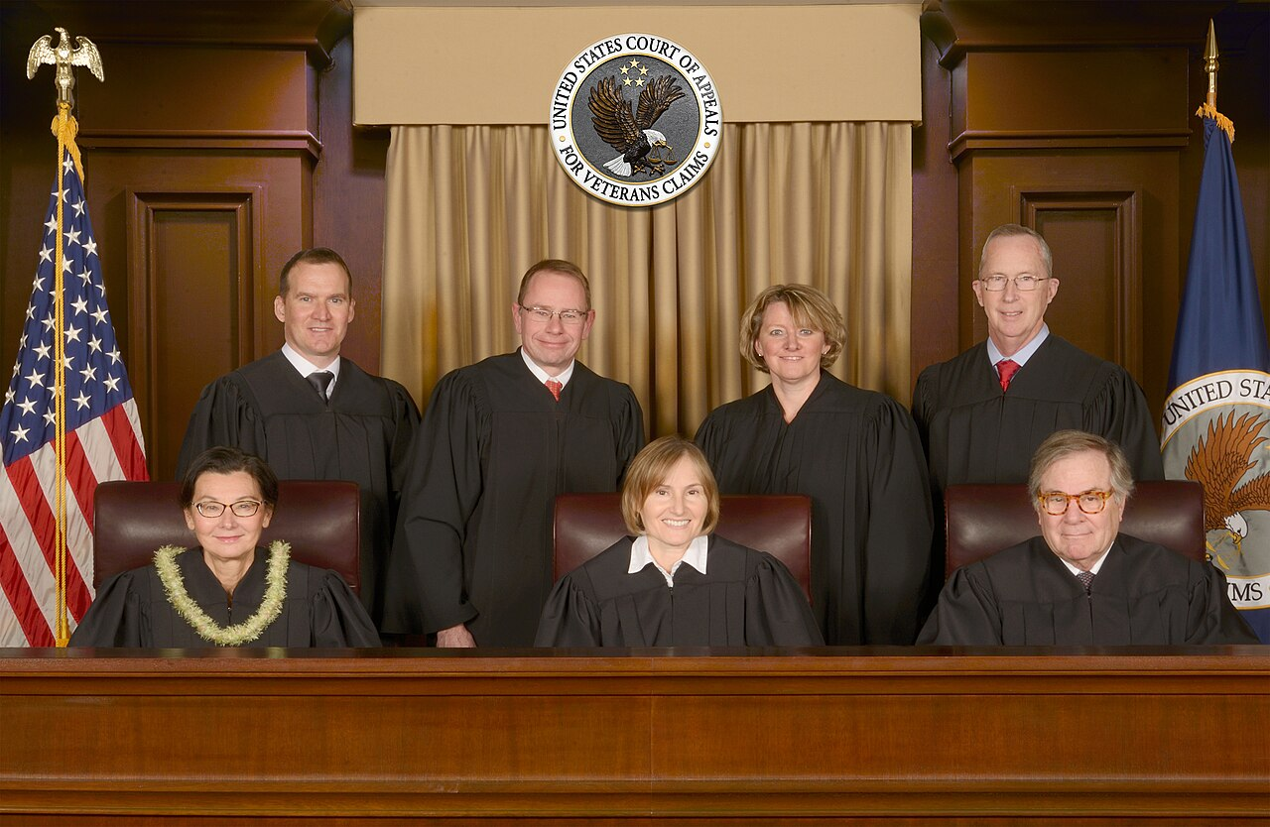
CAVC Vacancies
The CAVC is authorized to have ten judges.
The Court has eight judges, one of whom is leaving active status this summer.
There are three vacancies that need to be filled.
Currently, there are no nominations for these vacancies even though the first vacancy has existed since then end of 2024.
Wait times at the CAVC are very likely to rise if these positions are not filled.
Notes:
It’s also important to recognize that the process doesn’t end when you complete the request.
Hopefully, the doctor will send the evidence back to you.
At this point, you need to read what the doctor provided and decide what to do next.
Review the documents before submitting them. Don’t submit records without looking at them.
[click] The first thing you want to do is to make sure that it is complete and accurate.
If there is a minor problem, contact the doctor to see if you can obtain a clarification.
[click] If there is a significant problem, you will likely need to contact the Veteran to sort out what happened.
Hopefully, the issue can be fixed.
But sometimes a Veteran misinterprets what their doctor is saying or the medical evidence turns out to problematic for some reason. Ultimately, [click] you are not required to submit evidence to VA that you think is bad for the Veteran.
Assuming that you get useful evidence, [click] now you have to decide how to use it.

Slide 5
Learning Objectives
Learn about important recent court decisions.
  Review the different courts above VA.
  Learn about some recent court decisions.
  Learn arguments to make based off these recent decisions.
Notes:
In this lesson, we will learn about the federal courts over VA.
[click] To this this, we will identify the different courts over VA;
[click] Learn about some recent decisions from the courts;
[click] And learn about the implications of these recent decisions.

Slide 6


Brief Overview of VA’s Judicial Review
The Board of Veterans’ Appeals (Board) is the highest appellate body within VA.
Denials from Board can be appealed to the U.S. Court of Appeals for Veterans Claims (CAVC).
  CAVC handles only Board appeals from VA.
  Claimants cannot take VA appeals to any other court.
Denials from CAVC can be appealed to the U.S. Court of Appeals for the Federal Circuit (Fed. Cir.).
  Only decides questions of law.
  The next and highest court is the U.S. Supreme Court.
Notes:
Here is a brief overview of the federal courts that review decisions by VA.
[click] The Board of Veterans’ Appeals (Board) is the highest appellate body within VA.
Although its members are called judges, it is not a court. The employees work for VA.
[click] Denials from Board can be appealed to the Court of Appeals for Veterans Claims (CAVC).
[click] The CAVC handles only appeals from VA. Every type of VA benefit is handled by the CAVC, including education, healthcare, and other VA benefits.
[click] Claimants cannot appeal VA decisions to any other court.
[click] If the CAVC denies a claim, then that decision can be appealed to the U.S. Court of Appeals for the Federal Circuit
[click] However, that court only decides questions of law! So if the Veteran merely disagrees with the facts that were found or how the law was applied to those facts, then no further appeal is possible.
[click] If the Federal Circuit issues a ruling of law in a VA case, then it is possible to appeal to the U.S. Supreme Court, the highest court in our country.
However, the Supreme Court agrees to accept less than 1% of cases appealed to it. The Supreme Court decides a veteran law case only once every few years.

Slide 7

Ingram v. Collins
38 Vet.App. 130
(2025)
Notes:
The first recent case we will talk about is Ingram v. Collins from the CAVC.

Slide 8
Veteran Carlton Ingram applied for increased ratings for his back and left ankle. His medical records indicate that he takes a variety of prescription medications to alleviate his pain and inflammation of these joints. The Board rated his conditions based upon an examination that considered only the severity of his condition while taking these medications. Should the Board have evaluated based upon how bad his conditions would be if he were not taking those medications?
No. Ratings are based only upon the observed effect of a disability.
Yes. Ratings should not consider the effect of medication on a disability unless the diagnostic codes specifically says so.
A
B
0

Slide 9
Ingram v. Collins
Yes. Ratings should not consider the effect of medication on a disability unless the diagnostic codes specifically says so.
The CAVC held that the default rule, which it had announced in cases more than a decade ago, applies to ratings of orthopedic conditions.
Nothing in the diagnostic codes for orthopedic conditions mentions medications.
The Court also held that a VA examination should seek information on the Veteran’s unmedicated state just as it must for flare ups under Sharp v. Shinseki.
Notes:
[click] The answer here is Yes. Ratings should not consider the effect of medication on a disability unless the diagnostic codes specifically says so.
[click] The CAVC held that the default rule, which it had announced in cases more than a decade ago in cases called Jones v. Shinseki and McCarroll v. McDonald, applies to ratings of orthopedic conditions.
[click] Nothing in the diagnostic codes for orthopedic conditions mentions medications. Therefore, if the information is available, then veteran should be rated on the severity of their condition in an unmedicated state. This includes during flare ups and after repetitive use over time.
[click] The Court also held that a VA examination should seek information on the Veteran’s unmedicated state just as it must for flare ups under Sharp v. Shinseki. However, VA is not likely to rush to comply with this decision and you can help a veteran address the issue through a lay statement. Describing range of motion in a lay statement can be tricky but sometimes it is clear that it is worse, especially if the veteran has no functional use of the joint without medication.
To be clear, You should NOT suggest that a Veteran stop taking medication in order to get a higher rating! That would be interfering with their medical treatment and you are not a doctor. Rather, this information should be based on other sources, particularly the Veteran’s recollection of their condition from some time when they were not taking their medication.

Slide 10
Ingram v. Collins
VA appealed Ingram to the Federal Circuit and asked that court to overturn the CAVC.
While that appeal was pending, VA published a rulemaking purporting to abrogate Ingram, i.e., nullify it by changing the underlying law.
That rulemaking resulted in a huge uproar and was withdrawn.
Subsequently, VA withdrew its appeal of Ingram.
Presently, Ingram is good law.
Nothing prevents VA from trying a rulemaking in the future or challenging Ingram in a future Federal Circuit appeal.
Notes:
[click] The answer here is Yes. Ratings should not consider the effect of medication on a disability unless the diagnostic codes specifically says so.
[click] The CAVC held that the default rule, which it had announced in cases more than a decade ago in cases called Jones v. Shinseki and McCarroll v. McDonald, applies to ratings of orthopedic conditions.
[click] Nothing in the diagnostic codes for orthopedic conditions mentions medications. Therefore, if the information is available, then veteran should be rated on the severity of their condition in an unmedicated state. This includes during flare ups and after repetitive use over time.
[click] The Court also held that a VA examination should seek information on the Veteran’s unmedicated state just as it must for flare ups under Sharp v. Shinseki. However, VA is not likely to rush to comply with this decision and you can help a veteran address the issue through a lay statement. Describing range of motion in a lay statement can be tricky but sometimes it is clear that it is worse, especially if the veteran has no functional use of the joint without medication.
To be clear, You should NOT suggest that a Veteran stop taking medication in order to get a higher rating! That would be interfering with their medical treatment and you are not a doctor. Rather, this information should be based on other sources, particularly the Veteran’s recollection of their condition from some time when they were not taking their medication.

Slide 11

Stewart v. Collins
38 Vet.App. 407 (2025)
Notes:
The first recent case we will talk about is Terry v. McDonough from the CAVC.

Slide 12
Veteran Richard Stewart appealed a decision severing his award of special monthly compensation. The RO found that his award of TDIU for PTSD did not satisfy the requirement that he have a single disability rated at 100%. On appeal, the Board found that his PTSD did satisfy the 100% criteria, but that he did not meet the criteria for a separate 60% rating.
Did the Board have the authority to change the basis for the severance?
Yes. The Board’s review is de novo so it gives no deference to the RO findings.
No. The Board cannot ignore a favorable finding made by the RO that the Veteran has separate disabilities that satisfy the 60% requirement.
A
B
0

Slide 13
Stewart v. Collins
No. The Board cannot ignore a favorable finding made by the RO that the Veteran has separate disabilities that satisfy the 60% requirement.
The CAVC recognized that “any finding favorable to the claimant made by either a VA adjudicator . . . or by the Board . . . is binding on all subsequent [AOJ] and Board . . . adjudicators, unless rebutted by evidence that identifies a [CUE].” 38 C.F.R. § 3.104(c).
This includes favorable findings that were made previously rather than in the decision on appeal.
Notes:
[click] The answer here is that The Veteran can appeal the original decision because he was still within a year of that decision.
[click] The CAVC held that that the relevant AMA statute, 38 U.S.C. § 5104C(a), unambiguously permits the claimant to file more than one administrative review request in response to, and within 1 year of, a VA decision.
[click] This is important because creates the opportunity to preserve a Veteran’s effective date by continuously pursuing a merits decision even if the Veteran filed a Supplemental Claim that was not supported by new and relevant evidence.
Look for this issue when a Veteran comes to you after an unsuccessful Supplemental Claim. If possible, do not get caught up fighting over whether evidence was new and relevant. If you lose that fight, the Veteran can lose continuous pursuit and the best effective date
To be clear: Advocates should choose whichever type of review is appropriate in their best judgment. However, frame it as a dispute with the most recent decision on the merits rather than a denial of reopening if you are filing within a year of the merits decision. Of course, if it has been more than a year, then you’ll have to attack the Supplemental Claim decision.
.

Slide 14

Witkowski v. Collins
38 Vet.App. 459 (2025)
Notes:
The next recent case we will talk about is Witkowski v. Collins from the CAVC.

Slide 15
Veteran Witkowski’s combined ratings did not meet the schedular criteria for TDIU until June 17, 2021. He appealed denial of TDIU to the Board and specifically waived referral to the Director of Compensation Service for the period before June 17, 2021. The Board granted TDIU from June 17, 2021, but refused to consider extraschedular TDIU before that date. The Board stated it lacked authority to grant extraschedular TDIU in the first instance and that the Veteran had waived Director review.
Was the Board’s decision correct?
Yes. All extraschedular TDIU requests must be reviewed by the Director of Compensation Service at VBA first.
No. Referral to the Director of Comp Service is not a legal requirement.
A
B
0

Slide 16
Witkowski v. Collins
No. Referral to the Director of Comp Service is not a legal requirement.
The CAVC held that the Board does have jurisdiction to decide extraschedular TDIU in the first instance.
This decision overturned an earlier CAVC decision in Bowling v. Principi which had required Director review before the Board could act.
Waiving referral to the Director may lead to a quicker decision.
Notes:
[click] The answer here is No. Referral to the Director of Comp Service is not a legal requirement.
[click] The CAVC held that the Board does have jurisdiction to decide extraschedular TDIU in the first instance.
[click] This decision overturned an earlier CAVC decision in Bowling v. Principi which had required Director review before the Board could act. Accordingly, if you knew how the system worked before, now it is different.
As an advocate, it is up to you to decide whether to waive referral.
[click] Waiving referral to the Director may lead to a quicker decision. However, you are also giving up a bite at the apple. There isn’t one right answer for all situations.

Slide 17

Reynolds v. Collins 39 Vet.App. 53 (2025)
Notes:
The next case is Reynolds v. Collins. And this is a case that Bergmann & Moore handled at the CAVC.

Slide 18
Veteran Reynold’s claim for service connection for hearing loss was denied in 1991. The record at the time included his DD 214 showing he had received a Purple Heart and a VA exam opining his STRs were “negative” for hearing loss.
In 2020 he filed a new supplemental claim and submitted copies of a new service record reflecting he received a Bronze Star Medal. Service connection was granted after a new VA examiner said that his hearing loss was due to acoustic trauma in combat during service.
Should 3.156(c) apply to award an effective date back to 1991?
Yes. His claimed was granted after VA received new service records.
No. The new records of the Bronze Star were not cited in the August 2020 rating decision that granted service connection.
Maybe. It depends on what role the records played in the adjudication process.
A
B
C
0

Slide 19
Reynolds v. Collins
Maybe. It depends on what role the records played in the adjudication process.
The CAVC held that the Board was wrong to require the grant of benefits to cite the new service records for 38 C.F.R. § 3.156(c) effective date exception to apply.
The CAVC held the new service records need only “form a link in the chain of reasoning that supports an award of benefits.”
The CAVC then remanded the case back to the Board for them to apply this “link in the chain” analysis.
Notes:
[click] The answer here is Maybe. It depends on what role the records played in the adjudication process.
[click] The CAVC held that the Board was wrong to require the grant of benefits to cite the new service records for 3.156(c) effective date exception to apply.
[click] Instead, the Court held that the new service records need only “form a link in the chain of reasoning that supports an award of benefits.”
[click] The CAVC then remanded the case back to the Board for them to apply this “link in the chain” analysis.
Crucially, the opinion indicates that this is satisfied if the documents trigger the duty to assist and further development leads to a grant of benefits.
Whenever you help a veteran readjudicate a claim based in any part with new service department records, you should be thinking about § 3.156(c).

Slide 20

Cash v. Collins
166 F.4th 1046 (2026)
Notes:
The next case we will talk about is Cash v. Collins from the CAVC.

Slide 21
Veteran Cash’s claim for service connection for COPD was denied in a July 2021 rating decision. In February 2022, he submitted medical articles linking lead exposure to COPD in support of his claim. Then in June 2022 he filed a 10182 selecting the evidence docket. He also included an addendum asking the Board to review the evidence that he submitted in February 2022. The Board denied his claims without reviewing the evidence submitted in February 2022.
Was the Board correct not to review the February 2022 evidence?
Yes. The evidence was received after his rating decision but before his 10182.
No. Mr. Cash directed the Board’s attention to this evidence during a valid AMA evidentiary window.
A
B
0

Slide 22
Cash v. Collins
No. Mr. Cash directed the Board’s attention to this evidence during a valid AMA evidence window.
The Fed. Circ. reversed “Because we determine that Mr. Cash satisfied the statutory evidentiary submission requirement by clearly and timely referring to his prior submission to the Board in his Notice of Disagreement addendum.”
In appealing to the Board specifically identify evidence already in the file you would like them to review during a valid AMA evidentiary window.
Notes:
[click] The answer here No. Mr. Cash directed the Board’s attention to this evidence during a valid AMA evidence window.
[click] The Fed. Circ. reversed “Because we determine that Mr. Cash satisfied the statutory evidentiary submission requirement by clearly and timely referring to his prior submission to the Board in his Notice of Disagreement addendum.”
[click] In appealing to the Board specifically identify evidence already in the file you would like them to review during a valid AMA evidentiary window.
Of course, it is still safer to resubmit that evidence if possible, but this is a very helpful decision.

Slide 23

Westphal v. Collins
__ Vet.App. __
2026 U.S. App. Vet. Claims LEXIS 72 (Jan. 22, 2026)
Notes:
The next recent case we will talk about is Westphal v. Collins from the CAVC.

Slide 24
Veteran Sharon Westphal receives SMC(k) benefits for loss of use of creative organ for her uterus. She is now seeking entitlement to an additional SMC(k) award for loss of use of creative organ for her vagina.
Can veterans be entitled to more than one award of SMC(k) for loss of use of more than one creative organ?
No. The law at 1114(k) only authorizes VA to grant one award of SMC(k) based on loss of use of creative organ.
Yes. She has lost use of more than one creative organ so should receive more than one award.
A
B
0

Slide 25
Westphal v. Collins
No. The law at 1114(k) only authorizes VA to grant one award of SMC(k) based on loss of use of creative organ.
The CAVC held that the phrase “one or more” in 1114(k) means that veterans may only receive a single award of SMC(k) based on loss of use of creative organ even if the use of more than one creative organ is lost.
The statute is structured in a confusing way.
There are many ways to get multiple awards of SMC(k), but this is not one of them.
Notes:
[click] The answer here is No. The law at 1114(k) only authorizes VA to grant one award of SMC(k) based on loss of use of creative organ.
[click] The CAVC held that the phrase “one or more” in 1114(k) means that veterans may only receive a single award of SMC(k) based on loss of use of creative organ even if the use of more than one creative organ is lost.
[click] The statute is structured in a confusing way.
[click] There a many ways to get multiple awards of SMC(k), but this is not one of them.

Slide 26

Hamill v. Collins
__ Vet.App. __
2025 U.S. App. Vet. Claims LEXIS 155
(Feb. 6, 2026)
Notes:
The first recent case we will talk about is Terry v. McDonough from the CAVC.

Slide 27
In the past, David Hamill was denied benefits for PTSD because of an unfavorable character of discharge. In 2021, he filed a new claim to excuse his character of discharge and receive compensation for PTSD. The RO granted service connection for PTSD for treatment purposes only. It did not mention his character of discharge.
Did the RO implicitly deny the character of discharge issue?
Yes. The grant put him on notice that had not been changed.
No. There is no indication that this was considered.
No. Implicit denial no longer exists under the AMA.
A
B
C
0

Slide 28
Hamill v. Collins
No. Implicit denial no longer exists under the AMA.
“Under the AMA, a veteran’s claims can no longer be implicitly denied.”
The Fed. Circ. found the legislative history and notice provisions of the AMA means that implicit denial cannot survive under the AMA.
The consequences of this are unclear, but it seems most likely this will arise in effective date appeals in the future.
Notes:
-Because this is a weird case I’m breaking our format here. No attempt to play judge here, but I want to highlight this big take away.

Slide 29

Freund v. Collins
__ Vet.App. __
2026 U.S. App. Vet. Claims LEXIS 435
(Mar. 18, 2026)
Notes:
The first recent case we will talk about is Terry v. McDonough from the CAVC.

Slide 30
Freund Background
As far back as 1990, the Board’s legacy computer system (VACOLS) automatically closed appeals “on the first day of the month following” the expiration of the appeal period if a Form 9 was not entered into the system.
Thousands were closed erroneously, for example if the mail was received but just not logged in time.
No notice was sent to these Veterans.

Slide 31
Freund History
In 2021, Mr. Freund’s attorney petitioned to certify a class of Veterans whose appeals were improperly closed.
CAVC originally denied the class motion in 2022 as moot because Mr. Freund’s appeal was reopened.
In August 2024, the Federal Circuit found that the CAVC erred and remanded the case.
In December of 2025, the parties filed a Joint Motion to Approve the Proposed Settlement.

Slide 32
Expected Freund Notice
The class is based upon the period from December 12, 1990, to February 6, 2025.
Phase 1 – 28,000+ appeals with a timely Form 9 in VBMS
  VA will individually review and automatically reactivate.
  These Veterans will receive notice of the date of the SOC and appeal that has been reactivated.
Phase 2 – 64,000+ appeals with a VA Form 21-4138 in VBMS
  VA will attempt to screen out blank 21-4138s.
  Remaining Veterans will receive generic notice that they may have had an appeal improperly closed.
  If they respond within one year, VA will review for reactivation.

Slide 33
Timing and process
VA should have posted notice of the settlement last week.
Actual letters to veterans should go out this summer.
The CAVC still needs to decide who will get letters.
Representatives may need to examine what was filed within the relevant timeframe and submit argument that there was a valid appeal.
Once the legacy appeal is reopened, the claimant will need help with the merits.
VBA will likely send a Supplemental Statement of the Case and there will be an opportunity to opt into the AMA system at that point.

Slide 34
Look for Pending Appeals
Regardless of whether a veteran gets a Freund letter, be on the lookout for unprocessed substantive appeals.
If a substantive appeal was filed within 60 days of an SOC or within the remainder of one year of the rating decision.
  If no action was taken this may be a case where VACOLS improperly closed the appeal.
Help the client contact VA and ask for their appeal to be reactivated.
Freund is not the only pending class action where courts are ordering notice letters!

Slide 35

Supreme Court case we are closely watching
Notes:
Finally, here are two pending Supreme Court cases that we are keeping an eye on because they could be quite important.

Slide 36
Pending Decision
Johnson v. United States Congress
  Does the CAVC have exclusive jurisdiction over all VA benefits issues?
  Decision of the 11th Circuit Court of Appeals (Alabama, Florida, Georgia).
  Held that federal district court lacked jurisdiction over constitutional challenge to law reducing benefits to veterans while they are incarcerated.
  Review granted in April. Will likely be argued next autumn and decided late this year or early next.
Notes:
[click] The first case is Rudisill v. McDonough
[click] You may have heard of this case before as it was the subject of three CAVC and Federal Circuit decisions.
[click] The question presented is whether veterans with multiple periods of service who qualify under both the Montgomery G.I. Bill and the Post-9/11 G.I. bill eligible for 36 or 48 months of benefits? Although this was decided in the Veteran’s favor the first two times, the current ruling is that veterans are limited to 36 months of benefits.
[click] THe other case is Loper Bright Enterprises v. Raimondo, which has a companion case that was argued with it.
[click] This case is also pending before the Supreme Court..
[click] THe question in Loper Bright is How much deference do courts owe agencies in interpreting statutory provisions?
This is not a veterans benefits case, but if the Court changes the balance of power between agencies and courts, it could significantly affect veterans law and the courts may revisit issues that were previously decided in favor of VA.
[click] Be sure you check the email that you used to register for this course for case updates from Bergmann & Moore!

Slide 37
Pending Decision
Johnson v. United States Congress
  Prior to VJRA, the Supreme Court held that U.S. courts of general jurisdiction could hear claims involving constitutional violations.
    This is how Nehmer was decided prior to the VJRA.
  Beginning with Veterans for Common Sense in 2012, some courts have held that the VJRA eliminated all jurisdiction over veterans benefits in courts other than the CAVC.
  However, the CAVC is not a trial court, so it has no ability to receive evidence and make factual findings.
  If the Supreme Court affirms, a veteran trying to make a constitutional challenge must go through VA for evidence development and initial fact finding.
Notes:
[click] The first case is Rudisill v. McDonough
[click] You may have heard of this case before as it was the subject of three CAVC and Federal Circuit decisions.
[click] The question presented is whether veterans with multiple periods of service who qualify under both the Montgomery G.I. Bill and the Post-9/11 G.I. bill eligible for 36 or 48 months of benefits? Although this was decided in the Veteran’s favor the first two times, the current ruling is that veterans are limited to 36 months of benefits.
[click] THe other case is Loper Bright Enterprises v. Raimondo, which has a companion case that was argued with it.
[click] This case is also pending before the Supreme Court..
[click] THe question in Loper Bright is How much deference do courts owe agencies in interpreting statutory provisions?
This is not a veterans benefits case, but if the Court changes the balance of power between agencies and courts, it could significantly affect veterans law and the courts may revisit issues that were previously decided in favor of VA.
[click] Be sure you check the email that you used to register for this course for case updates from Bergmann & Moore!

Slide 38
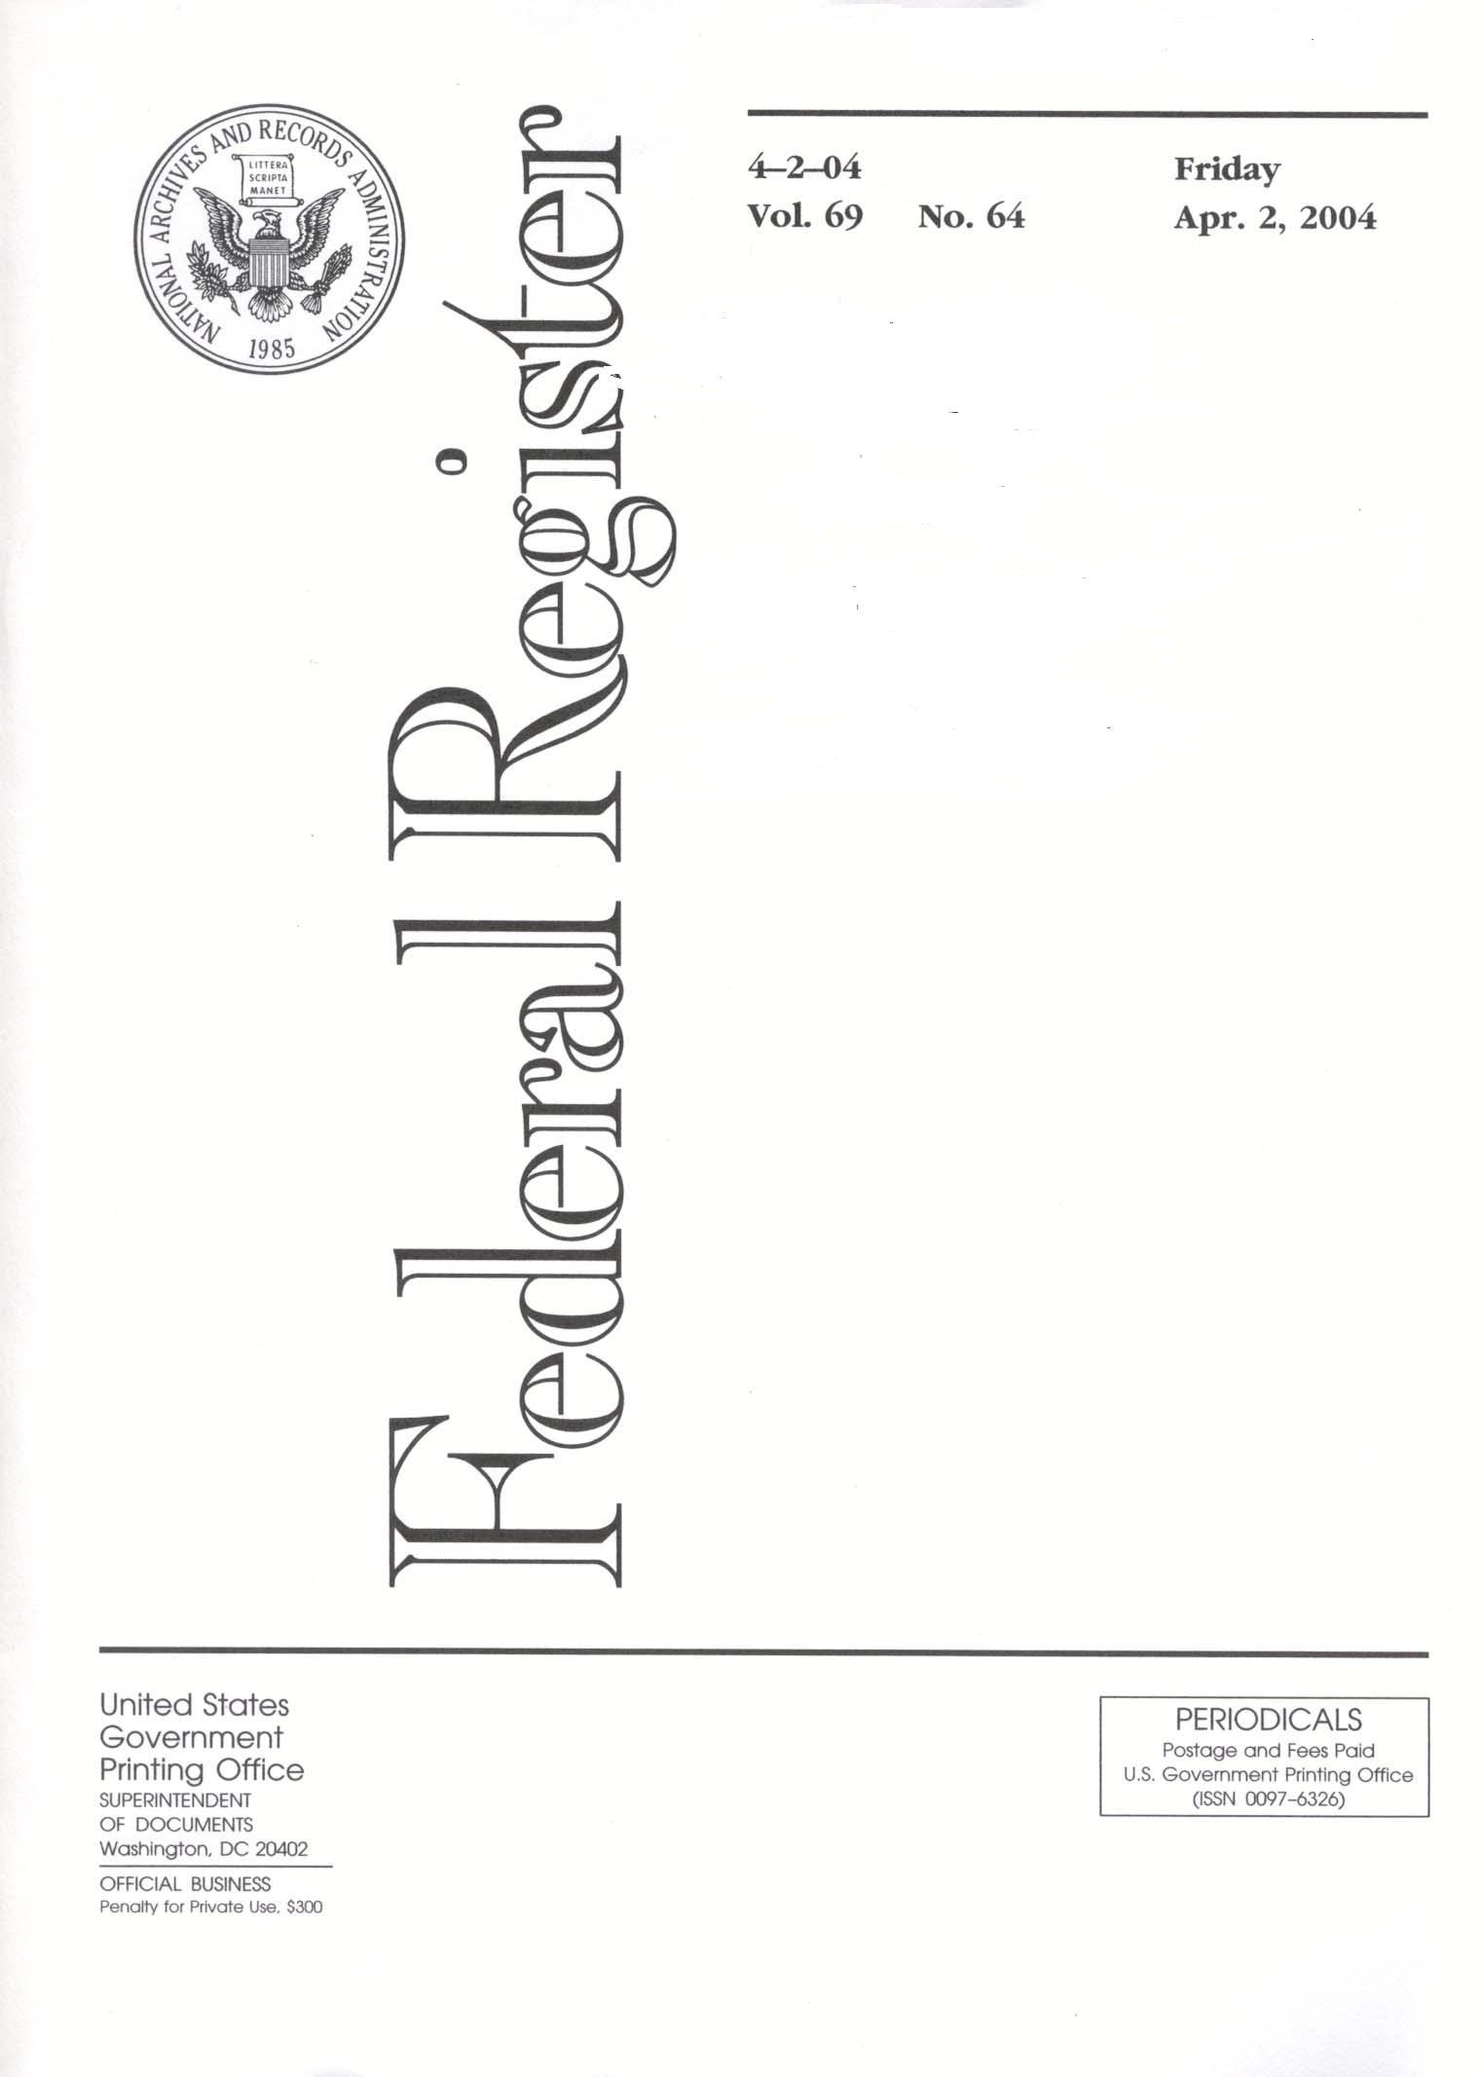
Regulatory Updates
Notes:
Now let’s turn to Final Rules that VA did publish in the past year. The first added new burn pit presumptive diseases.

Slide 39
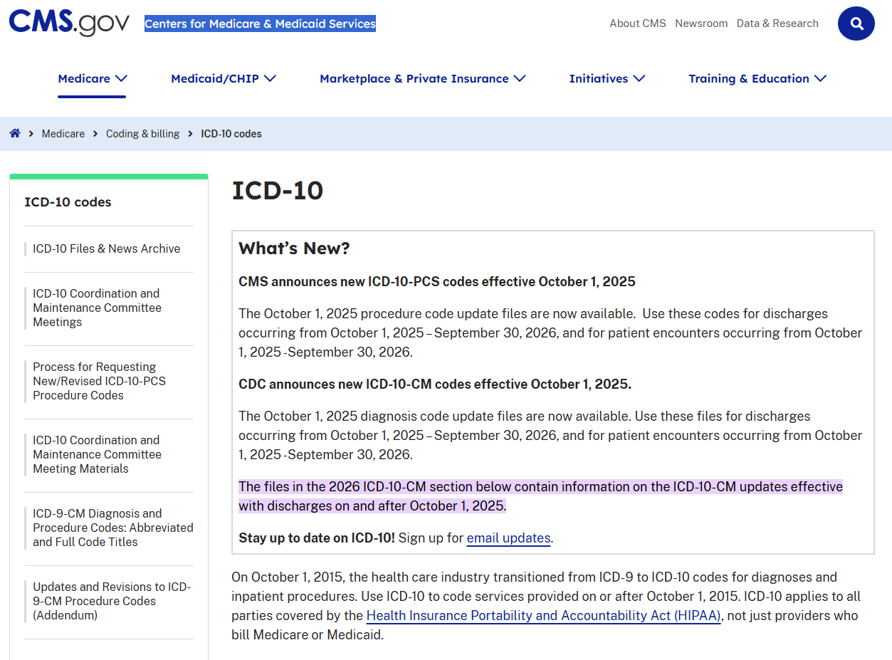
ICD Codes
Medical records use codes issued by the Centers for Medicare & Medicaid Services (CMS).
  International Classification of Diseases (ICD) codes allow different health care providers to communicate clearly.
Effective October 1, 2025, CMS added a new section to the ICD system: “T75.8, Other specified effects of external causes.”
  This section includes “T75.830, Gulf war illness” and “T75.83, Effects of war theater.”
Notes:
-The VA Rating Schedule will be covered in the next lesson
-OMB is the Office of Management and Budget. This is an executive branch office that reviews all regulations proposed by all agencies.

Slide 40

38 U.S.C. § 1117
The Gulf War compensation law provides benefits for “undiagnosed illnesses,” “medically unexplained chronic multisymptom illness,” and
“Any diagnosed illness that the Secretary determines in regulations prescribed under subsection (c) warrants a presumption of service-connection.”
It is up to VA to promulgate a regulation that makes conditions diagnosed under this new ICD code presumptive.

Slide 41
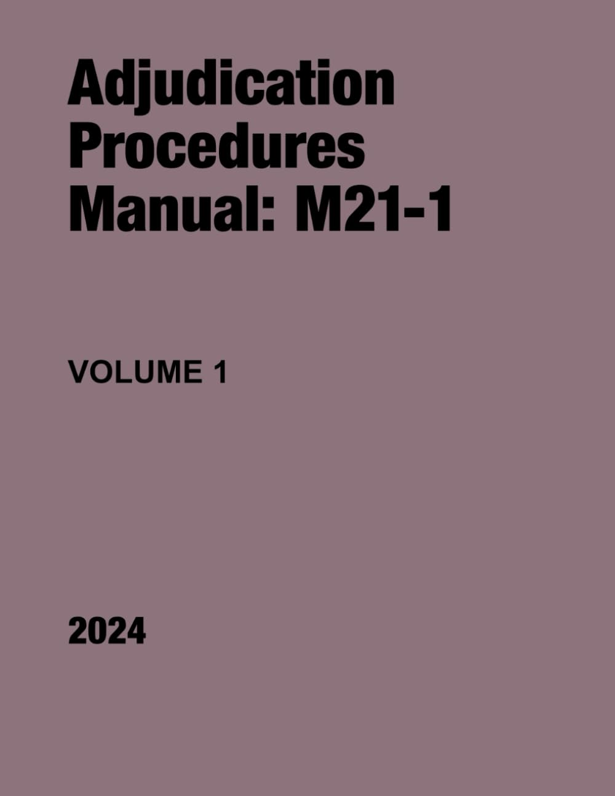
M21-1 Updates
Notes:
Now let’s turn to Final Rules that VA did publish in the past year. The first added new burn pit presumptive diseases.

Slide 42
M21-1 Question
Provisions of the M21-1 are binding on the Board. True or false?
True.
False.
A
B
0

Slide 43
M21-1 Answer
False.
The purpose of the M21-1 is to promote consistent decision making by the non-attorney adjudicators at the regional offices, who must decide large volumes of cases in limited amounts of time.
The M21-1 is not generally binding on the more sophisticated, legally trained adjudicators at the Board who often handle more complex and unusual fact patterns that are less amenable to accurate resolution through bright-line rules. See, e.g., Gray v. Sec'y of Veterans Affairs, 875 F.3d 1102 (Fed. Cir. 2017).
However, the Board must address potentially relevant M21-1 provisions to ensure that similar Veterans are treated consistently.

Slide 44
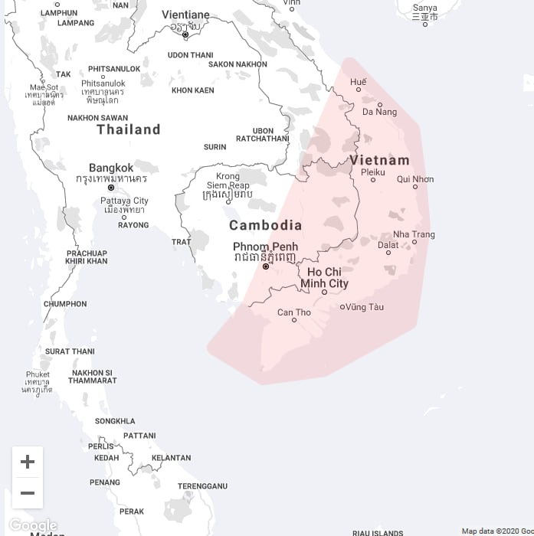
M21-1 Update
Herbicide Claims
(Sept. 15, 2025)
Notes:
Next we will look at VA’s final rule revising the character of discharge

Slide 45
M21-1, Part VIII, Subpart i, Ch. 1
Section A: Supplemental claims involving a new or modified presumption do not require new and relevant evidence.
Section B.1.b: Retroactive effective dates under BWNA and Nehmer require service in the Republic of Vietnam.
Section D.4.c.: “A previously denied claim is considered qualifying for retroactive entitlement only if the reason for denial was a lack of evidence that the disease was incurred or aggravated by the service of the Veteran.”
  Directly contrary to Crews v. McDonough, 36 Vet. App. 67 (2023).
Notes:
-Let’s look at an example of how the bilateral factor and this fix would apply.
-*Say this veteran hsaa a combined 93 percent rating plus two 10% ratings that would qualify for the bialtera factor.
-If VA applied the bilateral factor, then *10 combined with 10 is 19 using VA’s combined ratings table. Then add 10% of that 19, or 1.9, to get a combined rating of 21. This rounds down to a 20% rating.
-*93 combined with 20 using VA’s combined ratings table is 94. 94 rounds down to a total combined rating of 90%
-If the bilateral factor does not apply, then
-*93 and 10 combined to 94 under the combined ratings table
-That resulting 94 combined with the last 10% to 95. This 95 would round up to a 100% rating. So in this case, it would be better for the Veteran to not use the combined ratings table.

Slide 46
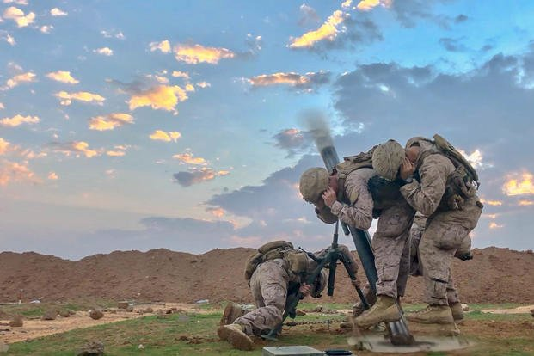
M21-1 Update
Hearing Loss Claims
(Apr. 30, 2025)
Notes:
Next we will look at VA’s final rule revising the character of discharge

Slide 47
M21-1, Part IV, Subpart i, Ch. 3
Section B.1.c: “In a case involving service connection (SC) for hearing loss where an etiology opinion is required, the examiner’s rationale should not solely discuss that hearing was normal at the times of the Veteran’s enlistment and separation.
Decision makers should not deny SC for hearing loss based on an examiner’s medical opinion rationale which solely discusses that hearing was normal during service to support a conclusion that the current hearing loss is not related to service. The examination report should be returned due to an insufficient medical opinion rationale.”
Notes:
-Let’s look at an example of how the bilateral factor and this fix would apply.
-*Say this veteran hsaa a combined 93 percent rating plus two 10% ratings that would qualify for the bialtera factor.
-If VA applied the bilateral factor, then *10 combined with 10 is 19 using VA’s combined ratings table. Then add 10% of that 19, or 1.9, to get a combined rating of 21. This rounds down to a 20% rating.
-*93 combined with 20 using VA’s combined ratings table is 94. 94 rounds down to a total combined rating of 90%
-If the bilateral factor does not apply, then
-*93 and 10 combined to 94 under the combined ratings table
-That resulting 94 combined with the last 10% to 95. This 95 would round up to a 100% rating. So in this case, it would be better for the Veteran to not use the combined ratings table.

Slide 48

M21-1 Update
Medical Examinations in PTSD Claims
(Feb. 4, 2025)
Notes:
Next we will look at VA’s final rule revising the character of discharge

Slide 49
M21-1, Part VIII, Subpart iv, Ch. 1
Section C.2.a : Adds note: “The Federal Circuit held in AZ and AY v. Shinseki, 731 F.3d 1303 (Fed. Cir. 2013), that the absence of a service record documenting an unreported sexual assault or a Veteran’s failure to report a claimed assault in service may not be treated as pertinent evidence that the assault did not occur. Accordingly, if an examiner provides a negative medical opinion in response to a request for clinical interpretation of behavioral changes and the examiner uses the absence of a report or documentation of the event in the service records to support the negative opinion, then the medical opinion should be returned as insufficient.”
Notes:
-Let’s look at an example of how the bilateral factor and this fix would apply.
-*Say this veteran hsaa a combined 93 percent rating plus two 10% ratings that would qualify for the bialtera factor.
-If VA applied the bilateral factor, then *10 combined with 10 is 19 using VA’s combined ratings table. Then add 10% of that 19, or 1.9, to get a combined rating of 21. This rounds down to a 20% rating.
-*93 combined with 20 using VA’s combined ratings table is 94. 94 rounds down to a total combined rating of 90%
-If the bilateral factor does not apply, then
-*93 and 10 combined to 94 under the combined ratings table
-That resulting 94 combined with the last 10% to 95. This 95 would round up to a 100% rating. So in this case, it would be better for the Veteran to not use the combined ratings table.

