Slide 1
What’s New at VA?
By Crystal Trulove
April 2026

Slide 2
Introduction
Federal employee from 1987-2019
Air Force, National Weather Service, VA
Oldest and only girl of five siblings
Mom of one human, 8 chickens, and 1 kitten
Jupyter: https://youtu.be/Jm-po6zeqIg
Cherokee Indian
Nerd
Squirrel-lover
Notes:
North Carolina

Slide 3
Overview
Review of court cases
  Rudisill v McDonough & Perkins v Collins
  Ingram v Collins
  Laska v McDonough
Changes to M21-1
  Infertility
  Mental health exams
  Apportionments
  Incompetency & Brady Act
  BDD exams
  Reasonably raised IU

Slide 4

Which court case is this?
SCOTUS Decision dated
April 16, 2024

Slide 5
Rudisill & GI Bill
Rudisill SCOTUS decision: If a veteran served at least two periods of service—one that qualifies for the Montgomery GI Bill (MGIB) and another that qualifies for the Post-9/11 GI Bill (PGIB)—they may be able to receive both benefits for up to 48-months of entitlement.

Slide 6

Do you remember this one?
CAVC Decision May 16, 2025

Slide 7
Perkins & GI Bill
Relying on the Supreme Court’s Rudisill decision, CAVC in Perkins held that:
“a veteran whose single period of service is long enough to qualify for benefits under both (MGIB and PGIB) programs without using any period of time twice to establish eligibility is entitled to receive benefits under both programs up to a statutory 48-month cap.”

Slide 8
Rudisill & Perkins & GI Bill
April 16, 2024 SCOTUS Rudisill v McDonough
  January 2025 VA announced changes
May 16, 2025 CAVC Perkins v Collins
  VA initially sought to appeal, but withdrew
  February 27, 2026 VA announced changes
Benefits that were a probably in 2025 are now a definitely
  Review, not news, thanks VFW leadership & support

Slide 9
Rudisill & Perkins & GI Bill
Entitlement to GI Bill benefits
  Post 9/11 GI Bill
    3 years honorable for full benefit
  Montgomery GI Bill
    2 years honorably + $1200 for full benefit
  The same years cannot be used to support both benefits
  Additional 12 months granted for total of 48 months
    Vet chooses how and when to use benefits
    36 month limit for a single GI Bill
  Letters may be sent to the veteran informing them of eligibility under these decisions

Slide 10

Rudisill & Perkins & GI Bill
https://benefits.va.gov/GIBILL/rudisill.asp
VA estimates that the Perkins decision may enable as many as 1.2 million additional Veterans to access up to an additional 12 months of education benefits.
“Staff Sgt. Kay Perkins, an Air Force veteran, after receiving a Distinguished Graduate award at Fort Meade, Maryland, in 2019. (Courtesy Kay Perkins)” Image from military.com
Notes:
Kassidy Perkins

Slide 11
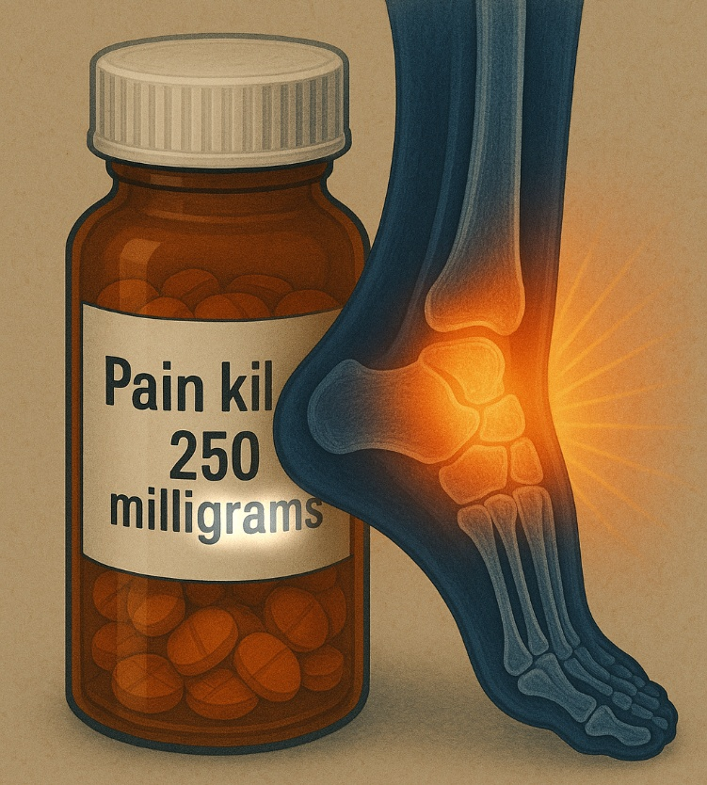
Which court case is this?
Notice “gram” is highlighted and so is the joint
Court case decided March 12, 2025

Slide 12

Do you remember this one?
December 20, 2021
What is the image painted with?

Slide 13
Wilson v McDonough
Service connection is possible when medications currently render HTN asymptomatic, as long as there is a history (reflected in V.iii.5.3.b.)
The disability percentage depends on whether the predominant diastolic pressure was 100 or more before symptoms were controlled with medication. (reflected in 38 CFR 4.104)

Slide 14
Ingram v Collins
CAVC decided Jones v Shinseki 2012
  VA cannot deny a higher disability rating based on symptoms improved by medication, unless the specific diagnostic code dictates considering medication effects.
CAVC decided Ingram v Collins 2025
  Jones applies to musculoskeletal as well
  Similar to Wilson
Notes:
Jones’ claim was regarding the evaluation of IBS

Slide 15
Ingram v Collins
Ingram v Collins 2025
  VA can no longer treat symptoms differently if meds are mentioned in the rating schedule
  just like it must consider functional loss during flare-ups.
VA Secretary ordered halt to compliance
  https://www.regulations.gov/document/VA-2026-VBA-0067-0001
  Said there had been “a series of erroneous court cases, culminating with Ingram”
    May have been referring to Jones & Wilson that had similar court findings

Slide 16
Ingram v Collins
Backlash from public (including VFW)
  Secretary Collins rescinded rule via social media post February 19, 2026
VA is currently complying with court
Federal Register still lists Secretary Collins’ instructions
  Has not been officially rescinded
As of April 2026, examiners and raters must account for symptoms without impact of medications

Slide 17

Which court case is this?
Decision September 26, 2024
Note the shape of the head and location of explosion

Slide 18
Laska v McDonough
CAVC Laska v McDonough 2024 held that old rules were invalid
  38 CFR 3.352 required that a Veteran show the need for a higher level of Aid & Attendance to qualify for SMC (t)
CAVC found in Laska that this regulation was stricter than the authorizing statute
  38 USC1114(t), which requires a need for regular level A&A for SC residuals of TBI

Slide 19
SMC (t) updates due to Laska
M21-1 VIII.iv.4.A.11.a.,b.,c., and d.
  Updated January 5, 2026
  Note added for clarification
Veteran with TBI must meet same criteria for any other request for SMC
If an examination is necessary
  examiner must state whether veteran requires hospitalization, nursing home care, or other residential institutional care

Slide 20
VA Rules Hierarchy
38 United States Code (USC)
  law
38 Code of Federal Regulations (CFR)
  law
M21-1 Adjudication Procedures Manual
  Policy, not binding law
  Primary guide VA raters follow, often leading to decisions
  Purpose is consistency across VA
Notes:
Laska as an example

Slide 21
Infertility
M21-1 V.iii.8.A.2.h Gynecological
  Updated September 30, 2025
New infertility section added
  Infertility is a symptom, not a compensable disability
  SC claims for infertility should rate the underlying injury or disease
  Do not establish SC for “infertility”
SMC may be warranted
Notes:
Adams v Collins

Slide 22
Infertility
M21-1 V.ii.3.C.4 Reviewing Diagnoses
  Updated September 30, 2025
  New section added for infertility
Definition: Infertility, for the purpose of SC disability benefits, is the inability to successfully procreate (with or without medical intervention), as a result of a Veteran’s SC injury or disease.
Applies to men and women
  Examples in M21-1 include ED as well as endometriosis

Slide 23
Infertility
Changes in Gynecological and Reviewing Diagnoses sections include instructions to Raters
SMC due to anatomical loss or loss of use of a creative organ is warranted when SC condition results in infertility
  If the underlying cause can be SC
  If the exam is not clear, it must be returned for diagnosis of underlying condition and nexus
Notes:
Adams v Collins

Slide 24
Mental Health Examinations
M21-1 IV.i.3.A.1.i Sufficiency of Exams
  Updated January 12, 2026
Updated guidance for mental health professionals conducting C&P psychological examinations
  Similar to qualifications already in place
  Now separated into qualifications for the initial exam, and for follow up exam

Slide 25
Mental Health Examinations
Initial psychological examination:
  a board-certified or board-eligible psychiatrist, or
  a licensed doctorate-level psychologist, or
  one of the following other mental health professionals, under close supervision:
    a non-licensed doctorate-level psychologist working toward licensure, or
    a psychiatry resident, or
    a VHA psychology trainee completing an internship or residency for the purpose of completing a doctorate-level degree program.

Slide 26
Mental Health Examinations
Follow up examination: includes everyone on previous slide, plus
  a licensed clinical social worker under close supervision, or
  a nurse practitioner, clinical nurse specialist, or physician assistant, if the individual is
    under close supervision, and
    clinically privileged by VHA to perform activities required for C&P psychological examinations.

Slide 27
Mental Health Examinations
“Under close supervision” means that the individual is supervised by a board-certified or board-eligible psychiatrist or licensed doctorate-level psychologist who must
  meet with the Veteran,
  confer with the supervised individual in providing the diagnosis and the final assessment, and
  co-sign the examination report.

Slide 28


Brain break

Slide 29
Apportionment
An apportionment is when VA directly pays a portion of a veteran's disability or pension benefits to their dependents.
Apportionments occur only in association with reduction of benefits due to incarceration or hospitalization.
  Only if full time (e.g. not work release)
  If veteran’s entire benefit is withheld, such as to repay debt, then it is not subject to apportionment.

Slide 30
Apportionment
M21-1 VI.iv.1.A.2.a. Amounts withheld when veteran incarcerated 61 days:
  If veteran is in receipt of 20% or more
    Reduce to amount equivalent to 10%
M21-1 X.iii.1.D.1.b. When veteran hospitalized 22 days:
  Pension reduced to $50/$90
Dependents may request apportionment of the rest

Slide 31
Apportionment
M21-1 VI.iv.2.A. & C. Apportionment
  Updated March 9, 2026
  Almost entire section is new but contains material previously located in VII.iii.1.A. & B.
Relocation and changes due to regulatory revisions of 38 CFR 3.450-3.455 explained in Federal Register dated January 9, 2026.

Slide 32
Apportionment
VA will stop making need-based apportionments for separation/no support
  M21-1 VI.iv.2.A.1.b. Legacy Apportionments
  VA claims processors’ expertise is VA benefits and not child or spousal support
    Yet they make reallocation decisions
    Without consent of beneficiary
  Significant financial consequences based on self-reported income and expenses
    Unlike State courts, VA has no ability to compel evidence of income and expenses
Notes:
Legacy means need-based

Slide 33
Apportionment
VA will stop making need-based apportionments for separation/no support
  Allegations of inadequate child or spousal support are best suited to State courts
  VA apportionments can conflict with State awards, requiring State court to readjudicate
  Significant amount of information is needed to adjudicate apportionment claims properly
    Typically available to State courts, but time consuming for VA

Slide 34
Apportionment
38 CFR 3.450 General Apportionment
  Sections 3.450 through 3.459 apply to all apportionment claims after February 9, 2026
  Apportionments being paid as of February 9, 2026, will continue to be paid while entitlement continues
  Claims for apportionment must be submitted to VA on a form prescribed by the Secretary
    VA Form 21-0788

Slide 35
Apportionment
CFR 3.451 Apportionment claims
Veteran - all or part of compensation payable to a veteran may be apportioned for the veteran's spouse, child, or children, or, in some cases, for the dependent parent if:
  The veteran is incompetent and under hospital treatment, nursing home, or government care; or
  The veteran is incarcerated and meets the conditions of CFR 3.665 or 3.666.
    Beneficiary is held for more than 60 days, VA is aware of dependents existence, dependent is not a fugitive felon, etc.

Slide 36
Apportionment
CFR 3.451 Apportionment claims
Surviving spouse – when the surviving spouse is incarcerated, the dependency and indemnity compensation or pension may be apportioned to the child or children.
  No apportionment shall be payable to a child who did not reside with the surviving spouse prior to incarceration.

Slide 37
Apportionment
CFR 3.451 Apportionment claims
Child on active duty
  If child is already on active duty, that child is not entitled to apportionment.
  If apportionment is granted, then child goes on active duty, apportionment won’t change.
Apportionment of death benefits.
  Amounts payable for children under CFR 3.454 and 3.455 will be equally divided among the children.

Slide 38
Apportionment
CFR 3.452 Veteran benefits apportionable when veteran receives hospital treatment, nursing home, or domiciliary care:
  Incompetent veteran: Amount may be sent to spouse, child(ren), or parents
    Pending fiduciary
  Competent veteran: Offset amount may be sent to spouse when pension benefits based on spouse are reduced
    Section 306 Pension $50
    Improved pension $90

Slide 39
Apportionment
CFR 3.453 Benefits not apportionable
VA May Not Apportion Benefits
  When a claim has not been submitted
  Unless claim is submitted by individual requesting apportionment (either spouse or children), not hospitalized or incarcerated beneficiary
  When the dependent is guilty of:
    Mutiny
    Treason
    Sabotage
    Fraud
    Subversive Activity

Slide 40
Apportionment
Additional M21-1 instructions to VA
  E.g.: screening, giving notice, due process, determining the amount of apportionment, and determining effective dates
Apportionment for veteran’s minor child
  Request for fiduciary must be made by VA
  If child is adopted out of veteran’s family, that child no longer qualifies

Slide 41






Brain Break

Slide 42




Brain Break
Mathilda the Hun

Slide 43
Reasonably Raised IU
History: Norris v West June 9, 1999
  A claim for TDIU is implicitly raised when
    Veteran claimant whose schedular rating meets the minimum criteria of 38 CFR 4.16(a), and
    Evidence shows unemployability, and
    Claim is for higher disability rating
  Regardless of whether the veteran specifically states that s/he is seeking TDIU
Robinson v Principi 2001
Comer v Peake 2009
Notes:
60%/ 70% & 40%

Slide 44
Reasonably Raised IU
M21-1 II.iii.2.B.1.b Supplemental Claims
  Updated September 18, 2025
Entitlement to IU may be reasonably raised as part of a supplemental claim for other issues even if IU has not been previously claimed or decided.
  New and relevant evidence
  M21-1 VIII.iv.3.B.1.f for guidance in Identifying Reasonably Raised Claims of IU
  Consistent with VA rules since 1999

Slide 45
Separation Health Assessment
M21-1 X.i.6.C.1.b BDD claims
  Updated December 18, 2025
Separation Health Assessment (SHA) Disability Benefits Questionnaire required for BDD claimants still on active duty.
  Specialist examinations should not occur for conditions that are not subject to service connection
  Examples:
    38 CFR 4.9 - Congenital or developmental defects
    38 CFR 3.303(c) Preservice disabilities noted in service
    38 CFR 3.381 (b) Treatable dental conditions like cavities

Slide 46
Incompetency
M21-1 X.ii.6.D.4. Information About the Brady Act has been removed as VA determined it is not subject to the Brady Act nor NICS.
  Updated March 4, 2026
Previously, VA had determined that veterans found to be incompetent met criteria from ATF because the language was the same.
Notes:
National Instant Criminal Background Check System (NICS)

Slide 47
Incompetency
The Bureau of Alcohol, Tobacco, Firearms and Explosives (ATF) defined mental defect
  “if…a person, as a result of marked subnormal intelligence, mental illness, incompetency, condition or disease is a danger to himself or others;
  “lacks the mental capacity to contract or manage his own affairs;
  “is found insane by a court in a criminal case; or
  "is found incompetent to stand trial.”
38 CFR 3.353 states that a mentally incompetent person “is one who, because of injury or disease, lacks the mental capacity to contract or manage his or her own affairs.”

Slide 48
Incompetency
VA will no longer report incompetent veterans to NICS
  Not being able to manage one’s finances does not necessarily imply a veteran is a danger to self or others, or could not responsibly own and use firearms;
Examiners have the agency to identify and note veterans who appear to be a danger to self or others.

Slide 49
Exercises
Jeremy Li
Calvin Freemont
Eugene Turner
Ruma Nandini

Slide 50
Jeremy Li
Served six years in the Army, from 2004-2010. Earned his Bachelor’s degree in 2024 and enrolled in Graduate School Fall 2025 and has been paying his own way. He used up all 36 months of the Post 9/11 GI Bill already. He called you and asked if there is any other educational assistance that he might qualify for. What can you suggest?

Slide 51
Calvin Freemont
SC R knee continues to get worse. He wants knee surgery but has not had it. He uses Motrin 800mg daily and gets a steroid injection every 3 months for pain. He made a claim for increased evaluation and told you he stopped taking his meds because he knows VA might record his symptoms wrong if he’s medicated. What court case will help him?

Slide 52
Eugene Turner
Veteran Turner was incarcerated in March 2026. He has a child with his first wife that was adopted by the child’s step-father, and another child with his second, and current, wife. Veteran asks you how apportionments can go to both children?

Slide 53
Ruma Nandini
Veteran Nandini made a claim for throat cancer in the past that was denied. She appealed in 2025, and her Supplemental Claim is pending. She lost her customer service job in 2023 because she lost her voice during treatment. Veteran tells you she plans to wait until the Appeal is decided before she makes a claim for IU. What can you explain that might help?
Notes:
Ruma only has 10% disability, but if throat cancer is SC, she might meet IU criteria.

Slide 54

QUESTIONS?
Crystal Trulove
crystal.trulove@gmail.com

